Slide 1
2017 ACC Update
As of July 2017
Presentation by:
<Enter Name of CV Team State Liaison>

Slide 2

Snapshot of ACC Today
52,000+ members across the entire cardiovascular care team
5,000+ CV Team members: APNs, RNs, PAs, PharmDs, Techs, Exercise Physiologists, Occupational and Physical Therapists, Registered Dieticians and other professionals!
48 Domestic Chapters
40 International Chapters
10 NCDR Registries

Slide 3
CV Team Demographics
Member Type | # of Members | % of Members
Nurse Practitioner | 1950 | 38%
Registered Nurse | 1340 | 26%
Physician Assistant | 730 | 14%
Emerging Professionals | 590 | 11%
Clinical CV Pharmacist | 450 | 8%
Clinical Nurse Specialist | 140 | 3%
Total | 5,200
Source: ACC Member Database Sept 2017
Note: Emerging Professionals sub-segment includes Technologists (e.g. RCIS, RCS, RCES, etc.), Exercise Physiologists, Registered Dietitians, Clinical Social Workers, Behavioral Scientists, Physical and Occupational Therapists, and Genetic Counselors.

Slide 4

Domestic Chapter Growth
1986:
First Chapters Formed
1990:
16 Chapters
2000:
39 Chapters
2017:
48 Chapters (Representing all 50 states plus Puerto Rico and DC)
Celebrating 30 years of ACC Chapters!

Slide 5
[Insert State] Chapter Update
Include any relevant updates from your local ACC Chapter here

Slide 6
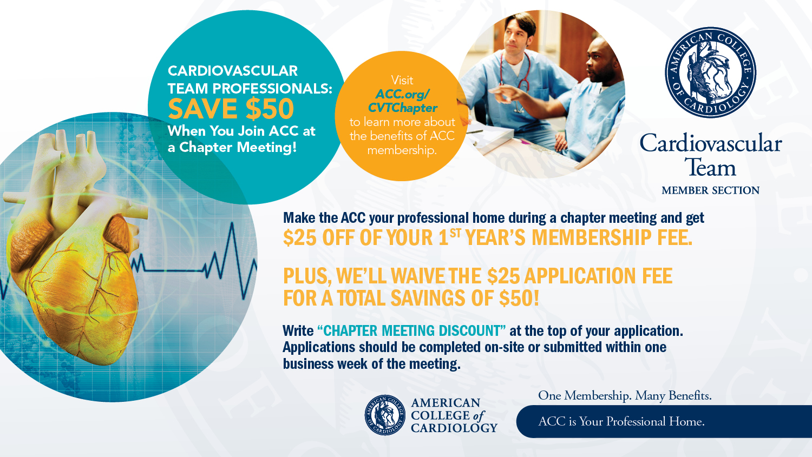

Slide 7
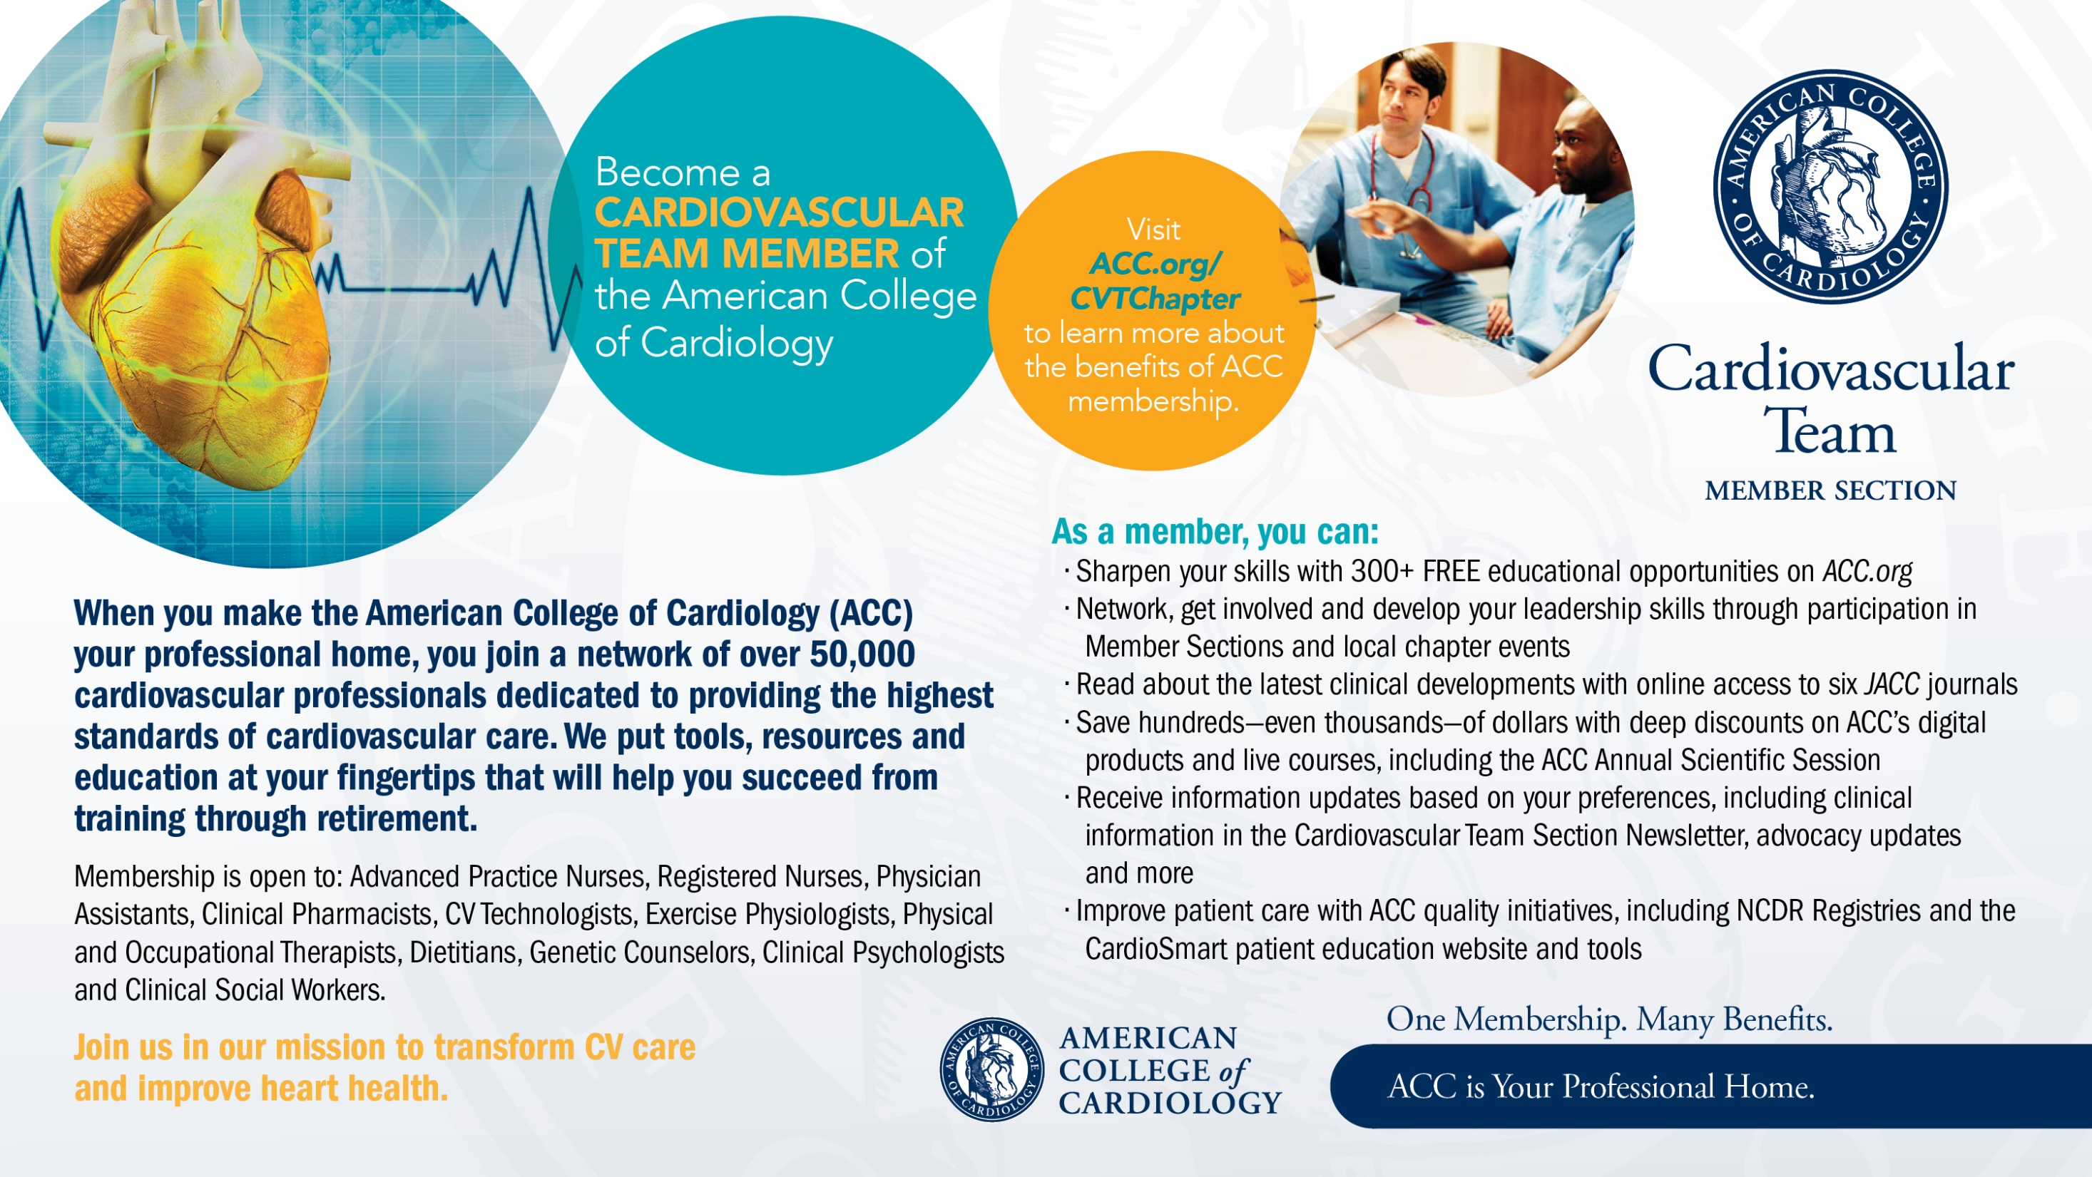

Slide 8
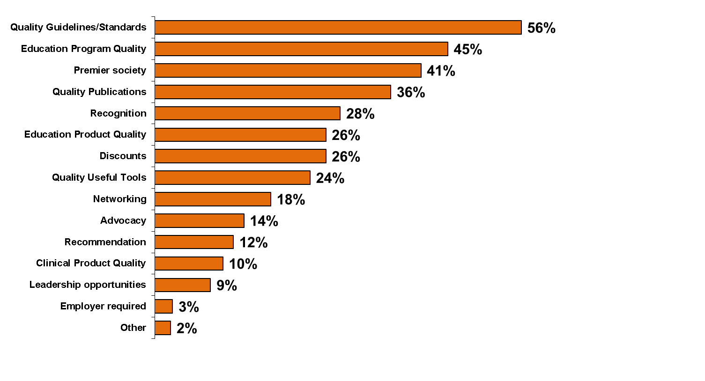
Reasons for ACC Membership
The top three reasons for CV Team Membership in the ACC are the quality of its practice guidelines/clinical standards, educational programs, and a belief that the ACC is the premier professional society for Cardiovascular Team professionals.
Q: Please indicate your top three reasons for being a member of the American College of Cardiology

Slide 9
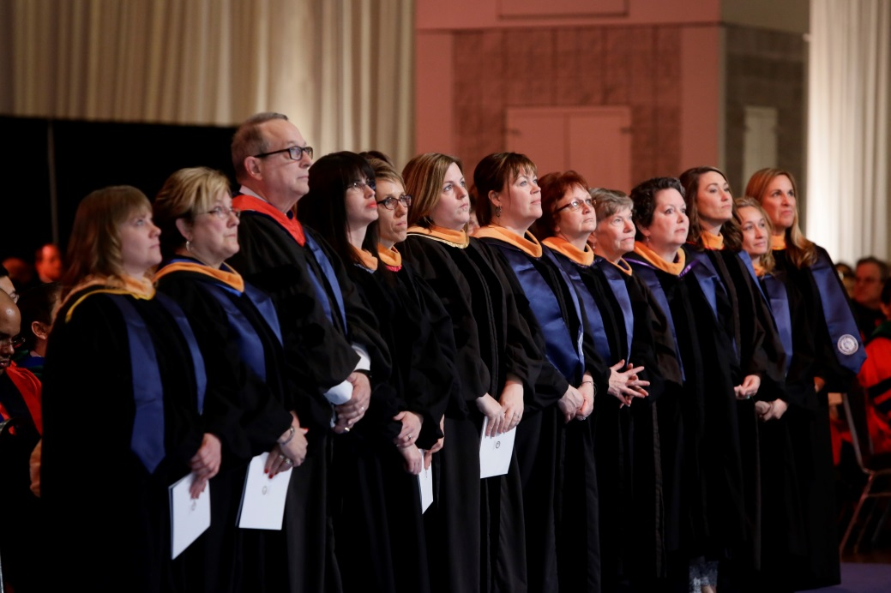
Associate of the American College of Cardiology (AACC) Designation
The AACC designation identifies individuals who, through advanced education, training and professional development, have risen to the top of their profession and proven themselves committed to the highest standards of CV care.
AACC is open to nurses, PAs, PharmDs and cardiac rehab professionals.
Since the launch of the designation in 2010, 300+ CV Team members have advanced to AACC.

Slide 10
AACC Demographics
Member Type | # of Members | % of Members
Nurse Practitioner | 178 | 56%
Registered Nurse | 68 | 21%
Physician Assistant | 39 | 12%
Clinical CV Pharmacist | 18 | 6%
Clinical Nurse Specialist | 12 | 4%
Other | 3 | 1%
Total | 318
Source: ACC Member Database June 2017

Slide 11
Annual Scientific Session
Three days of innovative education, groundbreaking science and interactive debates and discussion
Nearly 13,000 CV professionals attended ACC.17 in Washington, DC
  1,100+ CV Team professionals
ACC.18 takes place March 10 – 12, 2018 in Orlando

Slide 12
ACC.17 – CV Team Feedback
The top three reasons CV Team members gave for attending ACC.17 were general education/practical clinical applications, cutting-edge science, and networking opportunities
The most useful sessions according to CV Team members were the CV Team Section Meeting and Reception, the Pharmacology Program, and the Core Curriculum sessions (n = 156)

Slide 13
ACC.17 – CV Team Feedback
“As a pharmacist, it is great to participate at the same level as those physicians that I work with on a daily basis.”
“Better focus on all cardiology topics instead of primarily interventional. Inclusion of the Cardiac Care Team with offerings specific to our interests. Pharmacology CNEs.”
“Excellent information; great speakers; interesting topics and obviously many choices.”
“High quality conference with high quality lectures. . . . The app enhanced the conference experience and organization.

Slide 14
Questions?

Slide 15


