Slide 1
Is It Time for a Paradigm Shift in Treatment of Cardiometabolic Disorders?
Mikhail Kosiborod, MD
Professor of Medicine (Cardiology)

Slide 2
Disclosures
Research Grants:
  AstraZeneca, Boehringer Ingelheim
Consultant/Advisory Board:
  AstraZeneca, Sanofi, GSK, Amgen, Boehringer-Ingelheim, Novo Nordisk, Merck (Diabetes), ZS Pharma, Eisai, Glytec

Slide 3

Risk of Heart Failure by A1C

Slide 4
Intensive Glucose Control and Hospitalization for Heart Failure in Type 2 Diabetes
FM Turnbull et al. Diabetologia (2009) 52:2288–2298

Slide 5
ACCORD – HbA1c and CV Death

Slide 6
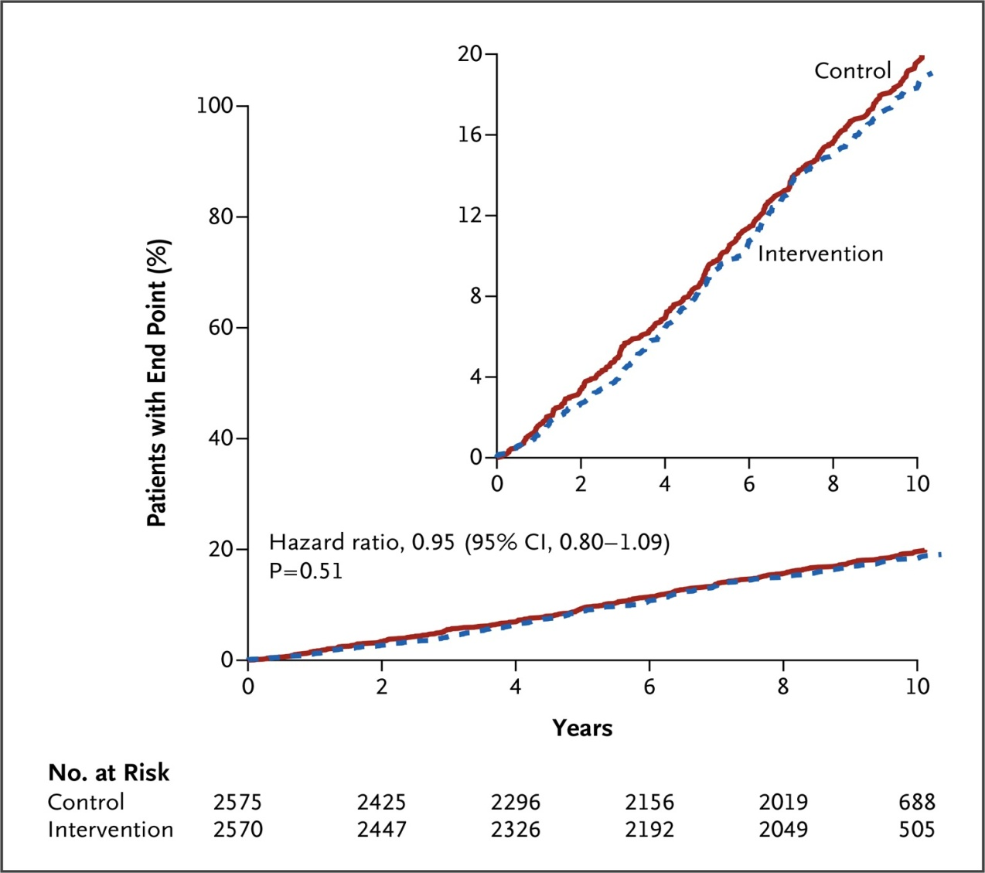

LOOK-AHEAD
The Look AHEAD Research Group. N Engl J Med 2013;369:145-154
Notes:
Figure 2 Cumulative Hazard Curves for the Primary Composite End Point. Shown are Kaplan–Meier estimates of the cumulative proportion of patients with a primary event. The primary outcome was a composite of death from cardiovascular causes, nonfatal myocardial infarction, nonfatal stroke, or hospitalization for angina. The numbers below the graph are the numbers of patients at risk in each study group at years 2, 4, 6, and 8 and at 10.4 years, when the last observed event occurred. The inset shows the same data on an expanded y axis.

Slide 7
Large Non-Insulin CVOTs in T2DM
✓
✓
✓
Study | SAVOR | EXAMINE | TECOS | CAROLINA | CARMELINA
DPP4-i | saxagliptin | alogliptin | sitagliptin | linagliptin | linagliptin
Comparator | placebo | placebo | placebo | sulfonylurea | placebo
N | 16,500 | 5,400 | 14,000 | 6,000 | 8,300
Results | 2013 | 2013 | June 2015 | 2017 | 2017
NEUTRAL
NEUTRAL
NEUTRAL
Study | LEADER | ELIXA | SUSTAIN 6 | EXSCEL | REWIND
GLP1-RA | liraglutide | lixisenatide | semaglutide | exenatide LR | dulaglutide
Comparator | placebo | placebo | placebo | placebo | placebo
N | 16,500 | 14,000 | 6,000 | 5,400 | 8,300
Results | 2016 | 2015 | 2016 | 2018 | 2019
✓
Courtesy of Silvio Inzucchi MD, Yale University
NEUTRAL
Study | EMPA-REG | CANVAS | DECLARE | NCT01986881
SGLT-2-i | empaglifozin | canagliflozin | dapagliflozin | ertugliflozin
Comparator | placebo | placebo | placebo | placebo
N | 7300 | 4300 | 22,200 | 3900
Results | Sept 2015 | 2017 | 2019 | 2020

Slide 8


IRIS
LEADER
SUSTAIN 6

Slide 9
EMPA-REG – HbA1c and CV Death

Slide 10
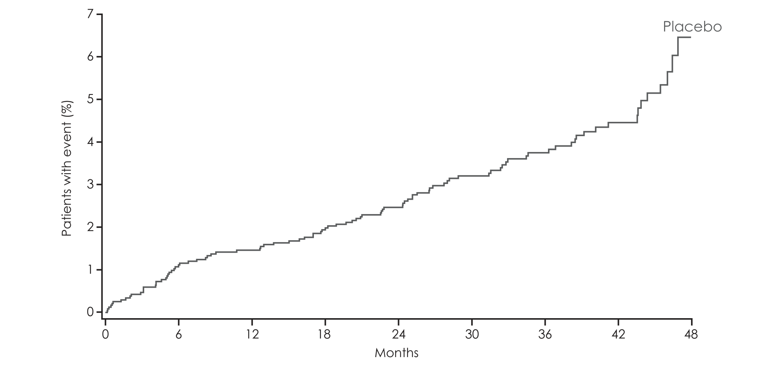
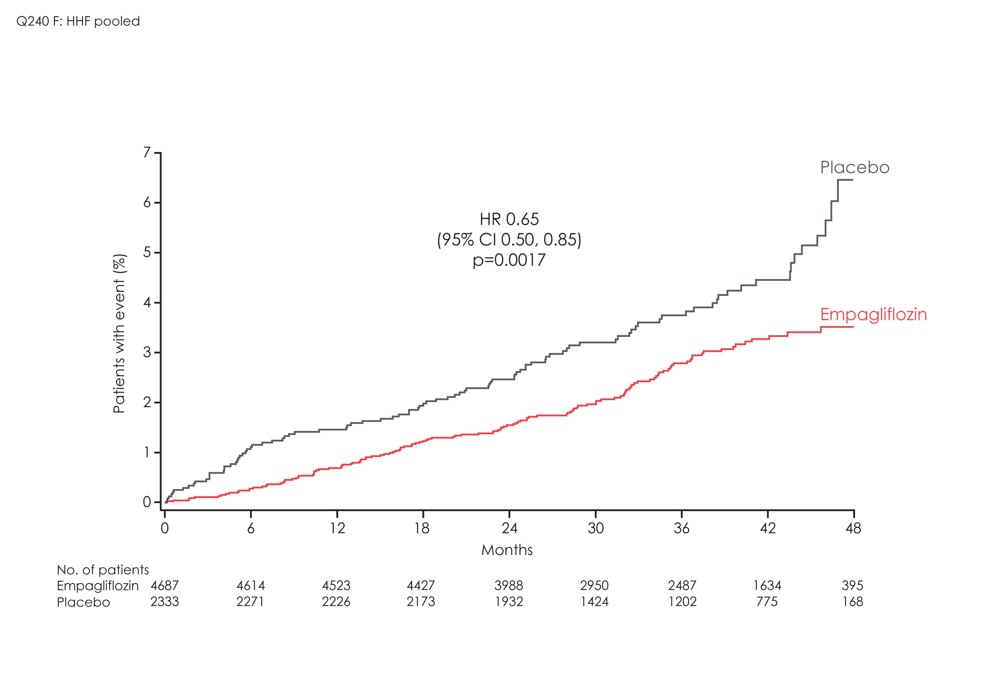
Hospitalization for Heart Failure
HR 0.65
(95% CI 0.50, 0.85)
p=0.0017

Slide 11

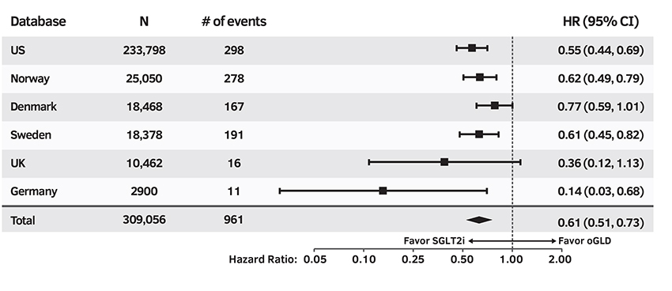
HHF Primary Analysis
P-value for
SGLT2i vs oGLD: <0.001
Heterogeneity p-value: 0.17
Data are on treatment, unadjusted; oGLD=other glucose-lowering drug; HR=hazard ratio.

Slide 12
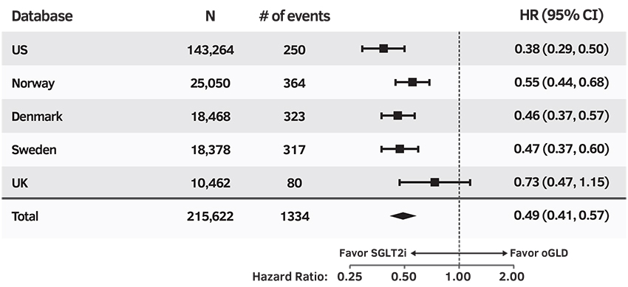
All-Cause Death
P-value for
SGLT2i vs oGLD: <0.001
Heterogeneity p-value: 0.09
Data are on treatment, unadjusted; oGLD=other glucose-lowering drug; HR=hazard ratio.
Notes:
H=0.181
P<0.001

Slide 13
IRIS Primary Outcome
Pioglitazone
Cumulative
Event-Free
Survival
Probability
9.0%*
Placebo
HR 0.76
95% CI, 0.62 to 0.93 P=0.007
11.8%*
*cumulative event rates
0
Months in Trial
Kernan WN et al. N Engl J Med, epub Feb 17, 2016
DOI: 10.1056/NEJMoa1506930

Slide 14
LEADER Trial: Primary Outcomes
CV Death, Non-fatal MI
or Non-fatal Stroke
CV Death
The cumulative incidences were estimated with the use of the Kaplan–Meier method, and the hazard ratios with the use of the Cox proportional-hazard regression model. The data analyses are truncated at 54 months, because less than 10% of the patients had an observation time beyond 54 months.
Marso SP et al, NEJM, 2016
Notes:
The primary outcome was the time from randomization to a composite outcome consisting of the first occurrence of cardiovascular death, nonfatal (including silent) myocardial infarction (MI), or nonfatal stroke.
Reference: Primary manuscript
Source: KM plot: EOT Figure 14.2.45 / ID14201320
HR: EOT Table 14.2.43/ID14201300_primary_analysis_fas.txt
P-value: EOT Table 14.2.44/ID14201310_primary_analysis_pvalues_fas.txt

Slide 15
SUSTAIN 6: CV Outcomes
Marso SP et al, NEJM, 2016
Notes:
Figure 1. Cardiovascular Outcomes.
Shown are Kaplan–Meier plots of the primary outcome (a composite of cardiovascular death, nonfatal myocardial infarction, or nonfatal stroke) (Panel A), nonfatal myocardial infarction (Panel B), nonfatal stroke (Panel C), and death from cardiovascular causes (Panel D). The trial included a planned observation period of 109 weeks for all patients (a 104-week treatment period with a 5-week follow-up period). In Panel C, there were no events in the semaglutide group after week 104. Insets show the same data on an expanded y axis.

Slide 16
ADA-EASD Position Statement: Managing Hyperglycemia in Type 2 Diabetes - 2015 Update
Metformin +
Metformin +
Metformin +
Metformin +
Metformin +
Metformin +
Metformin +
Metformin +
Metformin +
Metformin +
Metformin +
Metformin +
Diabetes Care 2015;38:140 Diabetologia 2015;58:429

Slide 17
New Paradigm for Managing Blood Glucose in Type 2 Diabetes
SPECTRUM OF CVD
CVD Risk
Factors Only
Established
CAD
History of
MI/Stroke
Recent
ACS
Recent
Stroke
Asymptomatic
LV Dysfunction
History
of HF
Symptomatic HF/
HF Hospitalization
End Stage
HF
?
GLP-1 Agonists
Metformin
? Metformin
? GLP-1
?DPP-4i
or SGLT2i
SGLT2
Inhibitors
Pioglitazone
Not Adequately
Studied
SGLT2i
seem promising
Modify based on co-morbidities, contraindications, HBA1C control preferably with agents that have proven safety
Future trials should target combination therapies

Slide 18
Summary
Fundamental shift in the cardiometabolic field
Effect on surrogates no longer sufficient
CV safety may no longer be sufficient
Treatments that improve CV outcomes within a reasonable time frame should be prioritized
Treatments that address multiple manifestation of cardio-renal-metabolic spectrum are likely to have the most clinical impact
Since CVD is the main cause of death in T2D – focus of initial T2D Rx should shift from HbA1c alone to comprehensive CV risk reduction

