Slide 1
The Evolution of Cardiovascular Outcomes Trials in T2DM Over the Years
Darren K. McGuire, MD, MHSc
Professor of Medicine
University of Texas Southwestern Medical Center

Slide 2
Conflict of Interest Disclosure
Clinical Trials Leadership
  Takeda
  Merck
  Astra Zeneca
  Janssen
  Eli Lilly
  Boerhinger Ingelheim
  Novo Nordisk
  Lexicon
  Eisai
  GlaxoSmithKline
Consultancy
  Novo Nordisk
  Regeneron
  Sanofi Aventis
  Boerhinger Ingelheim
  Merck

Slide 3
Guidance for Diabetes Drug Development 1990-2008
ICH Guidelines:
  1500 patients exposed
  300-600 x 6 months
  100 x 1 year
Approval based on as little as
200 patient-years of exposure

Slide 4
Paradigm shift
Increasing incidence/prevalence of T2DM
  >10% of US adult population
Growing awareness of CV impact of T2DM
Numerous examples of adverse drug effects
  On target
  Off target
Proliferation of medications available

Slide 5

Half-Century of HTN & T2DM Medications in U.S.
12
SGLT-2
inhibitors
zz
11
dopamine agonists
renin inhibitors
zz
angiotensin II
receptor
blockers
10
bile acid
sequestrants
9
DPP-4 inhibitors
ACE Inhibitors
8
Ca²⁺ channel blockers
amylin mimetics
peripheral
α-1 blockers
GLP-1 receptor agonists
7
Number of Medication Classes
6
β-blockers
meglitinides
central
α-2 agonists
5
thiazolidinediones
4
adrenergic
neuronal
blockers
$α$-glucosidase inhibitors
diuretics
3
Biguanides
biguanides
2
sulfonylureas
insulin
vasodilators
1
Courtesy of Silvio Inzucchi, MD, Yale University
1950 1960 1970 1980 1990 2000 2010 2015

Slide 6
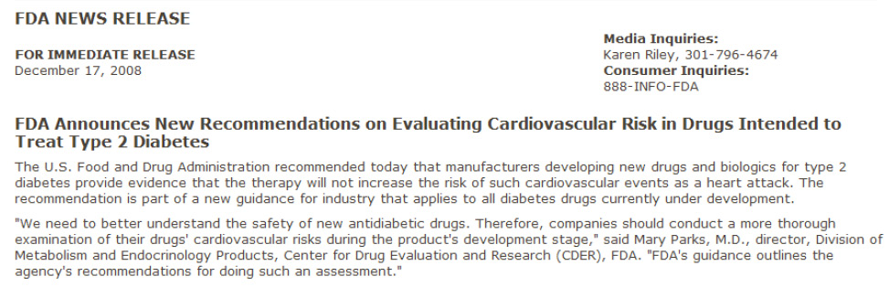
Present FDA Regulatory Guidance for Drugs for Type 2 Diabetes
  “…sponsors should demonstrate that the therapy will not result in an unacceptable increase in cardiovascular risk.”
Requires ~15,000 pt-yrs of exposure
http://www.fda.gov/NewsEvents/Newsroom/PressAnnouncements/2008/ucm116994.htm

Slide 7

The sky is falling…

Slide 8
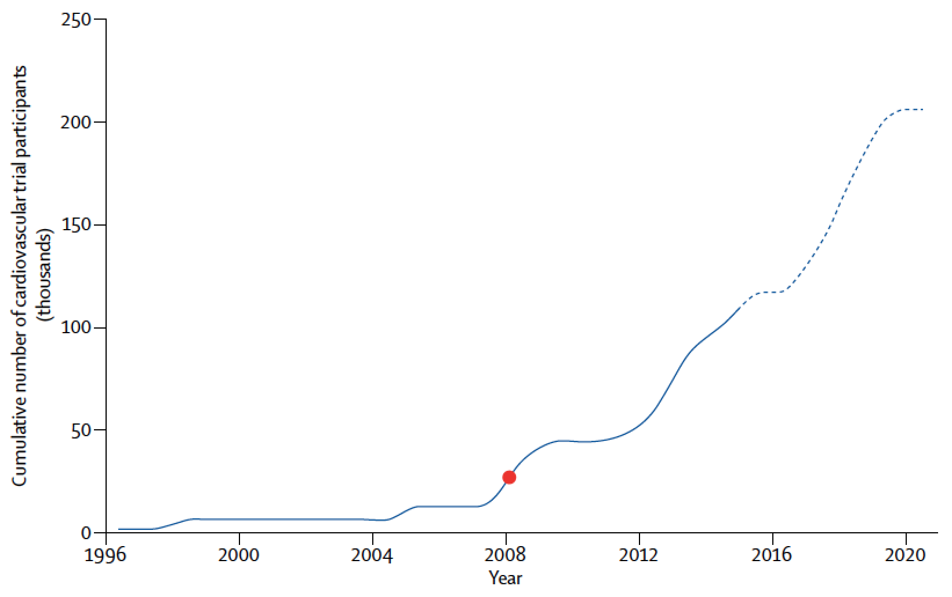
…it was just an acorn that fell.
25 Trials Ongoing/Completed
8 classes of medications
>200,000 planned participants
2008
FDA guidance
Holman RR et al. Lancet 2014; 383: 2008–17.

Slide 9
SAVOR-TIMI 53 Enrollment
Final Enrollment
n=16,492
Last Patient Enrolled
December 12, 2011
1st Patient Enrolled
May 5, 2010
Courtesy of Ben Scirica, MD, TIMI Study Group

Slide 10

Time to Onset of First Primary MACE in Prior Pooled Analysis
Saxagliptin
Controlled Phase 2b/3 Pooled Population
HR 0.44
(95% CI 0.24-0.82)
41 total events
Control
All Saxa
Patients at Risk
Control | 1251 | 935 | 860 | 774 | 545 | 288 | 144 | 123 | 102 | 57
All Saxa | 3356 | 2615 | 2419 | 2209 | 1638 | 994 | 498 | 436 | 373 | 197
Frederich R, et al. Postgraduate Medicine 2010;122(3). doi: 10.3810/pgm.2010.05.2138.
Notes:
10

Slide 11
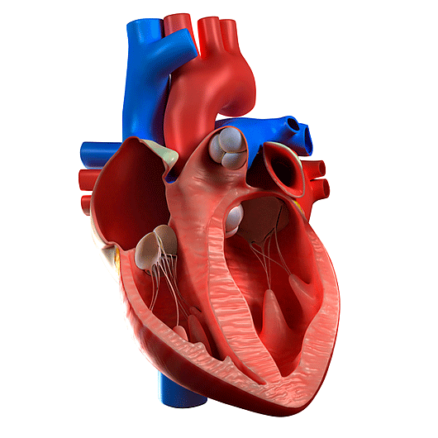

Proposed Pleiotropic CV Effects of DPP4 Inhibition and GLP1-RA
Myocardial
infarct size^{1,2}
Endothelial
function³
Triglycerides⁸
Inflammation and
oxidative stress⁴
Left
ventricular
function^{6,7}
Atherosclerotic
plaque volume⁵
1. Ye et al. Am J Physiol Heart Circ Physiol 2010;298:H1454–65. 2. Hocher et al. Int J Cardiol 2013;167:87–93.
3. van Poppel et al. Diabetes Care 2011;34:2072–77. 4. Kröller-Schön et al. Cardiovasc Res 2012;96:140–9.
5. Ta et al. J Cardiovasc Pharmacol 2011;58:157–66. 6. Sauvé et al. Diabetes 2010;59:1063–73.
7. Read et al. Circ Cardiovasc Imaging 2010;3:195–201. 8. Matikainen et al. Diabetologia 2006;49:2049–57.
Notes:
Notes
Several mechanistic studies have indicated potential CV effects of the DPP4 inhibitor class:
Ye et al. was a study in mice, which showed that the myocardial infarct size-limiting effect of sitagliptin was PKA-dependent.
Hocher et al. showed that linagliptin reduced infarct size after myocardial ischaemia/reperfusion in rats.
Van Poppel: vildagliptin for 4 weeks improved endothelium-dependent vasodilatation in 16 subjects with T2D.
Kröller-Schön: in vivo (rat) and cell culture studies revealed antioxidant and anti-inflammatory properties of linagliptin, independent of glucose-lowering properties.
Ta: alogliptin treatment reduced atherosclerotic lesions in diabetic mice.
Sauvé and Read: improvement in LV performance is after MI (mice, ex vivo) and stress (humans).
Matikainen: vildagliptin for 4 weeks improved postprandial plasma triglyceride in 15 T2D patients vs placebo (n = 16).
Abbreviations
CV, cardiovascular; DPP4, dipeptidyl peptidase 4; LV, left ventricular;
MI, myocardial infarction; PKA, protein kinase A; T2D, Type 2 Diabetes.

Slide 12
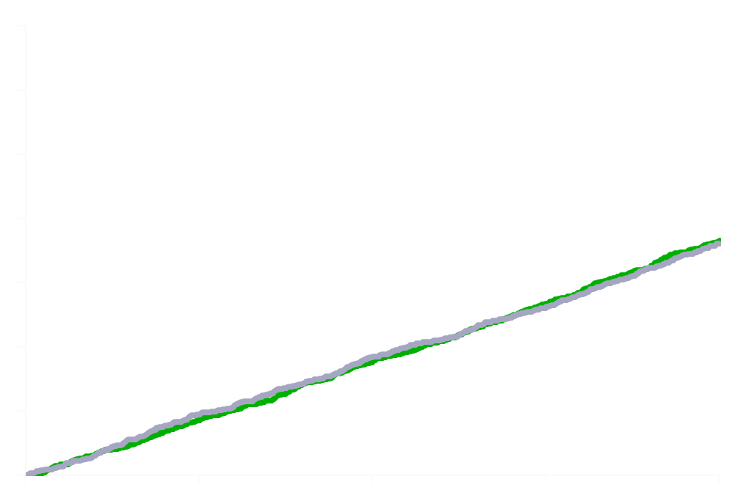
SAVOR TIMI 53-Primary Endpoint
N = 16,492
1222 Primary MACE Events
14
12
HR 1.00
95% CI 0.89-1.12
p<0.001 (non-inferiority)
10
2y KM
Saxagliptin 7.3%
Placebo 7.2%
8
CV Death, MI or Ischemic CVA (%)
6
4
2
6
12
18
24
Months
Placebo
8212
7983
7761
7267
4855
Saxagliptin
8280
8071
7836
7313
4920
Scirica BM, et aI. N Engl J Med 2013; 369: 1317-1326.

Slide 13
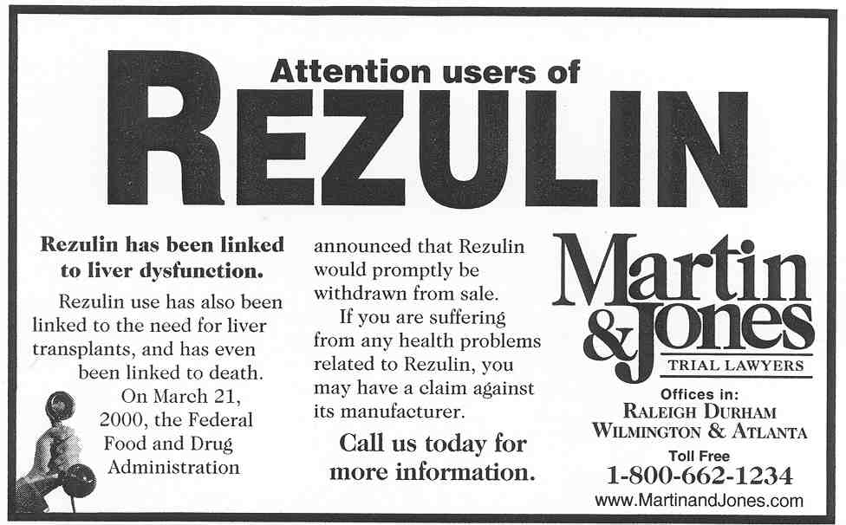
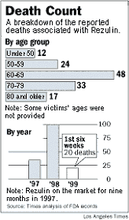
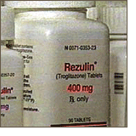
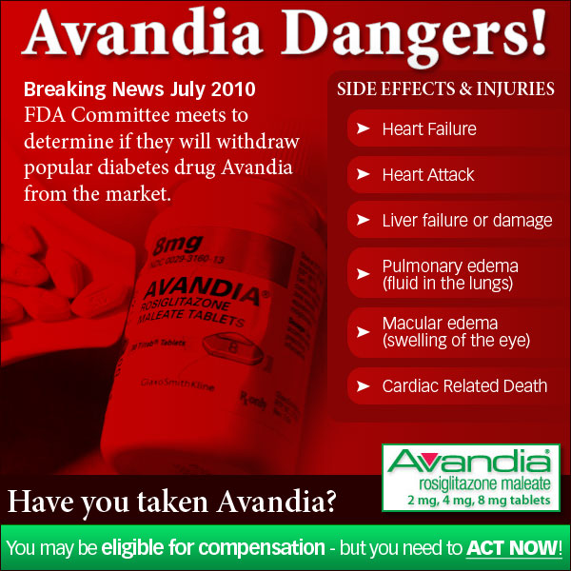
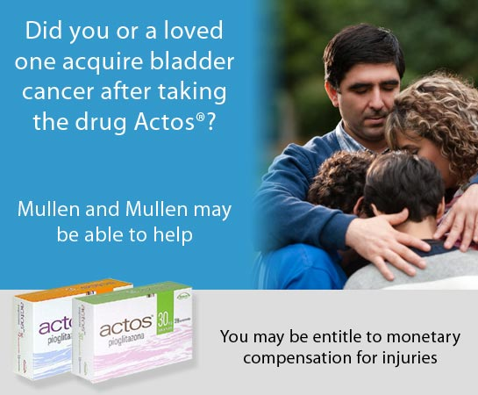
Rare but serious adverse drug reactions require large exposure…
Courtesy of Ben Scirica, MD, TIMI Study Group

Slide 14
Rare but serious adverse drug reactions require large exposure…
Taspoglutide (~600 pt years)
  Nausea
  Vomiting
  Antibody formation
  Anaphylactoid reactions
Aleglitazar (>14,000 patient years)
  HF
  Decline in eGFR
  Bone fracture
  GI Bleeds
Fasiglifam (~2000 patient years)
  Drug-associated liver injury (10-fold increase in elevated LFTs)
Rosenstock J et al. Diabetes Care 2013; 36: 498–504.
Lincoff AM et al. JAMA 2014; 311: 1515-1525.

Slide 15
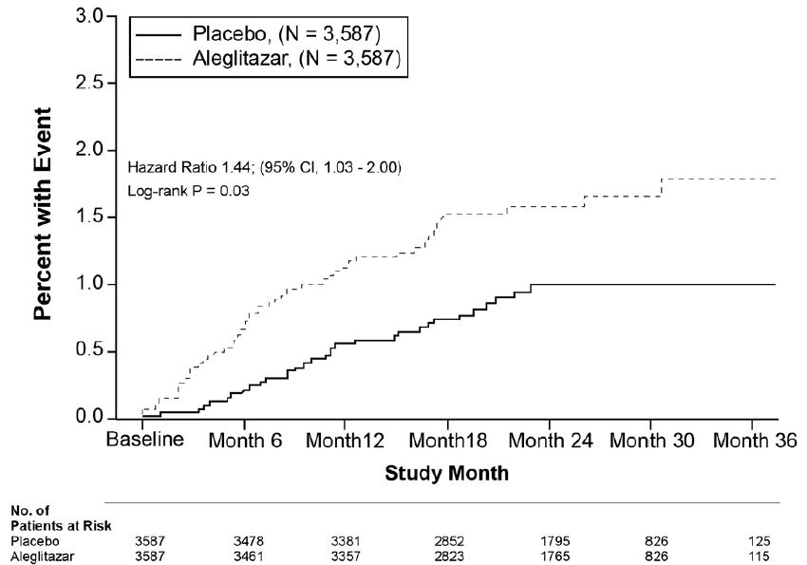
Gastrointestinal Bleeding Associated with Aleglitazar: ALECARDIO Trial
Lincoff AM et al. JAMA 2014; 311: 1515-1525.

Slide 16
SAVOR TIMI 53-Hospitalization for Heart Failure
Time to the 1st occurrence of any hospitalization for heart failure;
517 events
HR 1.27
P=0.007
Sa
x
a
g
l
i
p
ti
n
Pl
a
c
e
b
o
4%
3.5%
2.8%
)
%
(
HR 1.46
P=0.002
e
r
3%
HR 1.80
P=0.001
u
1.9%
l
i
a
F
t
r
a
e
2%
1.1%
H
r
o
Landmark Analysis at 12m
1.7% vs. 1.5% - HR 1.09, p=0.51
Time-varying interaction p value = 0.017
f
n
1.3%
o
i
t
a
1%
z
0.6%
i
l
a
t
i
p
s
o
0%
H
0
180
360
540
720
D
a
y
s
fr
o
m
R
a
n
d
o
m
i
za
ti
o
n
Scirica BM, et al. Circulation 2014; 130:1579-88.

Slide 17
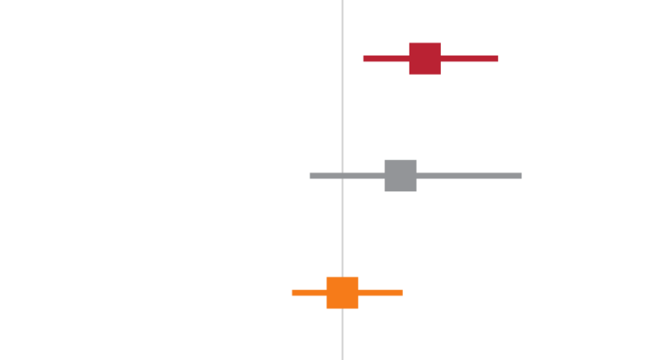

SAVOR-TIMI 53, EXAMINE, and TECOS*:
Hospitalization for Heart Failure
Trial | HR (95% CI) |  | P-Value
SAVOR-TIMI | 1.27 (1.07–1.51) |  | 0.007
EXAMINE | 1.19 (0.89–1.59) |  | 0.235
TECOS | 1.00 (0.84–1.20) |  | 1.000
SAVOR-TIMI + EXAMINE + TECOS | 1.14 (0.97–1.34) |  | 0.102
Test for heterogeneity for 3 trials:
p=0.16, I²=44.9
McGuire DK, et al. ESC 2015

Slide 18
Conclusions
Diabetes is common and increasing, with significant associated CV morbidity and mortality
Role of glucose control in CVD risk mitigation remains uncertain
    What drugs/strategies; what intensity; what timing
    Side effects-both on- and off-target
    Imperative to at a minimum establish CV safety
Evolution of regulatory guidance has dramatically altered the trial landscape of drug development for type 2 diabetes mellitus
    >200,000 patients enrolled/planned in CV outcomes trials
    4 trials now reported demonstrating CV safety
    EMPA REG outcome has reported CV efficacy with empagliflozin

