Slide 1
Leveraging Registry Data:
Uncovering Gaps and Discovering Opportunities to Improve How We Manage CVD Risk in Patients with T2DM
Suzanne V. Arnold, MD, MHA
Associate Professor and Clinical Scholar
University of Missouri-Kansas City
Saint Luke’s Mid America Heart Institute

Slide 2

Launched in 2014, DCR is large-scale, real-world, clinical quality assessment and improvement registry covering the spectrum of primary to specialty care
5114 providers from 374 practices
  89 primary care
  275 cardiology
  8 endocrinology

Slide 3







Collaborative Effort

Slide 4
Diabetes Collaborative Registry
Goals of DCR:
Study of diabetes presentation, progression, management, and outcomes
National benchmarking and reporting for quality improvement
Innovative research questions
Presentation
Progression
Management
Quality & Outcomes

Slide 5


Electronic Data Collection
Reporting provided back to the practices
Data collected in EHR
Clinical Data Repository
System Integration
System integrated data is extracted to the ACC
Registry works with EHR vendor to identify registry-relevant data fields

Slide 6
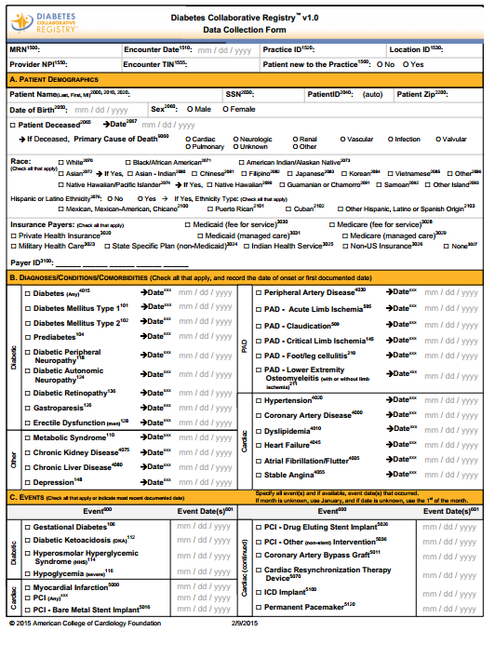
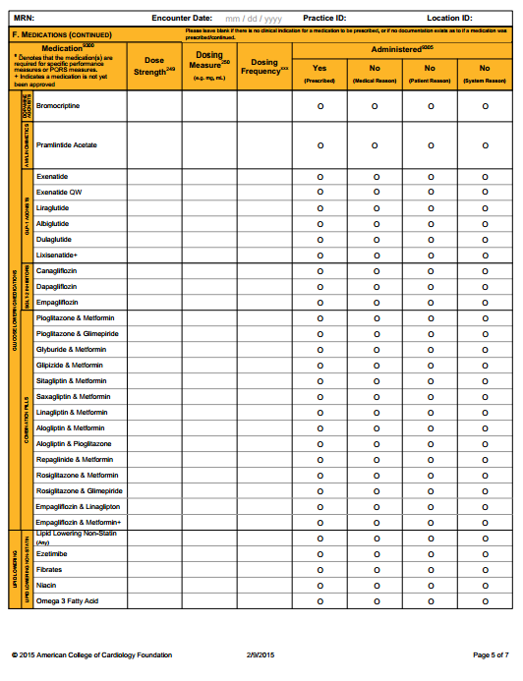
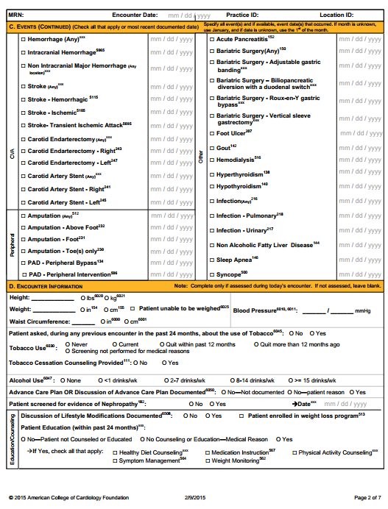
Data in DCR
Demographics
Diabetes type
Comorbidities
Exams and procedures (foot, eye, renal)
Lab values
Diabetes medications
Cardiac medications

Slide 7
Using DCR to Examine Quality
Quality Metric | Median | IQR
Glycemic Control | 9.1% | 2.2-31.6%
ACE-I or ARB with CAD | 71.7% | 67.8-78.6%
Nephropathy Screening | 70.3% | 66.1-74.5%
Tobacco Screening/Counseling | 89.3% | 80.2-94.2%
Diabetes Eye Exam | 0.1% | 0-7.3%
Diabetes Foot Exam | 0.0% | 0-0.3%
Blood Pressure Control | 92.1% | 87.0-94.7%
Notes:
574,972 patients with diabetes from 259 US practices

Slide 8
BP Control
CAD and on ACE-I/ARB
Nephropathy Screening
Eye exam

Slide 9
Using DCR to Examine Quality
Endocrinology practices did better at
  glycemic control, eye exams, and foot exams
Cardiology practices did better at
  BP control, nephropathy screening, use of ACE-I/ARBs in patients with CAD
Deficiencies felt to be due to
  fragmentation of care
  lack of ownership of certain domains of care
  incomplete documentation
  true gaps in care

Slide 10
Using DCR to Examine Specific Gaps
T2D and heart failure
  Not good: TZD, insulin, sulfonylureas
  Good: Metformin, SGLT2i
669,308 adults on ≥1 T2D medication
  Mean HbA1c 7.7%
  Mean LVEF 56%

Slide 11
T2D and Heart Failure
Age 69 y
71% men
82% CAD
31% MI
17% CKD
HFrEF
11%
Age 71 y
55% men
75% CAD
21% MI
16% CKD
Age 68 y
56% men
64% CAD
14% MI
7% CKD
HFpEF
25%

Slide 12
T2D and Heart Failure
 | HFrEF | HFpEF | No HF
Insulin | 43% | 40% | 29%
Metformin | 50% | 54% | 66%
Sulfonylurea | 38% | 36% | 33%
TZD | 6.1% | 7.6% | 8.4%
DPP-4i | 14% | 15% | 16%
GLP-1 RA | 4.0% | 4.7% | 5.3%
SGLT2i | 2.3% | 2.6% | 3.6%

Slide 13
Using DCR to Examine Specific Gaps
Large Clinical Trials of Glucose-Lowering Medications that Showed CV Benefit
EMPA-REG OUTCOME
Sept 2015
IRIS
Feb 2016
LEADER
June 2016

Slide 14
Patients in DCR
N=242,590
(313 sites)
A1c <7%
No Meds
N=60,065
Overt T2D
N=182,525
IRIS
EMPA-REG
LEADER
Age ≥40 + CVA/TIA
No CHF
N=6,772 (11.3%)
Age ≥18 + CV disease
N=47,872 (26.2%)
Age ≥50 + CV condition or
Age ≥60 + CV risk factor
N=87,601 (48.0%)
On pioglitazone
N=146 (2.2%)
On SGLT2i
N=2,497 (5.2%)
On GLP-1 RA
N=5,249 (6.0%)

Slide 15
DCR
Examine gaps in quality metrics
  Site variability, specialty variability, examine changes over time and with feedback
Examine specific treatment gaps
  Application of trial data
  Personalization of diabetes treatment that maximizes outcomes

Slide 16
Thank you

