Slide 1
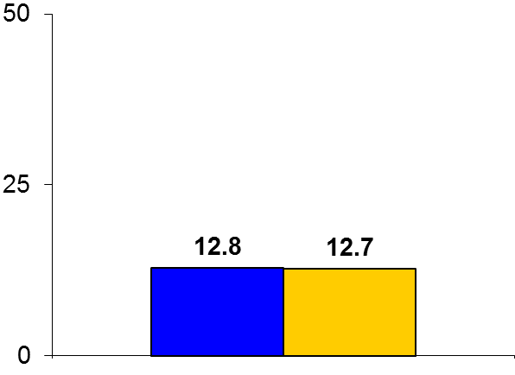

ACCELERATE
Trial design: Patients at high vascular risk were randomized to either evacetrapib 130 mg daily or placebo. They were followed for 30 months.
Results
(p = 0.85)
Primary outcome, CV death/MI/stroke/coronary revascularization/unstable angina, for evacetrapib vs. placebo: 12.8% vs. 12.7%, p = 0.85
CV death: 7.2% vs. 7.3%, p = 0.73; MI: 4.2% vs. 4.2%, p = 0.97; new hypertension: 11.4% vs. 10.1%, p < 0.05
Mean HDL-C for evacetrapib vs. placebo at 30 months: 104 mg/dl vs. 46 mg/dl, p < 0.001; mean LDL-C at 30 months: 55 mg/dl vs. 84 mg/dl, p < 0.001
%
Conclusions
Evacetrapib, a CETP inhibitor, is not superior to placebo in reducing CV outcomes in patients at high risk for vascular events despite a 130% increase in HDL-C and a 37% decrease in LDL-C
May be related to a blood pressure increasing effect of these drugs
Primary endpoint
Evacetrapib
(n = 6,038)
Placebo
(n = 6,054)
Presented by Dr. Stephen J. Nicholls at ACC 2016

