Slide 1
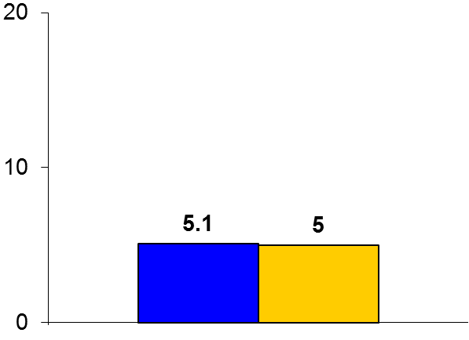

Rate vs. Rhythm Control for Postoperative AF
Trial design: Patients with postoperative atrial fibrillation (AF) were randomized to either rate control or rhythm control (with amiodarone and/or DC cardioversion) strategies. They were followed for 60 days.
Results
(p = 0.76)
Primary outcome, total no. of hospital days within 60 days of randomization, for rate vs. rhythm control: 5.1 vs. 5.0, p = 0.76
Cerebrovascular thromboembolic event: 0.8% vs. 0.4%, p = 0.4; death: 0.6% vs. 0.4%, p = 0.64
Index hospital cardiac arrhythmias: 4.3% vs. 4.6%, p = 0.8
Days
Conclusions
A rate control strategy was similar in efficacy to a rhythm control strategy (using amiodarone and/or DC cardioversion) for postoperative AF in patients undergoing cardiac surgery
Rate control could thus be considered first in these patients, similar to the management of patients with paroxysmal AF
Primary endpoint
Rate control
(n = 262)
Rhythm control
(n = 261)
Presented by Dr. A. Marc Gillinov at ACC 2016

