Slide 1
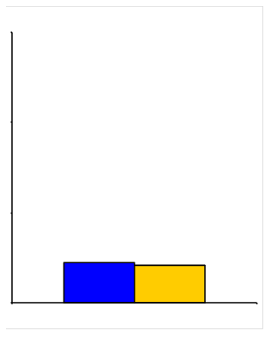


HOPE-3
Trial design: Patients without known cardiovascular disease, and with an intermediate risk of cardiovascular events, were randomized in a 2 x 2 factorial design to either cholesterol lowering or BP lowering or both. Patients were followed for a median of 5.6 years.
Results
(p = 0.002)
(p = 0.40)
Primary endpoint: CV death/MI/stroke
Rosuvastatin vs. placebo: 3.7% vs. 4.8%, HR 0.76, 95% CI 0.64-0.91, p = 0.002
Candesartan + HCTZ vs. placebo: 4.1% vs. 4.4%, HR 0.93, 95% CI 0.79-1.1, p = 0.40
Rosuvastatin + candesartan + HCTZ vs. placebo: 3.6% vs. 5.0%, HR 0.71, 95% CI 0.56-0.9, p = 0.005
30
30
20
20
%
%
10
10
Conclusions
3.7
4.8
4.1
4.4
Fixed-dose treatment with low-dose statin therapy, but not BP agents, was superior to placebo in reducing long-term cardiovascular events in an intermediate-risk population; combination group with benefits similar to statin arm
Provides support for a risk-based approach to the management of patients with hyperlipidemia and hypertension
0
0
Primary endpoint (CV death/MI/stroke)
Rosuva 10
n = 6,361
Placebo
n = 6,344
Cande 16 + HCTZ 12.5
n = 6,356
Placebo
n = 6,349
HOPE-3 Investigators. N Engl J Med 2016;Apr 2:[Epub]

