Slide 1
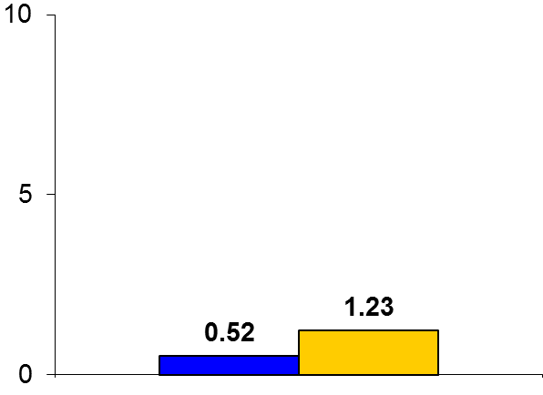
IMPEDENCE-HF
Trial design: Patients with chronic HFrEF were randomized to either noninvasive lung impedance-guided management or routine management. They were followed for 90 days.
Results
(p < 0.001)
Primary outcome, rate of hospitalization at 1 year for lung impedance-guided arm vs. routine management: 0.52 vs. 1.23 per patient-year (PY), p < 0.001
Significant reductions were noted in all-cause and cardiac mortality with lung impedance guidance (p < 0.001 for both)
/PY
Conclusions
Noninvasive lung impedance-guided management was superior to routine management in reducing CHF hospitalizations at 1 year and beyond; this is a small proof-of-concept study done at 2 centers
Future studies will need to validate these findings in a larger multicenter setting
Primary outcome
Impedence-guided management
(n = 128)
Routine
management
(n = 128)
Presented by Dr. Shochat at ACC 2016

