Slide 1
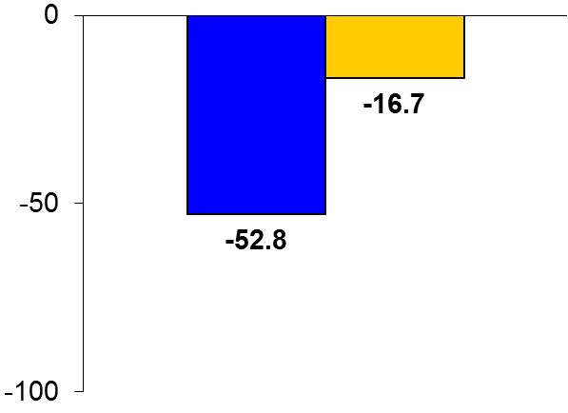

GAUSS-3
Trial design: Patients with objective evidence of intolerance to statin agents were randomized in a 2:1 fashion to either evolocumab 420 mg subcutaneously every month or ezetimibe 10 mg orally daily. They were followed for 24 weeks.
Results
(p < 0.001)
Primary endpoint, mean % change in LDL-C at week 24, for evolocumab vs. ezetimibe: -52.8% vs. -16.7%, p < 0.001
% achieving LDL-C <70 mg/dl at 24 weeks: 27.4% vs. 0%, p < 0.001
Total muscle-related events: 20.7% vs. 28.8%, p > 0.05; drug discontinuation for muscle symptoms: 0.7% vs. 6.8%
%
Conclusions
Evolocumab safely and reliably reduced LDL-C at 24 weeks compared with ezetimibe in a well-phenotyped group of patients with muscle-related statin intolerance
Adds to the growing body of evidence with PCSK9 inhibitors; other outcomes-based trials with this and other PCSK9 inhibitors are ongoing
Primary endpoint
Evolocumab
(n = 145)
Ezetimibe
(n = 73)
Nissen SE, et al. JAMA 2016;325:580-90

