Slide 1
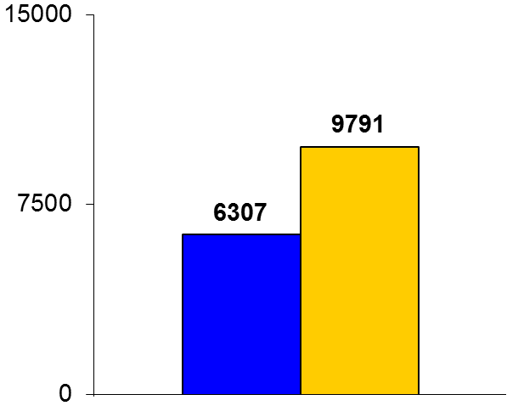
IMPRESSION
Trial design: Patients presenting with acute MI and undergoing an invasive approach, along with ticagrelor loading dose, were randomized to receive IV morphine 5 mg vs. placebo. They were followed for the duration of hospitalization.
(p = 0.38)
Results
AUC for ticagrelor at 12 hours for morphine vs. placebo: 6307 vs. 9791 ng h/ml; difference 36%; p = 0.003; AUC for AR-C124910XX at 12 hours: 1503 vs. 2388 ng h/ml; difference: 37%, p = 0.008
Prevalence of high platelet reactivity: 30 minutes: 91% vs. 71%, p = 0.06; 2 hours: 57% vs. 29%, p = 0.03; 4 hours: 37% vs. 17%, p = 0.1
Stent thrombosis: 1 vs. 0, p > 0.05
ng h/ml
Conclusions
Co-administration of ticagrelor and IV morphine resulted in diminished pharmacokinetics and pharmacodynamics for ticagrelor and its active metabolite in acute MI patients undergoing PCI
These results confirm earlier observational data on this topic; generalizability to all opioid agents needs investigation
Primary endpoint
Morphine
(n = 35)
Placebo
(n = 35)
Kubica J, et al. Eur Heart J 2016;37:245-52

