Slide 1
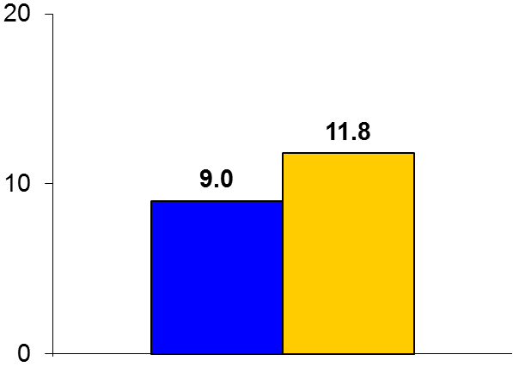

IRIS
Trial design: Patients without diabetes with a history of stroke or TIA within 6 months, with objective evidence of insulin resistance (HOMA-IR value >3.0), were randomized to either pioglitazone 45 mg or placebo. They were followed for 4.8 years.
Results
(p = 0.007)
The primary outcome, stroke or MI, for pioglitazone vs. placebo: 9.0% vs. 11.8%, HR 0.76, 95% CI 0.62-0.93, p = 0.007
All strokes: 6.5% vs. 8.0%, p = 0.19; ACS: 5.0% vs. 6.6%, p = 0.11; new-onset DM2: 3.8% vs. 7.7%, p < 0.001
Bone fracture: 5.1% vs. 3.2%, p = 0.003; weight gain >4.5 kg: 52.2% vs. 33.7%, p < 0.0001
%
Conclusions
Pioglitazone was superior to placebo in reducing the composite of stroke/MI in patients with recent stroke/TIA, no history of DM2, and objective evidence of insulin resistance
There was an increase in previously described side effects with TZDs, including bone fractures, edema, and weight gain
Primary endpoint
Pioglitazone
(n = 1,939)
Placebo
(n = 1,937)
Kernan WN, et al. N Engl J Med 2016;374:1321-31

