Slide 1
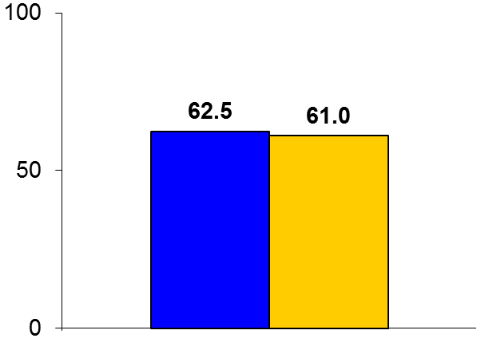
Ranolazine in Microvascular Dysfunction
Trial design: Patients with coronary ischemic symptoms and objectively documented CMD without significant epicardial stenoses were randomized in a 2 x 2 cross-over fashion to either ranolazine 500-1000 mg or placebo. They were followed for 2 weeks.
Results
(p > 0.05)
Primary endpoint: Seattle Angina Questionnaire overall scores for ranolazine vs. placebo: 62.5 vs. 61.0, p > 0.05
Anginal frequency: 63.9 vs. 62.7; p = 0.97; anginal episodes: 4.8 vs. 4.9, p = 0.81
Depressed (on HIS-GWB Mental Health Battery scale): 4.4 vs. 4.3, p = 0.0009
Conclusions
Short-term ranolazine was not superior to placebo in improving anginal symptoms, myocardial perfusion, or diastolic filling in patients with documented CMD and no significant epicardial stenoses (96% women)
Patients with CFR <2.5 had improvements in myocardial perfusion reserve index, suggesting a possible role for this therapy in this patient subset
Primary endpoint
Ranolazine
(n = 128)
Placebo
(n = 128)
Bairey Merz CN, et al. Eur Heart J 2016;37:1504-13

