Slide 1
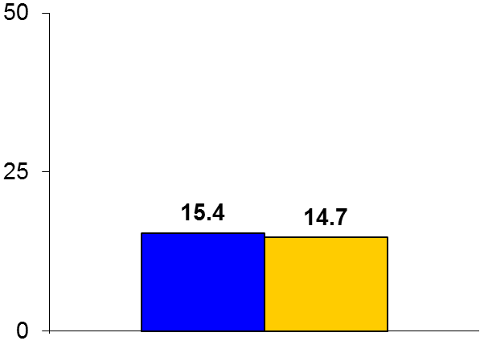

EXCEL
Trial design: Patients with unprotected left main disease were randomized to either PCI with an Xience everolimus-eluting stent (EES) or CABG. They were followed for 3 years.
Results
p_{noninferiority} = 0.018 p_{superiority} = 0.98
Primary endpoint: Death/MI/stroke: PCI vs. CABG: 15.4% vs. 14.7%, p_{non-inferiority} = 0.018; p_{superiority} = 0.98
Death/stroke/MI at 30 days: 4.9% vs. 7.9%, p = 0.008; between 30 days-3 years: 11.5% vs. 7.9%, p = 0.02
3-year stent thrombosis/graft occlusion: 0.7% vs. 5.4%, p < 0.001; revascularization: 12.6% vs. 7.5%, p < 0.0001
%
Conclusions
PCI with 2nd generation DES (Xience) was noninferior to CABG for clinical outcomes at 3 years following revascularization of unprotected left main lesions
Adverse clinical events were not uniformly distributed from a temporal standpoint; hazard was highest with CABG vs. PCI in the first 30 days. Between 30 days-3 years, outcomes were inferior with PCI vs. CABG
Primary endpoint
EES PCI
(n = 948)
CABG
(n = 957)
Stone GW, et al. N Engl J Med 2016;375:2223-5

