Slide 1
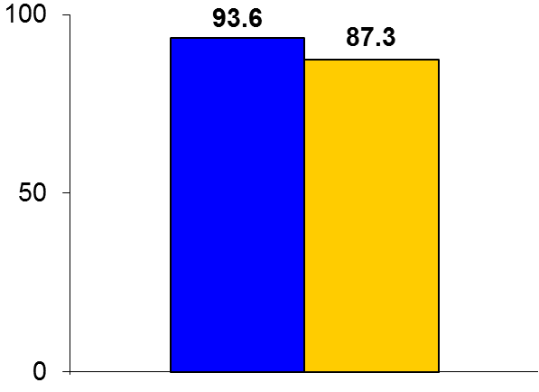
ILLUMENATE
Trial design: Patients with superficial femoral artery (SFA) and/or popliteal arterial stenoses were randomized in a 2:1 fashion to either balloon angioplasty with a paclitaxel drug-coated balloon (DCB) or standard balloon. They were followed for 12 months.
Results
(p < 0.05)
Primary efficacy outcome, clinically driven target lesion revascularization: DCB vs. standard balloon: 93.6% vs. 87.3%, p < 0.05
Primary patency at 12 months: 82.3% vs. 70.9%, p < 0.05
%
Conclusions
Percutaneous transluminal angioplasty (PTA) with a novel low-dose paclitaxel-coated balloon was superior to PTA with standard angioplasty alone in moderately long lesions in the SFA and/or popliteal arteries
Data were similar to the LEVANT 2 trial, which used a different balloon but the same drug (differences are in balloon design and dose of paclitaxel)
Primary endpoint
DCB
(n = 200)
Standard PTA
(n = 100)
Presented by Dr. Sean Lyden at TCT 2016

