Slide 1
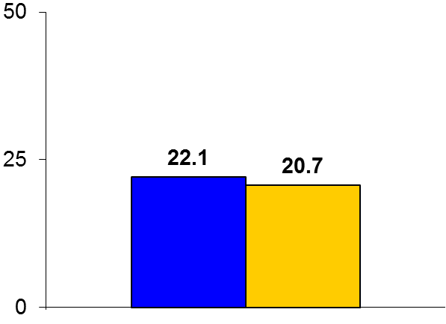

TRUE-AHF
Trial design: Patients with acute decompensated heart failure were randomized in a 1:1 fashion to either early ularitide infusion (within 12 hours) or placebo. They were followed for a median of 15 months.
Results
(p = 0.75)
Primary efficacy outcome, CV mortality: ularitide vs. placebo: 22.1% vs. 20.7%; p = 0.75
Hypotension: 22.4% vs. 10.1%, p < 0.001
30-day HF rehospitalization: 7.0% vs. 7.1%, p = 1.0; all-cause mortality or CV hospitalization within 6 months: 37.2% vs. 40.7%, p = 0.1
Systemic hypotension was more common with ularitide
%
Conclusions
Early administration of ularitide, a synthetic analogue of urodilatin, was not superior to placebo in reducing CV outcomes despite a more pronounced effect on acute intravascular decongestion
Primary endpoint
Ularitide
(n = 1,069)
Placebo
(n = 1,088)
Presented by Dr. Milton Packer at AHA 2016

