Slide 1
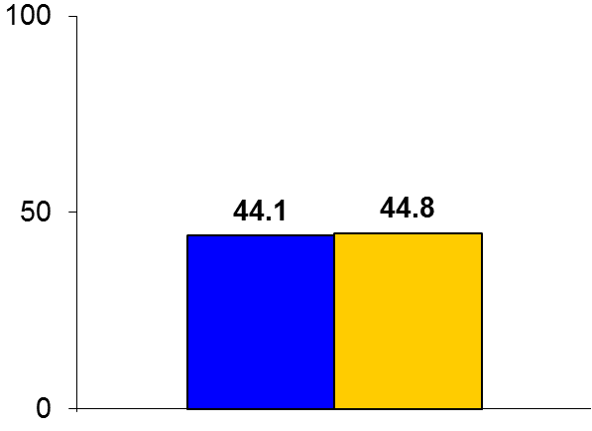

EXPLORE
Trial design: Patients with STEMI treated with primary PCI and with evidence of noninfarct artery chronic total occlusion (CTO) were randomized to CTO-PCI within 7 days or conservative management. They were followed for 4 months.
Results
(p = 0.6)
LVEF at 4 months: CTO-PCI vs. conservative: 44.1% vs. 44.8%, p = 0.6; LVEDV: 215.6 vs. 212.8 ml, p = 0.70
MACE at 4 months: 5.4% vs. 2.6%, p = 0.21
Periprocedural complications in CTO arm: Dissections: 13, tamponade 1, emergency CABG/ stroke/death: 0
%
Conclusions
Routine CTO-PCI performed within 1 week of primary PCI for STEMI does not result in improved LV function or clinical outcomes over an intermediate period of follow-up
Final LVEF at 4 months
CTO-PCI
(n = 150)
Conservative
(n = 154)
Presented by Dr. Jose Henriques at TCT 2016

