Slide 1
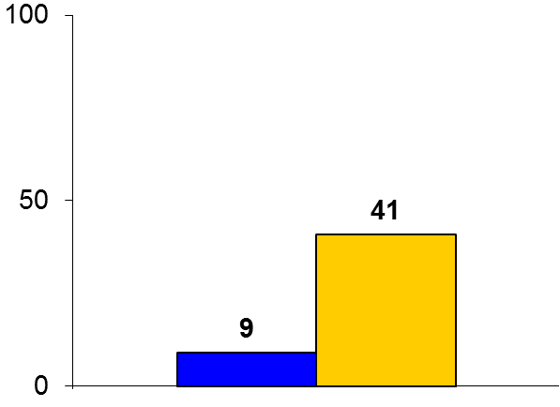

PROCAMIO
Trial design: Patients with hemodynamically stable wide complex monomorphic tachycardia were randomized 1:1 to either intravenous procainamide (single dose 10 mg/kg) or intravenous amiodarone (single dose 5 mg/kg). They were followed for 1 day.
Results
(p = 0.006)
Primary outcome, major adverse cardiac events within 40 minutes of infusion initiation, for procainamide vs. amiodarone = 9% vs. 41%, p = 0.006
Severe hypotension or symptoms requiring immediate DCCV: 6.3% vs. 31.0%
Tachycardia termination: 67% vs. 38%, p = 0.026
%
Conclusions
Procainamide is better tolerated and more efficacious acutely than amiodarone in the treatment of hemodynamically stable wide complex tachycardia (presumably VT)
Important limitation of the current trial is the open-label nature of drug administration, especially since the primary outcome was subjectively assessed
Primary outcome
Procainamide (n = 33)
Amiodarone
(n = 29)
Ortiz M, et al. Eur Heart J 2016;Jun 28:[Epub]

