Slide 1
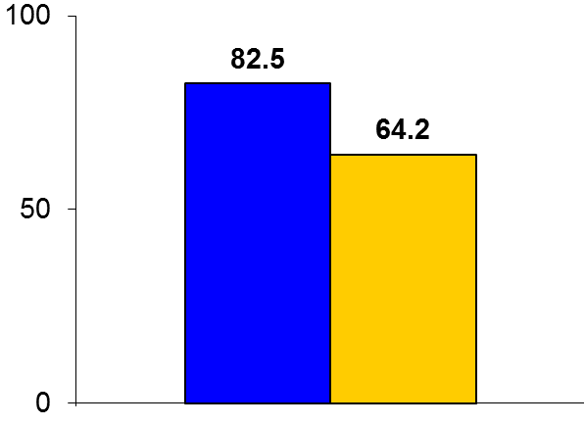
DOCTORS
Trial design: Patients undergoing PCI for NSTEMI were randomized in a 1:1 fashion to either OCT-guided PCI or routine management/angiography-guided PCI. They were followed for 6 months.
Results
(p = 0.0001)
Primary outcome, FFR value for OCT-guided vs. angiography-guided PCI: 0.94 vs. 0.92, p < 0.005; FFR >0.90: 82.5% vs. 64.2%, p = 0.0001
Optimization performed post-stent: 50% vs. 22.5%, p < 0.0001, including post-PCI overinflation
Procedural complications: 5.8% vs. 5.8%, p = 1.0
%
Conclusions
OCT-guided PCI results in a better functional outcome (as assessed by post-PCI FFR) compared with routine angiography-guided PCI in patients undergoing PCI of a single lesion for NSTEMI
There was an ↑ incidence of post-stent optimization procedures in the OCT arm, but also ↑ contrast, radiation, and time utilization in this arm
FFR >0.90
OCT-guided PCI
(n = 120)
Angiography-guided PCI
(n = 120)
Meneveau N, et al. Circulation 2016;134:906-17

