Slide 1
2020 ACC/AHA Guideline for the Management of Patients with Valvular Heart Disease
Developed in collaboration with and endorsed by the American Association for Thoracic Surgery, American Society of Echocardiography, Society for Cardiovascular Angiography and Interventions, Society of Cardiovascular Anesthesiologists, and Society of Thoracic Surgeons

Slide 2
Citation
This slide set is adapted from the 2020 ACC/AHA Guideline for the Management of Patients with Valvular Heart Disease. Published on [DATE], available at: Journal of the American College of Cardiology [(insert full link)] and Circulation [(insert full link)]
The full-text guidelines are available on the ACC website here, [(insert full link)] and the AHA website here, [(insert full link)]

Slide 3
2020 Writing Committee Members*
Catherine M. Otto, MD, FACC, FAHA, Co-Chair
Rick A. Nishimura, MD, MACC, FAHA, Co-Chair
Robert O. Bonow, MD, MS, MACC, FAHA | Christopher McLeod, MBCHB, PhD, FAHA
Blasé A. Carabello, MD, FACC, FAHA | Patrick O’Gara, MD, MACC, FAHA†
John P. Erwin III, MD, FACC, FAHA | Vera H. Rigolin, MD, FACC, FAHA
Federico Gentile, MD, FACC | Thoralf M. Sundt III, MD, FACC, FAHA
Hani Jneid, MD, FACC, FAHA | Annemarie Thompson, MD
Eric V. Krieger, MD, FACC | Christopher Toley
Michael Mack, MD, MACC
*Writing committee members are required to recuse themselves from voting on sections to which their specific relationships with industry may apply; see Appendix 1 for detailed information. †ACC/AHA Representative. †ACC/AHA Joint Committee on Clinical Practice Guidelines Liaison.

Slide 4
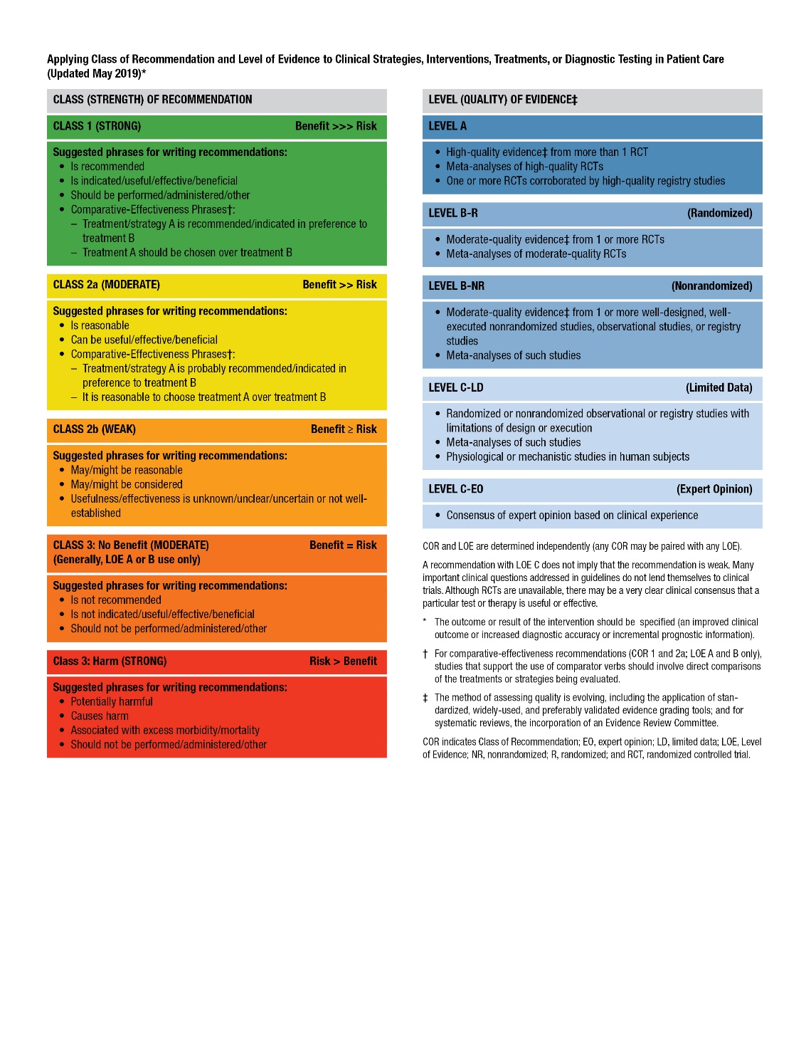
Table 2. ACC/AHA Applying Class of Recommendation and Level of Evidence to Clinical Strategies, Interventions, Treatments, or Diagnostic Testing in Patient Care (Updated May 2019)*

Slide 5
Top 10 Take-Home Messages
2020 Valvular Heart Disease Guidelines

Slide 6
Top 10 Take Home Messages
Disease stages in patients with valvular heart disease should be classified (Stages A, B, C, and D) on the basis of symptoms, valve anatomy, the severity of valve dysfunction, and the response of the ventricle and pulmonary circulation.

Slide 7
Top 10 Take Home Messages
2. In the evaluation of a patient with valvular heart disease, history and physical examination findings should be correlated with the results of noninvasive testing (i.e., ECG, chest x-ray, transthoracic echocardiogram). If there is discordance between the physical examination and initial noninvasive testing, consider further noninvasive (computed tomography, cardiac magnetic resonance imaging, stress testing) or invasive (transesophageal echocardiography, cardiac catheterization) testing to determine optimal treatment strategy.

Slide 8
Top 10 Take Home Messages
3. For patients with valvular heart disease and atrial fibrillation (except for patients with rheumatic mitral stenosis or a mechanical prosthesis), the decision to use oral anticoagulation to prevent thromboembolic events, with either a vitamin K antagonist or a non–vitamin K antagonist anticoagulant, should be made in a shared decision-making process based on the CHA₂DS₂-VASc score. Patients with rheumatic mitral stenosis or a mechanical prosthesis and atrial fibrillation should have oral anticoagulation with a vitamin K antagonist.

Slide 9
Top 10 Take Home Messages
4. All patients with severe valvular heart disease being considered for valve intervention should be evaluated by a multidisciplinary team, with either referral to or consultation with a Primary or Comprehensive Valve Center.

Slide 10
Top 10 Take Home Messages
5. Treatment of severe aortic stenosis with either a transcatheter or surgical valve prosthesis should be based primarily on symptoms or reduced ventricular systolic function. Earlier intervention may be considered if indicated by results of exercise testing, biomarkers, rapid progression, or the presence of very severe stenosis.

Slide 11
Top 10 Take Home Messages
6. Indications for transcatheter aortic valve implantation are expanding as a result of multiple randomized trials of transcatheter aortic valve implantation atrio versus surgical aortic valve replacement. The choice of type of intervention for a patient with severe aortic stenosis should be a shared decision-making process that considers the lifetime risks and benefits associated with type of valve (mechanical versus bioprosthetic) and type of approach (transcatheter versus surgical).

Slide 12
Top 10 Take Home Messages
7. Indications for intervention for valvular regurgitation are relief of symptoms and prevention of the irreversible long-term consequences of left ventricular volume overload. Thresholds for intervention now are lower than they were previously because of more durable treatment options and lower procedural risks.

Slide 13
Top 10 Take Home Messages
8. A percutaneous edge-to-edge mitral repair is of benefit to patients with severely symptomatic primary mitral regurgitation who are at high or prohibitive risk for surgery, as well as to a select subset of patients with severely symptomatic secondary mitral regurgitation despite guideline-directed management and therapy for heart failure.

Slide 14
Top 10 Take Home Messages
9. Patients presenting with severe symptomatic isolated tricuspid regurgitation, commonly associated with device leads and atrial fibrillation, may benefit from surgical intervention to reduce symptoms and recurrent hospitalizations if done before the onset of severe right ventricular dysfunction or end-organ damage to the liver and kidney.

Slide 15
Top 10 Take Home Messages
10. Bioprosthetic valve dysfunction may occur because of either degeneration of the valve leaflets or valve thrombosis. Catheter-based treatment for prosthetic valve dysfunction is reasonable in selected patients for bioprosthetic leaflet degeneration or paravalvular leak in the absence of active infection.

Slide 16
General Principles

Slide 17
Table 3. Evaluation of Patients with Known or Suspected VHD
Reason | Test | Indication
Initial evaluation: All patients with known or suspected valve disease | TTE* | Establishes chamber size and function, valve morphology and severity, and effect on pulmonary and systemic circulation
 | History and physical | Establishes symptom severity, comorbidities, valve disease presence and severity, and presence of HF
 | ECG | Establishes rhythm, LV function, and presence or absence of hypertrophy
*TTE is the standard initial diagnostic test in the initial evaluation of patients with known or suspected VHD

Slide 18
Table 3. Evaluation of Patients with Known or Suspected VHD
Reason | Test | Indication
Further diagnostic testing: Information required for equivocal symptom status, discrepancy between examination and echocardiogram, further definition of valve disease, or assessing response of the ventricles and pulmonary circulation to load and to exercise | Chest x-ray | Important for the symptomatic patient; establishes heart size and presence or absence of pulmonary vascular congestion, intrinsic lung disease, and calcification of aorta and pericardium
 | TEE | Provides high-quality assessment of mitral and prosthetic valve, including definition of intracardiac masses and possible associated abnormalities (e.g., intracardiac abscess, LA thrombus)
 | CMR | Provides assessment of LV volumes and function, valve severity, and aortic disease

Slide 19
Table 3. Evaluation of Patients with Known or Suspected VHD
Reason | Test | Indication
Further diagnostic testing: Information required for equivocal symptom status, discrepancy between examination and echocardiogram, further definition of valve disease, or assessing response of the ventricles and pulmonary circulation to load and to exercise | PET CT | Aids in determination of active infection or inflammation
 | Stress testing | Gives an objective measure of exercise capacity
 | Catheterization | Provides measurement of intracardiac and pulmonary pressures, valve severity, and hemodynamic response to exercise and drugs

Slide 20
Table 3. Evaluation of Patients with Known or Suspected VHD
Reason | Test | Indication
Further risk stratification: Information on future risk of the valve disease, which is important for determination of timing of intervention | Biomarkers | Provide indirect assessment of filling pressures and myocardial damage
 | TTE strain | Helps assess intrinsic myocardial performance
 | CMR | Assesses fibrosis by gadolinium enhancement

Slide 21
Table 3. Evaluation of Patients with Known or Suspected VHD
Reason | Test | Indication
Further risk stratification: Information on future risk of the valve disease, which is important for determination of timing of intervention | Stress testing | Provides prognostic markers
 | Procedural risk | Quantified by STS (Predicted Risk of Mortality) and TAVI scores
 | Frailty score | Provides assessment of risk of procedure and chance of recovery of quality of life

Slide 22
Table 3. Evaluation of Patients with Known or Suspected VHD
Reason | Test | Indication
Preprocedural testing: Testing required before valve intervention | Dental examination | Rules out potential infection sources
 | CT coronary angiogram or invasive coronary angiogram | Provides an assessment of coronary anatomy
 | CT: peripheral | Assess femoral access for TAVI and other transcatheter procedures
 | CT: cardiac | Assesses suitability for TAVI and other transcatheter procedures
CMR indicates cardiac magnetic resonance; CT, computed tomography; ECG, electrocardiogram; HF, heart failure; LV, left ventricular; PET, positron emission tomography; STS, Society of Thoracic Surgeons; TAVI, transcatheter aortic valve implantation; TEE, transesophageal echocardiography; TTE, transthoracic echocardiography; and VHD, valvular heart disease.

Slide 23
Table 4. Stages of VHD
Stage | Definition | Description
A | At risk | Patients with risk factors for development of VHD
B | Progressive | Patients with progressive VHD (mild to moderate severity and asymptomatic)
C | Asymptomatic severe | Asymptomatic patients who have the criteria for severe VHD: C1: Asymptomatic patients with severe VHD in whom the LV or RV remains compensated space C2: asymptomatic patients with severe VHD with decompensation of LV or RV
D | Symptomatic severe | Patients who have developed symptoms as a result of VHD

Slide 24
Diagnosis and Follow-up

Slide 25
Diagnostic Testing: Routine Follow-up
Table 5. Frequency of Echocardiograms in Asymptomatic Patients with VHD and Normal LV Function
 | Type of Valve Lesion
Stage | Aortic Stenosis* | Aortic Regurgitation | Mitral Stenosis | Mitral Regurgitation
Progressive (Stage B) | Every 3–5 y (mild severity; V_{max} 2.0–2.9 m/s) | Every 3–5 y (mild severity) | Every 3–5 y (MV area >1.5 cm²) | Every 3–5 y (mild severity)
 | Every 1–2 y moderate severity; V_{max} 3.0–3.9 m/s) | Every 1–2 y (moderate severity) |  | Every 1–2 y (moderate severity)
Patients with mixed valve disease may require serial evaluations at intervals earlier than recommended for single-valve lesions. These intervals apply to most patients with each valve lesion and do not take into consideration the etiology of the valve disease.
*With normal stroke volume.

Slide 26
Diagnostic Testing: Routine Follow-up
Table 5. Frequency of Echocardiograms in Asymptomatic Patients with VHD and Normal LV Function
 | Type of Valve Lesion
Stage | Aortic Stenosis* | Aortic Regurgitation | Mitral Stenosis | Mitral Regurgitation
Severe asymptomatic (Stage C1) | Every 6–12 mo (V_{max} ≥4 m/s) | Every 6–12 mo | Every 1–2 y (MV area 1.0–1.5 cm²) | Every 6–12 mo
 |  | Dilating LV: More frequently | Every year (MV area <1.0 cm²) | Dilating LV: More frequently
Patients with mixed valve disease may require serial evaluations at intervals earlier than recommended for single-valve lesions. These intervals apply to most patients with each valve lesion and do not take into consideration the etiology of the valve disease.
*With normal stroke volume.

Slide 27
Basic Principles of Medical Therapy

Slide 28
Secondary Prevention of Rheumatic Fever
COR | LOE | Recommendation
1 | C-EO | In patients with rheumatic heart disease, secondary prevention of rheumatic fever is indicated.

Slide 29
Table 6. Secondary Prevention of Rheumatic Fever
Antibiotics for Prevention | Dosage‡
Penicillin G benzathine | 1.2 million U intramuscularly every 4 wk*
Penicillin V potassium | 200 mg orally twice daily
Sulfadiazine | 1 g orally once daily
Macrolide or azalide antibiotic (for patients allergic to penicillin and sulfadiazine)† | Varies
‡ In patients with documented valvular heart disease, the duration of rheumatic fever prophylaxis should be ≥10 years or until the patient is 40 years of age (whichever is longer). Lifelong prophylaxis may be recommended if the patient is at high risk of group A streptococcus exposure. Secondary rheumatic heart disease prophylaxis is required even after valve replacement.
*Administration every 3 wk is recommended in certain high-risk situations.
†Macrolide antibiotics should not be used in persons taking other medications that inhibit cytochrome P450 3A, such as azole antifungal agents, HIV protease inhibitors, and some selective serotonin reuptake inhibitors.
Adapted from Gerber et al

Slide 30
Table 7. Duration of Secondary Prophylaxis for Rheumatic Fever
Type | Duration After Last Attack*
Rheumatic fever with carditis and residual heart disease (persistent VHD†) | 10 y or until patient is 40 y of age (whichever is longer)
Rheumatic fever with carditis but no residual heart disease (no valvular disease†) | 10 y or until patient is 21 y of age (whichever is longer)
Rheumatic fever without carditis | 5 y or until patient is 21 y of age (whichever is longer)
*Lifelong prophylaxis may be recommended if the patient is at high risk of group A streptococcus exposure. Secondary rheumatic heart disease prophylaxis is required even after valve replacement. †Clinical or echocardiographic evidence. Adapted from Gerber et al

Slide 31
IE Prophylaxis
COR | LOE | Recommendation
2a | C-LD | Antibiotic prophylaxis is reasonable before dental procedures that involve manipulation of gingival tissue, manipulation of the periapical region of teeth, or perforation of the oral mucosa in patients with VHD who have any of the following: Prosthetic cardiac valves, including transcatheter-implanted prostheses and homografts. Prosthetic material used for cardiac valve repair, such as annuloplasty rings, chords, or clips. Previous IE. Unrepaired cyanotic congenital heart disease or repaired congenital heart disease, with residual shunts or valvular regurgitation at the site of or adjacent to the site of a prosthetic patch or prosthetic device. Cardiac transplant with valve regurgitation attributable to a structurally abnormal valve.

Slide 32
IE Prophylaxis
COR | LOE | Recommendation
3: No Benefit | B-NR | 2. In patients with VHD who are at high risk of IE, antibiotic prophylaxis is not recommended for nondental procedures (e.g., TEE, esophagogastroduodenoscopy, colonoscopy, or cystoscopy) in the absence of active infection.

Slide 33
Anticoagulation for AF in Patients With VHD
COR | LOE | Recommendations
1 | A | For patients with AF and native valve heart disease (except rheumatic mitral stenosis [MS]) or who received a bioprosthetic valve >3 months ago, a non–vitamin K oral anticoagulant (NOAC) is an effective alternative to VKA anticoagulation and should be administered on the basis of the patient’s CHA₂DS₂-VASc score.
1 | C-EO | 2. For patients with AF and rheumatic MS, long-term VKA oral anticoagulation is recommended.

Slide 34
Anticoagulation for AF in Patients With VHD
COR | LOE | Recommendations
2a | B-NR | 3. For patients with new-onset AF ≤ 3 months after surgical or transcatheter bioprosthetic valve replacement, anticoagulation with a VKA is reasonable .
3: Harm | B-R | 4. In patients with mechanical heart valves with or without AF who require long-term anticoagulation with VKA to prevent valve thrombosis, NOACs are not recommended.

Slide 35
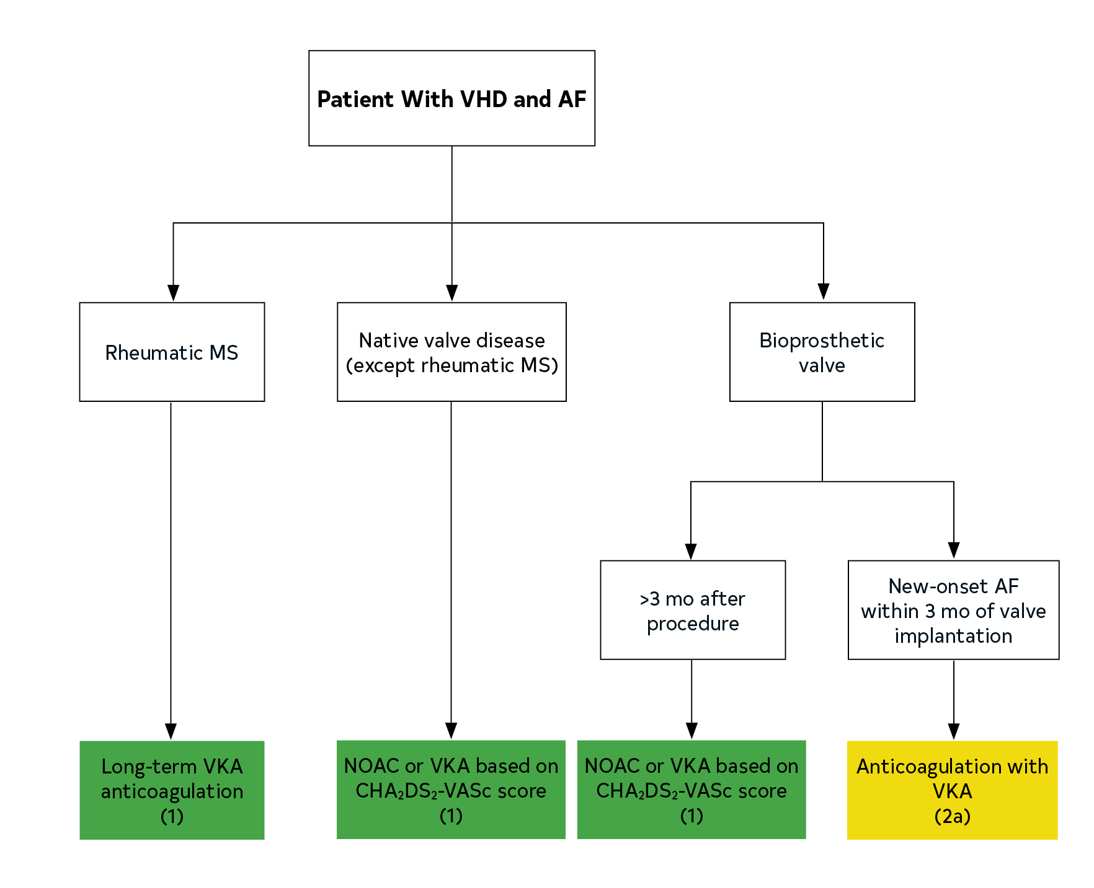
Figure 1. Anticoagulation for AF in Patients With VHD.
Colors corresponds to Table 2.

Slide 36
Evaluation of Surgical and Interventional Risk
COR | LOE | Recommendation
1 | C-EO | For patients with VHD for whom intervention is contemplated, individual risks should be calculated for specific surgical and/or transcatheter procedures, using online tools when available, and discussed before the procedure as a part of a shared decision-making process.

Slide 37
Table 8. Risk Assessment for Surgical Valve Procedures
Footnote text located on the next slide
Criteria | Low-Risk SAVR (Must Meet ALL Criteria in This Column) | Low-Risk Surgical Mitral Valve Repair for Primary MR (Must Meet ALL Criteria in This Column) | High Surgical Risk (Any 1 Criterion in This Column) | Prohibitive Surgical Risk (Any 1 Criterion in This Column)
STS-predicted risk of death* | <3% AND | <1% AND | >8% OR | Predicted risk of death or major morbidity (all-cause) >50% at 1 y OR
Frailty† | None AND | None AND | ≥2 Indices (moderate to severe) OR | ≥2 Indices (moderate to severe) OR
Cardiac or other major organ system compromise not to be improved postoperatively‡ | None AND | None AND | 1 to 2 Organ systems OR | ≥3 Organ systems OR
Procedure-specific impediment§ | None | None | Possible procedure-specific impediment | Severe procedure-specific impediment

Slide 38
Table 8. Surgical Risk Assessment
*Use of the STS Predicted Risk of Mortality (http://riskcalc.sts.org/stswebriskcalc/#/) to predict risk in a given institution with reasonable reliability is appropriate only if institutional outcomes are within 1 standard deviation of the STS average observed/expected mortality ratio for the procedure in question. The EUROSCORE II risk calculator may also be considered for use and is available at http://www.euroscore.org/calc.html.
†Seven frailty indices: Katz Activities of Daily Living (independence in feeding, bathing, dressing, transferring, toileting, and urinary continence) plus independence in ambulation (no walking aid or assistance required, or completion of a 5-m walk in <6 s). Other scoring systems can be applied to calculate no, mild, or moderate to severe frailty.
‡Examples of major organ system compromise include cardiac dysfunction (severe LV systolic or diastolic dysfunction or RV dysfunction, fixed pulmonary hypertension); kidney dysfunction (chronic kidney disease, stage 3 or worse); pulmonary dysfunction (FEV₁ <50% or D_{LCO2} <50% of predicted); central nervous system dysfunction (dementia, Alzheimer’s disease, Parkinson’s disease, cerebrovascular accident with persistent physical limitation); gastrointestinal dysfunction (Crohn’s disease, ulcerative colitis, nutritional impairment, or serum albumin <3.0); cancer (active malignancy); and liver dysfunction (any history of cirrhosis, variceal bleeding, or elevated INR in the absence of VKA therapy).
§Examples of procedure-specific impediments include presence of tracheostomy, heavily calcified (porcelain) ascending aorta, chest malformation, arterial coronary graft adherent to posterior chest wall, and radiation damage.

Slide 39
Table 9. Examples of Procedure-Specific Risk Factors for Interventions Not Incorporated Into Existing Risk Scores
SAVR | TAVI | Surgical MV Repair or Replacement | Transcatheter Edge-to-Edge Mitral Valve Repair
Technical or anatomic
Prior mediastinal radiation | Aorto-iliac occlusive disease precluding transfemoral approach | Prior sternotomy | Multivalve disease
Ascending aortic calcification (porcelain aorta may be prohibitive) | Aortic arch atherosclerosis (protuberant lesions) Severe MR or TR Low-lying coronary arteries Basal septal hypertrophy Valve morphology (e.g., bicuspid or unicuspid valve) Extensive LV outflow tract calcification | Prior mediastinal radiation Ascending aortic calcification (porcelain aorta may be prohibitive) | Valve morphology (e.g., thickening, perforations, clefts, calcification, and stenosis) Prior mitral valve surgery

Slide 40
Table 9. Examples of Procedure-Specific Risk Factors for Interventions Not Incorporated Into Existing Risk Scores
SAVR | TAVI | Surgical MV Repair or Replacement | Transcatheter Edge-to-Edge Mitral Valve Repair
Comorbidities
Severe COPD or home oxygen therapy Pulmonary hypertension Severe RV dysfunction Hepatic dysfunction Frailty* | Severe COPD or home oxygen therapy Pulmonary hypertension Severe RV dysfunction Hepatic dysfunction Frailty* | Severe COPD or home oxygen therapy Pulmonary hypertension Hepatic dysfunction Frailty* | Severe COPD or home oxygen therapy Pulmonary hypertension Hepatic dysfunction Frailty*

Slide 41
Table 9. Examples of Procedure-Specific Risk Factors for Interventions Not Incorporated Into Existing Risk Scores
SAVR |  | TAVI | Surgical MV Repair or Replacement | Transcatheter Edge-to-Edge Mitral Valve Repair
Futility
STS score >15 Life expectancy <1 y Poor candidate for rehabilitation | STS score >15 Life expectancy <1 y Poor candidate for rehabilitation | STS score >15 Life expectancy <1 y Poor candidate for rehabilitation | STS score >15 Life expectancy <1 y Poor candidate for rehabilitation | STS score >15 Life expectancy <1 y Poor candidate for rehabilitation

Slide 42
Table 10. Median Operative Mortality Rates for Specific Surgical Procedures
(STS Adult Cardiac Surgery Database, 2019)
Procedure | Mortality Rate (%)
AVR | 2.2
AVR and CABG | 4
AVR and mMitral vValve replacement | 9
Mitral vValve replacement | 5
Mitral vValve replacement and CABG | 9
Mitral vValve repair | 1
Mitral vValve repair and CABG | 5

Slide 43
The Multidisciplinary Heart Valve Team and Heart Valve Centers
COR | LOE | Recommendations
1 | C-EO | Patients with severe VHD should be evaluated by a Multidisciplinary Heart Valve Team (MDT) when intervention is considered.
2a | C-LD | 2. Consultation with or referral to a Primary or Comprehensive Heart Valve Center is reasonable when treatment options are being discussed for 1) asymptomatic patients with severe VHD, 2) patients who may benefit from valve repair versus valve replacement, or 3) patients with multiple comorbidities for whom valve intervention is considered.

Slide 44
PLACEHOLDER
Table 11. Structure of Primary and Comprehensive Valve Centers

Slide 45
Periodic Imaging After Valve Intervention
COR | LOE | Recommendation
1 | C-EO | In asymptomatic patients with any type of valve intervention, a baseline postprocedural TTE followed by periodic monitoring with TTE is recommended, depending on type of intervention, length of time since intervention, ventricular function, and concurrent cardiac conditions.

Slide 46
Table 12. Timing of Periodic Imaging After Valve Intervention
Footnote text located on the next slide
Valve Intervention | Minimal Imaging Frequency† | Location
Mechanical valve (surgical) | Baseline | Primary Valve Center
Bioprosthetic valve (surgical) | Baseline, 5 and 10 y after surgery,‡ and then annually | Primary Valve Center
Bioprosthetic valve (transcatheter) | Baseline and then annually | Primary Valve Center
Mitral valve repair (surgical) | Baseline, 1 y, and then every 2 to 3 y | Primary Valve Center
Mitral valve repair (transcatheter) | Baseline and then annually | Comprehensive Valve Center
Bicuspid aortic valve disease | Continued post-AVR monitoring of aortic size if aortic diameter is ≥4.0 cm at time of AVR, as detailed in Section 5.1 | Primary Valve Center

Slide 47
Table 12. Timing of Periodic Imaging
After Valve Intervention
*Initial postprocedural TTE is recommended for all patients, ideally 1 to 3 months after the procedure. Annual clinical follow-up is recommended annually for all patients after valve intervention at a Primary or Comprehensive Valve Center.
†Repeat imaging is appropriate at shorter follow-up intervals for changing signs or symptoms, during pregnancy, and to monitor residual or concurrent cardiac dysfunction.
‡Imaging may be done more frequently in patients with bioprosthetic surgical valves if there are risk factors for early valve degeneration (e.g., younger age, renal failure, diabetes).

Slide 48
Aortic Stenosis

Slide 49
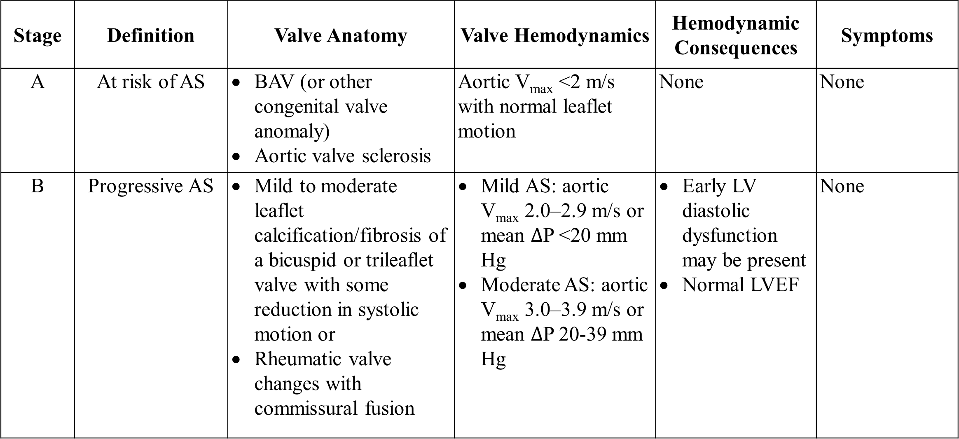
Table 13. Stages of Valvular Aortic Stenosis
Stage | Definition | Valve Anatomy | Valve Hemodynamics | Hemodynamic Consequences | Symptoms
A | At risk of AS | BAV (or other congenital valve anomaly) Aortic valve sclerosis | Aortic V_{max} <2 m/s with normal leaflet motion | None | None
B | Progressive AS | Mild to moderate leaflet calcification/fibrosis of a bicuspid or trileaflet valve with some reduction in systolic motion or Rheumatic valve changes with commissural fusion | Mild AS: aortic V_{max} 2.0–2.9 m/s or mean $∆$P <20 mm Hg Moderate AS: aortic V_{max} 3.0–3.9 m/s or mean $∆$P 20-39 mm Hg | Early LV diastolic dysfunction may be present Normal LVEF | None

Slide 50
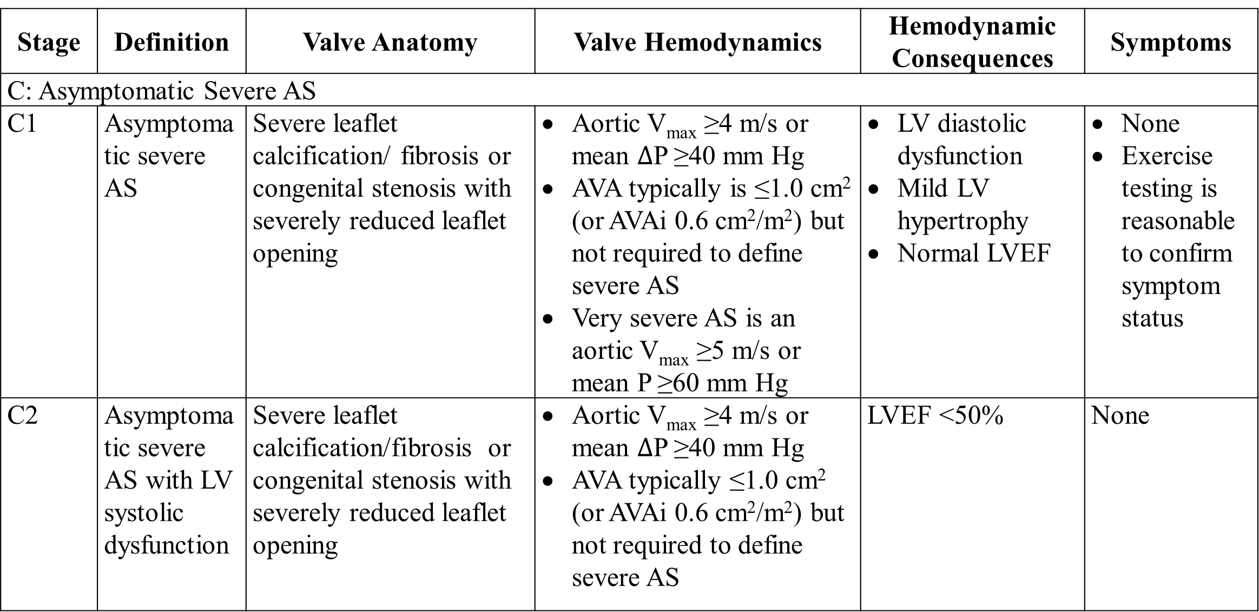
Table 13. Stages of Valvular Aortic Stenosis
Stage | Definition | Valve Anatomy | Valve Hemodynamics | Hemodynamic Consequences | Symptoms
C: Asymptomatic Severe AS
C1 | Asymptomatic severe AS | Severe leaflet calcification/ fibrosis or congenital stenosis with severely reduced leaflet opening | Aortic V_{max} ≥4 m/s or mean $∆$P ≥40 mm Hg AVA typically is ≤1.0 cm² (or AVAi 0.6 cm²/m²) but not required to define severe AS Very severe AS is an aortic V_{max} ≥5 m/s or mean P ≥60 mm Hg | LV diastolic dysfunction Mild LV hypertrophy Normal LVEF | None Exercise testing is reasonable to confirm symptom status
C2 | Asymptomatic severe AS with LV systolic dysfunction | Severe leaflet calcification/fibrosis or congenital stenosis with severely reduced leaflet opening | Aortic V_{max} ≥4 m/s or mean $∆$P ≥40 mm Hg AVA typically ≤1.0 cm² (or AVAi 0.6 cm²/m²) but not required to define severe AS | LVEF <50% | None

Slide 51
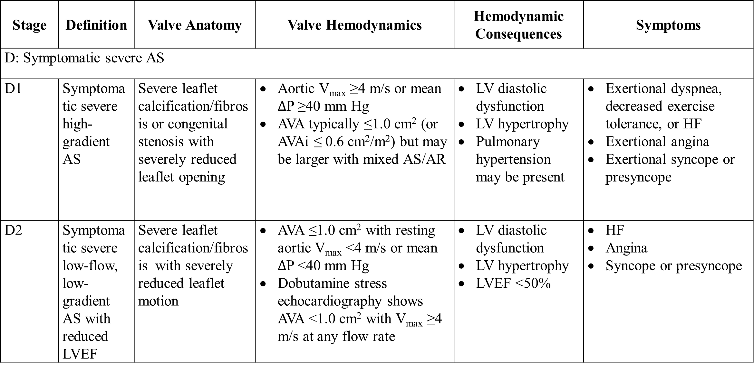
Table 13. Stages of Valvular Aortic Stenosis
Stage | Definition | Valve Anatomy | Valve Hemodynamics | Hemodynamic Consequences | Symptoms
D: Symptomatic severe AS
D1 | Symptomatic severe high-gradient AS | Severe leaflet calcification/fibrosis or congenital stenosis with severely reduced leaflet opening | Aortic V_{max} ≥4 m/s or mean $∆$P ≥40 mm Hg AVA typically ≤1.0 cm² (or AVAi ≤ 0.6 cm²/m²) but may be larger with mixed AS/AR | LV diastolic dysfunction LV hypertrophy Pulmonary hypertension may be present | Exertional dyspnea, decreased exercise tolerance, or HF Exertional angina Exertional syncope or presyncope
D2 | Symptomatic severe low-flow, low-gradient AS with reduced LVEF | Severe leaflet calcification/fibrosis with severely reduced leaflet motion | AVA ≤1.0 cm² with resting aortic V_{max} <4 m/s or mean $∆$P <40 mm Hg Dobutamine stress echocardiography shows AVA <1.0 cm² with V_{max} ≥4 m/s at any flow rate | LV diastolic dysfunction LV hypertrophy LVEF <50% | HF Angina Syncope or presyncope

Slide 52
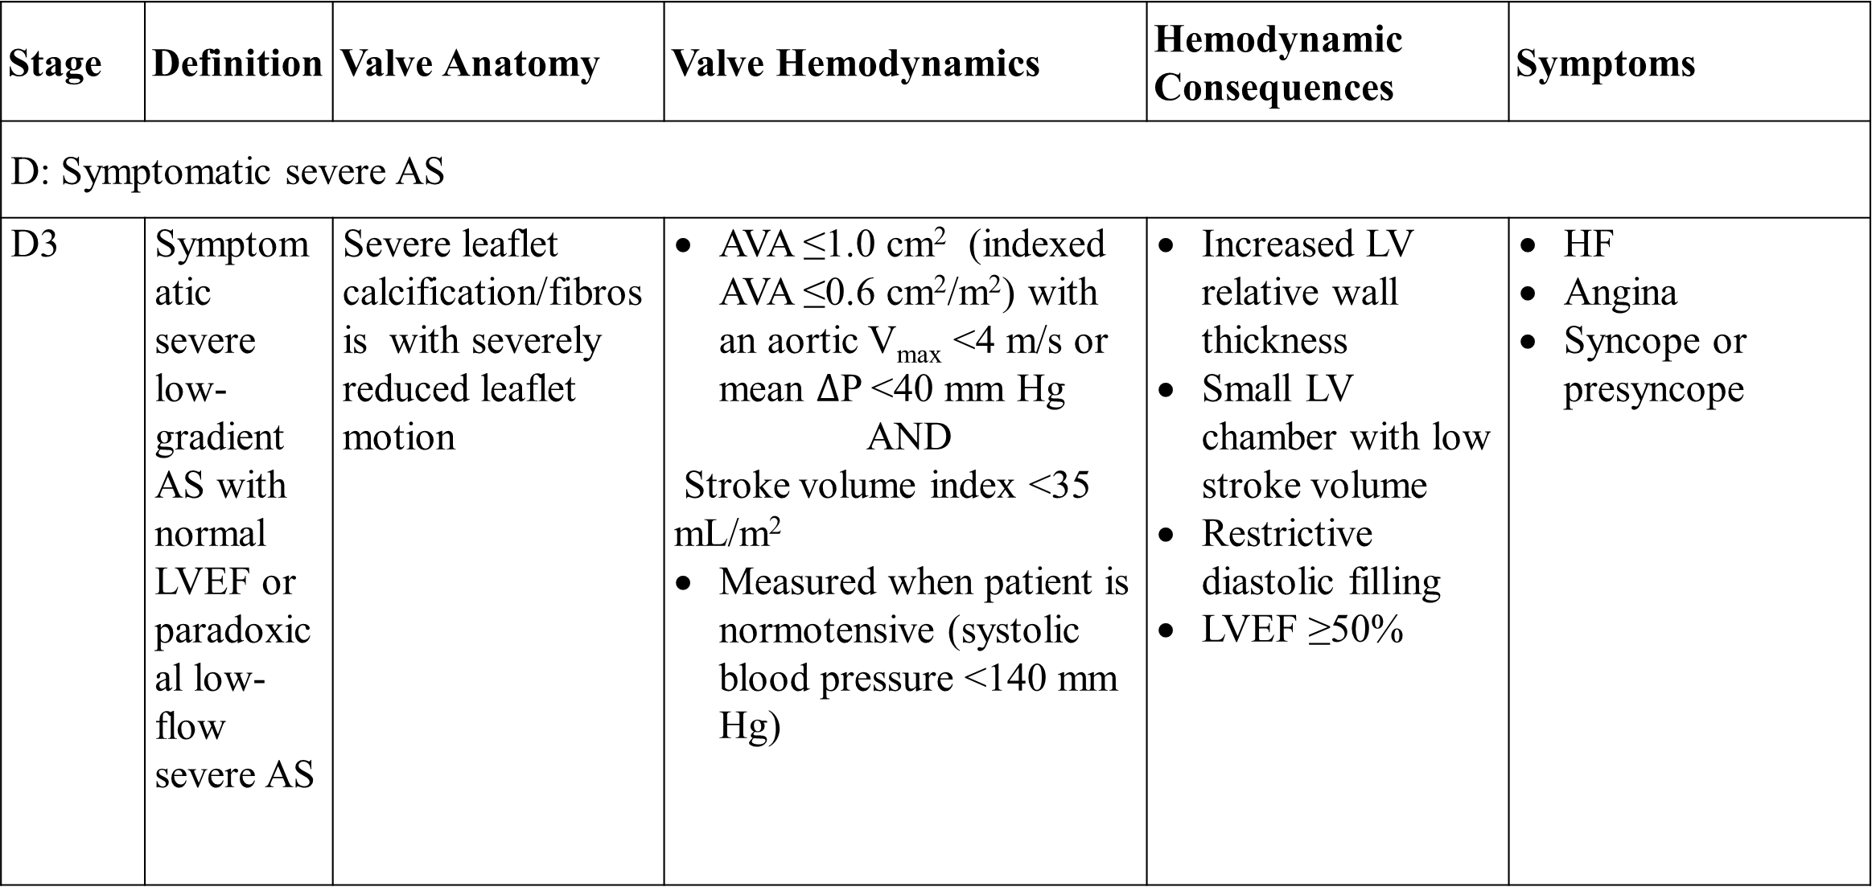
Table 13. Stages of Valvular Aortic Stenosis
Stage | Definition | Valve Anatomy | Valve Hemodynamics | Hemodynamic Consequences | Symptoms
D: Symptomatic severe AS
D3 | Symptomatic severe low-gradient AS with normal LVEF or paradoxical low-flow severe AS | Severe leaflet calcification/fibrosis with severely reduced leaflet motion | AVA ≤1.0 cm² (indexed AVA ≤0.6 cm²/m²) with an aortic V_{max} <4 m/s or mean $∆$P <40 mm Hg AND Stroke volume index <35 mL/m² Measured when patient is normotensive (systolic blood pressure <140 mm Hg) | Increased LV relative wall thickness Small LV chamber with low stroke volume Restrictive diastolic filling LVEF ≥50% | HF Angina Syncope or presyncope

Slide 53
Initial Diagnosis and Follow-up of AS
COR | LOE | Recommendations
1 | A | In patients with signs or symptoms of AS or a BAV, TTE is indicated for accurate diagnosis of the cause of AS, assessment of hemodynamic severity, measurement of LV size and systolic function, and determination of prognosis and timing of valve intervention.
1 | B-NR | 2. In patients with suspected low-flow, low-gradient severe AS with normal LVEF (Stage D3), optimization of blood pressure control is recommended before measurement of AS severity by TTE, TEE, cardiac catheterization, or CMR.

Slide 54
Diagnosis and Follow-up: Iinitial Ddiagnosis of AS
COR | LOE | Recommendations
2a | B-NR | 3. In patients with suspected low-flow, low-gradient severe AS with reduced LVEF (Stage D2), low-dose dobutamine stress testing with echocardiographic or invasive hemodynamic measurements is reasonable to further define severity and assess contractile reserve.
2a | B-NR | 4. In patients with suspected low-flow, low-gradient severe AS with normal or reduced LVEF (Stages D2 and D3), calculation of the ratio of the outflow tract to aortic velocity is reasonable to further define severity.

Slide 55
Diagnosis and Follow-up: Iinitial Ddiagnosis of AS
COR | LOE | Recommendations
2a | B-NR | 5. In patients with suspected low-flow, low-gradient severe AS with normal or reduced LVEF (Stages D2 and D3), measurement of aortic valve calcium score by CT imaging is reasonable to further define severity.

Slide 56
Diagnosis and Follow-up: Eexercise Ttesting
COR | LOE | Recommendations
2a | B-NR | In asymptomatic patients with severe AS (Stage C1), exercise testing is reasonable to assess physiological changes with exercise and to confirm the absence of symptoms.
3: Harm | B-NR | 2. In symptomatic patients with severe AS (Stage D1, aortic velocity ≥4.0 m/s or mean pressure gradient ≥40 mm Hg), exercise testing should not be performed because of the risk of severe hemodynamic compromise.

Slide 57
Medical Therapy of Patients with AS
COR | LOE | Recommendations
1 | B-NR | In patients at risk of developing AS (Stage A) and in patients with asymptomatic AS (Stages B and C), hypertension should be treated according to standard GDMT, started at a low dose, and gradually titrated upward as needed, with appropriate clinical monitoring.
1 | A | 2. In all patients with calcific AS, statin therapy is indicated for primary and secondary prevention of ​atherosclerosis on the basis of standard risk score.

Slide 58
Medical Therapy of Patients with AS
COR | LOE | Recommendations
2b | B-R | 3. In patients who have undergone TAVI, renin–angiotensin system blocker therapy (ACE inhibitor or ARB) may be considered to reduce the long-term risk of all-cause mortality.
3: No Benefit | A | 4. In patients with calcific AS (Stages B and C), statin therapy is not indicated for prevention of hemodynamic progression of AS.

Slide 59
Timing of Intervention of AS
COR | LOE | Recommendations
1 | A | In adults with severe high-gradient AS (Stage D1) and symptoms of exertional dyspnea, HF, angina, syncope, or presyncope by history or on exercise testing, AVR is indicated.
1 | B-NR | 2. In asymptomatic patients with severe AS and an LVEF <50% (Stage C2), AVR is indicated.
1 | B-NR | 3. In asymptomatic patients with severe AS (Stage C1) who are undergoing cardiac surgery for other indications, AVR is indicated.

Slide 60
Timing of Intervention of AS
COR | LOE | Recommendations
1 | B-NR | 4. In symptomatic patients with low-flow, low-gradient severe AS with reduced LVEF (Stage D2), AVR is recommended.
1 | B-NR | 5. In symptomatic patients with low-flow, low-gradient severe AS with normal LVEF (Stage D3), AVR is recommended if AS is the most likely cause of symptoms.

Slide 61
Timing of Intervention of AS
COR | LOE | Recommendations
2a | B-NR | 6. In apparently asymptomatic patients with severe AS (Stage C1) and low surgical risk, AVR is reasonable when an exercise test demonstrates decreased exercise tolerance (normalized for age and sex) or a fall in systolic blood pressure of ≥10 mm Hg from baseline to peak exercise.
2a | B-R | 7. In asymptomatic patients with very severe AS (defined as an aortic velocity of ≥5 m/s) and low surgical risk, AVR is reasonable.

Slide 62
Timing of Intervention of AS
COR | LOE | Recommendations
2a | B-NR | 8. In apparently asymptomatic patients with severe AS (Stage C1) and low surgical risk, AVR is reasonable when the serum B-type natriuretic peptide (BNP) level is >3 times normal.
2a | B-NR | 9. In asymptomatic patients with high-gradient severe AS (Stage C1) and low surgical risk, AVR is reasonable when serial testing shows an increase in aortic velocity ≥0.3 m/s per year

Slide 63
Timing of Intervention of AS
COR | LOE | Recommendations
2b | B-NR | 10. In asymptomatic patients with severe high-gradient AS (Stage C1) and a progressive decrease in LVEF on at least 3 serial imaging studies to <60%, AVR may be considered.
2b | C-EO | 11. In patients with moderate AS (Stage B) who are undergoing cardiac surgery for other indications, AVR may be considered.

Slide 64
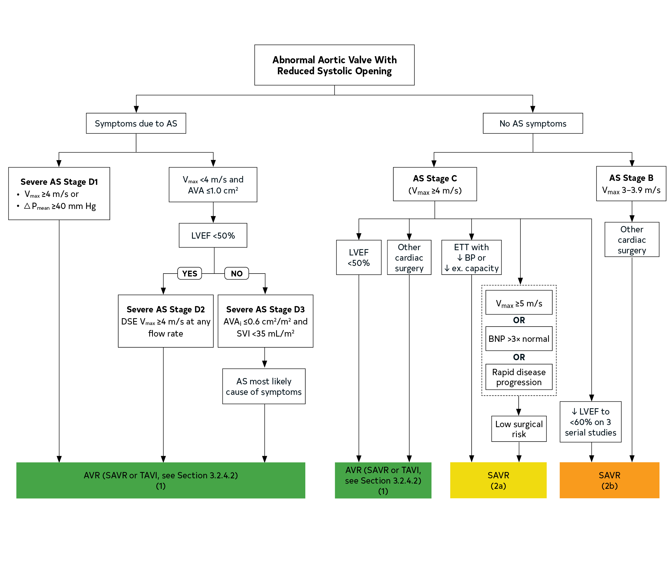
Figure 2. Timing of Intervention for AS
Colors correspond to Table 2.
Arrows show the decision pathways that result in a recommendation for AVR.
Periodic monitoring is indicated for all patients in whom AVR is not yet indicated, including those with asymptomatic (Stage C) and symptomatic (Stage D) AS and those with low-gradient AS (Stage D2 or D3) who do not meet the criteria for intervention.
See Section 3.2.4 for choice of valve type (mechanical versus bioprosthetic [TAVIR or SAVR]) when AVR is indicated.

Slide 65
Choice of Intervention: Mechanical Versus Bioprosthetic AVR
COR | LOE | Recommendations
1 | C-EO | In patients with an indication for AVR, the choice of prosthetic valve should be based on a shared decision-making process that accounts for the patient’s values and preferences and includes discussion of the indications for and risks of anticoagulant therapy and the potential need for and risks associated with valve reintervention.
1 | C-EO | 2. For patients of any age requiring AVR for whom VKA anticoagulant therapy is contraindicated, cannot be managed appropriately, or is not desired, a bioprosthetic AVR is recommended.
2a | B-R | 3. For patients <50 years of age who do not have a contraindication to anticoagulation and require AVR, it is reasonable to choose a mechanical aortic prosthesis over a bioprosthetic valve.

Slide 66
Choice of Intervention: Mechanical Versus Bioprosthetic AVR
COR | LOE | Recommendation
2a | B-NR | 4. For patients 50 to 65 years of age who require AVR and who do not have a contraindication to anticoagulation, it is reasonable to individualize the choice of either a mechanical or bioprosthetic AVR with consideration of individual patient factors and after informed shared decision-making.
2a | B-R | 5. In patients >65 years of age who require AVR, it is reasonable to choose a bioprosthesis over a mechanical valve.
2b | B-NR | 6. In patients <50 years of age who prefer a bioprosthetic AVR and have appropriate anatomy, replacement of the aortic valve by a pulmonic autograft (the Ross procedure) may be considered at a Comprehensive Valve Center.

Slide 67
Choice of Intervention: SAVR Versus TAVI for Patients for Whom a Bioprosthetic AVR is Appropriate
COR | LOE | Recommendations
1 | A | 1. For symptomatic and asymptomatic patients with severe AS and any indication for AVR who are <65 years of age or have a life expectancy >20 years, SAVR is recommended.
1 | A | For symptomatic patients with severe AS who are 65 to 80 years of age and have no anatomic contraindication to transfemoral TAVI, either SAVR or transfemoral TAVI is recommended after shared decision-making about the balance between expected patient longevity and valve durability.
1 | A | For symptomatic patients with severe AS who are >80 years of age or for younger patients with a life expectancy <10 years and no anatomic contraindication to transfemoral TAVI, ​transfemoral TAVI is recommended in preference to SAVR.

Slide 68
Choice of Intervention: SAVR Versus TAVI for Patients for Whom a Bioprosthetic AVR is Appropriate
COR | LOE | Recommendation
1 | B-NR | 4. In asymptomatic patients with severe AS and an LVEF <50% who are ≤80 years of age and have no anatomic contraindication to ​transfemoral TAVI, the decision between TAVI and SAVR should follow the same recommendations as for symptomatic patients in Recommendations 1, 2, and 3 above.
1 | B-NR | 5. For asymptomatic patients with severe AS and an abnormal exercise test, very severe AS, rapid progression, or an elevated BNP (COR 2a indications for AVR), SAVR is recommended in preference to TAVI.
1 | A | 6. For patients with an indication for AVR for whom a bioprosthetic valve is preferred but valve or vascular anatomy or other factors are not suitable for transfemoral TAVI, SAVR is recommended.

Slide 69
Choice of Intervention
SAVR Versus TAVI for Patients for Whom a Bioprosthetic AVR is Appropriate
COR | LOE | Recommendations
1 | A | 7. For symptomatic patients of any age with severe AS and a high or prohibitive surgical risk, TAVI is recommended if predicted post-TAVI survival is >12 months with an acceptable quality of life.
1 | C-EO | 8. For symptomatic patients with severe AS for whom predicted post-TAVI or post-SAVR survival is <12 months or for whom minimal improvement in quality of life is expected, palliative care is recommended after shared decision-making, including discussion of patient preferences and values.
2b | C-EO | 9. In critically ill patients with severe AS, percutaneous aortic balloon dilation may be considered as a bridge to SAVR or TAVI.

Slide 70
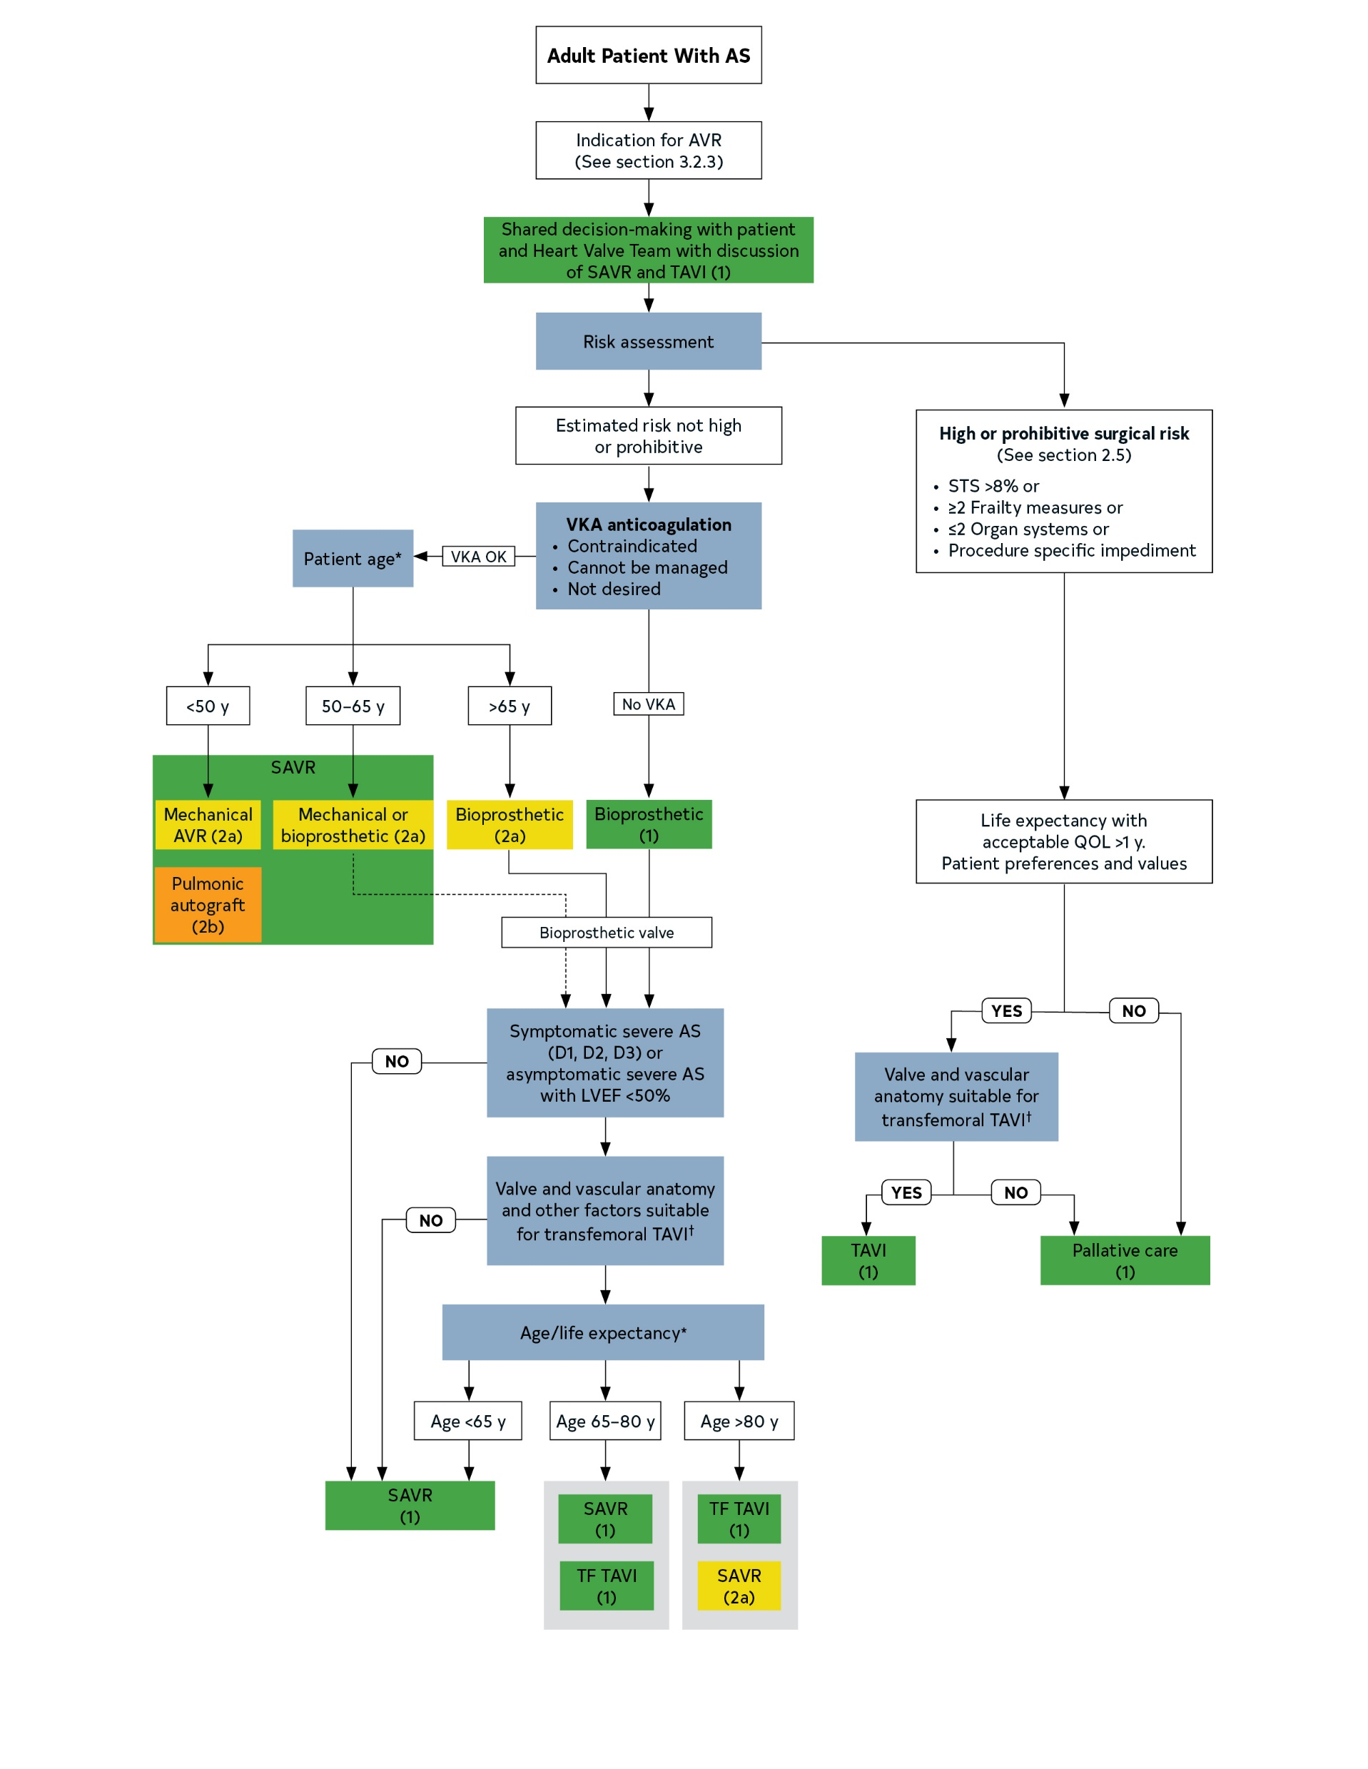
Figure 3. Choice of SAVR versus TAVI when AVR is indicated for valvular AS.
Colors correspond to Table 2
Footnote text located on the next slide

Slide 71
*Approximate ages, based on U.S. Actuarial Life Expectancy tables, are provided for guidance.
The balance between expected patient longevity and valve durability varies continuously across the age range, with more durable valves preferred for patients with a longer life expectancy. Bioprosthetic valve durability is finite (with shorter durability for younger patients), whereas mechanical valves are very durable but require lifelong anticoagulation. Long-term (20-year) data on outcomes with surgical bioprosthetic valves are available; robust data on transcatheter bioprosthetic valves extend to only 5 years, leading to uncertainty about longer-term outcomes. The decision about valve type should be individualized on the basis of patient-specific factors that might affect expected longevity.
†Placement of a transcatheter valve requires vascular anatomy that allows transfemoral delivery and the absence of aortic root dilation that would require surgical replacement. Valvular anatomy must be suitable for placement of the specific prosthetic valve, including annulus size and shape, leaflet number and calcification, and coronary ostial height. See ACC Expert Consensus Statement.

Slide 72
Table 14. A Simplified Framework With Examples of Factors Favoring SAVR, TAVI, or Palliation Instead of Aortic Valve Intervention
 | Favors SAVR | Favors TAVI | Favors Palliation
Age/life expectancy* | Younger age/longer life expectancy | Older age/fewer expected remaining years of life | Limited life expectancy
Valve anatomy | BAV Subaortic (LV outflow tract) calcification Rheumatic valve disease Small or large aortic annulus† | Calcific AS of a trileaflet valve
Prosthetic valve preference | Mechanical or surgical bioprosthetic valve preferred Concern for patient–prosthesis mismatch (annular enlargement might be considered) | Bioprosthetic valve preferred Favorable ratio of life expectancy to valve durability TAVI provides larger valve area than same size SAVR
Concurrent cardiac conditions | Aortic dilation‡ Severe primary MR Severe CAD requiring bypass grafting Septal hypertrophy requiring myectomy AF | Severe calcification of the ascending aorta (“porcelain” aorta) | Irreversible severe LV systolic dysfunction Severe MR attributable to annular calcification

Slide 73
Table 14. A Simplified Framework With Examples of Factors Favoring SAVR, TAVI, or Palliation Instead of Aortic Valve Intervention
 | Favors SAVR | Favors TAVI | Favors Palliation
Noncardiac conditions |  | Severe lung, liver, or renal disease Mobility issues (high procedural risk with sternotomy) | Symptoms likely attributable to noncardiac conditions Severe dementia Moderate to severe involvement of ≥2 other organ systems
Frailty | Not frail or few frailty measures | Frailty likely to improve after TAVI | Severe frailty unlikely to improve after TAVI
Estimated procedural or surgical risk of SAVR or TAVI | SAVR risk low TAVI risk high | TAVI risk low to medium SAVR risk high to prohibitive | Prohibitive SAVR risk (>15%) or post-TAVI life expectancy <1 y
Procedure-specific impediments | Valve anatomy, annular size, or low coronary ostial height precludes TAVI Vascular access does not allow transfemoral TAVI | Previous cardiac surgery with at-risk coronary grafts Previous chest irradiation | Valve anatomy, annular size, or coronary ostial height precludes TAVI Vascular access does not allow transfemoral TAVI

Slide 74
Table 14. A Simplified Framework With Examples of Factors Favoring SAVR, TAVI, or Palliation Instead of Aortic Valve Intervention
 | Favors SAVR | Favors TAVI | Favors Palliation
Goals of Care and patient preferences and values | Less uncertainty about valve durability Avoid repeat intervention Lower risk of permanent pacer Life prolongation Symptom relief Improved long-term exercise capacity and QOL Avoid vascular complications Accepts longer hospital stay, pain in recovery period | Accepts uncertainty about valve durability and possible repeat intervention Higher risk of permanent pacer Life prolongation Symptom relief Improved exercise capacity and QOL Prefers shorter hospital stay, less postprocedural pain | Life prolongation not an important goal Avoid futile or unnecessary diagnostic or therapeutic procedures Avoid procedural stroke risk Avoid possibility of cardiac pacer

Slide 75
*Expected remaining years of life can be estimated from U.S. Actuarial Life Expectancy tables. The balance between expected patient longevity and valve durability varies continuously across the age range, with more durable valves preferred for patients with a longer life expectancy. Bioprosthetic valve durability is finite (with shorter durability for younger patients), whereas mechanical valves are very durable but require lifelong anticoagulation. Long-term (20-y) data on outcomes with surgical bioprosthetic valves are available; robust data on transcatheter bioprosthetic valves extend only to 5 y, leading to uncertainty about longer-term outcomes. The decision about valve type should be individualized on the basis of patient-specific factors that might affect expected longevity.
†A large aortic annulus may not be suitable for currently available transcatheter valve sizes. With a small aortic annulus or aorta, a surgical annulus-enlarging procedure may be needed to allow placement of a larger prosthesis and avoid patient–prosthesis mismatch.
‡Dilation of the aortic sinuses or ascending aorta may require concurrent surgical replacement, particularly in younger patients with a BAV.
Modified from Burke et al.

Slide 76
Aortic Regurgitation

Slide 77
Table 15. Stages of Chronic AR
Stage | Definition | Valve Anatomy | Valve Hemodynamics | Hemodynamic Consequences | Symptoms
A | At risk of AR | BAV (or other congenital valve anomaly) Aortic valve sclerosis Diseases of the aortic sinuses or ascending aorta History of rheumatic fever or known rheumatic heart disease IE | AR severity: none or trace | None | None
B | Progressive AR | Mild to moderate calcification of a trileaflet valve BAV (or other congenital valve anomaly) Dilated aortic sinuses Rheumatic valve changes Previous IE | Mild AR: Jet width <25% of LVOT Vena contracta <0.3 cm Regurgitant volume <30 mL/beat Regurgitant fraction <30% ERO <0.10 cm² Angiography grade 1 Moderate AR: Jet width 25%–64% of LVOT Vena contracta 0.3–0.6 cm Regurgitant volume 30–59 mL/beat Regurgitant fraction 30% to 49% ERO 0.10–0.29 cm² Angiography grade 2 | Normal LV systolic function Normal LV volume or mild LV dilation | None

Slide 78
Table 15. Stages of Chronic AR
Stage | Definition | Valve Anatomy | Valve Hemodynamics | Hemodynamic Consequences | Symptoms
C | Asymptomatic severe AR | Calcific aortic valve disease Bicuspid valve (or other congenital abnormality) Dilated aortic sinuses or ascending aorta Rheumatic valve changes IE with abnormal leaflet closure or perforation | Severe AR: Jet width ≥65% of LVOT Vena contracta >0.6 cm Holodiastolic flow reversal in the proximal abdominal aorta Regurgitant volume ≥60 mL/beat Regurgitant fraction ≥50% ERO ≥0.3 cm² Angiography grade 3 to 4 In addition, diagnosis of chronic severe AR requires evidence of LV dilation | C1: Normal LVEF (>55%) and mild to moderate LV dilation (LVESD <50 mm) C2: Abnormal LV systolic function with depressed LVEF (≤55%) or severe LV dilation (LVESD >50 mm or indexed LVESD >25 mm/m²) | None; exercise testing is reasonable to confirm symptom status
D | Symptomatic severe AR | Calcific valve disease Bicuspid valve (or other congenital abnormality) Dilated aortic sinuses or ascending aorta Rheumatic valve changes Previous IE with abnormal leaflet closure or perforation | Severe AR: Doppler jet width ≥65% of LVOT Vena contracta >0.6 cm Holodiastolic flow reversal in the proximal abdominal aorta Regurgitant volume ≥60 mL/beat Regurgitant fraction ≥50% ERO ≥0.3 cm² Angiography grade 3 to 4 In addition, diagnosis of chronic severe AR requires evidence of LV dilation | Symptomatic severe AR may occur with normal systolic function (LVEF >55%), mild to moderate LV dysfunction (LVEF 40% to 55%), or severe LV dysfunction (LVEF <40%) Moderate to severe LV dilation is present | Exertional dyspnea or angina or more severe HF symptoms

Slide 79
Diagnosis of Chronic Aortic Regurgitation
COR | LOE | Recommendations
1 | B-NR | In patients with signs or symptoms of AR, TTE is indicated for assessment of the cause and severity of regurgitation, LV size and systolic function, prognosis, and timing of valve intervention.
1 | B-NR | 2. In patients with a BAV or with known dilation of the aortic sinuses or ascending aorta, TTE is indicated to evaluate the presence and severity of AR.
1 | B-NR | 3. In patients with moderate or severe AR and suboptimal TTE images or a discrepancy between clinical and TTE findings, TEE, CMR, or cardiac catheterization is indicated for the assessment of LV systolic function, systolic and diastolic volumes, aortic size, and AR severity.

Slide 80
Medical Therapy of Chronic AR
COR | LOE | Recommendations
1 | B-NR | In asymptomatic patients with chronic AR (Stages B and C), treatment of hypertension (systolic blood pressure >140 mm Hg) is recommended.
1 | B-NR | 2. In patients with severe AR who have symptoms and/or LV systolic dysfunction (Stages C2 and D) but a prohibitive surgical risk, GDMT for reduced LVEF with ACE inhibitors, ARBs, and/or sacubitril/valsartan is recommended.

Slide 81
Timing of Intervention for Patients with Chronic AR
COR | LOE | Recommendations
1 | B-NR | In symptomatic patients with severe AR (Stage D), aortic valve surgery is indicated regardless of LV systolic function.
1 | B-NR | 2. In asymptomatic patients with chronic severe AR and LV systolic dysfunction (LVEF ≤55%) (Stage C2), aortic valve surgery is indicated if no other cause for systolic dysfunction is identified.
1 | C-EO | 3. In patients with severe AR (Stage C or D) who are undergoing cardiac surgery for other indications, aortic valve surgery is indicated.
2a | B-NR | 4. In asymptomatic patients with severe AR and normal LV systolic function (LVEF >55%), aortic valve surgery is reasonable when the LV is severely enlarged (LVESD >50 mm or indexed LVESD >25 mm/m²) (Stage C2).

Slide 82
Timing of Intervention for Patients with Chronic AR
COR | LOE | Recommendations
2a | C-EO | 5. In patients with moderate AR (Stage B) who are undergoing cardiac or aortic surgery for other indications, aortic valve surgery is reasonable.
2b | B-NR | 6. In asymptomatic patients with severe AR and normal LV systolic function at rest (LVEF >55%; Stage C1) and low surgical risk, aortic valve surgery may be considered when there is a progressive decline in LVEF on at least 3 serial studies to the low–normal range (LVEF 55% to 60%) or a progressive increase in LV dilation into the severe range (LV end-diastolic dimension [LVEDD] >65 mm).
3: Harm | B-NR | 7. In patients with isolated severe AR who have indications for SAVR and are candidates for surgery, TAVI should not be performed.

Slide 83
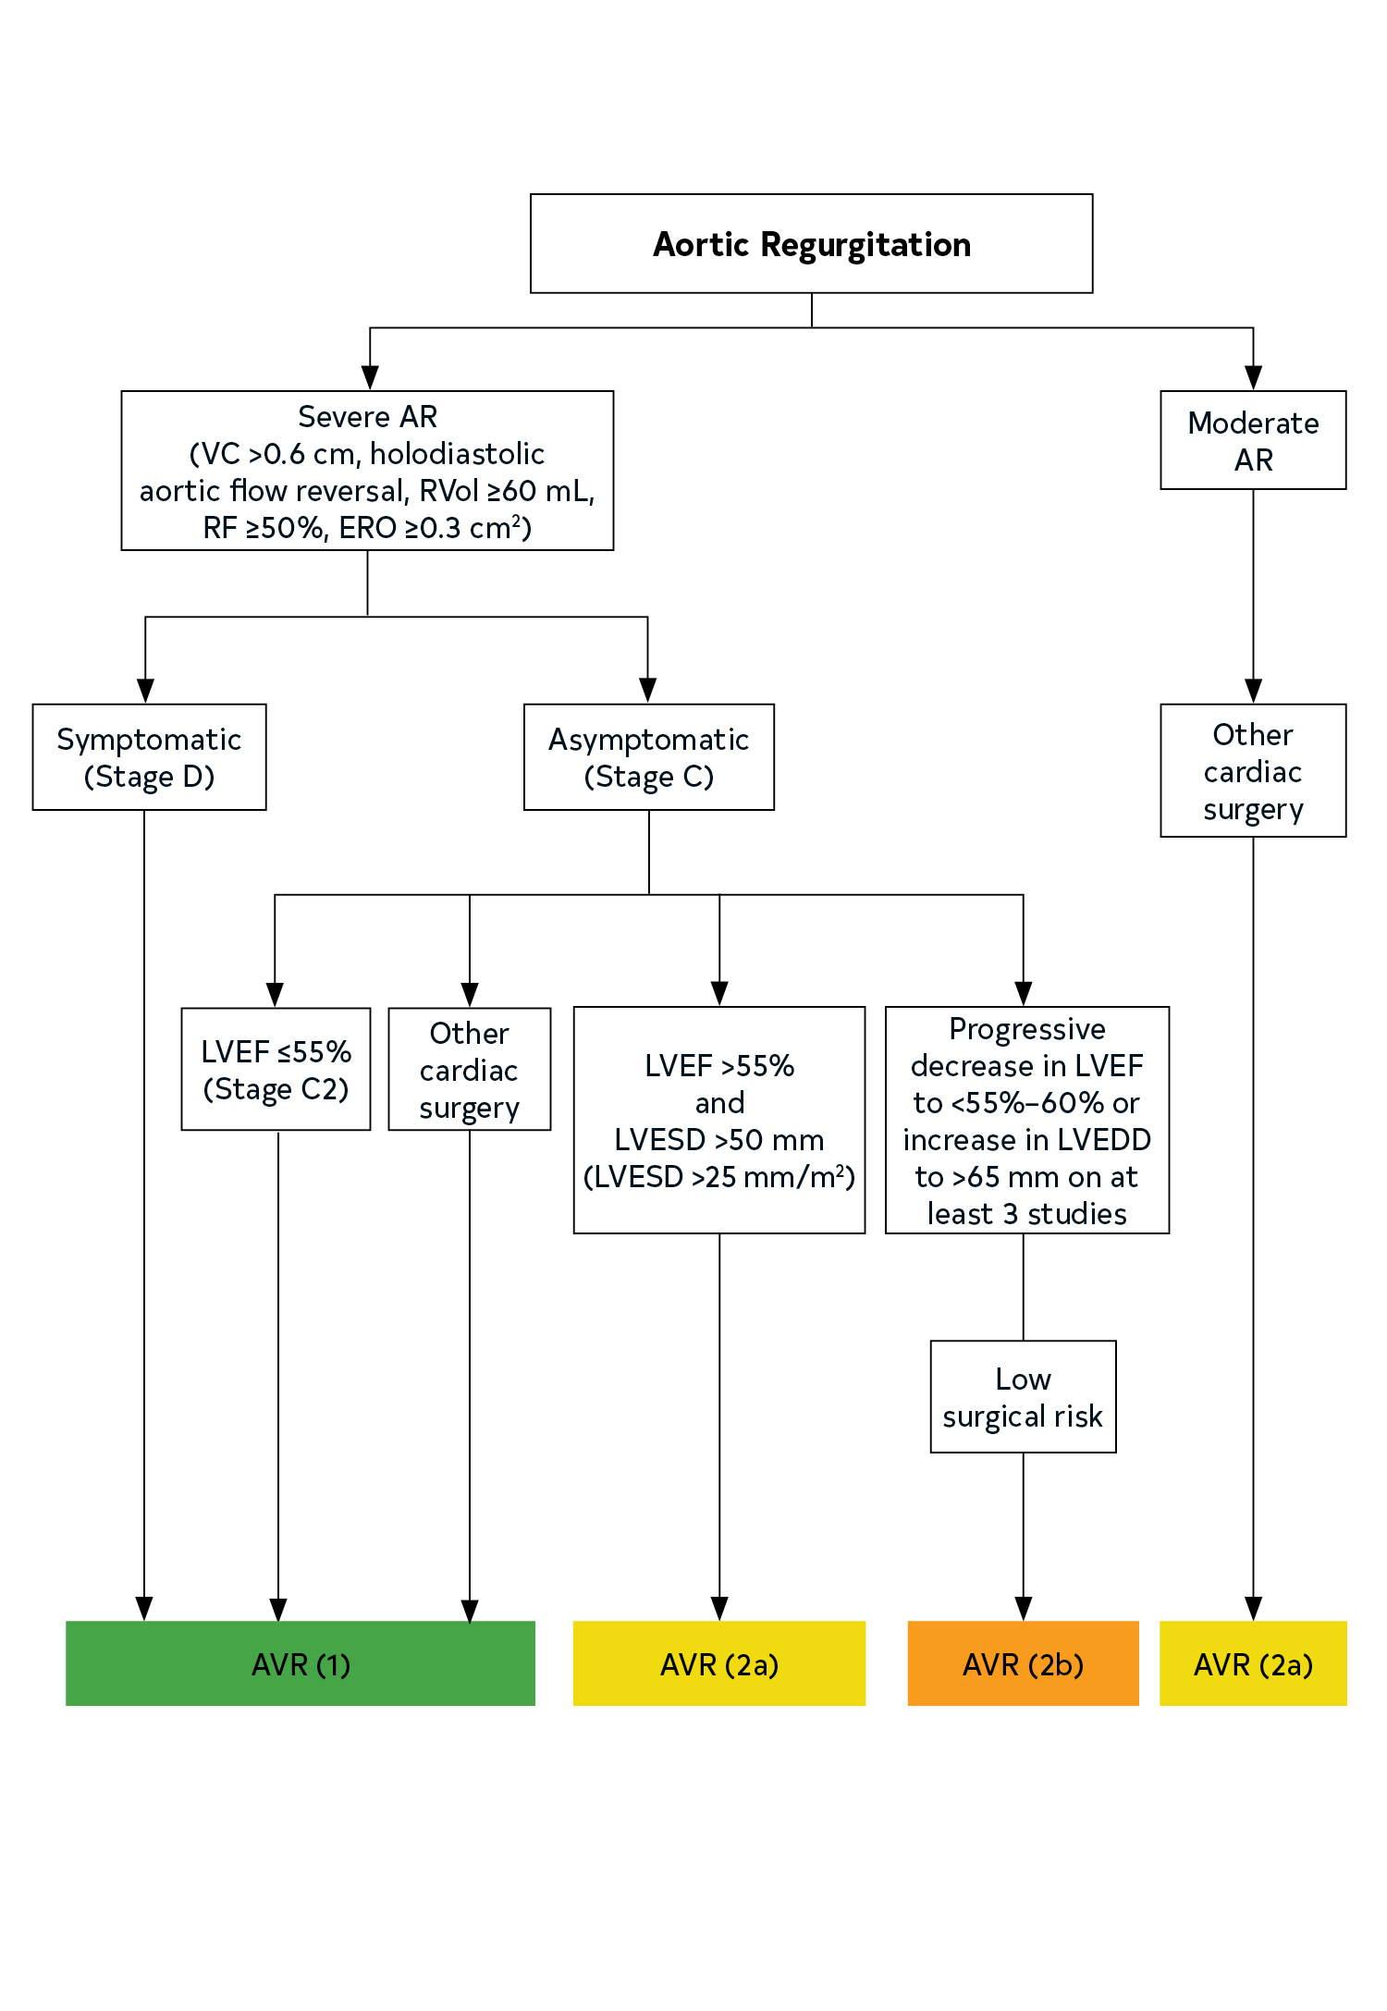
Figure 4. Timing of Intervention for Patients with AR.
Colors correspond to Table 2.

Slide 84
Bicuspid Aortic Valve

Slide 85
Diagnostic Testing: Initial Diagnosis of BAV
COR | LOE | Recommendations
1 | B-NR | In patients with a known BAV, TTE is indicated to evaluate valve morphology, measure severity of AS and AR, assess the shape and diameter of the aortic sinuses and ascending aorta, and evaluate for the presence of aortic coarctation for prediction of clinical outcome and to determine timing of intervention
1 | C-LD | 2. In patients with BAV, CMR angiography or CT angiography is indicated when morphology of the aortic sinuses, sinotubular junction, or ascending aorta cannot be assessed accurately or fully by echocardiography.
2b | B-NR | 3. In first-degree relatives of patients with a known BAV, a screening TTE might be considered to look for the presence of a BAV or asymptomatic dilation of the aortic sinuses and ascending aorta.

Slide 86
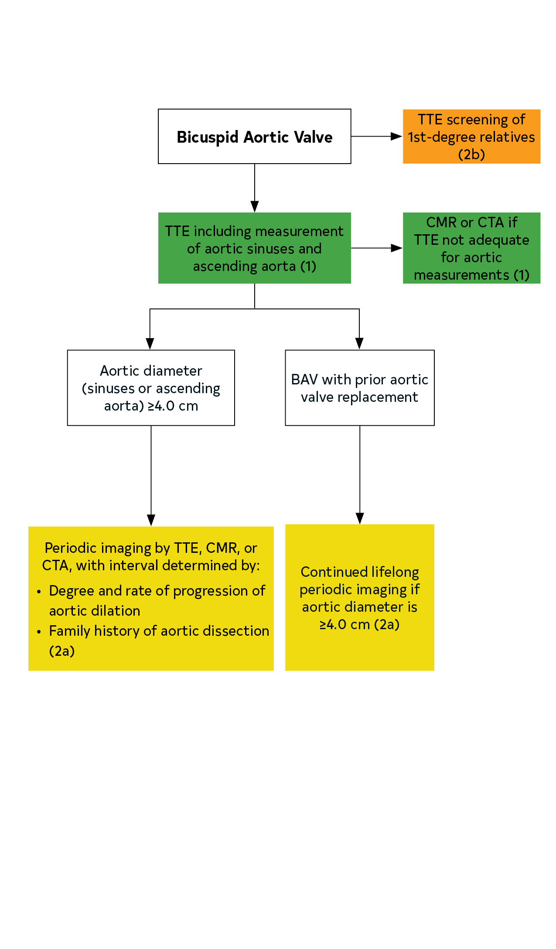
Figure 5. Intervals for Imaging the aorta in patients with BAV.
Colors correspond to Table 2.

Slide 87
Diagnostic Testing: Routine Follow-Up of Patients with BAV
COR | LOE | Recommendations
2a | C-LD | In patients with BAV and a diameter of the aortic sinuses or ascending aorta of ≥4.0 cm, lifelong serial evaluation of the size and morphology of the aortic sinuses and ascending aorta by echocardiography, CMR, or CT angiography is reasonable, with the examination interval determined by the degree and rate of progression of aortic dilation and by family history.
2a | B-NR | 2. In patients with a BAV who have undergone AVR, continued lifelong serial interval imaging of the aorta is reasonable if the diameter of the aortic sinuses or ascending aorta is ≥4.0 cm.

Slide 88
Interventions: Repair or Replacement of the Aorta in Patients with BAV
COR | LOE | Recommendations
1 | B-NR | In asymptomatic or symptomatic patients with a BAV and a diameter of the aortic sinuses or ascending aorta >5.5 cm, operative intervention to replace the aortic sinuses and/or the ascending aorta is recommended.
2a | B-NR | 2. In asymptomatic patients with a BAV, a diameter of the aortic sinuses or ascending aorta of 5.0 to 5.5 cm, and an additional risk factor for dissection (e.g., family history of aortic dissection, aortic growth rate >0.5 cm per year, aortic coarctation), operative intervention to replace the aortic sinuses and/or the ascending aorta is reasonable if the surgery is performed at a Comprehensive Valve Center.

Slide 89
Interventions: Repair or Replacement of the Aorta in Patients with BAV
COR | LOE | Recommendations
2a | B-NR | 3. In patients with a BAV with indications for SAVR and a diameter of the aortic sinuses or ascending aorta ≥4.5 cm, replacement of the aortic sinuses and/or ascending aorta is reasonable if the surgery is performed at a Comprehensive Valve Center.
2b | C-LD | 4. In patients with a BAV who meet criteria for replacement of the aortic sinuses, valve-sparing surgery may be considered if the surgery is performed at a Comprehensive Valve Center.
2b | B-NR | 5. In asymptomatic patients with a BAV who are at low surgical risk, have a diameter of the aortic sinuses or ascending aorta of 5.0 to 5.5 cm, and have no additional risk factors for dissection, operative intervention to replace the aortic sinuses and/or the ascending aorta may be considered if the surgery is performed at a Comprehensive Valve Center.

Slide 90
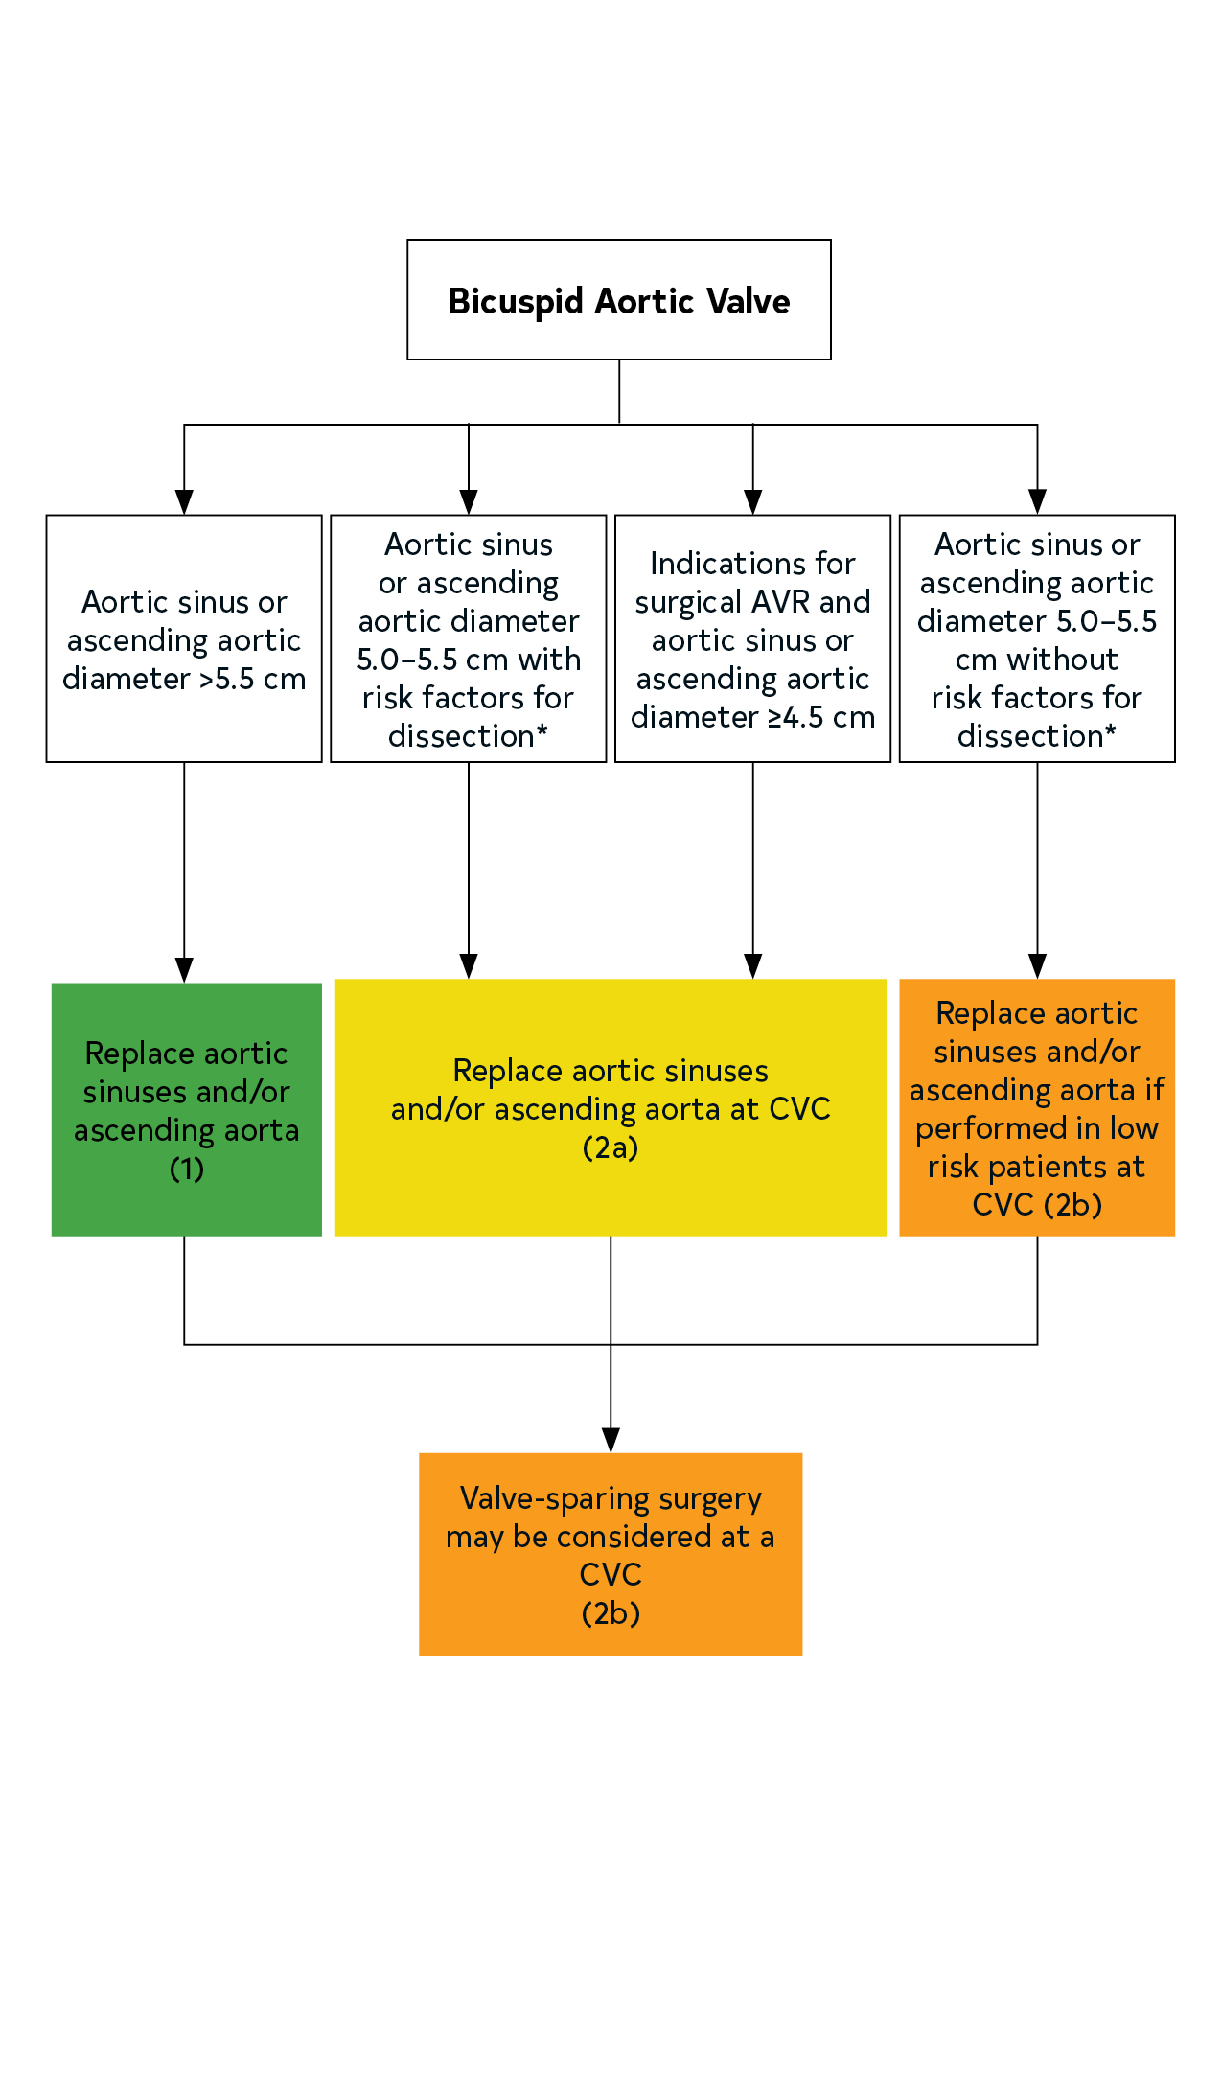
Figure 6. Intervention for replacement of the aorta in patients with a BAV.
Colors correspond to Table 2.
*Family history of aortic dissection, aortic growth rate ≥0.5 cm per year, and/or presence of aortic coarctation.

Slide 91
Interventions: Repair or Replacement of the Aortic Valve
COR | LOE | Recommendations
2b | C-LD | In patients with BAV and severe AR who meet criteria for AVR, aortic valve repair may be considered in selected patients if the surgery is performed at a Comprehensive Valve Center.
2b | B-NR | 2. In patients with BAV and symptomatic, severe AS, TAVI may be considered as an alternative to SAVR after consideration of patient-specific procedural risks, values, trade-offs, and preferences, and when the surgery is performed at a Comprehensive Valve Center.

Slide 92
Mitral Stenosis

Slide 93
Table 16. Stages of MS
Footnote text located on the next slide
Stage | Definition | Valve Anatomy | Valve Hemodynamics | Hemodynamic Consequences | Symptoms
A | At risk of MS | Mild valve doming during diastole | Normal transmitral flow velocity | None | None
B | Progressive MS | Rheumatic valve changes with commissural fusion and diastolic doming of the mitral valve leaflets Planimetered mitral valve area >1.5 cm² | Increased transmitral flow velocities Mitral valve area >1.5 cm² Diastolic pressure half-time <150 ms | Mild to moderate LA enlargement Normal pulmonary pressure at rest | None
C | Asymptomatic severe MS | Rheumatic valve changes with commissural fusion and diastolic doming of the mitral valve leaflets Planimetered mitral valve area ≤1.5 cm² | Mitral valve area ≤1.5 cm² Diastolic pressure half-time ≥150 ms | Severe LA enlargement Elevated PASP >50 mm Hg | None
D | Symptomatic severe MS | Rheumatic valve changes with commissural fusion and diastolic doming of the mitral valve leaflets Planimetered mitral valve area ≤1.5 cm² | Mitral valve area ≤1.5 cm² Diastolic pressure half-time ≥150 ms | Severe LA enlargement Elevated PASP >50 mm Hg | Decreased exercise tolerance Exertional dyspnea

Slide 94
Table 16. Stages of MS
The transmitral mean pressure gradient should be obtained to further determine the hemodynamic effect of the MS and is usually >5 mm Hg to 10 mm Hg in severe MS; however, because of the variability of the mean pressure gradient with heart rate and forward flow, it has not been included in the criteria for severity.

Slide 95
Diagnostic Testing: Initial Diagnosis of Rheumatic MS
COR | LOE | Recommendations
1 | B-NR | In patients with signs or symptoms of rheumatic MS, TTE is indicated to establish the diagnosis, quantify hemodynamic severity, assess concomitant valvular lesions, and demonstrate valve morphology (to determine suitability for mitral commissurotomy).
1 | C-LD | 2. In patients considered for percutaneous mitral balloon commissurotomy (PMBC), TEE should be performed to assess the presence or absence of LA thrombus and to evaluate the severity of MR.

Slide 96
Diagnostic Testing: Exercise Testing in Patients with Rheumatic MS
COR | LOE | Recommendation
1 | C-LD | In patients with rheumatic MS and a discrepancy between resting echocardiographic findings and clinical symptoms, exercise testing with Doppler or invasive hemodynamic assessment is recommended to evaluate symptomatic response, exercise capacity, and the response of the mean mitral gradient and pulmonary artery pressure.

Slide 97
Medical Therapy in Patients with Rheumatic MS
COR | LOE | Recommendations
1 | C-LD | In patients with rheumatic MS and 1) AF, 2) a prior embolic event, or 3) an LA thrombus, anticoagulation with a VKA is indicated.
2a | C-LD | 2. In patients with rheumatic MS and AF with a rapid ventricular response, heart rate control can be beneficial.
2a | A | 3. In patients with rheumatic MS in normal sinus rhythm with symptomatic resting or exertional sinus tachycardia, heart rate control can be beneficial to manage symptoms.

Slide 98
Intervention for Patients with Rheumatic MS
COR | LOE | Recommendations
1 | A | In symptomatic patients (NYHA class II, III, or IV) with severe rheumatic MS (mitral valve area ≤1.5 cm², Stage D) and favorable valve morphology with less than moderate (2+) MR* in the absence of LA thrombus, PMBC is recommended if it can be performed at a Comprehensive Valve Center.
1 | B-NR | 2. In severely symptomatic patients (NYHA class III or IV) with severe rheumatic MS (mitral valve area ≤1.5 cm², Stage D) who 1) are not candidates for PMBC, 2) have failed a previous PMBC, 3) require other cardiac procedures, or 4) do not have access to PMBC, mitral valve surgery (repair, commissurotomy, or valve replacement) is indicated.
*2+ on a 0 - 4+ scale according to Sellar’s criteria or less than < moderate by Doppler Echo

Slide 99
Intervention – Patients with Rheumatic MS
COR | LOE | Recommendations
2a | B-NR | 3. In asymptomatic patients with severe rheumatic MS (mitral valve area ≤1.5 cm², Stage C) and favorable valve morphology with less than 2+ MR* in the absence of LA thrombus who have elevated pulmonary pressures (pulmonary artery systolic pressure >50 mm Hg), PMBC is reasonable if it can be performed at a Comprehensive Valve Center.
*2+ on a 0 - 4+ scale according to Sellar’s criteria or less than < moderate by Doppler Echo

Slide 100
Intervention – Patients with Rheumatic MS
*2+ on a 0 - 4+ scale according to Sellar’s criteria or < moderate by Doppler Echo
COR | LOE | Recommendations
2b | C-LD | 4. In asymptomatic patients with severe rheumatic MS (mitral valve area ≤1.5 cm², Stage C) and favorable valve morphology with less than 2+/ MR* in the absence of LA thrombus who have new onset of AF, PMBC may be considered if it can be performed at a Comprehensive Valve Center.
2b | C-LD | 5. In symptomatic patients (NYHA class II, III, or IV) with rheumatic MS and an mitral valve area >1.5 cm², if there is evidence of hemodynamically significant rheumatic MS on the basis of a pulmonary artery wedge pressure >25 mm Hg or a mean mitral valve gradient >15 mm Hg during exercise, PMBC may be considered if it can be performed at a Comprehensive Valve Center.
2b | B-NR | 6. In severely symptomatic patients (NYHA class III or IV) with severe rheumatic MS (mitral valve area ≤1.5 cm², Stage D) who have a suboptimal valve anatomy and who are not candidates for surgery or are at high risk for surgery, PMBC may be considered if it can be performed at a Comprehensive Valve Center.

Slide 101
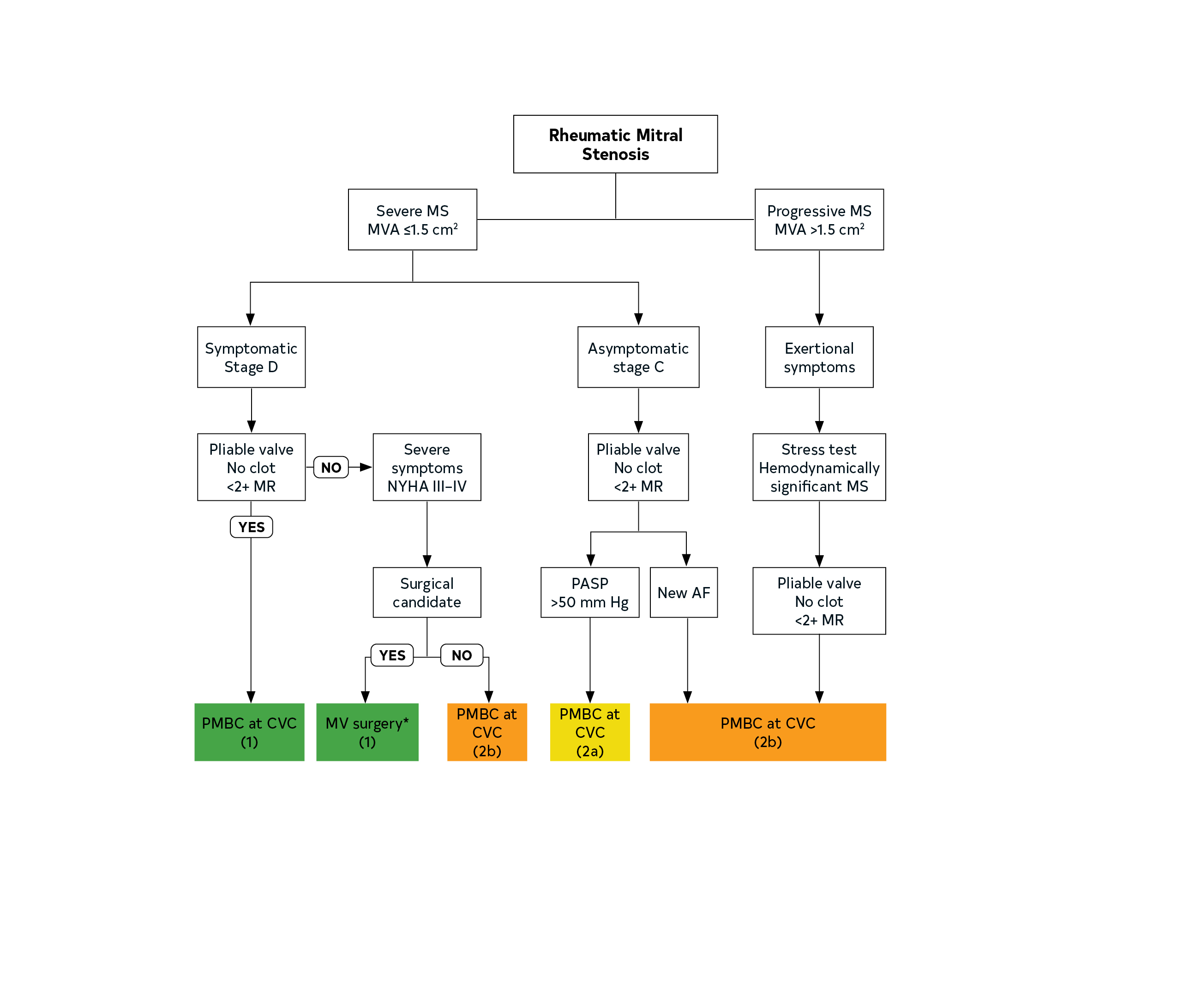
Figure 7. Intervention for Patients with MS.
Colors correspond to Table 2.
*Repair, commissurotomy, or valve replacement.

Slide 102
Nonrheumatic Calcific MS
COR | LOE | Recommendation
2b | C-LD | In severely symptomatic patients (NYHA class III or IV) with severe MS (mitral valve area ≤1.5 cm², Stage D) attributable to extensive mitral annular calcification, valve intervention may be considered only after discussion of the high procedural risk and the individual patient’s preferences and values.

Slide 103
Mitral Regurgitation

Slide 104
Table 17. Stages of Chronic Primary MR
Grade | Definition | Valve Anatomy | Valve Hemodynamics* | Hemodynamic Consequences | Symptoms
A | At risk of MR | Mild mitral valve prolapse with normal coaptation Mild valve thickening and leaflet restriction | No MR jet or small central jet area <20% LA on Doppler Small vena contracta <0.3 cm | None | None
B | Progressive MR | Moderate to severe mitral valve prolapse with normal coaptation Rheumatic valve changes with leaflet restriction and loss of central coaptation Prior IE | Central jet MR 20%–40% LA or late systolic eccentric jet MR Vena contracta <0.7 cm Regurgitant volume <60 mL Regurgitant fraction <50% ERO <0.40 cm² Angiographic grade 1+ to 2+ | Mild LA enlargement No LV enlargement Normal pulmonary pressure | None

Slide 105
Table 17. Stages of Chronic Primary MR
Footnote text located on the next slide
Grade | Definition | Valve Anatomy | Valve Hemodynamics* | Hemodynamic Consequences | Symptoms
C | Asymptomatic severe MR | Severe mitral valve prolapse with loss of coaptation or flail leaflet Rheumatic valve changes with leaflet restriction and loss of central coaptation Prior IE Thickening of leaflets with radiation heart disease | Central jet MR >40% LA or holosystolic eccentric jet MR Vena contracta ≥0.7 cm Regurgitant volume ≥60 mL Regurgitant fraction ≥50% ERO ≥0.40 cm² Angiographic grade 3+ to 4+ | Moderate or severe LA enlargement LV enlargement Pulmonary hypertension may be present at rest or with exercise C1: LVEF >60% and LVESD <40 mm C2: LVEF ≤60% and/or LVESD ≥40 mm | None
D | Symptomatic severe MR | Severe mitral valve prolapse with loss of coaptation or flail leaflet Rheumatic valve changes with leaflet restriction and loss of central coaptation Prior IE Thickening of leaflets with radiation heart disease | Central jet MR >40% LA or holosystolic eccentric jet MR Vena contracta ≥0.7 cm Regurgitant volume ≥60 mL Regurgitant fraction ≥50% ERO ≥0.40 cm² Angiographic grade 3+ to 4+ | Moderate or severe LA enlargement LV enlargement Pulmonary hypertension present | Decreased exercise tolerance Exertional dyspnea

Slide 106
Table 17. Stages of Chronic Primary MR
*Several valve hemodynamic criteria are provided for assessment of MR severity, but not all criteria for each category will be present in each patient. Categorization of MR severity as mild, moderate, or severe depends on data quality and integration of these parameters in conjunction with other clinical evidence.

Slide 107
Diagnostic Testing: Initial Diagnosis of Chronic MR
COR | LOE | Recommendations
1 | B-NR | In patients with known or suspected primary MR, TTE is indicated for baseline evaluation of LV size and function, RV function, LA size, pulmonary artery pressure, and the mechanism and severity of primary MR (Stages A to D).
1 | C-EO | 2. In patients with primary MR, when TTE provides insufficient or discordant information, TEE is indicated for evaluation of the severity of MR, mechanism of MR, and status of LV function (Stages B to D).
1 | B-NR | 3. In patients with primary MR, CMR is indicated to assess LV and RV volumes and function and may help with assessing MR severity when there is a discrepancy between the findings on clinical assessment and echocardiography.
1 | B-NR | 4. In patients with severe primary MR undergoing mitral intervention, intraoperative TEE is indicated to establish the anatomic basis for primary MR (Stages C and D) and to guide repair.

Slide 108
Diagnostic Testing: Changing Signs or Symptoms in Patients With Primary MR
COR | LOE | Recommendation
1 | B-NR | In patients with primary MR (Stages B to D) and new-onset or changing symptoms, TTE is indicated to evaluate the mitral valve apparatus and LV function.

Slide 109
Routine Follow-Up for Patients with Chronic Primary MR
COR | LOE | Recommendations
1 | B-NR | For asymptomatic patients with severe primary MR (Stages B and C1), TTE is indicated every 6 to 12 months for surveillance of LV function (estimated by LVEF, LVEDD, and LVESD) and assessment of pulmonary artery pressure.
2b | B-NR | 2. In asymptomatic patients with severe primary MR (Stages B and C1), use of serum biomarkers and novel measurements of LV function, such as global longitudinal strain, may be considered as an adjunct to guide timing of intervention.

Slide 110
Exercise Testing for Patients with Chronic Primary MR
COR | LOE | Recommendation
2a | B-NR | In patients with primary MR (Stages B and C) and symptoms that might be attributable to MR, hemodynamic exercise testing using Doppler echocardiography or cardiac catheterization or cardiopulmonary exercise testing is reasonable.

Slide 111
Medical Therapy for Patients with Chronic Primary MR
COR | LOE | Recommendations
2a | B-NR | 1. In symptomatic or asymptomatic patients with severe primary MR and LV systolic dysfunction (Stages C2 and D) in whom surgery is not possible or must be delayed, GDMT for systolic dysfunction is reasonable.
3: No Benefit | B-NR | 2. In asymptomatic patients with primary MR and normal LV systolic function (Stages B and C1), vasodilator therapy is not indicated if the patient is normotensive.

Slide 112
Intervention for Patients with Chronic Primary MR
COR | LOE | Recommendations
1 | B-NR | In symptomatic patients with severe primary MR (Stage D), mitral valve intervention is recommended irrespective of LV systolic function.
1 | B-NR | 2. In asymptomatic patients with severe primary MR and LV systolic dysfunction (LVEF ≤60%, LVESD ≥40 mm) (Stage C2), mitral valve surgery is recommended.
1 | B-NR | 3. In patients with severe primary MR for whom surgery is indicated, mitral valve repair is recommended in preference to mitral valve replacement when the anatomic cause of MR is degenerative disease, if a successful and durable repair is possible.
2a | B-NR | 4. In asymptomatic patients with severe primary MR and normal LV systolic function (LVEF ≥60% and LVESD ≤40 mm) (Stage C1), mitral valve repair is reasonable when the likelihood of a successful and durable repair without residual MR is >95% with an expected mortality rate of <1%, when it can be performed at a Primary or Comprehensive Valve Center.

Slide 113
Intervention for Patients with Chronic Primary MR
COR | LOE | Recommendations
2b | C-LD | 5. In asymptomatic patients with severe primary MR and normal LV systolic function (LVEF >60% and LVESD <40 mm) (Stage C1) but with a progressive increase in LV size or decrease in EF on ≥3 serial imaging studies, mitral valve surgery may be considered irrespective of the probability of a successful and durable repair.
2a | B-NR | 6. In severely symptomatic patients (NYHA class III or IV) with primary severe MR and high or prohibitive surgical risk, transcatheter edge-to-edge repair (TEER) is reasonable if mitral valve anatomy is favorable for the repair procedure and patient life expectancy is at least 1 year.
2b | B-NR | 7. In symptomatic patients with severe primary MR attributable to rheumatic valve disease, mitral valve repair may be considered at a Comprehensive Valve Center by an experienced team when surgical treatment is indicated, if a durable and successful repair is likely
3: Harm | B-NR | 8. In patients with severe primary MR where leaflet pathology is limited to less than one half the posterior leaflet, mitral valve replacement should not be performed unless mitral valve repair has been attempted at a Primary or Comprehensive Valve Center and was unsuccessful.

Slide 114
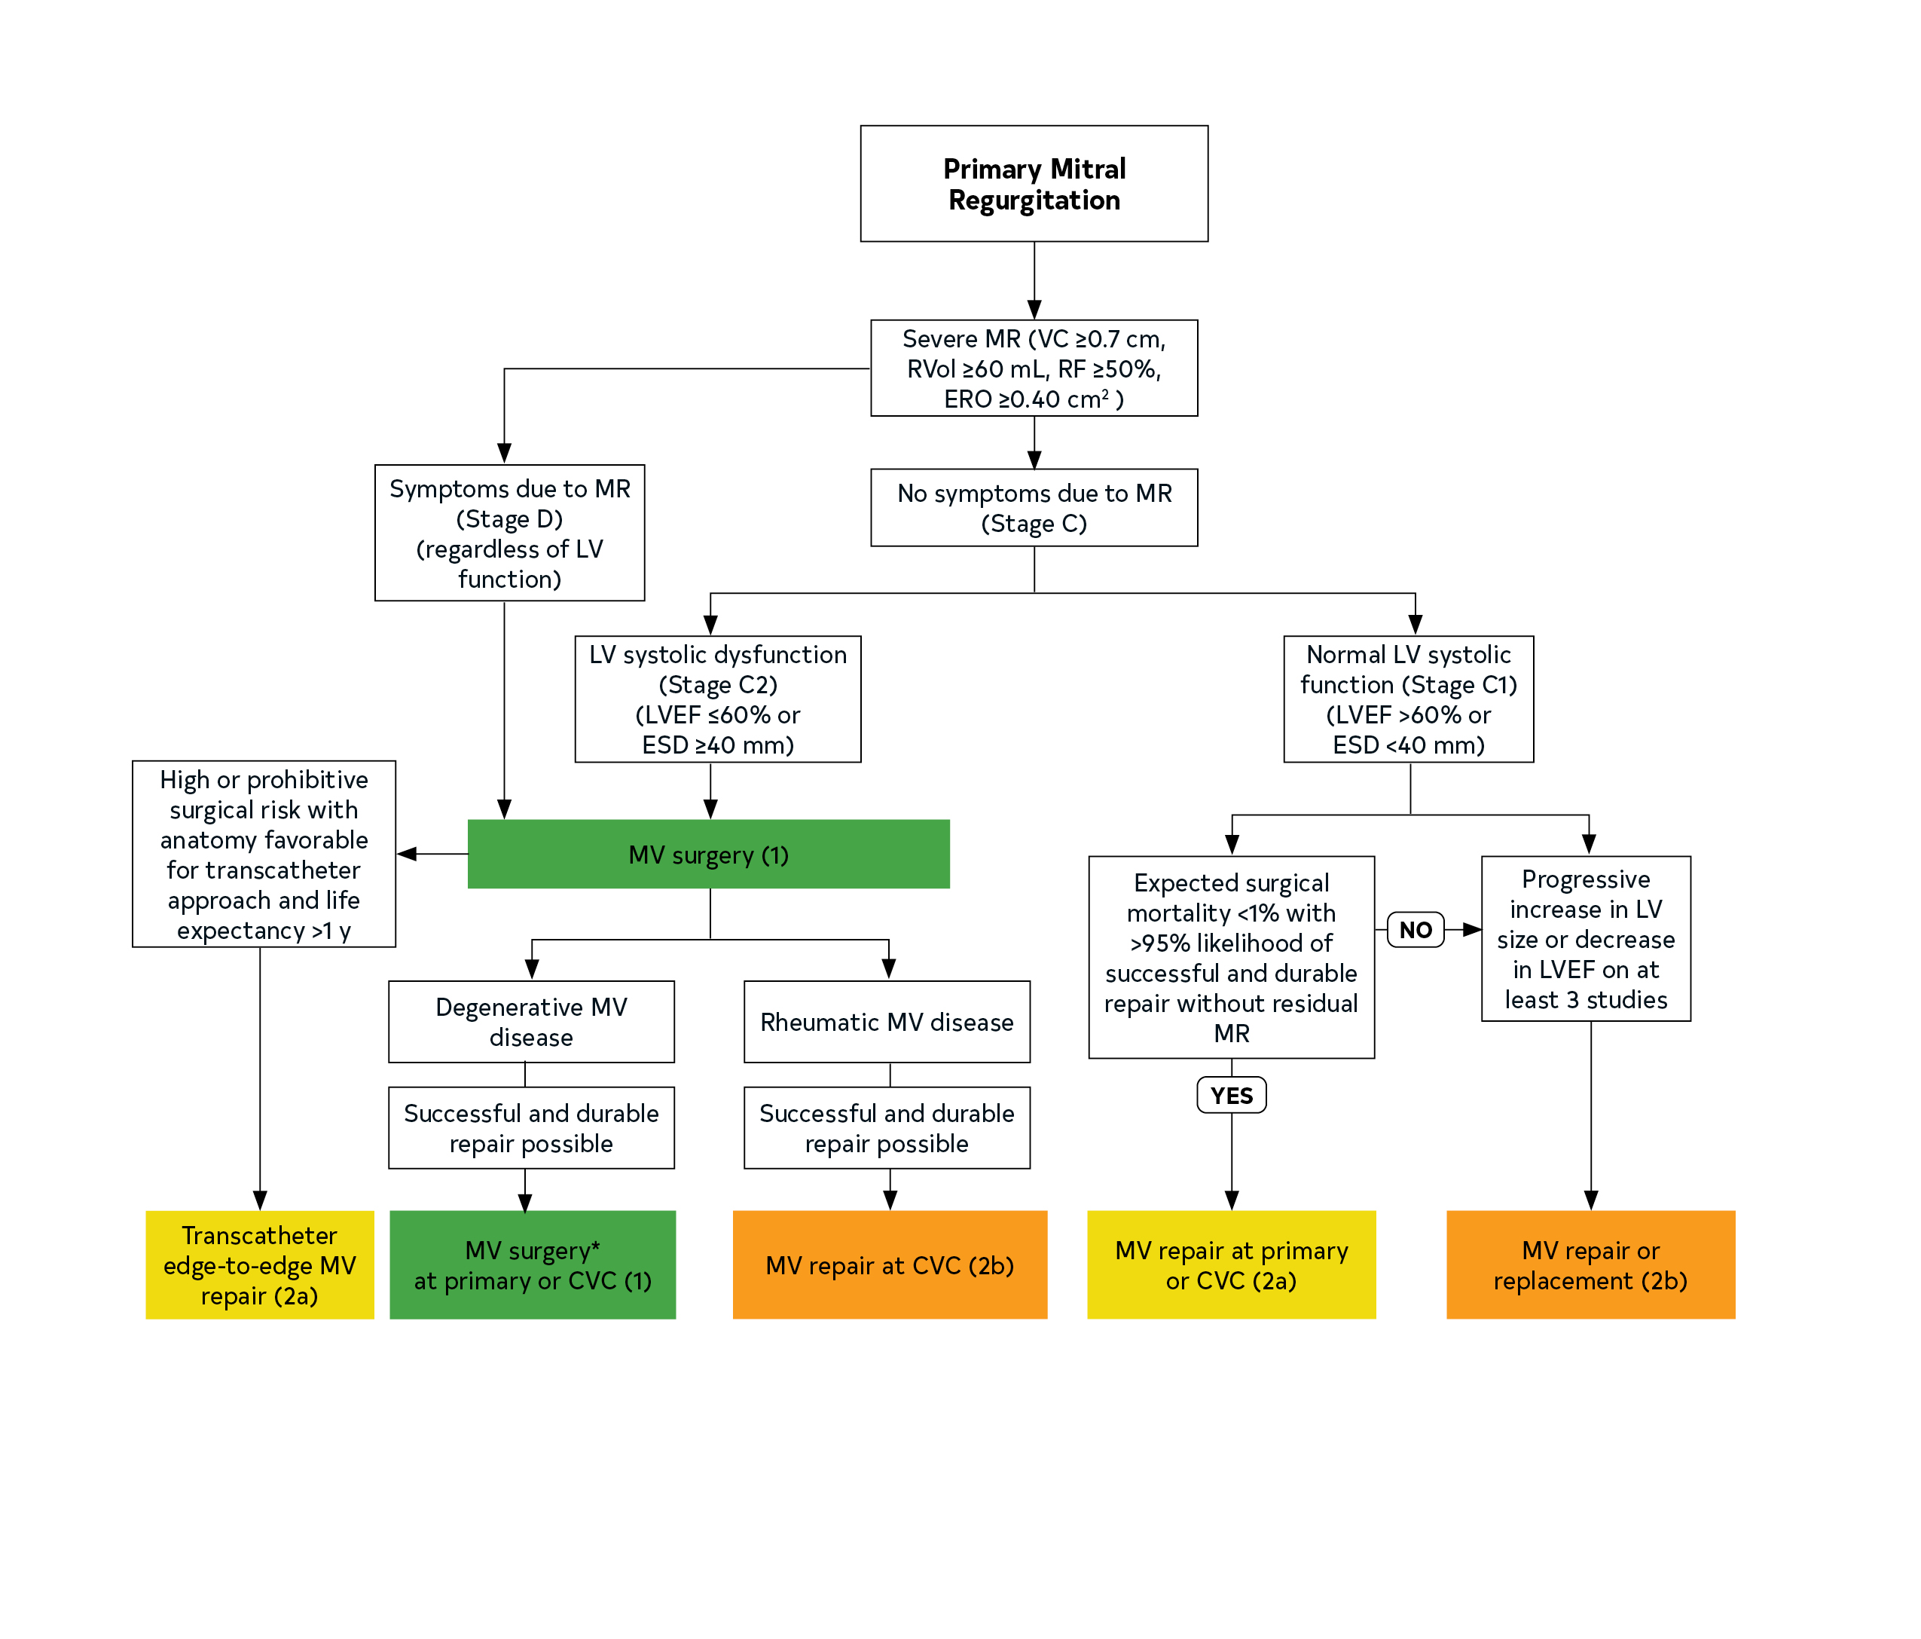
Figure 8. *See Prosthetic Valve section (11.1.2) for choice of mitral valve replacement if mitral valve repair is not possible.

Slide 115
Table 18. Stages of Secondary MR
Grade | Definition | Valve Anatomy | Valve Hemodynamics* | Associated Cardiac Findings | Symptoms
A | At risk of MR | Normal valve leaflets, chords, and annulus in a patient with CAD or cardiomyopathy | No MR jet or small central jet area <20% LA on Doppler Small vena contracta <0.30 cm | Normal or mildly dilated LV size with fixed (infarction) or inducible (ischemia) regional wall motion abnormalities Primary myocardial disease with LV dilation and systolic dysfunction | Symptoms attributable to coronary ischemia or HF may be present that respond to revascularization and appropriate medical therapy
B | Progressive MR | Regional wall motion abnormalities with mild tethering of mitral leaflet Annular dilation with mild loss of central coaptation of the mitral leaflets | ERO <0.40 cm²† Regurgitant volume <60 mL Regurgitant fraction <50% | Regional wall motion abnormalities with reduced LV systolic function LV dilation and systolic dysfunction attributable to primary myocardial disease | Symptoms attributable to coronary ischemia or HF may be present that respond to revascularization and appropriate medical therapy

Slide 116
Table 18. Stages of Secondary MR
Footnote text located on the next slide
Grade | Definition | Valve Anatomy | Valve Hemodynamics* | Associated Cardiac Findings | Symptoms
C | Asymptomatic severe MR | Regional wall motion abnormalities and/or LV dilation with severe tethering of mitral leaflet Annular dilation with severe loss of central coaptation of the mitral leaflets | ERO ≥0.40 cm²† Regurgitant volume ≥60 mL‡ Regurgitant fraction ≥50% | Regional wall motion abnormalities with reduced LV systolic function LV dilation and systolic dysfunction attributable to primary myocardial disease | Symptoms attributable to coronary ischemia or HF may be present that respond to revascularization and appropriate medical therapy
D | Symptomatic severe MR | Regional wall motion abnormalities and/or LV dilation with severe tethering of mitral leaflet Annular dilation with severe loss of central coaptation of the mitral leaflets | ERO ≥0.40 cm²† Regurgitant volume ≥60 mL‡ Regurgitant fraction ≥50% | Regional wall motion abnormalities with reduced LV systolic function LV dilation and systolic dysfunction attributable to primary myocardial disease | HF symptoms attributable to MR persist even after revascularization and optimization of medical therapy Decreased exercise tolerance Exertional dyspnea

Slide 117
Table 18. Stages of Secondary MR
*Several valve hemodynamic criteria are provided for assessment of MR severity, but not all criteria for each category will be present in each patient. Categorization of MR severity as mild, moderate, or severe depends on data quality and integration of these parameters in conjunction with other clinical evidence.
†The measurement of the proximal isovelocity surface area by 2D TTE in patients with secondary MR underestimates the true ERO because of the crescentic shape of the proximal convergence.
‡May be lower in low-flow states.

Slide 118
Diagnosis of Secondary MR
COR | LOE | Recommendations
1 | B-NR | In patients with chronic secondary MR (Stages B to D), TTE is useful to establish the etiology and to assess the extent of regional and global LV remodeling and systolic dysfunction, severity of MR, and magnitude of pulmonary hypertension.
1 | C-EO | 2. In patients with chronic secondary MR (Stages B to D), noninvasive imaging (stress nuclear/PET, CMR, or stress echocardiography), coronary CT angiography, or coronary arteriography is useful to establish etiology of MR and to assess myocardial viability.
1 | B-NR | 3. In patients with chronic secondary MR with severe symptoms (Stage D) that are unresponsive to GDMT who are being considered for transcatheter mitral valve interventions, TEE is indicated to determine suitability for the procedure.
1 | C-EO | 4. In patients with chronic secondary MR undergoing transcatheter mitral valve intervention, intraprocedural guidance with TEE is recommended.

Slide 119
Medical Therapy for Secondary MR
COR | LOE | Recommendations
1 | A | Patients with chronic severe secondary MR (Stages C and D) and HF with reduced LVEF should receive standard GDMT for HF, including ACE inhibitors, ARBs, beta blockers, aldosterone antagonists, and/or sacubitril/valsartan, and biventricular pacing as indicated.
1 | C-EO | 2. In patients with chronic severe secondary MR and HF with reduced LVEF, a cardiologist expert in the management of patients with HF and LV systolic dysfunction should be the primary MDT member responsible for implementing and monitoring optimal GDMT.

Slide 120
Intervention of Patients with Secondary MR
COR | LOE | Recommendations
2a | B-R | In patients with chronic severe secondary MR related to LV systolic dysfunction (LVEF <50%) who have persistent symptoms (NYHA class II, III, or IV) while on optimal GDMT for HF (Stage D), transcatheter edge-to-edge mitral valve repair (TEER) is reasonable in patients with appropriate anatomy as defined on TEE and with LVEF between 20% and 50%, LVESD ≤70 mm, and pulmonary artery systolic pressure ≤70 mm Hg.
2a | B-NR | 2. In patients with severe secondary MR (Stages C and D), mitral valve surgery is reasonable when CABG is undertaken for the treatment of myocardial ischemia.
2b | B-NR | 3. In patients with chronic severe secondary MR from atrial annular dilation with preserved LV systolic function (LVEF ≥50%) who have severe persistent symptoms (NYHA class III or IV) despite therapy for HF and therapy for associated AF or other comorbidities (Stage D), mitral valve surgery may be considered.

Slide 121
Intervention of Patients with Secondary MR
COR | LOE | Recommendations
2b | B-NR | In patients with chronic severe secondary MR related to LV systolic dysfunction (LVEF <50%) who have persistent severe symptoms (NYHA class III or IV) while on optimal GDMT for HF (Stage D), mitral valve surgery may be considered.
2b | B-R | In patients with CAD and chronic severe secondary MR related to LV systolic dysfunction (LVEF <50%) (Stage D) who are undergoing mitral valve surgery because of severe symptoms (NYHA class III or IV) that persist despite GDMT for HF, chordal-sparing mitral valve replacement may be reasonable to choose over downsized annuloplasty repair.

Slide 122
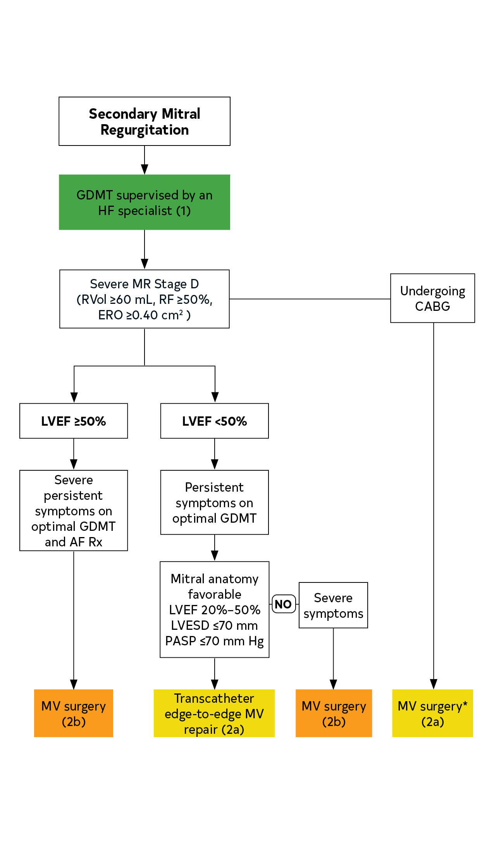
Figure 9. Secondary MR
*Chordal-sparing MV replacement may be reasonable to choose over downsized annuloplasty repair.
Colors correspond to Table 2.

Slide 123
Table 19. Classification of TR
Primary | Secondary
Rheumatic Infective endocarditis Iatrogenic (device leads, endomyocardial biopsy) Congenital (e.g., Ebstein’s, levo-transposition of the great arteries.) Other (trauma, carcinoid, drugs, irradiation, etc.) | Pulmonary hypertension with RV remodeling (primary or secondary to left-sided heart disease) Dilated cardiomyopathy Annular dilation (associated with AF)* RV volume overload (shunts/ high output)
*Isolated TR is associated with AF and has LVEF >60%, pulmonary artery systolic pressure <50 mm Hg, and no left-sided valve disease, with normal-appearing tricuspid valve leaflets

Slide 124
Table 20. Stages of TR
Stage | Definition | Valve Hemodynamics | Hemodynamic Consequences | Clinical Symptoms and Presentation
B | Progressive TR | Central jet < 50% RA Vena contracta width < 0.7 cm ERO < 0.40 cm² Regurgitant volume < 45 mL | None | None
C | Asymptomatic severe TR | Central jet >50% RA Vena contracta width >0.7 cm ERO >0.40 cm² Regurgitant volume >45 mL Dense continuous wave signal with triangular shape Hepatic vein systolic flow reversal | Dilated RV and RA Elevated RA with “c-V” wave | Elevated venous pressure No symptoms
D | Symptomatic severe TR | Central jet >50% RA Vena contracta width >0.7 cm ERO >0.40 cm² Regurgitant volume >45 mL Dense continuous wave signal with triangular shape Hepatic vein systolic flow reversal | Dilated RV and RA Elevated RA with “c-V” wave | Elevated venous pressure Dyspnea on exertion, fatigue, ascites, edema

Slide 125
Diagnosis of Tricuspid Regurgitation
COR | LOE | Recommendations
1 | C-LD | In patients with TR, TTE is indicated to evaluate the presence and severity of TR, determine the etiology, measure the sizes of the right-sided chambers and inferior vena cava, assess RV systolic function, estimate pulmonary artery systolic pressure, and characterize any associated left-sided heart disease.
2a | C-LD | 2. In patients with TR, invasive measurement of the cardiac index, right-sided diastolic pressures, pulmonary artery pressures, and pulmonary vascular resistance, as well as right ventriculography, can be useful when clinical and noninvasive data are discordant or inadequate.

Slide 126
Medical Therapy for Patients with Tricuspid Regurgitation
COR | LOE | Recommendations
2a | C-EO | In patients with signs and symptoms of right-sided HF attributable to severe TR (Stages C and D), diuretics can be useful.
2a | C-EO | 2. In patients with signs and symptoms of right-sided HF attributable to severe secondary TR (Stages C and D), therapies to treat the primary cause of HF (e.g., pulmonary vasodilators to reduce elevated pulmonary artery pressures, GDMT for HF with reduced LVEF, or rhythm control of AF) can be useful.

Slide 127
Timing of Intervention of TR
COR | LOE | Recommendations
1 | B-NR | 1. In patients with severe TR (Stages C and D) undergoing left-sided valve surgery, tricuspid valve surgery is recommended.
2a | B-NR | 2. In patients with progressive TR (Stage B) undergoing left-sided valve surgery, tricuspid valve surgery can be beneficial in the context of either 1) tricuspid annular dilation (tricuspid annulus end diastolic diameter>4.0 cm) or 2) prior signs and symptoms of right-sided HF.
2a | B-NR | 3. In patients with signs and symptoms of right-sided HF and severe primary TR (Stage D), isolated tricuspid valve surgery can be beneficial to reduce symptoms and recurrent hospitalizations.

Slide 128
Timing of Intervention of TR
COR | LOE | Recommendations
2a | B-NR | 4. In patients with signs and symptoms of right-sided HF and severe isolated secondary TR attributable to annular dilation (in the absence of pulmonary hypertension or left-sided disease) who are poorly responsive to medical therapy (Stage D), isolated tricuspid valve surgery can be beneficial to reduce symptoms and recurrent hospitalizations.
2b | C-LD | 5. In asymptomatic patients with severe primary TR (Stage C) and progressive RV dilation or systolic dysfunction, isolated tricuspid valve surgery may be considered.
2b | B-NR | 6. In patients with signs and symptoms of right-sided HF and severe TR (Stage D) who have undergone previous left-sided valve surgery, reoperation with isolated tricuspid valve surgery may be considered in the absence of severe pulmonary hypertension or severe RV systolic dysfunction.

Slide 129
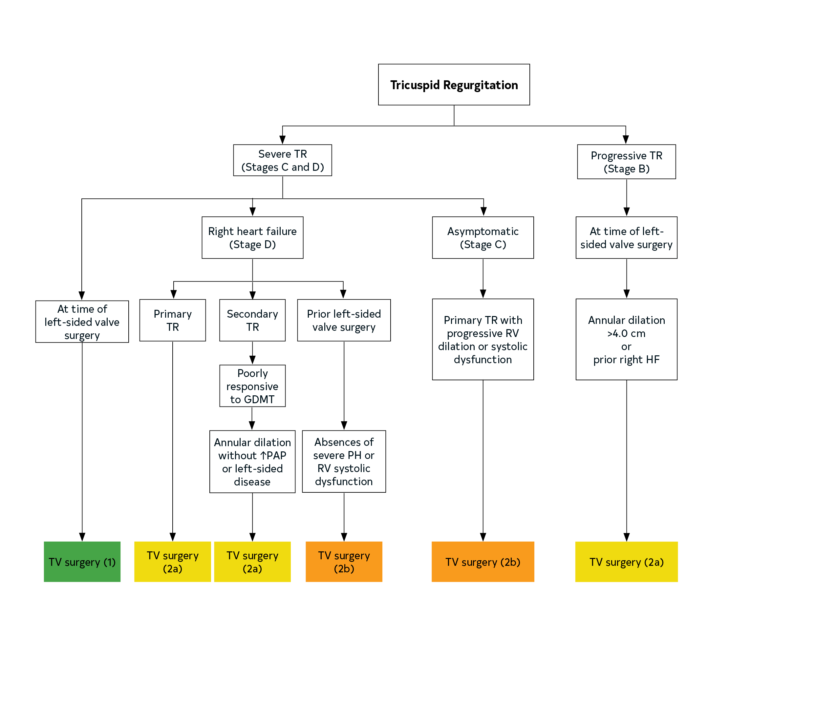
Figure 10. Tricuspid Regurgitation
Colors corresponds to Table 2

Slide 130
Pulmonic Valve Disease

Slide 131
Diagnosis and Follow-up of Patients with Mixed Valve Disease
COR | LOE | Recommendations
1 | C-EO | 1. For patients with mixed valve disease, TTE is recommended to assess the etiology, severity, and pathophysiological impact.
2a | C-EO | 2. In patients with ambiguous symptoms that are suspected to be attributable to mixed mitral valve disease, further assessment of filling pressure by using biomarkers or invasive hemodynamic measurements at rest or with exercise is reasonable.

Slide 132
Timing of Intervention of Patients with Mixed AS and AR
COR | LOE | Recommendations
1 | B-NR | 1. In symptomatic patients with combined AS and AR and a peak transvalvular jet velocity of at least 4.0 m/s or a mean transvalvular gradient of at least 40 mm Hg, AVR is recommended
1 | C-EO | 2. In asymptomatic patients with combined AS and AR who have a jet velocity of ≥4.0 m/s with an LVEF <50%, SAVR is recommended.

Slide 133
Table 21. AS/MR Mixed Valve Disease
Severe AS | Severe MR | Surgical Risk | Procedure
SAVR candidate | Primary MR Repairable valve | Low intermediate | SAVR Surgical mitral valve MV repair
SAVR candidate | Primary MR Valve not repairable | Low intermediate | SAVR Surgical mitral valve replacement
TAVI candidate | Primary Repairable valve | High prohibitive | TAVI Mitral TEER*
SAVR candidate TAVI candidate | Secondary MR | Low intermediate | SAVR Surgical mitral valve repair/mitral valve replacement or TAVI Mitral TEER*
TAVI candidate | Secondary MR | High prohibitive | TAVI Mitral TEER*
*Consider TEER as a later staged procedure if symptoms and severe MR persist after treatment of the AS.

Slide 134
Diagnosis and Follow-up of Patients with Prosthetic Valves
COR | LOE | Recommendations
1 | B-NR | 1. In patients with a surgical or transcatheter prosthetic valve and in patients who have had valve repair, an initial postprocedural TTE study is recommended for evaluation of valve hemodynamics and ventricular function.
1 | C-EO | 2. In patients with a prosthetic valve or prior valve repair and a change in clinical symptoms or signs suggesting valve dysfunction, repeat TTE is recommended.

Slide 135
Diagnosis and Follow-up of Patients with Prosthetic Valves
COR | LOE | Recommendations
1 | C-LD | 3. In patients with a prosthetic valve replacement or prior valve repair and clinical symptoms or signs that suggest prosthetic valve dysfunction, additional imaging with TEE, gated cardiac CT, or fluoroscopy is recommended, even if TTE does not show valve dysfunction.
2a | C-LD | 4. In patients with a bioprosthetic surgical valve, TTE at 5 and 10 years and then annually after implantation is reasonable, even in the absence of a change in clinical status.
2a | C-LD | 5. In patients with a bioprosthetic TAVI, TTE annually is reasonable.

Slide 136
Prosthetic Valve Type: Bioprosthetic Versus Mechanical Valve
COR | LOE | Recommendations
1 | C-LD | 1. For patients who require heart valve replacement, the choice of prosthetic valve should be based on a shared decision-making process that accounts for the patient’s values and preferences and includes discussion of the indications for and risks of anticoagulant therapy and the potential need for and risks associated with valve reintervention.
1 | C-EO | 2. For patients of any age requiring valve replacement for whom anticoagulant therapy is contraindicated, cannot be managed appropriately, or is not desired, a bioprosthetic valve is recommended.
2a | B-NR | 3. For patients <50 years of age who do not have a contraindication to anticoagulation and require AVR, it is reasonable to choose a mechanical aortic prosthesis over a bioprosthetic valve.

Slide 137
Prosthetic Valve Type – Bioprosthetic Versus Mechanical Valve
COR | LOE | Recommendations
2a | B-NR | 4. For patients 50 to 65 years of age who require AVR and who do not have a contraindication to anticoagulation, it is reasonable to individualize the choice of either a mechanical or bioprosthetic AVR, with consideration of individual patient factors and after informed shared decision-making.
2a | B-NR | 5. In patients >65 years of age who require AVR, it is reasonable to choose a bioprosthesis over a mechanical valve.
2a | B-NR | 6. For patients <65 years of age who have an indication for mitral valve replacement, do not have a contraindication to anticoagulation, and are unable to undergo mitral valve repair, it is reasonable to choose a mechanical mitral prosthesis over a bioprosthetic valve.

Slide 138
Prosthetic Valve Type – Bioprosthetic Versus Mechanical Valve
COR | LOE | Recommendations
2a | B-NR | 7. For patients ≥65 years of age who require mitral valve replacement and are unable to undergo mitral valve repair, it is reasonable to choose a bioprosthesis over a mechanical valve.
2b | B-NR | 8. In patients <50 years of age who prefer a bioprosthetic AVR and have appropriate anatomy, replacement of the aortic valve by a pulmonic autograft (the Ross procedure) may be considered at a Comprehensive Valve Center.

Slide 139
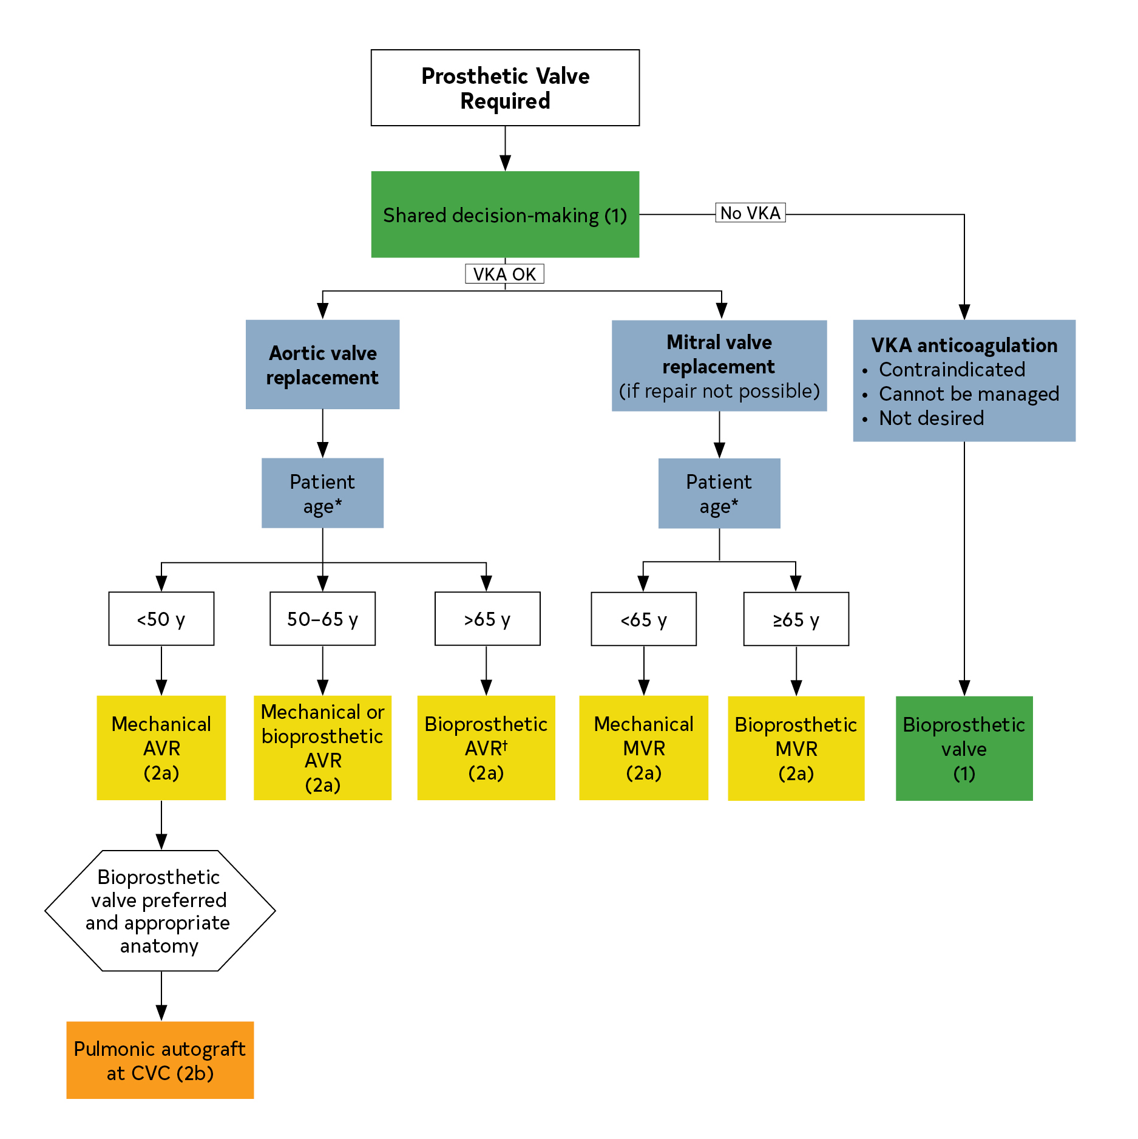
Figure 11. Prosthetic valves: choice of bioprosthetic versus mechanical valve type.
Colors correspond to Table 2
Footnote text located on the next slide

Slide 140
Figure 11. Prosthetic valves: choice of bioprosthetic versus mechanical valve type.
*Approximate ages, based on U.S. Actuarial Life Expectancy tables, are provided for guidance. The balance between expected patient longevity and valve durability varies continuously across the age range, with more durable valves preferred for patients with a longer life expectancy. Bioprosthetic valve durability is finite (with shorter durability for younger patients), whereas mechanical valves are very durable but require lifelong anticoagulation. Long-term (20-y) data on outcomes with surgical bioprosthetic valves are available; robust data on transcatheter bioprosthetic valves extend to only 5 y, leading to uncertainty about longer-term outcomes. The decision about valve type should be individualized on the basis of patient-specific factors that might affect expected longevity.
†See Section 3.2.4.2 for a discussion of the choice of TAVI versus SAVR.

Slide 141
Table 22. Selected Factors That May Impact Shared Decision-Making for the Choice of Prosthetic Valve
Favor Mechanical Prosthesis | Favor Bioprosthesis
Age <50 y Increased incidence of structural deterioration with bioprosthesis (15-y risk: 30% for age 40 y, 50% for age 20 y) Lower risk of anticoagulation complications | Age >65 y Low incidence of structural deterioration (15-y risk: <10% for age >70 y) Higher risk of anticoagulation complications
Patient preference (avoid risk of reintervention) | Patient preference (avoid risk and inconvenience of anticoagulation)
Low risk of long-term anticoagulation | High risk of long-term anticoagulation
Compliant patient with either home monitoring or close access to INR monitoring | Limited access to medical care or inability to regulate VKA
Other indication for long-term anticoagulation (e.g., AF) | Access to surgical centers with low reoperation mortality rate
High-risk reintervention (e.g., porcelain aorta, prior radiation therapy) | Access to transcatheter ViV replacement
Small aortic root size for AVR (may preclude ViV procedure in future) | TAVI valves have larger effective orifice areas for smaller valve sizes (avoid patient–prosthesis mismatch)

Slide 142
Antithrombotic Therapy for Prosthetic Valves
COR | LOE | Recommendations
1 | A | In patients with a mechanical prosthetic valve, anticoagulation with a VKA is recommended.
1 | B-NR | 2. For patients with a mechanical bileaflet or current-generation single-tilting disk AVR and no risk factors for thromboembolism, anticoagulation with a VKA to achieve an INR of 2.5 is recommended.
1 | B-NR | 3. For patients with a mechanical AVR and additional risk factors for thromboembolism (e.g., AF, previous thromboembolism, LV dysfunction, hypercoagulable state) or an older-generation prosthesis (e.g., ball-in-cage), anticoagulation with a VKA is indicated to achieve an INR of 3.0.
1 | B-NR | 4. For patients with a mechanical mitral valve replacement, anticoagulation with a VKA is indicated to achieve an INR of 3.0.

Slide 143
Antithrombotic Therapy for Prosthetic Valves
COR | LOE | Recommendations
2a | B-R | 5. For patients with a bioprosthetic TAVI, aspirin 75 to 100 mg daily is reasonable in the absence of other indications for oral anticoagulants.
2a | B-NR | 6. For all patients with a bioprosthetic SAVR or mitral valve replacement, aspirin 75 to 100 mg daily is reasonable in the absence of other indications for oral anticoagulants.
2a | B-NR | 7. For patients with a bioprosthetic SAVR or mitral valve replacement who are at low risk of bleeding, anticoagulation with a VKA to achieve an INR of 2.5 is reasonable for at least 3 months and for as long as 6 months after surgical replacement.
2b | B-R | 8. For patients with a mechanical SAVR or mitral valve replacement who are managed with a VKA and have an indication for antiplatelet therapy, addition of aspirin 75 to 100 mg daily may be considered when the risk of bleeding is low.

Slide 144
Antithrombotic Therapy for Prosthetic Valves
COR | LOE | Recommendations
2b | B-R | 9. For patients with a mechanical On-X AVR and no thromboembolic risk factors, use of a VKA targeted to a lower INR (1.5–2.0) may be reasonable starting ≥3 months after surgery, with continuation of aspirin 75 to 100 mg daily.
2b | B-NR | 10. For patients with a bioprosthetic TAVI who are at low risk of bleeding, dual-antiplatelet therapy with aspirin 75 to 100 mg and clopidogrel 75 mg may be reasonable for 3 to 6 months after valve implantation.
2b | B-NR | 11. For patients with a bioprosthetic TAVI who are at low risk of bleeding, anticoagulation with a VKA to achieve an INR of 2.5 may be reasonable for at least 3 months after valve implantation.

Slide 145
Antithrombotic Therapy for Prosthetic Valves
COR | LOE | Recommendations
3: Harm | B-R | 11. For patients with bioprosthetic TAVI, treatment with low-dose rivaroxaban (10 mg daily) plus aspirin (75–100 mg) is contraindicated in the absence of other indications for oral anticoagulants.
3: Harm | B-R | 13. For patients with a mechanical valve prosthesis, anticoagulation with the direct thrombin inhibitor, dabigatran, is contraindicated.
3: Harm | C-EO | 14. For patients with a mechanical valve prosthesis, the use of anti-Xa direct oral anticoagulants has not been assessed and is not recommended.

Slide 146
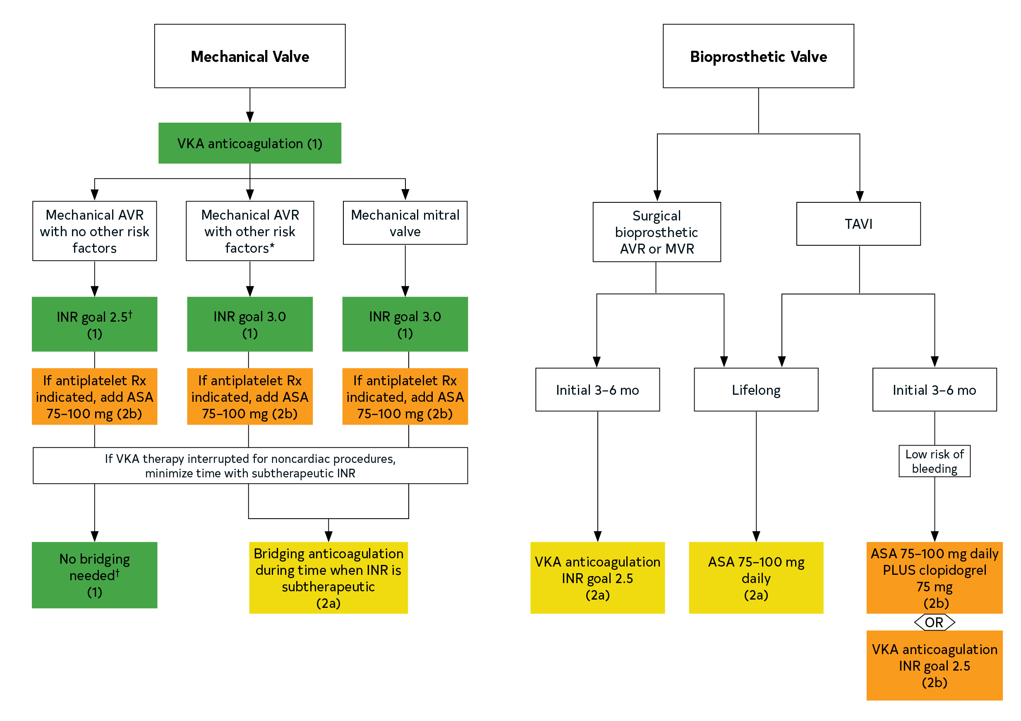
Figure 12. Antithrombotic therapy for prosthetic valves.
Colors correspond to Table 2.
Footnote text located on the next slide

Slide 147
Figure 12. Antithrombotic therapy for prosthetic valves.
*Thromboembolic risk factors include an older-generation valve, AF, previous thromboembolism, hypercoagulable state, and LV systolic dysfunction.
†For a mechanical On-X AVR and no thromboembolic risk factors, a goal INR of 1.5 to 2.0 plus aspirin 75 to 100 mg daily may be reasonable starting ≥3 months after surgery.

Slide 148
Bridging Therapy During Interruption of Oral Anticoagulation in Patients With Prosthetic Heart Valves
COR | LOE | Recommendations
1 | C-EO | 1. For patients with mechanical heart valves who are undergoing minor procedures (e.g., dental extractions or cataract removal) where bleeding is easily controlled, continuation of VKA anticoagulation with a therapeutic INR is recommended.
1 | C-LD | 2. For patients with a bileaflet mechanical AVR and no other risk factors for thromboembolism who are undergoing invasive procedures, temporary interruption of VKA anticoagulation, without bridging agents while the INR is subtherapeutic, is recommended.
2a | C-LD | 3. For patients with a mechanical valve prosthesis receiving VKA therapy who require immediate/emergency noncardiac surgery or an invasive procedure, administration of 4-factor prothrombin complex concentrate (or its activated form) is reasonable.

Slide 149
Bridging Therapy During Interruption of Oral Anticoagulation in Patients With Prosthetic Heart Valves
COR | LOE | Recommendations
2a | C-LD | 4. For patients with bioprosthetic heart valves or annuloplasty rings who are receiving anticoagulation for AF, it is reasonable to consider the need for bridging anticoagulant therapy around the time of invasive procedures on the basis of the CHA₂DS₂-VASc score weighed against the risk of bleeding.
2a | C-LD | 5. For patients who are undergoing invasive procedures and have 1) a mechanical AVR and any thromboembolic risk factor, 2) an older-generation mechanical AVR, or 3) a mechanical mitral valve replacement, bridging anticoagulation therapy during the preoperative time interval when the INR is subtherapeutic is reasonable on an individualized basis, with the risks of bleeding weighed against the benefits of thromboembolism prevention.

Slide 150
Management of Excessive Anticoagulation and Serious Bleeding in Patients with Prosthetic Valves
COR | LOE | Recommendations
2a | C-LD | 1. For patients with mechanical valves and uncontrollable bleeding who require immediate reversal of anticoagulation, administration of 4-factor prothrombin complex (or its activated form) is reasonable.
2a | C-LD | 2. For patients with mechanical valves and uncontrollable bleeding who have received 4-factor prothrombin concentrate complex, adjunctive use of intravenous vitamin K is reasonable if resumption of VKA therapy is not anticipated for 7 days.
2a | B-NR | 3. For patients with bioprosthetic valves or annuloplasty rings who are receiving a direct oral anticoagulant and who require immediate reversal of anticoagulation because of uncontrollable bleeding, treatment with idarucizumab (for dabigatran) or andexanet alfa (for anti-Xa agents) is reasonable.
2b | C-LD | 4. For patients with a mechanical prosthetic valve and supratherapeutic INR (>5.0) who are not actively bleeding, the benefit of individualized treatment with oral vitamin K, in addition to temporary withdrawal of the VKA, is uncertain.

Slide 151
Management of Patients with Thromboembolic Events and Prosthetic Valves
COR | LOE | Recommendations
2a | C-EO | In patients with a mechanical AVR who experience a stroke or systemic embolic event while in therapeutic range on VKA anticoagulation, it is reasonable to increase the INR goal from 2.5 (range, 2.0–3.0) to 3.0 (range, 2.5–3.5) or to add daily low-dose aspirin (75–100 mg), with assessment of bleeding risk.
2a | C-EO | 2. In patients with a mechanical mitral valve replacement who experience a stroke or systemic embolic event while in therapeutic range on VKA anticoagulation, it is reasonable to increase the INR goal from 3.0 (range, 2.5–3.5) to 4.0 (range, 3.5–4.0) or to add daily low-dose aspirin (75–100 mg), with assessment of bleeding risk.
2b | C-EO | 3. In patients with a bioprosthetic surgical or transcatheter aortic valve or bioprosthetic mitral valve who experience a stroke or systemic embolic event while on antiplatelet therapy, VKA anticoagulation, instead of antiplatelet therapy may be considered after assessment of bleeding risk.

Slide 152
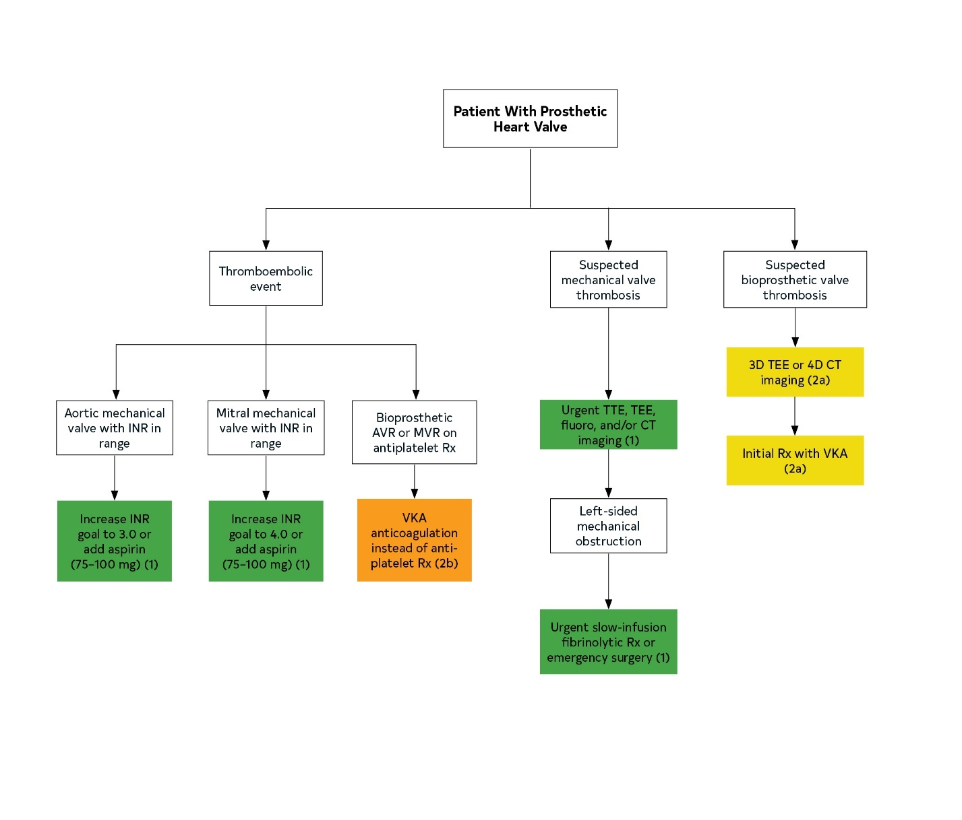
Figure 13.
Management of embolic events and valve thrombosis.
Colors correspond to Table 2

Slide 153
Diagnosis of Acute Mechanical Valve Thrombosis
COR | LOE | Recommendation
1 | B-NR | In patients with suspected mechanical prosthetic valve thrombosis, urgent evaluation with TTE, TEE, fluoroscopy, and/or multidetector CT imaging is indicated to assess valve function, leaflet motion, and the presence and extent of thrombus.

Slide 154
Intervention for Patients with Mechanical Prosthetic Valve Thrombosis
COR | LOE | Recommendation
1 | B-NR | For patients with a thrombosed left-sided mechanical prosthetic heart valve who present with symptoms of valve obstruction, urgent initial treatment with either slow-infusion, low-dose fibrinolytic therapy or emergency surgery is recommended.

Slide 155
Table 23. Systemic Fibrinolysis Versus Surgery for Prosthetic Valve Thrombosis
Favor Surgery | Favor Fibrinolysis
Readily available surgical expertise | No surgical expertise available
Low surgical risk | High surgical risk
Contraindication to fibrinolysis | No contraindication to fibrinolysis
Recurrent valve thrombosis | First-time episode of valve thrombosis
NYHA class IV | NYHA class I, II, or III
Large clot (>0.8 cm²) | Small clot (≤0.8 cm²)
LA thrombus | No LA thrombus
Concomitant CAD in need of revascularization | No or mild CAD
Other valve disease | No other valve disease
Possible pannus | Thrombus visualized
Patient choice | Patient choice

Slide 156
Diagnosis of Bioprosthetic Valve Thrombosis
COR | LOE | Recommendation
2a | C-LD | In patients with suspected bioprosthetic valve thrombosis, 3D TEE or 4D CT imaging can be useful to rule out leaflet thrombosis.

Slide 157
Medical Therapy: In Ppatients with Ssuspected or Cconfirmed Bbioprosthetic Vvalve Tthrombosis
COR | LOE | Recommendation
2a | B-NR | 1. In patients with suspected or confirmed bioprosthetic valve thrombosis who are hemodynamically stable and have no contraindications to anticoagulation, initial treatment with a VKA is reasonable.

Slide 158
Diagnosis of Prosthetic Valve Stenosis
COR | LOE | Recommendations
1 | B-NR | 1. In patients with suspected mechanical or bioprosthetic valve stenosis, TTE and TEE are recommended to diagnosis the cause and severity of valve obstruction, assess ventricular function, and estimate pulmonary artery systolic pressure.
1 | C-EO | 2. In patients with mechanical valve stenosis, fluoroscopy or cine-CT is recommended to assess motion of the mechanical valve leaflets.
2a | C-LD | 3. In patients with bioprosthetic valve stenosis, 3D TEE or 4D CT imaging can be useful to rule out leaflet thrombosis.

Slide 159
Intervention of Patients with Prosthetic Valve Stenosis
COR | LOE | Recommendations
1 | B-NR | 1. In patients with symptomatic severe stenosis of a bioprosthetic or mechanical prosthetic valve, repeat surgical intervention is indicated unless surgical risk is high or prohibitive.
2a | B-NR | 2. For severely symptomatic patients with bioprosthetic aortic valve stenosis and high or prohibitive surgical risk, a transcatheter ViV procedure is reasonable when performed at a Comprehensive Valve Center.
2a | B-NR | 3. For patients with significant bioprosthetic valve stenosis attributable to suspected or documented valve thrombosis, oral anticoagulation with a VKA is reasonable.

Slide 160
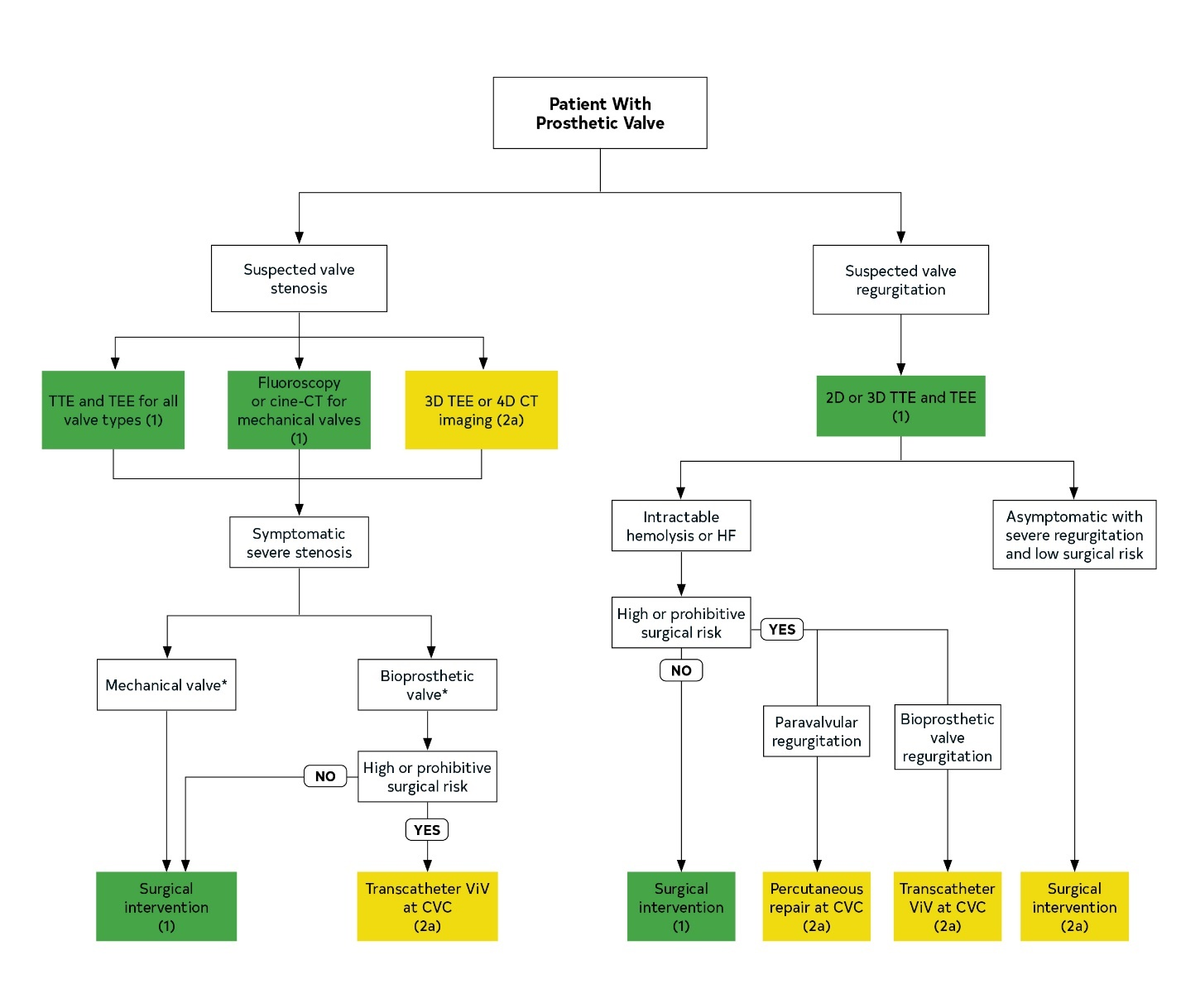
Figure 14. Management of prosthetic valve stenosis and regurgitation.
Colors correspond to Table 2.

Slide 161
Diagnosis of Prosthetic Valve Regurgitation
COR | LOE | Recommendations
1 | B-NR | 1. In patients with suspected mechanical or bioprosthetic valve regurgitation, TTE and TEE are recommended to determine the cause and severity of the leak, assess ventricular function, and estimate pulmonary artery systolic pressure.
1 | C-EO | 2. In patients undergoing a transcatheter procedure for paravalvular prosthetic regurgitation, 3D TEE is recommended for intraprocedural guidance.

Slide 162
Intervention: Patients with Pprosthetic Vvalve Rregurgitation
COR | LOE | Recommendations
1 | B-NR | In patients with intractable hemolysis or HF attributable to prosthetic transvalvular or paravalvular leak, surgery is recommended unless surgical risk is high or prohibitive.
2a | B-NR | 2. In asymptomatic patients with severe prosthetic regurgitation and low operative risk, surgery is reasonable.

Slide 163
Intervention: Patients with Pprosthetic Vvalve Rregurgitation
COR | LOE | Recommendations
2a | B-NR | 3. In patients with prosthetic paravalvular regurgitation with the following: 1) either intractable hemolysis or NYHA class III or IV symptoms and 2) who are at high or prohibitive surgical risk and 3) have anatomic features suitable for catheter-based therapy, percutaneous repair of paravalvular leak is reasonable when performed at a Comprehensive Valve Center.
2a | B-NR | 4. For patients with severe HF symptoms caused by bioprosthetic valve regurgitation who are at high to prohibitive surgical risk, a transcatheter ViV procedure is reasonable when performed at a Comprehensive Valve Center.

Slide 164
Infective Endocarditis

Slide 165
Diagnosis of Infective Endocarditis
COR | LOE | Recommendations
1 | B-NR | In patients at risk of IE (e.g., those with congenital or acquired VHD, previous IE, prosthetic heart valves, certain congenital or heritable heart malformations, immunodeficiency states, or injection drug use) who have unexplained fever blood, culture samples should be obtained.
1 | B-NR | 2. In patients with the recent onset of left-sided valve regurgitation, at least 2 sets of blood culture samples should be obtained.
1 | B-NR | 3. In patients with suspected IE, the Modified Duke Criteria should be used for diagnosis.

Slide 166
Diagnosis of Infective Endocarditis
COR | LOE | Recommendations
1 | B-NR | 4. Patients with IE should be evaluated and managed with consultation with a multispecialty Heart Valve Team, which includes an infectious disease specialist, cardiologist, and cardiac surgeon; a cardiac anesthesiologist for surgically managed patients and a neurologist for patients with neurological events.
1 | B-NR | 5. In patients with suspected IE, TTE is recommended to identify vegetations, characterize the hemodynamic severity of valvular lesions, assess ventricular function and pulmonary pressures, and detect complications.

Slide 167
Diagnosis of Infective Endocarditis
COR | LOE | Recommendations
1 | B-NR | 6. In all patients with known or suspected IE and nondiagnostic TTE results, when complications have developed or are clinically suspected or when intracardiac device leads are present, TEE is recommended.
1 | B-NR | 7. In patients with IE who have a change in clinical signs or symptoms (e.g., new murmur, embolism, persistent fever, HF, abscess, or atrioventricular heart block) and in patients at high risk of complications (e.g., extensive infected tissue, large vegetation on initial echocardiogram, or staphylococcal, enterococcal, or fungal infections), TTE and/or TEE are recommended for reevaluation.

Slide 168
Diagnosis of Infective Endocarditis
COR | LOE | Recommendations
1 | B-NR | 8. In patients undergoing valve surgery for IE, intraoperative TEE is recommended.
1 | B-NR | 9. In patients being considered for an early change to oral antibiotic therapy for the treatment of stable IE, a baseline TEE before switching to oral therapy and a repeat TEE 1 to 3 days before completion of the oral antibiotic regimen should be performed.

Slide 169
Diagnosis of Infective Endocarditis
COR | LOE | Recommendations
2a | B-NR | 10. In patients with Staphylococcus aureus bacteremia without a known source, TEE is reasonable to diagnose possible IE.
2a | B-NR | 11. In patients with a prosthetic valve in the presence of persistent fever without bacteremia or a new murmur, a TEE is reasonable to aid in the diagnosis of IE.

Slide 170
Diagnosis of Infective Endocarditis
COR | LOE | Recommendations
2a | B-NR | 12. In patients in whom the anatomy cannot be clearly delineated by echocardiography in the setting of suspected paravalvular infections, CT imaging is reasonable.
2a | B-NR | 13. In patients classified by Modified Duke Criteria as having “possible IE,” ¹⁸F-fluorodeoxyglucose PET/CT is reasonable as adjunct diagnostic imaging.
2b | B-NR | 14. In patients with nosocomial S. aureus bacteremia with a known portal of entry from an extracardiac source, TEE might be considered to detect concomitant staphylococcal IE.

Slide 171
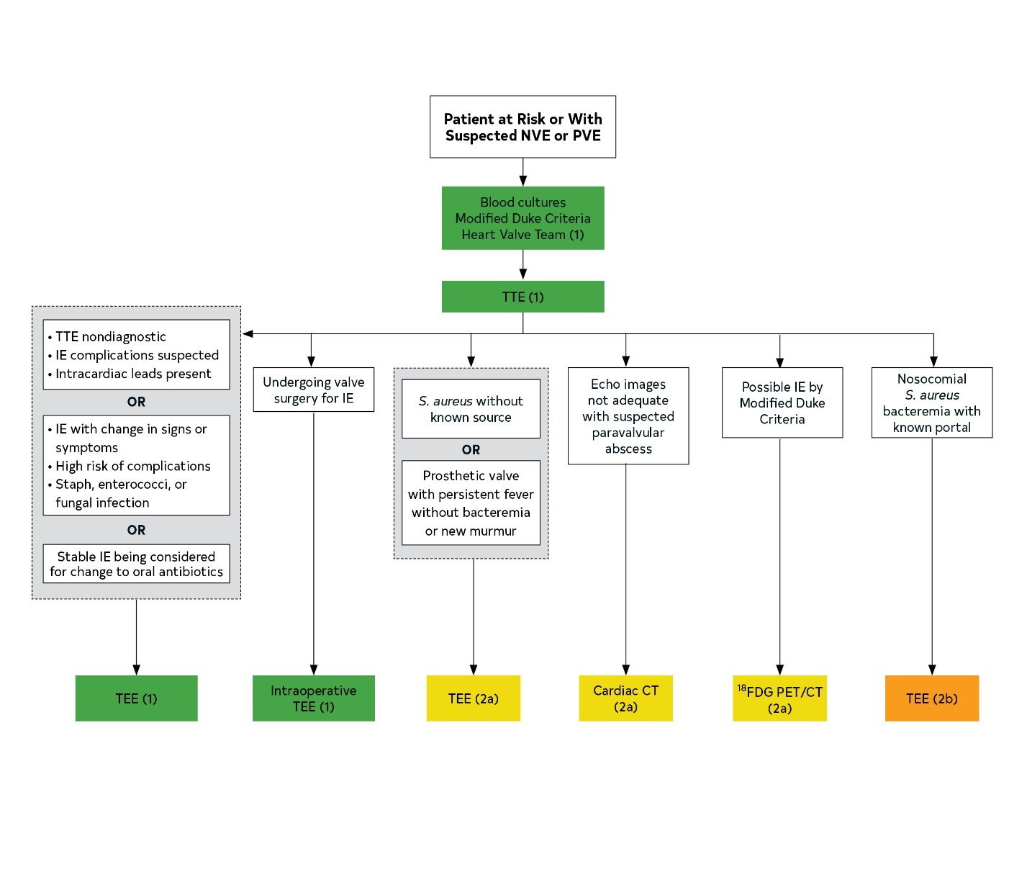
Figure 15. Diagnosis of IE.
Colors corresponds to Table 2.

Slide 172
Definite IE
Pathological criteria
Microorganisms demonstrated by culture or histological examination of a vegetation, a vegetation that has embolized, or an intracardiac abscess specimen; or Pathological lesions: vegetation or intracardiac abscess confirmed by histological examination showing active endocarditis
Clinical criteria
2 major criteria; or 1 major criterion and 3 minor criteria; or 5 minor criteria
Possible IE
1 major criterion and 1 minor criterion; or 3 minor criteria
Rejected
Firm alternative diagnosis explaining evidence of IE; or Resolution of IE syndrome with antibiotic therapy for <4 d; or No pathological evidence of IE at surgery or autopsy, with antibiotic therapy for <4 d; or Does not meet criteria for possible IE as listed above
Table 24. Diagnosis of IE According to the Proposed Modified Duke Criteria

Slide 173
Major Criteria
Blood culture positive for IE
Typical microorganisms consistent with IE from 2 separate blood cultures: Viridans streptococci, Streptococcus bovis, HACEK group (Haemophilus spp., Actinobacillus actinomycetemcomitans, Cardiobacterium hominis, Eikenella spp., and Kingella kingae), S. aureus; or community-acquired enterococci, in the absence of a primary focus; Or Microorganisms consistent with IE from persistently positive blood culture results, defined as follows: At least 2 positive culture results of blood samples drawn 12 h apart; or All of 3 or most of ≥4 separate culture samples of blood (with first and last samples drawn at least 1 h apart) Single positive blood culture result for Coxiella burnetii or antiphase I IgG antibody titer >1:800
Table 25. Diagnosis of IE According to the Proposed Modified Duke Criteria

Slide 174
Major Criteria
Evidence of endocardial involvement
Echocardiogram positive for IE defined as follows: Oscillating intracardiac mass on valve or supporting structures, in the path of regurgitant jets, or on implanted material in the absence of an alternative anatomic explanation Abscess; or New partial dehiscence of prosthetic valve New valvular regurgitation (worsening or changing of preexisting murmur not sufficient)
Table 25 cont. Diagnosis of IE According to the Proposed Modified Duke Criteria

Slide 175
Minor Criteria
Predisposition, predisposing heart condition, or injection drug use Fever, temperature >38°C (100.4°F) Vascular phenomena, major arterial emboli, septic pulmonary infarcts, mycotic aneurysm, intracranial hemorrhage, conjunctival hemorrhages, and Janeway lesions Immunological phenomena: glomerulonephritis, Osler’s nodes, Roth’s spots, and rheumatoid factor Microbiological evidence: positive blood culture but does not meet a major criterion as noted above* or serological evidence of active infection with organism consistent with IE *Excludes single positive cultures for coagulase-negative staphylococci and organisms that do not cause IE.
Table 25 cont. Diagnosis of IE According to the Proposed Modified Duke Criteria

Slide 176
Medical Therapy for IE
COR | LOE | Recommendations
1 | B-NR | 1. In patients with IE, appropriate antibiotic therapy should be initiated and continued after blood cultures are obtained, with guidance from antibiotic sensitivity data and the infectious disease experts on the multidisciplinary team (MDT).
1 | B-R | 2. Patients with suspected or confirmed IE associated with drug use should be referred to addiction treatment for opioid substitution therapy.
2a | B-NR | 3. In patients with IE and with evidence of cerebral embolism or stroke, regardless of the other indications for anticoagulation, it is reasonable to temporarily discontinue anticoagulation.

Slide 177
Medical Therapy for IE
COR | LOE | Recommendations
2b | B-R | 4. In patients with left-sided IE caused by streptococcus, Enterococcus faecalis, S. aureus, or coagulase-negative staphylococci deemed stable by the MDT after initial intravenous antibiotics, a change to oral antibiotic therapy may be considered if TEE before the switch to oral therapy shows no paravalvular infection, if frequent and appropriate follow-up can be assured by the care team, and if a follow-up TEE can be performed 1 to 3 days before the completion of the antibiotic course.
2b | B-NR | 5. In patients receiving VKA anticoagulation at the time of IE diagnosis, temporary discontinuation of VKA anticoagulation may be considered.
3: Harm | C-LD | 6. Patients with known VHD should not receive antibiotics before blood cultures are obtained for unexplained fever.

Slide 178
Intervention of Patients with IE
COR | LOE | Recommendations
1 | B-NR | 1. Decisions about the timing of surgical intervention for IE should be made by a Heart Valve Team.
1 | B-NR | 2. In patients with IE who present with valve dysfunction resulting in symptoms of HF, early surgery (during initial hospitalization and before completion of a full therapeutic course of antibiotics) is indicated.

Slide 179
Intervention of Patients with IE
COR | LOE | Recommendations
1 | B-NR | 3. In patients with left-sided IE caused by S. aureus, a fungal organism, or other highly resistant organisms, early surgery (during initial hospitalization and before completion of a full therapeutic course of antibiotics) is indicated.
1 | B-NR | 4. In patients with IE complicated by heart block, annular or aortic abscess, or destructive penetrating lesions, early surgery (during initial hospitalization and before completion of a full therapeutic course of antibiotics) is indicated.

Slide 180
Intervention of Patients with IE
COR | LOE | Recommendations
1 | B-NR | 5. In patients with IE and evidence of persistent infection as manifested by persistent bacteremia or fevers lasting >5 days after onset of appropriate antimicrobial therapy, early surgery (during initial hospitalization and before completion of a full therapeutic course of antibiotics) for IE is indicated.
1 | B-NR | 6. In all patients with definite endocarditis and an implanted cardiac electronic device, complete removal of the pacemaker or defibrillator systems, including all leads and the generator, is indicated.

Slide 181
Intervention of Patients with IE
COR. | LOE | Recommendations
1 | C-LD | 7. For patients with prosthetic valve endocarditis and relapsing infection (defined as recurrence of bacteremia after a complete course of appropriate antibiotics and subsequent negative blood culture results) without other identifiable source of infection, surgery is recommended.
1 | C-LD | 8. In patients with recurrent endocarditis and continued intravenous drug use, consultation with addiction medicine is recommended to discuss the long-term prognosis for the patient’s refraining from actions that risk reinfection before repeat surgical intervention is considered.
2a | B-NR | 9. In patients with IE who present with recurrent emboli and persistent vegetations despite appropriate antibiotic therapy, early surgery (during initial hospitalization and before completion of a full therapeutic course of antibiotics) is reasonable.

Slide 182
Intervention of Patients with IE
COR | LOE | Recommendations
2b | B-NR | 10. In patients with native left-sided valve endocarditis who exhibit mobile vegetations >10 mm in length (with or without clinical evidence of embolic phenomenon), early surgery (during initial hospitalization and before completion of a full therapeutic course of antibiotics) may be considered.
2b | B-NR | 11. In patients with IE and an indication for surgery who have suffered a stroke but have no evidence of intracranial hemorrhage or extensive neurological damage, operation without delay may be considered.
2b | B-NR | 12. For patients with IE and major ischemic stroke with extensive neurological damage or intracranial hemorrhage, if the patient is hemodynamically stable, delaying valve surgery for at least 4 weeks may be considered.

Slide 183
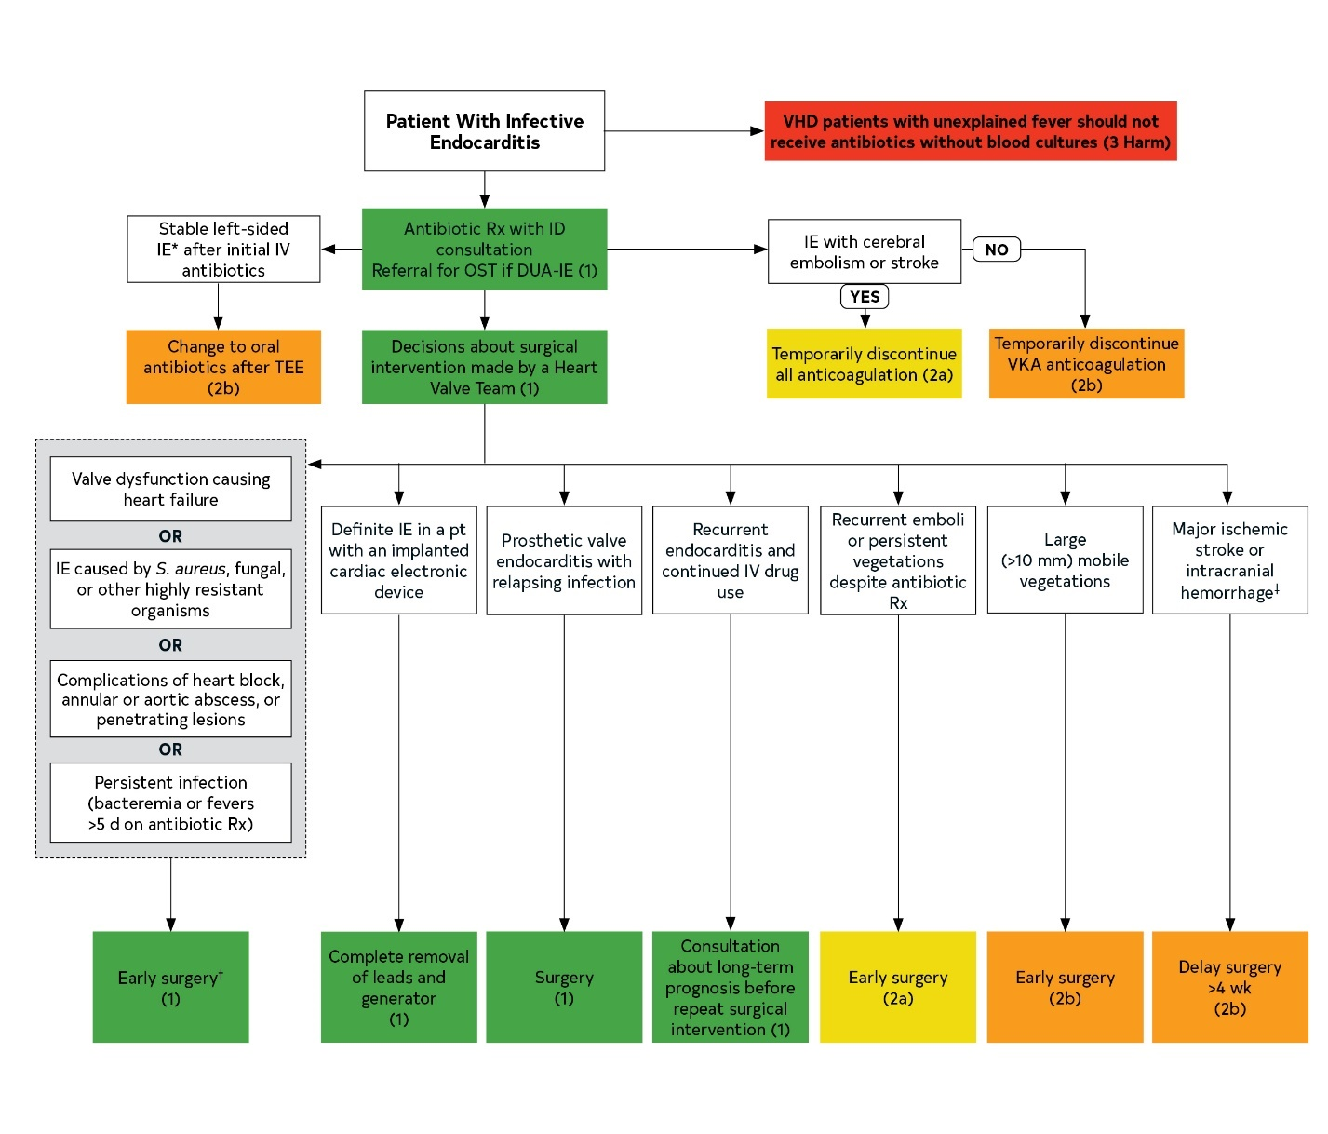
Figure 16. Treatment of Patients with Endocarditis
Colors correspond to Table 2
Footnote text located on the next slide

Slide 184
Figure 16. Treatment of Patients with Endocarditis
*IE caused by streptococcus, E. faecalis, S. aureus, or coagulase-negative staphylococci deemed stable by the Heart Valve Team.
†Early surgery defined as during initial hospital course and before completion of a full course of appropriate antibiotics.
‡In patients with an indication for surgery and a stroke but no evidence of intracranial hemorrhage or extensive neurological damage, surgery without delay may be considered.

Slide 185
Pregnancy and VHD

Slide 186
Initial Management of Women With VHD Before and During Pregnancy
COR | LOE | Recommendations
1 | B-NR | Women with suspected valve disease who are considering pregnancy should undergo a clinical evaluation and TTE before pregnancy.
1 | B-NR | 2. Women with severe valve disease (Stages C and D) who are considering pregnancy should undergo pre-pregnancy counseling by a cardiologist with expertise in managing women with VHD during pregnancy.

Slide 187
Initial Management of Women With VHD Before and During Pregnancy
COR | LOE | Recommendations
1 | B-NR | 3. Pregnant women with severe valve disease (Stages C and D) should be monitored in a tertiary-care center with a dedicated Heart Valve Team of cardiologists, surgeons, anesthesiologists, and maternal-fetal medicine obstetricians with expertise in the management of high-risk cardiac conditions during pregnancy.
2a | B-NR | 4. In asymptomatic women with severe valve disease (Stage C1) who are considering pregnancy, exercise testing is reasonable before pregnancy for risk assessment.

Slide 188
Medical Therapy of Pregnant Women with VHD
COR | LOE | Recommendations
2a | C-LD | In pregnant women with VHD, beta-blocker medications are reasonable as required for heart rate control or treatment of arrhythmias.
2a | C-LD | 2. In pregnant women with VHD and HF symptoms (Stage D), diuretic medications are reasonable if needed for volume overload.
3: Harm | B-NR | 3. In pregnant women with VHD, ACE inhibitors and ARBs should not be given because of fetal risk.

Slide 189
Pre-Pregnancy Intervention in Women With VHD
COR | LOE | Recommendations
1 | B-NR | 1. In symptomatic women with severe VHD who are considering pregnancy, intervention before pregnancy is recommended on the basis of standard indications.
1 | C-EO | 2. In women who require a valve intervention before pregnancy, the choice of prosthetic valve should be based on a shared decision-making process that accounts for the patient’s values and preferences, including discussion of the risks of mechanical valves during pregnancy and the reduced durability of bioprosthetic valves in young women.
2a | C-LD | 3. In asymptomatic women with severe rheumatic MS (mitral valve area ≤1.5 cm², Stage C1) who are considering pregnancy, PMBC at a Comprehensive Valve Center is reasonable before pregnancy for those who have favorable valve morphology.

Slide 190
Pre-Pregnancy Intervention in Women With VHD
COR | LOE | Recommendations
2a | B-NR | 4. In women of childbearing age who require valve replacement, bioprosthetic valves are preferred over mechanical valves because of the increased maternal and fetal risks of mechanical heart valves in pregnancy.
2a | C-EO | 5. In asymptomatic women with severe AS (aortic velocity ≥4.0 m/s or mean pressure gradient ≥40 mm Hg, Stage C1) who are considering pregnancy, valve intervention before pregnancy is reasonable.

Slide 191
Pre-Pregnancy Intervention in Women With VHD
COR | LOE | Recommendations
2b | C-EO | 6. In asymptomatic women with severe AS (aortic velocity ≥4.0 m/s or mean pressure gradient ≥40 mm Hg, Stage C1) who are considering pregnancy, do not meet COR 1 criteria for intervention, and have a preconception evaluation confirming the absence of symptoms (including normal exercise stress testing and serum BNP measurements), medical management during pregnancy may be considered to avoid prosthetic valve replacement.
2b | C-EO | 7. In asymptomatic women with severe MR (Stage C1) and a valve suitable for repair who are considering pregnancy, valve repair before pregnancy at a Comprehensive Valve Center may be considered but only after detailed discussion with the patient about the risks and benefits of the surgery and its effect on future pregnancies.

Slide 192
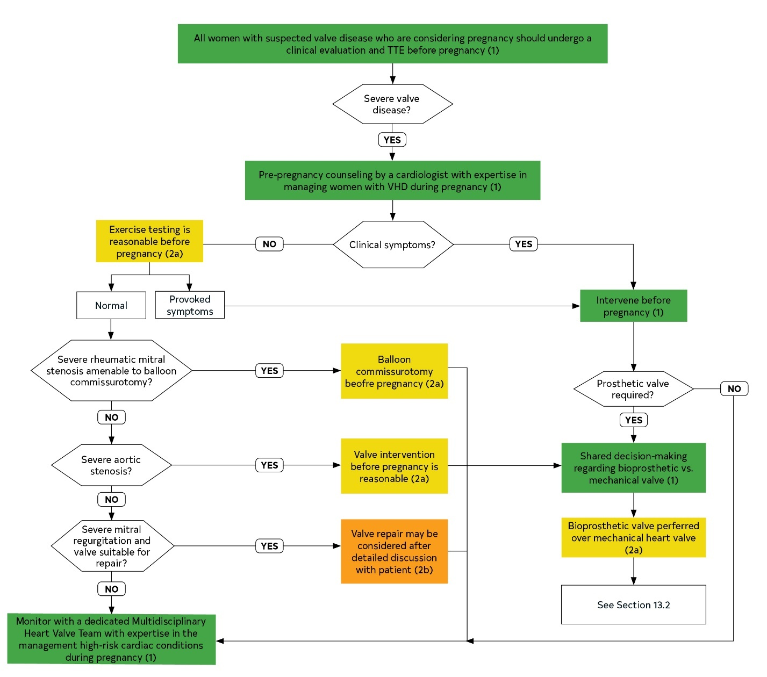
Figure 17. Preconception management of women with native valve disease.

Slide 193
Intervention During Pregnancy in Women with VHD
COR | LOE | Recommendations
2a | B-NR | 1. In pregnant women with severe AS (mean pressure gradient ≥40 mm Hg, Stage D), valve intervention during pregnancy is reasonable if there is hemodynamic deterioration or if there are NYHA class III or IV HF symptoms.
2a | B-NR | 2. In pregnant women with severe rheumatic MS (mitral valve area ≤1.5 cm², Stage D) and with valve morphology favorable for PMBC who remain symptomatic with NYHA class III or IV HF symptoms despite medical therapy, PMBC is reasonable during pregnancy if it is performed at a Comprehensive Valve Center.
2a | C-LD | 3. In pregnant women with severe valve regurgitation and with NYHA class IV HF symptoms (Stage D) refractory to medical therapy, valve surgery is reasonable during pregnancy.
3: Harm | C-LD | 4. In pregnant women with VHD, valve surgeries should not be performed in the absence of severe HF symptoms refractory to medical therapy.

Slide 194
Initial Management of Prosthetic Heart Valves in Pregnant Women
COR | LOE | Recommendations
1 | C-EO | 1. Women with a prosthetic valve should undergo pre-pregnancy assessment, including echocardiography, by a cardiologist with expertise in managing women with VHD during pregnancy.
1 | C-EO | 2. Pregnant women with a mechanical prosthesis should be monitored in a tertiary-care center with a dedicated MDT of cardiologists, surgeons, anesthesiologists, and maternal-fetal medicine obstetricians with expertise in the management of high-risk cardiac conditions during pregnancy.
1 | B-NR | 3. Women with mechanical heart valves considering pregnancy should be counselled that pregnancy is high risk and that there is no anticoagulation strategy that is consistently safe for the mother and baby.
1 | B-NR | 4. Pregnant women with a mechanical prosthetic valve who have prosthetic valve obstruction or experience an embolic event should undergo a TEE.

Slide 195
Anticoagulation for Pregnant Women With Mechanical Prosthetic Heart Valves
COR | LOE | Recommendations
1 | B-NR | 1. Pregnant women with mechanical prostheses should receive therapeutic anticoagulation with frequent monitoring during pregnancy.
1 | B-NR | 2. Women with mechanical heart valves who cannot maintain therapeutic anticoagulation with frequent monitoring should be counseled against pregnancy.
1 | B-NR | 3. Women with mechanical heart valves and their providers should use shared decision-making to choose an anticoagulation strategy for pregnancy. Women should be informed that VKA during pregnancy is associated with the lowest likelihood of maternal complications but the highest likelihood of miscarriage, fetal death, and congenital abnormalities, particularly if taken during the first trimester and if the warfarin dose exceeds 5 mg/d.

Slide 196
Anticoagulation for Pregnant Women With Mechanical Prosthetic Heart Valves
COR | LOE | Recommendations
1 | C-LD | 4. Pregnant women with mechanical valve prostheses who are on warfarin should switch to twice-daily LMWH (with a target anti-Xa level of 0.8 U/mL to 1.2 U/mL at 4 to 6 hours after dose) or intravenous UFH (with an activated partial thromboplastin time [aPTT] 2 times control) at least 1 week before planned delivery.
1 | C-LD | 5. Pregnant women with mechanical valve prostheses who are on LMWH should switch to UFH (with an aPTT 2 times control) at least 36 hours before planned delivery.
1 | C-LD | 6. Pregnant women with valve prostheses should stop UFH at least 6 hours before planned vaginal delivery.
1 | C-LD | 7. If labor begins or urgent delivery is required in a woman therapeutically anticoagulated with a VKA, cesarean section should be performed after reversal of anticoagulation.

Slide 197
Anticoagulation for Pregnant Women With Mechanical Prosthetic Heart Valves
COR | LOE | Recommendations
2a | B-NR | 8. For pregnant women with mechanical prostheses who require a dose of warfarin ≤5 mg/d to maintain a therapeutic INR, continuation of warfarin for all 3 trimesters is reasonable after full discussion with the patient about risks and benefits.
2a | B-NR | 9. For pregnant women with mechanical prostheses who require >5 mg/d of warfarin to achieve a therapeutic INR, dose-adjusted LMWH (with a target anti-Xa level of 0.8 to 1.2 U/mL at 4 to 6 hours after dose) at least 2 times per day during the first trimester, followed by warfarin during the second and third trimesters, is reasonable.
2a | B-NR | 10. For pregnant women with mechanical prostheses who require a dose of warfarin >5 mg/d to achieve a therapeutic INR, and for whom dose-adjusted LMWH is unavailable, dose-adjusted continuous intravenous UFH during the first trimester (with aPTT 2 times control), followed by warfarin for the second and third trimesters, is reasonable.

Slide 198
Anticoagulation for Pregnant Women With Mechanical Prosthetic Heart Valves
COR | LOE | Recommendations
2a | B-NR | 11. For hemodynamically stable pregnant women with obstructive left-sided mechanical valve thrombosis, it is reasonable to manage with slow-infusion, low-dose fibrinolytic therapy.
2b | B-NR | 12. For pregnant women with mechanical prostheses who require a warfarin dose >5 mg/d to achieve a therapeutic INR, dose-adjusted LMWH (with a target anti-Xa level of 0.8 to 1.2 U/mL at 4 to 6 hours after dose) at least 2 times per day for all 3 trimesters may be considered.
2b | B-NR | 13. For pregnant women with mechanical prostheses who require a dose of warfarin ≤5 mg/d to maintain a therapeutic INR, dose-adjusted LMWH at least 2 times per day during the first trimester, followed by warfarin for the second and third trimesters, may be considered.

Slide 199
Anticoagulation for Pregnant Women With Mechanical Prosthetic Heart Valves
COR | LOE | Recommendations
2b | B-NR | 14. For pregnant women with mechanical prostheses, aspirin 75 to 100 mg daily may be considered, in addition to anticoagulation.
3: Harm | B-NR | 15. For pregnant women with mechanical prostheses, LMWH should not be administered unless anti-Xa levels are monitored 4 to 6 hours after administration and dose is adjusted according to levels.
3: Harm | B-R | 16. For patients with mechanical valve prostheses, anticoagulation with the direct thrombin inhibitor, dabigatran, should not be administered.
3: Harm | C-EO | 17. The use of anti-Xa direct oral anticoagulants with mechanical heart valves in pregnancy has not been assessed and is not recommended.

Slide 200
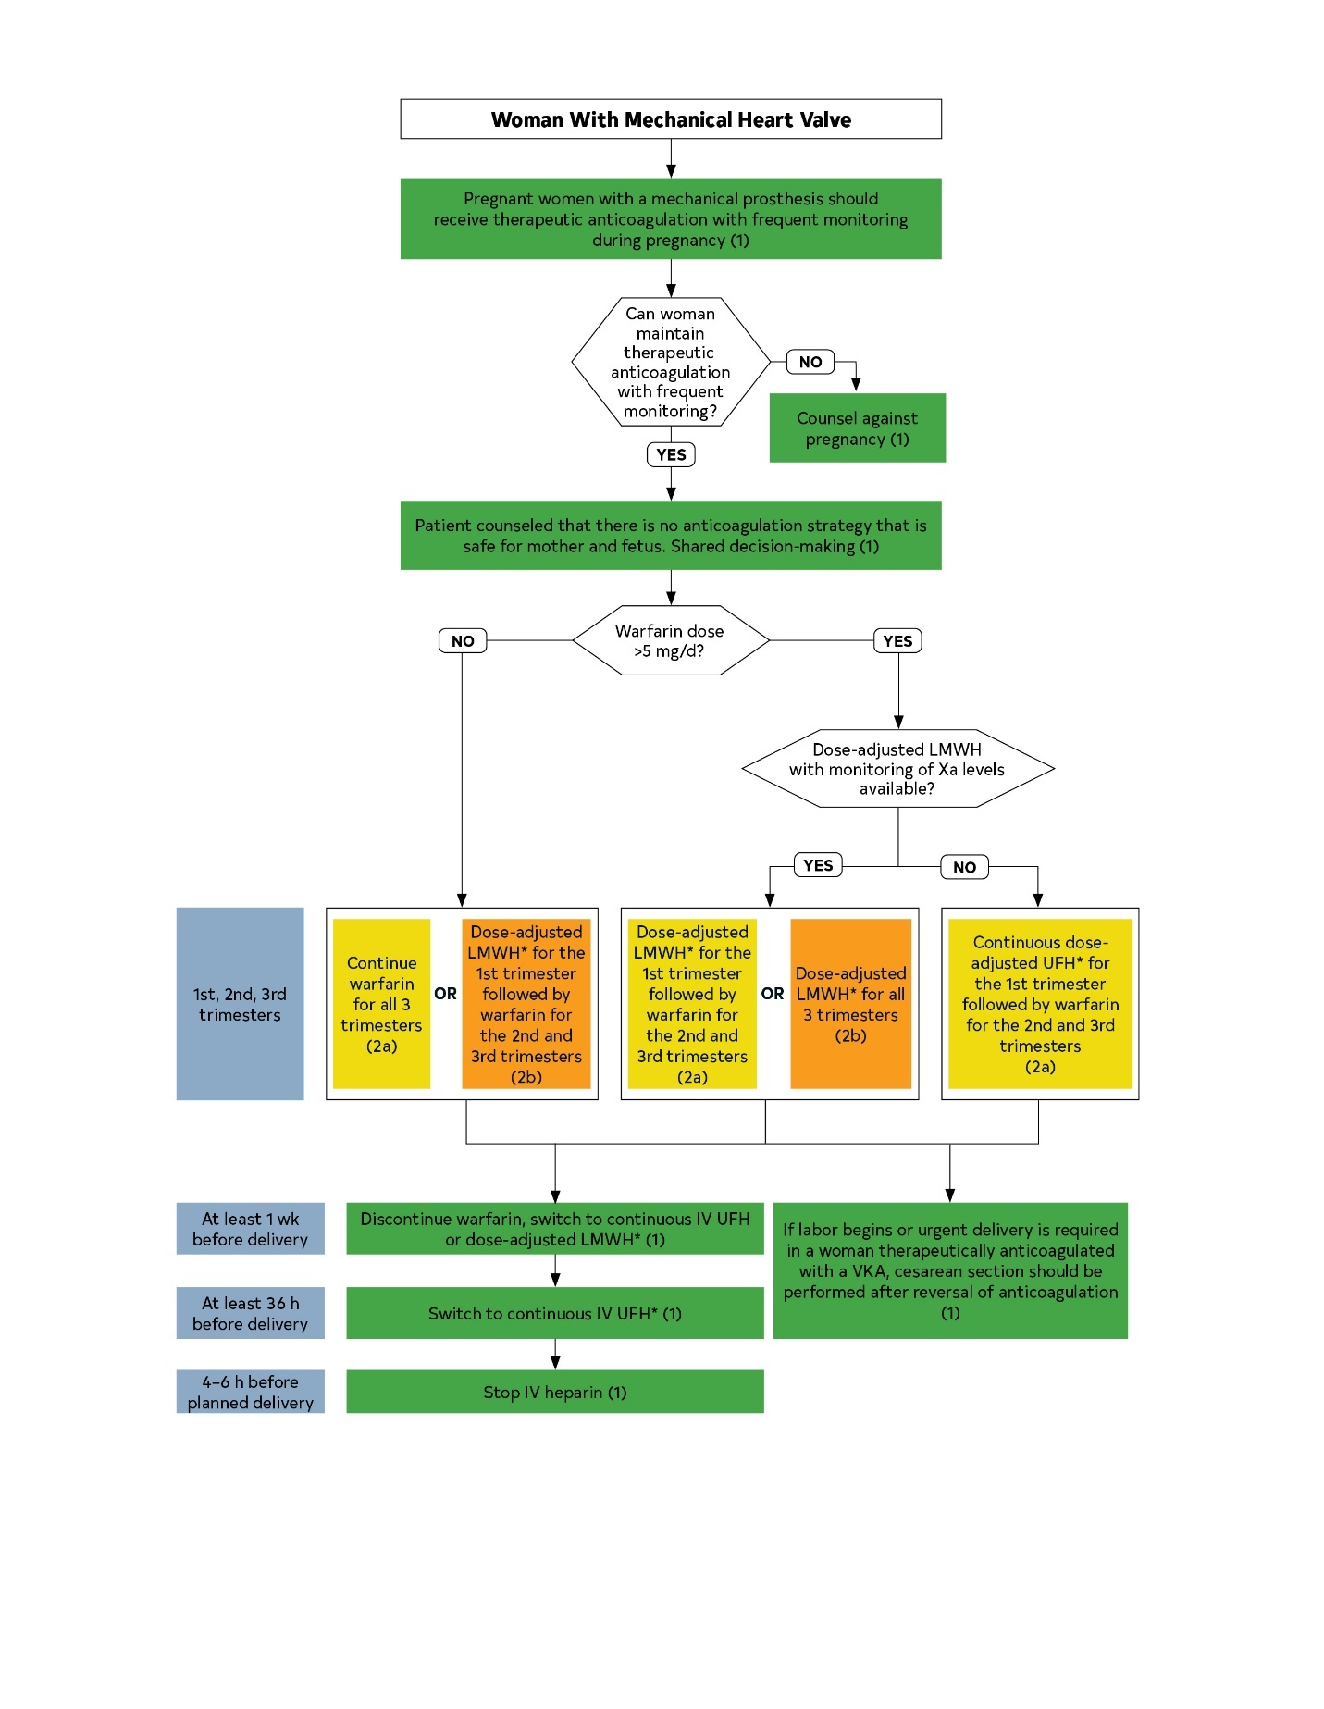
Figure 18. Anticoagulation for prosthetic mechanical heart valves in women during pregnancy.
Colors corresponds to Table 2.
Footnote text located on the next slide

Slide 201
Figure 18. Anticoagulation for prosthetic mechanical heart valves in women during pregnancy.
* Dose-adjusted LMWH should be given at least 2 times per day, with close monitoring of anti-Xa levels. Target to Xa level of 0.8 to 1.2 U/mL, 4 to 6 hours after dose. Trough levels may aid in maintaining patient in therapeutic range. Continuous UFH should be adjusted to aPTT 2 times control.

Slide 202
Surgical Considerations

Slide 203
Management of CAD in Patients Undergoing TAVI
COR | LOE | Recommendations
1 | C-EO | In patients undergoing TAVI, 1) contrast-enhanced coronary CT angiography (in patients with a low pretest probability for CAD) or 2) an invasive coronary angiogram is recommended to assess coronary anatomy and guide revascularization.
2a | C-LD | 2. In patients undergoing TAVI with significant left main or proximal CAD with or without angina, revascularization by PCI before TAVI is reasonable.
2a | C-LD | 3. In patients with significant AS and significant CAD (luminal reduction >70% diameter, fractional flow reserve <0.8, instantaneous wave-free ratio <0.89) consisting of complex bifurcation left main and/or multivessel CAD with a SYNTAX (Synergy Between Percutaneous Coronary Intervention With Taxus and Cardiac Surgery) score >33, SAVR and CABG are reasonable and preferred over TAVI and PCI.

Slide 204
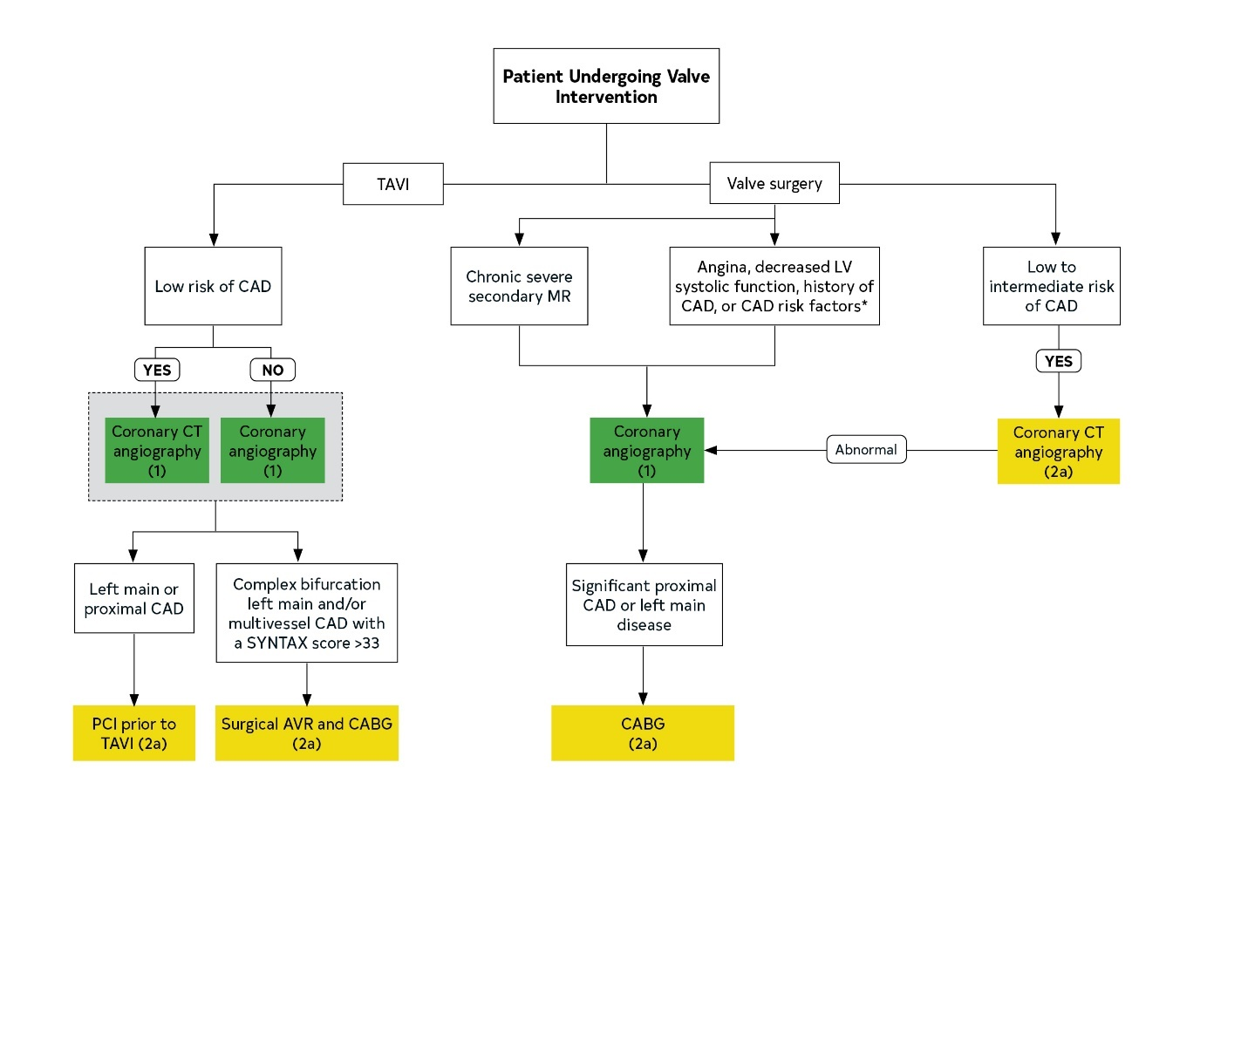
Figure 19. Management of CAD in patients undergoing valve interventions.
*Including men age >40 years and postmenopausal women.
Colors correspond to Table 2.

Slide 205
Management of CAD in Patients Undergoing Valve Surgery
COR | LOE | Recommendations
1 | C-LD | 1. In patients with symptoms of angina, objective evidence of ischemia, decreased LV systolic function, history of CAD, or coronary risk factors (including men >40 years of age and postmenopausal women), invasive coronary angiography is indicated before valve intervention.
1 | C-LD | 2. In patients with chronic severe secondary MR, invasive coronary angiography should be performed as part of the evaluation.
2a | B-NR | 3. In selected patients with a low to intermediate pretest probability of CAD, contrast-enhanced coronary CT angiography is reasonable to exclude the presence of significant obstructive CAD.
2a | C-LD | 4. In patients undergoing valve repair or replacement with significant proximal CAD (≥70% reduction in luminal diameter in major coronary arteries or ≥50% reduction in luminal diameter in the left main coronary artery and/or physiologically significance), CABG is reasonable for selective patients.

Slide 206
Intervention for AF in Patients With VHD
COR | LOE | Recommendations
1 | C-LD | In patients with VHD and AF for whom surgical intervention is planned, the potential symptomatic benefits and additional procedural risks of adjunctive arrhythmia surgery at the time of cardiac valvular surgery should be discussed with the patient.
2a | B-R | 2. For symptomatic patients with paroxysmal or persistent AF who are undergoing valvular surgery, surgical pulmonary vein isolation or a maze procedure can be beneficial to reduce symptoms and prevent recurrent arrhythmias.
2a | B-NR | 3. For patients with AF or atrial flutter who are undergoing valve surgery, LA appendage ligation/excision is reasonable to reduce the risk of thromboembolic events.

Slide 207
Intervention for AF in Patients With VHD
COR | LOE | Recommendations
2a | B-NR | 4. In patients undergoing LA surgical ablation of atrial arrhythmias and/or LA appendage ligation/excision, anticoagulation therapy is reasonable for at least 3 months after the procedure.
3: Harm | B-NR | 5. For patients without atrial arrhythmias who are undergoing valvular surgery, LA appendage occlusion/exclusion/amputation is potentially harmful.

Slide 208
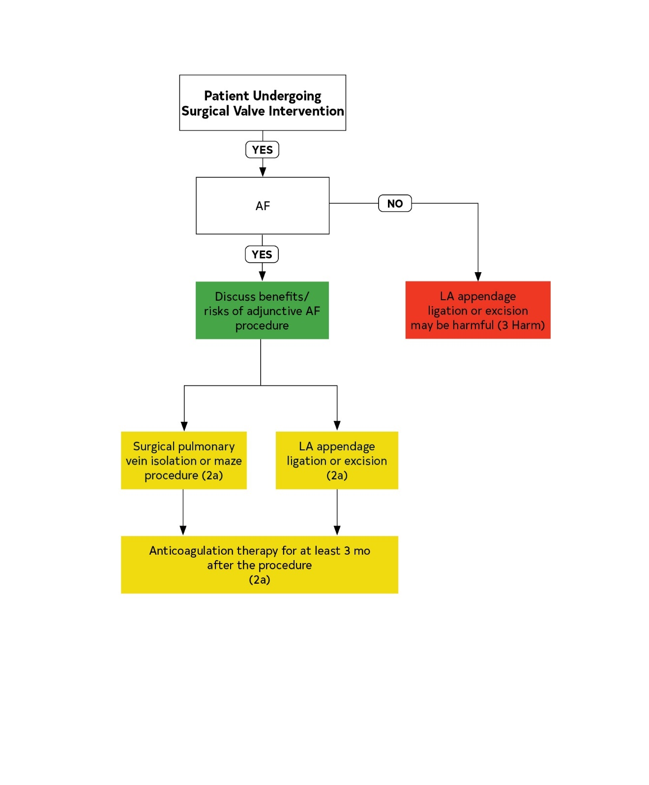
Figure 20. Intervention for AF in patients with VHD.
Colors correspond to Table 2.

Slide 209
Noncardiac Surgery in Patients with VHD

Slide 210
Diagnosis in Patients With VHD Undergoing Noncardiac Surgery
COR | LOE | Recommendation
1 | C-EO | 1. In patients with clinically suspected moderate or greater degrees of valvular stenosis or regurgitation who are undergoing noncardiac surgery, preoperative echocardiography is recommended.

Slide 211
Management of the Symptomatic Patient With VHD Undergoing Noncardiac Surgery
COR | LOE | Recommendation
1 | C-EO | 1. In patients who meet standard indications for intervention for VHD (replacement and repair) on the basis of symptoms and disease severity, intervention should be performed before elective noncardiac surgery to reduce perioperative risk if possible, depending on the urgency and risk of the noncardiac procedure.

Slide 212
Management of the Asymptomatic Patient With VHD Undergoing Noncardiac Surgery
COR | LOE | Recommendations
2a | B-R | 1. In asymptomatic patients with moderate or greater degrees of AS and normal LV systolic function, it is reasonable to perform elective noncardiac surgery.
2a | C-EO | 2. In asymptomatic patients with moderate or greater degrees of rheumatic MS with less than severe pulmonary hypertension (pulmonary artery systolic pressure <50 mm Hg), it is reasonable to perform elective noncardiac surgery.
2a | C-LD | 3. In asymptomatic patients with moderate or greater degrees of MR and normal LV systolic function with less than severe pulmonary hypertension (pulmonary artery systolic pressure <50 mm Hg), it is reasonable to perform elective noncardiac surgery.
2a | C-LD | 4. In asymptomatic patients with moderate or greater degrees of AR and normal LV systolic function, it is reasonable to perform elective noncardiac surgery.

Slide 213
Table 26. Evidence Gaps and Future Directions for Patients With VHD
Evidence Gaps | Future Directions
Identification of patients at risk and valve disease prevention (Stage A)
Disease mechanisms | Basic science to identify specific targets for medical therapy
Rheumatic heart disease | Primary and secondary prevention
Calcific valve disease | Identification of patients at risk Risk factor intervention Prevention of disease initiation
Medical therapy for progressive valve disease (Stage B)
Disease mechanisms | Basic science to identify specific targets to slow or reverse disease progression
Medical intervention | Targeted therapy using advanced imaging endpoints to study disease mechanisms
Ventricular and vascular interactions | Dynamic interplay between valve disease severity and changes in ventricular anatomy and function Modulation of ventricular and vascular dysfunction in patients with VHD

Slide 214
Table 26. Evidence Gaps and Future Directions for Patients With VHD
Evidence Gaps | Future Directions
Optimal timing of intervention (Stage C)
Improved measures of disease severity | Validation of newer measures of LV size (e.g., volumes instead of dimension) and function (e.g., strain) for timing of intervention decisions. Evaluation of nonimaging parameters (serum markers and other novel approaches)
Timing of intervention | Timing of intervention in asymptomatic patients with valve regurgitation Intervention for asymptomatic severe AS Intervention for moderate AS with LV dysfunction Identification of patients with secondary MR who benefit from intervention
Patient-centered research | Involvement of patients in identifying research questions, study design, and definition of outcomes
Inclusion of diverse patient groups | Adequate representation of diverse patient populations in RCTs for VHD
Decision aids | Development and validation of improved decision aids for shared decision-making with patients Implementation and validation of decision algorithms for physicians and Heart Valve Teams

Slide 215
Table 26. Evidence Gaps and Future Directions for Patients With VHD
Evidence Gaps | Future Directions
Intervention options and long-term management (Stage D)
Improved prosthetic valves | Durability of TAVI valves Nonthrombogenic durable surgical and transcatheter valves
Optimal antithrombotic therapy | Alternatives to VKA anticoagulation for mechanical valves Management of anticoagulation during pregnancy Optimal antithrombotic therapy after TAVI
Medical therapy after AVR | Medical therapy to address ventricular and vascular function Optimal blood pressure targets after valve intervention
Lower procedural risk | Approaches to lower surgical morbidity and mortality rates Prevention of postoperative AF Noninvasive approaches for correction of valve dysfunction
Prevention of complications | Approaches to avoid need for permanent pacing after SAVR or TAVI Better prevention, diagnosis and treatment of endocarditis. Better prevention of thromboembolic events.
Promoting equity | Identify and address disparities in outcomes and survival across diverse patient populations Develop novel, cost-effective approaches for long-term management in rural settings Expand access to therapies for valvular dysfunction

Slide 216
Abbreviations
Abbreviation | Meaning/Phrase
2D | 2-dimensional
3D | 3-dimensional
ACE | angiotensin-converting enzyme
AF | atrial fibrillation
ARB | angiotensin receptor blocker
aPTT | activated partial thromboplastin time
AR | aortic regurgitation
AS | aortic stenosis
AVR | aortic valve replacement

Slide 217
Abbreviations
Abbreviation | Meaning/Phrase
BAV | bicuspid aortic valve
BNP | B-type natriuretic peptide
CABG | coronary artery bypass graft
CAD | coronary artery disease
CMR | cardiac magnetic resonance
COR | Class of Recommendation
CT | computed tomography
ECG | electrocardiogram
GDMT | guideline-directed management and therapy

Slide 218
Abbreviations
Abbreviation | Meaning/Phrase
HF | heart failure
IE | infective endocarditis
INR | international normalized ratio
LA | left atrium (left atrial)
LMWH | low-molecular-weight heparin
LOE | Level of Evidence
LV | left ventricle (left ventricular)
LVEDD | left ventricular end-diastolic dimension
LVEF | left ventricular ejection fraction
LVESD | left ventricular end-systolic dimension

Slide 219
Abbreviations
Abbreviation | Meaning/Phrase
MDT | multidiscplinaryy team
MR | mitral regurgitation
MS | mitral stenosis
NOAC | non-vitamin K oral anticoagulant
NYHA | New York Heart Association
PCI | percutaneous coronary intervention
PET | positron emission tomography
PMBC | percutaneous mitral balloon commissurotomy
RCT | randomized control trial
RV | right ventricle (right ventricular)

Slide 220
Abbreviations
Abbreviation | Meaning/Phrase
SAVR | surgical aortic valve replacement
TAVI | transcatheter aortic valve implantation
TR | tricuspid regurgitation
TEE | transesophageal echocardiography (echocardiogram)
TTE | transthoracic echocardiography (echocardiogram)
TEER | TEER for transcatheter edge to edge mitral valve repair
UFH | unfractionated heparin
VHD | valvular heart disease
ViV | valve-in-valve
VKA | vitamin K antagonist

