Slide 1
2021 AHA/ACC/ASE/CHEST/SAEM/SCCT/SCMR Guideline for the Evaluation and Diagnosis of Chest Pain
Endorsed by the American Society of Echocardiography, American College of Chest Physicians, Society for Academic Emergency Medicine, Society of Cardiovascular Computed Tomography, and Society for Cardiovascular Magnetic Resonance

Slide 2
Citation
This slide set is adapted from the 2021 AHA/ACC Guideline for the Evaluation and Diagnosis of Chest Pain. Published online ahead of print October 29, 2021, available at: Circulation. https://www.ahajournals.org/doi/10.1161/CIR.0000000000001029 and Journal of the American College of Cardiology published online ahead of print October 29, 2021. J Am Coll Cardiol. https://doi.org/10.1016/j.jacc.2021.07.053

Slide 3
2021 Writing Committee Members*
Martha Gulati, MD, MS, FACC, FAHA, Chair†
Phillip D. Levy, MD, MPH, FACC, FAHA, Vice Chair †
Debabrata Mukherjee, MD, MS, FACC, FAHA, Vice Chair†
Ezra Amsterdam, MD, FACC†
Deepak L. Bhatt, MD, MPH, FACC, FAHA†
Kim K. Birtcher, MS, PharmD, AACC‡
Ron Blankstein, MD, FACC, MSCCT §
Jack Boyd, MD†
Renee P. Bullock-Palmer, MD, FACC, FAHA, FASE, FSCCT†
Theresa Conejo, RN, BSN, FAHA║
Deborah B. Diercks, MD, MSc, FACC¶
Federico Gentile, MD, FACC#
John P. Greenwood, MBChB, PhD, FSCMR, FACC**
Erik P. Hess, MD, MSc†
Steven M. Hollenberg, MD, FACC, FAHA, FCCP††
Wael A. Jaber, MD, FACC, FASE‡‡
Hani Jneid, MD, FACC, FAHA§§
José A. Joglar, MD, FAHA, FACC‡
David A. Morrow, MD, MPH, FACC, FAHA†
Robert E. O’Connor, MD, MPH, FAHA†
Michael A. Ross, MD, FACC†
Leslee J. Shaw, PhD, FACC, FAHA, MSCCT†
*Writing committee members are required to recuse themselves from voting on sections to which their specific relationships with industry may apply; see Appendix 1 for detailed information. †ACC/AHA Representative. ‡ ACC/AHA Joint Committee on Clinical Practice Guidelines Liaison. §Society of Cardiovascular Computed Tomography Representative. ║ Lay Patient Representative. ¶Society for Academic Emergency Medicine Representative. #Former ACC/AHA Joint Committee member; current member during the writing effort. **Society for Cardiovascular Magnetic Resonance Representative. ††American College of Chest Physicians Representative. ‡‡American Society of Echocardiography Representative. §§Task Force on Performance Measures, Liaison.

Slide 4
Top 10 Take-Home Messages
2021 Evaluation and Diagnosis of Chest Pain

Slide 5
Top 10 Take Home Messages
1. Chest Pain Means More Than Pain in the Chest. Pain, pressure, tightness, or discomfort in the chest, shoulders, arms, neck, back, upper abdomen, or jaw, as well as shortness of breath and fatigue should all be considered anginal equivalents.

Slide 6
Top 10 Take Home Messages
2. High-Sensitivity Troponins Preferred. High-sensitivity cardiac troponins are the preferred standard for establishing a biomarker diagnosis of acute myocardial infarction, allowing for more accurate detection and exclusion of myocardial injury.

Slide 7
Top 10 Take Home Messages
3. Early Care for Acute Symptoms. Patients with acute chest pain or chest pain equivalent symptoms should seek medical care immediately by calling 9-1-1. Although most patients will not have a cardiac cause, the evaluation of all patients should focus on the early identification or exclusion of life-threatening causes.

Slide 8
Top 10 Take Home Messages
4. Share the Decision-Making. Clinically stable patients presenting with chest pain should be included in decision-making; information about risk of adverse events, radiation exposure, costs, and alternative options should be provided to facilitate the discussion.

Slide 9
Top 10 Take Home Messages
5. Testing Not Needed Routinely for Low-Risk Patients. For patients with acute or stable chest pain determined to be low risk, urgent diagnostic testing for suspected coronary artery disease is not needed.

Slide 10
Top 10 Take Home Messages
6. Pathways. Clinical decision pathways for chest pain in the emergency department and outpatient settings should be used routinely.

Slide 11
Top 10 Take Home Messages
7. Accompanying Symptoms. Chest pain is the dominant and most frequent symptom for both men and women ultimately diagnosed with Acute Coronary Syndrome. Women may be more likely to present with accompanying symptoms such as nausea and shortness of breath.

Slide 12
Top 10 Take Home Messages
8. Identify Patients Most Likely to Benefit From Further Testing. Patients with acute or stable chest pain who are at intermediate risk or intermediate to high pre-test risk of obstructive coronary artery disease, respectively, will benefit the most from cardiac imaging and testing.

Slide 13
Top 10 Take Home Messages
9. Noncardiac Is In. Atypical Is Out. “Noncardiac” should be used if heart disease is not suspected. “Atypical” is a misleading descriptor of chest pain, and its use is discouraged.

Slide 14
Top 10 Take Home Messages
10. Structured Risk Assessment Should Be Used. For patients presenting with acute or stable chest pain, risk for coronary artery disease and adverse events should be estimated using evidence-based diagnostic protocols.

Slide 15
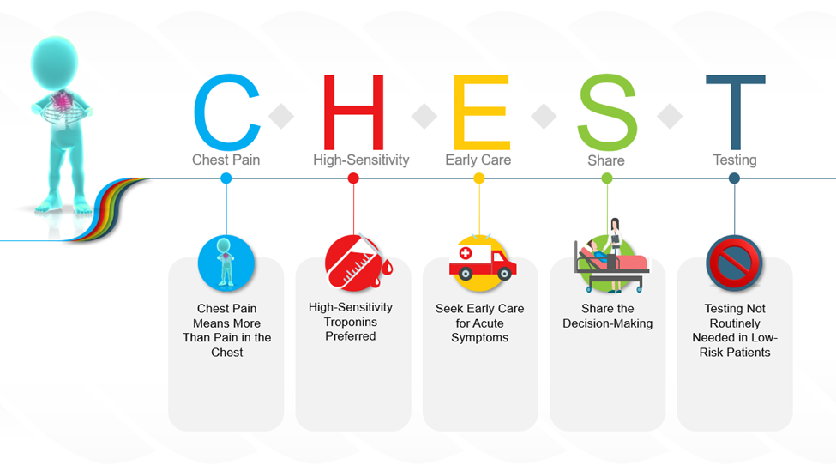
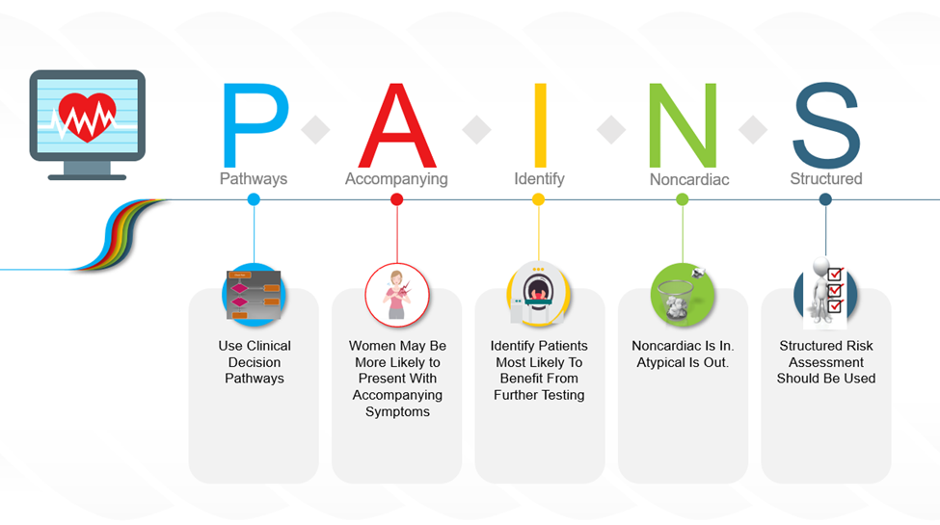
Figure 1. Take-Home Messages for the Evaluation and Diagnosis of Chest Pain

Slide 16
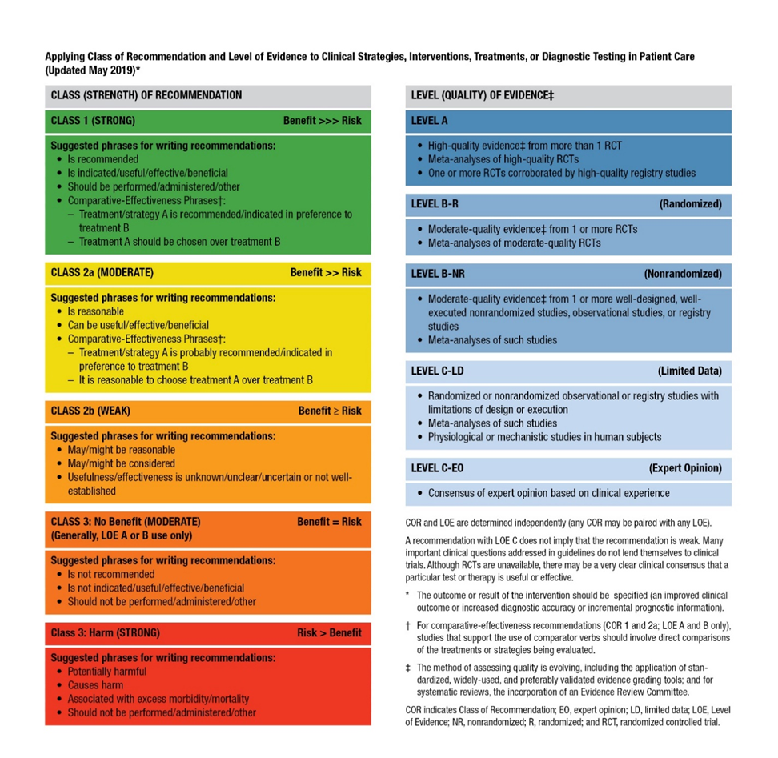
Table 1. ACC/AHA Applying Class of Recommendation and Level of Evidence to Clinical Strategies, Interventions, Treatments, or Diagnostic Testing in Patient Care (Updated May 2019)

Slide 17
Defining Chest Pain

Slide 18
Defining Chest Pain
 | Recommendations for Defining Chest Pain Referenced studies that support the recommendations are summarized in Online Data Supplements 1 and 2.
COR | LOE | Recommendations
1 | B-NR | An initial assessment of chest pain is recommended to triage patients effectively on the basis of the likelihood that symptoms may be attributable to myocardial ischemia.
1 | C-LD | Chest pain should not be described as atypical, because it is not helpful in determining the cause and can be misinterpreted as benign in nature. Instead, chest pain should be described as cardiac, possibly cardiac, or noncardiac because these terms are more specific to the potential underlying diagnosis.

Slide 19
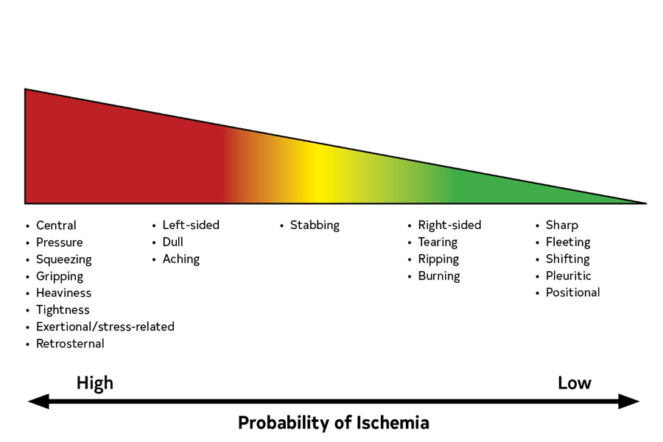
Figure 2. Index of Suspicion That Chest “Pain” Is Ischemic in Origin on the Basis of Commonly Used Descriptors.

Slide 20
Initial Evaluation

Slide 21
History
 | Recommendation for History
COR | LOE | Recommendation
1 | C-LD | In patients with chest pain, a focused history that includes characteristics and duration of symptoms relative to presentation as well as associated features, and cardiovascular risk factor assessment should be obtained.

Slide 22
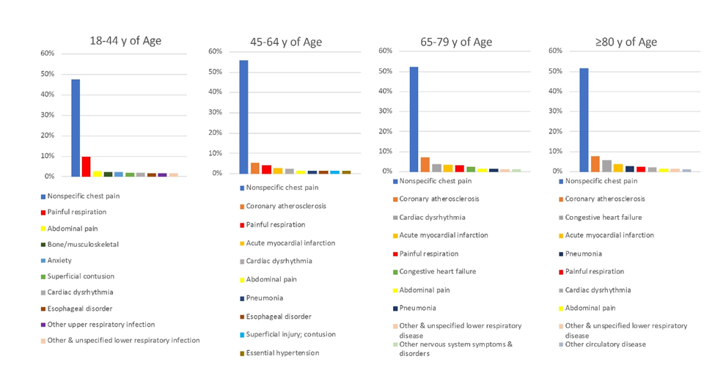
Figure 3. Top 10 Causes of Chest Pain in the ED Based on Age
(Weighted Percentage).
Created using data from Hsia RY, et al. (3).

Slide 23
Table 3. Chest Pain Characteristics and Corresponding Causes
Nature
Anginal symptoms are perceived as retrosternal chest discomfort (e.g., pain, discomfort, heaviness, tightness, pressure, constriction, squeezing) (Section 1.4.2, Defining Chest Pain).
Sharp chest pain that increases with inspiration and lying supine is unlikely related to ischemic heart disease (e.g., these symptoms usually occur with acute pericarditis).
Onset and duration
Anginal symptoms gradually build in intensity over a few minutes.
Sudden onset of ripping chest pain (with radiation to the upper or lower back) is unlikely to be anginal and is suspicious of an acute aortic syndrome.
Fleeting chest pain—of few seconds’ duration—is unlikely to be related to ischemic heart disease.
Location and radiation
Pain that can be localized to a very limited area and pain radiating to below the umbilicus or hip are unlikely related to myocardial ischemia.

Slide 24
Table 3. Chest Pain Characteristics and Corresponding Causes (con’t.)
Severity
Ripping chest pain (“worse chest pain of my life”), especially when sudden in onset and occurring in a hypertensive patient, or with a known bicuspid aortic valve or aortic dilation, is suspicious of an acute aortic syndrome (e.g., aortic dissection).
Precipitating factors
Physical exercise or emotional stress are common triggers of anginal symptoms.
Occurrence at rest or with minimal exertion associated with anginal symptoms usually indicates ACS.
Positional chest pain is usually nonischemic (e.g., musculoskeletal).
Relieving factors
Relief with nitroglycerin is not necessarily diagnostic of myocardial ischemia and should not be used as a diagnostic criterion.
Associated symptoms
Common symptoms associated with myocardial ischemia include, but are not limited to, dyspnea, palpitations, diaphoresis, lightheadedness, presyncope or syncope, upper abdominal pain, or heartburn unrelated to meals and nausea or vomiting.
Symptoms on the left or right side of the chest, stabbing, sharp pain, or discomfort in the throat or abdomen may occur in patients with diabetes, women, and elderly patients.
ACS indicates acute coronary syndrome.

Slide 25
A Focus on the Uniqueness of Chest Pain in Women
 | Recommendations for a Focus on the Uniqueness of Chest Pain in Women Referenced studies that support the recommendations are summarized in Online Data Supplements 3 and 4.
COR | LOE | Recommendations
1 | B-NR | Women who present with chest pain are at risk for underdiagnosis, and potential cardiac causes should always be considered.
1 | B-NR | In women presenting with chest pain, it is recommended to obtain a history that emphasizes accompanying symptoms that are more common in women with ACS.

Slide 26
Considerations for Older Patients With Chest Pain
 | Recommendation for Considerations for Older Patients With Chest Pain
COR | LOE | Recommendation
1 | C-LD | In patients with chest pain who are >75 years of age, ACS should be considered when accompanying symptoms such as shortness of breath, syncope, or acute delirium are present, or when an unexplained fall has occurred.

Slide 27
Considerations for Diverse Patient Populations With Chest Pain
 | Recommendations for Considerations for Diverse Patient Populations With Chest Pain
COR | LOE | Recommendations
1 | C-LD | Cultural competency training is recommended to help achieve the best outcomes in patients of diverse racial and ethnic backgrounds who present with chest pain.
1 | C-LD | Among patients of diverse race and ethnicity presenting with chest pain in whom English may not be their primary language, addressing language barriers with the use of formal translation services is recommended.

Slide 28
Patient-Centric Considerations
 | Recommendation for Patient-Centric Considerations
COR | LOE | Recommendation
1 | C-LD | In patients with acute chest pain, it is recommended that 9-1-1 be activated by patients or bystanders to initiate transport to the closest ED by emergency medical services (EMS).

Slide 29
Physical Examination
 | Recommendation for Physical Examination
COR | LOE | Recommendation
1 | C-EO | In patients presenting with chest pain, a focused cardiovascular examination should be performed initially to aid in the diagnosis of ACS or other potentially serious causes of chest pain (e.g., aortic dissection, PE, or esophageal rupture) and to identify complications.

Slide 30
Clinical Syndrome | Findings
Emergency
ACS | Diaphoresis, tachypnea, tachycardia, hypotension, crackles, S3, MR murmur; examination may be normal in uncomplicated cases
PE | Tachycardia + dyspnea—>90% of patients; pain with inspiration
Aortic dissection | Connective tissue disorders (e.g., Marfan syndrome), extremity pulse differential (30% of patients, type A>B) Severe pain, abrupt onset + pulse differential + widened mediastinum on CXR >80% probability of dissection Frequency of syncope >10% (8), AR 40%–75% (type A)
Esophageal rupture | Emesis, subcutaneous emphysema, pneumothorax (20% patients), unilateral decreased or absent breath sounds
Table 4. Physical Examination in Patients With Chest Pain
ACS indicates acute coronary syndrome; AR, aortic regurgitation; AS, aortic stenosis; CXR, chest x-ray; LR, likelihood ratio; HCM, hypertrophic cardiomyopathy; MR, mitral regurgitation; PE, pulmonary embolism; and PUD, peptic ulcer disease.

Slide 31
Other
Noncoronary cardiac: AS, AR, HCM | AS: Characteristic systolic murmur, tardus or parvus carotid pulse AR: Diastolic murmur at right of sternum, rapid carotid upstroke HCM: Increased or displaced left ventricular impulse, prominent a wave in jugular venous pressure, systolic murmur
Pericarditis Myocarditis | Fever, pleuritic chest pain, increased in supine position, friction rub Fever, chest pain, heart failure, S3
Esophagitis, peptic ulcer disease, gall bladder disease | Epigastric tenderness Right upper quadrant tenderness, Murphy sign
Pneumonia | Fever, localized chest pain, may be pleuritic, friction rub may be present, regional dullness to percussion, egophony
Pneumothorax | Dyspnea and pain on inspiration, unilateral absence of breath sounds
Costochondritis, Tietze syndrome | Tenderness of costochondral joints
Herpes zoster | Pain in dermatomal distribution, triggered by touch; characteristic rash (unilateral and dermatomal distribution)
Table 4. Physical Examination in Patients With Chest Pain (con’t.)
ACS indicates acute coronary syndrome; AR, aortic regurgitation; AS, aortic stenosis; CXR, chest x-ray; LR, likelihood ratio; HCM, hypertrophic cardiomyopathy; MR, mitral regurgitation; PE, pulmonary embolism; and PUD, peptic ulcer disease.

Slide 32
Setting Considerations
Recommendations for Setting Considerations Referenced studies that support the recommendations are summarized in Online Data Supplement 5.
COR | LOE | Recommendations
1 | B-NR | Unless a noncardiac cause is evident, an ECG should be performed for patients seen in the office setting with stable chest pain; if an ECG is unavailable the patient should be referred to the ED so one can be obtained.
1 | C-LD | Patients with clinical evidence of ACS or other life-threatening causes of acute chest pain seen in the office setting should be transported urgently to the ED, ideally by EMS.

Slide 33
Setting Considerations (con’t.)
1 | C-LD | In all patients who present with acute chest pain regardless of the setting, an ECG should be acquired and reviewed for STEMI within 10 minutes of arrival.
1 | C-LD | In all patients presenting to the ED with acute chest pain and suspected ACS, cTn should be measured as soon as possible after presentation.
3: Harm | C-LD | For patients with acute chest pain and suspected ACS initially evaluated in the office setting, delayed transfer to the ED for cTn or other diagnostic testing should be avoided.

Slide 34
Electrocardiogram
Recommendations for Electrocardiogram (ECG) Referenced studies that support the recommendations are summarized in Online Data Supplement 6.
COR | LOE | Recommendations
1 | C-EO | In patients with chest pain in which an initial ECG is nondiagnostic, serial ECGs to detect potential ischemic changes should be performed, especially when clinical suspicion of ACS is high, symptoms are persistent, or the clinical condition deteriorates.
1 | C-EO | Patients with chest pain in whom the initial ECG is consistent with an ACS should be treated according to STEMI and NSTE-ACS guidelines.
2a | B-NR | In patients with chest pain and intermediate-to-high clinical suspicion for ACS in whom the initial ECG is nondiagnostic, supplemental electrocardiographic leads V7 to V9 are reasonable to rule out posterior MI.

Slide 35
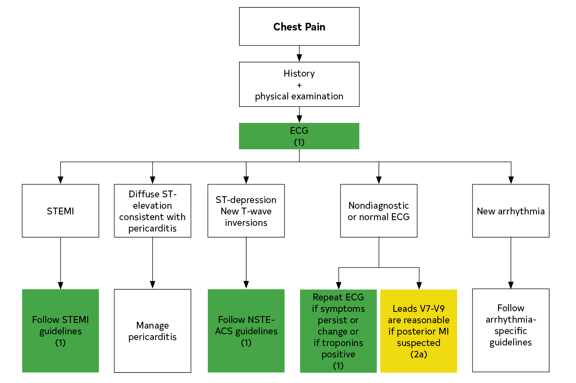
Figure 4. Electrocardiographic-Directed Management of Chest Pain.
ECG indicates electrocardiogram; NSTE-ACS, non–ST-segment–elevation acute coronary syndrome; MI, myocardial infarction; and STEMI, ST-segment elevation myocardial infarction.
Colors correspond to the Class of Recommendation in Table 1.

Slide 36
Chest Radiography
 | Recommendation for Chest Radiography
COR | LOE | Recommendation
1 | C-EO | In patients presenting with acute chest pain, a chest radiograph is useful to evaluate for other potential cardiac, pulmonary, and thoracic causes of symptoms.

Slide 37
Biomarkers
 | Recommendations for Biomarkers Referenced studies that support the recommendations are summarized in Online Data Supplement 7.
COR | LOE | Recommendations
1 | B-NR | In patients presenting with acute chest pain, serial cTn I or T levels are useful to identify abnormal values and a rising or falling pattern indicative of acute myocardial injury (1-21).
1 | B-NR | In patients presenting with acute chest pain, high-sensitivity cTn is the preferred biomarker because it enables more rapid detection or exclusion of myocardial injury and increases diagnostic accuracy (17, 21-25).

Slide 38
Biomarkers (con’t.)
1 | C-EO | Clinicians should be familiar with the analytical performance and the 99th percentile upper reference limit that defines myocardial injury for the cTn assay used at their institution.
3: No benefit | B-NR | With availability of cTn, creatine kinase myocardial (CK-MB) isoenzyme and myoglobin are not useful for diagnosis of acute myocardial injury.

Slide 39
Cardiac Testing General Considerations

Slide 40
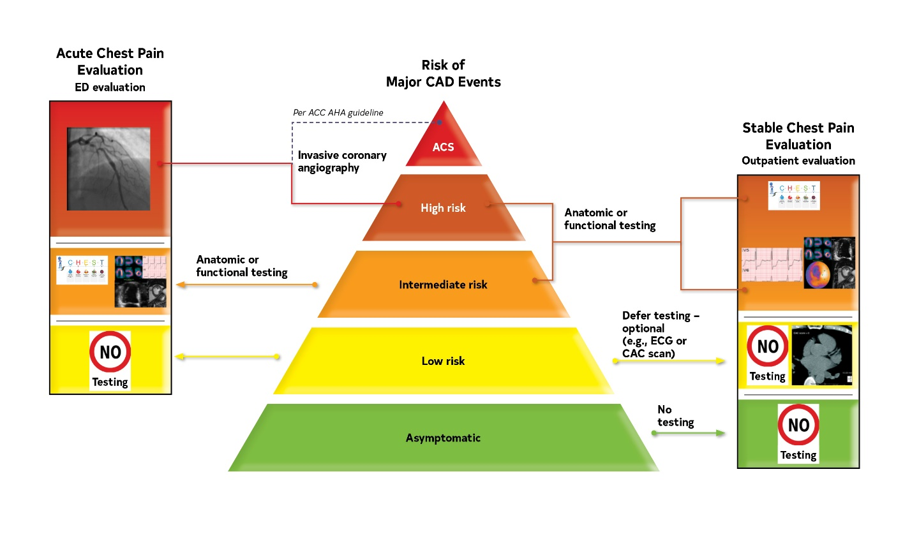
Figure 5. Chest Pain and Cardiac Testing Considerations.
The choice of imaging depends on the clinical question of importance, to either a) ascertain the diagnosis of CAD and define coronary anatomy or b) assess ischemia severity among patients with an expected higher likelihood of ischemia with an abnormal resting ECG or those incapable of performing maximal exercise.
ACS indicates acute coronary syndrome; CAC, coronary artery calcium; CAD, coronary artery disease; and ECG, electrocardiogram.
Please refer to Section 4.1.
For risk assessment in acute chest pain: See Figure 9.
For risk assessment in stable chest pain: See Figure 11.

Slide 41
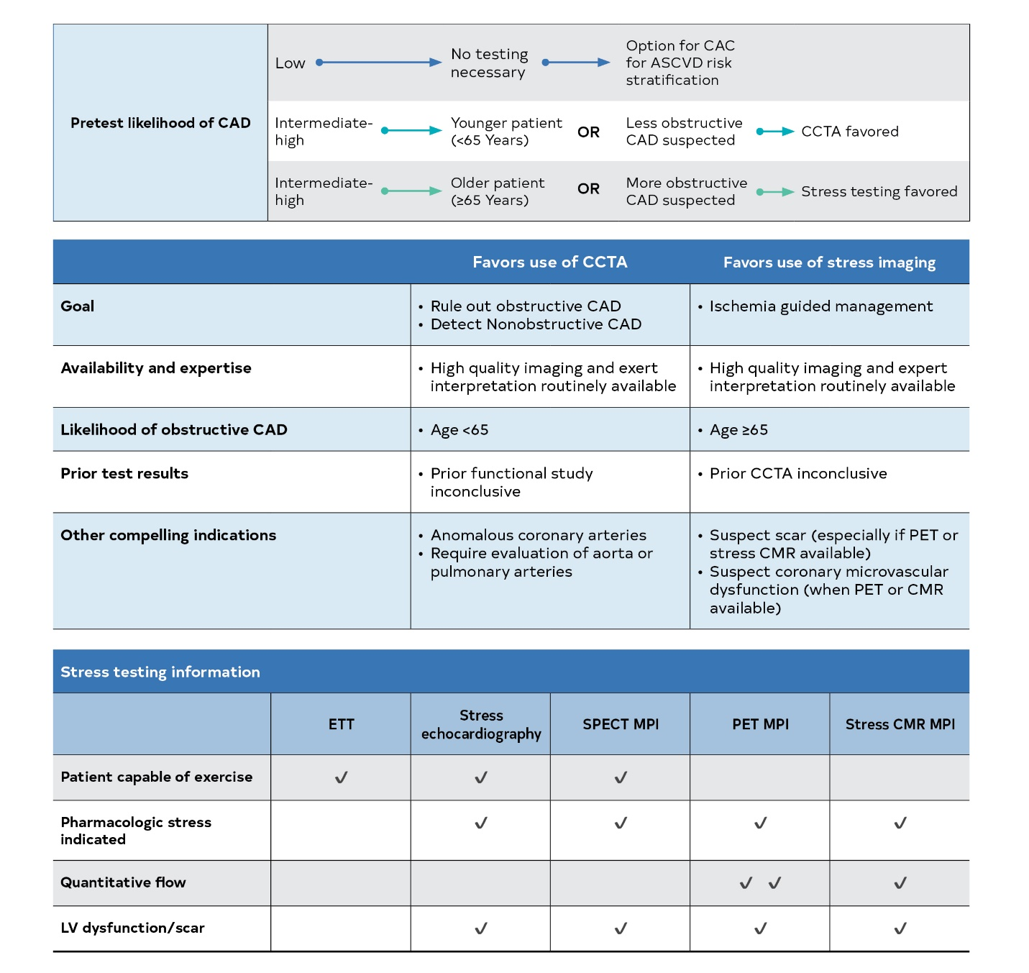
Figure 6. Choosing the Right Diagnostic Test.
ASCVD indicates atherosclerotic cardiovascular disease; CAD, coronary artery disease; CAC, coronary artery calcium; CCTA, coronary computed tomography angiography; CMR, cardiovascular magnetic resonance; LV, left ventricular; MPI, myocardial perfusion imaging; and PET, positron emission tomography.

Slide 42
Table 5. Contraindication by Type of Imaging Modality and Stress Protocol
Exercise ECG | Stress Nuclear (1)* | Stress Echocardiography (2-4) | Stress CMR (5) | CCTA (6)*
Abnormal ST changes on resting ECG, digoxin, left bundle branch block, Wolff-Parkinson-White pattern, ventricular paced rhythm (unless test is performed to establish exercise capacity and not for diagnosis of ischemia) Unable to achieve ≥5 METs or unsafe to exercise High-risk unstable angina or AMI (<2 d) i.e., active ACS Uncontrolled heart failure Significant cardiac arrhythmias (e.g., VT, complete atrioventricular block) or high risk for arrhythmias caused by QT prolongation Severe symptomatic aortic stenosis Severe systemic arterial hypertension (e.g., ≥200/110 mm Hg) Acute illness (e.g., acute PE, acute myocarditis/pericarditis, acute aortic dissection) | High-risk unstable angina, complicated ACS or AMI (<2 d) Contraindications to vasodilator administration Significant arrhythmias (e.g., VT, second- or third-degree atrioventricular block) or sinus bradycardia <45 bpm Significant hypotension (SBP <90 mm Hg) Known or suspected bronchoconstrictive or bronchospastic disease Recent use of dipyridamole or dipyridamole-containing medications Use of methylxanthines (e.g., aminophylline, caffeine) within 12 hours Known hypersensitivity to adenosine, regadenoson Severe systemic arterial hypertension (e.g., ≥200/110 mm Hg) | Limited acoustic windows (e.g., in COPD patients) Inability to reach target heart rate Uncontrolled heart failure High-risk unstable angina, active ACS or AMI (<2 d) Serious ventricular arrhythmia or high risk for arrhythmias attributable to QT prolongation Respiratory failure Severe COPD, acute pulmonary emboli, severe pulmonary hypertension Contraindications to dobutamine (if pharmacologic stress test needed) Aatrioventricular block, uncontrolled atrial fibrillation Critical aortic stenosis† Acute illness (e.g., acute PE, acute myocarditis/pericarditis, acute aortic dissection) Hemodynamically significant LV outflow tract obstruction Contraindications to atropine use: Narrow-angle glaucoma Myasthenia gravis Obstructive uropathy Obstructive gastrointestinal disorders Severe systemic arterial hypertension (e.g., ≥200/110 mm Hg) Use of Contrast Contraindicated in: Hypersensitivity to perflutren Hypersensitivity to blood, blood products, or albumin (for Optison only) | Reduced GFR (<30 mL/min/1.73 m²) Contraindications to vasodilator administration Implanted devices not safe for CMR or producing artifact limiting scan quality/interpretation Significant claustrophobia Caffeine use within last 12 h | Allergy to iodinated contrast Inability to cooperate with scan acquisition and/or breath-hold instructions; Clinical instability (e.g., acute respiratory distress, , severe hypotension, unstable arrhythmia); Renal impairment as defined by local protocols Contraindication to beta blockade in the presence of an elevated heart rate and no alternative medications available for achieving target heart rate; Heart rate variability and arrhythmia; Contraindication to nitroglycerin (if indicated)
For all the imaging modalities, inability to achieve high-quality images should be considered, in particular for obese patients

Slide 43
Table 5. Contraindication by Type of Imaging Modality and Stress Protocol (cont..)
ACS indicates acute coronary syndrome; AMI, acute myocardial infarction; AS, aortic stenosis; CCTA, cardiac computed tomography angiography; CMR, cardiovascular magnetic resonance imaging; COPD, chronic obstructive pulmonary disease; GFR, glomerular filtration rate; LV, left ventricular; MET, metabolic equivalent; MRI, magnetic resonance imaging; PE, pulmonary embolism; SBP, systolic blood pressure; and VT, ventricular tachycardia.
Readers should also review each imaging society’s guidelines for more details on test contraindications.
*Screening for potential pregnancy by history and/or pregnancy testing should be performed according to the local imaging facilities policies for undertaking radiological examinations that involve ionizing radiation in women of child-bearing age.
†Low-dose dobutamine may be useful for assessing for low-gradient AS.

Slide 44
Choosing the Right Pathway With Patient-Centric Algorithms for Acute Chest Pain

Slide 45
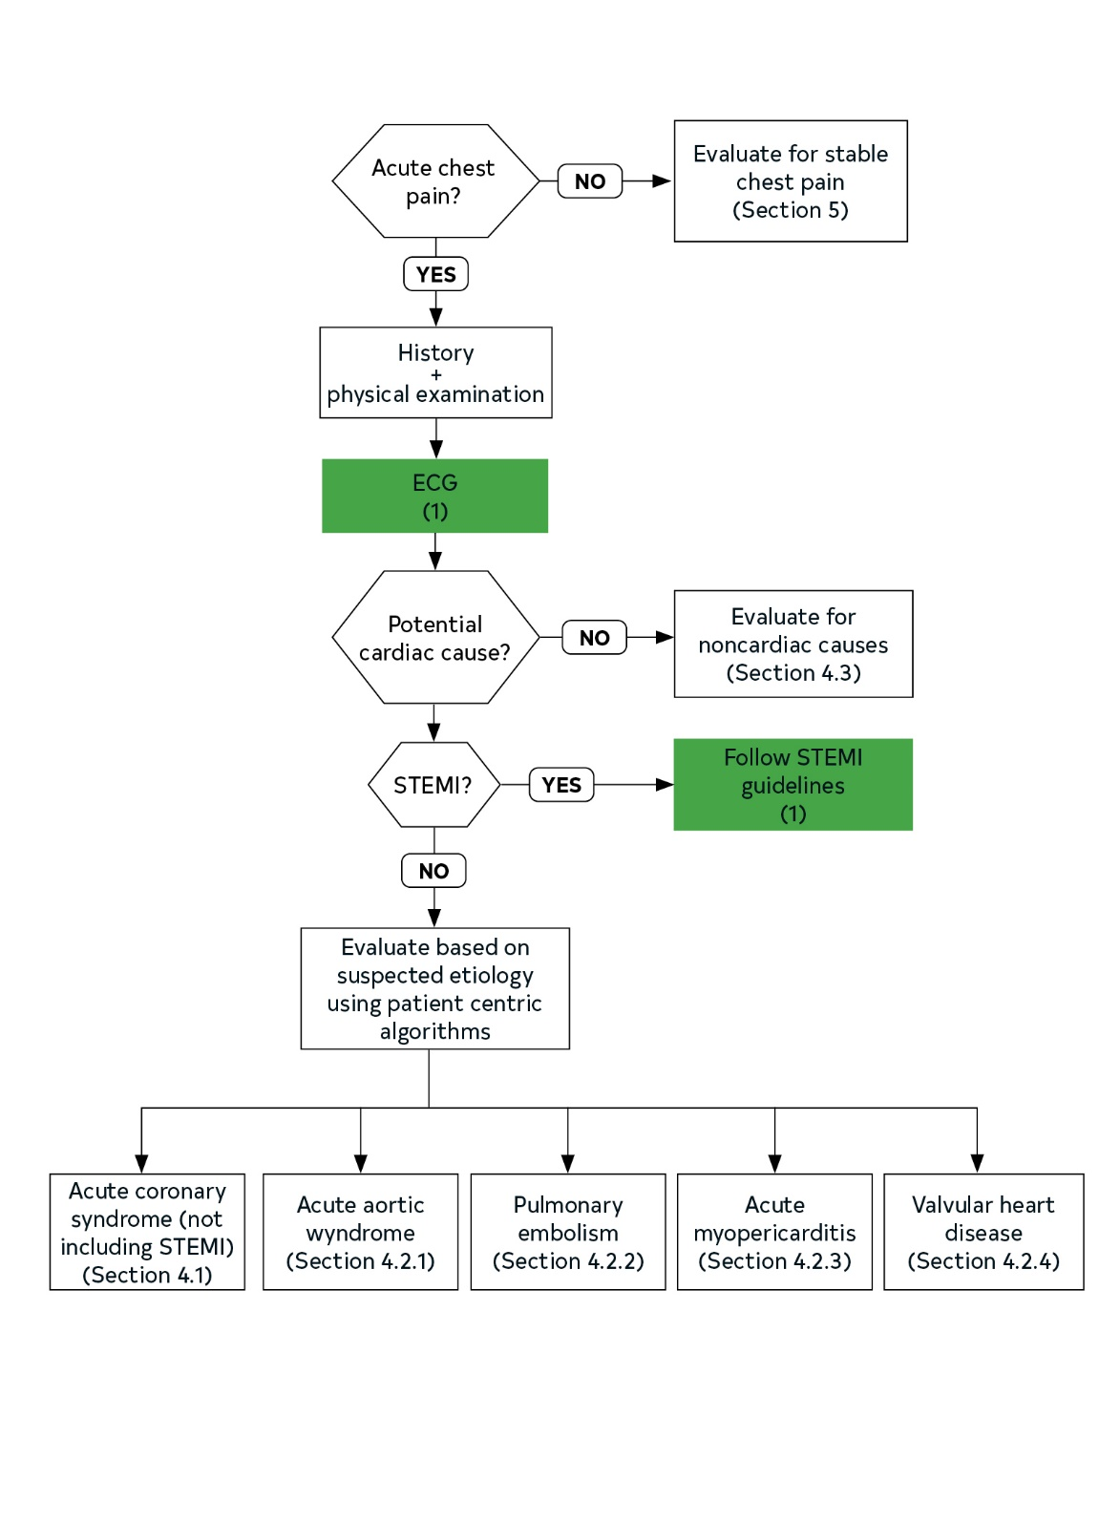
Figure 7. Patient-Centric Algorithms for Acute Chest Pain.
Colors correspond to the Class of Recommendation in Table 1.
ECG indicates electrocardiogram; and STEMI, ST-segment–elevation myocardial infarction.

Slide 46
Patients With Acute Chest Pain and Suspected ACS (Not Including STEMI)
Recommendations for Patients With Acute Chest Pain and Suspected ACS (Not Including STEMI) Referenced studies that support the recommendations are summarized in Online Data Supplements 8 and 9.
COR | LOE | Recommendations
1 | B-NR | In patients presenting with acute chest pain and suspected ACS, clinical decision pathways (CDPs) should categorize patients into low-, intermediate-, and high-risk strata to facilitate disposition and subsequent diagnostic evaluation.
1 | B-NR | In the evaluation of patients presenting with acute chest pain and suspected ACS for whom serial troponins are indicated to exclude myocardial injury, recommended time intervals after the initial troponin sample collection (time zero) for repeat measurements are: 1 to 3 hours for high-sensitivity troponin and 3 to 6 hours for conventional troponin assays.

Slide 47
Patients With Acute Chest Pain and Suspected ACS (Not Including STEMI) (cont..)
1 | C-LD | To standardize the detection and differentiation of myocardial injury in patients presenting with acute chest pain and suspected ACS, institutions should implement a CDP that includes a protocol for troponin sampling based on their particular assay.
1 | C-LD | In patients with acute chest pain and suspected ACS, previous testing when available should be considered and incorporated into CDPs.
2a | B-NR | For patients with acute chest pain, a normal ECG, and symptoms suggestive of ACS that began at least 3 hours before ED arrival, a single hs-cTn concentration that is below the limit of detection on initial measurement (time zero) is reasonable to exclude myocardial injury.

Slide 48
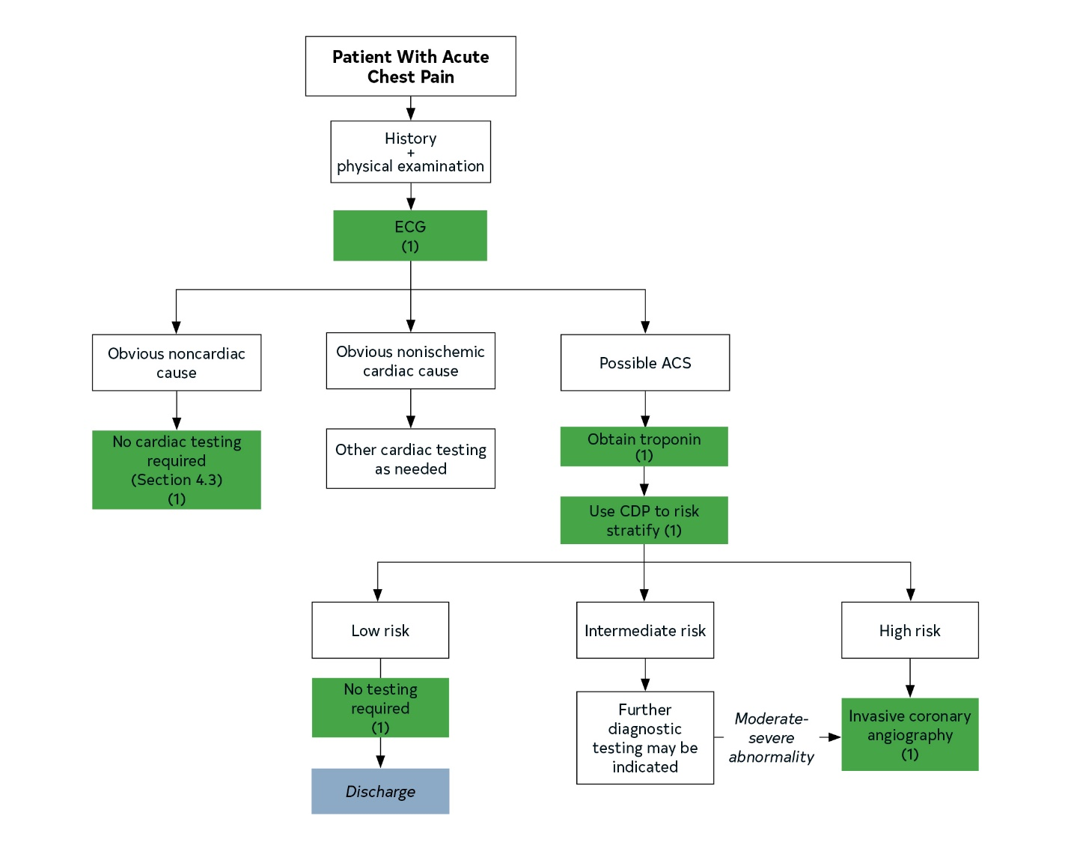
Figure 8. General Approach to Risk Stratification of Patients With Suspected ACS.
Colors correspond to the Class of Recommendation in Table 1.
ACS indicates acute coronary syndrome; CDP, clinical decision pathway; and ECG, electrocardiogram

Slide 49
Table 6. Sample Clinical Decision Pathways Used to Define Risk
 | HEART Pathway | EDACS | ADAPT (mADAPT) | NOTR | 2020 ESC/ hs-cTn* | 2016 ESC/GRACE
Target population | Suspected ACS | Suspected ACS, CP >5 min, planned serial troponin | Suspected ACS, CP >5 min, planned observation | Suspected ACS, ECG, troponin ordered | Suspected ACS, stable | Suspected ACS, planned serial troponin
Target outcome | ↑ ED discharge without increasing missed 30-d or 1-y MACE | ↑ ED discharge rate without increasing missed 30-d MACE | ↑ ED discharge rate without increasing missed 30-d MACE | ↑ Low-risk classification without increasing missed 30-d MACE | Early detection of AMI; 30-d MACE | Early detection of AMI
Patients with primary outcome in study population, % | 6–22 | 12 | 15 | 5–8 | 9.8 | 10–17

Slide 50
Table 6. Sample Clinical Decision Pathways Used to Define Risk (cont..)
Troponin | cTn, hs-cTn | hs-cTn | cTn, hs-cTn | cTn, hs-cTn | hs-cTn | cTn, hs-cTn
Variables used | History ECG Age Risk factors Troponin (0, 3 h) | Age Sex Risk factors History Troponin (0, 2 h) | TIMI score 0-1 No ischemic ECG changes Troponin (0, 2 h) | Age Risk factors Previous AMI or CAD Troponin (0, 2 h) | History ECG hs-cTn (0, 1 or 2 h) | Age HR, SBP Serum Cr Cardiac arrest ECG Cardiac biomarker Killip class
Risk thresholds:
Low risk | HEART score <3 Neg 0, 3-h cTn Neg 0, 2-h hs-cTn | EDACS score <16 Neg 0, 2 h hs-cTn No ischemic ECG ∆ | TIMI score 0 (or <1 for mADAPT) • Neg 0, 2-h cTn or hs-cTn • No ischemic ECG ∆ | Age <50 y <3 risk factors Previous AMI or CAD Neg cTn or hs-cTn (0, 2 h) | • Initial hs-cTn is “very low” and Sx onset >3 h ago -or- • Initial hs-cTn “low” and 1- or 2-h hs-cTn ∆ is “low” | Chest pain free, GRACE <140 • Sx <6 h - hs-cTn <ULN (0, 3 h) • Sx >6 h - hs-cTn <ULN (arrival)

Slide 51
Table 6. Sample Clinical Decision Pathways Used to Define Risk (cont..)
Intermediate risk | HEART score 4-6 | N.A. | TIMI score 2-4 | N.A. | • Initial hs-cTn is between “low” and “high” -and/or- • 1- or 2-h hs-cTn ∆ is between low and high thresholds | • T0 hs-cTn = 12–52 ng/L or • 1-h ∆ = 3–5 ng/L
High risk | HEART score 7-10 | N.A. | TIMI score 5-7 | N.A. | • Initial hs-cTn is “high” -or- • 1- or 2-h hs-cTn ∆ is high | • T0 hs-cTn >52 ng/L or • ∆ 1 h >5 ng/L

Slide 52
Table 6. Sample Clinical Decision Pathways Used to Define Risk (con’t.)
Performance | ↑ ED discharges by 21% (40% versus 18%) ↓ 30-d objective testing by 12% (69% versus 57%) ↓ length of stay by 12 h (9.9 versus 21.9 h) | More patients identified as low risk versus ADAPT (42% versus 31%) | ADAPT: More discharged ≤6 h (19% versus 11%) | 30-d MACE sensitivity =100% 28% eligible for ED discharge | AMI sensitivity >99% 62% Ruled out (0.2% 30-d MACE) 25% Observe 13% Rule in | AMI sensitivity >99% 30-d MACE not studied
AMI sensitivity, % | 100 | 100 | 100 | 100 | >99 | 96.7
cTn accuracy: 30-d MACE sensitivity, % | 100 | 100 | 100 | 100 | N.A. | N.A.
hs-cTn accuracy: 30-d MACE sensitivity, % | 95 | 92 | 93 | 99 | 99 | --
ED discharge, % | 40 | 49 | 19 (ADAPT) 39 (mADAPT) | 28 | -- | --

Slide 53
Table 6. Sample Clinical Decision Pathways Used to Define Risk (con’t.)
*The terms “very low,” “low,” “high,” “1 h ∆,” and “2 h ∆” refer to hs-cTn assay-specific thresholds published in the ESC guideline (46, 47).
ACS indicates acute coronary syndrome; ADAPT, Accelerated Diagnostic protocol to Assess chest Pain using Troponins; AMI, acute myocardial infarction; CP, chest pain or equivalent; Cr, creatinine; cTn, cardiac troponin; hs-cTn, high-sensitivity cardiac troponin; ECG, electrocardiogram; ED, emergency department; EDACS, emergency department ACS; ESC, European Society of Cardiology; GRACE, Global Registry of Acute Coronary Events; HEART, history, ECG, age, risk factors, troponin; HR, heart rate; hs, high sensitivity; MACE, major adverse cardiac events; mADAPT, modified (including TIMI scores of 1) ADAPT; N.A., not applicable; neg, negative; NICE, National Institute for Health and Clinical Excellence; NOTR, No Objective Testing Rule; SBP, systolic blood pressure; SSACS, symptoms suggestive of ACS; Sx, symptoms; and ULN, upper limit of normal.

Slide 54
Table 7. Warranty Period for Prior Cardiac Testing
Test Modality | Result | Warranty Period
Anatomic | Normal coronary angiogram CCTA with no stenosis or plaque | 2 y
Stress testing | Normal stress test (given adequate stress) | 1 y
CCTA indicates coronary computed tomographic angiography.

Slide 55
Low-Risk Patients With Acute Chest Pain
 | Recommendations for Low-Risk Patients With Acute Chest Pain Referenced studies that support the recommendations are summarized in Online Data Supplements 10 and 11.
COR | LOE | Recommendations
1 | B-NR | Patients with acute chest pain and a 30-day risk of death or MACE <1% should be designated as low risk.
2a | B-R | In patients with acute chest pain and suspected ACS who are deemed low-risk (<1% 30-day risk of death or MACE), it is reasonable to discharge home without admission or urgent cardiac testing.

Slide 56
Table 8. Definition Used for Low-Risk Patients With Chest Pain
 | Low Risk (<1% 30-d Risk for Death or MACE)
hs-cTn Based
T-0 | T-0 hs-cTn below the assay limit of detection or “very low” threshold if symptoms present for at least 3 h
T-0 and 1- or 2-h Delta | T-0 hs-cTn and 1- or 2-h delta are both below the assay “low” thresholds (>99% NPV for 30-d MACE)
Clinical Decision Pathway Based
HEART Pathway | HEART score <3, initial and serial cTn/hs-cTn < assay 99th percentile
EDACS | EDACS score <16; initial and serial cTn/hs-cTn < assay 99th percentile
ADAPT | TIMI score 0, initial and serial cTn/hs-cTn < assay 99th percentile
mADAPT | TIMI score 0/1, initial and serial cTn/hs-cTn < assay 99th percentile
NOTR | 0 factors

Slide 57
Table 8. Definition Used for Low-Risk Patients With Chest Pain (con’t.)
ADAPT indicates 2-hour Accelerated Diagnostic Protocol to Access Patients with Chest Pain Symptoms Using Contemporary Troponins as the Only Biomarkers; cTn, cardiac troponin; EDACS, Emergency Department Acute Coronary Syndrome; HEART Pathway, History, ECG, Age, Risk Factors, Troponin; hs-cTn, high-sensitivity cardiac troponin; MACE, major adverse cardiac events; mADAPT, modified 2-hour Accelerated Diagnostic Protocol to Access Patients with Chest Pain Symptoms Using Contemporary Troponins as the Only Biomarkers; NOTR, No Objective Testing Rule; NPV, negative predictive value; and TIMI, Thrombolysis in Myocardial Infarction.

Slide 58
Intermediate-Risk Patients With Acute Chest Pain
 | Recommendations for Intermediate-Risk Patients With Acute Chest Pain Referenced studies that support the recommendations are summarized in Online Data Supplements 12 and 13.
COR | LOE | Recommendations
1 | C-EO | For intermediate-risk patients with acute chest pain, TTE is recommended as a rapid, bedside test to establish baseline ventricular and valvular function, evaluate for wall motion abnormalities, and to assess for pericardial effusion.
2a | A | For intermediate-risk patients with acute chest pain, management in an observation unit is reasonable to shorten length of stay and lower cost relative to an inpatient admission.

Slide 59
Intermediate-Risk Patients With Acute
Chest Pain and No Known CAD
 | Recommendations for Intermediate-Risk Patients With No Known CAD Referenced studies that support the recommendations are summarized in Online Data Supplements 14 and 15.
COR | LOE |  | Recommendations
Anatomic Testing
1 |  | A |  | For intermediate-risk patients with acute chest pain and no known CAD eligible for diagnostic testing after a negative or inconclusive evaluation for ACS, CCTA is useful for exclusion of atherosclerotic plaque and obstructive CAD.
1 |  | C-EO |  | For intermediate-risk patients with acute chest pain, moderate-severe ischemia on current or prior (≤1 year) stress testing, and no known CAD established by prior anatomic testing, ICA is recommended.
2a |  | C-LD |  | For intermediate-risk patients with acute chest pain with evidence of previous mildly abnormal stress test results (≤1 year), CCTA is reasonable for diagnosing obstructive CAD.

Slide 60
Intermediate-Risk Patients With Acute
Chest Pain and No Known CAD (con’t.)
Stress Testing
1 | B-NR | For intermediate-risk patients with acute chest pain and no known CAD who are eligible for cardiac testing, either exercise ECG, stress echocardiography, stress PET/SPECT MPI, or stress CMR is useful for the diagnosis of myocardial ischemia.

Slide 61
Intermediate-Risk Patients With Acute
Chest Pain and No Known CAD (con’t.)
Sequential or Add-on Diagnostic Testing
2a | B-NR | For intermediate-risk patients with acute chest pain and no known CAD, with a coronary artery stenosis of 40% to 90% in a proximal or middle coronary artery on CCTA, FFR-CT can be useful for the diagnosis of vessel-specific ischemia and to guide decision-making regarding the use of coronary revascularization.
2a | C-EO | For intermediate-risk patients with acute chest pain and no known CAD, as well as an inconclusive prior stress test, CCTA can be useful for excluding the presence of atherosclerotic plaque and obstructive CAD.
2a | C-EO | For intermediate-risk patients with acute chest pain and no known CAD, with an inconclusive CCTA, stress imaging (with echocardiography, PET/SPECT MPI, or CMR) can be useful for the diagnosis of myocardial ischemia.

Slide 62
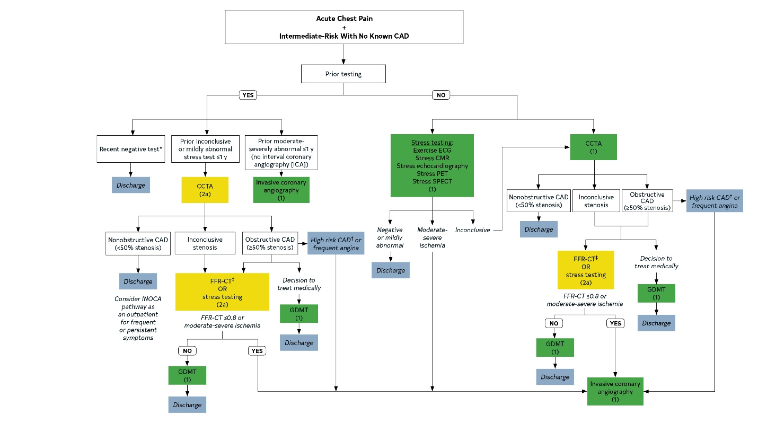
Figure 9. Evaluation Algorithm for Patients With Suspected ACS at Intermediate Risk With No Known CAD.
Colors correspond to the Class of Recommendation in Table 1.

Slide 63
Figure 9. Evaluation Algorithm for Patients With Suspected ACS at Intermediate Risk With No Known CAD.
Test choice should be guided by local availability and expertise.
*Recent negative test: normal CCTA ≤2 years (no plaque/no stenosis) OR negative stress test ≤1 year, given adequate stress.
†High-risk CAD means left main stenosis ≥ 50%; anatomically significant 3-vessel disease (≥70% stenosis).
‡For FFR-CT, turnaround times may impact prompt clinical care decisions. However, the use of FFR-CT does not require additional testing, as would be the case when adding stress testing.
CAD indicates coronary artery disease; CCTA, coronary CT angiography; CMR, cardiovascular magnetic resonance imaging; FFR-CT, fractional flow reserve with CT; GDMT, guideline-directed management and therapy; ICA, invasive coronary angiography; INOCA, ischemia and no obstructive coronary artery disease; PET, positron emission tomography; and SPECT, single-photon emission computed tomography.

Slide 64
Intermediate-Risk Patients With Acute
Chest Pain and Known CAD
 | Recommendations for Intermediate-Risk Patients With Acute Chest Pain and Known CAD Referenced studies that support the recommendations are summarized in Online Data Supplements 16 and 17.
COR | LOE | Recommendations
1 | A | For intermediate-risk patients with acute chest pain who have known CAD and present with new onset or worsening symptoms, GDMT should be optimized before additional cardiac testing is performed.

Slide 65
Intermediate-Risk Patients With Acute
Chest Pain and Known CAD (con’t.)
1 | A | For intermediate-risk patients with acute chest pain who have worsening frequency of symptoms with significant left main, proximal left anterior descending stenosis, or multivessel CAD on prior anatomic testing or history of prior coronary revascularization, ICA is recommended.
2a | B-NR | For intermediate-risk patients with acute chest pain and known nonobstructive CAD, CCTA can be useful to determine progression of atherosclerotic plaque and obstructive CAD .

Slide 66
Intermediate-Risk Patients With Acute
Chest Pain and Known CAD (con’t.)
2a | B-NR | For intermediate-risk patients with acute chest pain and coronary artery stenosis of 40% to 90% in a proximal or middle segment on CCTA, FFR-CT is reasonable for diagnosis of vessel-specific ischemia and to guide decision-making regarding the use of coronary revascularization.
2a | B-NR | For intermediate-risk patients with acute chest pain and known CAD who have new onset or worsening symptoms, stress imaging (PET/SPECT MPI, CMR, or stress echocardiography) is reasonable.

Slide 67
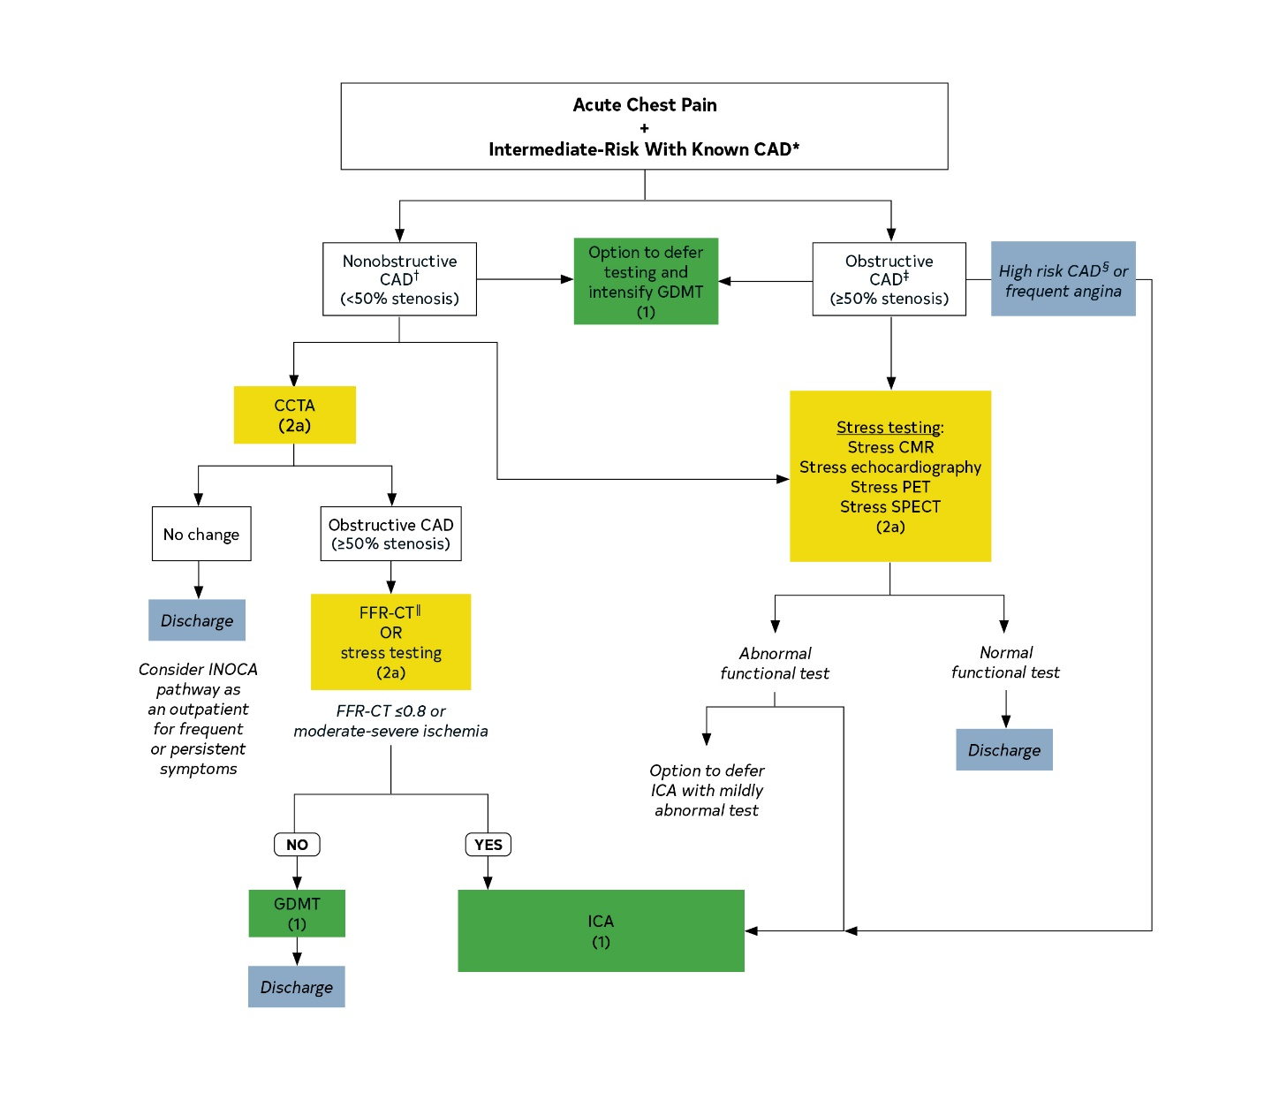
Figure 10. Evaluation Algorithm for Patients With Suspected ACS at Intermediate Risk With Known CAD.
Colors correspond to the Class of Recommendation in Table 1.

Slide 68
Figure 10. Evaluation Algorithm for Patients With Suspected ACS at Intermediate Risk With Known CAD (con’t).
Test choice should be guided by local availability and expertise.
*Known CAD is prior MI, revascularization, known obstructive or nonobstructive CAD on invasive or CCTA.
†If extensive plaque is present a high-quality CCTA is unlikely to be achieved, and stress testing is preferred
‡Obstructive CAD includes prior coronary artery bypass graft/percutaneous coronary intervention.
§High-risk CAD means left main stenosis ≥ 50%; anatomically significant 3-vessel disease (≥70% stenosis).
║FFR-CT turnaround times may impact prompt clinical care decisions.
CAD indicates coronary artery disease; CCTA, coronary CT angiography; CMR, cardiovascular magnetic resonance imaging; CT, computed tomography; FFR-CT, fractional flow reserve with CT; GDMT, guideline-directed management and therapy; ICA, invasive coronary angiography; INOCA, ischemia and no obstructive coronary artery disease; PET, positron emission tomography; and SPECT, single-photon emission CT.

Slide 69
High-Risk Patients With Acute Chest Pain
 | Recommendations for High-Risk Patients With Acute Chest Pain Referenced studies that support the recommendations are summarized in Online Data Supplements 18 and 19.
COR | LOE | Recommendations
Recommendations for High-Risk Patients, Including Those With High-Risk Findings on CCTA or Stress Testing
1 | B-NR | For patients with acute chest pain and suspected ACS who have new ischemic changes on electrocardiography, troponin-confirmed acute myocardial injury, new-onset left ventricular systolic dysfunction (ejection fraction <40%), newly diagnosed moderate-severe ischemia on stress testing, hemodynamic instability, and/or a high clinical decision pathway (CDP) risk score should be designated as high risk for short-term MACE.

Slide 70
High-Risk Patients With Acute
Chest Pain (con’t.)
1 | C-EO | For patients with acute chest pain and suspected ACS who are designated as high risk, ICA is recommended.
2a | B-NR | For high-risk patients with acute chest pain who are troponin positive in whom obstructive CAD has been excluded by CCTA or ICA, CMR or echocardiography can be effective in establishing alternative diagnoses.

Slide 71
Acute Chest Pain in Patients With Prior Coronary Artery Bypass Graft (CABG) Surgery
Recommendations for Acute Chest Pain in Patients With Prior CABG Surgery
COR | LOE | Recommendations
1 | C-LD | In patients with prior CABG surgery presenting with acute chest pain who do not have ACS, performing stress imaging is effective to evaluate for myocardial ischemia or CCTA for graft stenosis or occlusion.
1 | C-LD | In patients with prior CABG surgery presenting with acute chest pain, who do not have ACS (8-14) or who have an indeterminate/nondiagnostic stress test, ICA is useful.

Slide 72
Evaluation of Patients With Acute Chest Pain Receiving Dialysis
 | Recommendation for Evaluation of Patients With Acute Chest Pain Receiving Dialysis Referenced studies that support the recommendation are summarized in Online Data Supplement 20.
COR | LOE | Recommendation
1 | B-NR | In patients who experience acute unremitting chest pain while undergoing dialysis, transfer by EMS to an acute care setting is recommended (1-5).

Slide 73
Evaluation of Acute Chest Pain in Patients With Cocaine and Methamphetamine Use
 | Recommendation for Evaluation of Acute Chest Pain in Patients With Cocaine and Methamphetamine Use Referenced studies that support the recommendation are summarized in Online Data Supplement 21.
COR | LOE | Recommendation
2a | B-NR | In patients presenting with acute chest pain, it is reasonable to consider cocaine and methamphetamine use as a cause of their symptoms .

Slide 74
Shared Decision-Making in Patients With Acute Chest Pain
Recommendations for Shared Decision-Making in Patients With Acute Chest Pain Referenced studies that support the recommendations are summarized in Online Data Supplement 22.
COR | LOE | Recommendations
1 | B-R | For patients with acute chest pain and suspected ACS who are deemed low risk by a CDP, patient decision aids are beneficial to improve understanding and effectively facilitate risk communication.
1 | B-R | For patients with acute chest pain and suspected ACS who are deemed intermediate risk by a CDP, shared decision-making between the clinician and patient regarding the need for admission, for observation, discharge, or further evaluation in an outpatient setting is recommended for improving patient understanding and reducing low-value testing.

Slide 75
Evaluation of Acute Chest Pain With Nonischemic Cardiac Pathologies
 | Recommendation for Evaluation of Acute Chest Pain With Nonischemic Cardiac Pathologies
COR | LOE | Recommendation
1 | C-EO | In patients with acute chest pain in whom other potentially life-threatening nonischemic cardiac conditions are suspected (e.g., aortic pathology, pericardial effusion, endocarditis), TTE is recommended for diagnosis.

Slide 76
Acute Chest Pain With Suspected Acute Aortic Syndrome
 | Recommendations for Acute Chest Pain With Suspected Acute Aortic Syndrome
COR | LOE | Recommendations
1 | C-EO | In patients with acute chest pain where there is clinical concern for aortic dissection, computed tomography angiography (CTA) of the chest, abdomen, and pelvis is recommended for diagnosis and treatment planning.
1 | C-EO | In patients with acute chest pain where there is clinical concern for aortic dissection, TEE or CMR should be performed to make the diagnosis if CT is contraindicated or unavailable.

Slide 77
Acute Chest Pain With Suspected PE
 | Recommendations for Acute Chest Pain With Suspected PE Referenced studies that support the recommendations are summarized in Online Data Supplement 23.
COR | LOE | Recommendations
1 | B-NR | In stable patients with acute chest pain with high clinical suspicion for PE, CTA using a PE protocol is recommended.
1 | C-EO | For patients with acute chest pain and possible PE, need for further testing should be guided by pretest probability.

Slide 78
Acute Chest Pain With Suspected Myopericarditis
 | Recommendations for Acute Chest Pain With Suspected Myopericarditis Referenced studies that support the recommendations are summarized in Online Data Supplement 24.
COR | LOE | Recommendations
1 | B-NR | In patients with acute chest pain and myocardial injury who have nonobstructive coronary arteries on anatomic testing, CMR with gadolinium contrast is effective to distinguish myopericarditis from other causes, including myocardial infarction and nonobstructive coronary arteries (MINOCA).
1 | B-NR | In patients with acute chest pain with suspected acute myopericarditis, CMR is useful if there is diagnostic uncertainty, or to determine the presence and extent of myocardial and pericardial inflammation and fibrosis.

Slide 79
Acute Chest Pain With Suspected Myopericarditis (con’t.)
1 | C-EO | In patients with acute chest pain and suspected myopericarditis, TTE is effective to determine the presence of ventricular wall motion abnormalities, pericardial effusion, valvular abnormalities, or restrictive physiology.
2b | C-LD | In patients with acute chest pain with suspected acute pericarditis, noncontrast or contrast cardiac CT scanning may be reasonable to determine the presence and degree of pericardial thickening.

Slide 80
Acute Chest Pain With Valvular Heart Disease
Recommendations for Acute Chest Pain With Valvular Heart Disease
COR | LOE | Recommendations
1 | C-EO | In patients presenting with acute chest pain with suspected or known history of valvular heart disease (VHD), TTE is useful in determining the presence, severity, and cause of VHD.

Slide 81
Acute Chest Pain With Valvular Heart Disease (con’t.)
1 | C-EO | In patients presenting with acute chest pain with suspected or known VHD in whom TTE diagnostic quality is inadequate, TEE (with 3D imaging if available) is useful in determining the severity and cause of VHD.
2a | C-EO | In patients presenting with acute chest pain with known or suspected VHD, CMR imaging is reasonable as an alternative to TTE and/or TEE is nondiagnostic.

Slide 82
Evaluation of Acute Chest Pain With Suspected Noncardiac Causes
Recommendation for Evaluation of Acute Chest Pain With Suspected Noncardiac Causes
COR | LOE | Recommendation
1 | C-EO | Patients with acute chest pain should be evaluated for noncardiac causes if they have persistent or recurring symptoms despite a negative stress test or anatomic cardiac evaluation, or a low-risk designation by a CDP.

Slide 83
Table 9. Differential Diagnosis of Noncardiac Chest Pain
Respiratory
 | Pulmonary embolism
 | Pneumothorax/hemothorax
 | Pneumomediastinum
 | Pneumonia
 | Bronchitis
 | Pleural irritation
 | Malignancy
Gastrointestinal
 | Cholecystitis
 | Pancreatitis
 | Hiatal hernia
 | Gastroesophageal reflux disease/gastritis/esophagitis
 | Peptic ulcer disease
 | Esophageal spasm
 | Dyspepsia

Slide 84
Table 9. Differential Diagnosis of Noncardiac Chest Pain (con’t.)
Chest wall
 | Costochondritis
 | Chest wall trauma or inflammation
 | Herpes zoster (shingles)
 | Cervical radiculopathy
 | Breast disease
 | Rib fracture
 | Musculoskeletal injury/spasm
Psychological
 | Panic disorder
 | Anxiety
 | Clinical depression
 | Somatization disorder
 | Hypochondria

Slide 85
Table 9. Differential Diagnosis of Noncardiac Chest Pain (con’t.)
Other
 | Hyperventilation syndrome
 | Carbon monoxide poisoning
 | Sarcoidosis
 | Lead poisoning
 | Prolapsed intervertebral disc
 | Thoracic outlet syndrome
 | Adverse effect of certain medications (e.g., 5-fluorouracil)
 | Sickle cell crisis

Slide 86
Evaluation of Acute Chest Pain With Suspected Gastrointestinal Syndromes
Recommendation for Evaluation of Acute Chest Pain With Suspected Gastrointestinal Syndromes
COR | LOE | Recommendation
2a | C-LD | In patients with recurrent acute chest pain without evidence of a cardiac or pulmonary cause, evaluation for gastrointestinal causes is reasonable.

Slide 87
Evaluation of Acute Chest Pain With Suspected Anxiety and Other Psychosomatic Considerations
Recommendation for Evaluation of Acute Chest Pain With Suspected Anxiety and Other Psychosomatic Considerations Referenced studies that support the recommendation are summarized in Online Data Supplement 25.
COR | LOE | Recommendation
2a | B-R | For patients with recurrent, similar presentations for acute chest pain with no evidence of a physiological cause on prior diagnostic evaluation including a negative workup for myocardial ischemia, referral to a cognitive-behavioral therapist is reasonable.

Slide 88
Evaluation of Acute Chest Pain in Patients With Sickle Cell Disease
 | Recommendations for Evaluation of Acute Chest Pain in Patients With Sickle Cell Disease Referenced studies that support the recommendations are summarized in Online Data Supplement 26.
COR | LOE | Recommendations
1 | B-NR | In patients with sickle cell disease who report acute chest pain, emergency transfer by EMS to an acute care setting is recommended.
1 | C-LD | In patients with sickle cell disease who report acute chest pain, ACS should be excluded.

Slide 89
Evaluation of Patients With Stable Chest Pain

Slide 90
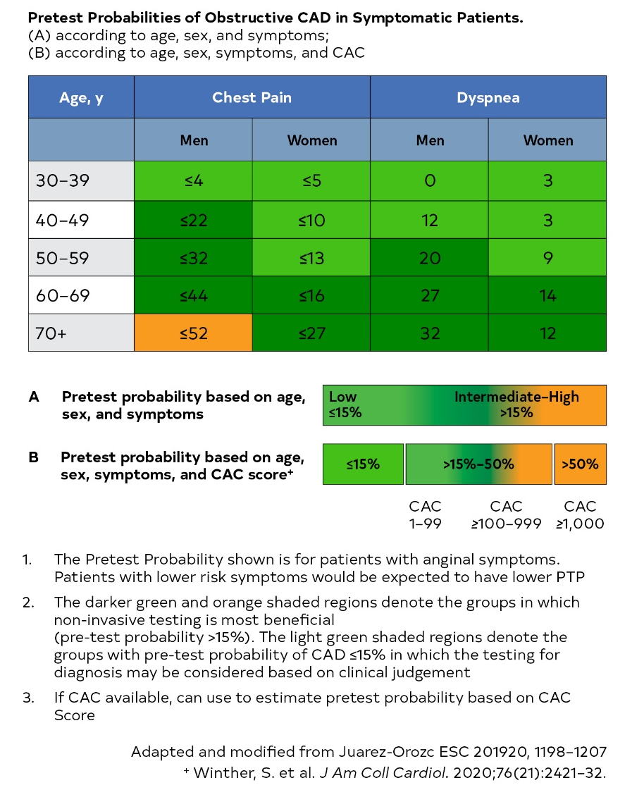
Figure 11. Pretest Probabilities of Obstructive CAD in Symptomatic Patients According to Age, Sex, and Symptoms.
Colors correspond to the Class of Recommendation in Table 1.
CAC indicates coronary artery calcium; and CAD, coronary artery disease.

Slide 91
Low-Risk Patients With Stable Chest Pain and No Known CAD
Recommendations for Low-Risk Patients With Stable Chest Pain and No Known CAD Referenced studies that support the recommendations are summarized in Online Data Supplements 27 and 28.
COR | LOE | Recommendations
1 | B-NR | For patients with stable chest pain and no known CAD presenting to the outpatient clinic, a model to estimate pretest probability of obstructive CAD is effective to identify patients at low risk for obstructive CAD and favorable prognosis in whom additional diagnostic testing can be deferred .

Slide 92
Low-Risk Patients With Stable Chest Pain and No Known CAD (con’t.)
2a | B-R | For patients with stable chest pain and no known CAD categorized as low risk, CAC testing is reasonable as a first-line test for excluding calcified plaque and identifying patients with a low likelihood of obstructive CAD.
2a | B-NR | For patients with stable chest pain and no known CAD categorized as low risk, exercise testing without imaging is reasonable as a first-line test for excluding myocardial ischemia and determining functional capacity in patients with an interpretable ECG.

Slide 93
Intermediate-High Risk Patients With Stable Chest Pain and No Known CAD
Recommendations for Intermediate-High Risk Patients With Stable Chest Pain and No Known CAD Referenced studies that support the recommendations are summarized in Online Data Supplements 29 and 30.
Index Diagnostic Testing: Selecting the Appropriate Test
COR | LOE | Recommendations
Anatomic Testing
1 | A | For intermediate-high risk patients with stable chest pain and no known CAD, CCTA is effective for diagnosis of CAD, for risk stratification, and for guiding treatment decisions.

Slide 94
Intermediate-High Risk Patients With Stable Chest Pain and No Known CAD (con’t.)
Stress Testing
1 | B-R | For intermediate-high risk patients with stable chest pain and no known CAD, stress imaging (stress echocardiography, PET/SPECT MPI or CMR) is effective for diagnosis of myocardial ischemia and for estimating risk of MACE.
2a | B-R | For intermediate-high risk patients with stable chest pain and no known CAD for whom rest/stress nuclear MPI is selected, PET is reasonable in preference to SPECT, if available to improve diagnostic accuracy and decrease the rate of non-diagnostic test results.

Slide 95
Intermediate-High Risk Patients With Stable Chest Pain and No Known CAD (con’t.)
2a | B-R | For intermediate-high risk patients with stable chest pain and no known CAD with an interpretable ECG and ability to achieve maximal levels of exercise (≥5 METs), exercise electrocardiography is reasonable.
2b | B-NR | In intermediate-high risk patients with stable chest pain selected for stress MPI using SPECT, the use of attenuation correction or prone imaging may be reasonable to decrease the rate of false-positive findings.

Slide 96
Intermediate-High Risk Patients With Stable Chest Pain and No Known CAD (con’t.)
Assessment of Left Ventricular Function
1 | B-NR | In intermediate-high risk patients with stable chest pain who have pathological Q waves, symptoms or signs suggestive of heart failure, complex ventricular arrhythmias, or a heart murmur with unclear diagnosis, use of TTE is effective for diagnosis of resting left ventricular systolic and diastolic ventricular function and detection of myocardial, valvular, and pericardial abnormalities.

Slide 97
Intermediate-High Risk Patients With Stable Chest Pain and No Known CAD (con’t.)
Secondary Diagnostic Testing: What to Do If Index Test Results Are Positive or Inconclusive
Sequential or Add-on Testing
2a | B-NR | For intermediate-high risk patients with stable chest pain and known coronary stenosis of 40% to 90% in a proximal or middle coronary segment on CCTA, FFR-CT can be useful for diagnosis of vessel-specific ischemia and to guide decision-making regarding the use of coronary revascularization.
2a | B-NR | For intermediate-high risk patients with stable chest pain after an inconclusive or abnormal exercise ECG or stress imaging study, CCTA is reasonable.

Slide 98
Intermediate-High Risk Patients With Stable Chest Pain and No Known CAD (con’t.)
2a | B-NR | For intermediate-high risk patients with stable chest pain and no known CAD undergoing stress testing, the addition of CAC testing can be useful.
2a | B-NR | For intermediate-high risk patients with stable chest pain after inconclusive CCTA, stress imaging is reasonable.
2b | C-EO | For intermediate-high risk patients with stable chest pain after a negative stress test but with high clinical suspicion of CAD, CCTA or ICA may be reasonable.

Slide 99
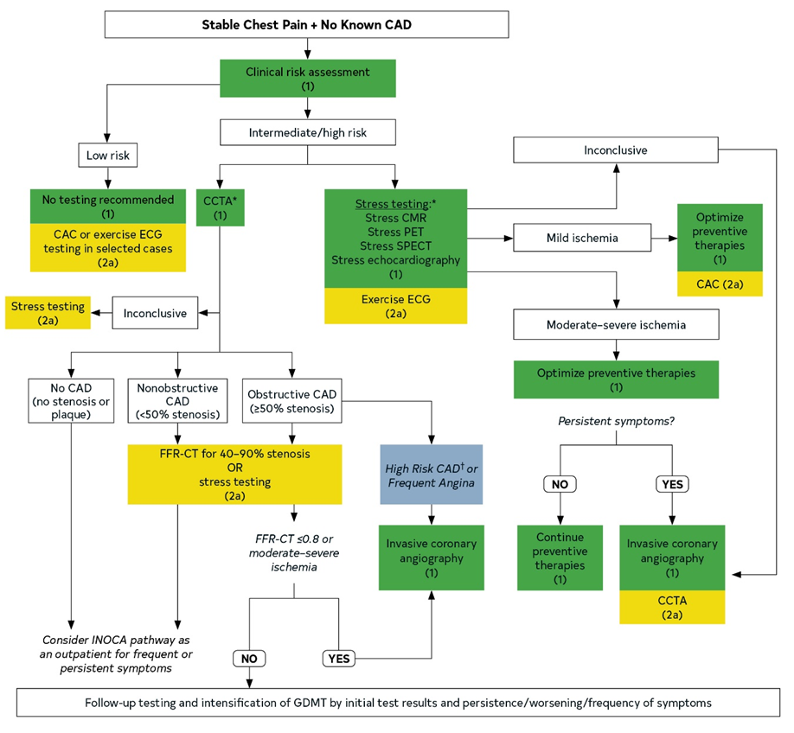
Figure 12. Clinical Decision Pathway for Patients With Stable Chest Pain and No Known CAD
Colors correspond to the Class of Recommendation in Table 1.

Slide 100
Figure 12. Clinical Decision Pathway for Patients With Stable Chest Pain and No Known CAD (con’t.)
Test choice should be guided by local availability and expertise.
*Test choice guided by patient’s exercise capacity, resting electrocardiographic abnormalities; CCTA preferable in those <65 years of age and not on optimal preventive therapies; stress testing favored in those ≥65 years of age (with a higher likelihood of ischemia).
†High-risk CAD means left main stenosis ≥ 50%; anatomically significant 3-vessel disease (≥70% stenosis).
CAD indicates coronary artery disease; CCTA, coronary CT angiography; CMR, cardiovascular magnetic resonance imaging; CT, computed tomography; FFR-CT, fractional flow reserve with CT; GDMT, guideline-directed management and therapy; INOCA, ischemia and no obstructive coronary artery disease; PET, positron emission tomography; and SPECT, single-photon emission CT.

Slide 101
Patients With Known CAD Presenting With Stable Chest Pain
Recommendations for Patients With Known CAD Presenting With Stable Chest Pain Referenced studies that support the recommendations are summarized in Online Data Supplement 31.
COR | LOE | Recommendations
1 | A | For patients with obstructive CAD and stable chest pain, it is recommended to optimize GDMT.
1 | C-EO | For patients with known nonobstructive CAD and stable chest pain, it is recommended to optimize preventive therapies.

Slide 102
Patients With Obstructive CAD Who Present With Stable Chest Pain
Recommendations for Patients With Obstructive CAD Who Present With Stable Chest Pain Referenced studies that support the recommendations are summarized in Online Data Supplements 32 and 33.
COR | LOE | Recommendations
Index Diagnostic Testing
Anatomic Testing
1 | A | For patients with obstructive CAD who have stable chest pain despite GDMT and moderate-severe ischemia, ICA is recommended for guiding therapeutic decision-making.
1 | A | For patients with obstructive CAD who have stable chest pain despite optimal GDMT, those referred for ICA without prior stress testing benefit from FFR or instantaneous wave free ratio.

Slide 103
Patients With Obstructive CAD Who Present With Stable Chest Pain (con’t.)
1 | B-R | For symptomatic patients with obstructive CAD who have stable chest pain with CCTA-defined ≥50% stenosis in the left main coronary artery, obstructive CAD with FFR with CT ≤0.80, or severe stenosis (≥70%) in all 3 main vessels, ICA is effective for guiding therapeutic decision-making.
2a | B-NR | For patients who have stable chest pain with previous coronary revascularization, CCTA is reasonable to evaluate bypass graft or stent patency (for stents ≥3 mm).

Slide 104
Patients With Obstructive CAD Who Present With Stable Chest Pain (con’t.)
Stress Testing
1 | B-NR | For patients with obstructive CAD who have stable chest pain despite optimal GDMT, stress PET/SPECT MPI, CMR, or echocardiography is recommended for diagnosis of myocardial ischemia, estimating risk of MACE, and guiding therapeutic decision-making.
2a | B-R | For patients with obstructive CAD who have stable chest pain despite optimal GDMT, when selected for rest/stress nuclear MPI, PET is reasonable in preference to SPECT, if available, to improve diagnostic accuracy and decrease the rate of non-diagnostic test results.

Slide 105
Patients With Obstructive CAD Who Present With Stable Chest Pain (con’t.)
2a | B-NR | For patients with obstructive CAD who have stable chest pain despite GDMT, exercise treadmill testing can be useful to determine if the symptoms are consistent with angina pectoris, assess the severity of symptoms, evaluate functional capacity and select management, including cardiac rehabilitation.
2a | B-NR | For patients with obstructive CAD who have stable chest pain symptoms undergoing stress PET MPI or stress CMR, the addition of MBFR is useful to improve diagnosis accuracy and enhance risk stratification.

Slide 106
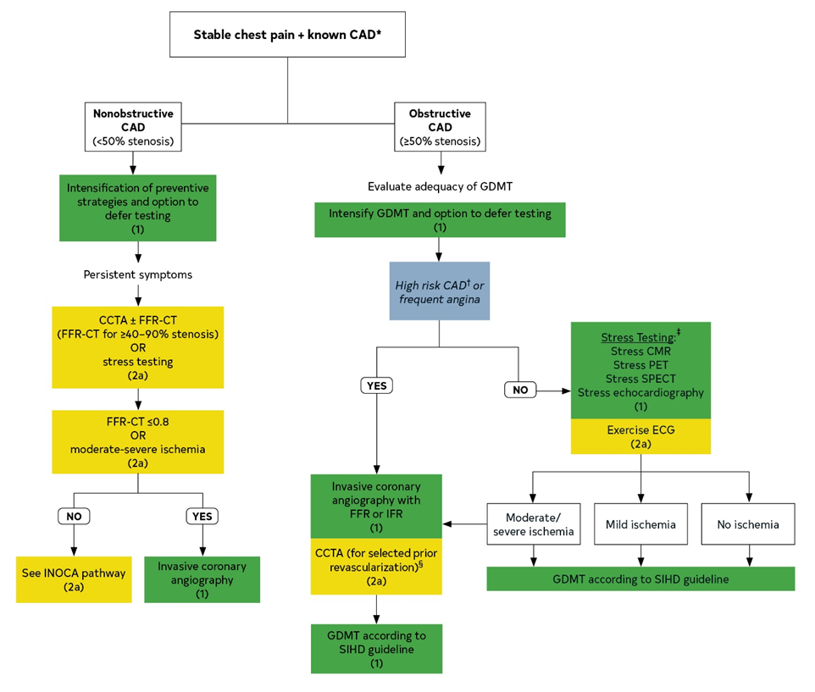
Figure 13. Clinical Decision Pathway for Patients With Stable Chest Pain (or Equivalent) Symptoms With Prior MI, Prior Revascularization, or Known CAD on Invasive Coronary Angiography or CCTA, Including Those With Nonobstructive CAD.
Colors correspond to the Class of Recommendation in Table 1.

Slide 107
Test choice should be guided by local availability and expertise.
*Known CAD means prior MI, revascularization, known obstructive CAD, nonobstructive CAD.
†High-risk CAD means left main stenosis ≥50%; or obstructive CAD with FFR-CT ≤0.80.
‡Test choice guided by the patient’s exercise capacity, resting electrocardiographic abnormalities.
§Patients with prior CABG or stents >3.0 mm.
Follow-up Testing and Intensification of GDMT Guided by Initial Test Results and Persistence / Worsening / Frequency of Symptoms and Shared Decision Making
CABG indicates coronary artery bypass graft; CAD, coronary artery disease; CCTA, coronary CT angiography; CMR, cardiovascular magnetic resonance imaging; CT, computed tomography; ECG, electrocardiogram; FFR-CT, fractional flow reserve with CT; GDMT, guideline-directed management and therapy; ICA, invasive coronary angiography; iFR, instant wave-free ratio; INOCA, ischemia and no obstructive coronary artery disease; MI, myocardial infarction; MPI, myocardial perfusion imaging; PET, positron emission tomography; SIHD, stable ischemic heart disease; and SPECT, single-photon emission CT.
Figure 13. Clinical Decision Pathway for Patients With Stable Chest Pain (or Equivalent) Symptoms With Prior MI, Prior Revascularization, or Known CAD on Invasive Coronary Angiography or CCTA, Including Those With Nonobstructive CAD (con’t.)

Slide 108
Patients With Prior Coronary Artery Bypass Surgery With Stable Chest Pain
Recommendations for Patients With Prior Coronary Artery Bypass Surgery With Stable Chest Pain
COR | LOE | Recommendations
1 | C-LD | In patients who have had prior coronary artery bypass surgery presenting with stable chest pain whose noninvasive stress test results show moderate to severe ischemia, or in those suspected to have myocardial ischemia with indeterminate/nondiagnostic stress test, ICA is recommended for guiding therapeutic decision-making.
2a | C-LD | In patients who have had prior coronary artery bypass surgery presenting with stable chest pain who are suspected to have myocardial ischemia, it is reasonable to perform stress imaging or CCTA to evaluate for myocardial ischemia or graft stenosis or occlusion.

Slide 109
Patients With Known Nonobstructive CAD Presenting With Stable Chest Pain
Recommendations for Patients With Known Nonobstructive CAD Presenting With Stable Chest Pain Referenced studies that support the recommendations are summarized in Online Data Supplements 34 and 35.
COR | LOE | Recommendations
Index Diagnostic Testing: Selecting the Appropriate Test
Anatomic Testing
2a | B-NR | For symptomatic patients with known nonobstructive CAD who have stable chest pain, CCTA is reasonable for determining atherosclerotic plaque burden and progression to obstructive CAD, and guiding therapeutic decision-making.

Slide 110
Patients With Known Nonobstructive CAD Presenting With Stable Chest Pain (con’t.)
2a | B-NR | For patients with known coronary stenosis from 40% to 90% on CCTA, FFR can be useful for diagnosis of vessel-specific ischemia and to guide decision-making regarding the use of ICA.
Stress Testing
2a | C-LD | For patients with known extensive nonobstructive CAD with stable chest pain symptoms, stress imaging (PET/SPECT, CMR, or echocardiography) is reasonable for the diagnosis of myocardial ischemia.

Slide 111
Patients With Suspected Ischemia and No Obstructive CAD (INOCA)
Recommendations for Patients With Ischemia and No Obstructive CAD (INOCA) Referenced studies that support the recommendations are summarized in Online Data Supplements 36 and 37.
COR | LOE | Recommendations
2a | B-NR | For patients with persistent stable chest pain and nonobstructive CAD and at least mild myocardial ischemia on imaging, it is reasonable to consider invasive coronary function testing to improve the diagnosis of coronary microvascular dysfunction and to enhance risk stratification.
2a | B-NR | For patients with persistent stable chest pain and nonobstructive CAD, stress PET MPI with MBFR is reasonable to diagnose microvascular dysfunction and enhance risk stratification.

Slide 112
Patients With Suspected Ischemia and No Obstructive CAD (INOCA) (con’t.)
2a | B-NR | For patients with persistent stable chest pain and nonobstructive CAD, stress CMR with the addition of MBFR measurement is reasonable to improve diagnosis of coronary myocardial dysfunction and for estimating risk of MACE.
2b | C-EO | For patients with persistent stable chest pain and nonobstructive CAD, stress echocardiography with the addition of coronary flow velocity reserve measurement may be reasonable to improve diagnosis of coronary myocardial dysfunction and for estimating risk of MACE.

Slide 113
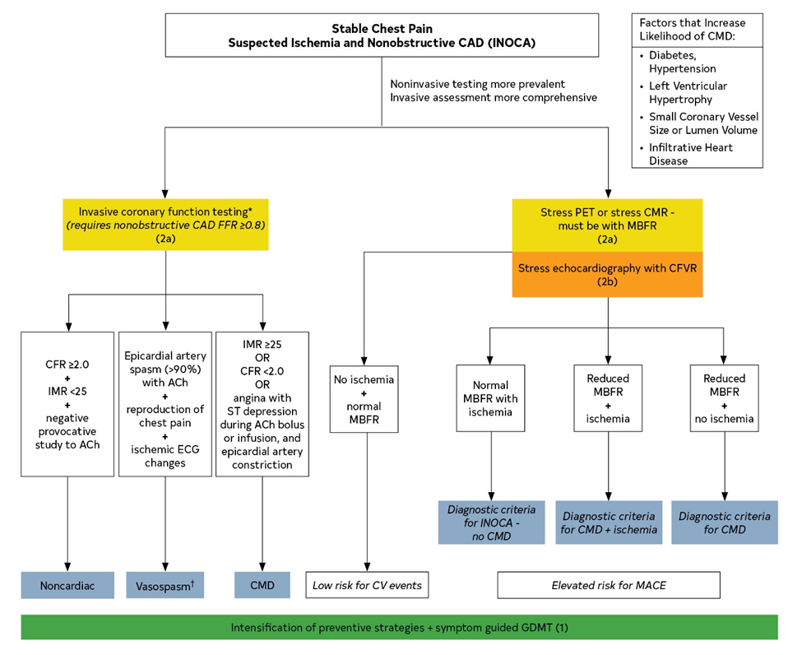
Figure 14. Clinical Decision Pathway for INOCA.
Colors correspond to the Class of Recommendation in Table 1.

Slide 114
Figure 14. Clinical Decision Pathway for INOCA (con’t.).
Test choice should be guided by local availability and expertise.
*Ford T, et al. (16).
†Cannot exclude microvascular vasospasm.
ACh indicates acetylcholine; CFR, coronary flow reserve; CMD, coronary microvascular dysfunction; CFVR, coronary flow velocity reserve; CV, cardiovascular; FFR, fractional flow reserve; IMR, index of microcirculatory restriction; INOCA, ischemia and nonobstructive CAD; MACE, major adverse cardiovascular events; and MBFR, myocardial blood flow reserve.

Slide 115
Abbreviations used in this Guideline
Abbreviation | Meaning/Phrase
ACS | acute coronary syndrome
AMI | acute myocardial infarction
CABG | coronary artery bypass graft
CAC | coronary artery calcium
CAD | coronary artery disease
CCTA | coronary computed tomographic angiography
CDP | clinical decision pathway
CMR | cardiovascular magnetic resonance
cTn | cardiac troponin
ECG | electrocardiogram

Slide 116
Abbreviations used in this Guideline
Abbreviation | Meaning/Phrase
ED | emergency department
EMS | emergency medical services
FFR-CT | fractional flow reserve with computed tomography
GDMT | guideline-directed management and therapy
hs-cTn | high-sensitivity cardiac troponin
ICA | invasive coronary angiography
INOCA | ischemia and nonobstructive coronary artery disease
MACE | major adverse cardiac events

Slide 117
Abbreviations used in this Guideline
Abbreviation | Meaning/Phrase
MBFR | myocardial blood flow reserve
METs | metabolic equivalents
MINOCA | myocardial infarction and nonobstructive coronary arteries
MPI | myocardial perfusion imaging
NSTE-ACS | non–ST-segment–elevation acute coronary syndrome
PCI | percutaneous coronary intervention
PE | pulmonary embolism
PET | positron emission tomography

Slide 118
Abbreviations used in this Guideline
Abbreviation | Meaning/Phrase
SIHD | stable ischemic heart disease
SPECT | single-photon emission computed tomography
STEMI | ST-segment–elevation myocardial infarction
TEE | transesophageal echocardiography
TTE | transthoracic echocardiography
VF | ventricular fibrillation
VHD | valvular heart disease
VT | ventricular tachycardia

