Slide 1
2023 ACC/AHA/ACCP/HRS Guideline for the Diagnosis and Management of Atrial Fibrillation
A Report of the American College of Cardiology/American Heart Association Joint Committee on Clinical Practice Guidelines

Slide 2
Citation
This slide set is adapted from the 2023 ACC/AHA/ACCP/HRS Guideline for the Diagnosis and Management of Atrial Fibrillation. Published ahead of print November 30, 2023, available at: Circulation. https://www.ahajournals.org/doi/10.1161/CIR.0000000000001193 And Journal of the American College of Cardiology, published online ahead of print November 30, 2023. J Am Coll Cardiol. https://www.jacc.org/doi/10.1016/j.jacc.2023.08.017
© 2023 the American Heart Association, Inc. and the American College of Cardiology Foundation. All rights reserved. This article has been published in Circulation and the Journal of the American College of Cardiology.

Slide 3
2023 Writing Committee Members*
José A. Joglar, MD, FACC, FAHA, FHRS, Chair
Mina K. Chung, MD, FACC, FAHA, FHRS, Vice Chair
Anastasia L. Armbruster, PharmD, FACC†
Emelia J. Benjamin, MD, ScM, FACC, FAHA
Janice Y. Chyou, MD, FACC, FAHA, FHRS
Edmond M. Cronin, MB, BCh, BAO, FHRS
Anita Deswal, MD, MPH, FACC, FAHA†
Lee L. Eckhardt, MD, MS, FHRS
Zachary D. Goldberger, MD, FACC, FAHA, FHRS
Rakesh Gopinathannair, MD, MA, FAHA, FACC, FHRS
Bulent Gorenek, MD, FACC
Paul L. Hess, MD, MHS‡
Mark Hlatky, MD, FAHA, FACC
Gail Hogan§
Chinwe Ibeh, MD
Julia H. Indik, MD, PhD, FAHA, FACC, FHRS
Kazuhiko Kido, PharmD, PhD, MS, FCCP║
Fred Kusumoto, MD, FAHA, FACC, FHRS
Mark S. Link, MD, FAHA, FACC, FHRS
Kathleen T. Linta§
Gregory M. Marcus, MD, MAS, FACC, FAHA, FHRS
Patrick M. McCarthy, MD, FACC
Nimesh Patel, MD
Kristen K. Patton, MD, FACC, FAHA, FHRS
Marco V. Perez, MD, FAHA
Jonathan P. Piccini, MD, MHS, FACC, FAHA, FHRS
Andrea M. Russo, MD, FACC, FHRS, FAHA¶
Prashanthan Sanders, MBBS, PhD, FHRS, FAHA
Megan M. Streur, PhD, MN, ARNP
Kevin L. Thomas, MD, FACC, FHRS
Sabrina Times, DHSC, MPH#
James E. Tisdale, PharmD, FCCP, FAHA, FACC
Anne Marie Valente, MD, FAHA, FACC**
David R. Van Wagoner, PhD, FAHA, FHRS
*Writing committee members are required to recuse themselves from voting on sections to which their specific relationships with industry may apply; see Appendix 1 for detailed information. †ACC/AHA Joint Committee on Clinical Practice Guidelines liaison; ‡ACC/AHA Joint Committee on Performance Measures liaison; §Lay Stakeholder representative; ║American College of Clinical Pharmacy representative; ¶Heart Rhythm Society representative; #Joint ACC/AHA staff representative; **AHA/ACC Joint Committee on Clinical Data Standards liaison.

Slide 4
Top 10 Take-Home Messages
2023 Guideline for Atrial Fibrillation

Slide 5
Top 10 Take Home Messages
1. Stages of atrial fibrillation (AF): The previous classification of AF, which was based only on arrhythmia
duration, although useful, tended to emphasize therapeutic interventions. The new proposed classification,
using stages, recognizes AF as a disease continuum that requires a variety of strategies at the different stages, from prevention, lifestyle and risk factor modification, screening, and therapy.

Slide 6
Top 10 Take Home Messages
2. AF risk factor modification and prevention: This guideline recognizes lifestyle and risk factor modification as a pillar of AF management to prevent onset, progression, and adverse outcomes. The guideline emphasizes risk factor management throughout the disease continuum and offers more prescriptive recommendations, accordingly, including management of obesity, weight loss, physical activity, smoking cessation, alcohol moderation, hypertension, and other comorbidities.

Slide 7
Top 10 Take Home Messages
3. Flexibility in using clinical risk scores and expanding beyond CHA2DS2-VASc for prediction of stroke and systemic embolism: Recommendations for anticoagulation are now made based on yearly thromboembolic event risk using a validated clinical risk score, such as CHA2DS2-VAS_{C}. However, patients at an intermediate annual risk score who remain uncertain about the benefit of anticoagulation can benefit from consideration of other risk variables to help inform the decision, or the use of other clinical risk scores to improve prediction, facilitate shared decision making, and incorporate into the electronic medical record.

Slide 8
Top 10 Take Home Messages
4. Consideration of stroke risk modifiers: Patients with AF at intermediate to low (<2%) annual risk of ischemic stroke can benefit from consideration of factors that might modify their risk of stroke, such as the characteristics of their AF (eg, burden), nonmodifiable risk factors (sex), and other dynamic or modifiable factors (blood pressure control) that may inform shared decision-making discussions.

Slide 9
Top 10 Take Home Messages
5. Early rhythm control: With the emergence of new and consistent evidence, this guideline emphasizes the importance of early and continued management of patients with AF that should focus on maintaining sinus rhythm and minimizing AF burden.

Slide 10
Top 10 Take Home Messages
6. Catheter ablation of AF receives a Class 1 indication as first-line therapy in selected patients: Recent randomized studies have demonstrated the superiority of catheter ablation over drug therapy for rhythm control in appropriately selected patients. In view of the most recent evidence, we upgraded the Class of Recommendation.

Slide 11
Top 10 Take Home Messages
7. Catheter ablation of AF in appropriate patients with heart failure with reduced ejection fraction receives a Class 1 indication: Recent randomized studies have demonstrated the superiority of catheter ablation over drug therapy for rhythm control in patients with heart failure and reduced ejection failure. In view of the data, we upgraded the Class of Recommendation for this population of patients.

Slide 12
Top 10 Take Home Messages
8. Recommendations have been updated for device-detected AF: In view of recent studies, more prescriptive recommendations are provided for patients with device-detected AF that consider the interaction between episode duration and the patient's underlying risk for thromboembolism. This includes considerations for patients with AF detected via implantable devices and wearables.

Slide 13
Top 10 Take Home Messages
9. Left atrial appendage occlusion devices receive higher level Class of Recommendation: In view of additional data on safety and efficacy of left atrial appendage occlusion devices, the Class of Recommendation has been upgraded to 2a compared with the 2019 AF Focused Update for use of these devices in patients with long-term contraindications to anticoagulation.

Slide 14
Top 10 Take Home Messages
10. Recommendations are made for patients with AF identified during medical illness or surgery (precipitants): Emphasis is made on the risk of recurrent AF after AF is discovered during noncardiac illness or other precipitants, such as surgery.

Slide 15
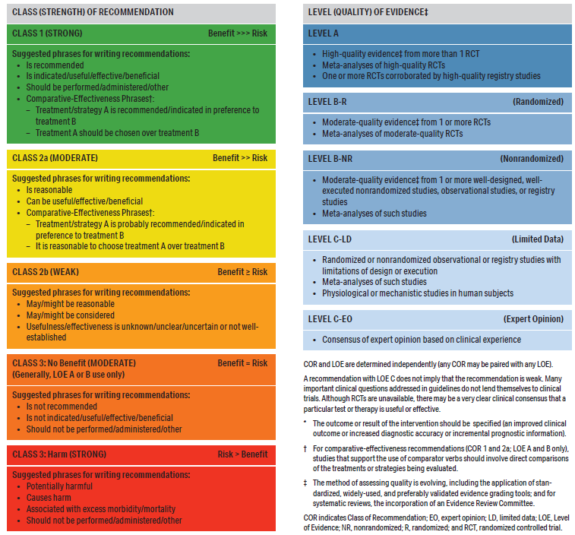
Table 2. Applying American College of Cardiology/American Heart Association Class of Recommendation and Level of Evidence to Clinical Strategies, Interventions, Treatments, or Diagnostic Testing in Patient Care* (Updated May 2019)

Slide 16
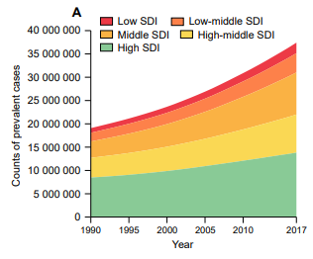
Figure 1. Temporal Trends in Counts and Age-Standardized Rates of AF-Prevalent Cases by Social Demographic Index Quintile for Both Sexes Combined, 1990 to 2017.
Trends in counts of AF-prevalent cases by Social Demographic Index quintile, 1990 to 2017. SDI was made up of the geometric mean of three common indicators: the lag distributed income per capita, mean educational achievement for those aged ≥15 y, and total fertility rate < 25 y. SDI ranged from 0 to 1, where 0 represents the theoretical minimum level of development, whereas 1 represents the theoretical maximum level of development.
AF indicates atrial fibrillation; and SDI, Social Demographic Index.

Slide 17
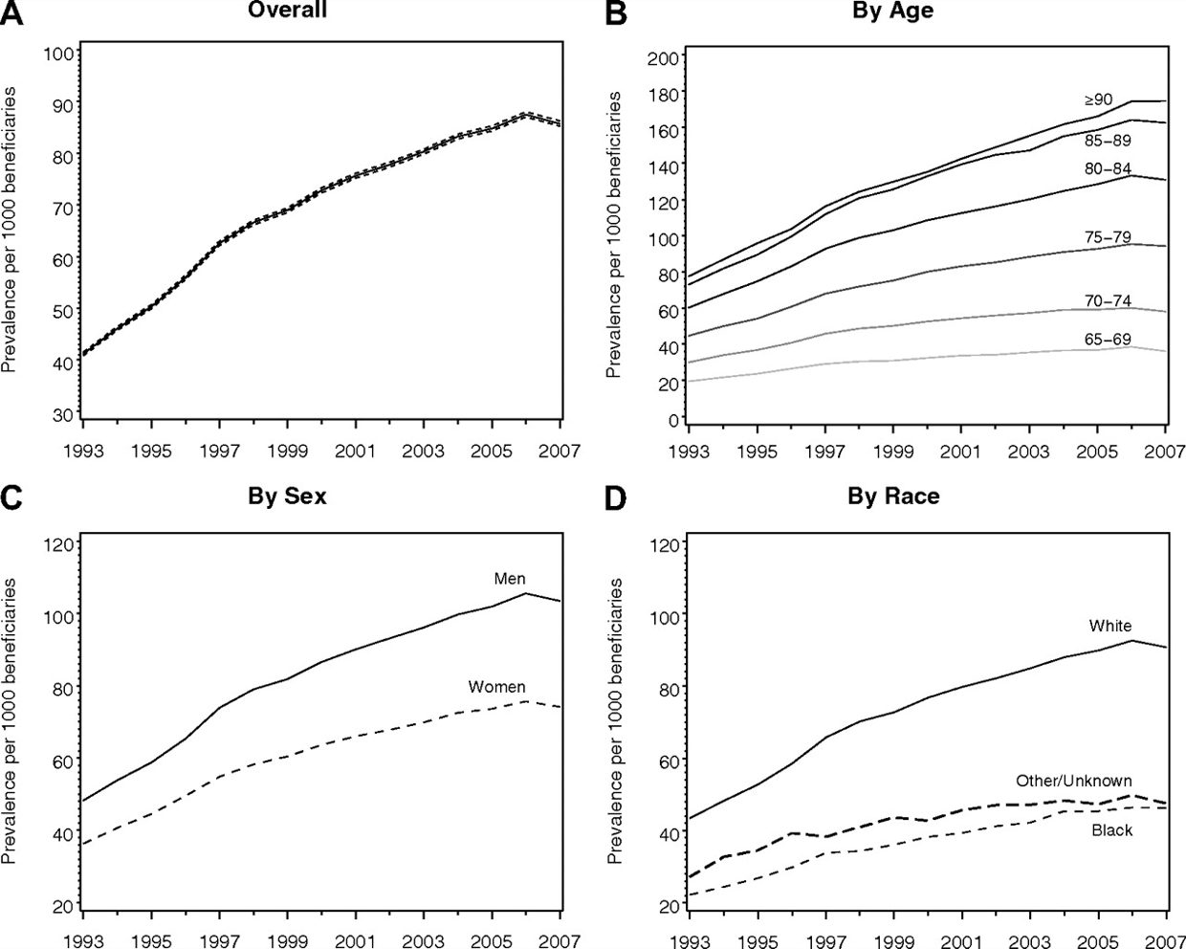
Figure 2. Prevalence of AF Among Medicare Beneficiaries, 1993–2007.
(A) In the overall cohort, (B) by age group, (C) by sex, and (D) by race. The dashed lines in panel A represent 95% CIs.
AF indicates atrial fibrillation.

Slide 18
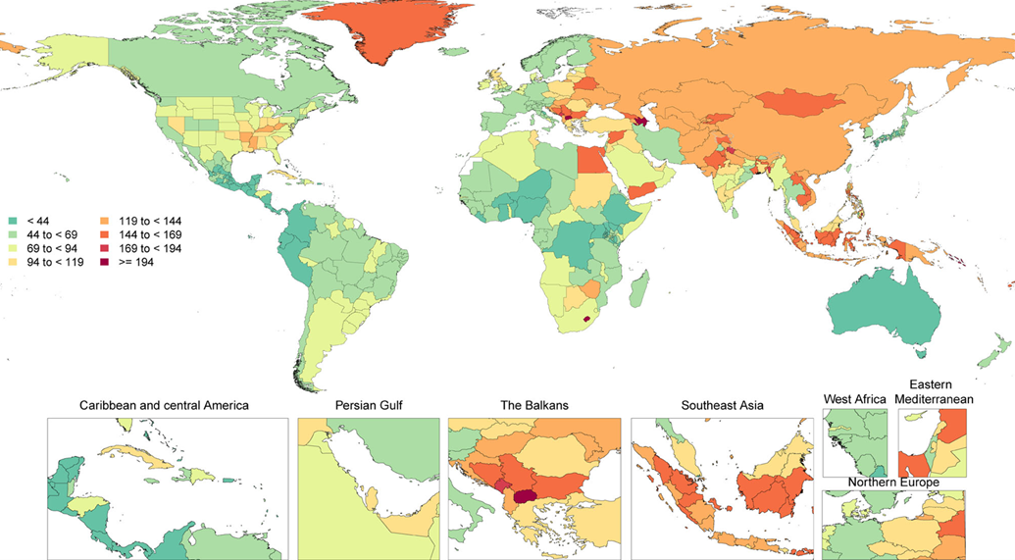
Figure 2. Prevalence of AF Among Medicare Beneficiaries, 1993–2007.
During each annual GBD Study cycle, population health estimates are produced for the full-time series. Improvements in statistical and geospatial modeling methods and the addition of new data sources may lead to changes in past results across GBD Study cycles.
AF indicates atrial fibrillation; and GBD, Global Burden of Disease.

Slide 19
Table 3. Risk Factors for Diagnosed AF
Condition | Study Type | Effect on Risk of AF | Summary Risk of Incident AF | Effect of LRFM
Risk Factors
Advancing age | SR/MA | Age per 5 y: ↑ risk (HR, 1.43-1.66) | ↑ Risk | N/A
 | MR | Accelerated epigenetic age by MR: no association
Smoking | Single study | Current smoking: ↑ risk (9.8%) | ↑ Risk | N/A
 | SR/MA | Smoking: ↑ risk (HR, 1.21-1.43)
 | MR | Smoking initiation: ↑ risk (OR, 1.11)
Physical activity | SR/MA | Sedentary lifestyle: ↑ risk (OR, 2.47) Guideline-recommended physical activity: ↓ risk (HR, 0.94) Elite athletes vs. nonathletes: ↑ risk (OR, 2.46) | U curve: Sedentary lifestyle and elite/extreme exercise: ↑ risk | Exercise: ↓ AF burden, recurrence, symptoms; ↑ quality of life, functional capacity
↓ indicates decreased; ↑, increased; ↔no significant change in risk
AF, atrial fibrillation; HR, hazard ratio; LRFM, lifestyle and risk factor modification; MA, meta-analysis; MR, Mendelian randomization; N/A, not available/applicable; OR, odds ratio; SR, systematic review;

Slide 20
Table 3. Risk Factors for Diagnosed AF (con’t.)
Alcohol | Single studies | Risk of AF episode within 4 h of 1 drink: ↑ risk (OR, 2.02) Greater access to alcohol law: ↑ risk | ↑ Risk | Randomized abstinence: ↓ AF recurrence and burden N-of-1 studies of alcohol avoidance: ↓ near-term AF Alcohol avoidance or reduction as part of a comprehensive LRFM program: ↓ AF burden, symptoms, progression of AF
 | SR/MA | Dose response (#drinks/d): ↑ risk (RR) 1: 1.08; 2: 1.17; 3: 1.33; 4: 1.36; 5: 1.47
 | MR | Genetically predicted heavy alcohol consumption (>35 U/week for women and >50 U/week for men): ↑ risk (OR, 1.11)
↓ indicates decreased; ↑, increased; ↔no significant change in risk
AF, atrial fibrillation; LRFM, lifestyle and risk factor modification; MA, meta-analysis; MR, Mendelian randomization; N/A, not available/applicable; OR, odds ratio; RR, relative risk; SR, systematic review

Slide 21
Table 3. Risk Factors for Diagnosed AF (con’t.)
Adiposity markers: weight, BMI, obesity | Single study | Obesity: population attributable fraction 12.7%-16.9% | ↑ Risk | Weight loss in overweight or obese patients with AF as part of a comprehensive LRFM program: ↓ AF symptoms, burden, recurrence, progression Bariatric surgery in class III obesity: associated with reversal of AF type, ↑ sinus rhythm postablation Weight loss in long-lasting persistent AF and obesity: ↔
 | SR/MA | BMI: RR, 1.28 per 5-unit ↑ in BMI Weight: HR, 1.12 per 15 kg ↑
 | MR | Obesity Birthweight: 1.26 per SD ↑ Childhood BMI (OR, 1.18) BMI 1.31 per unit BMI
↓ indicates decreased; ↑, increased; ↔no significant change in risk
AF, atrial fibrillation; ASCVD, atherosclerotic cardiovascular disease; BMI, body mass index; BNP, brain naturiuretic peptide; BP, blood pressure; CABG, coronary artery bypass graft surgery; CAD, coronary artery disease; CI, confidence interval; CKD, chronic kidney disease; DBP, diastolic blood pressure; DM, diabetes mellitus; ECG, electrocardiogram; GWAS, genome-wide association study; HF, heart failure; HR, hazard ratio; LA, left atrial; LRFM, lifestyle and risk factor modification; LV, left ventricular; LVH, left ventricular hypertrophy; MA, meta-analysis; MR, Mendelian randomization; N/A, not available/applicable; OR, odds ratio; RR, relative risk; OSA, obstructive sleep apnea; SMD, standardized mean difference; SBP, systolic blood pressure; SES, socioeconomic status; SR, systematic review; and VHD, valvular heart disease

Slide 22
Table 3. Risk Factors for Diagnosed AF (con’t.)
Height | MA | Height per 10 cm: ↑ risk (HR, 1.28) | ↑ Risk | N/A
 | SR/MA | Increasing height: ↑ risk
 | MR | Increasing height: ↑ risk (OR per unit, 1.33)
↓ indicates decreased; ↑, increased; ↔no significant change in risk
AF, atrial fibrillation; ASCVD, atherosclerotic cardiovascular disease; BMI, body mass index; BNP, brain naturiuretic peptide; BP, blood pressure; CABG, coronary artery bypass graft surgery; CAD, coronary artery disease; CI, confidence interval; CKD, chronic kidney disease; DBP, diastolic blood pressure; DM, diabetes mellitus; ECG, electrocardiogram; GWAS, genome-wide association study; HF, heart failure; HR, hazard ratio; LA, left atrial; LRFM, lifestyle and risk factor modification; LV, left ventricular; LVH, left ventricular hypertrophy; MA, meta-analysis; MR, Mendelian randomization; N/A, not available/applicable; OR, odds ratio; RR, relative risk; OSA, obstructive sleep apnea; SMD, standardized mean difference; SBP, systolic blood pressure; SES, socioeconomic status; SR, systematic review; and VHD, valvular heart disease

Slide 23
Table 3. Risk Factors for Diagnosed AF (con’t.)
Hypertension and BP
Single studies | Elevated BP: ↑ risk, population attributable fraction, 21.6% Presence of hypertension treatment: ↑ risk (HR, 1.35-1.68), incidence 9.8%-19.5%; both AF and SBP decreased over time | Hypertension: ↑ risk SBP: ↑ risk DBP: ↑ ↓ ↔ risk | Renal denervation: ↓ AF postablation Mineralocorticoid receptor antagonists: ↓ AF burden BP control postablation: ↔ Intensive BP control to SBP <120 mm Hg in patients with hypertension at high risk for CVD: ↓ AF risk BP control as part of a comprehensive LRFM program: ↓ AF burden
MA | BP: SBP: ↑ risk (HR per 20 mm Hg, 1.22); DBP per 10 mm Hg ↓ risk (HR, 0.90); use of BP medications ↑ risk (HR, 1.42)
SR/MA | Hypertension: ↑ risk
MR | SBP ↑ risk; DBP mixed results ↔ ↑ risk; pulse pressure ↑ risk
↓ indicates decreased; ↑, increased; ↔no significant change in risk
AF, atrial fibrillation; ASCVD, atherosclerotic cardiovascular disease; BMI, body mass index; BNP, brain naturiuretic peptide; BP, blood pressure; CABG, coronary artery bypass graft surgery; CAD, coronary artery disease; CI, confidence interval; CKD, chronic kidney disease; DBP, diastolic blood pressure; DM, diabetes mellitus; ECG, electrocardiogram; GWAS, genome-wide association study; HF, heart failure; HR, hazard ratio; LA, left atrial; LRFM, lifestyle and risk factor modification; LV, left ventricular; LVH, left ventricular hypertrophy; MA, meta-analysis; MR, Mendelian randomization; N/A, not available/applicable; OR, odds ratio; RR, relative risk; OSA, obstructive sleep apnea; SMD, standardized mean difference; SBP, systolic blood pressure; SES, socioeconomic status; SR, systematic review; and VHD, valvular heart disease

Slide 24
Table 3. Risk Factors for Diagnosed AF (con’t.)
Resting heart rate | SR/MA | Resting heart rate: J-shaped relationship with incident AF. Lowest risk at 68-80 bpm; <70 bpm, (RR, 1.09 per 10 bpm ↓); >70 bpm (RR, per 10 bpm ↑ RR 1.06) | Slow heart rate: ↑ ↓ variable risk Higher heart rate: ↑ ↓ variable risk | N/A
MR | Heart rate: <65 bpm slower (HR ↑ risk); heart rate per 5 bpm ↑, 0.82
↓ indicates decreased; ↑, increased; ↔no significant change in risk
AF, atrial fibrillation; ASCVD, atherosclerotic cardiovascular disease; BMI, body mass index; BNP, brain naturiuretic peptide; BP, blood pressure; CABG, coronary artery bypass graft surgery; CAD, coronary artery disease; CI, confidence interval; CKD, chronic kidney disease; DBP, diastolic blood pressure; DM, diabetes mellitus; ECG, electrocardiogram; GWAS, genome-wide association study; HF, heart failure; HR, hazard ratio; LA, left atrial; LRFM, lifestyle and risk factor modification; LV, left ventricular; LVH, left ventricular hypertrophy; MA, meta-analysis; MR, Mendelian randomization; N/A, not available/applicable; OR, odds ratio; RR, relative risk; OSA, obstructive sleep apnea; SMD, standardized mean difference; SBP, systolic blood pressure; SES, socioeconomic status; SR, systematic review; and VHD, valvular heart disease

Slide 25
Table 3. Risk Factors for Diagnosed AF (con’t.)
Diabetes
Single study | Diabetes: ↑ risk, population attributable fraction 3.1% Diabetes: ↑ risk, population attributable fraction ↑ over time 3.2%-5.9% | ↑ Risk | Optimal glycemic control preablation may ↓ AF recurrence postablation
MA | Diabetes: ↑ risk (HR, 1.27 [95% CI, 1.10-1.46])
SR/MA | Diabetes: ↑ risk (RR, 1.28, excluding large outlying study) Pre-diabetes: ↑ risk (RR, 1.20) Blood glucose; ↑ risk (RR per 20 mg/dL↑, 1.11)
↓ indicates decreased; ↑, increased; ↔no significant change in risk
AF, atrial fibrillation; ASCVD, atherosclerotic cardiovascular disease; BMI, body mass index; BNP, brain naturiuretic peptide; BP, blood pressure; CABG, coronary artery bypass graft surgery; CAD, coronary artery disease; CI, confidence interval; CKD, chronic kidney disease; DBP, diastolic blood pressure; DM, diabetes mellitus; ECG, electrocardiogram; GWAS, genome-wide association study; HF, heart failure; HR, hazard ratio; LA, left atrial; LRFM, lifestyle and risk factor modification; LV, left ventricular; LVH, left ventricular hypertrophy; MA, meta-analysis; MR, Mendelian randomization; N/A, not available/applicable; OR, odds ratio; RR, relative risk; OSA, obstructive sleep apnea; SMD, standardized mean difference; SBP, systolic blood pressure; SES, socioeconomic status; SR, systematic review; and VHD, valvular heart disease

Slide 26
Table 3. Risk Factors for Diagnosed AF (con’t.)
Cardiovascular disease
HF or CAD | Single study | HF or CAD: population attributable fraction 5.4% | Risk | N/A
HF | Single studies | HF: ↑ risk but population attributable fraction ↓ d over time 7.8%-1.4% Bidirectional relation between AF and HF | Risk | N/A
 | MA | History of HF: ↑ risk (HR, 2.02)
 | MR | Genetically predicted HF: ↑ risk OR, 1.86
↓ indicates decreased; ↑, increased; ↔no significant change in risk
AF, atrial fibrillation; ASCVD, atherosclerotic cardiovascular disease; BMI, body mass index; BNP, brain naturiuretic peptide; BP, blood pressure; CABG, coronary artery bypass graft surgery; CAD, coronary artery disease; CI, confidence interval; CKD, chronic kidney disease; DBP, diastolic blood pressure; DM, diabetes mellitus; ECG, electrocardiogram; GWAS, genome-wide association study; HF, heart failure; HR, hazard ratio; LA, left atrial; LRFM, lifestyle and risk factor modification; LV, left ventricular; LVH, left ventricular hypertrophy; MA, meta-analysis; MR, Mendelian randomization; N/A, not available/applicable; OR, odds ratio; RR, relative risk; OSA, obstructive sleep apnea; SMD, standardized mean difference; SBP, systolic blood pressure; SES, socioeconomic status; SR, systematic review; and VHD, valvular heart disease

Slide 27
Table 3. Risk Factors for Diagnosed AF (con’t.)
CAD | Single study | MI: Population attributable fraction 3.6% | Risk | N/A
 | MA | History of MI: HR, 1.64
 | MR | Genetically predicted CAD: OR, 1.18
VHD | Single studies | Significant heart murmur: ↑ risk (HR, 2.38) Significant heart murmur (any diastolic and grade ≥3/6 systolic murmur): ↑ risk, population attributable fraction 21.9% ↓ d over time to 3.1% | ↑ Risk | N/A
 | MR | Genetically predicted risk of AF in individuals of European ancestry: associated with VHD with rheumatic fever (OR, 1.26) and nonrheumatic VHD (OR, 1.27)
AF, atrial fibrillation; CAD, coronary artery disease; HR, hazard ratio; MA, meta-analysis; MR, Mendelian randomization; N/A, not available/applicable; OR, odds ratio; and VHD, valvular heart disease
↓ indicates decreased; ↑, increased; ↔no significant change in risk

Slide 28
Table 3. Risk Factors for Diagnosed AF (con’t.)
Cardiac surgery
Single study | Multicenter validated risk prediction model: ↑ risk AF after CABG | ↑ Risk | Prophylactic amiodarone, beta blockers: ↓ ↔ postop AF Posterior left pericardiotomy during CABG, aortic valve, ascending aortic aneurysm surgery: ↓ postop AF
SR/MA | Postop AF incidence: 23.7%-25.5% of cardiac surgery patients
↓ indicates decreased; ↑, increased; ↔no significant change in risk
AF, atrial fibrillation; ASCVD, atherosclerotic cardiovascular disease; BMI, body mass index; BNP, brain naturiuretic peptide; BP, blood pressure; CABG, coronary artery bypass graft surgery; CAD, coronary artery disease; CI, confidence interval; CKD, chronic kidney disease; DBP, diastolic blood pressure; DM, diabetes mellitus; ECG, electrocardiogram; GWAS, genome-wide association study; HF, heart failure; HR, hazard ratio; LA, left atrial; LRFM, lifestyle and risk factor modification; LV, left ventricular; LVH, left ventricular hypertrophy; MA, meta-analysis; MR, Mendelian randomization; N/A, not available/applicable; OR, odds ratio; RR, relative risk; OSA, obstructive sleep apnea; SMD, standardized mean difference; SBP, systolic blood pressure; SES, socioeconomic status; SR, systematic review; and VHD, valvular heart disease

Slide 29
Table 3. Risk Factors for Diagnosed AF (con’t.)
CKD | SR/MA | CKD: ↑ risk (HR, 1.47) | ↑ ↔ Risk | N/A
 | MR | Bidirectional relation between CKD and AF AF causal for CKD; CKD not causal for AF
Obstructive sleep apnea | SR/MA | OSA: ↑ risk (OR, 1.71), with potential dose response relation by severity | ↑ Risk | Observational studies of SDB treatment: ↓AF burden Small RCTs of SDB treatment: ↔
 | MR | Genetically predicted OSA: ↑ risk (OR, 1.21)
Thyroid disease | SR/MA | Clinical hyperthyroidism: ↑ risk (RR, 2.35) | ↑ Risk
 | MR | Hyperthyroidism: ↑ risk (OR, 1.31)
↓ indicates decreased; ↑, increased; ↔no significant change in risk
AF, atrial fibrillation; ASCVD, atherosclerotic cardiovascular disease; BMI, body mass index; BNP, brain naturiuretic peptide; BP, blood pressure; CABG, coronary artery bypass graft surgery; CAD, coronary artery disease; CI, confidence interval; CKD, chronic kidney disease; DBP, diastolic blood pressure; DM, diabetes mellitus; ECG, electrocardiogram; GWAS, genome-wide association study; HF, heart failure; HR, hazard ratio; LA, left atrial; LRFM, lifestyle and risk factor modification; LV, left ventricular; LVH, left ventricular hypertrophy; MA, meta-analysis; MR, Mendelian randomization; N/A, not available/applicable; OR, odds ratio; RR, relative risk; OSA, obstructive sleep apnea; SMD, standardized mean difference; SBP, systolic blood pressure; SES, socioeconomic status; SR, systematic review; and VHD, valvular heart disease

Slide 30
Table 3. Risk Factors for Diagnosed AF (con’t.)
Sepsis
Single study | Severe sepsis: ↑ risk (OR, 6.82); Medicare population | ↑ Risk | N/A
SR/MA | Sepsis severity: ↑ risk
↓ indicates decreased; ↑, increased; ↔no significant change in risk
AF, atrial fibrillation; ASCVD, atherosclerotic cardiovascular disease; BMI, body mass index; BNP, brain naturiuretic peptide; BP, blood pressure; CABG, coronary artery bypass graft surgery; CAD, coronary artery disease; CI, confidence interval; CKD, chronic kidney disease; DBP, diastolic blood pressure; DM, diabetes mellitus; ECG, electrocardiogram; GWAS, genome-wide association study; HF, heart failure; HR, hazard ratio; LA, left atrial; LRFM, lifestyle and risk factor modification; LV, left ventricular; LVH, left ventricular hypertrophy; MA, meta-analysis; MR, Mendelian randomization; N/A, not available/applicable; OR, odds ratio; RR, relative risk; OSA, obstructive sleep apnea; SMD, standardized mean difference; SBP, systolic blood pressure; SES, socioeconomic status; SR, systematic review; and VHD, valvular heart disease

Slide 31
Table 3. Risk Factors for Diagnosed AF (con’t.)
Markers on ECG
PR interval | SR/MA | Prolonged PR: ↑ risk (RR, 1.45) | Prolonged PR: ↑ risk PR interval polygenic risk score: ↓ risk PR interval risk SNPs: variable ↑ ↓ risk | N/A
 | MR | Polygenic risk score PR interval prolongation: ↓ AF risk (OR, 0.95; P=4.30×10⁻⁸) with some variants associated with ↑ and some with ↓ AF risk
LVH | Single study | ECG LVH: Population attributable fraction 10.4% ↓ d over time to 1.8% | ↑ Risk | N/A
 | SR/MA | LVH: ↑ risk (RR, 1.46)
↓ indicates decreased; ↑, increased; ↔no significant change in risk
AF, atrial fibrillation; ASCVD, atherosclerotic cardiovascular disease; BMI, body mass index; BNP, brain naturiuretic peptide; BP, blood pressure; CABG, coronary artery bypass graft surgery; CAD, coronary artery disease; CI, confidence interval; CKD, chronic kidney disease; DBP, diastolic blood pressure; DM, diabetes mellitus; ECG, electrocardiogram; GWAS, genome-wide association study; HF, heart failure; HR, hazard ratio; LA, left atrial; LRFM, lifestyle and risk factor modification; LV, left ventricular; LVH, left ventricular hypertrophy; MA, meta-analysis; MR, Mendelian randomization; N/A, not available/applicable; OR, odds ratio; RR, relative risk; OSA, obstructive sleep apnea; SMD, standardized mean difference; SBP, systolic blood pressure; SES, socioeconomic status; SR, systematic review; and VHD, valvular heart disease

Slide 32
Table 3. Risk Factors for Diagnosed AF (con’t.)
Biomarkers
Natriuretic peptides | MA | BNP: ↑ risk (HR per 1-SD ln-BNP, 1.66) | ↑ ↔ Risk | N/A
 | MR | Natriuretic peptides not associated
Inflammatory markers | SR/MA | CRP: ↑ risk (SMD, 0.95) IL-6: ↑ risk (SMD, 0.89) TNF-α: ↑ risk (SMD, 2.20) | CRP, IL-6, TNF-α, DUSP13, FKBP7, Spondin-1: ↑ risk IL-6R, TNFS12: ↓ risk | N/A
 | MR | DUSP13, FKBP7, Spondin-1 ↑ risk IL-6R, TNFS12 ↓ risk
↓ indicates decreased; ↑, increased; ↔no significant change in risk
AF, atrial fibrillation; ASCVD, atherosclerotic cardiovascular disease; BMI, body mass index; BNP, brain naturiuretic peptide; BP, blood pressure; CABG, coronary artery bypass graft surgery; CAD, coronary artery disease; CI, confidence interval; CKD, chronic kidney disease; DBP, diastolic blood pressure; DM, diabetes mellitus; ECG, electrocardiogram; GWAS, genome-wide association study; HF, heart failure; HR, hazard ratio; LA, left atrial; LRFM, lifestyle and risk factor modification; LV, left ventricular; LVH, left ventricular hypertrophy; MA, meta-analysis; MR, Mendelian randomization; N/A, not available/applicable; OR, odds ratio; RR, relative risk; OSA, obstructive sleep apnea; SMD, standardized mean difference; SBP, systolic blood pressure; SES, socioeconomic status; SR, systematic review; and VHD, valvular heart disease

Slide 33
Table 3. Risk Factors for Diagnosed AF (con’t.)
Lp(a) | SR/MA | Lp(a): HR, 1.03; only 39% of Lp(a) risk mediated via ASCVD
 | MR | Genetically predicted ↑ Lp(a): ↑risk (HR per 23 mg/dL genetically predicted ↑ Lp(a), 1.04)
↑ Risk | N/A
↓ indicates decreased; ↑, increased; ↔no significant change in risk
AF, atrial fibrillation; ASCVD, atherosclerotic cardiovascular disease; BMI, body mass index; BNP, brain naturiuretic peptide; BP, blood pressure; CABG, coronary artery bypass graft surgery; CAD, coronary artery disease; CI, confidence interval; CKD, chronic kidney disease; DBP, diastolic blood pressure; DM, diabetes mellitus; ECG, electrocardiogram; GWAS, genome-wide association study; HF, heart failure; HR, hazard ratio; LA, left atrial; LRFM, lifestyle and risk factor modification; LV, left ventricular; LVH, left ventricular hypertrophy; MA, meta-analysis; MR, Mendelian randomization; N/A, not available/applicable; OR, odds ratio; RR, relative risk; OSA, obstructive sleep apnea; SMD, standardized mean difference; SBP, systolic blood pressure; SES, socioeconomic status; SR, systematic review; and VHD, valvular heart disease

Slide 34
Table 3. Risk Factors for Diagnosed AF (con’t.)
Imaging markers
LA size or function | Single studies | LA anterior-posterior dimension: ↑ risk (HR per 5 mm ↑, 1.39) End diastolic LA volume (min): ↑ risk (HR, 1.12) LA emptying fraction: ↑ risk (HR, 1.03) | ↑ LA size, emptying fraction: ↑ risk | Surgical LA reduction in conjunction with cardiac surgery or surgical AF ablation in patients with persistent AF may ↑ rates of sinus rhythm
 | MR | Genetic susceptibility to AF (independent measure) is associated with ↑indexed LA size and ↓ LA ejection fraction (dependent measures)
LV wall thickness | Single study | LV posterior wall thickness: ↑risk HR per 4-mm ↑, 1.28 | ↑risk | N/A
 | SR/MA | LVH: ↑risk RR, 1.46
AF, atrial fibrillation; ASCVD, atherosclerotic cardiovascular disease; BMI, body mass index; BNP, brain naturiuretic peptide; BP, blood pressure; CABG, coronary artery bypass graft surgery; CAD, coronary artery disease; CI, confidence interval; CKD, chronic kidney disease; DBP, diastolic blood pressure; DM, diabetes mellitus; ECG, electrocardiogram; GWAS, genome-wide association study; HF, heart failure; HR, hazard ratio; LA, left atrial; LRFM, lifestyle and risk factor modification; LV, left ventricular; LVH, left ventricular hypertrophy; MA, meta-analysis; MR, Mendelian randomization; N/A, not available/applicable; OR, odds ratio; RR, relative risk; OSA, obstructive sleep apnea; SMD, standardized mean difference; SBP, systolic blood pressure; SES, socioeconomic status; SR, systematic review; and VHD, valvular heart disease
↓ indicates decreased; ↑, increased; ↔no significant change in risk

Slide 35
Table 3. Risk Factors for Diagnosed AF (con’t.)
Social determinants of health
Education | Single studies | Higher education: ↑ lifetime risk of AF (U.S. based ARIC study) Higher education in young individuals: ↓ risk of AF diagnosis (Danish study) | Variable ↑↓ risk | N/A
 | MR | AF risk related but largely mediated via BMI (57.5%), type 2 Diabetes (9.8%), SBP (18.7%), and smoking (7.1%)
Income | Single studies | Higher income: ↑ lifetime risk of AF (U.S. based ARIC study) Higher income in young individuals: ↓ risk of AF diagnosis (Danish study) | Variable ↑↓ risk | N/A
↓ indicates decreased; ↑, increased; ↔no significant change in risk
AF, atrial fibrillation; ASCVD, atherosclerotic cardiovascular disease; BMI, body mass index; BNP, brain naturiuretic peptide; BP, blood pressure; CABG, coronary artery bypass graft surgery; CAD, coronary artery disease; CI, confidence interval; CKD, chronic kidney disease; DBP, diastolic blood pressure; DM, diabetes mellitus; ECG, electrocardiogram; GWAS, genome-wide association study; HF, heart failure; HR, hazard ratio; LA, left atrial; LRFM, lifestyle and risk factor modification; LV, left ventricular; LVH, left ventricular hypertrophy; MA, meta-analysis; MR, Mendelian randomization; N/A, not available/applicable; OR, odds ratio; RR, relative risk; OSA, obstructive sleep apnea; SMD, standardized mean difference; SBP, systolic blood pressure; SES, socioeconomic status; SR, systematic review; and VHD, valvular heart disease

Slide 36
Table 3. Risk Factors for Diagnosed AF (con’t.)
Socioeconomic status | Single studies | Cumulative socioeconomic disadvantage: ↑ risk (HR, 1.57) Individual’s poorest areas: 12% ↑ d risk | Low SES: ↑ ↔ risk | N/A
 | SR/MA | Heterogeneous results
↓ indicates decreased; ↑, increased; ↔no significant change in risk
AF, atrial fibrillation; ASCVD, atherosclerotic cardiovascular disease; BMI, body mass index; BNP, brain naturiuretic peptide; BP, blood pressure; CABG, coronary artery bypass graft surgery; CAD, coronary artery disease; CI, confidence interval; CKD, chronic kidney disease; DBP, diastolic blood pressure; DM, diabetes mellitus; ECG, electrocardiogram; GWAS, genome-wide association study; HF, heart failure; HR, hazard ratio; LA, left atrial; LRFM, lifestyle and risk factor modification; LV, left ventricular; LVH, left ventricular hypertrophy; MA, meta-analysis; MR, Mendelian randomization; N/A, not available/applicable; OR, odds ratio; RR, relative risk; OSA, obstructive sleep apnea; SMD, standardized mean difference; SBP, systolic blood pressure; SES, socioeconomic status; SR, systematic review; and VHD, valvular heart disease

Slide 37
Table 3. Risk Factors for Diagnosed AF (con’t.)
Genetics
Family history/ heritability | Single studies | Family history of AF: ↑ risk | ↑ Risk | N/A
 | MR | Proportion heritability explained by loci in European ancestry analysis, 42%
GWAS | MA | Number of AF risk loci ↑s with ↑ number of subjects studied. In 2018, 97-111 loci explained ~11%-42% of the heritability of AF in individuals of European ancestry | ↑ Risk | N/A
↓ indicates decreased; ↑, increased; ↔no significant change in risk
AF, atrial fibrillation; ASCVD, atherosclerotic cardiovascular disease; BMI, body mass index; BNP, brain naturiuretic peptide; BP, blood pressure; CABG, coronary artery bypass graft surgery; CAD, coronary artery disease; CI, confidence interval; CKD, chronic kidney disease; DBP, diastolic blood pressure; DM, diabetes mellitus; ECG, electrocardiogram; GWAS, genome-wide association study; HF, heart failure; HR, hazard ratio; LA, left atrial; LRFM, lifestyle and risk factor modification; LV, left ventricular; LVH, left ventricular hypertrophy; MA, meta-analysis; MR, Mendelian randomization; N/A, not available/applicable; OR, odds ratio; RR, relative risk; OSA, obstructive sleep apnea; SMD, standardized mean difference; SBP, systolic blood pressure; SES, socioeconomic status; SR, systematic review; and VHD, valvular heart disease

Slide 38
Atrial Arrhythmia Classiﬁcation and Definitions

Slide 39
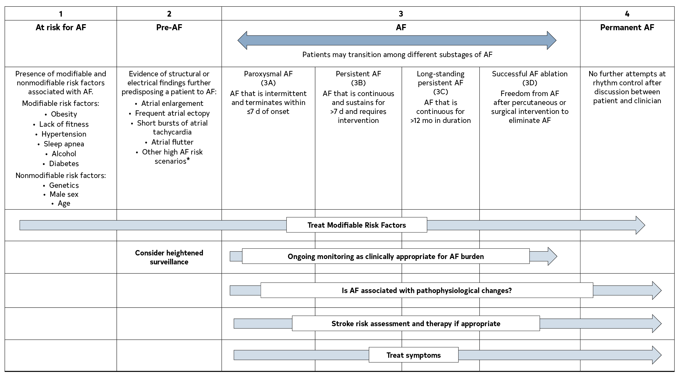
Figure 4. AF Stages: Evolution of Atrial Arrhythmia Progression
AF indicates atrial fibrillation.

Slide 40
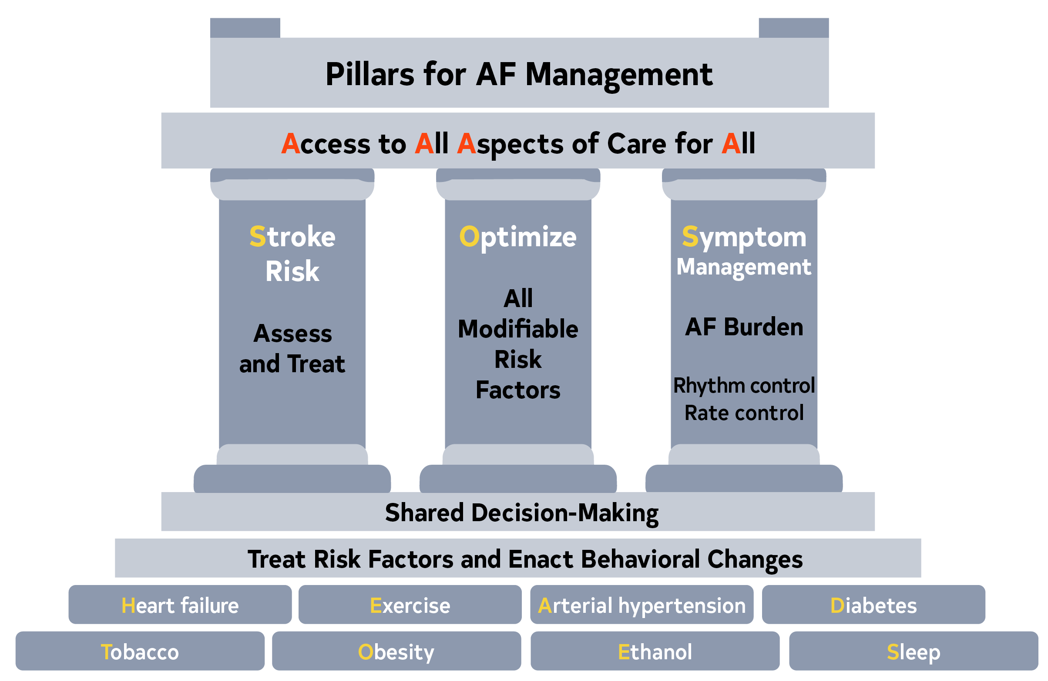
Figure 5. Pillars for AF Management
AF indicates atrial fibrillation.

Slide 41
Figure 5. Pillars for AF Management (con’t.)
When AF develops, holistic and optimal care of the patient at risk for AF, or who has developed AF, can be simply modeled using a building. The foundation of care is treatment of comorbidities and risk factors and implementing behavioral change in all individuals to decrease the likelihood of developing AF and reducing its burden (Screening for all risk factors from HEAD 2 TOES). Once AF develops, there are 3 important care processes that must be specifically addressed with all patients and aligned with their goals of therapy: Stroke risk assessment and treatment, if appropriate, Optimizing all modifiable risk factors, and Symptom management using rate- and rhythm-control strategies that consider AF burden in the context of an individual patient’s needs (SOS). The overarching principle for AF management is Access to All Aspects of care to All (4 A’s).
AF indicates atrial fibrillation.

Slide 42
Table 4. Definitions
Term | Definition
Atrial fibrillation (AF) | A supraventricular tachyarrhythmia with uncoordinated atrial activation and ineffective atrial contraction
 | Electrocardiographic characteristics include (1) irregular R-R intervals (when atrioventricular conduction is present), (2) absence of distinct P waves, and (3) irregular atrial activity also known as fibrillatory waves. AF can be documented by, for example, 12-lead ECG, rhythm strips, wearables, intracardiac electrograms, but will always require visual confirmation that the diagnosis is accurate.
Clinical AF | With the increasing availability of wearable devices and other continuous monitoring technologies, the distinction between clinical and subclinical AF has become increasingly blurred, thus the writing committee felt the term clinical AF has become less useful. Yet, the term was kept because most of the evidence from randomized trials that have led to guideline recommendations for the treatment of AF refer to “clinical AF.” These trials required electrocardiographic documentation of the arrhythmia for inclusion and most patients presented for clinical evaluation and/or therapy of the arrhythmia.

Slide 43
Table 4. Definitions (con’t.)
Subclinical AF | Subclinical AF refers to this arrhythmia identified in individuals who do not have symptoms attributable to AF and in whom there are no previous ECGs documenting AF This includes AF identified by implanted devices (pacemakers, defibrillators, or implantable loop recorders) or wearable monitors
Atrial high-rate episodes (AHRE) | These are defined as atrial events exceeding the programmed detection rate limit set by the device. These are recorded by implanted devices but require visual inspection to confirm AF and exclude other atrial arrhythmias, artifact or oversensing.
AF burden | AF burden encompasses both frequency and duration and refers to the amount of AF that an individual has. AF burden has been defined differently across studies. For the purpose of this guideline, AF burden will be defined as the durations of an an episode or as a percentage of AF duration during the monitoring period depending on how it was defined in the individual studies.

Slide 44
Table 4. Definitions (con’t.)
First detected AF | The first documentation of AF, regardless of previous symptoms
Paroxysmal AF | AF that is intermittent and terminates within <7 d of onset
Persistent AF | AF that is continuous and sustains for >7 d and requires intervention. Of note, patients with persistent AF who, with therapy, become paroxysmal should still be defined as persistent as this reflects their original pattern and is a more useful to predict outcomes and define substrate.
Long-standing persistent AF | AF that is continuous for >12 mo in duration
Permanent AF | A term that is used when the patient and clinician make a joint decision to stop further attempts to restore and/or maintain sinus rhythm Acceptance of AF represents a therapeutic decision and does not represent an inherent pathophysiological attribute of AF

Slide 45
Table 4. Definitions (con’t.)
Terms considered obsolete
Chronic AF | This historical term has had variable definitions and should be abandoned. It has been replaced by the “paroxysmal”, “persistent”, “long-standing persistent” and “permanent” terminology.
Valvular and nonvalvular AF | The distinction between “valvular” and “non-valvular “AF remains a matter of debate. Their definitions may be confusing. Recent trials comparing vitamin K antagonists with non-vitamin K antagonist oral anticoagulants in AF were performed among patients with so-called "non-valvular" AF. These trials have all allowed native valvular heart disease other than mitral stenosis (mostly moderate and severe) and prosthetic heart valves to be included. We should no longer consider the classification of AF as ‘‘valvular’’ or “non-valvular” for the purpose of defining the etiology of AF, since the term was specific for eligibility of stroke risk reduction therapies. Valvular and nonvalvular terminology should be abandoned.
Lone AF | This term has been used in the past to identify AF in younger patients without structural heart disease who are at a lower risk for thromboembolism. This term does not enhance patient care, is not currently used and should be abandoned.

Slide 46
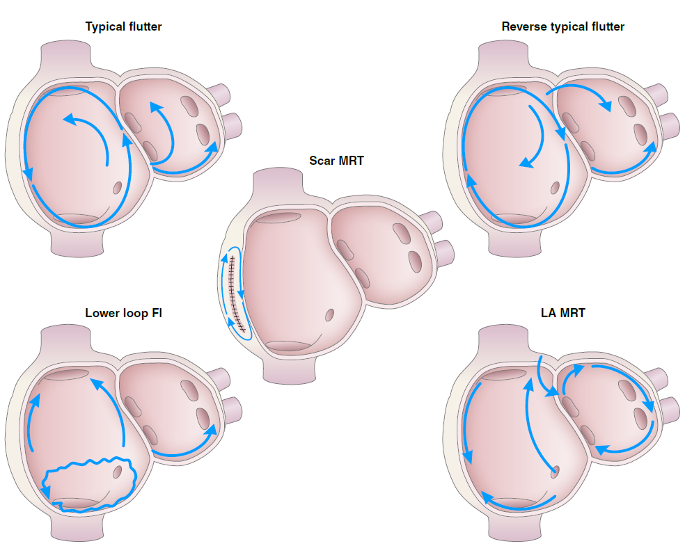
Figure 6. Types of Atrial Flutter and Macroreentrant Atrial Tachycardia
The typical, reverse typical, and the lower-loop flutter all have the low right atrial isthmus incorporated in the flutter circuit. Other macroreentrant flutters include scar-mediated reentrant tachycardia and left mitral isthmus flutter.
Fl indicates flutter; LA, left atrium; and MRT, macroreentrent.

Slide 47
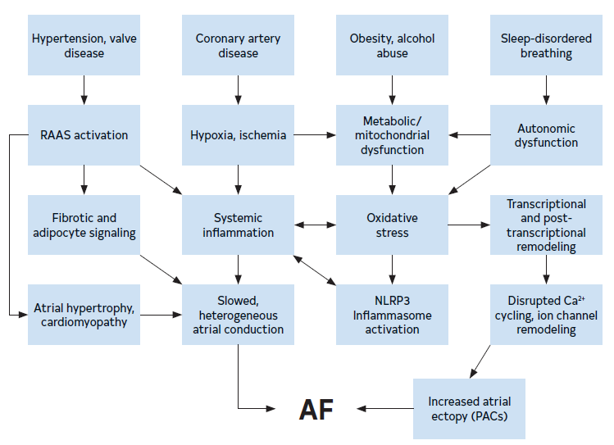
Figure 7. Mechanisms and Pathways Leading to AF
The pathways that contribute to the development of AF create a substrate for re-entry and provide triggers that can initiate arrhythmic activity.
AF indicates atrial fibrillation; PACs, premature atrial contractions; and RAAS, renin-angiotensin-aldosterone system.

Slide 48
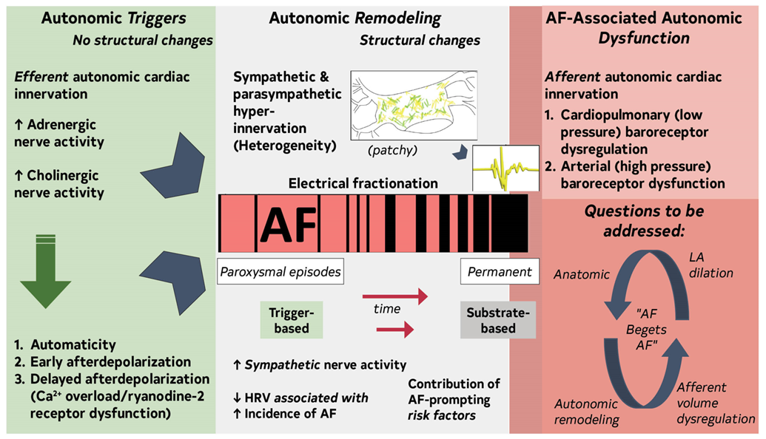
Figure 8. Contemporary Summary of the Role of the ANS in AF
AF indicates atrial fibrillation; ANS, autonomic nervous system; HRV, heart rate variability; and LA, left atrium

Slide 49
Addressing Health Inequities and Barriers to AF Management
Recommendations to Address Health Inequities and Barriers to AF Management Referenced studies that support the recommendations are summarized in the Online Data Supplement. | Recommendations to Address Health Inequities and Barriers to AF Management Referenced studies that support the recommendations are summarized in the online supplement.
COR | LOE | Recommendations
1 | B-NR | Patients with AF, regardless of sex and gender diversity, race and ethnicity, or adverse social determinants of health (SDOH), should be equitably offered guideline-directed stroke risk reduction therapies as well as rate or rhythm control strategies and LRFM as indicated to improve quality of life (QOL) and prevent adverse outcomes.

Slide 50
Shared Decision-Making (SDM) in AF Management
Recommendation for SDM in AF Management Referenced studies that support the recommendations are summarized in the Online Data Supplement. | Recommendation for SDM in AF Management Referenced studies that support the recommendations are summarized in the online data supplement.
COR | LOE | Recommendation
2b | B-R | In patients with AF, the use of evidence-based decision aids might be useful to guide stroke reduction therapy treatment decisions throughout the disease course to improve engagement, decisional quality, and patient satisfaction.

Slide 51
Table 5. Publicly Available Decision Aids
Agency | Website | Focus Area
American College of Cardiology Colorado Program for Patient Centered Decisions | https://patientdecisionaid.org/icd/atrial-fibrillation/ | Stroke risk reduction therapies
Anticoagulation Choice Decision Aid | https://anticoagulationdecisionaid.mayoclinic.org/ | Stroke risk reduction therapies
Ottawa Hospital Research Institute Developer Healthwise | https://decisionaid.ohri.ca/AZlist.html | AF ablation Stroke risk reduction
Stanford | https://afibguide.com/ | Stroke risk reduction therapies

Slide 52
Clinical Evaluation

Slide 53
Table 6. CHARGE-AF Risk Score for Detecting Incident AF*
Variable (X) | Estimated β coefficient (SE) | HR (95% CI)
Age (per 5-y increment) | 0.508 (0.022) | 1.66 (1.59-1.74)
White race | 0.465 (0.093) | 1.59 (1.33-1.91)
Height (per 10-cm increment) | 0.248 (0.036) | 1.28 (1.19-1.38)
Weight (per 15-kg increment) | 0.115 (0.033) | 1.12 (1.05-1.20)
Systolic BP (per 20-mm Hg increment) | 0.197 (0.033) | 1.22 (1.14-1.30)
Diastolic BP (per 10-mm Hg increment) | -0.101 (0.032) | 0.90 (0.85-0.96)
Smoking (current versus former/never) | 0.359 (0.063) | 1.42 (1.25-1.60)
Diabetes (yes) | 0.237 (0.073) | 1.27 (1.64-2.48)
Myocardial infarction (yes) | 0.496 (0.089) | 1.64 (1.38-1.96)
*Five-year risk is given by: 1 – 0.9718412736exp^{(ΣβX – 12.4411305)} , where β is the regression coefficient (column 2) and X is the level of each variable risk factor. Table 6 does not encompass all complications.
AF indicates atrial fibrillation; BP, blood pressure; CHARGE-AF, Cohorts for Heart and Aging Research in Genomic Epidemiology model for atrial fibrillation; HR, hazard ratio; and SE, standard error.

Slide 54
Table 7. C₂HEST Risk Score for Detecting Incident AF*
Acronym | Risk Factor | Points
C₂ | CAD/COPD | 1-2
H | Hypertension | 1
E | Elderly (age ≥75 y) | 2
S | Systolic heart failure | 2
T | Thyroid disease (hyperthyroidism) | 1
*Total points 0-8. For the C₂HEST score, the C statistic was 0.749, with 95% CI of 0.729–0.769. The incident rate of AF increased significantly with higher C₂HEST scores.
AF indicates atrial fibrillation; CAD, coronary artery disease; C₂HEST, coronary artery disease or chronic obstructive pulmonary disease [1 point each]; hypertension [1 point]; elderly [age ≥75 y, 2 points]; systolic HF [2 points]; thyroid disease [hyperthyroidism, 1 point]); and COPD, chronic obstructive pulmonary disease.

Slide 55
Basic Clinical Evaluation
Recommendations for Basic Clinical Evaluation Referenced studies that support the recommendations are summarized in the Online Data Supplement. | Recommendations for Basic Clinical Evaluation Referenced studies that support the recommendations are summarized in the online data supplement.
COR | LOE | Recommendations
1 | B-NR | In patients with newly diagnosed AF, a transthoracic echocardiogram to assess cardiac structure, laboratory testing to include a complete blood count, metabolic panel, and thyroid function,⁵⁻⁷ and when clinical suspicion exists, targeted testing to assess for other medical conditions associated with AF are recommended to determine stroke and bleeding risk factors, as well as underlying conditions that will guide further management.
3: No benefit | B-NR | In patients with newly diagnosed AF, protocolized testing for ischemia, acute coronary syndrome (ACS), and pulmonary embolism (PE) should not routinely be performed to assess the etiology of AF unless there are additional signs or symptoms to indicate those disorders.

Slide 56
Rhythm Monitoring Tools and Methods
Recommendations for Rhythm Monitoring Tools and Methods Referenced studies that support the recommendations are summarized in the Online Data Supplement. | Recommendations for Rhythm Monitoring Tools and Methods Referenced studies that support the recommendations are summarized in the online supplement.
COR | LOE | Recommendations
1 | B-NR | Among individuals without a known history of AF, it is recommended that an initial AF diagnosis be made by a clinician using visual interpretation of the electrocardiographic signals, regardless of the type of rhythm or monitoring device.
1 | B-NR | In patients with an intracardiac rhythm device capable of a diagnosis of AF, such as from an atrial pacemaker lead, a diagnosis of AF should only be made after it is visually confirmed by reviewing intracardiac tracings to exclude signal artifacts and other arrhythmias.

Slide 57
Rhythm Monitoring Tools and Methods (con’t.)
2a | B-R | For patients who have had a systemic thromboembolic event without a known history of AF and in whom maximum sensitivity to detect AF is sought, an implantable cardiac monitor is reasonable.
2a | B-NR | Among patients with a diagnosis of AF, it is reasonable to infer AF frequency, duration, and burden using automated algorithms available from electrocardiographic monitors, implantable cardiac monitors, and cardiac rhythm devices with an atrial lead, recognizing that periodic review can be required to exclude other arrythmias.
2a | B-R | Among patients with AF in whom cardiac monitoring is advised, it is reasonable to recommend use of a consumer-accessible electrocardiographic device that provides a high-quality tracing to detect recurrences.

Slide 58
Lifestyle and Risk Factor Modification (LRFM) for AF Management

Slide 59
Primary Prevention
Recommendation for Primary Prevention Referenced studies that support the recommendations are summarized in the Online Data Supplement. | Recommendations for Primary Prevention Referenced studies that support the recommendations are summarized in the online data supplement.
COR | LOE | Recommendation
1 | B-NR | Patients at increased risk of AF should receive comprehensive guideline-directed LRFM for AF, targeting obesity, physical inactivity, unhealthy alcohol consumption, smoking, diabetes, and hypertension.

Slide 60
Weight Loss in Individuals Who Are Overweight or Obese
Recommendation for Weight Loss in Individuals Who Are Overweight or Obese Referenced studies that support the recommendation are summarized in the Online Data Supplement. | Recommendation for Weight Loss in Individuals Who Are Overweight or Obese Referenced studies that support the recommendation are summarized in the online data supplement.
COR | LOE | Recommendation
1 | B-R | In patients with AF who are overweight or obese (with body mass index [BMI] >27 kg/m²), weight loss is recommended, with an ideal target of at least 10% weight loss to reduce AF symptoms, burden, recurrence, and progression to persistent AF.

Slide 61
Physical Fitness
Recommendation for Physical Fitness Referenced studies that support the recommendation are summarized in the Online Data Supplement. | Recommendation for Physical Fitness Referenced studies that support the recommendation are summarized in the online data supplement.
COR | LOE | Recommendation
1 | B-R | In individuals with AF,* moderate to vigorous exercise training to a target of 210 minutes per week is recommended to reduce AF symptoms and burden, increase maintenance of sinus rhythm, increase functional capacity, and improve QOL.
*In patients without AF related to excessive exercise training.

Slide 62
Smoking Cessation
Recommendation for Smoking Cessation Referenced studies that support the recommendation are summarized in the Online Data Supplement. | Recommendation for Smoking Cessation Referenced studies that support the recommendation are summarized in the online data supplement.
COR | LOE | Recommendation
1 | B-NR | Patients with a history of AF who smoke cigarettes should be strongly advised to quit smoking and should receive GDMT for tobacco cessation to mitigate increased risks of AF-related cardiovascular complications and other adverse outcomes.

Slide 63
Alcohol Consumption
Recommendation for Alcohol Consumption Referenced studies that support the recommendation are summarized in the Online Data Supplement. | Recommendation for Alcohol Consumption Referenced studies that support the recommendation are summarized in the online data supplement.
COR | LOE | Recommendation
1 | B-R | Patients with AF seeking a rhythm-control strategy should minimize or eliminate alcohol consumption to reduce AF recurrence and burden.

Slide 64
Caffeine Consumption
Recommendation for Caffeine Consumption Referenced studies that support the recommendation are summarized in the Online Data Supplement. | Recommendation for Caffeine Consumption Referenced studies that support the recommendation are summarized in the online data supplement.
COR | LOE | Recommendation
3: No Benefit | B-NR | 1. For patients with AF, recommending caffeine abstention to prevent AF episodes is of no benefit, although it may reduce symptoms in patients who report caffeine triggers or worsens AF symptoms.

Slide 65
Treatment of Hypertension
Recommendation for the Treatment of Hypertension Referenced studies that support the recommendation are summarized in the Online Data Supplement. | Recommendation for the Treatment of Hypertension Referenced studies that support the recommendation are summarized in the online data supplement.
COR | LOE | Recommendation
1 | B-NR | For patients with AF and hypertension, optimal BP control is recommended to reduce AF recurrence and AF-related cardiovascular events.

Slide 66
Sleep
Recommendation for Sleep Referenced studies that support the recommendation are summarized in the Online Data Supplement. | Recommendation for Sleep Referenced studies that support the recommendation are summarized in the online data supplement.
COR | LOE | Recommendation
2b | B-NR | Among patients with AF, it may be reasonable to screen for obstructive sleep apnea, given its high prevalence in patients with AF, although the role of treatment of sleep-disordered breathing (SDB) to maintain sinus rhythm is uncertain.

Slide 67
Comprehensive Care
Recommendations for Comprehensive Care Referenced studies that support the recommendations are summarized in the Online Data Supplement. |  | Recommendations for Comprehensive Care Referenced studies that support the recommendations are summarized in the online data supplement.
COR | LOE | Recommendations
1 | A | Patients with AF should receive comprehensive care addressing guideline-directed LRFM, AF symptoms, risk of stroke, and other associated medical conditions to reduce AF burden, progression, or consequences.
2a | B-R | In patients with AF, use of clinical care pathways, such as nurse-led AF clinics, is reasonable to promote comprehensive, team-based care and to enhance adherence to evidence-based therapies for AF and associated conditions.

Slide 68
Prevention of Thromboembolism

Slide 69
Risk Stratiﬁcation Schemes
Recommendations for Risk Stratification Schemes Referenced studies that support the recommendations are summarized in the Online Data Supplement. | Recommendations for Risk Stratification Schemes Referenced studies that support the recommendations are summarized in the online data supplement.
COR | LOE | Recommendations
1 | B-NR | Patients with AF should be evaluated for their annual risk of thromboembolic events using a validated clinical risk score, such as CHA₂DS₂-VASc.
1 | B-NR | Patients with AF should be evaluated for factors that specifically indicate a higher risk of bleeding, such as previous bleeding and use of drugs that increase bleeding risk, in order to identify possible interventions to prevent bleeding on anticoagulation.

Slide 70
Risk Stratiﬁcation Schemes (con’t.)
2a | C-LD | Patients with AF at intermediate annual risk of thromboembolic events by risk scores (eg, equivalent to CHA₂DS₂-VASc score of 1 in men or 2 in women), who remain uncertain about the benefit of anticoagulation, can benefit from consideration of factors that might modify their risk of stroke to help inform the decision.*
3: No Benefit | B-NR | In patients who are deemed at high risk for stroke, bleeding risk scores should not be used in isolation to determine eligibility for oral anticoagulation but instead to identify and modify bleeding risk factors and to inform medical decision-making.
*Factors may include AF burden or other features in Table 3.

Slide 71
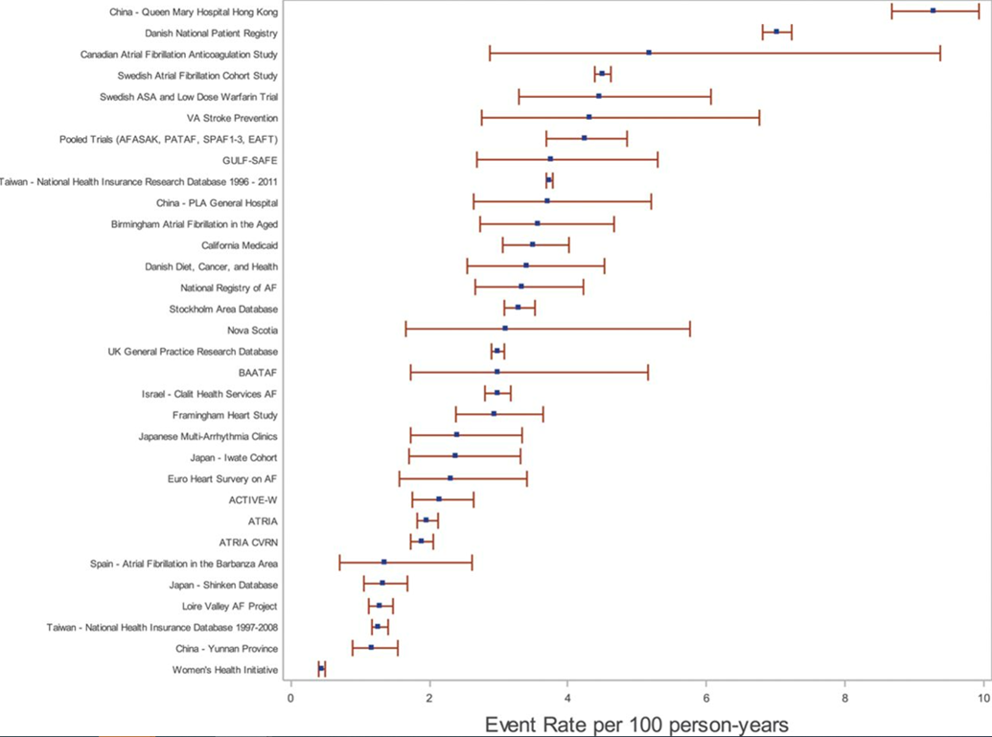
Figure 9. Rates of Stroke by Stroke Risk Score Levels in Different Cohorts.
Overall stroke rate in atrial fibrillation cohorts in order of descending stroke rate (events per 100 person-years).

Slide 72
Table 8. Three Validated Risk Models for Stroke
Risk Factor | CHA₂DS₂-VASc | ATRIA | GARFIELD
Age ≥85 y |  | 6 | 0.98
Age ≥75 y | 2 | 5 | 0.59
Age 65-74 y | 1 | 3 | 0.20
Female sex | 1 | 1
Hypertension | 1 |  | 0.16
Renal disease |  | 1 | 0.35
Diabetes | 1 | 1 | 0.21
Current smoking |  |  | 0.48
Congestive heart failure | 1 | 1 | 0.23
Previous stroke or TIA | 2 | 2–8* | 0.80
Vascular disease | 1 |  | 0.20
Dementia |  |  | 0.51
Previous bleeding |  |  | 0.30
Proteinuria |  | 1
Low risk score | 0 | 0–5 | 0–0.89
Intermediate risk score | 1 | 6 | 0.90–1.59
High risk score | ≥2 | 7–15 | ≥1.60
C-index (11) | 0.63 | 0.66 | -
C-index (13) | 0.67 | - | 0.71
ATRIA indicates Anticoagulation and Risk Factors in Atrial Fibrillation: anemia, renal
disease, elderly (age ≥75 y), any previous bleeding, hypertension; CHA₂DS₂-VASc, indicates
congestive heart failure, hypertension, age ≥75 y (doubled), diabetes mellitus,
prior stroke or transient ischemic attack or thromboembolism (doubled), vascular disease,
age 65 to 74 y, sex category; GARFIELD-AF, Global Anticoagulant Registry in the
Field-Atrial Fibrillation; and TIA, transient ischemic attack.
* 8 points if age <65 y; 4 points if age 65-74 y; 2 points if age 75-84 y; and 3 points if
≥85 y.
TIA indicates transient ischemic attack.

Slide 73
Table 9. Some Best Known Published Clinical Scores With Potential Advantages
Year of Publication Score Name | Score Components | Potential Advantages | No. of Validation Studies | Hyperlink to Online Score Calculator if Available
2001 CHADS₂ | CHF, hypertension, age (≥65 y is 1 point, ≥75 y is 2 points), diabetes, stroke/TIA (2 points) | CHADS₂ was superior to existing risk classification schemes AFI scheme: C-statistic = 0.68 (0.65–0.71) SPAF-III scheme: C-statistic = 0.74 (0.71–0.76) CHADS₂ score: C-statistic = 0.82 (0.80–0.84) | 46 | https://www.mdcalc.com/calc/40/chads2-score-atrial-fibrillation-stroke-risk
2010 CHA₂DS₂-VASc | CHF, hypertension, age ≥75 y, diabetes, stroke or TIA, vascular disease, age 65–74 y, female sex | Most commonly used and studied, superior to CHADS₂ score. C-statistic = 0.606 (0.513–0.699) for CHA₂DS₂-VASc score vs 0.561 (0.450–0.672) for CHADS₂ score Improved compared with original CHADS₂ score | 82 | https://www.mdcalc.com/calc/801/cha2ds2-vasc-score-atrial-fibrillation-stroke-risk#next-steps
CHF indicates congestive heart failure; GFR, glomerular filtration rate; SPAF-III, stroke prevention atrial fibrillation, and TIA, transient ischemic attack.

Slide 74
Table 9. Some Best Known Published Clinical Scores With Potential Advantages (con’t.)
2013 ATRIA | Age (65–74 y is 3 points, 75–84 y is 5 points, ≥85 y is 6 points), hypertension, diabetes, CHF, proteinuria, GFR <45 mL/min/1.73 m², sex | Includes more age categories, renal function, and proteinuria More patients were classified as low or high risk but not as well tested in general. | 11 | https://www.mdcalc.com/calc/1842/atria-stroke-risk-score
2017 GARFIELD-AF | Web-based, uses routinely collected clinical data, and includes a total of 16 questions | Web-based tool for predicting stroke and mortality, includes the effect of the different anticoagulants, bleeding risk and mortality to facilitate shared decision making on the potential benefits/risks of anticoagulation | 4 | https://af.garfieldregistry.org/garfield-af-risk-calculator
2016 modified CHA₂DS₂-VASc | Expanded lower threshold for age to 50 y (1 point for age 50–74 y) | Validated in Asian cohort Can further identify Asian AF patients who may derive benefits from stroke prevention. In one study, mCHA₂DS₂-VASc was superior to CHA₂DS₂-VASc C-statistics = 0.708 (0.703–0.712) vs. 0.689 (0.684–0.694) | 1
CHF indicates congestive heart failure; GFR, glomerular filtration rate; SPAF-III, stroke prevention atrial fibrillation, and TIA, transient ischemic attack.

Slide 75
Table 10. Risk Factor Definitions for CHA₂DS₂-VASc² Score as in the Original Article
C | Heart Failure | The presence of signs and symptoms of either right (elevated central venous pressure, hepatomegaly, dependent edema) or left ventricular failure (exertional dyspnea, cough, fatigue, orthopnea, paroxysmal nocturnal dyspnea, cardiac enlargement, rates, gallop rhythm, pulmonary venous congestion) or both, confirmed by noninvasive or invasive measurements demonstrating objective evidence of cardiac dysfunction
H | Hypertension | A resting blood pressure >140 mm Hg systolic and/or >90 mm Hg diastolic on at least 2 occasions or current antihypertensive pharmacological treatment
A₂ | Age, additional risk/point | Age ≥75 y
D | Diabetes | Fasting plasma glucose level ≥7.0 mmol/L (126 mg/dL) or treatment with hypoglycemic agent and/or insulin

Slide 76
Table 10. Risk Factor Definitions for CHA₂DS₂-VASc² Score as in the Original Article (con’t.)
S₂ | Thromboembolism | Either an ischemic stroke, transient ischemic attack, peripheral embolism, or pulmonary embolism
V | Vascular disease | Coronary artery disease (prior myocardial infarction, angina pectoris, percutaneous coronary intervention, or coronary artery bypass surgery) or peripheral vascular disease (the presence of any of the following: intermittent claudication, previous surgery or percutaneous intervention on the abdominal aorta or the lower extremity vessels, abdominal or thoracic vascular surgery, arterial and venous thrombosis)
A | Age standard risk/weight | Age 65–74 y
Sc | Sex Category | Female sex

Slide 77
Table 11. Additional Risk Factors That Increase Risk of Stroke Not Included in CHA₂DS₂-VASc
Higher AF burden/Long duration
Persistent/permanent AF vs paroxysmal
Obesity (BMI ≥30 kg/m²)
HCM
Poorly controlled hypertension
eGFR (<45 mL/h)
Proteinuria (>150 mg/24 h or equivalent)
Enlarged LA volume (≥73 mL) or diameter (≥4.7 cm)
AF indicates atrial fibrillation; BMI, body mass index; eGFR, estimated glomerular filtration rate; HCM, hypertrophic cardiomyopathy; and LA, left atrium.

Slide 78
Table 12. Thromboembolic Event Rates by Point Score for ATRIA, CHADS₂, and CHA₂DS₂‐VASc Risk Scores*
Points | ATRIA |  |  | CHADS₂† |  |  | CHA₂DS₂‐VASc‡
 | Events | Person‐Years | Rate per 100 Person‐Years | Events | Person‐Years | Rate per 100 Person‐Years | Events | Person‐Years | Rate per 100 Person‐Years
0 | 2 | 2652 | 0.08 | 22 | 6126 | 0.36 | 1 | 2493 | 0.04
1 | 12 | 2819 | 0.43 | 121 | 10 084 | 1.20 | 21 | 3806 | 0.55
2 | 14 | 1419 | 0.99 | 253 | 9757 | 2.59 | 46 | 5560 | 0.83
3 | 13 | 1780 | 0.73 | 178 | 4782 | 3.72 | 121 | 7305 | 1.66
4 | 19 | 2960 | 0.64 | 81 | 1309 | 6.19 | 193 | 6898 | 2.80
5 | 36 | 3614 | 0.99 | 19 | 450 | 4.23 | 175 | 4057 | 4.31
6 | 83 | 4346 | 1.91 | 11 | 101 | 10.84 | 85 | 1783 | 4.77
*Black lines identify thresholds for low‐, moderate‐, and high‐risk categories for the 3 stroke risk point scores using published cut points.
†The CHADS2 score assigns points as follows: 1 point each for the presence of congestive heart failure, hypertension, age ≥75 y, and diabetes mellitus and 2 points for history of stroke/transient ischemic attack.
‡The CHA2DS2‐VASc score assigns points as follows: 1 point each for congestive heart failure/left ventricular dysfunction, hypertension, diabetes mellitus, vascular disease, age 65 to 74 y, and female sex, and 2 points each for age ≥75 years and stroke/transient ischemic attack/thromboembolism.

Slide 79
Table 12. Thromboembolic Event Rates by Point Score for ATRIA, CHADS₂, and CHA₂DS₂‐VASc Risk Scores* (con’t.)
Points | ATRIA |  |  | CHADS₂† |  |  | CHA₂DS₂‐VASc‡
 | Events | Person‐Years | Rate per 100 Person‐Years | Events | Person‐Years | Rate per 100 Person‐Years | Events | Person‐Years | Rate per 100 Person‐Years
7 | 119 | 4768 | 2.50 | — | — | — | 24 | 498 | 4.82
8 | 151 | 3913 | 3.86 | — | — | — | 14 | 179 | 7.82
9 | 104 | 2400 | 4.33 | — | — | — | 5 | 30 | 16.62
10 | 75 | 1181 | 6.35 | — | — | — | — | — | —
11 | 31 | 501 | 6.18 | — | — | — | — | — | —
*Black lines identify thresholds for low‐, moderate‐, and high‐risk categories for the 3 stroke risk point scores using published cut points.
†The CHADS₂ score assigns points as follows: 1 point each for the presence of congestive heart failure, hypertension, age ≥75 y, and diabetes mellitus and 2 points for history of stroke/transient ischemic attack.
‡The CHA₂DS₂‐VASc score assigns points as follows: 1 point each for congestive heart failure/left ventricular dysfunction, hypertension, diabetes mellitus, vascular disease, age 65 to 74 y, and female sex, and 2 points each for age ≥75 years and stroke/transient ischemic attack/thromboembolism.
ATRIA indicates Anticoagulation and Risk Factors in Atrial Fibrillation: anemia, renal disease, elderly (age $75 y), any previous bleeding, hypertension; CHADS2, congestive heart failure, hypertension, age >75 y, diabetes, stroke/transient ischemia attack/thromboembolism; and CHA2DS2-VASc, indicates congestive heart failure, hypertension, age $75 y (doubled), diabetes mellitus, prior stroke or transient ischemic attack or thromboembolism (doubled), vascular disease, age 65 to 74 y, sex category.

Slide 80
Table 12. Thromboembolic Event Rates by Point Score for ATRIA, CHADS₂, and CHA₂DS₂‐VASc Risk Scores* (con’t.)
Points | ATRIA |  |  | CHADS₂† |  |  | CHA₂DS₂‐VASc‡
 | Events | Person‐Years | Rate per 100 Person‐Years | Events | Person‐Years | Rate per 100 Person‐Years | Events | Person‐Years | Rate per 100 Person‐Years
12 | 20 | 183 | 10.95 | — | — | — | — | — | —
13 | 4 | 53 | 7.52 | — | — | — | — | — | —
14 | 2 | 12 | 16.36 | — | — | — | — | — | —
15 | 0 | 7 | 0 | — | — | — | — | — | —
All | 685 | 32 609 | 2.10 | — | — | — | — | — | —
*Black lines identify thresholds for low‐, moderate‐, and high‐risk categories for the 3 stroke risk point scores using published cut points.
†The CHADS2 score assigns points as follows: 1 point each for the presence of congestive heart failure, hypertension, age ≥75 y, and diabetes mellitus and 2 points for history of stroke/transient ischemic attack.
‡The CHA2DS2‐VASc score assigns points as follows: 1 point each for congestive heart failure/left ventricular dysfunction, hypertension, diabetes mellitus, vascular disease, age 65 to 74 y, and female sex, and 2 points each for age ≥75 years and stroke/transient ischemic attack/thromboembolism.
ATRIA indicates Anticoagulation and Risk Factors in Atrial Fibrillation: anemia, renal disease, elderly (age $75 y), any previous bleeding, hypertension; CHADS2, congestive heart failure, hypertension, age >75 y, diabetes, stroke/transient ischemia attack/thromboembolism; and CHA2DS2-VASc, indicates congestive heart failure, hypertension, age $75 y (doubled), diabetes mellitus, prior stroke or transient ischemic attack or thromboembolism (doubled), vascular disease, age 65 to 74 y, sex category.

Slide 81
Risk-Based Selection of Oral Anticoagulation: Balancing Risks and Benefits
Recommendations for Risk-Based Selection of Oral Anticoagulation: Balancing Risks and Benefits Referenced studies that support the recommendations are summarized in the Online Data Supplement. | Recommendations for Risk-Based Selection of Oral Anticoagulation: Balancing Risks and Benefits Referenced studies that support the recommendations are summarized in the online data supplement.
COR | LOE | Recommendations
1 | B-R | In patients diagnosed with AF who have an estimated annual risk of stroke or thromboembolic events ≥2%, selection of therapy to reduce the risk of stroke should be based on the risk of thromboembolism, regardless of whether the AF pattern is paroxysmal, persistent, long-standing persistent, or permanent.
1 | B-NR | In patients with AF at risk for stroke, reevaluation of the need for and choice of stroke risk reduction therapy at periodic intervals is recommended to reassess stroke and bleeding risk, net clinical benefit, and proper dosing.

Slide 82
Antithrombotic Therapy
Recommendations for Antithrombotic Therapy Referenced studies that support the recommendations are summarized in the Online Data Supplement. | Recommendations for Antithrombotic Therapy Referenced studies that support the recommendations are summarized in the online data supplement.
COR | LOE | Recommendations
1 | A | For patients with AF and an estimated annual thromboembolic risk of ≥2% per year (eg, CHA₂DS₂-VASc score of ≥2 in men and ≥3 in women), anticoagulation is recommended to prevent stroke and systemic thromboembolism.
1 | A | In patients with AF who do not have a history of moderate to severe rheumatic mitral stenosis or a mechanical heart valve, and who are candidates for anticoagulation, DOACs are recommended over warfarin to reduce the risk of mortality, stroke, systemic embolism, and ICH.

Slide 83
Antithrombotic Therapy (con’t.)
2a | A | For patients with AF and an estimated annual thromboembolic risk of ≥1% but <2% per year (equivalent to CHA₂DS₂-VASc score of 1 in men and 2 in women), anticoagulation is reasonable to prevent stroke and systemic thromboembolism.
3: Harm | B-R | In patients with AF who are candidates for anticoagulation and without an indication for antiplatelet therapy, aspirin either alone or in combination with clopidogrel as an alternative to anticoagulation is not recommended to reduce stroke risk.
3: No Benefit | B-NR | In patients with AF without risk factors for stroke, aspirin monotherapy for prevention of thromboembolic events is of no benefit.

Slide 84
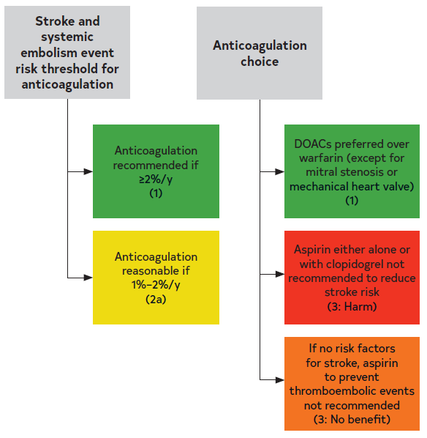
Figure 10. Antithrombotic Options in Patients with AF
DOAC indicates direct oral anticoagulant.
Colors correspond to Table 2.

Slide 85
Considerations in Managing Anticoagulants
Recommendations for Considerations in Managing Anticoagulants Referenced studies that support the recommendations are summarized in the Online Data Supplement. | Recommendations for Considerations in Managing Anticoagulants Referenced studies that support the recommendations are summarized in the online data supplement.
COR | LOE | Recommendations
1 | C-LD | For patients with AF receiving DOACs, optimal management of drug interactions is recommended for those receiving concomitant therapy with interacting drugs, especially CYP 3A4 and/or p-glycoprotein inhibitors or inducers (Table 13).
1 | B-R | For patients with AF receiving warfarin,* a target INR between 2 and 3 is recommended, as well as optimal management of drug-drug interactions, consistency in vitamin K dietary intake, and routine INR monitoring to improve time in therapeutic range and to minimize risks of preventable thromboembolism or major bleeding.
3: Harm | B-NR | For patients with AF, nonevidence-based doses of DOACs should be avoided to minimize risks of preventable thromboembolism or major bleeding and to improve survival.
*Excludes patients with mechanical valves.

Slide 86
Table 13. OACs Pharmacokinetic Characteristics and Dosing
Class | VKA | Direct Thrombin Inhibitor | Factor Xa Inhibitor
Name | Warfarin | Dabigatran | Rivaroxaban | Apixaban | Edoxaban
Metabolism | S-isomer: CYP2C9 R-isomer: CYP1A2, CYP2C19, CYP3A4 | Minimal | CYP3A4/5 | CYP3A4 | Minimal CYP3A4
P-glycoprotein substrate | No | Yes | Yes | Yes | Yes
Excretion | 0% renal; very little warfarin excreted unchanged in urine | 80% renal | 66% renal, 28% feces | 27% renal, 73% biliary and intestinal | 50% renal, 50% liver and biliary/intestinal
Half-life | 20-60 h | 12-17 h | 5-9 h | 12 h | 10-14 h
CrCl indicates creatinine clearance; INR, international normalized ratio; OAC, oral anticoagulant; Scr, serum creatinine; and VKA, vitamin K antagonist.

Slide 87
Table 13. OACs Pharmacokinetic Characteristics and Dosing (con’t.)
Renal dosing adjustment based on actual body weight | N/A | CrCl >30 mL/min | 150 mg twice daily | CrCl >50 mL/ min | 20 mg daily with the biggest meal* |  | 5 mg twice daily | CrCl >50 to ≤95 mL/ min | 60 mg once daily
 |  | CrCl 15-30 mL/min | 75 mg twice Daily | CrCl 15-50 mL/min | 15 mg daily with the biggest meal* | If any 2 of the following: age ≥80 y, body weight ≤60 kg, SCr ≥1.5 mg/dL | 2.5 mg twice daily | CrCl 15-50 mL/min | 30 mg once daily
CrCl indicates creatinine clearance; INR, international normalized ratio; OAC, oral anticoagulant; Scr, serum creatinine; and VKA, vitamin K antagonist.
*The effect of food (high-fat, high-calorie meal) on bioavailability for 10- and 20-mg tablet was evaluated in 24 subjects under fed and fasting conditions. After a single oral 20-mg dose, area
under the curve was increased by 39%, and Cmax was increased by 76% under fed condition, but area under the curve and Cmax were similar between fasting and fed conditions.19

Slide 88
Table 13. OACs Pharmacokinetic Characteristics and Dosing (con’t.)
Drug interaction management based on concomitant therapy of CYP3A4 inhibitors/p-glycoprotein inhibitors | Adjust dose based on INR trends | CrCl 30-50 mL/ min with concomitant use of dronedarone or systemic ketoconazole: 75 mg twice daily CrCl < 30 mL/min: avoid dabigatran use concomitantly with dronedarone or systemic ketoconazole | Avoid rivaroxaban use with concomitant therapy of combined p-glycoprotein and strong CYP3A4 inhibitors (eg, systemic ketoconazole and ritonavir) No dose adjustment required with clarithromycin Avoid rivaroxaban use in patients with CrCl 15 to < 80 mL/min receiving combined p-glycoprotein and moderate CYP3A4 inhibitors (eg, erythromycin) | In patients receiving apixaban 5 mg twice daily, reduce dose to 2.5 mg twice daily when combined p-glycoprotein and strong CYP3A4 inhibitors (eg, itraconazole, systemic ketoconazole, ritonavir) are concomitantly used If patients already receiving apixaban 2.5 mg twice daily, avoid apixaban use if combined p-glycoprotein and strong CYP3A4 inhibitors are used concomitantly | No dose adjustment is required
CrCl indicates creatinine clearance; INR, international normalized ratio; OAC, oral anticoagulant; Scr, serum creatinine; and VKA, vitamin K antagonist.

Slide 89
Table 13. OACs Pharmacokinetic Characteristics and Dosing (con’t.)
Drug interaction management based on concomitant therapy of p-glycoprotein/ CYP3A4 inducers (eg, carbamazepine, phenytoin, rifampin, St. John’s wort) | Adjust dose based on INR trends | Avoid use | Avoid use | Avoid use | Avoid use with rifampin. No study evaluated the effect of other p-glycoprotein/ CYP3A4 inducers on edoxaban drug levels
CrCl indicates creatinine clearance; INR, international normalized ratio; OAC, oral anticoagulant; Scr, serum creatinine; and VKA, vitamin K antagonist.

Slide 90
Table 13. OACs Pharmacokinetic Characteristics and Dosing (con’t.)
Appropriate use based on liver function (Child-Pugh score)† Child-Pugh A (mild) | Not mentioned in the labeling | No dose adjustment needed | No dose adjustment needed | No dose adjustment needed | No dose adjustment needed
Child-Pugh B (moderate) |  | Use with caution | Avoid use | Use with caution | Use with caution
Child-Pugh C (severe) |  | Avoid use | Avoid use | Avoid use | Avoid use
†Child-Pugh scoring: the severity of liver disease, primarily cirrhosis. Child-Pugh A (mild): 5 to 6 points; Child-Pugh B (moderate): 7 to 9 points; Child-Pugh C (severe): 10 to 15 points. The score is based on the 5 variables: encephalopathy (none=1 point, grade 1 and 2=2 points, grade 3 and 4=3 points); ascites (none=1 point, slight=2 points, moderate=3 points); total bilirubin (<2 mg/mL=1 point, 2-3 mg/mL=2 points, >3 mg/mL=3 points); albumin (>3.5 mg/mL=1 point, 2.8-3.5 mg/mL=2 points, <2.8 mg/mL=3 points); INR (<1.7=1 point, 1.7-2.2=2 points, >2.2=3 points).

Slide 91
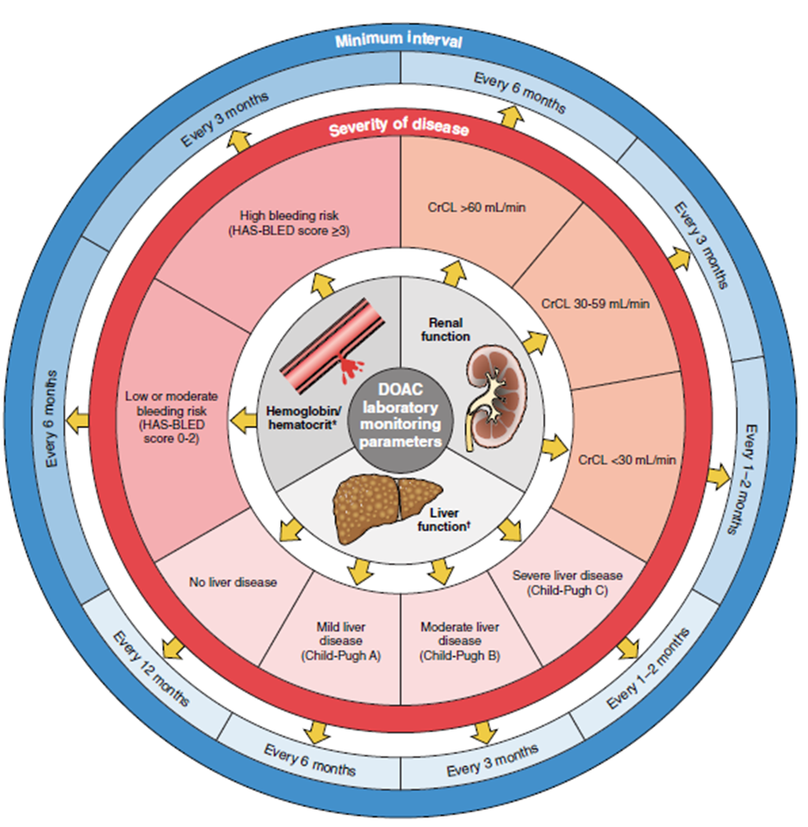
Figure 11. DOAC Laboratory Monitoring
CrCL indicates creatinine clearance based on actual body weight; DOAC, direct oral anticoagulant; and INR, international normalized ratio

Slide 92
Figure 11. DOAC Laboratory Monitoring (con’t.)
*HAS-BLED scoring (low risk=score 0, moderate risk=score 1-2, high risk=score ≥3): uncontrolled hypertension (systolic blood pressure >160 mm Hg)=1 point; abnormal renal (serum creatinine >2.26 mg/dL, dialysis, or kidney transplant) or hepatic function (bilirubin >2 times upper limit normal, alanine aminotransferase/aspartate aminotransferase/alkaline phosphatase >3 times upper limit normal, or cirrhosis)=1 or 2 points; stroke (hemorrhagic or ischemic)=1 point; bleeding history or predisposition=1 point; labile INR (time in therapeutic range <60%)=1 point; elderly age >65 years=1 point; drugs (antiplatelet agents or nonsteroidal anti-inflammatory drugs) or excessive alcohol intake (8 units/week)=1 or 2 points.
†Child-Pugh scoring: the severity of liver disease, primarily cirrhosis in patients with documented liver disease. Child-Pugh A (mild): 5 to 6 points; Child-Pugh B (moderate): 7 to 9 points; Child-Pugh C (severe): 10 to 15 points. The score is based on the 5 variables: encephalopathy (none=1 point, grade 1 and 2=2 points, grade 3 and 4=3 points); ascites (none=1 point, slight=2 points, moderate=3 points); total bilirubin (<2 mg/mL=1 point, 2-3 mg/mL=2 points, >3 mg/mL=3 points); albumin (>3.5 mg/mL=1 point, 2.8-3.5 mg/mL=2 points, <2.8 mg/mL=3 points); INR (<1.7=1 point, 1.7-2.2=2 points, >2.2=3 points).

Slide 93
Silent AF and Stroke of Undetermined Cause
Recommendation for Silent AF and Stroke of Undetermined Cause Referenced studies that support the recommendation are summarized in the Online Data Supplement. | Recommendation for Silent AF and Stroke of Undetermined Cause Referenced studies that support the recommendation are summarized in the online data supplement.
COR | LOE | Recommendation
2a | B-R | In patients with stroke or TIA of undetermined cause, initial cardiac monitoring, and, if needed, extended monitoring with an implantable loop recorder are reasonable to improve detection of AF.

Slide 94
Oral Anticoagulation for Device-Detected Atrial High-Rate Episodes Among Patients Without a Previous Diagnosis of AF
Recommendations for Oral Anticoagulation for Device-Detected Atrial High-Rate Episodes Among Patients Without a Previous Diagnosis of AF Referenced studies that support the recommendations are summarized in the Online Data Supplement. | Recommendations for Oral Anticoagulation for Device-Detected Atrial High-Rate Episodes Among Patients Without a Prior Diagnosis of AF Referenced studies that support the recommendations are summarized in the online data supplement.
COR | LOE | Recommendations
2a | B-NR | For patients with a device-detected atrial high-rate episode (AHRE) lasting ≥24 hours and with a CHA₂DS₂-VASc score ≥2 or equivalent stroke risk, it is reasonable to initiate oral anticoagulation within a SDM framework that considers episode duration and individual patient risk.

Slide 95
Patients Without a Prior Diagnosis of AF (con’t.)
2b | B-NR | For patients with a device-detected AHRE lasting between 5 minutes and 24 hours and with a CHA₂DS₂-VASc score ≥3 or equivalent stroke risk, it may be reasonable to initiate anticoagulation within a SDM framework that considers episode duration and individual patient risk.
3: No Benefit | B-NR | Patients with a device-detected AHRE lasting <5 minutes and without another indication for oral anticoagulation should not receive oral anticoagulation.

Slide 96
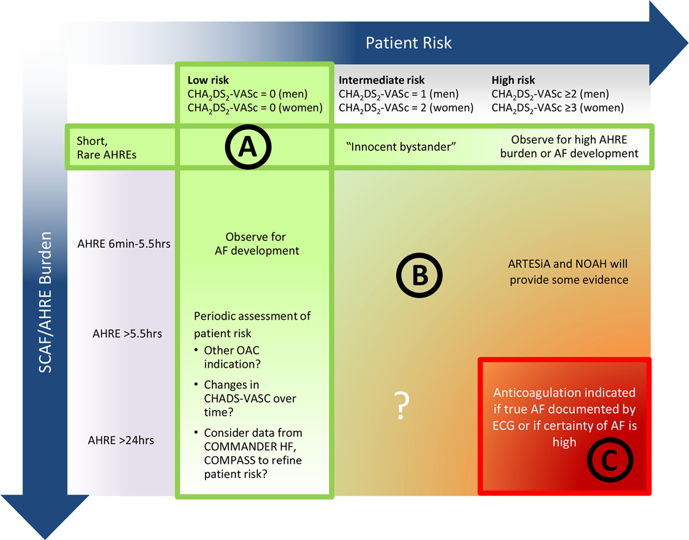
Figure 12. Consideration of Oral Anticoagulation for Device-Detected AHREs According to Patient Stroke Risk by CHA₂DS₂-VASc Score and Episode Duration

Slide 97
Figure 12. Consideration of Oral Anticoagulation for Device-Detected AHREs According to Patient Stroke Risk by CHA₂DS₂-VASc Score and Episode Duration (con’t.)
AF indicates atrial fibrillation; AHRE, atrial high-rate episode; ARTESiA, Apixaban for the Reduction of Thrombo-Embolism in Patients With Device-Detected Subclinical Atrial Fibrillation trial; COMMANDER HF, A Study to Assess the Effectiveness and Safety of Rivaroxaban in Reducing the Risk of Death, Myocardial Infarction, or Stroke in Participants With Heart Failure and Coronary Artery Disease Following an Episode of Decompensated Heart Failure; COMPASS, Cardiovascular Outcomes for People Using Anticoagulation Strategies; ECG, eletrocardiogram; NOAH, Non–Vitamin K Antagonist Oral Anticoagulants in Patients With Atrial High Rate Episodes Trial; OAC, oral anticoagulation; and SCAF, subclinical atrial fibrillation.

Slide 98
Percutaneous Approaches to Occlude the Left Atrial Appendage (LAA)
Recommendations for Percutaneous Approaches to Occlude the Left Atrial Appendage (LAA) Referenced studies that support the recommendations are summarized in the Online Data Supplement. | Recommendations for Percutaneous Approaches to Occlude the Left Atrial Appendage (LAA) Referenced studies that support the recommendations are summarized in the Online Data Supplement.
COR | LOE | Recommendations
2a | B-NR | In patients with AF, a moderate to high risk of stroke (CHAD₂DS₂-VASc score ≥2), and a contraindication (Table 14) to long-term oral anticoagulation due to a nonreversible cause, percutaneous LAAO (pLAAO) is reasonable.
2b | B-R | In patients with AF and a moderate to high risk of stroke and a high risk of major bleeding on oral anticoagulation, pLAAO may be a reasonable alternative to oral anticoagulation based on patient preference, with careful consideration of procedural risk and with the understanding that the evidence for oral anticoagulation is more extensive.

Slide 99
Table 14. Situations in Which Long-Term Anticoagulation Is Contraindicated and Situations When It Remains Reasonable
Long-Term Anticoagulation Contraindicated | Long-Term Anticoagulation Is Still Reasonable
Severe bleeding due to a nonreversible cause involving the gastrointestinal, pulmonary, or genitourinary systems Spontaneous intracranial/intraspinal bleeding due to a nonreversible cause Serious bleeding related to recurrent falls when cause of falls is not felt to be treatable | Bleeding involving the gastrointestinal, pulmonary, or genitourinary systems that is treatable Bleeding related to isolated trauma Bleeding related to procedural complications

Slide 100
Cardiac Surgery—Left Atrial Appendage (LAA) Exclusion/Excision
Recommendations for Cardiac Surgery—LAA Exclusion/Excision Referenced studies that support the recommendations are summarized in the Online Data Supplement. | Recommendations for Cardiac Surgery—LAA Exclusion/Excision Referenced studies that support the recommendations are summarized in the online supplement.
COR | LOE | Recommendations
1 | A | In patients with AF undergoing cardiac surgery with a CHA₂DS₂-VASc score ≥2 or equivalent stroke risk, surgical LAA exclusion, in addition to continued anticoagulation, is indicated to reduce the risk of stroke and systemic embolism.
1 | A | In patients with AF undergoing cardiac surgery and LAA exclusion, a surgical technique resulting in absence of flow across the suture line and a stump of <1 cm as determined by intraoperative transesophageal echocardiography should be used.
2b | A | In patients with AF undergoing cardiac surgery with CHA₂DS₂-VASc score ≥2 or equivalent stroke risk, the benefit of surgical LAA exclusion in the absence of continued anticoagulation to reduce the risk of stroke and systemic embolism is uncertain.

Slide 101
Active Bleeding on Anticoagulant Therapy and Reversal Drugs
 | Recommendations for Active Bleeding on Anticoagulant Therapy and Reversal Drugs Referenced studies that support the recommendations are summarized in the Online Data Supplement.
COR | LOE | Recommendations
1 | B-NR | In patients with AF receiving dabigatran who develop life-threatening bleeding, treatment with idarucizumab is recommended to rapidly reverse dabigatran’s anticoagulation effect.
2a | C-LD | In patients with AF receiving dabigatran who develop life-threatening bleeding, treatment with activated prothrombin complex concentrate (PCC) is reasonable to reverse dabigatran’s anticoagulation effect if idarucizumab is unavailable.

Slide 102
Active Bleeding on Anticoagulant Therapy and Reversal Drugs (con’t.)
1 | B-NR* | In patients with AF receiving factor Xa inhibitors who develop life-threatening bleeding, treatment with either andexanet alfa (apixaban or rivaroxaban,* edoxaban†) or 4-factor prothrombin complex concentrate† is recommended to rapidly reverse factor Xa inhibitor’s anticoagulation effect.
 | C-LD†
1 | A | In patients with AF receiving warfarin who develop life-threatening bleeding, treatment with 4-factor prothrombin complex concentrate (if available) in addition to intravenous vitamin K is recommended to rapidly achieve INR correction over fresh frozen plasma and intravenous vitamin K treatment.
2b | B-NR | In patients with AF who develop major gastrointestinal bleeding, resumption of oral anticoagulation therapy may be reasonable after correction of reversible causes of bleeding and reassessment of its long-term benefits and risks with a multidisciplinary team approach during SDM with patients.
* B-NR LOE applies to data on apixaban or rivaroxaban.
† C-LD LOE applies to data on edoxaban.

Slide 103
Table 15. Reversal Agents for Oral Anticoagulants
 | Idarucizumab | Andexanet alfa | 4-Factor PCC | Activated PCC
Class | Humanized monoclonal antibody fragment binding to dabigatran and neutralizing anticoagulation effects | A recombinant modified human factor Xa protein binding and sequestering the factor Xa inhibitors | Prothrombin complex concentrate: coagulation factors II, VII, IX, and X Anticoagulation proteins C and S | Nonactivated factors II, IX, and X Activated VII
FDA indications | Reversal of dabigatran effects -For emergency surgery/ urgent procedures -Life-threatening or uncontrolled bleeding | Reversal of apixaban or rivaroxaban -For life-threatening or uncontrolled bleeding | The urgent reversal for acute major bleeding or need for an urgent surgery/invasive procedure in patients receiving vitamin K antagonists | Control and prevention of bleeding episodes, perioperative management, prophylaxis to prevent or reduce bleeding frequency in hemophilia A and B
aPTT indicates activated partial thromboplastin time; FDA, US Food and Drug Administration; PCC, prothrombin complex concentrate; and VKA, vitamin K antagonists.

Slide 104
Table 15. Reversal Agents for Oral Anticoagulants (con’t.)
 | Idarucizumab | Andexanet alfa | 4-Factor PCC | Activated PCC
Off-label indications | N/A | Edoxaban-associated life-threatening bleeding | Reversal of factor Xa inhibitors in patients requiring urgent procedure or with life- threatening bleeding | Dabigatran- associated life-threatening bleeding
aPTT indicates activated partial thromboplastin time; FDA, US Food and Drug Administration; PCC, prothrombin complex concentrate; and VKA, vitamin K antagonists.

Slide 105
Table 15. Reversal Agents for Oral Anticoagulants (con’t.)
 | Idarucizumab | Andexanet alfa | 4-Factor PCC | Activated PCC
Dosing | 5-g (2 separate vials of 2.5 g/vial) intravenous infusion over 5 min. Additional 5 g may be given if reappearance of bleeding with elevated coagulation parameters have been observed or patients require second emergent surgery/procedure and elevated coagulation parameters | Low-dose regimen: 400-mg bolus at a target rate of 30 mg/min followed by 4 mg/min for up to 120 min High-dose regimen: 800-mg bolus at a target rate of 30 mg/min followed by 8 mg/min for up to 120 min The recommended dosing is based on apixaban or rivaroxaban, dose, and time since the patient’s last dose of apixaban or rivaroxaban | Warfarin reversal based on pretreatment INR (units of factor IX): 1. INR 2-<4: 25 units/kg (up to 2500 units) 2. INR 4-6: 35 units/kg (up to 3500 units) 3. INR >6: 50 units/kg (up to 5000 units) Oral factor Xa inhibitors: 2000 units once or 25 to 50 units/kg | Dabigatran- associated life- threatening bleeding: 50 units/kg once
aPTT indicates activated partial thromboplastin time; FDA, US Food and Drug Administration; PCC, prothrombin complex concentrate; and VKA, vitamin K antagonists.

Slide 106
Table 15. Reversal Agents for Oral Anticoagulants (con’t.)
 | Idarucizumab | Andexanet alfa | 4-Factor PCC | Activated PCC
Onset | Within 5 min | Within 2 min | Within 10 min | Within 30 min
Duration | 12-24 h | 2 h | 8 h | 12 h
Monitoring | Coagulation parameters (aPTT, diluted thrombin time, or ecarin clotting time) between 12 and 24 h to assess redistribution of dabigatran from peripheral to plasma | Current commercial anti-Xa activity assays are unsuitable for measuring factor Xa activities after andexanet alfa use | Warfarin reversal: Repeat INR within 30 min after the administration | N/A
aPTT indicates activated partial thromboplastin time; FDA, US Food and Drug Administration; PCC, prothrombin complex concentrate; and VKA, vitamin K antagonists.

Slide 107
Table 15. Reversal Agents for Oral Anticoagulants (con’t.)
 | Idarucizumab | Andexanet alfa | 4-Factor PCC | Activated PCC
Others | Risk of serious reactions (hypoglycemia, hypophosphatemia, metabolic acidosis, increase in uric acid, acute liver failure) in patients with hereditary fructose intolerance (due to sorbitol excipient 4 g in each 5 g of idarucizumab) No procoagulant effect based on endogenous thrombin potential | No FDA indication for other factor Xa inhibitors other than apixaban or rivaroxaban Andexanet alfa may interfere with the anticoagulation effect of heparin US black box warning: Serious and life-threatening adverse events (arterial and venous thromboembolism, myocardial infarction, ischemic stroke, cardiac arrest, sudden deaths) | May not be indicated for patients with thromboembolic events in the previous 3 mon It includes heparin Administer intravenous vitamin K 10 mg over 10-20 min in addition to 4-factor PCC | It does not include heparin Coagulation parameters do not correlate with the drug’s efficacy Not effective to reverse factor Xa inhibitors
aPTT indicates activated partial thromboplastin time; FDA, US Food and Drug Administration; PCC, prothrombin complex concentrate; and VKA, vitamin K antagonists.

Slide 108
Table 16. Bleeding Events (Precent Per Year) in Direct Oral Anticoagulant Pivotal Clinical Trials
Bleeding Event | RE-LY (n=18,113) | ARISTOTLE (n=18,201) | ENGAGE-AF TIMI 48 (n=21,105) | ROCKET AF (n=14,264)
Major bleeding | Dabigatran 150 mg 3.11% (RR, 0.93, [95% CI, 0.81–1.07]; P=0.31) Dabigatran 110 mg 2.71% (RR, 0.80, [95% CI, 0.69–0.93]; P=0.003) Warfarin 3.36% | Apixaban 2.13% (HR, 0.69, [95% CI, 0.60–0.80]; P<0.001) Warfarin 3.09% | Edoxaban 60 mg 2.75% vs. warfarin 3.43% (HR, 0.80, [95% CI, 0.71–0.91]; P<0.001) Edoxaban 30 mg 1.61% vs. warfarin 3.43% (HR, 0.47, [95% CI, 0.41–0.55]; P<0.001) | Rivaroxaban 3.6% vs. warfarin 3.4% (HR, 1.04, [95% CI, 0.90–1.20]; P=0.58)
ARISTOTLE indicates Apixaban for Reduction in Stroke and Other Thromboembolic Events in Atrial Fibrillation; DOAC, direct anticoagulant; ENGAGE AF-TIMI 48, Effective Anticoagulation with Factor Xa Next Generation in Atrial Fibrillation – Thrombolysis in Myocardial Infarction 48; HR indicates hazard ratio; RE-LY, Randomized Evaluation of Long-Term Anticoagulation Therapy; ROCKET AF, Rivaroxaban Once Daily Oral Direct Factor Xa Inhibition Compared with Vitamin K Antagonism for Prevention of Stroke and Embolism Trial in Atrial Fibrillation; and RR, relative risk.

Slide 109
Table 16. Bleeding Events (Precent Per Year) in Direct Oral Anticoagulant Pivotal Clinical Trials (con’t.)
Bleeding Event | RE-LY (n=18,113) | ARISTOTLE (n=18,201) | ENGAGE-AF TIMI 48 (n=21,105) | ROCKET-AF (n=14,264)
Gastrointestinal bleeding | Dabigatran 150 mg 1.51% vs. warfarin 1.02% (RR, 1.50, [95% CI, 1.19–1.89]; P<0.001) Dabigatran 110 mg 1.12% vs. warfarin 1.02% (RR, 1.10, [95% CI, 0.86–1.41]; P=0.43) | Apixaban 0.76% (HR, 0.89, [95% CI, 0.70–1.15]; P=0.37) Warfarin 0.86% | Edoxaban 60 mg 1.51% (HR, 1.23, [95% CI, 1.02–1.50]; P=0.03) Edoxaban 30 mg 0.82% (HR, 0.67, [95% CI, 0.53–0.83]; P<0.001) Warfarin 1.23% | Rivaroxaban 3.2% (HR not reported, P<0.001) Warfarin 2.2%
ARISTOTLE indicates Apixaban for Reduction in Stroke and Other Thromboembolic Events in Atrial Fibrillation; DOAC, direct anticoagulant; ENGAGE AF-TIMI 48, Effective Anticoagulation with Factor Xa Next Generation in Atrial Fibrillation – Thrombolysis in Myocardial Infarction 48; HR indicates hazard ratio; RE-LY, Randomized Evaluation of Long-Term Anticoagulation Therapy; ROCKET AF, Rivaroxaban Once Daily Oral Direct Factor Xa Inhibition Compared with Vitamin K Antagonism for Prevention of Stroke and Embolism Trial in Atrial Fibrillation; and RR, relative risk.

Slide 110
Table 16. Bleeding Events (Precent Per Year) in Direct Oral Anticoagulant Pivotal Clinical Trials (con’t.)
Bleeding Event | RE-LY (n=18,113) | ARISTOTLE (n=18,201) | ENGAGE-AF TIMI 48 (n=21,105) | ROCKET-AF (n=14,264)
Intracranial bleeding | Dabigatran 150 mg 0.30% (RR, 0.40, [95% CI, 0.27–0.60]; P<0.001) Dabigatran 110 mg 0.23% (RR, 0.31, [95% CI, 0.20–0.47]; P<0.001) Warfarin 0.74% | Apixaban 0.33% (HR, 0.42, [95% CI, 0.30–0.58]; P<0.001) Warfarin 0.80% | Edoxaban 60 mg 0.39% (HR, 0.47, [95% CI, 0.34–0.63]; P<0.001) Edoxaban 30 mg 0.26% (HR, 0.30, [95% CI, 0.21–0.43]; P<0.001) Warfarin 0.85% | Rivaroxaban 0.80% (HR, 0.67, [95% CI, 0.47–0.93]; P=0.02) Warfarin 1.20%
ARISTOTLE indicates Apixaban for Reduction in Stroke and Other Thromboembolic Events in Atrial Fibrillation; DOAC, direct anticoagulant; ENGAGE AF-TIMI 48, Effective Anticoagulation with Factor Xa Next Generation in Atrial Fibrillation – Thrombolysis in Myocardial Infarction 48; HR indicates hazard ratio; RE-LY, Randomized Evaluation of Long-Term Anticoagulation Therapy; ROCKET AF, Rivaroxaban Once Daily Oral Direct Factor Xa Inhibition Compared with Vitamin K Antagonism for Prevention of Stroke and Embolism Trial in Atrial Fibrillation; and RR, relative risk.

Slide 111
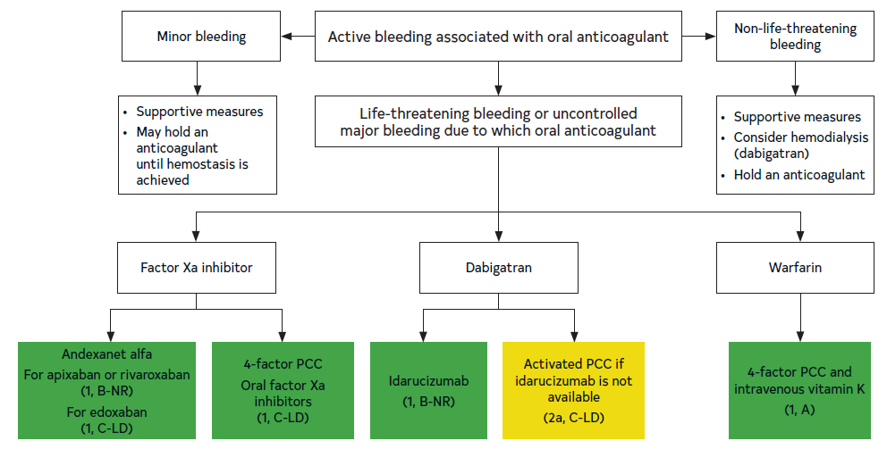
Figure 13. Active Bleeding Associated With Oral Anticoagulant
Colors correspond to Table 2.
PCC indicates prothrombin complex concentrate.

Slide 112
Management of Patients with AF and ICH
Recommendations for Management of Patients with AF and Intracranial Hemorrhage Referenced studies that support the recommendations are summarized in the Online Data Supplement. | Recommendations for Management of Patients with AF and Intracranial Hemorrhage Referenced studies that support the recommendations are summarized in the online data supplement.
COR | LOE | Recommendations
2a | C-LD | In patients with AF and conditions associated with very high risk of thromboembolic events (>5%/year), such as rheumatic heart disease or a mechanical heart valve, early (1-2 weeks) resumption of anticoagulation after ICH is reasonable to reduce the risk of thromboembolic events.

Slide 113
Management of Patients with AF and ICH (con’t.)
2b | C-LD | In patients with AF and ICH, delayed (4-8 weeks) resumption of anticoagulation may be considered to balance the risks of thromboembolic and hemorrhagic complications after careful risk benefit assessment.
2b | B-NR | In patients with AF and conditions associated with high risk of recurrent ICH (eg, cerebral amyloid angiopathy) anticoagulation-sparing strategies (eg, LAAO) may be considered to reduce the risk of recurrent hemorrhage.

Slide 114
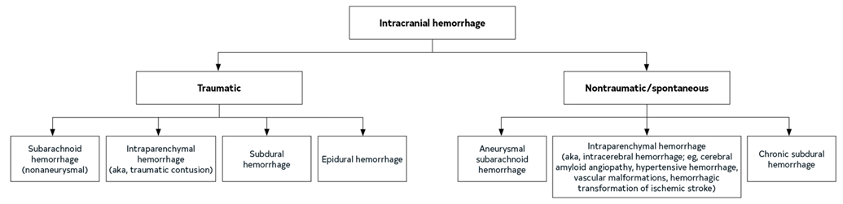
Figure 14. Forms of ICH, Classified by Mechanism

Slide 115
Table 17. Risk Factors for Thromboembolic Complications and Recurrent ICH
Factors Associated With High Risk of Thromboembolism | Factors Associated With High Risk of Recurrent ICH
Mechanical heart valve | Suspected cerebral amyloid angiopathy
Rheumatic valve disease | Lobar IPH
Previous history of stroke/thromboembolism | Older age
Hypercoagulable state (eg, active malignancy, genetic thrombophilia) | >10 cerebral microbleeds on MRI
High CHA₂DS₂-VASc score (>5) | Disseminated cortical superficial siderosis on MRI
 | Poorly controlled hypertension
 | Previous history of spontaneous ICH
 | Genetic/acquired coagulopathy
 | Untreated symptomatic vascular malformation or aneurysm
CHA₂DS₂-VASc indicates congestive heart failure, hypertension, age ≥75 y (doubled), diabetes mellitus, prior stroke or transient ischemic attack or thromboembolism (doubled), vascular disease, age 65 to 74 y, sex category; ICH, intracranial hemorrhage; IPH, intraparenchymal hemorrhage; and MRI, magnetic resonance imaging.

Slide 116
Periprocedural Management
Recommendations for Periprocedural Management Referenced studies that support the recommendations are summarized in the Online Data Supplement. | Recommendations for Periprocedural Management Referenced studies that support the recommendations are summarized in the online data supplement.
COR | LOE | Recommendations
1 | B-R* | In patients with AF (excluding those with recent stroke or TIA, or a mechanical valve) and on oral anticoagulation with either warfarin* or DOAC† who are scheduled to undergo an invasive procedure or surgery, temporary cessation of oral anticoagulation without bridging anticoagulation is recommended.
 | B-NR†
1 | A | In patients with AF on warfarin anticoagulation and an annual predicted risk of thromboembolism of ≥5% undergoing pacemaker or defibrillator implantation or generator change, continued anticoagulation is recommended in preference to interruption of warfarin and bridging anticoagulation with heparin to reduce the risk of pocket hematoma.
*B-R LOE applies to the data on warfarin.
†B-NR LOE applies to the data on DOAC.

Slide 117
Periprocedural Management (con’t.)
2a | A | In patients with AF with CHA₂DS₂-VASc score ≥2 or equivalent risk of stroke, on DOAC anticoagulation and undergoing PM or defibrillator implantation or generator change, either uninterrupted or interrupted DOAC is reasonable.
1 | B-NR | In patients with AF on DOAC and scheduled to undergo an invasive procedure or surgery that cannot be performed safely on uninterrupted anticoagulation, the timing of interruption of DOAC should be guided by the specific agent, renal function, and the bleeding risk of the procedure (Table 18).

Slide 118
Periprocedural Management (con’t.)
2a | B-NR | In patients with AF on DOAC that has been interrupted for an invasive procedure or surgery, in general, resumption of anticoagulation the day after low bleeding risk surgery and between the evening of the second day and the evening of the third day after high bleeding risk surgery is reasonable, as long as hemostasis has been achieved and further bleeding is not anticipated.
3: Harm | B-R | In patients with AF on warfarin anticoagulation, who are undergoing surgeries or procedures for which they are holding warfarin, except in patients with mechanical valve or recent stroke or TIA, bridging anticoagulation with low-molecular-weight heparin should not be administered.

Slide 119
Table 18. Timing of Discontinuation of OACs in Patients With AF Scheduled to Undergo an Invasive Procedure or Surgery in Whom Anticoagulation Is to Be Interrupted
Anticoagulant | Low Bleeding Risk Procedure | High Bleeding Risk Procedure
Apixaban (CrCl >25 mL/min)* | 1 d** | 2 d
Dabigatran (CrCl >50 mL/min) | 1 d | 2 d
Dabigatran (CrCl 30-50 mL/min) | 2 d | 4 d
Edoxaban (CrCl >15 mL/min) | 1 d | 2 d
Rivaroxaban (CrCl >30 mL/min) | 1 d | 2 d
Warfarin | 5 d for a target INR <1.5 2-3 d for a target INR <2 | 5 d
AF indicates atrial fibrillation; CrCl, creatinine clearance; DOAC, direct oral anticoagulation;
INR, international normalized ratio; and OAC, oral anticoagulant.
*For patients on DOAC with creatinine clearance lower than the values in the table, few clinical data exist. Consider holding for an additional 1 to 3 days, especially for high bleeding risk procedures.
†The number of days is the number of full days before the day of surgery in which the patient does not take any dose of anticoagulant. The drug is also not taken the day of surgery. For example, in the case of holding a twice daily drug for 1 day, if the drug is taken at 8 pm, and surgery is at 8 am, at the time of surgery, it will be 36 hours since the last dose was taken.

Slide 120
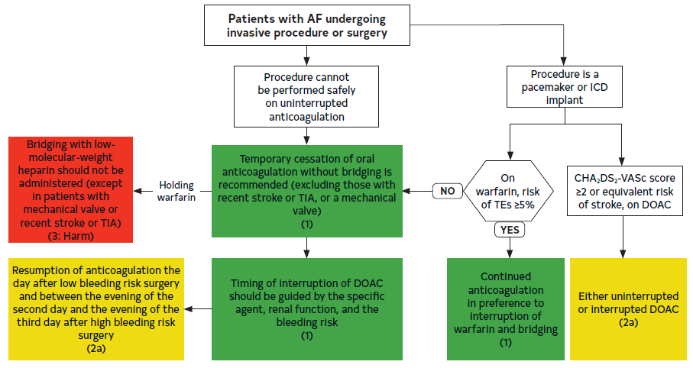
Figure 15. Flowchart: Management of Periprocedural Anticoagulation in Patients With AF
AF indicates atrial fibrillation; CHA₂DS₂-VASc, congestive heart failure, hypertension, age ≥75 years (doubled), diabetes mellitus, prior stroke or transient ischemic attack or thromboembolism (doubled), vascular disease, age 65 to 74 years, sex category; DOAC, direct oral anticoagulant; ICD, implantable cardioverter-defibrillator; TE, thromboembolism; and TIA, transient ischemic attack.
Colors correspond to Table 2.

Slide 121
AF Complicating ACS or PCI
Recommendations for AF Complicating Acute Coronary Syndrome (ACS) or Percutaneous Coronary Intervention (PCI) Referenced studies that support the recommendations are summarized in the Online Data Supplement. | Recommendations for AF Complicating Acute Coronary Syndrome (ACS) or Percutaneous Coronary Intervention (PCI) Referenced studies that support the recommendations are summarized in the Online Data Supplement.
COR | LOE | Recommendations
1 | A | In patients with AF and an increased risk for stroke who undergo PCI, DOACs are preferred over VKAs in combination with APT to reduce the risk of clinically relevant bleeding.
1 | A | In most patients with AF who take oral anticoagulation and undergo PCI, early discontinuation of aspirin (1-4 wk) and continuation of dual antithrombotic therapy with OAC and a P2Y12 inhibitor is preferred over triple therapy (OAC, P2Y12 inhibitor, and aspirin) to reduce the risk of clinically relevant bleeding.

Slide 122
Chronic Coronary Disease (CCD)
Recommendation for Chronic Coronary Disease (CCD) Referenced studies that support the recommendation are summarized in the Online Data Supplement. | Recommendation for Chronic Coronary Disease (CCD) Referenced studies that support the recommendation are summarized in the online data supplement.
COR | LOE | Recommendation
1 | B-R | In patients with AF and CCD (beyond 1 year after revascularization or CAD not requiring coronary revascularization) without history of stent thrombosis, oral anticoagulation monotherapy is recommended over the combination therapy of OAC and single APT (aspirin or P2Y12 inhibitor) to decrease the risk of major bleeding.

Slide 123
Peripheral Artery Disease (PAD)
Recommendation for PAD Referenced studies that support the recommendation are summarized in the Online Data Supplement. | Recommendation for PAD Referenced studies that support the recommendation are summarized in the online data supplement.
COR | LOE | Recommendation
2a | B-NR | In patients with AF and concomitant stable PAD, monotherapy oral anticoagulation is reasonable over dual therapy (anticoagulation plus aspirin or P2Y12 inhibitors) to reduce the risk of bleeding.

Slide 124
Chronic Kidney Disease (CKD)/Kidney Failure
 | Recommendations for CKD/Kidney Failure Referenced studies that support the recommendations are summarized in the Online Data Supplement.
COR | LOE | Recommendations
1 | B-R | For patients with AF at elevated risk for stroke and CKD stage 3, treatment with warfarin or, preferably, evidence-based doses of direct thrombin or factor Xa inhibitors (Table 19) is recommended to reduce the risk of stroke.
2a | B-NR | For patients with AF at elevated risk for stroke and CKD stage 4, treatment with warfarin or labeled doses of DOACs is reasonable to reduce the risk of stroke.
2b | B-NR | For patients with AF at elevated risk for stroke and who have end-stage CKD (CrCl <15 mL/min) or are on dialysis, it might be reasonable to prescribe warfarin (INR 2.0-3.0) or an evidence-based dose of apixaban for oral anticoagulation to reduce the risk of stroke.

Slide 125
Table 19. Recommended Doses of Currently Approved DOACs According to Renal Function
DOAC | CrCl (mL/min)
 | >95 | 51-95 | 31-50 | 15-30 | <15 or on dialysis
Apixaban | 5 or 2.5 mg twice daily* | 5 or 2.5 mg twice daily* | 5 or 2.5 mg twice daily* | 5 or 2.5 mg twice daily* | 5 or 2.5 mg twice daily*
Dabigatran | 150 mg twice daily | 150 mg twice daily | 150 mg twice daily | 75 mg twice daily | Contraindicated
Edoxaban | Contraindicated | 60 mg once daily | 30 mg once daily | 30 mg once daily | Contraindicated
Rivaroxaban | 20 mg once daily | 20 mg once daily | 15 mg once daily | 15 mg once daily | 15 mg once daily†
* If at least 2 of the following are present: serum creatinine $1.5 mg/dL, age $80 y, or body
weight #60 kg, the recommended dose is 2.5 mg twice daily. The ARISTOTLE trial excluded patients
with either a creatinine of >2.5 mg/dL or a calculated CrCl <25 mL/min.
Note that other, nonrenal considerations such as drug interactions may also apply. The gray area
indicates doses not studied in the pivotal clinical trials of these agents.
†Rivaroxaban is not recommended for other indications in patients with a CrCl <15 mL/min, but such
a recommendation is not made for the AF indication. However, pharmacokinetic data are limited.
AF indicates atrial fibrillation; ARISTOTLE, Apixaban for Reduction in Stroke and Other Thromboembolic Events in Atrial Fibrillation; CrCl, creatinine clearance; and DOAC, direct oral anticoagulant.

Slide 126
AF in Valvular Heart Disease (VHD)
 | Recommendations for AF in VHD Referenced studies that support the recommendations are summarized in the Online Data Supplement.
COR | LOE | Recommendations
1 | B-R | In patients with rheumatic mitral stenosis or mitral stenosis of moderate or greater severity and history of AF, long-term anticoagulation with warfarin is recommended over DOACs, independent of the CHA₂DS₂-VASc score to prevent cardiovascular events, including stroke or death.
1 | B-NR | In patients with AF and valve disease other than moderate or greater mitral stenosis or a mechanical heart valve, DOACs are recommended over VKAs.

Slide 127
Anticoagulation of Typical Atrial Flutter (AFL)
 | Recommendations for Anticoagulation of Typical AFL* Referenced studies that support the recommendations are summarized in Online Data Supplement.
COR | LOE | Recommendations
1 | B-NR | For patients with AFL, anticoagulant therapy is recommended according to the same risk profile used for AF.
1 | C-LD | In patients with AFL who undergo successful cardioversion or ablation resulting in restoration of sinus rhythm, anticoagulation should be continued for at least 4 weeks postprocedure.

Slide 128
Anticoagulation of Typical Atrial Flutter (AFL)
(con’t.)
1 | A | Patients with typical AFL who have undergone successful CTI ablation and have had AF previously detected before AFL ablation should receive ongoing oral anticoagulation postablation as indicated for AF.
1 | B-NR | Patients with typical AFL who have undergone successful CTI ablation and are deemed to be at high thromboembolic risk, without any known previous history of AF, should receive close follow-up and arrhythmia monitoring to detect silent AF if they are not receiving ongoing anticoagulation in view of significant risk of AF.
2b | B-NR | In patients with typical AFL who have undergone successful CTI ablation without any known previous history of AF who are at high risk for development of AF (eg, LA enlargement, inducible AF, chronic obstructive pulmonary disease [COPD], HF), it may be reasonable to prescribe long-term anticoagulation if thromboembolic risk assessment suggests high risk (>2% annual risk) for stroke.

Slide 129
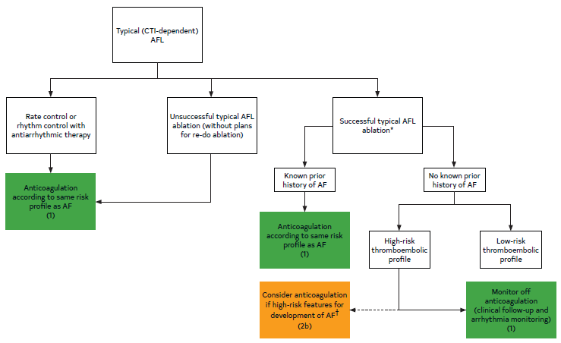
Figure 16. Anticoagulation for Typical (CTI-Dependent) AFL
AF indicates atrial fibrillation; AFL, atrial flutter; COPD, chronic obstructive pulmonary disease;and CTI, cavotricuspid isthmus.
*Intraprocedural documentation of bidirectional block.
Colors correspond to Table 2.
†For example, left atrial enlargement, inducible AF, chronic obstructive pulmonary disease, concomitant heart failure.

Slide 130
Rate Control

Slide 131
Broad Considerations for Rate Control
 | Recommendations for Broad Considerations in Rate Control Referenced studies that support the recommendations are summarized in the Online Data Supplement.
COR | LOE | Recommendations
1 | B-NR | In patients with AF, SDM with the patient is recommended to discuss rhythm- versus rate-control strategies (taking into consideration clinical presentation, comorbidity burden, medication profile, and patient preferences), discuss therapeutic options, and for assessing long-term benefits.
2a | B-R | In patients with AF without HF who are candidates for select rate-control strategies, heart rate target should be guided by underlying patient symptoms, in general aiming at a resting heart rate of <100 to 110 bpm.

Slide 132
Table 20. Clinical Presentations and Objectives of Heart Rate Control
Presentation | Objective
Symptomatic AF | To reduce symptoms
Tachycardia-induced cardiomyopathy | To improve heart function or reduce the risk of recurrent cardiomyopathy
ICD use | To reduce risk of inappropriate shock
Cardiac resynchronization therapy use | To enhance biventricular pacing, likelihood of myocardial recovery, and/or preservation of function
Tachycardia-bradycardia form of sick sinus syndrome among those with a pacemaker | To reduce the risk of hospitalization
AF indicates atrial fibrillation; and ICD, implantable cardioverter-defibrillator.

Slide 133
Table 21. Pharmacological Agents for Rate Control in Patients With AF
 | Intravenous Administration | Oral Maintenance Dose | Elimination Half-Life | Notes
Beta blockers
Metoprolol tartrate | 2.5-5 mg bolus over 2 min; up to 3 doses | 25-200 mg, twice daily | 3-4 h
Metoprolol succinate | N/A | 50-400 mg daily or twice daily in divided doses | 3-7 h
Atenolol | N/A | 25-100 mg daily | 6-7 h | Renally eliminated
Bisoprolol | N/A | 2.5-10 mg daily | 9-12 h
Carvedilol | N/A | 3.125-25 mg twice daily | 7-10 h
Esmolol | 500 µg/kg bolus over 1 min; then 50-300 µg/kg/min | N/A | 9 min
Nadolol | N/A | 10-240 mg daily | 20-24 h
AF indicates atrial fibrillation; ER, extended release; HFrEF, heart failure with reduced ejection fraction; IV, intravenous; and N/A, not applicable.

Slide 134
Table 21. Pharmacological Agents for Rate Control in Patients With AF (con’t.)
Propranolol | 1 mg over 1 min; repeat as needed every 2 min; up to 3 doses | 10-40 mg, 3-4 times daily | IV: 2.4 h Oral: 3-6 h ER: 8-20 h
Nondihydropyridine calcium channel blockers
Diltiazem | 0.25 mg/kg (actual body weight) IV over 2 min May repeat 0.35 mg/kg over 2 min; then 5-15 mg/h continuous infusion | 120-360 mg daily (ER) | IV: 3-5 h Oral immediate release: 3-4.5 h ER: 4-9.5 h | Avoid in HFrEF
Verapamil | 5-10 mg over ≥2 min (may repeat twice); then 5 mg/h continuous infusion (max 20 mg/h) | 180-480 mg daily (ER) | IV: 6-8 h Oral: 2-7 h ER: 12-17 h | Avoid in HFrEF
AF indicates atrial fibrillation; ER, extended release; HFrEF, heart failure with reduced ejection fraction; IV, intravenous; and N/A, not applicable.

Slide 135
Table 21. Pharmacological Agents for Rate Control in Patients With AF (con’t.)
Digitalis glycoside
Digoxin | 0.25-0.5 mg over several min; repeat doses of 0.25 mg every 6 h (maximum 1.5 mg/24 h) | 0.0625-0.25 mg daily | 1-2 d | Renally eliminated Increased mortality at plasma concentrations exceeding 1.2 ng/mL
Other
Amiodarone | 150-300 mg IV over 1 h, then 10-50 mg/h over 24 h | 100-200 mg daily (generally IV form used for rate control) | IV: 9-36 d Oral: 26-107 d | Loading dose 6-10 g administered over 2-4 wk; can combine IV and oral dosing to complete
AF indicates atrial fibrillation; ER, extended release; HFrEF, heart failure with reduced ejection fraction; IV, intravenous; and N/A, not applicable.

Slide 136
Acute Rate Control
Recommendations for Acute Rate Control Referenced studies that support the recommendations are summarized in the Online Data Supplement.
COR | LOE | Recommendations
1 | B-R | In patients with AF with rapid ventricular response who are hemodynamically stable, beta blockers or nondihydropyridine calcium channel blockers (verapamil, diltiazem; provided that EF >40%) are recommended for acute rate control (Figure 17).

Slide 137
Acute Rate Control (con’t.)
2a | B-R | In patients with AF with rapid ventricular response in whom beta blockers and nondihydropyridine calcium channel blockers are ineffective or contraindicated, digoxin can be considered for acute rate control, either alone or in combination with the aforementioned agents.
2a | A | In patients with AF with rapid ventricular response, the addition of intravenous magnesium to standard rate-control measures is reasonable to achieve and maintain rate control.
2b | B-NR | In patients with AF with rapid ventricular response who are critically ill and/or in decompensated HF in whom beta blockers and nondihydropyridine calcium channel blockers are ineffective or contraindicated, intravenous amiodarone may be considered for acute rate control.*
3: Harm | B-NR | In patients with AF with rapid ventricular response and known moderate or severe LV systolic dysfunction with or without decompensated HF, intravenous nondihydropyridine calcium channel blockers should not be administered.
*Consider the risk of cardioversion and stroke when using amiodarone as a rate-control agent.

Slide 138
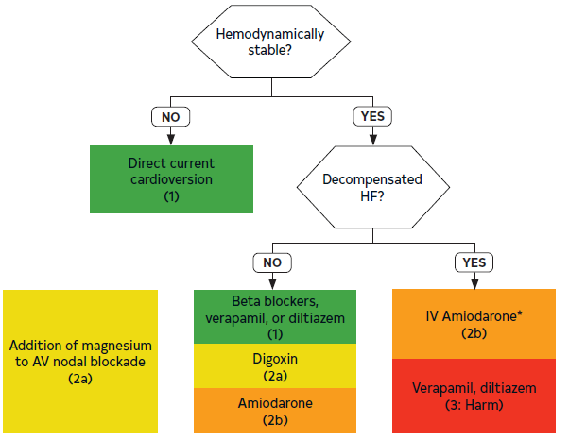
Figure 17. Acute Rate Control in AF With Rapid Ventricular Response (RVR)
AF indicates atrial fibrillation; AV, atrioventricular; HF, heart failure; LV, left ventricular; and RVR, rapid ventricular response.
* Note: Contraindicated in patients with moderate-severe LV dysfunction regardless of decompensated HF.
Colors correspond to Table 2.

Slide 139
Long-Term Rate Control
Recommendations for Long-Term Rate Control Referenced studies that support the recommendations are summarized in the Online Data Supplement. | Recommendations for Long-Term Rate Control Referenced studies that support the recommendations are summarized in the online data supplement.
COR | LOE | Recommendations
1 | B-NR | In patients with AF, beta blockers or nondihydropyridine calcium-channel blockers (diltiazem, verapamil) are recommended for long-term rate control with the choice of agent according to underlying substrate and comorbid conditions.
2a | B-NR | For patients with AF in whom measuring serum digoxin levels is indicated, it is reasonable to target levels <1.2 ng/mL.

Slide 140
Long-Term Rate Control (con’t.)
2a | B-R | In patients with AF and HF symptoms, digoxin is reasonable for long-term rate control in combination with other rate-controlling agents, or as monotherapy if other agents are not preferred, not tolerated, or contraindicated.
3: Harm | C-LD | In patients with AF and LVEF <40%, nondihydropyridine calcium channel-blocking drugs should not be administered given their potential to exacerbate HF.
3: Harm | B-R | In patients with permanent AF who have risk factors for cardiovascular events, dronedarone should not be used for long-term rate control.

Slide 141
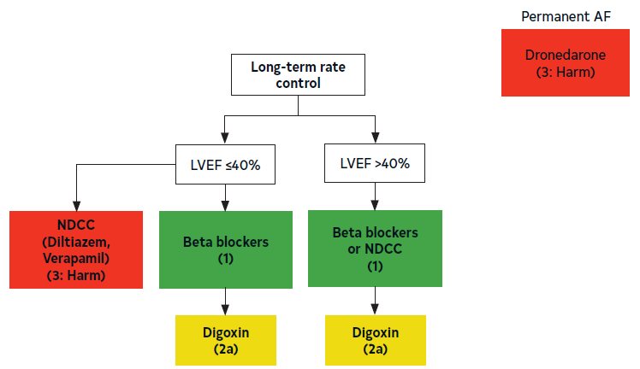
Figure 18. AF Long-Term Rate Control
AF indicates atrial fibrillation; LVEF, left ventricular ejection fraction; and NDCC, nondihydropyridine calcium channel blocker.
Colors correspond to Table 2.

Slide 142
Atrioventricular Nodal Ablation (AVNA)
Recommendations for AVNA Referenced studies that support the recommendations are summarized in the Online Data Supplement. | Recommendations for AVNA Referenced studies that support the recommendations are summarized in the online data supplement.
COR | LOE | Recommendations
1 | C-LD | In patients with AF and a persistently rapid ventricular response who undergo AVNA, initial pacemaker lower rate programming should be 80 to 90 bpm to reduce the risk of sudden death.
2a | B-R | In patients with AF and uncontrolled rapid ventricular response refractory to rate-control medications (who are not candidates for or in whom rhythm control has been unsuccessful), AVNA can be useful to improve symptoms and QOL.

Slide 143
Atrioventricular Nodal Ablation (AVNA) (con’t.)
1 | B-NR | In patients with AF who are planned to undergo AVNA, implantation of a pacemaker before the ablation (ie, before or same day of ablation) is recommended to ensure adequacy of the pacing leads before performing ablation.
2b | C-LD | In patients with AF with normal EF undergoing AVNA, conduction system pacing of the His bundle or left bundle area may be reasonable.

Slide 144
Rhythm Control

Slide 145
Goals of Therapy With Rhythm Control
Recommendations for Goals of Therapy With Rhythm Control Referenced studies that support the recommendations are summarized in the Online Data Supplement. | Recommendations for Goals of Therapy With Rhythm Control Referenced studies that support the recommendations are summarized in the online data supplement.
COR | LOE | Recommendations
1 | B-R | In patients with reduced LV function and persistent (or high burden) AF, a trial of rhythm control should be recommended to evaluate whether AF is contributing to the reduced LV function.
2a | B-R | In patients with symptomatic AF, rhythm control can be useful to improve symptoms.
2a | B-R | In patients with a recent diagnosis of AF (<1 year), rhythm control can be useful to reduce hospitalizations, stroke, and mortality.

Slide 146
Goals of Therapy With Rhythm Control (con’t.)
2a | B-R | In patients with AF and HF, rhythm control can be useful for improving symptoms and improving outcomes, such as mortality and hospitalizations for HF and ischemia.
2a | B-NR | In patients with AF, rhythm-control strategies can be useful to reduce the likelihood of AF progression.
2b | C-LD | In patients with AF where symptoms associated with AF are uncertain, a trial of rhythm control (eg, cardioversion or pharmacological therapy) may be useful to determine what if any symptoms are attributable to AF.
2b | B-NR | In patients with AF, rhythm-control strategies may be useful to reduce the likelihood of development of dementia or worsening cardiac structural abnormalities.

Slide 147
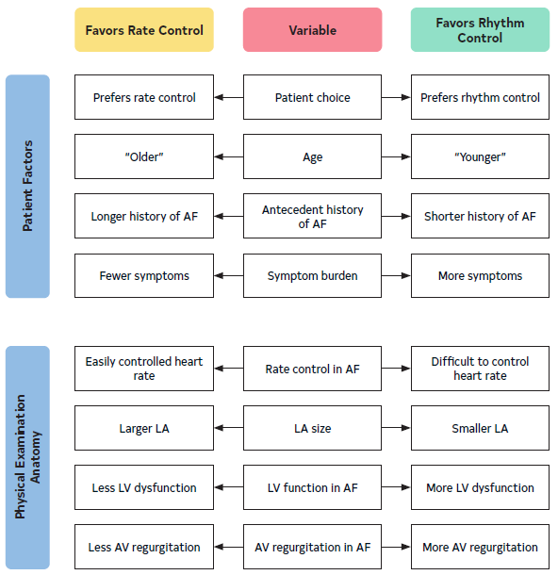
Figure 19. Patient and Clinical Considerations for Choosing Between Rhythm Control and Rate Control
Patient and clinical considerations for deciding between rhythm- and rate-control strategies in a patient with a high burden of AF.
AF indicates atrial fibrillation; AV, atrioventricular; LA, left atrium; and LV, left ventricular.

Slide 148
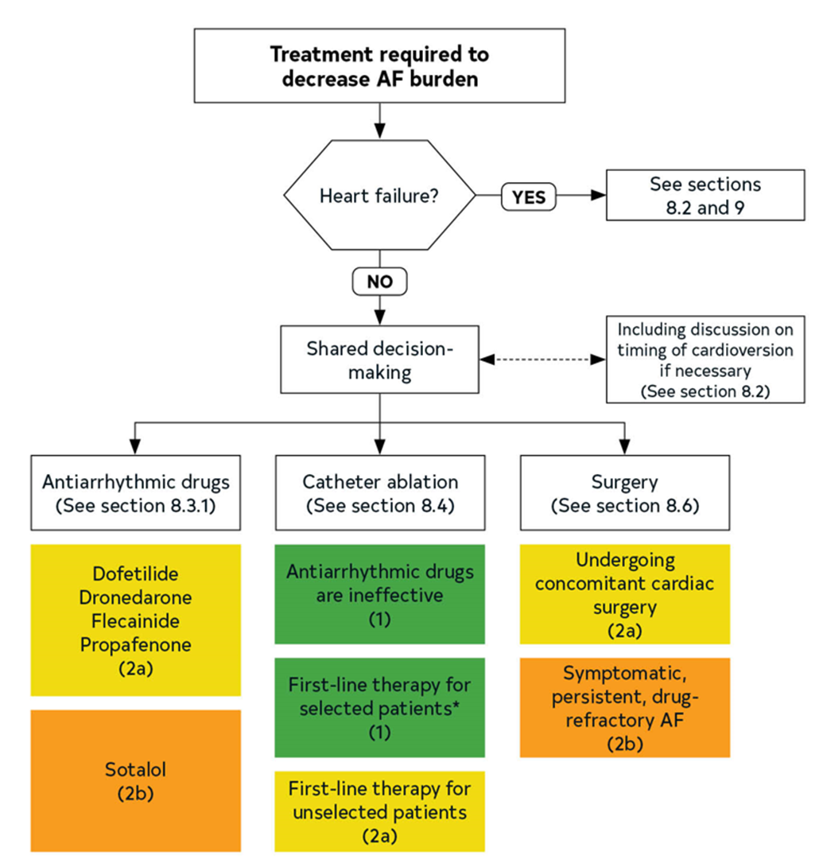
Figure 20. Flowchart for Treatment Choices When Required to Decrease AF Burden
Flowchart outlining overall strategy and treatment options for patient with AF in whom rhythm-control therapy is required. AF indicates atrial fibrillation.
*Younger with few comorbidities.

Slide 149
Prevention of Thromboembolism in the Setting of Cardioversion
Recommendations for Prevention of Thromboembolism in the Setting of Cardioversion Referenced studies that support the recommendations are summarized in the Online Data Supplement. | Recommendations for Prevention of Thromboembolism in the Setting of Cardioversion Referenced studies that support the recommendations are summarized in the online supplement.
COR | LOE | Recommendations
1 | B-R | In patients with AF duration of ≥48 hours, a 3-week duration of uninterrupted therapeutic anticoagulation or imaging evaluation to exclude intracardiac thrombus is recommended before elective cardioversion.
1 | B-NR | In patients with AF undergoing cardioversion, therapeutic anticoagulation should be established before cardioversion and continued for at least 4 weeks afterwards without interruption to prevent thromboembolism.
1 | C-LD | In patients with AF in whom cardioversion is deferred due to LAA thrombus detected on precardioversion imaging, therapeutic anticoagulation should be instituted for at least 3 to 6 weeks, after which imaging should be repeated before cardioversion.

Slide 150
Prevention of Thromboembolism in the Setting of Cardioversion (con’t.)
2b | B-NR | In patients with AF and prior LAAO who are not on anticoagulation, imaging evaluation to assess the adequacy of LAAO and exclude device-related thrombosis before cardioversion may be reasonable.
2b | C-LD | In patients with AF and previous LAAO with residual leak, pericardioversion anticoagulation may be considered and continued thereafter.
2b | C-LD | In patients with reported AF duration of <48 hours (not in the setting of cardiac surgery) and who are not on anticoagulation, precardioversion imaging to exclude intracardiac thrombus may be considered in those who are at elevated thromboembolic risk (CHA₂DS₂-VASc score ≥2 or equivalent).
2b | C-LD | In patients with low thromboembolic risks (CHA₂DS₂-VASc 0-1 or equivalent) and AF duration of <12 hours, the benefit of precardioversion imaging or pericardioversion anticoagulation is uncertain given the low incidence of pericardioversion thromboembolic events in this population.

Slide 151
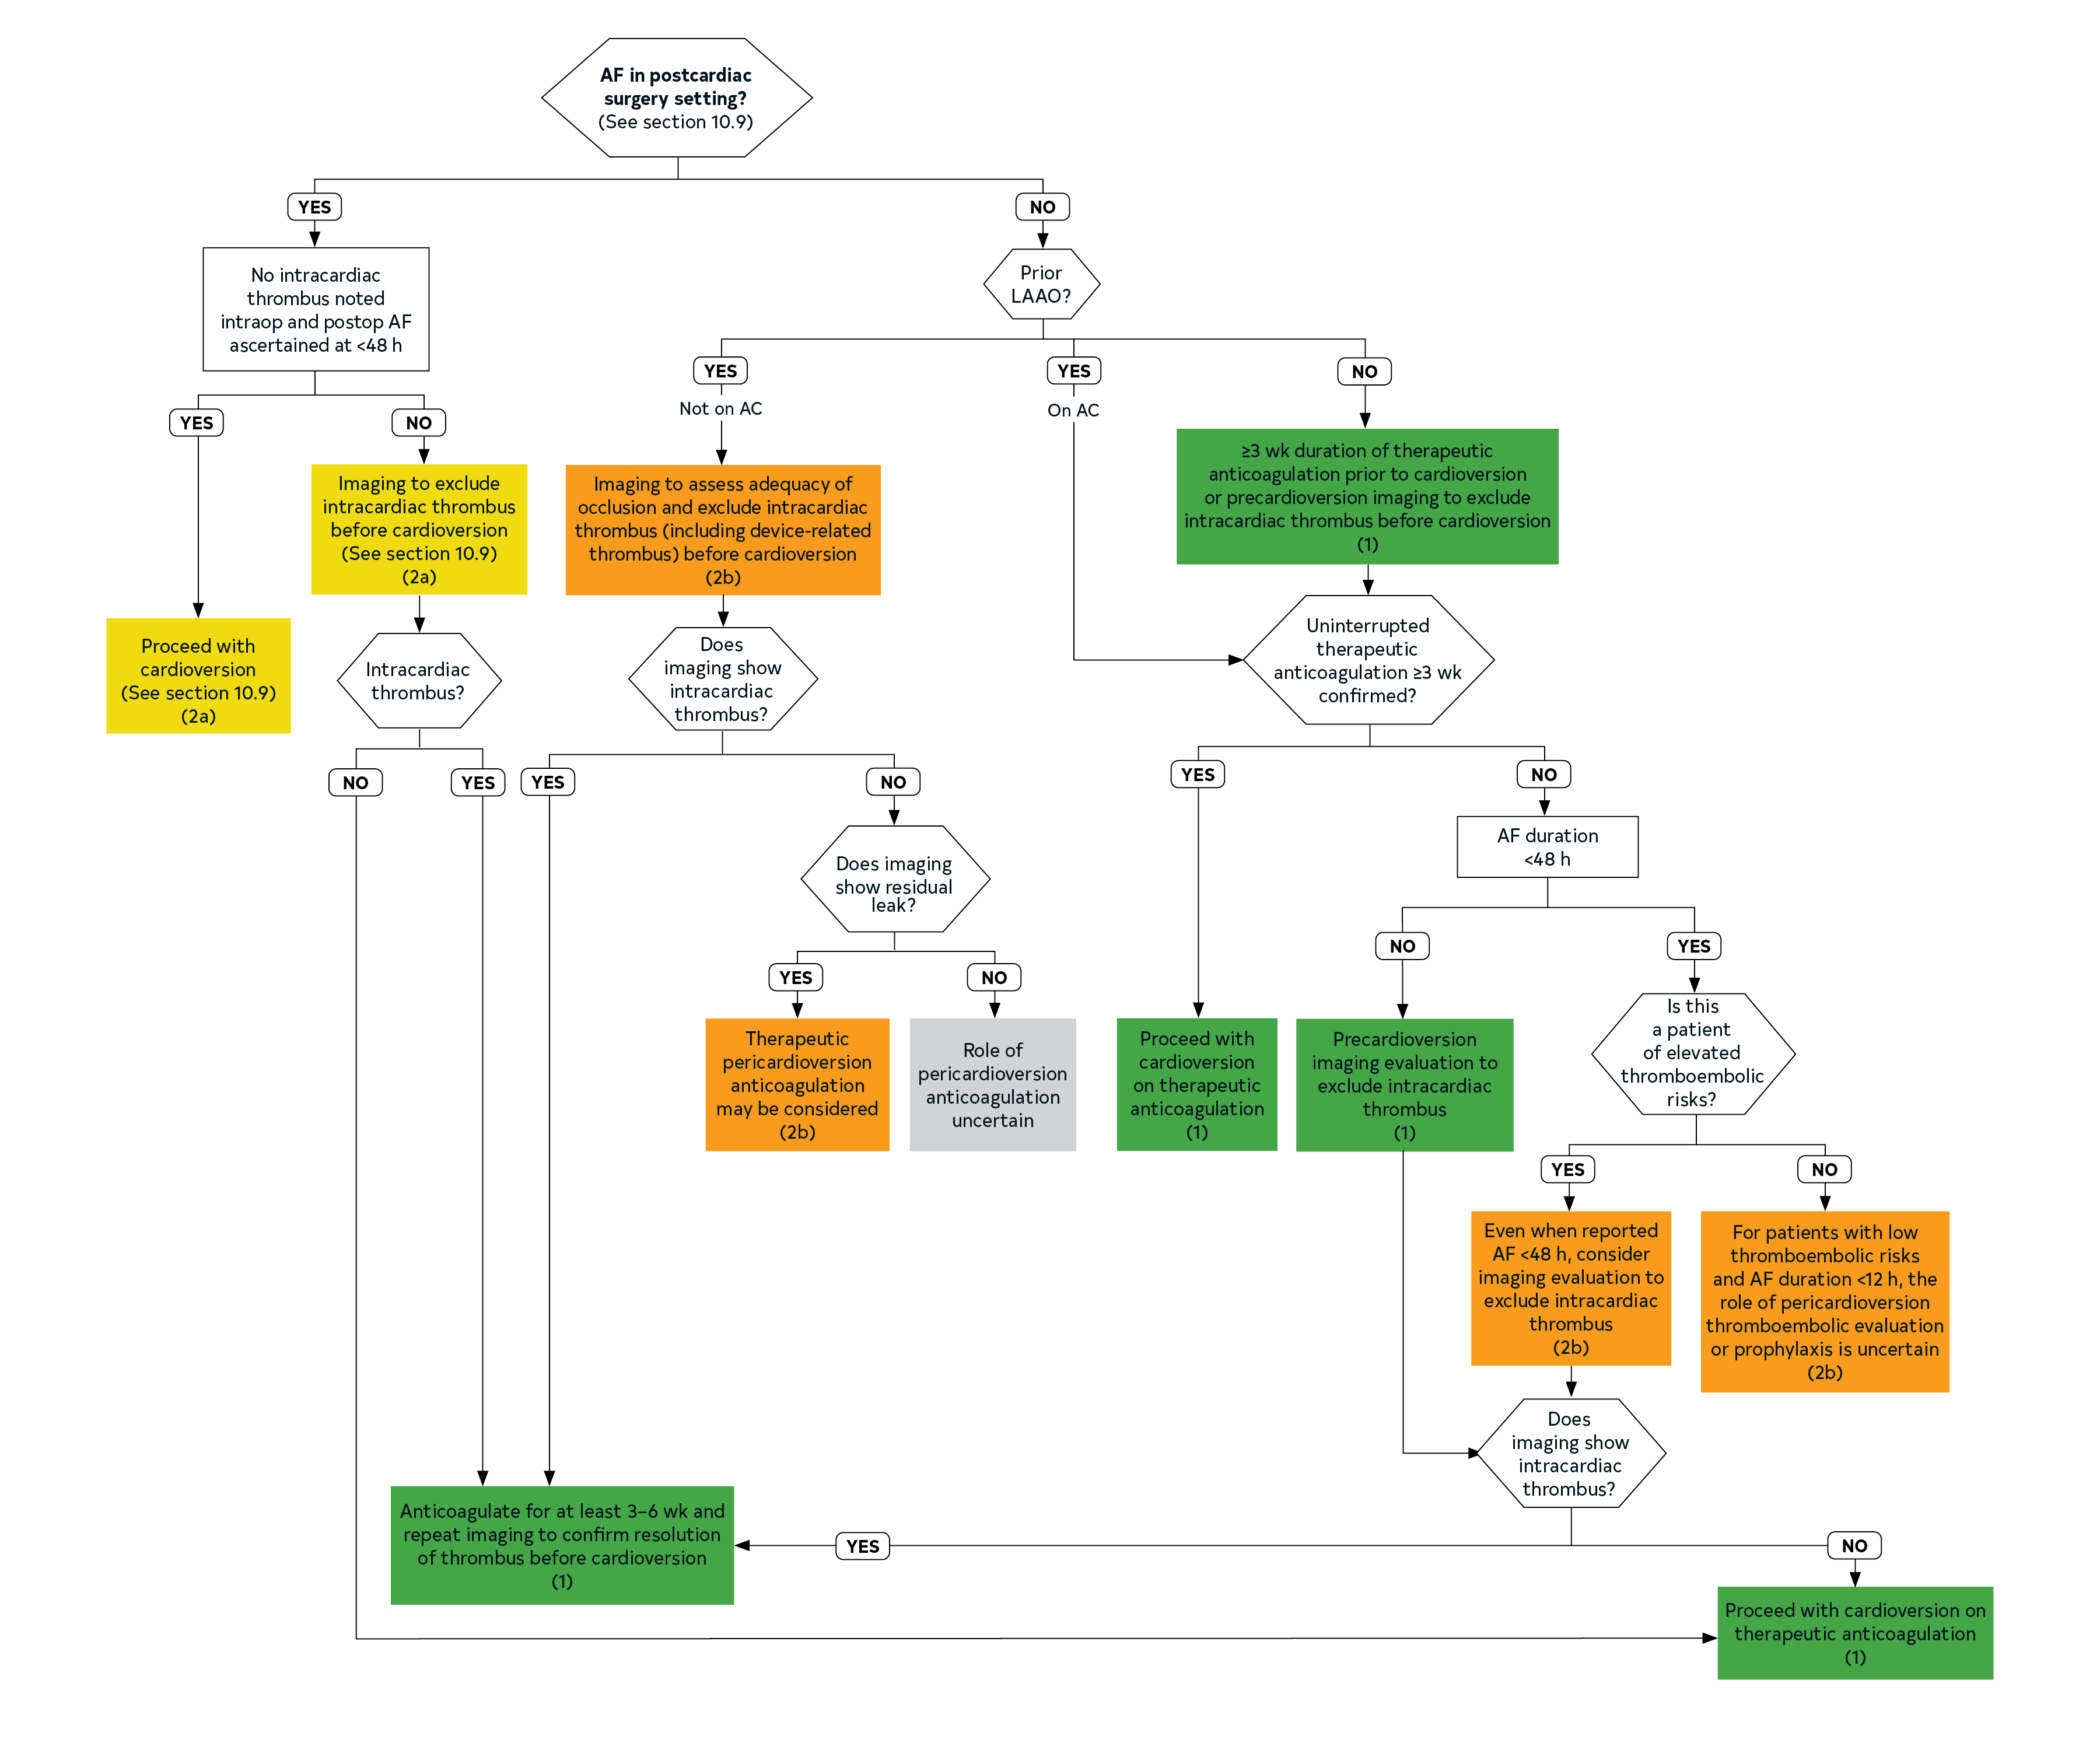
Figure 21. Patients With Hemodynamically Stable AF Planned for Cardioversion
AC indicates anticoagulation; AF, atrial fibrillation; and LAAO, left atrial appendage occlusion.
Colors correspond to Table 2.

Slide 152
Electrical Cardioversion
Recommendations for Electrical Cardioversion Referenced studies that support the recommendations are summarized in the Online Data Supplement. | Recommendations for Electrical Cardioversion Referenced studies that support the recommendations are summarized in the online supplement.
COR | LOE | Recommendations
1 | C-LD | In patients with hemodynamic instability attributable to AF, immediate electrical cardioversion should be performed to restore sinus rhythm.
1 | B-R | In patients with AF who are hemodynamically stable, electrical cardioversion can be performed as initial rhythm-control strategy or after unsuccessful pharmacological cardioversion.

Slide 153
Electrical Cardioversion (con’t.)
1 | C-LD | In patients with AF undergoing electrical cardioversion, energy delivery should be confirmed to be synchronized to the QRS to reduce the risk of inducing VF.
2a | B-R | For patients with AF undergoing elective electrical cardioversion, the use of biphasic energy of at least 200 J as initial energy can be beneficial to improve success of initial electrical shock.
2a | B-NR | In patients with AF undergoing elective cardioversion, with longer duration of AF or unsuccessful initial shock, optimization of electrode vector, use of higher energy, and pretreatment with antiarrhythmic drugs can facilitate success of electrical cardioversion.
2b | C-LD | In patients with obesity and AF, use of manual pressure augmentation and/or further escalation of electrical energy may be beneficial to improve success of electrical cardioversion.

Slide 154
Pharmacological Cardioversion
Recommendations for Pharmacological Cardioversion Referenced studies that support the recommendations are summarized in the Online Data Supplement. | Recommendations for Pharmacological Cardioversion Referenced studies that support the recommendations are summarized in the online data supplements.
COR | LOE | Recommendations
2a | C-LD | For patients with AF, pharmacological cardioversion is reasonable as an alternative to electrical cardioversion for those who are hemodynamically stable or in situations when electrical cardioversion is preferred but cannot be performed.
2a | A | For patients with AF, ibutilide is reasonable for pharmacological cardioversion for patients without depressed LV function (LVEF <40%).

Slide 155
Pharmacological Cardioversion (con’t.)
2a | A | For patients with AF, intravenous amiodarone is reasonable for pharmacological cardioversion, although time to conversion is generally longer than with other agents (8-12 hours).
2a | A | For patients with recurrent AF occurring outside the setting of a hospital, the “pill-in-the-pocket” (PITP) approach with a single oral dose of flecainide or propafenone, with a concomitant atrioventricular nodal blocking agent, is reasonable for pharmacological cardioversion if previously tested in a monitored setting.
2b | B-R | For patients with AF, use of intravenous procainamide may be considered for pharmacological cardioversion when other intravenous agents are contraindicated or not preferred.

Slide 156
Table 22. Drugs for Pharmacological Conversion of AF to Sinus Rhythm
Drug | Route of Administration | Loading Dose | Maintenance Dose | Approximate Time to Conversion to Sinus Rhythm | Primary Route(s) of Elimination | Elimination Half-Life | Major Adverse Effects
Amiodarone | IV | 5-7 mg/kg or 300 mg* | 1200-3000 mg via continuous infusion over 24 h | 8-12 h | Liver metabolism Biliary excretion | 9-36 d | Bradycardia Hypotension QT prolongation Phlebitis TdP
*Some studies have administered intravenous amiodarone for 24 hours followed by oral administration.
AV indicates atrioventricular; AF, atrial fibrillation; HFrEF, heart failure with reduced ejection fraction; IV, intravenous; N/A, not applicable; NAPA, N-acetylprocainamide; TdP, torsades de pointes; and VT, ventricular tachycardia.

Slide 157
Table 22. Drugs for Pharmacological Conversion of AF to Sinus Rhythm (con’t.)
Flecainide | Oral† | 200 mg if <70 kg, 300 mg if >70 kg, single dose | N/A | 3-8 h | Liver (70%) Kidney (30%)‡ | 12-27 h | Atrial flutter AV block Dizziness Dyspnea Exacerbation of HFrEF Headache Nausea QT prolongation VT Visual disturbances
† Flecainide is available in an intravenous dosage form in Europe.
‡ Percentage of a dose excreted unchanged in urine
AV indicates atrioventricular; AF, atrial fibrillation; HFrEF, heart failure with reduced ejection fraction; IV, intravenous; N/A, not applicable; NAPA, N-acetylprocainamide; TdP, torsades de pointes; and VT, ventricular tachycardia.

Slide 158
Table 22. Drugs for Pharmacological Conversion of AF to Sinus Rhythm (con’t.)
Ibutilide | IV | ≥60 kg: 1 mg over 10 min <60 kg: 0.01 mg/kg over 10 min If arrhythmia does not terminate within 10 min after the end of the first infusion, may administer a second dose, equal to the first dose | N/A | 30-90 min | Liver | 2-12 h | Nonsustained VT QT prolongation TdP
AV indicates atrioventricular; AF, atrial fibrillation; HFrEF, heart failure with reduced ejection fraction; IV, intravenous; N/A, not applicable; NAPA, N-acetylprocainamide; TdP, torsades de pointes; and VT, ventricular tachycardia.

Slide 159
Table 22. Drugs for Pharmacological Conversion of AF to Sinus Rhythm (con’t.)
Procainamide | IV | 1 g over 30 min | 2 mg/min continuous infusion over 1 h | 30-60 min | Liver (16-33%) Kidney (50-65%)‡ | 3-4 h (parent) 7 h (NAPA) | Agranulocytosis AV block Exacerbation of HFrEF Hypotension Neutropenia QT prolongation Rash Thrombocytopenia TdP
‡ Percentage of a dose excreted unchanged in urine.
AV indicates atrioventricular; AF, atrial fibrillation; HFrEF, heart failure with reduced ejection fraction; IV, intravenous; N/A, not applicable; NAPA, N-acetylprocainamide; TdP, torsades de pointes; and VT, ventricular tachycardia.

Slide 160
Table 22. Drugs for Pharmacological Conversion of AF to Sinus Rhythm (con’t.)
Propafenone | Oral | 450 mg if <70 kg, 600 mg if >70 kg, single dose | N/A | 3-8 h | Liver | 9 h | Atrial flutter AV block Dizziness Dyspnea Exacerbation of HFrEF Nausea Taste disturbances VT Visual disturbances
AV indicates atrioventricular; AF, atrial fibrillation; HFrEF, heart failure with reduced ejection fraction; IV, intravenous; N/A, not applicable; NAPA, Nacetylprocainamide; TdP, torsades de pointes; and VT, ventricular tachycardia.

Slide 161
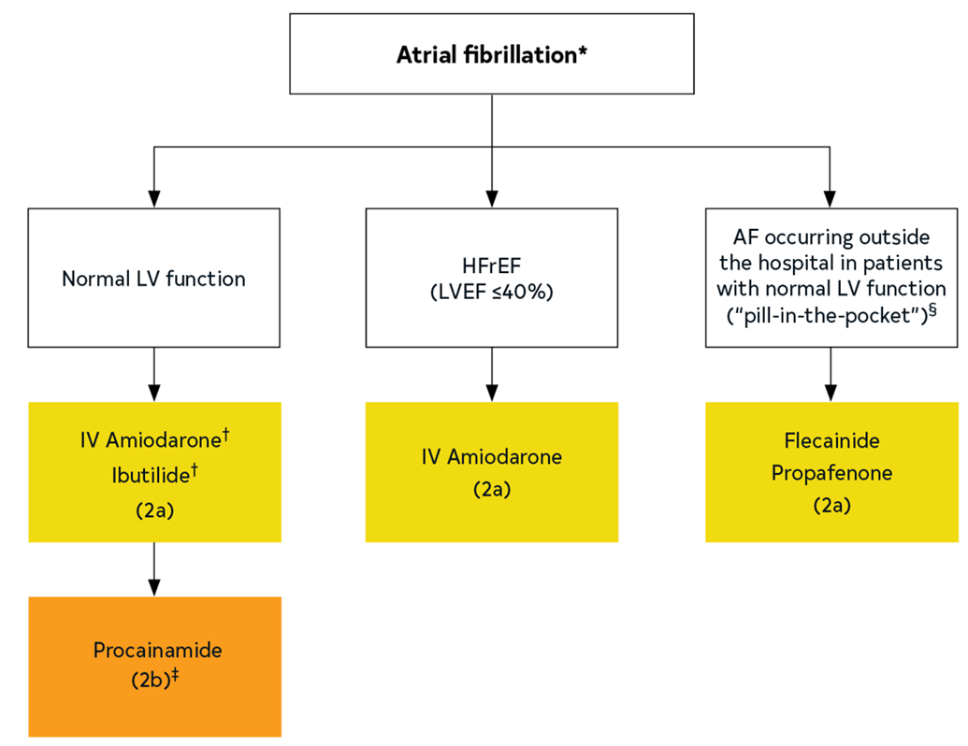
Figure 22. Treatment Algorithm for Pharmacological Conversion of AF to Sinus Rhythm
*In the absence of preexcitation.
†First dose administered in a facility that can provide continuous electrocardiographic monitoring and cardiac resuscitation because of the potential for proarrhythmia or postconversion bradycardia.
‡IV amiodarone requires several hours for efficacy; ibutilide is generally effective in 30 to 90 min but carries a higher risk of QT interval prolongation and torsades de pointes.
§Recommend avoidance of IV procainamide for patients initially treated with amiodarone or ibutilide to avoid excessive QT interval prolongation and torsades de pointes. Rather, procainamide may be considered for patients for whom amiodarone and ibutilide are not considered optimal as first-line drugs.
AF indicates atrial fibrillation; HFrEF, heart failure with reduced ejection fraction; IV, ntravenous; LV, left ventricular; LVEF, left ventricular ejection fraction.
Colors correspond to Table 2.

Slide 162
Speciﬁc Drug Therapy for Long-Term Maintenance of Sinus Rhythm
Recommendations for Specific Drug Therapy for Long-Term Maintenance of Sinus Rhythm Referenced studies that support the recommendations are summarized in the Online Data Supplement. | Recommendations for Specific Drug Therapy for Long-Term Maintenance of Sinus Rhythm Referenced studies that support the recommendations are summarized in the online data supplement.
COR | LOE | Recommendations
2a | A* | For patients with AF and HFrEF (≤40%), therapy with dofetilide* or amiodarone† is reasonable for long-term maintenance of sinus rhythm.
 | B-NR†
2a | A | For patients with AF and no previous MI, or known or suspected significant structural heart disease, or ventricular scar or fibrosis, use of flecainide or propafenone is reasonable for long-term maintenance of sinus rhythm.
2a | A | For patients with AF without recent decompensated HF or severe LV dysfunction, use of dronedarone is reasonable for long-term maintenance of sinus rhythm.
*A LOE applies to data on dofetilide.
†B-NR LOE applies to data on amiodarone.

Slide 163
Speciﬁc Drug Therapy for Long-Term Maintenance of Sinus Rhythm (con’t.)
2a | A | For patients with AF without significant baseline QT interval prolongation or uncorrected hypokalemia or hypomagnesemia, use of dofetilide is reasonable for long-term maintenance of sinus rhythm, with proper dose selection based on kidney function and close monitoring of the QT interval, serum potassium and magnesium concentrations, and kidney function.
2a | A | For patients with AF and normal LV function, use of low-dose amiodarone (100-200 mg/d) is reasonable for long-term maintenance of sinus rhythm but, in view of its adverse effect profile, should be reserved for patients in whom other rhythm control strategies are ineffective, not preferred, or contraindicated.
2b | A | For patients with AF without significant baseline QT interval prolongation, hypokalemia, hypomagnesemia, or bradycardia, use of sotalol may be considered for long-term maintenance of sinus rhythm, with proper dose selection based on kidney function and close monitoring of the QT interval, heart rate, serum potassium and magnesium concentrations, and kidney function.

Slide 164
Speciﬁc Drug Therapy for Long-Term Maintenance of Sinus Rhythm (con’t.)
3: Harm | B-R | In patients with prior MI and/or significant structural heart disease, including HFrEF (LVEF ≤40%), flecainide and propafenone should not be administered to due to the risk of worsening HF, potential proarrhythmia, and increased mortality.
3: Harm | B-R | For patients with AF, dronedarone should not be administered for maintenance of sinus rhythm to those with NYHA class III and IV HF or patients who have had an episode of decompensated HF in the past 4 weeks, due to the risk of increased early mortality associated with worsening HF.

Slide 165
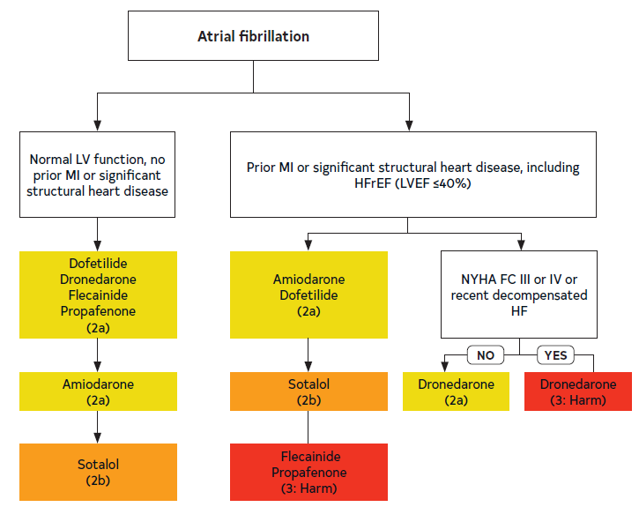
Figure 23. Treatment Algorithm for Drug Therapy for Maintenance of Sinus Rhythm
In each box, drugs are listed in alphabetical order. Significant structural heart disease with scar or fibrosis.
HFrEF indicates heart failure with reduced ejection fraction; HF, heart failure; IV, intravenous; LV, left ventricular; LVEF, left ventricular ejection fraction; MI, myocardial infarction; and NYHA FC, New York Heart Association Functional Class.
Colors correspond to Table 2.

Slide 166
Table 23. Specific Drug Therapy for Maintenance of Sinus Rhythm in Patients With AF
Drug | Loading Dose | Maintenance Dose | Primary Route(s) of Elimination | Elimination Half-Life | Mechanism of Action | Major Adverse Effects | Important Pharmacokinetic Drug Interactions
Amiodarone | Total loading dose 6-10 g, given 400-800 mg daily in 2-4 divided doses for 1-4 wk | 200 mg once daily | Liver metabolism Biliary excretion | 14-59 d | Inhibits I_{Kr}, I_{Ks}, I_{Na}, I_{Kur}, I_{to}, I_{Ca-L}, I_{KAch} Noncompetitive beta blocker | AV block Bradycardia Corneal microdeposits Elevation in transaminases Hepatotoxicity Hyperthyroidism Hypothyroidism Nausea QT prolongation Peripheral neuropathy Photosensitivity Pulmonary fibrosis Skin pigmentation (blue-grey) TdP | Moderate* inhibitor of CYP2C9, weak† inhibitor of CYP2D6 Some inhibition of CYP3A Increases plasma concentrations of warfarin, lovastatin,‡ simvastatin, § cyclosporine Inhibits p-gp Increases plasma concentrations of digoxin

Slide 167
Table 23. Specific Drug Therapy for Maintenance of Sinus Rhythm in Patients With AF (con’t.)
Dofetilide | N/A | CrCl > 60 mL/min: 500 µg twice daily CrCl 40-60 mL/min: 250 µg twice daily CrCl 20-40 mL/min: 125 µg twice daily CrCl < 20 mL/min: Contraindicated | Kidney | 10 h | Inhibits I_{Kr} and augments late I_{Na} | QT prolongation TdP | Dofetilide is renally excreted via the renal cation transport system. These drugs inhibit renal cation transport, increase plasma dofetilide concentrations, and are contraindicated in patients taking dofetilide: Cimetidine Dolutegravir Ketoconazole Megestrol Prochlorperazine Trimethoprim (alone or in combination with sulfamethoxazole) Verapamil In addition, hydrochlorothiazide (alone or in combination with triamterene) increases plasma dofetilide concentrations and should not be coadministered with dofetilide

Slide 168
Table 23. Specific Drug Therapy for Maintenance of Sinus Rhythm in Patients With AF (con’t.)
Dronedarone | N/A | 400 mg twice daily | Liver metabolism | 13-19 h | Inhibits I_{Kr} I_{Ks}, I_{Na}, I_{Kur}, I_{to}, I_{Ca-L}, I_{KAch} Noncompetitive beta blocker | Abdominal pain Asthenia Bradycardia Diarrhea Nausea and vomiting QT prolongation Rash TdP | Dronedarone is a substrate for CYP3A and is a moderate inhibitor of CYP3A and CYP 2D6 Dronedarone is also a substrate for, and inhibitor of, p-gp Dronedarone may increase plasma concentrations of: Dabigatran Digoxin SimvastatinII Sirolimus Tacrolimus Warfarin These drugs may increase plasma dronedarone concentrations: Grapefruit juice These drugs may decrease plasma dronedarone concentrations: CYP3A inducers including St. John’s wort, rifampin, and phenytoin

Slide 169
Table 23. Specific Drug Therapy for Maintenance of Sinus Rhythm in Patients With AF (con’t.)
Flecainide | N/A | 50-300 mg/d PO divided q 8-12 h | Liver (70%) Kidney (30%) ¶ | 12-27 h | Inhibits I_{Na} | Atrial flutter AV block Dizziness Dyspnea Exacerbation of HFrEF Headache Nausea QT prolongation VT Visual disturbances | Flecainide is a substrate for CYP2D6 These drugs may increase plasma flecainide concentrations: Amiodarone Duloxetine Fluoxetine Paroxetine

Slide 170
Table 23. Specific Drug Therapy for Maintenance of Sinus Rhythm in Patients With AF (con’t.)
Propafenone | N/A | 150-300 mg/ PO q 8 h, ER 225-425 PO q 12 h | Liver | 9 h | Inhibits I_{Na} | Atrial flutter Bradycardia AV block Dizziness Dyspnea Exacerbation of HFrEF Nausea Taste disturbances VT Visual disturbances | Propafenone is a substrate for CYP2D6 These drugs may increase plasma propafenone concentrations: Fluoxetine Paroxetine Propafenone may increase plasma digoxin concentrations Propafenone may increase plasma warfarin concentrations

Slide 171
Table 23. Specific Drug Therapy for Maintenance of Sinus Rhythm in Patients With AF (con’t.)
Sotalol | CrCl >60 mL/min: 40-80 mg twice daily for 3 d CrCl: 40-60 mL/min: 80 mg once daily for 3 d CrCl <40 mL/min: Contraindicated | CrCl >60 mL/min: 80-160 mg twice daily CrCl: 40-60 mL/min: 80-160 mg once daily CrCl <40 mL/min: Contraindicated | Kidney | 12 h | Inhibits I_{Kr} Beta blocker d-Sotalol augments late I_{Na} | AV block Bradycardia Bronchospasm Diarrhea Exacerbation of HFrEF Fatigue Nausea and vomiting QT prolongation TdP | None

Slide 172
Table 23. Specific Drug Therapy for Maintenance of Sinus Rhythm in Patients With AF (con’t.)
AF indicates atrial fibrillation; AUC, area under the plasma concentration vs. time curve; AV, atrioventricular; CrCl, creatinine clearance; CYP, cytochrome P-450; ER, extended release; HFrEF, heart failure with reduced ejection fraction; IV, intravenous; N/A, not applicable; NAPA, N-acetylprocainamide; p-gp, p-glycoprotein; TdP, torsades de pointes; and VT, ventricular tachycardia.
*Moderate inhibitor: Causes a 2-fold to <5-fold increase in AUC or a 50% to 80% decrease in clearance.
†Mild inhibitor: Causes a ≥1.25-fold but <2-fold increase in AUC or a 20% to 50% decrease in clearance.
‡Lovastatin doses should not exceed 40 mg daily in patients taking amiodarone.
§Simvastatin doses should not exceed 20 mg daily in patients taking amiodarone.
II Simvastatin doses should not exceed 10 mg daily in patients taking dronedarone.
¶ Percentage of a dose excreted unchanged in urine.

Slide 173
Inpatient Initiation of Antiarrh-ythmic Agents
Recommendations for Inpatient Initiation of Antiarrhythmic Agents Referenced studies that support the recommendations are summarized in the Online Data Supplement. | Recommendations for Inpatient Initiation of Antiarrhythmic Agents Referenced studies that support the recommendations are summarized in the online data supplement.
COR | LOE | Recommendations
1 | A | Patients with AF who are initiating, increasing the dose of, or reinitiating dofetilide therapy should be admitted for a minimum of 3 days to a facility that can provide continuous electrocardiographic monitoring, calculations of CrCl, and cardiac resuscitation, given the potential for proarrhythmia.
2a | B-R | In patients with AF, it is reasonable to initiate sotalol therapy in a facility that can provide continuous electrocardiographic monitoring, calculations of CrCl, and cardiac resuscitation, given the potential for proarrhythmia and bradycardia.
2a | B-NR | In patients with AF who are initiating PITP dosing of flecainide and propafenone with concomitant atrioventricular nodal blocking drugs, it is reasonable to receive the first dose in a facility that can provide continuous electrocardiographic monitoring, given the potential for proarrhythmia.

Slide 174
Table 24. Recommended Monitoring for Patients Taking Oral Amiodarone
Adverse Effect | Baseline Testing | Initial Follow-Up Testing | Additional Follow-Up Testing
Hypo- or hyperthyroidism | TSH (T4 and T3 if TSH abnormal) | 3-6 mon | Every 6 mo
Hepatotoxicity | AST, ALT | 3-6 mon | Every 6 mo
QT interval prolongation | ECG | Annually | --
Interstitial lung disease | Chest x-ray: Recommended CT chest: Not recommended | Chest x-ray: Unexplained cough or dyspnea or other signs/symptoms suspicious for interstitial lung disease | CT chest: As indicated to follow-up ongoing symptoms or chest x-ray findings
Corneal microdeposits (epithelial keratopathy) | Not recommended | Development of visual abnormalities which may indicate optic neuropathy | --
Dermatologic (blue-grey skin discoloration), photosensitivity | Not recommended | Physical examination annually | Development of skin discoloration, severe sunburn
Neurological | Not recommended | Physical examination annually | Development of peripheral neuropathy or other neurological abnormalities
ALT indicates alanine transaminase; AST, aspartate transaminase; BP, blood pressure; CT, computed tomography; ECG, electrocardiogram; TSH, thyroid-stimulating hormone; and TdP, torsades de pointes.

Slide 175
Table 25. Recommended Monitoring for Patients Taking Other Antiarrhythmic Drugs
Drug | Baseline Testing | Follow-Up Testing | Additional Follow-Up Testing
Dofetilide | 12-lead ECG* Continuous ECG monitoring during 3-d hospitalization for dofetilide initiation Serum potassium and magnesium concentration Serum creatinine for estimation of CrCl | In 3-6 mo: 12-lead ECG* Serum potassium and magnesium concentration Serum creatinine for estimation of CrCl | Every 3-6 mo (more frequently for patients concomitantly taking other QT interval-prolonging drugs or with changing kidney function: 12-lead ECG* Serum potassium and magnesium concentration Serum creatinine for estimation of CrCl
* Assess rhythm and calculate QTc.
† To facilitate early detection of potential dronedarone-associated hepatotoxicity.
ALT indicates alanine transaminase; AST, aspartame transaminase; BP, blood pressure; ECG, electrocardiogram; CrCl, creatinine clearance; and TdP, torsades de pointes.

Slide 176
Table 25. Recommended Monitoring for Patients Taking Other Antiarrhythmic Drugs (con’t.)
Dronedarone | 12-lead ECG* AST† ALT† | Within first 6 mo: AST† ALT† | --
Ibutilide | 12-lead ECG* Determination of serum potassium and magnesium concentrations and correction of hypokalemia and/or hypomagnesemia is recommended before initiation of the infusion | Continuous electrocardiographic monitoring for assessment of QTc interval duration is recommended for at least 4 h after infusion or until the QTc has returned to baseline to minimize the risk of ibutilide-associated TdP | --
Procainamide | 12-lead ECG* BP | Electrocardiographic monitoring for assessment of rhythm, QRS width and QTc interval is recommended during the infusion to minimize the risk of procainamide-associated ventricular proarrhythmia, including TdP BP monitoring is recommended during the infusion to detect clinically relevant hypotension | --
* Assess rhythm and calculate QTc.
† To facilitate early detection of potential dronedarone-associated hepatotoxicity.
ALT indicates alanine transaminase; AST, aspartame transaminase; BP, blood pressure; ECG, electrocardiogram; CrCl, creatinine clearance; and TdP, torsades de pointes.

Slide 177
Table 25. Recommended Monitoring for Patients Taking Other Antiarrhythmic Drugs (con’t.)
Sotalol | 12-lead ECG* Continuous electrocardiographic monitoring during 3-d hospitalization for sotalol initiation Serum potassium and magnesium concentration Serum creatinine for estimation of CrCl | In 3-6 mo: 12-lead ECG* Serum potassium and magnesium concentration Serum creatinine for estimation of CrCl | Every 3-6 mo (more frequently for patients concomitantly taking other QT interval-prolonging drugs or with changing kidney function: 12-lead ECG* Serum potassium and magnesium concentration Serum creatinine for estimation of CrCl
* Assess rhythm and calculate QTc.
† To facilitate early detection of potential dronedarone-associated hepatotoxicity.
ALT indicates alanine transaminase; AST, aspartame transaminase; BP, blood pressure; ECG, electrocardiogram; CrCl, creatinine clearance; and TdP, torsades de pointes.

Slide 178
AF Catheter Ablation
Recommendations for AF Catheter Ablation Referenced studies that support the recommendations are summarized in the Online Data Supplement. | Recommendations for Catheter Ablation Referenced studies that support the recommendations are summarized in the online data supplement.
COR | LOE | Recommendations
1 | A | In patients with symptomatic AF in whom antiarrhythmic drugs have been ineffective, contraindicated, not tolerated or not preferred, and continued rhythm control is desired, catheter ablation is useful to improve symptoms.
1 | A | In selected patients (generally younger with few comorbidities) with symptomatic paroxysmal AF in whom rhythm control is desired, catheter ablation is useful as first-line therapy to improve symptoms and reduce progression to persistent AF.

Slide 179
AF Catheter Ablation (con’t.)
1 | A | In patients with symptomatic or clinically significant AFL, catheter ablation is useful for improving symptoms.
2a | B-NR | In patients who are undergoing ablation for AF, ablation of additional clinically significant supraventricular arrhythmias can be useful to reduce the likelihood of future arrhythmia.
2a | B-R | In patients (other than younger with few comorbidities) with symptomatic paroxysmal or persistent AF who are being managed with a rhythm-control strategy, catheter ablation as first-line therapy can be useful to improve symptoms.

Slide 180
AF Catheter Ablation (con’t.)
Cost Value Statement: Intermediate | B-R | Catheter ablation for symptomatic AF provides intermediate economic value compared with antiarrhythmic drug therapy.
2b | B-NR | In selected* patients with asymptomatic or minimally symptomatic AF, catheter ablation may be useful for reducing progression of AF and its associated complications.
*Younger patients with few comorbidities and a moderate to high burden of AF or persistent AF and AFL.

Slide 181
Techniques and Technologies for AF Catheter Ablation
 | Recommendations for Techniques and Technologies for AF Catheter Ablation Referenced studies that support the recommendations are summarized in the Online Data Supplement.
COR | LOE | Recommendations
1 | A | In patients undergoing ablation for AF, PVI is recommended as the primary lesion set for all patients unless a different specific trigger is identified.
2b | B-R | In patients undergoing ablation for AF, the value of other endpoints beyond PVI such as noninducibility and ablation of additional anatomic ablation targets (eg, posterior wall sites, low voltage areas, complex fractionated electrograms, rotors) is uncertain.

Slide 182
Management of Recurrent AF After Catheter Ablation
 | Recommendations for Management of Recurrent AF After Catheter Ablation Referenced studies that support the recommendations are summarized in the Online Data Supplement.
COR | LOE | Recommendations
1 | B-NR | In patients with recurrent symptomatic AF after catheter ablation, repeat catheter ablation or antiarrhythmic drug therapy is useful to improve symptoms and freedom from AF.
2a | A | In some patients who have undergone catheter ablation of AF, short-term antiarrhythmic drug therapy after ablation can be useful to reduce early recurrences of atrial arrhythmia and hospitalization.

Slide 183
Anticoagulation Therapy Before and After Catheter Ablation
Recommendations for Anticoagulation Therapy Before and After Catheter Ablation Referenced studies that support the recommendations are summarized in the Online Data Supplement. | Recommendations for Anticoagulation Therapy Before and After Catheter Ablation Referenced studies that support the recommendations are summarized in the online data supplement.
COR | LOE | Recommendations
1 | B-NR | In patients on warfarin who are undergoing catheter ablation of AF, catheter ablation should be performed on uninterrupted therapeutic anticoagulation with a goal INR of 2.0 to 3.0.
1 | A | In patients on a DOAC who are undergoing catheter ablation of AF, catheter ablation should be performed with either continuous or minimally interrupted oral anticoagulation.
1 | B-NR | In patients who have undergone catheter ablation of AF, oral anticoagulation should be continued for at least 3 months after the procedure with a longer duration determined by underlying risk.
1 | B-NR | In patients who have undergone catheter ablation of AF, continuation of longer-term oral anticoagulation should be dictated according to the patients’ stroke risk (eg, CHA₂DS₂-VASc score ≥2).

Slide 184
Table 26. Complications After AF Catheter Ablation
Complication | Frequency of Complication ¹⁻⁴ | Timing of Complication | Signs and Symptoms | Diagnosis | Treatment
LA-esophageal fistula | 0.2% | 1-4 wk | Chest pain, pain with swallowing, fever, stroke symptoms | CT scan of chest | Surgery
Cardiac perforation with tamponade | 0.4%-1.5% | During procedure | Hypotension | Echocardiography | Pericardiocentesis
CVA/TIA | 0.1%-1.0% | During procedure and up to 1 wk | Neurological findings | MRI or CT scan | Anticoagulate when safe
PV stenosis | 0.1%-0.8% | Months | Dyspnea, hemoptysis | MRI or CT Scan | Stent
Phrenic nerve paralysis | 0.2%-0.4% | During procedure | Dyspnea | Fluoroscopy | Time
Vascular access complications | 1%-7% | During procedure and up to 1 mo | Pain, swelling at access site | Ultrasound or CT scan | Observation
Vascular access complications requiring surgery | 0.1%-0.3% | During procedure and up to 1 mo | Pain and swelling at access site | Ultrasound or CT scan | Surgery
Death | 0.1%-0.4% | During procedure
Pneumonia | 0.4%-1.0% | Days | Cough, fever | Chest x-ray | Antibiotics
CT indicates computed tomography; CVA, cerebrovascular accident; LA, left atrial; PV, pulmonary vein; TIA, transient ischemic attack; and MRI, magnetic resonance imaging.

Slide 185
Role of Pacemakers and ICDs for the Prevention and Treatment of AF
Recommendations for the Role of PMs and ICDs for the Prevention and Treatment of AF Referenced studies that support the recommendations are summarized in the Online Data Supplement. | Recommendations for the Role of PMs and ICDs for the Prevention and Treatment of AF Referenced studies that support the recommendations are summarized in the online data supplements.
COR | LOE | Recommendations
1 | A | In patients with bradycardia requiring cardiac-implanted electronic devices who have normal atrioventricular conduction, device selection and programming strategies to maintain atrioventricular synchrony and minimize ventricular pacing should be used to reduce the incidence and progression of AF.

Slide 186
Role of Pacemakers and ICDs for the Prevention and Treatment of AF
2b | B-NR | In selected patients with a pacemaker and symptomatic atrial tachyarrhythmias, antitachycardia atrial pacing and ventricular pacing minimization may be useful for reducing symptoms.
2b | C-LD | In patients with AF who require significant ventricular pacing, conduction system pacing may be useful to reduce progression of AF.
3: No benefit | B-R | In patients with AF, specialized atrial pacing algorithms designed to suppress AF are not useful for reducing the incidence or slowing the progression of AF.

Slide 187
Surgical Ablation
Recommendations for Surgical Ablation Referenced studies that support the recommendations are summarized in the Online Data Supplement. | Recommendations for Surgical Ablation Referenced studies that support the recommendations are summarized in the online data supplement.
COR | LOE | Recommendations
2a | B-R | For patients with AF who are undergoing cardiac surgery, concomitant surgical ablation can be beneficial to reduce the risk of recurrent AF.
2a | B-NR | In patients undergoing surgical ablation, anticoagulation therapy is reasonable for at least 3 months after the procedure to reduce the risk of stroke or systemic embolism.
2b | B-R | For patients with symptomatic, persistent AF refractory to antiarrhythmic drug therapy, a hybrid epicardial and endocardial ablation might be reasonable to reduce the risk of recurrent atrial arrhythmia.

Slide 188
Management of Patients With Heart Failure (HF)

Slide 189
Management of AF in Patients With HF
Recommendations for Management of AF in Patients With HF Referenced studies that support the recommendations are summarized in the Online Data Supplement. | Recommendations for Management of AF in Patients With HF Referenced studies that support the recommendations are summarized in the online data supplement.
COR | LOE | Recommendations
1 | B-NR | In patients who present with a new diagnosis of HFrEF and AF, arrhythmia-induced cardiomyopathy should be suspected, and an early and aggressive approach to AF rhythm control is recommended.
1 | A | In appropriate patients with AF and HFrEF who are on GDMT, and with reasonable expectation of procedural benefit (Figure 24), catheter ablation is beneficial to improve symptoms, QOL, ventricular function, and cardiovascular outcomes.
2a | B-NR | In appropriate patients with symptomatic AF and HFpEF with reasonable expectation of benefit, catheter ablation can be useful to improve symptoms and improve QOL.

Slide 190
Management of AF in Patients With HF (con’t.)
2a | B-R | In patients with AF and HF, digoxin is reasonable for rate control, in combination with other rate-controlling agents or as monotherapy if other agents are not tolerated.
2a | B-NR | In patients with AF and HF with rapid ventricular rates in whom beta blockers or calcium channel blockers are contraindicated or ineffective, intravenous amiodarone is reasonable for acute rate control.†
2a | B-R | In patients with AF, HFrEF (LVEF <50%), and refractory rapid ventricular response who are not candidates for or in whom rhythm control has failed, AVNA and biventricular pacing therapy can be useful to improve symptoms, QOL, and EF.
2a | B-NR | In patients with AF, HF, and implanted biventricular pacing therapy in whom an effective pacing percentage cannot be achieved with pharmacological therapy, AVNA can be beneficial to improve functional class, reduce the risk of ICD shock, and improve survival.
†Consider the risk of cardioversion and stroke when using amiodarone as a rate-control agent

Slide 191
Management of AF in Patients With HF (con’t.)
2a | B-NR | In patients with AF-induced cardiomyopathy who have recovered LV function, long-term surveillance can be beneficial to detect recurrent AF in view of the high risk of recurrence of arrhythmia-induced cardiomyopathy.
2b | B-NR | In patients with suspected AF-induced cardiomyopathy or refractory HF symptoms undergoing pharmacological rate-control therapy for AF, a stricter rate-control strategy (target heart rate <80 bpm at rest and <110 bpm during moderate exercise) may be reasonable.
2b | C-LD | In patients with AF and HFrEF who undergo AVNA, conduction system pacing of the His bundle or left bundle branch area may be reasonable as an alternative to biventricular pacing to improve symptoms, QOL, and LV function.

Slide 192
Management of AF in Patients With HF (con’t.)
3: Harm | B-R | In patients with AF and known LVEF <40%, nondihydropyridine calcium channel-blocking drugs should not be administered because of their potential to exacerbate HF.
3: Harm | B-R | For patients with AF, dronedarone should not be administered for maintenance of sinus rhythm to those with NYHA class III and IV HF or patients who have had an episode of decompensated HF in the past 4 weeks, due to the risk of increased early mortality associated with worsening HF.
*Please see other recommendations on anticoagulation in AF (Section 8.4.4, “Anticoagulation Therapy Before and After Catheter Ablation”), rate control in HF (Section 7, “Rate Control”), and agents for pharmacological cardioversion (Section 7.2, “Speciﬁc Pharmacological Agents for Rate Control”) and maintenance of sinus rhythm (Section 8.3.1, “Speciﬁc Drug Therapy for Long-Term Maintenance of Sinus Rhythm”).

Slide 193
Table 27. Randomized Trials of Rhythm Control in HF
Study/ Author (year) | No. Pts. | Inclusion | Exclusion | Intervention | Primary Outcome | Death and Hospitalization | Death | Hospitalizations | Reduction in AF | LVEF | QOL | 6MWT | Peak VO₂ Max | BNP
Roy (2008) | 1376 | LVEF <35%, CHF |  | AAD (primarily amiodarone) vs. rate control | Cardiovascular mortality was no different between rhythm vs. rate control | No change | No difference | No difference
AAD indicates antiarrhythmic drug; AATAC, Ablation vs Amiodarone for Treatment of Atrial Fibrillation in Patients With Congestive Heart Failure and an Implanted ICD/CRTD; AF, atrial fibrillation; AMICA, Atrial Fibrillation Management in Congestive Heart Failure With Ablation; ARC-HF, A Randomised Trial to Assess Catheter Ablation Versus Rate Control in the Management of Persistent Atrial Fibrillation in Chronic Heart Failure; BNP, brain natriuretic peptide; CABANA, Catheter Ablation vs Antiarrhythmic Drug Therapy for Atrial Fibrillation; CAMERA MRI, Catheter Ablation versus Medical Rate Control in Atrial Fibrillation and Systolic Dysfunction-an MRI-Guided Multi-centre Randomised Controlled Trial; CAMTAF, Catheter Ablation Versus Medical Treatment of AF in Heart Failure; CASTLE-AF, Catheter Ablation versus Standard Conventional Therapy in Patients with Left Ventricular Dysfunction and Atrial Fibrillation; CHF, congestive heart failure; CM, cardiomyopathy; CMR, cardiac magnetic resonance: HF, heart failure; HFpEF, heart failure with persistent ejection fraction; ICD, implantable cardioverter-defibrillator; LVEF, left ventricular ejection fraction; MACE, major adverse cardiovascular events; NSR, normal sinus rhythm; NYHA, New York Heart Association; PAF, paroxysmal atrial fibrillation; QOL, quality of life; RAFT-AF, Rhythm Control–Catheter Ablation With or Without Anti-arrhythmic Drug Control of Maintaining Sinus Rhythm Versus Rate Control With Medical Therapy and/or Atrio-ventricular Junction Ablation and Pacemaker Treatment for Atrial Fibrillation; RF, radiofrequency; VO2 max, maximal oxygen consumption; 6MWT, 6-minute walk test.

Slide 194
Table 27. Randomized Trials of Rhythm Control in HF (con’t.)
MacDonald (2011) | 41 | Persistent AF; LVEF <35%, CHF II-IV | PAF; QRS >150 | RF to medical therapy | Similar increase in CMR LVEF |  |  | No difference | Improved with RF | Improved | No change | No change
ARC-HF: Jones (2013) | 52 | Persistent AF; LVEF <35%, CHF |  | RF to medical therapy | Improvement in peak VO₂ with RF | No change | No difference | No difference |  | No change | Improved with RF | No change | Improved
AAD indicates antiarrhythmic drug; AATAC, Ablation vs Amiodarone for Treatment of Atrial Fibrillation in Patients With Congestive Heart Failure and an Implanted ICD/CRTD; AF, atrial fibrillation; AMICA, Atrial Fibrillation Management in Congestive Heart Failure With Ablation; ARC-HF, A Randomised Trial to Assess Catheter Ablation Versus Rate Control in the Management of Persistent Atrial Fibrillation in Chronic Heart Failure; BNP, brain natriuretic peptide; CABANA, Catheter Ablation vs Antiarrhythmic Drug Therapy for Atrial Fibrillation; CAMERA MRI, Catheter Ablation versus Medical Rate Control in Atrial Fibrillation and Systolic Dysfunction-an MRI-Guided Multi-centre Randomised Controlled Trial; CAMTAF, Catheter Ablation Versus Medical Treatment of AF in Heart Failure; CASTLE-AF, Catheter Ablation versus Standard Conventional Therapy in Patients with Left Ventricular Dysfunction and Atrial Fibrillation; CHF, congestive heart failure; CM, cardiomyopathy; CMR, cardiac magnetic resonance: HF, heart failure; HFpEF, heart failure with persistent ejection fraction; ICD, implantable cardioverter-defibrillator; LVEF, left ventricular ejection fraction; MACE, major adverse cardiovascular events; NSR, normal sinus rhythm; NYHA, New York Heart Association; PAF, paroxysmal atrial fibrillation; QOL, quality of life; RAFT-AF, Rhythm Control–Catheter Ablation With or Without Anti-arrhythmic Drug Control of Maintaining Sinus Rhythm Versus Rate Control With Medical Therapy and/or Atrio-ventricular Junction Ablation and Pacemaker Treatment for Atrial Fibrillation; RF, radiofrequency; VO2 max, maximal oxygen consumption; 6MWT, 6-minute walk test.

Slide 195
Table 27. Randomized Trials of Rhythm Control in HF (con’t.)
CAMTAF (2014) | 50 | Persistent AF; LVEF <50%; CHF |  | RF to medical therapy | LVEF significantly improved with RF | No change | No difference |  |  | Improved | Improved with RF |  | Improved
AATAC (2016) | 203 | Persistent AF; LVEF <40%, CHF II-III |  | RF to amiodarone | At 24 mo, RF patients more likely to be in NSR | Improvement with RF | Improved | Improved |  | Improved | Improved with ablation | Improved
CAMERA MRI (2017) | 66 | Persistent AF; LVEF <45%, CHF II-III; idiopathic CM |  | RF to medical therapy | Improved LVEF with RF |  |  |  |  | Improved | No change | No change |  | improved
AATAC, Ablation vs Amiodarone for Treatment of Atrial Fibrillation in Patients With Congestive Heart Failure and an Implanted ICD/CRTD; AF, atrial fibrillation; CAMERA MRI, Catheter Ablation versus Medical Rate Control in Atrial Fibrillation and Systolic Dysfunction-an MRI-Guided Multi-centre Randomised Controlled Trial; CAMTAF, Catheter Ablation Versus Medical Treatment of AF in Heart Failure; CHF, congestive heart failure; CM, cardiomyopathy; HF, heart failure; LVEF, left ventricular ejection fraction; NSR, normal sinus rhythm; NYHA, New York Heart Association; PAF, paroxysmal atrial fibrillation; QOL, quality of life; RF, radiofrequency;

Slide 196
Table 27. Randomized Trials of Rhythm Control in HF (con’t.)
CASTLE AF (2018) | 363 | PAF or persistent AF; LVEF <36%, CHF II-IV and ICD |  | RF to medical therapy | Composite of death and hospitalization lower with RF | Improvement with RF | Improved | Improved |  | Improved
AMICA (2019) | 140 | Persistent AF; LVEF <36% |  | RF to medical therapy | No difference in change in LVEF |  |  |  |  | No change | No change | No change |  | No change
CABANA substudy (2021) | 778 | Clinical HF (largely HFpEF) |  | RF to medical therapy | Decrease in composite of MACE |  | Improved |  | Improved with RF |  | Improved with RF
AAD indicates antiarrhythmic drug; AATAC, Ablation vs Amiodarone for Treatment of Atrial Fibrillation in Patients With Congestive Heart Failure and an Implanted ICD/CRTD; AF, atrial fibrillation; AMICA, Atrial Fibrillation Management in Congestive Heart Failure With Ablation; ARC-HF, A Randomised Trial to Assess Catheter Ablation Versus Rate Control in the Management of Persistent Atrial Fibrillation in Chronic Heart Failure; BNP, brain natriuretic peptide; CABANA, Catheter Ablation vs Antiarrhythmic Drug Therapy for Atrial Fibrillation; CAMERA MRI, Catheter Ablation versus Medical Rate Control in Atrial Fibrillation and Systolic Dysfunction-an MRI-Guided Multi-centre Randomised Controlled Trial; CAMTAF, Catheter Ablation Versus Medical Treatment of AF in Heart Failure; CASTLE-AF, Catheter Ablation versus Standard Conventional Therapy in Patients with Left Ventricular Dysfunction and Atrial Fibrillation; CHF, congestive heart failure; CM, cardiomyopathy; CMR, cardiac magnetic resonance: HF, heart failure; HFpEF, heart failure with persistent ejection fraction; ICD, implantable cardioverter-defibrillator; LVEF, left ventricular ejection fraction; MACE, major adverse cardiovascular events; NSR, normal sinus rhythm; NYHA, New York Heart Association; PAF, paroxysmal atrial fibrillation; QOL, quality of life; RAFT-AF, Rhythm Control–Catheter Ablation With or Without Anti-arrhythmic Drug Control of Maintaining Sinus Rhythm Versus Rate Control With Medical Therapy and/or Atrio-ventricular Junction Ablation and Pacemaker Treatment for Atrial Fibrillation; RF, radiofrequency; VO2 max, maximal oxygen consumption; 6MWT, 6-minute walk test.

Slide 197
Table 27. Randomized Trials of Rhythm Control in HF (con’t.)
RAFT AF (2022) | 411 | >4 PAF/y or persistent AF, NYHA class II or III HF, elevated pro-BNP |  | RF to medical therapy | No difference in change in mortality/HF | No difference in change in mortality/HF | No change | No change | Improved with RF | Improved with RF | Improved with RF | Improved with RF |  | Improved with RF
Meta-analysis- Turagam (2019) | 775 |  |  | RF to medical therapy |  |  | Improved | Reduced |  | Improved | Improved | Improved | Improved
AF, atrial fibrillation; BNP, brain natriuretic peptide; HF, heart failure; NYHA, New York Heart Association; PAF, paroxysmal atrial fibrillation; QOL, quality of life; RAFT-AF, Rhythm Control–Catheter Ablation With or Without Anti-arrhythmic Drug Control of Maintaining Sinus Rhythm Versus Rate Control With Medical Therapy and/or Atrio-ventricular Junction Ablation and Pacemaker Treatment for Atrial Fibrillation; RF, radiofrequency;

Slide 198
Table 27. Randomized Trials of Rhythm Control in HF (con’t.)
Meta-analysis- Chen (2020) | 1112 |  |  | RF to medical therapy |  |  | Improved | Reduced | Improved with RF | Improved | Improved
Meta-analysis- Pan (2021) | 775 |  |  | RF to medical therapy |  |  | Improved | Reduced |  | Improved | Improved | Improved
AAD indicates antiarrhythmic drug; AATAC, Ablation vs Amiodarone for Treatment of Atrial Fibrillation in Patients With Congestive Heart Failure and an Implanted ICD/CRTD; AF, atrial fibrillation; AMICA, Atrial Fibrillation Management in Congestive Heart Failure With Ablation; ARC-HF, A Randomised Trial to Assess Catheter Ablation Versus Rate Control in the Management of Persistent Atrial Fibrillation in Chronic Heart Failure; BNP, brain natriuretic peptide; CABANA, Catheter Ablation vs Antiarrhythmic Drug Therapy for Atrial Fibrillation; CAMERA MRI, Catheter Ablation versus Medical Rate Control in Atrial Fibrillation and Systolic Dysfunction-an MRI-Guided Multi-centre Randomised Controlled Trial; CAMTAF, Catheter Ablation Versus Medical Treatment of AF in Heart Failure; CASTLE-AF, Catheter Ablation versus Standard Conventional Therapy in Patients with Left Ventricular Dysfunction and Atrial Fibrillation; CHF, congestive heart failure; CM, cardiomyopathy; CMR, cardiac magnetic resonance: HF, heart failure; HFpEF, heart failure with persistent ejection fraction; ICD, implantable cardioverter-defibrillator; LVEF, left ventricular ejection fraction; MACE, major adverse cardiovascular events; NSR, normal sinus rhythm; NYHA, New York Heart Association; PAF, paroxysmal atrial fibrillation; QOL, quality of life; RAFT-AF, Rhythm Control–Catheter Ablation With or Without Anti-arrhythmic Drug Control of Maintaining Sinus Rhythm Versus Rate Control With Medical Therapy and/or Atrio-ventricular Junction Ablation and Pacemaker Treatment for Atrial Fibrillation; RF, radiofrequency; VO2 max, maximal oxygen consumption; 6MWT, 6-minute walk test.

Slide 199
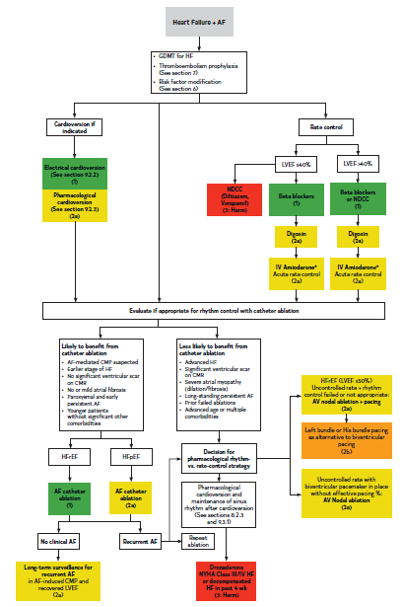
Figure 24. Management of Patients with HF and AF
AF indicates atrial fibrillation; AV, atrioventricular; CMP, cardiomyopathy; CMR, cardiac magnetic resonance; GDMT, guideline-directed medical therapy; HF, heart failure; HFpEF, heart failure with preserved ejection fraction; HFrEF, heart failure with reduced ejection fraction; IV, intravenous; LVEF, left ventricular ejection fraction; NDCC, nondihydropyridine calcium channel blocker; and NYHA, New York Heart Association.
Colors correspond to Table 2.

Slide 200
AF and Specific Patient Groups

Slide 201
Management of Early Onset AF, Including Genetic Testing
Recommendations for Management of Early Onset AF, Including Genetic Testing Referenced studies that support the recommendations are summarized in the Online Data Supplement. | Recommendations for Management of Early Onset AF, Including Genetic Testing Referenced studies that support the recommendations are summarized in the online data supplement.
COR | LOE | Recommendations
2b | B-NR | In patients with an onset of unexplained AF before 30 years of age, electrophysiological study to evaluate and treat reentrant supraventricular tachyarrhythmias with a targeted ablation may be reasonable because of the high prevalence of reentrant arrhythmias in this group.
2b | B-NR | In patents with an onset of AF before 45 years of age without obvious risk factors for AF, referral for genetic counseling, genetic testing for rare pathogenic variants, and surveillance for cardiomyopathy or arrhythmia syndromes may be reasonable.

Slide 202
Athletes
Recommendation for Athletes Referenced studies that support the recommendation are summarized in the Online Data Supplement. | Recommendation for Athletes Referenced studies that support the recommendation are summarized in the online data supplement.
COR | LOE | Recommendation
2a | B-NR | In athletes who develop AF, catheter ablation with PVI is a reasonable strategy for rhythm control because of its effectiveness and low risk of detrimental effect on exercise capacity.

Slide 203
Anticoagulation Considerations in Patients With Class III Obesity
Recommendations for Anticoagulation Considerations in Patients With Class III Obesity Referenced studies that support the recommendations are summarized in the Online Data Supplement. | Recommendations for Anticoagulation Considerations in Patients With Class III Obesity Referenced studies that support the recommendations are summarized in the online supplement.
COR | LOE | Recommendations
2a | B-NR | In patients with AF and class III obesity (BMI ≥40 kg/m²), DOACs are reasonable to choose over warfarin for stroke risk reduction.
2b | C-LD | In patients with AF who have undergone bariatric surgery, warfarin may be reasonable to choose over DOACs for stroke risk reduction in view of concerns about DOAC drug absorption.

Slide 204
Wolff-Parkinson-White (WPW) and Pre-Excitation Syndromes
Recommendations for WPW and Pre-Excitation Syndromes Referenced studies that support the recommendations are summarized in the Online Data Supplement. | Recommendations for WPW and Pre-Excitation Syndromes Referenced studies that support the recommendations are summarized in the online data supplement.
COR | LOE | Recommendations
1 | B-NR | Patients with AF with rapid anterograde conduction (preexcited AF), and hemodynamic instability should be treated with electrical cardioversion.
1 | B-NR | For patients with AF with rapid anterograde conduction (preexcited AF), catheter ablation of accessory pathways (APs) is recommended.

Slide 205
Wolff-Parkinson-White (WPW) and Pre-Excitation Syndromes (con’t.)
1 | C-LD | In patients with AF with rapid anterograde conduction (preexcited AF) and hemodynamic stability, pharmacological cardioversion with intravenous ibutilide or intravenous procainamide is recommended as an alternative to elective cardioversion.
3: Harm | B-NR | For patients with AF with anterograde accessory pathway conduction (preexcited AF), pharmacological agents that block atrioventricular nodal conduction (verapamil, diltiazem, amiodarone, digoxin, adenosine, or beta blockers) are contraindicated due to risk of precipitating VF or hemodynamic deterioration.

Slide 206
Adult Congenital Heart Disease (ACHD)
Recommendations for ACHD Referenced studies that support the recommendations are summarized in the Online Data Supplement. | Recommendations for ACHD Referenced studies that support the recommendations are summarized in the online supplement.
COR | LOE | Recommendations
1 | B-NR | In adults with congenital heart disease and AF, it is recommended to evaluate for and treat precipitating factors and reversible causes of AF, recognizing that residual hemodynamic sequalae may contribute to the occurrence of the arrhythmia.
1 | C-LD | In adults with AF and moderate or complex congenital heart disease, electrophysiological procedures should be performed by operators with expertise in ACHD procedures and in collaboration with an ACHD cardiologist, ideally in specialized centers, when available.

Slide 207
Adult Congenital Heart Disease (ACHD)
(con’t.)
1 | C-LD | In adults with congenital heart disease and symptomatic or hemodynamically significant paroxysmal or persistent AF, an initial strategy of rhythm control is recommended regardless of lesion severity as AF in this population is often poorly tolerated.
2a | B-NR | In symptomatic patients with simple congenital heart disease with antiarrhythmic drug-refractory AF, it is reasonable to choose ablation over long-term antiarrhythmic therapies.
2b | C-LD | In adults with congenital heart disease with AF undergoing PVI, it may be reasonable to include an ablative strategy in the right atrium directed at reentrant arrhythmia secondary to atriotomy scars and the CTI.
2b | C-LD | In adults with AF and moderate or severe forms of congenital heart disease, particularly those with low-flow states such as Fontan circulation, blind-ending cardiac chambers, and cyanosis, it may be reasonable to treat with anticoagulation independent of conventional risk score to reduce risk of thromboembolic events.

Slide 208
Prevention and Treatment of AF After Cardiac Surgery
Recommendations for Prevention of AF After Cardiac Surgery Referenced studies that support the recommendations are summarized in the Online Data Supplement. | Recommendations for Prevention of AF After Cardiac Surgery Referenced studies that support the recommendations are summarized in the online data supplement.
COR | LOE | Recommendations
2a | B-R | In patients undergoing cardiac surgery who are at high risk for postoperative AF, it is reasonable to administer short-term prophylactic beta blockers or amiodarone to reduce the incidence of postoperative AF.
2a | B-R | In patients undergoing CABG, aortic valve, or ascending aortic aneurysm operations, it is reasonable to perform concomitant posterior left pericardiotomy to reduce the incidence of postoperative AF.

Slide 209
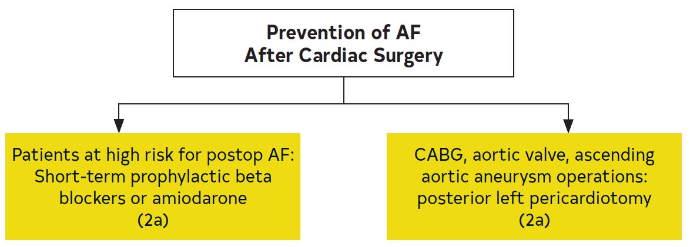
Figure 25. Prevention of AF After Cardiac Surgery
AF indicates atrial fibrillation; and CABG, coronary artery bypass graft.
Colors correspond to Table 2.

Slide 210
Treatment of AF After Cardiac Surgery
Recommendations for Treatment of AF After Cardiac Surgery Referenced studies that support the recommendations are summarized in the Online Data Supplement. | Recommendations for Treatment of AF After Cardiac Surgery Referenced studies that support the recommendations are summarized in the online data supplement.
COR | LOE | Recommendations
1 | A* | In postoperative cardiac surgery patients, beta blockers* are recommended to achieve rate control for AF, unless contraindicated or ineffective in which case a nondihydropyridine calcium channel blocker† is recommended.
 | B-R†
1 | B-R | In hemodynamically stable cardiac surgery patients with postoperative AF, rate-control (target heart rate, <100 bpm) and/or rhythm-control medications are recommended as initial therapy, with the choice of strategy according to patient symptoms, hemodynamic consequences of the arrhythmia, and physician preference.
*A LOE applies to the data on beta blockers.​
†B-R LOE applies to the data on nondihydropyridine calcium channel blockers.

Slide 211
Treatment of AF After Cardiac Surgery (con’t.)
1 | B-R | In patients who develop poorly tolerated AF after cardiac surgery, direct current cardioversion in combination with antiarrhythmic drug therapy is recommended, with consideration of imaging to rule out left appendage thrombus before cardioversion in those patients in whom AF has been present >48 hours and who have not been on anticoagulation.
2a | B-NR | In patients who develop postoperative AF after cardiac surgery, it is reasonable to administer anticoagulation when deemed safe in regard to surgical bleeding for 60 days after surgery unless complications develop and to reevaluate the need for longer term anticoagulation at that time.
2a | C-LD | In patients who develop AF after cardiac surgery and who are treated with rate-control strategy, at 30- to 60-day follow-up it is reasonable to perform rhythm assessment and, if AF does not revert to sinus rhythm spontaneously, consider cardioversion after an adequate duration of anticoagulation.

Slide 212
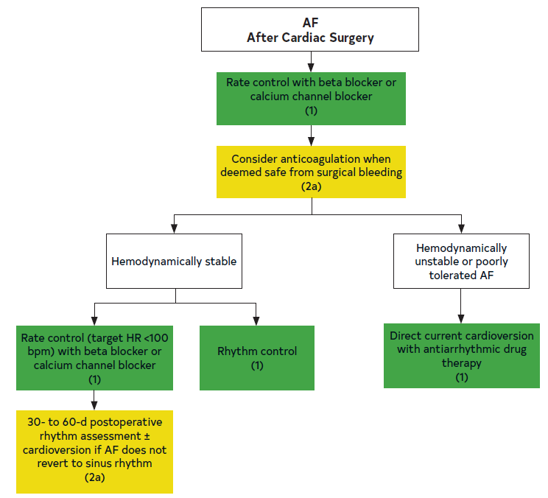
Figure 26. Treatment of AF After Cardiac Surgery
AF indicates atrial fibrillation; and HR, heart rate.
Colors correspond to Table 2.

Slide 213
Acute Medical Illness or Surgery (Including AF in Critical Care)
Recommendations for Acute Medical Illness or Surgery (Including AF in Critical Care) Referenced studies that support the recommendations are summarized in the Online Data Supplement. | Recommendations for Acute Medical Illness or Surgery (Including AF in Critical Care) Referenced studies that support the recommendations are summarized in the online data supplement
COR | LOE | Recommendations
1 | B-NR | Patients with AF who are identified in the setting of acute medical illness or surgery should be counseled about the significant risk of recurrent AF after the acute illness is resolved.
2a | B-NR | In patients with AF who are identified in the setting of acute medical illness or surgery, outpatient follow-up for thromboembolic risk stratification and decision-making on OAC initiation or continuation, as well as AF surveillance, can be beneficial given a high risk of AF recurrence.
2b | B-NR | In patients with AF who are identified in the setting of critical illness due to sepsis, the benefits of anticoagulation during critical illness for stroke prevention are uncertain.

Slide 214
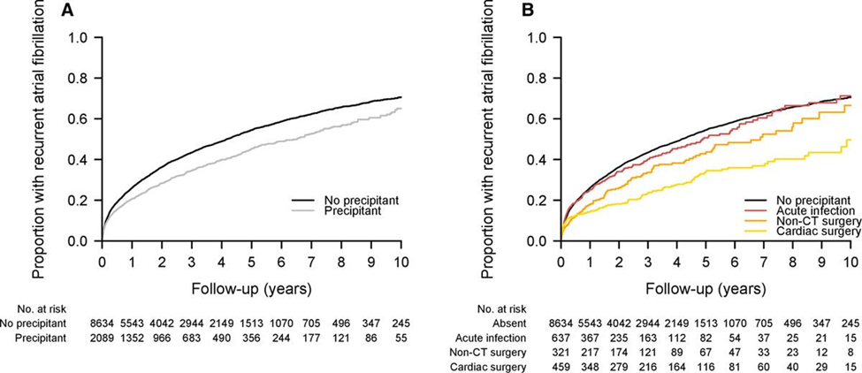
Figure 27. Unadjusted Cumulative Risk of AF Recurrence
Unadjusted curves displaying cumulative risk of recurrent AF, generated using Kaplan-Meier method. (A) Overall risk of recurrent AF among individuals with and without acute precipitants. (B) Overall risk of recurrent AF among individuals with infection, cardiac surgery, and noncardiothoracic surgery compared with no precipitant. These 3 precipitants were selected for display because the risk of recurrent AF was significantly lower compared with the referent group without precipitants in multivariable adjusted models. Individuals with other AF precipitants were excluded from this plot for clarity. AF indicates atrial fibrillation; and CT, cardiothoracic.

Slide 215
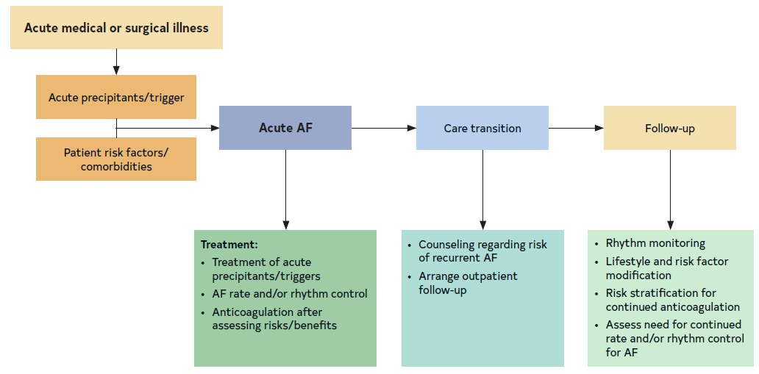
Figure 28. Acute Medical or Surgical Illness
AF indicates atrial fibrillation.

Slide 216
Hyperthyroidism
Recommendation for Hyperthyroidism Referenced studies that support the recommendation are summarized in the Online Data Supplement. | Recommendation for Hyperthyroidism Referenced studies that support the recommendation are summarized in the online data supplement.
COR | LOE | Recommendation
1 | B-NR | In patients with hyperthyroidism and AF who have an elevated risk of stroke based on a standard clinical risk score, anticoagulation is recommended until thyroid function has returned to normal and sinus rhythm can be maintained.

Slide 217
Pulmonary Disease
Recommendations for Pulmonary Disease Referenced studies that support the recommendations are summarized in the Online Data Supplement. | Recommendations for Pulmonary Disease Referenced studies that support the recommendations are summarized in the online data supplement.
COR | LOE | Recommendations
2a | B-R | In patients with AF and COPD, it is reasonable to use cardioselective beta blockers for rate control of AF, especially where other indications exist (eg, MI and HF).
2a | B-NR | In patients with pulmonary hypertension (PH) with pulmonary vascular disease and AF or AFL, a rhythm-control strategy is reasonable to improve functional status and potentially prolong survival.

Slide 218
Pregnancy
Recommendations for Pregnancy Referenced studies that support the recommendations are summarized in the Online Data Supplement. | Recommendations for Pregnancy Referenced studies that support the recommendations are summarized in the online supplement.
COR | LOE | Recommendations
1 | B-NR | In pregnant patients with AF, DCCV is safe to the patient and fetus and should be performed in the same manner as in patients who are not pregnant.
2b | C-LD | In pregnant individuals with structurally normal hearts and hemodynamically stable AF, pharmacological cardioversion with agents with history of safe use in pregnancy, such as intravenous procainamide, may be considered.

Slide 219
Pregnancy (con’t.)
2a | C-LD | In pregnant individuals with AF and without structural heart disease, antiarrhythmic agents with history of safe use in pregnancy (eg, flecainide and sotalol) are reasonable for maintenance of sinus rhythm.
2a | B-NR | In pregnant individuals with persistent AF, rate-control agents with a record of safety in pregnancy, such as beta blockers (eg, propranolol or metoprolol) and digoxin, either alone or in combination with beta blockers, are reasonable as first-line agents.
2b | C-LD | Pregnant individuals with AF and elevated risk of stroke may be considered for anticoagulation with the recognition that no anticoagulation strategy is completely safe for both the mother and fetus, and an SDM discussion should take place regarding risks to both mother and fetus (Table 28).

Slide 220
Table 28. Anticoagulation Strategies During Pregnancy
Antenatal Options
 | Method 1 | Method 2 | Method 3 | Alternative Method 4
First trimester | Warfarin ≤5 mg | LMWH | UFH | LMWH
Second trimester | Warfarin | Warfarin | Warfarin | LMWH
Third trimester | Warfarin | Warfarin | Warfarin | LMWH
Delivery Planning
 | Method 1 |  | Method 2
1 wk before | Discontinue warfarin → continuous IV UFH |  | Dose-adjusted LMWH
36 h before | Continuous IV UFH |  | Switch to continuous IV UFH
4-6 h before | Stop IV heparin |  | Stop IV heparin
IV indicates intravenous; LMWH, low- molecular-weight heparin; and UFH, unfractionated heparin.

Slide 221
Cardio-Oncology and Anticoagulation Considerations
 | Recommendations for Cardio-Oncology and Anticoagulation Considerations Referenced studies that support the recommendations are summarized in the Online Data Supplement.
COR | LOE | Recommendations
1 | C-LD | In patients with cancer and AF, multidisciplinary communication including cardiology, oncology and other clinicians, and SDM with the patient is recommended to optimize cancer and AF treatment and to reduce the risk of drug-drug interactions, QTc prolongation, proarrhythmia, bleeding, and thromboembolism.
2a | C-LD | In patients who are to be initiated on cancer therapies associated with an increased risk of developing AF, increased vigilance for incident AF and treatment of contributing factors is reasonable to decrease morbidity.
2a | B-NR | In most patients with AF and cancer (remote history or receiving active cancer treatment), DOACs are reasonable to choose over VKAs for stroke risk reduction.

Slide 222
Table 29. Medical Cancer Therapy Associated With Increased Risk of AF (>1%)
Cancer Therapy | Frequency Reported in Clinical Trials and Observational Studies
 | Common: Incidence 1%-10% | Frequent: >10% | Comments
Anthracyclines Doxorubicin, epirubicin, idarubicin, mitoxantrone |  | X | AF may be a secondary result of anthracycline cardiotoxicity; studies in different populations demonstrate variable risk of AF
Antimetabolites Clofarabine combined with cytarabine 5FU Cepecitabine Gemcitabine | X X X | X
AF indicates atrial fibrillation; BTKi, Bruton’s kinase inhibitor; CAR, chimeric antigen receptor; FDA, US Food and Drug Administration; 5FU, 5 fluorouracil; and TKI, tyrosine kinase inhibitor.

Slide 223
Table 29. Medical Cancer Therapy Associated With Increased Risk of AF (>1%) (con’t.)
Alkylating agents Cyclophosphamide Melphalan + stem cell transplantation | X | X* | *Stem cell transplantation is associated with an increased risk of AF, and the risk may be higher with melphalan-associated regimens
Immunomodulatory drugs Lenalidomide Interleukin-2 | X X |  | Given rates reported from patients with multiple myeloma, AF due to underlying cardiac AL amyloid may contribute
AF indicates atrial fibrillation; BTKi, Bruton’s kinase inhibitor; CAR, chimeric antigen receptor; FDA, US Food and Drug Administration; 5FU, 5 fluorouracil; and TKI, tyrosine kinase inhibitor.

Slide 224
Table 29. Medical Cancer Therapy Associated With Increased Risk of AF (>1%) (con’t.)
TKIs Ibrutinib (BTKi) Acalbrutinib (2nd- generation BTKi) Zanubrutinib (2nd- generation BTKi) Ponatinib (BCR-ABL TKI) and other TKIs (eg, trametinib, osimertinib, nilotinib, ribociclib) VEGF inhibitor Sorafenib in combination with 5FU BRAF inhibitor Vemurafenib | X† X X X X | X† | †Reported AF rates with ibrutinib have varied across trials (4%-18%), partly related to varying duration of follow-up and patient factors. Second-generation BTKis have more selective BTK activity and are associated with a lower incidence of AF than ibrutinib Based on US FDA adverse event reporting system
AF indicates atrial fibrillation; BTKi, Bruton’s kinase inhibitor; CAR, chimeric antigen receptor; FDA, US Food and Drug Administration; 5FU, 5 fluorouracil; and TKI, tyrosine kinase inhibitor.

Slide 225
Table 29. Medical Cancer Therapy Associated With Increased Risk of AF (>1%) (con’t.)
CAR T-cell therapy Tisagenlecleucel Axicabtagene ciloleucel | X
Monoclonal antibodies Rituximab | X
AF indicates atrial fibrillation; BTKi, Bruton’s kinase inhibitor; CAR, chimeric antigen receptor; FDA, US Food and Drug Administration; 5FU, 5 fluorouracil; and TKI, tyrosine kinase inhibitor.

Slide 226
Table 30. Special Considerations for Anticoagulation in Patients With AF on Active Cancer Treatment
Increased bleeding risk | High bleeding risk estimators (eg, HAS-BLED) Thrombocytopenia (platelet <50,000/uL) Intracranial malignancy Gastrointestinal malignancy History of major bleeding Severe kidney dysfunction (eGFR <30 mL/min/1.73m²)
Drug interactions | P-glycoprotein inducers or inhibitors CYP3A4 inducers or inhibitors
AF indicates atrial fibrillation; eGFR, estimated glomerular filtration rate; and HASBLED, hypertension, abnormal renal/liver function, stroke, bleeding history or predisposition, labile international normalized ratio (INR), elderly (age $65 years), drugs/alcohol concomitantly).

Slide 227
Anticoagulation Use in Patients With Liver Disease
Recommendations for Anticoagulation Use in Patients With Liver Disease Referenced studies that support the recommendations are summarized in the Online Data Supplement. | Recommendations for Anticoagulation Use in Patients With Liver Disease Referenced studies that support the recommendations are summarized in the online data supplement.
COR | LOE | Recommendations
2a | B-NR | For patients with AF who are at increased risk of systemic thromboembolism and mild or moderate liver disease (Child-Pugh* class A or B), OAC therapy is reasonable in the absence of clinically significant liver disease-induced coagulopathy or thrombocytopenia.
*Child-Pugh scoring: the severity of liver disease, primarily cirrhosis in patients with diagnosed liver disease. Child-Pugh A (mild): 5-6 points; Child-Pugh B (moderate): 7-9 points; Child-Pugh C (severe): 10-15 points. The score is based on the 5 variables: encephalopathy (none=1 point, grade 1 and 2=2 points, grade 3 and 4= 3 points); ascites (none=1 point, slight=2 points, moderate=3 points); total bilirubin (<2 mg/mL=1 point, 2-3 mg/mL=2 points, >3 mg/mL=3 points); albumin (>3.5 mg/mL=1 point, 2.8-3.5 mg/mL=2 points, <2.8 mg/mL=3 points); INR (<1.7=1 point, INR 1.7-2.2=2 points, INR >2.2=3 points).

Slide 228
Anticoagulation Use in Patients With Liver Disease (con’t.)
2a | B-NR | For patients with AF who are at increased risk of systemic thromboembolism and mild or moderate liver disease (Child-Pugh class A or B) and who are deemed to be candidates for anticoagulation, it is reasonable to prescribe DOACs (Child-Pugh class A: any DOAC; Child-Pugh class B: apixaban, dabigatran, or edoxaban) over warfarin.
3: Harm | C-LD | For patients with AF and moderate liver disease (Child-Pugh class B) at increased risk of systemic thromboembolism, rivaroxaban is contraindicated due to the potentially increased risk of bleeding.
*Child-Pugh scoring: the severity of liver disease, primarily cirrhosis in patients with diagnosed liver disease. Child-Pugh A (mild): 5-6 points; Child-Pugh B (moderate): 7-9 points; Child-Pugh C (severe): 10-15 points. The score is based on the 5 variables: encephalopathy (none¼1 point, grade 1 and 2¼2 points, grade 3 and 4¼ 3 points); ascites (none¼1 point, slight¼2 points, moderate¼3 points); total bilirubin (<2 mg/mL¼1 point, 2-3 mg/mL¼2 points, >3 mg/mL¼3 points); albumin (>3.5 mg/mL¼1 point, 2.8-3.5 mg/mL¼2 points, <2.8 mg/mL¼3 points); INR (<1.7¼1 point, INR 1.7-2.2¼2 points, INR >2.2¼3 points).

