Slide 1
2024 AHA/ACC/ACS/ASNC/HRS/SCA/SCCT/SCMR/SVM Guideline for Perioperative Cardiovascular Management for Noncardiac Surgery
A Report of the American Heart Association/American College of Cardiology Joint Committee on Clinical Practice Guidelines
Developed in Collaboration With and Endorsed by the American College of Surgeons, American Society of Nuclear Cardiology, Heart Rhythm Society, Society of Cardiovascular Anesthesiologists, Society of Cardiovascular Computed Tomography, Society of Cardiovascular Magnetic Resonance, and the Society for Vascular Medicine

Slide 2
Citation
This slide set is adapted from the 2024 AHA/ACC/ACS/ASNC/HRS/SCA/SCCT/SCMR/SVM Guideline for Perioperative Cardiovascular Management for Noncardiac Surgery. Published ahead of print September 24, 2024, available at: Circulation. https://www.ahajournals.org/doi/10.1161/CIR.0000000000001285 and Journal of the American College of Cardiology, published online ahead of print September 24, 2024. J Am Coll Cardiol. https://www.jacc.org/doi/10.1016/j.jacc.2024.06.013
© 2024 the American Heart Association, Inc. and the American College of Cardiology Foundation. All rights reserved. This article has been published in Circulation and the Journal of the American College of Cardiology.

Slide 3
2024 Writing Committee Members*
Annemarie Thompson, MD, MBA, FAHA, Chair
Kirsten E. Fleischmann, MD, MPH, FACC, Vice-Chair
Nathaniel R. Smilowitz, MD, MS, FACC, Vice-Chair
Lisa de las Fuentes, MD, MS, FAHA, JC Liaison†
Debabrata Mukherjee, MD, MS, FACC, FAHA, JC Liaison‡
Niti R. Aggarwal, MD, FACC, FASNC
Faraz S. Ahmad, MD, MS, FACC, FAHA§
Robert B. “Skip” Allen, JD
S. Elissa Altin, MD, FACC, FSVM║
Andrew Auerbach, MD, MPH
Jeffrey S. Berger, MD, MS, FAHA, FACC
Benjamin Chow, MD, PhD, FACC, FASNC, MSCCT¶
Habib A. Dakik, MD, FACC
Eric L. Eisenstein, DBA
Marie Gerhard-Herman, MD, FACC, FAHA
Kamrouz Ghadimi, MD, MHSc, FAHA
Bessie Kachulis, MD#
Jacinthe Leclerc, RN, PhD, FAHA
Christopher S. Lee, PhD, RN, FAHA**
Tracy E. Macaulay, PharmD, FACC
Gail Mates, BS
Geno J. Merli, MD, FSVM
Purvi Parwani, MBBS, MPH, FACC††
Jeanne E. Poole, MD, FACC, FHRS‡‡
Michael W. Rich, MD, FACC
Kurt Ruetzler, MD, PhD, FAHA
Steven C. Stain, MD, FACS§§
BobbieJean Sweitzer, MD
Amy W. Talbot, MPH
Saraschandra Vallabhajosyula, MD, MSc, FAHA, FACC
John Whittle, MD
Kim Allan Williams, Sr., MD, MACC, FAHA, MASNC║║
*Writing committee members are required to recuse themselves from voting on sections to which their specific relationships with industry may apply; see Appendix 1 for detailed information.
†Former ACC/AHA JCCPG member; current member during the writing effort. ‡ACC/AHA Joint Committee on Clinical Practice Guidelines. §AHA/ACC Joint Committee on Clinical Data Standards. ║Society for Vascular Medicine representative. ¶Society of Cardiovascular Computed Tomography representative. #Society of Cardiovascular Anesthesiologists representative. **AHA/ACC Joint Committee on Performance Measures. ††Society for Cardiovascular Magnetic Resonance representative. ‡‡Heart Rhythm Society representative. §§American College of Surgeons representative. ║║American Society of Nuclear Cardiology representative.

Slide 4
Top Take-Home Messages

Slide 5
Top Take Home Messages
1. A stepwise approach to perioperative cardiac assessment assists clinicians in determining when surgery should proceed or when a pause for further evaluation is warranted.

Slide 6
Top Take Home Messages
2. Cardiovascular screening and treatment of patients undergoing noncardiac surgery (NCS) should adhere to the same indications as nonsurgical patients, carefully timed to avoid delays in surgery and chosen in ways to avoid overscreening and overtreatment.

Slide 7
Top Take Home Messages
3. Stress testing should be performed judiciously in patients undergoing NCS, especially those at lower risk, and only in patients in whom testing would be appropriate independent of planned surgery.

Slide 8
Top Take Home Messages
4. Team-based care should be emphasized when managing patients with complex anatomy or unstable cardiovascular disease.

Slide 9
Top Take Home Messages
5. New therapies for management of diabetes, heart failure, and obesity have significant perioperative implications. Sodium-glucose cotransporter 2 inhibitors should be discontinued 3 to 4 days before surgery to minimize the risk of perioperative ketoacidosis associated with their use.

Slide 10
Top Take Home Messages
6. Myocardial injury after NCS is a newly identified disease process that should not be ignored because it portends real consequences for affected patients.

Slide 11
Top Take Home Messages
7. Patients with newly diagnosed atrial fibrillation identified during or after NCS have an increased risk of stroke. These patients should be followed closely after surgery to treat reversible causes of arrhythmia and to assess the need for rhythm control and long-term anticoagulation.

Slide 12
Top Take Home Messages
8. Perioperative bridging of oral anticoagulant therapy should be used selectively only in those patients at highest risk for thrombotic complications and is not recommended in the majority of cases.

Slide 13
Top Take Home Messages
9. In patients with unexplained hemodynamic instability and when clinical expertise is available, emergency focused cardiac ultrasound can be used for preoperative evaluation; however, focused cardiac ultrasound should not replace comprehensive transthoracic echocardiography.

Slide 14
Table 2. Definitions of Surgical Timing and Surgical Risk
Timing | Definition
Emergency | Immediate threat to life or limb without surgical intervention, where there is very limited or no time for preoperative clinical evaluation, typically <2 h.
Urgent | Threat to life or limb without surgical intervention, where there may be time for preoperative clinical evaluation to allow interventions that could reduce risk of MACE or other postoperative complications, typically ≥2 to <24 h.
Time-sensitive | Surgery may be delayed up to 3 mo to allow for preoperative evaluation and management without negatively impacting outcomes.
Elective | The surgical procedure can be delayed to permit a complete preoperative evaluation and appropriate management.
*Determining elevated calculated risk depends on the calculator used. Traditionally a Revised Cardiac Risk Index (RCRI) >1 or a calculated risk of MACE with any perioperative risk calculator >1% is used as a threshold to identify patients at elevated risk.
†Encompasses patients at intermediate or high surgical risk.
MACE indicates major adverse cardiovascular event; and RCRI, Revised Cardiac Risk Index.

Slide 15
Table 2. Definitions of Surgical Timing and Surgical Risk (con’t.)
Risk Category* | Definition
Low risk | Combined surgical and patient characteristics predict a low risk of MACE of <1%.*
Elevated risk† | Combined surgical and patient characteristics predict an elevated risk of MACE of ≥1%.*
*Determining elevated calculated risk depends on the calculator used. Traditionally a Revised Cardiac Risk Index (RCRI) >1 or a calculated risk of MACE with any perioperative risk calculator >1% is used as a threshold to identify patients at elevated risk.
†Encompasses patients at intermediate or high surgical risk.
MACE indicates major adverse cardiovascular event; and RCRI, Revised Cardiac Risk Index.

Slide 16
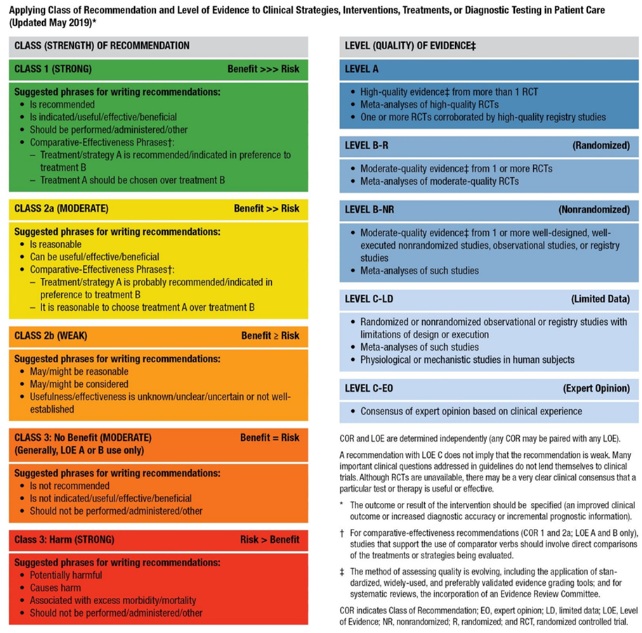
Table 3. Applying the American College of Cardiology/American Heart Association Class of Recommendation and Level of Evidence to Clinical Strategies, Interventions, Treatments, or Diagnostic Testing in Patient Care (Updated May 2019)

Slide 17
Risk Calculators

Slide 18
Cardiovascular Risk Indices
Recommendation for Cardiovascular Risk Indices Referenced studies that support the recommendations are summarized in the Online Data Supplement.
COR | LOE | Recommendation
2a | B-NR | In patients with known CVD being considered for NCS, a validated risk-prediction tool can be useful to estimate the risk of perioperative MACE.

Slide 19
Table 4. Risk Scores and Calculators
 | Goldman Index of Cardiac Risk (1977) | Revised Cardiac Risk Index (RCRI) (1999) | Gupta NSQIP Risk Calculator for Perioperative Myocardial Infarction or Cardiac Arrest (MICA) (2011) | ACS NSQIP Surgical Risk Calculator (2023) | Surgical Outcome Risk Tool (2014) | NSQIP Geriatric-Sensitive Perioperative Cardiac Risk Index (2017) | AUB-HAS2 Cardiovascular Risk Index (2019)
Criteria | • Age >70 y (5 points) • Recent MI within 6 mo (10 points) • Jugular venous distention or a third heart sound on auscultation (11 points) • ≥5 PVCs per minute (7 points) • Nonsinus rhythm or PACs on preoperative ECG (7 points) • Aortic stenosis (3 points) • Intraperitoneal, intrathoracic, or aortic surgery (3 points) • Any emergency surgery (4 points) | • Ischemic heart disease • Cerebrovascular disease • History of HF • Insulin therapy for diabetes • Serum creatinine ≥2.0 mg/dL • Planned high-risk procedure (intraperitoneal, intrathoracic, or vascular surgery) (1 point for each criterion) | • Age • ASA class • Preoperative function • Creatinine • Procedure type (anorectal surgery, aortic, bariatric, brain, breast, cardiac, ENT, foregut/hepato-pancreatobiliary, gallbladder/appendix/adrenal/spleen, intestinal, neck, obstetric/ gynecologic, orthopedic, other abdomen, peripheral vascular, skin, spine, thoracic, urology, vein) | • Age group • Sex • ASA class • Functional status • Emergency case • Steroid use for chronic condition • Ascites within 30 d preoperatively • System sepsis within 48 h preoperatively • Ventilator dependent • Disseminated cancer • Diabetes • HTN requiring medication • Previous cardiac event • HF in 30 d preoperatively • Dyspnea • Current smoker within 1 y • History of COPD • Dialysis • Acute renal failure • BMI class • CPT-specific linear risk | • Age group • ASA class • Urgency of surgery • Specialty • Severity of surgery • Cancer | •ASA class • History of HF • History of stroke • Diabetes • Functional status (partially versus totally dependent) • Creatinine >1.5mg/dL • Surgical category | • Age ≥75 y • History of heart disease • Symptoms of angina/dyspnea • Hemoglobin <12 mg/dL • Vascular surgery • Emergency surgery

Slide 20
Table 4. Risk Scores and Calculators (con’t.)
Score Range | Class I: 0-5 points (lowest risk) Class II: 6-12 points Class III: 13-25 points Class IV: ≥26 points (highest risk) | Class I: RCRI 0 (lowest risk) Class II: RCRI 1 Class III: RCRI 2 Class IV: RCRI 3+ (highest risk) | 0%-100% (0% lowest risk, 100% highest risk) | 0%-100% (0% lowest risk, 100% highest risk) | 0%-100% (0% lowest risk, 100% highest risk) | 0%-100% (0% lowest risk, 100% highest risk) | CVRI Score 0 (lowest risk) CVRI Score 1 CVRI Score 2 CVRI Score 3 CVRI Score >3 (highest risk)
Threshold Denoting Elevated Risk | Class II or higher (≥6 points) | RCRI >1 | >1% | >1% |  | >1% | CVRI Score ≥2
Outcome | Intraoperative/postoperative MI, pulmonary edema, VT, cardiac death | MI, pulmonary edema, ventricular fibrillation, complete heart block, cardiac death | Intraoperative/postoperative MI or cardiac arrest within 30 d | Cardiac arrest, MI, all-cause mortality within 30 d | 30-d mortality | Cardiac arrest, MI, all-cause mortality within 30 d | Death, MI, or stroke at 30 d
Derivation (n) | 1001 | 1422 | 211,410 | 1,414,006 | 19,097 | 584,931 | 3284
Derivation Set ROC | 0.61 | 0.76 | 0.88 | 0.90 (cardiac arrest or MI) 0.94 (mortality) |  | N/A | 0.90
Validation Set ROC | 0.70 | 0.81 0.75† | 0.87* | 0.88 (cardiac arrest or MI)* 0.94 (mortality)* | 0.91‡ | 0.83* (0.76 in adults age ≥65 y) | 0.82*
Score Range | Class I: 0-5 points (lowest risk) Class II: 6-12 points Class III: 13-25 points Class IV: ≥26 points (highest risk) | Class I: RCRI 0 (lowest risk) Class II: RCRI 1 Class III: RCRI 2 Class IV: RCRI 3+ (highest risk) | 0%-100% (0% lowest risk, 100% highest risk) | 0%-100% (0% lowest risk, 100% highest risk) | 0%-100% (0% lowest risk, 100% highest risk) | 0%-100% (0% lowest risk, 100% highest risk) | CVRI Score 0 (lowest risk) CVRI Score 1 CVRI Score 2 CVRI Score 3 CVRI Score >3 (highest risk)

Slide 21
Table 4. Risk Scores and Calculators (con’t.)
*Validated using the NSQIP database.
†Pooled validation studies assessing the performance of the RCRI in mixed noncardiac surgery.
‡Derived and validated using the NCEPOD Knowing the Risk study.
ACS indicates American College of Surgeons; ASA, American Society of Anesthesiologists; AUB, American University of Beirut; BMI, body mass index; COPD, chronic obstructive pulmonary disease; CPT, current procedural terminology; CVRI, Coronary Vascular Resistance Index; ECG, electrocardiogram; ENT, ear, nose and throat; HF, heart failure; HTN, hypertension; MI, myocardial infarction; MICA, MI and cardiac arrest; NCEPOD, National Confidential Enquiry into Patient Outcome and Death; NSQIP, National Surgical Quality Improvement Program; PAC, premature atrial contraction; PVC, premature ventricular complex; RCRI, Revised Cardiac Risk Index; ROC, receiver operating characteristic; and VT, ventricular tachycardia.

Slide 22
Functional Capacity Assessment
Recommendation for Functional Capacity Assessment Referenced studies that support the recommendations are summarized in the Online Data Supplement.
COR | LOE | Recommendation
2a | B-NR | In patients undergoing elevated-risk NCS, a structured assessment of functional capacity (such as the Duke Activity Status Index [DASI]) is reasonable to stratify the risk of perioperative adverse cardiovascular events.

Slide 23
Table 5. Duke Activity Status Index (DASI)
Activity: Can you… | Weight
take care of yourself (eg, eating, dressing, bathing, or using the toilet)? | 2.75
walk indoors, such as around your house? | 1.75
walk a block or 2 on level ground? | 2.75
climb a flight of stairs or walk a hill? | 5.5
run a short distance? | 8
do light work around the house (eg, dusting, washing dishes)? | 2.7
do moderate work around the house (eg, vacuuming, sweeping floors, carrying in groceries)? | 3.5
do heavy work around the house (eg, scrubbing floors, lifting or moving heavy furniture)? | 8
do yardwork (eg, raking leaves, weeding, pushing a power mower)? | 4.5
have sexual relations? | 5.25
participate in moderate recreational activities (eg, golf, bowling, dancing, doubles tennis, throwing a baseball or football)? | 6
participate in strenuous sports (eg, swimming, singles tennis, basketball, skiing)? | 7.5
The DASI score is calculated by adding the points of all performed activities together. The higher the score (range, 0-58.2), the higher the functional status.

Slide 24
Frailty
Recommendation for Frailty Referenced studies that support the recommendations are summarized in the Online Data Supplement.
COR | LOE | Recommendation
2a | B-NR | In all patients ≥65 years of age and in those <64 years with perceived frailty who are undergoing elevated-risk NCS, preoperative frailty assessment using a validated tool can be useful for evaluating perioperative risk and guiding management.

Slide 25
Table 6. Frailty Assessment Tools
Name | Items | Scoring
Physical Frailty Phenotype (Fried Phenotype) | Slowness, low activity, weight loss, exhaustion, weakness (1 point each) | 0=Nonfrail 1-2=Prefrail 3-5=Frail
Deficit Accumulation Index | Variable; typically 30-70 items from multiple domains | Number of deficits/number of items scored; higher scores indicate greater frailty
Edmonton Frail Scale | 10 items across multiple domains | Sum of scores/17; higher scores indicate greater frailty

Slide 26
Table 6. Frailty Assessment Tools (con’t.)
Name | Items | Scoring
FRAIL Scale | Fatigue, stair climb, ambulation, illnesses >5, weight loss ≥5% (1 point each) | 0=Nonfrail 1-2=Intermediate 3-5=Frail
Clinical Frailty Scale | 9 categories ranging from very fit to terminally ill as assessed by clinicians | Categories 5-8 indicate mild, moderate, severe, and very severe frailty
SPPB | Gait speed, chair stands, balance tests | Maximum 4 points per item, range, 0-12 points; ≥10=Nonfrail, 3-9=Frail, ≤2=Disabled
SPPB indicates Short Physical Performance Battery.

Slide 27
Preoperative Biomarkers for Risk Stratification
Recommendations for Preoperative Biomarkers for Risk Stratification Referenced studies that support the recommendations are summarized in the Online Data Supplement.
COR | LOE | Recommendations
2a | B-NR | In patients with known CVD, or age ≥65 years, or age ≥45 years with symptoms suggestive of CVD undergoing elevated-risk NCS, it is reasonable to measure B-type natriuretic peptide (BNP) or N-Terminal pro B-type natriuretic peptide (NT-proBNP) before surgery to supplement evaluation of perioperative risk.
2b | B-NR | In patients with known CVD, or age ≥65 years, or age ≥45 years with symptoms suggestive of CVD undergoing elevated-risk NCS, it may be reasonable to measure cardiac troponin (cTn) before surgery to supplement evaluation of perioperative risk.

Slide 28
Preoperative Cardiovascular Diagnostic Testing

Slide 29
12-Lead Electrocardiogram
Recommendations for 12-Lead Electrocardiogram Referenced studies that support the recommendations are summarized in the Online Data Supplement.
COR | LOE | Recommendations
2a | B-NR | For patients with known coronary heart disease, significant arrhythmia, peripheral arterial disease, cerebrovascular disease, other significant structural heart disease, or symptoms* of CVD undergoing elevated-risk surgery, a preoperative resting 12-lead electrocardiogram (ECG) is reasonable to establish a preoperative baseline and guide perioperative management.
*Active symptoms and signs of CVD include chest pain, dyspnea, undiagnosed palpitations, tachycardia, syncope, or murmurs.

Slide 30
12-Lead Electrocardiogram (con’t.)
2a | B-NR | In patients undergoing NCS with a preoperative ECG exhibiting new abnormalities†, further evaluation is reasonable to refine assessment of cardiovascular risk.
2b | B-NR | For asymptomatic patients undergoing elevated-risk surgeries without known CVD, a preoperative resting 12-lead ECG may be considered to establish a baseline and guide perioperative management.
3: No benefit | B-NR | For asymptomatic patients undergoing low-risk surgical procedures, a routine preoperative resting 12-lead ECG is not recommended to improve outcomes.
†Abnormalities may include ST-segment elevation, ST depression, T-wave inversions, left ventricular (LV) hypertrophy, significant pathologic Q-waves, Mobitz type II or higher atrioventricular (AV) block, bundle branch block, QT prolongation, or AF.

Slide 31
Left Ventricular Function
Recommendations for Assessment of Left Ventricular Function Referenced studies that support the recommendations are summarized in the Online Data Supplement.
COR | LOE | Recommendations
1 | B-NR | In patients undergoing NCS with new dyspnea, physical examination findings of HF, or suspected new/worsening ventricular dysfunction, it is recommended to perform preoperative evaluation of LV function to help guide perioperative management.
2a | C-LD | In patients with a known diagnosis of HF with worsening dyspnea or other change in clinical status undergoing NCS, preoperative assessment of LV function is reasonable to help guide perioperative management.
3: No Benefit | B-NR | In asymptomatic and clinically stable patients undergoing NCS, routine preoperative evaluation of LV function is not recommended due to lack of benefit.

Slide 32
Stress Testing
Recommendations for Stress Testing Referenced studies that support the recommendations are summarized in the Online Data Supplement.
COR | LOE | Recommendations
2b | B-NR | For patients undergoing elevated-risk NCS with poor or unknown functional capacity and elevated risk for perioperative cardiovascular events based on a validated risk tool, stress testing may be considered to evaluate for inducible myocardial ischemia.
3: No benefit | B-R | In patients who are at low risk for perioperative cardiovascular events, have adequate* functional capacity with stable symptoms, or who are undergoing low-risk procedures, routine stress testing before NCS is not recommended due to lack of benefit.
*Poor functional capacity is considered <4 METS or a DASI score of ≤34.

Slide 33
Table 7. Considerations and Contraindications for Specific Stress Testing Modalities
Modality | Contraindication*
Vasodilator pharmacological stress imaging | Significant arrhythmias (eg, VT, second- or third-degree atrioventricular block), significant hypotension (SBP <90 mm Hg), known or suspected bronchoconstrictive or bronchospastic disease or recent use of dipyridamole or methylxanthines (eg, aminophylline, caffeine) within 12 h
Exercise stress testing (with or without imaging) | Inability to exercise
Dobutamine stress echocardiography | Critical aortic stenosis, hemodynamically significant LVOT obstruction
*In general, the following contraindications apply to all stress testing modalities: ACS, decompensated HF, severe/symptomatic aortic stenosis, uncontrolled arrhythmia, systemic arterial HTN (eg, ≥200/110 mm Hg), acute aortic dissections, pericarditis/myocarditis, pulmonary embolism, and severe pulmonary HTN.
ACS indicates acute coronary syndrome; HF, heart failure; HTN, hypertension; LVOT, left ventricular outflow tract; SBP, systolic blood pressure; and VT, ventricular tachycardia.

Slide 34
Coronary Computed Tomography Angiography
Recommendations for Coronary Computed Tomography Angiography Referenced studies that support the recommendations are summarized in the Online Data Supplement.
COR | LOE | Recommendations
2b | B-NR | For patients undergoing elevated-risk surgery with poor* or unknown functional capacity, and elevated risk for perioperative cardiovascular events based on a validated risk tool, coronary computed tomography angiography (CCTA) for the detection of high-risk coronary anatomy† may be considered.
3: No benefit | B-NR | In patients who are at low risk for perioperative cardiovascular events, have adequate* functional capacity with stable symptoms, or who are undergoing low-risk procedures, routine CCTA before NCS is not recommended due to lack of benefit.
*Poor functional capacity is considered <4 METS or a DASI score of ≤34.
†High-risk coronary anatomy is defined as patients with obstructive stenosis who have ≥50% left main stenosis or anatomically significant 3-vessel disease (≥70% stenosis).6

Slide 35
Invasive Coronary Angiography
Recommendation for Invasive Coronary Angiography
COR | LOE | Recommendation
3: No benefit | C-LD | In patients undergoing NCS, routine preoperative invasive coronary angiography (ICA) is not recommended to improve perioperative outcomes.

Slide 36
Approach to Perioperative Cardiac Testing

Slide 37
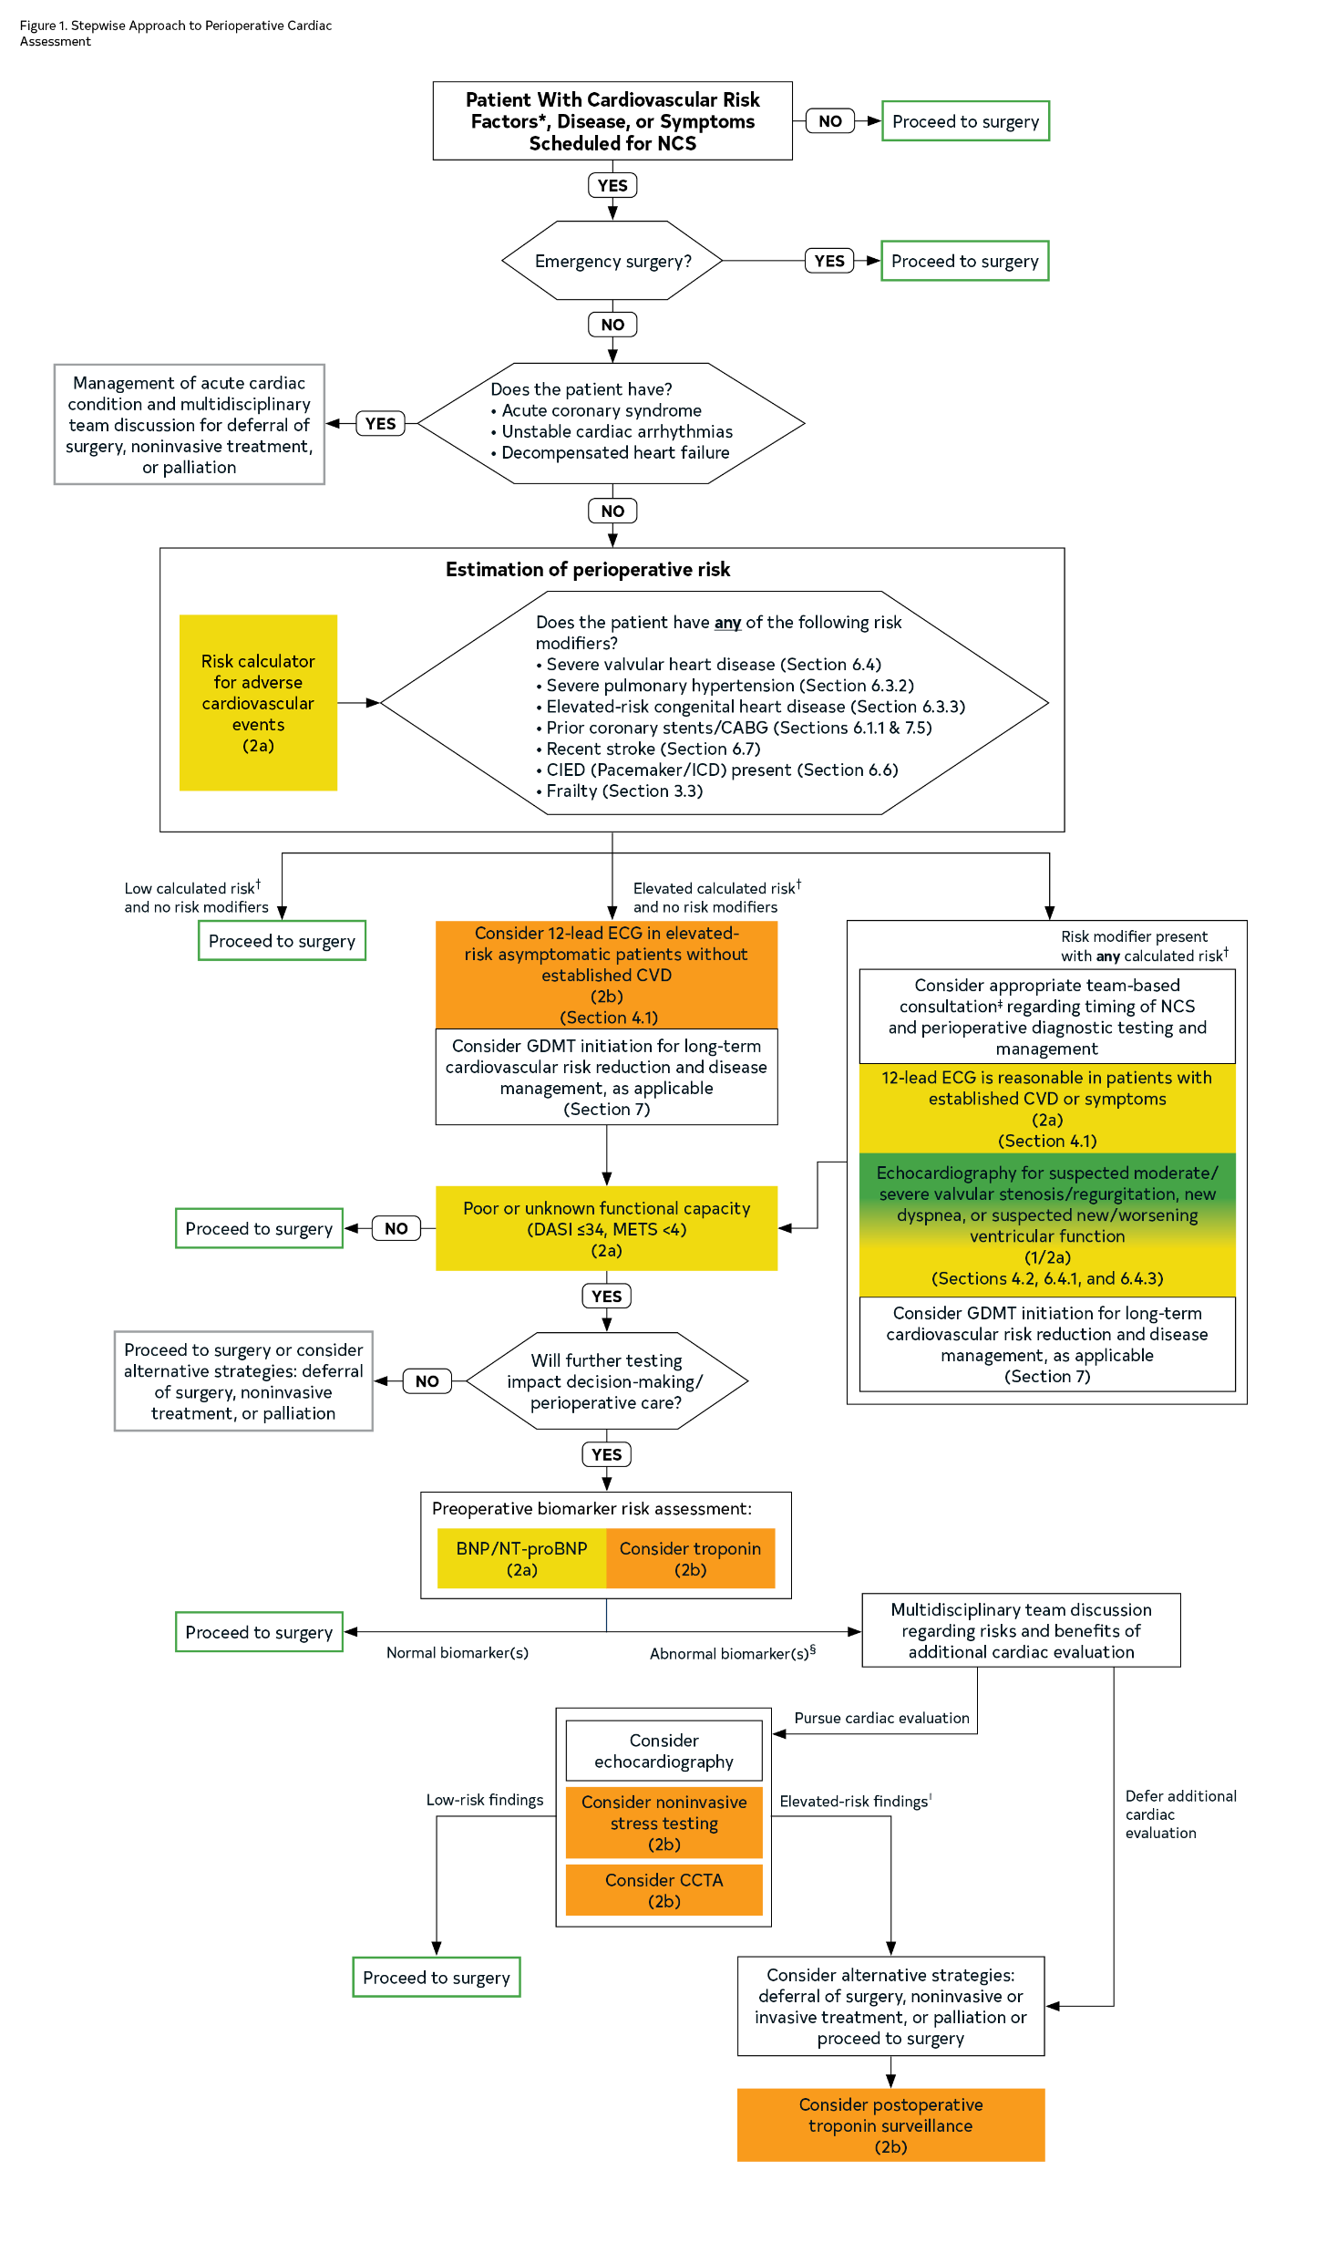
Figure 1. Stepwise Approach to Perioperative Cardiac Assessment.
BNP indicates B-type natriuretic peptide; CABG, coronary artery bypass grafting; CAD, coronary artery disease; CCTA, coronary computed tomography angiography; CIED, cardiovascular implantable electronic device; CVD, cardiovascular disease; DASI, Duke Activity Status Index; ECG, electrocardiogram; GDMT, guideline-directed management and therapy; HTN, hypertension; ICD, implantable cardioverter-defibrillator; LM, left main; MACE, major adverse cardiovascular event; METS, metabolic equivalents; NCS, noncardiac surgery; NT-proBNP, N-terminal pro b-type natriuretic peptide; RCRI, Revised Cardiac Risk Index; and URL, upper reference limit.
*Cardiovascular risk factors: HTN, smoking, high cholesterol, diabetes, women age >65; men age >55; obesity; family history of premature CAD.
†Determining elevated calculated risk depends on the calculator used. Traditionally, RCRI >1 or a calculated risk of MACE with any perioperative risk calculator >1% is used as a threshold to identify patients at elevated risk.
§Abnormal biomarker thresholds: troponin >99th percentile URL for the assay; BNP >92 ng/L, NT-proBNP ≥300 ng/L.
‡Conditions that pose additional risk for MACE.
║Noninvasive stress testing or CCTA suggestive of LM or multivessel CAD.
Colors correspond to Class of Recommendation in Table 3.

Slide 38
Cardiovascular Comorbidities and Perioperative Management

Slide 39
Coronary Revascularization
Recommendations for Revascularization Referenced studies that support the recommendations are summarized in the Online Data Supplement.
COR | LOE | Recommendations
1 | C-LD | In patients with ACS being considered for elective NCS, coronary revascularization as appropriate and deferral of surgery is recommended to reduce perioperative cardiovascular events.
2a | C-LD | In patients with CCD and hemodynamically significant left main coronary artery stenosis ≥50% who are planning elective NCS, coronary revascularization and deferral of surgery is reasonable to reduce perioperative cardiovascular events.
3: No benefit | B-R | In patients with non-left main CAD who are planned for NCS, routine preoperative coronary revascularization is not recommended to reduce perioperative cardiovascular events.*
*Modified from the 2021 ACC/AHA/SCAI Coronary Revascularization Guideline.

Slide 40
Hypertension and Perioperative Blood Pressure Management
Recommendations for Hypertension and Perioperative Blood Pressure Management Referenced studies that support the recommendations are summarized in the Online Data Supplement.
COR | LOE | Recommendations
Preoperative Blood Pressure Management
2a | C-EO | In most* patients with HTN planned for elective NCS, it is reasonable to continue medical therapy for HTN throughout the perioperative period.†
2b | C-LD | In patients undergoing elective elevated-risk surgery who have cardiovascular risk factors for perioperative complications‡ and recent history of poorly controlled HTN (systolic blood pressure [SBP] ≥180 mm Hg or diastolic blood pressure [DBP] ≥110 mm Hg before the day of surgery), deferring surgery may be considered to reduce the risk of perioperative complications.†
*Caution is advised when continuing antihypertensive therapy in patients with low or low-normal perioperative BPs, older adults (≥65 years), and patients in whom the risk for perioperative hypotension is high based on an evaluation of the patient’s overall clinical status, surgery type, and anesthetic plan.
†Modified from the “2017 ACC/AHA/AAPA/ABC/ACPM/AGS/APhA/ASH/ASPC/NMA/PCNA High Blood Pressure Guideline.”

Slide 41
Hypertension and Perioperative Blood Pressure Management (con’t.)
Intraoperative Blood Pressure Management
1 | B-NR | In patients undergoing NCS, maintaining an intraoperative mean arterial pressure (MAP) ≥60 to 65 mm Hg or SBP ≥90 mm Hg is recommended to reduce the risk of myocardial injury.
Postoperative Blood Pressure Management
1 | B-NR | In patients undergoing NCS, treatment of hypotension (MAP <60-65 or SBP <90 mm Hg) in the postoperative period is recommended to limit the risk of cardiovascular, cerebrovascular, renal events, and mortality.
1 | C-EO | In patients with HTN undergoing NCS, it is recommended that preoperative antihypertensive medications be restarted as soon as clinically reasonable to avoid complications from postoperative HTN.

Slide 42
Heart Failure
Recommendations for Heart Failure Referenced studies that support the recommendations are summarized in the Online Data Supplement.
COR | LOE | Recommendations
1 | C-LD | In patients with HF undergoing elective NCS, sodium-glucose cotransporter-2 inhibitors (SGLT2i) should be withheld for 3 to 4 days* before surgery when feasible to reduce the risk of perioperative metabolic acidosis.
2a | C-LD | In patients with compensated HF undergoing NCS, it is reasonable to continue GDMT (excluding SGLT2i) in the perioperative period, unless contraindicated, to reduce the risk of worsening HF.
*Canagliflozin, dapagliflozin, and empagliflozin should be stopped ≥3 days and ertugliflozin ≥4 days before scheduled surgery.

Slide 43
Table 8. Association of Heart Failure and Left Ventricular Ejection Fraction With 90-day Mortality in Patients Undergoing Noncardiac Surgery
 | N | Crude Mortality | Crude OR | Adjusted OR
No heart failure | 561,738 | 1.22% | Reference | Reference
HFpEF, LVEF ≥50% | 28,742 | 4.88% | 4.14 (3.90-4.39) | 1.51 (1.40-1.62)
LVEF 40-49% | 7,612 | 5.11% | 4.34 (3.91-4.82) | 1.53 (1.38-1.71)
LVEF 30-39% | 6,048 | 6.58% | 5.68 (5.12-6.31) | 1.85 (1.68-2.05)
LVEF<30% | 4,185 | 8.34% | 7.34 (6.56-8.21) | 2.35 (2.09-2.63)
HFpEF indicates heart failure with preserved ejection fraction; LVEF, left ventricular ejection fraction; and OR, odds ratio (with 95% CI).

Slide 44
Hypertrophic Cardiomyopathy
Recommendation for Hypertrophic Cardiomyopathy
COR | LOE | Recommendation
3-Harm | C-LD | For patients with hypertrophic cardiomyopathy (HCM) undergoing NCS, factors that aggravate or trigger dynamic outflow obstructions (eg, positive inotropic agents, tachycardia, or reduced preload) are harmful and should be avoided to reduce the risk of hemodynamic instability.

Slide 45
Table 9. Preoperative and Intraoperative Management Considerations in Patients With Hypertrophic Cardiomyopathy
Management Considerations
Continue beta blockers and/or nondihydropyridine calcium channel blockers without interruption in the perioperative period
Avoid hypovolemia and reduced preload (can worsen LVOT obstruction)
Avoid hypotension and reduced afterload (can worsen LVOT obstruction)
Avoid tachycardia to ensure adequate LV filling
If hypotension develops: Prioritize intravenous fluid administration to correct hypovolemia Use alpha-agonists, such as phenylephrine or vasopressin,⁷ rather than beta-agonists, which can worsen LVOT obstruction Consider intraoperative echocardiography to evaluate LVOT obstruction in the setting of hypotension In selected cases, intravenous beta-blockade may be necessary to reduce LV myocardial contractility and relieve LVOT obstruction
LV indicates left ventricular; and LVOT, left ventricular outflow tract.

Slide 46
Pulmonary Hypertension
Recommendations for Pulmonary Hypertension Referenced studies that support the recommendations are summarized in the Online Data Supplement.
COR | LOE | Recommendations
1 | C-LD | In patients receiving stable doses of targeted medical therapies* for pulmonary arterial hypertension (PAH) undergoing NCS, it is recommended to continue these agents to reduce the risk for the development of perioperative MACE.
*For example, nitric oxide pathway mediators, endothelin receptor antagonists, prostacyclin pathway agonists, or a combination of these.

Slide 47
Pulmonary Hypertension (con’t.)
2a | C-LD | In patients with severe† pulmonary hypertension (PH) undergoing elevated-risk NCS, referral to or consultation with a specialized PH center that can support risk assessment, optimization, and postoperative management (with consideration of intensive care after NCS) is reasonable to reduce perioperative cardiopulmonary complications.
2a | C-LD | In patients with severe† PH undergoing elevated-risk NCS, invasive hemodynamic monitoring is reasonable to guide intraoperative and postoperative care.
2b | C-EO | In patients with precapillary PH undergoing elevated-risk NCS, perioperative administration of short-acting inhaled pulmonary vasodilators (eg, nitric oxide, aerosolized prostacyclins) may be reasonable to reduce elevated RV afterload and prevent acute decompensated right HF.
†Severe PH is defined according to hemodynamics (severe precapillary PH component by right heart catheterization and echocardiography) and additional data derived from clinical assessment, exercise tests, and laboratory biomarkers. Hemodynamically, severe PH displays a mean pulmonary artery (PA) pressure >40 mm Hg, pulmonary vascular resistance >5 Wood units, or echocardiographic evidence of significant RV dysfunction (eg, RV-to-LV diastolic diameter ratio >0.8 or RV dysfunction that is graded as moderate or severe). Although all 5 World Symposium Pulmonary Hypertension group classifications display some degree of risk for developing severe PH, Group 1 (PAH), Group 3 (PH due to lung disease), and Group 4 (chronic thromboembolic PH) are at high risk for developing severe PH if left untreated and may be best managed and followed at a center with PH specialists.

Slide 48
Adult Congenital Heart Disease
Recommendation for Adult Congenital Heart Disease Referenced studies that support the recommendation are summarized in the Online Data Supplement.
COR | LOE | Recommendation
1 | B-NR | In patients with intermediate- to elevated-risk congenital heart disease (CHD) lesions (Table 10) undergoing elective NCS, preoperative consultation with an adult congenital heart disease (ACHD) specialist is recommended before the surgery.*
*Modified from the “2018 AHA/ACC Guideline for Management of ACHD.”

Slide 49
Table 10. ACHD Risk Stratification Before Noncardiac Surgery
Risk | Anatomy | Functional/Hemodynamic Status
Low Risk | Patients with isolated small CHD lesions Patients with repaired CHD lesion with no residual shunt Patients with bicuspid aortic valve disease and aortopathy | NYHA class I functional status, normal exercise capacity No chamber enlargement on imaging No residual shunt No PAH No arrhythmias
ASD indicates atrial septal defect; AVSD, atrioventricular septal defect; CCTGA, congenitally corrected transposition of the great arteries; CHD, congenital heart disease; CoA, coarctation of the aorta; d-TGA, dextro-transposition of the great arteries; FC, functional class; HF, heart failure; L-TGA, Levo-transposition of the great arteries; NYHA, New York Heart Association; PA, pulmonary artery; PAH, pulmonary arterial hypertension; TGA, transposition of the great arteries; VHD, valvular heart disease, anatomic and physiological; and VSD, ventricular septal defect.

Slide 50
Table 10. ACHD Risk Stratification Before Noncardiac Surgery (con’t.)
Risk | Anatomy | Functional/Hemodynamic Status
Intermediate risk | Unrepaired moderate-large shunts (ASD, VSD, PDA, AVSD) Repaired CHD with moderate to large residual shunt (ASD, VSD, PDA, AVSD) Obstructive left-sided lesions (congenital mitral stenosis, subaortic stenosis, supravalvular aortic stenosis, coarctation of aorta) except the ones described as low risk Obstructive right-sided lesion (pulmonary stenosis, branch pulmonary stenosis, repaired tetralogy of Fallot) | NYHA class II-IV functional status Limited exercise capacity Presence of residual shunt Presence of PAH Presence of cardiac chamber enlargement Significant valvular dysfunction (more than mild in severity) Arrhythmias requiring treatment Presence of HF
ASD indicates atrial septal defect; AVSD, atrioventricular septal defect; CCTGA, congenitally corrected transposition of the great arteries; CHD, congenital heart disease; CoA, coarctation of the aorta; d-TGA, dextro-transposition of the great arteries; FC, functional class; HF, heart failure; L-TGA, Levo-transposition of the great arteries; NYHA, New York Heart Association; PA, pulmonary artery; PAH, pulmonary arterial hypertension; TGA, transposition of the great arteries; VHD, valvular heart disease, anatomic and physiological; and VSD, ventricular septal defect.

Slide 51
Table 10. ACHD Risk Stratification Before Noncardiac Surgery (con’t.)
Risk | Anatomy | Functional/Hemodynamic Status
Intermediate risk | Ebstein anomaly (disease spectrum includes mild, moderate, and severe variations) Anomalous coronary artery arising from the pulmonary artery Anomalous aortic origin of a coronary artery from the opposite sinus, especially with an interarterial or intramural course | NYHA class II-IV functional status Limited exercise capacity Presence of residual shunt Presence of PAH Presence of cardiac chamber enlargement Significant valvular dysfunction (more than mild in severity) Arrhythmias requiring treatment Presence of HF
ASD indicates atrial septal defect; AVSD, atrioventricular septal defect; CCTGA, congenitally corrected transposition of the great arteries; CHD, congenital heart disease; CoA, coarctation of the aorta; d-TGA, dextro-transposition of the great arteries; FC, functional class; HF, heart failure; L-TGA, Levo-transposition of the great arteries; NYHA, New York Heart Association; PA, pulmonary artery; PAH, pulmonary arterial hypertension; TGA, transposition of the great arteries; VHD, valvular heart disease, anatomic and physiological; and VSD, ventricular septal defect.

Slide 52
Table 10. ACHD Risk Stratification Before Noncardiac Surgery (con’t.)
Risk | Anatomy | Functional/Hemodynamic Status
Elevated risk | Single-ventricle patients (palliated or status post Fontan procedure), unrepaired or palliated cyanotic CHD, double outlet right ventricle, pulmonary atresia, truncus arteriosus, TGA (classic or d-TGA; CCTGA or l-TGA), interrupted aortic arch | NYHA class II-IV functional status Limited exercise capacity Significant valvular dysfunction (more than mild in severity) Arrhythmias requiring treatment Presence of PAH Presence of HF
ASD indicates atrial septal defect; AVSD, atrioventricular septal defect; CCTGA, congenitally corrected transposition of the great arteries; CHD, congenital heart disease; CoA, coarctation of the aorta; d-TGA, dextro-transposition of the great arteries; FC, functional class; HF, heart failure; L-TGA, Levo-transposition of the great arteries; NYHA, New York Heart Association; PA, pulmonary artery; PAH, pulmonary arterial hypertension; TGA, transposition of the great arteries; VHD, valvular heart disease, anatomic and physiological; and VSD, ventricular septal defect.

Slide 53
Table 11. ACHD Patient Management for Noncardiac Surgery
Clarify the ACHD diagnosis and review cardiac anatomy
Clarify prior procedures, residua, sequelae, and current functional status
Identify factors associated with increased risk of perioperative morbidity and mortality
Cyanosis
HF
Poor functional capacity
Pulmonary hypertension
Intermediate- to high-risk CHD lesions
Urgent/emergency procedures
Operations of the respiratory and nervous systems
ACHD indicates adult congenital heart disease; CHD, congenital heart disease; and HF, heart failure.

Slide 54
Table 11. ACHD Patient Management for Noncardiac Surgery (con’t.)
Multidisciplinary team discussion to develop management strategies to minimize risk and optimize outcomes
Issues to consider
Endocarditis prophylaxis
Prevention of venous thrombosis
Monitoring of renal and liver function and appropriate drug dosing
Complications related to underlying hemodynamics
Need for hemodynamic monitoring
Periprocedural anticoagulation
Abnormal venous and/or arterial anatomy affecting venous and arterial access
Meticulous line care, including air filters for intravenous lines to reduce risk of paradoxical embolus in patients who are cyanotic because of right-to-left shunts
Arrhythmias, including bradyarrhythmias
Erythrocytosis
Pulmonary vascular disease
Adjustment of anticoagulant volume in tubes for some blood work in cyanotic patients

Slide 55
Left Ventricular Assist Devices
Recommendation for Left Ventricular Assist Devices
COR | LOE | Recommendation
1 | C-EO | In patients with a left ventricular assist device (LVAD), coordination with the LVAD care team on the appropriate timing and perioperative considerations of elective NCS is recommended to mitigate the risk of perioperative MACE.

Slide 56
Aortic Stenosis
Recommendations for Aortic Stenosis
COR | LOE | Recommendations
1 | C-LD | Patients with severe AS should be evaluated for the need for aortic valve intervention before elective NCS to reduce perioperative risk.*
1 | C-EO | In patients with suspected moderate or severe AS who are undergoing elevated-risk NCS, preoperative echocardiography is recommended before elective NCS to guide perioperative management.*
2a | C-LD | In asymptomatic patients with moderate or severe AS and normal LV systolic function as assessed by echocardiography within the past year, it is reasonable to proceed with elective low-risk NCS.
*Modified from the “2020 ACC/AHA Guideline for the Management of Patients With Valvular Heart Disease.”

Slide 57
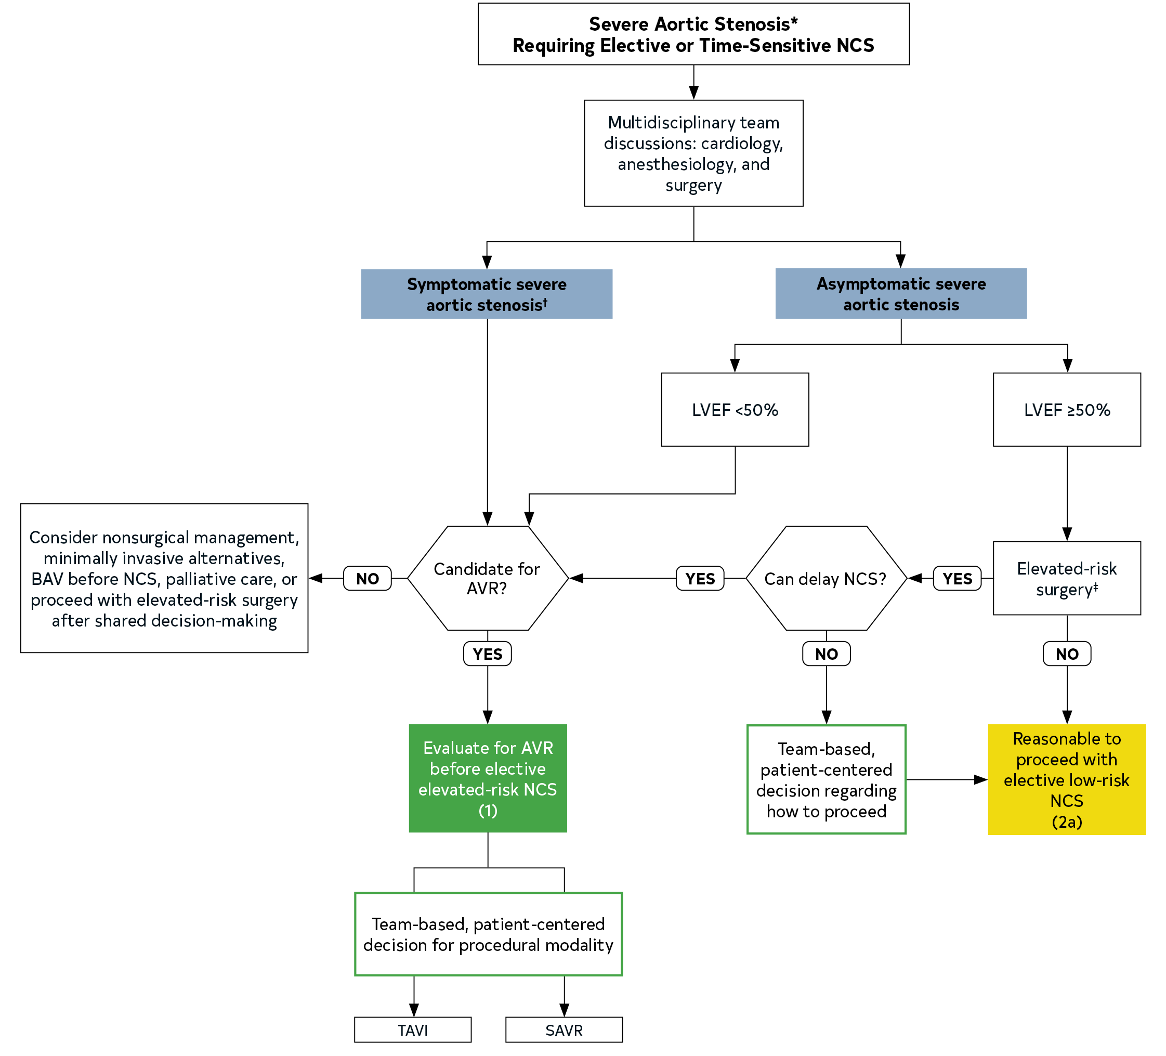
Figure 2. Management of Patients With Severe Aortic Stenosis Requiring Elective or Time-Sensitive Noncardiac Surgery.
Colors correspond to Class of Recommendation in Table 3.
*Severe aortic stenosis: aortic valve area <1.0 cm2, mean aortic valve gradient ≥40 mm Hg, or peak aortic valve velocity Vmax ≥4.0 m/s.
†Symptoms of exertional dyspnea, angina, HF, syncope, or presyncope.
‡Including elevated risk for hemodynamic instability, large volume shifts, or major bleeding.
AVR indicates aortic valve replacement; BAV, balloon aortic valvuloplasty; CAD, coronary artery disease; LVEF, left ventricular ejection fraction; NCS, noncardiac surgery; SAVR, surgical aortic valve replacement; and TAVI, transcatheter aortic valve implantation.

Slide 58
Mitral Stenosis
Recommendations for Mitral Stenosis Referenced studies that support the recommendations are summarized in the Online Data Supplement.
COR | LOE | Recommendations
1 | B-NR | Patients with severe mitral stenosis (MS) should be evaluated for the need for mitral valve (MV) intervention before elective NCS.
2a | C-EO | In patients with severe MS who cannot undergo MV intervention before NCS, perioperative invasive hemodynamic monitoring is reasonable to guide management to reduce the risk of cardiovascular complications.
2b | C-LD | In patients with severe MS who cannot undergo MV intervention before NCS, perioperative heart-rate control (eg, beta blockers, calcium channel blockers [CCBs], ivabradine, digoxin) may be considered to prolong diastolic filling time and decrease perioperative cardiovascular complications.

Slide 59
Chronic Aortic and Mitral Regurgitation
Recommendations for Chronic Aortic and Mitral Regurgitation
COR | LOE | Recommendations
1 | C-EO | In patients with suspected moderate or severe valvular regurgitation, preoperative echocardiography is recommended before elective NCS to guide perioperative management.*
1 | C-EO | In patients with VHD who meet indications for valvular intervention based on clinical presentation and severity of regurgitation, the need for valvular intervention should be considered before elective elevated-risk NCS to reduce perioperative risk.*
2a | C-LD | In asymptomatic patients with moderate or severe MR, normal LV systolic function, and estimated PA systolic pressure <50 mm Hg, it is reasonable to perform elective NCS.*
2a | C-LD | In asymptomatic patients with moderate or severe aortic regurgitation and normal LV systolic function (LVEF >55%), it is reasonable to perform elective NCS.*
*Modified from the “2020 ACC/AHA Guideline for the Management of Patients With Valvular Heart Disease.”

Slide 60
Previous Transcatheter Aortic Valve Implantation or Mitral Valve Transcatheter Edge-to-Edge Repair
Recommendations for Patients With Previous Transcatheter Aortic Valve Implantation or Mitral Valve Transcatheter Edge-to-Edge Repair Referenced studies that support the recommendations are summarized in the Online Data Supplement.
COR | LOE | Recommendations
2a | B-NR | For patients who undergo successful transcatheter aortic valve implantation (TAVI), it is reasonable to perform NCS early* as clinically indicated.
2a | C-EO | For patients who undergo MV TEER, it is reasonable to perform NCS after the successful MV intervention as clinically indicated.
*Evidence supports the safety of NCS within 30 days of TAVI, if indicated.

Slide 61
Atrial Fibrillation
Recommendations for Atrial Fibrillation
COR | LOE | Recommendations
Perioperative
2a | C-LD | In patients with rapid AF identified in the setting of NCS, it is reasonable to treat potential underlying triggers contributing to AF and rapid ventricular response (eg, sepsis, anemia, pain).*
2a | C-LD | In patients with new-onset AF identified in the setting of NCS, initiation of postoperative anticoagulation therapy can be beneficial after considering the competing risks associated with thromboembolism and perioperative bleeding.*
Post-discharge
1 | C-LD | In patients with new-onset AF identified in the setting of NCS, outpatient follow-up for thromboembolic risk stratification and AF surveillance are recommended given a high risk of AF recurrence.*
*Adapted from the “2023 ACC/AHA/ACCP/HRS Guideline for the Diagnosis and Management of Atrial Fibrillation.”

Slide 62
Cardiovascular Implantable Electronic Devices
Recommendations for Preoperative Management of Patients With Cardiovascular Implantable Electronic Devices Referenced studies that support the recommendations are summarized in the Online Data Supplement.
COR | LOE | Recommendations
1 | B-NR | Patients with cardiovascular implantable electronic devices (CIED) having elective NCS should have a management plan developed before surgery if electromagnetic interference (EMI) is anticipated, including identification of the type of CIED (eg, pacemaker, implantable cardioverter-defibrillator [ICD], implantable monitor), manufacturer, and model.
1 | B-NR | Patients who are pacemaker-dependent having surgeries above the umbilicus with anticipated EMI should have the pacemaker reprogrammed or have a magnet placed on the generator to provide an asynchronous mode to avoid pacing inhibition.

Slide 63
Cardiovascular Implantable Electronic Devices (con’t.)
1 | B-NR | Pacemaker-dependent patients with a transvenous ICD undergoing surgery above the umbilicus with anticipated EMI should have the device reprogrammed*; if the patient is not pacemaker-dependent, then either reprogramming or a magnet placed on the generator can be used to inhibit tachytherapies or inappropriate shocks.
1 | B-NR | Patients who have a pacemaker or ICD reprogrammed to asynchronous pacing or have tachytherapies programmed off before surgery should have device functioning restored in the postoperative period before hospital discharge.
1 | C-LD | Patients with leadless pacemakers who are pacemaker-dependent having surgeries with anticipated EMI above the umbilicus should have their pacemakers reprogrammed to an asynchronous mode.
2a | C-LD | For patients with subcutaneous ICD having noncardiac or nonthoracic surgery with anticipated EMI above the groin, it is reasonable to reprogram the device or use a magnet to temporarily disable tachytherapies.
*For pacemaker-dependent patients with an ICD, tachytherapies should be disabled and the device should be reprogrammed to an asynchronous mode to avoid pacing inhibition.

Slide 64
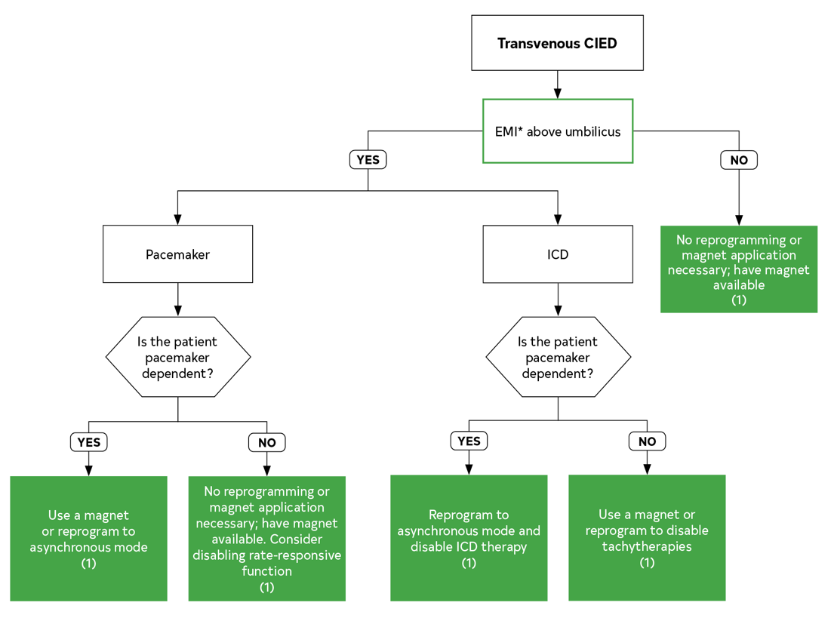
Figure 3. Patients With Transvenous CIEDs.
Colors correspond to Class of Recommendation in Table 3.
*EMI is considered a significant risk when the source is <15 cm from the CIED generator. External pacing and/or defibrillation must be available. Clinicians must confirm device magnet capabilities are enabled and individual magnet responses are known. Consider consulting a CIED team for cardiac resynchronization therapy devices.
CIED indicates cardiovascular implantable electronic device; EMI, electromagnetic interference; and ICD, implantable cardioverter-defibrillator.

Slide 65
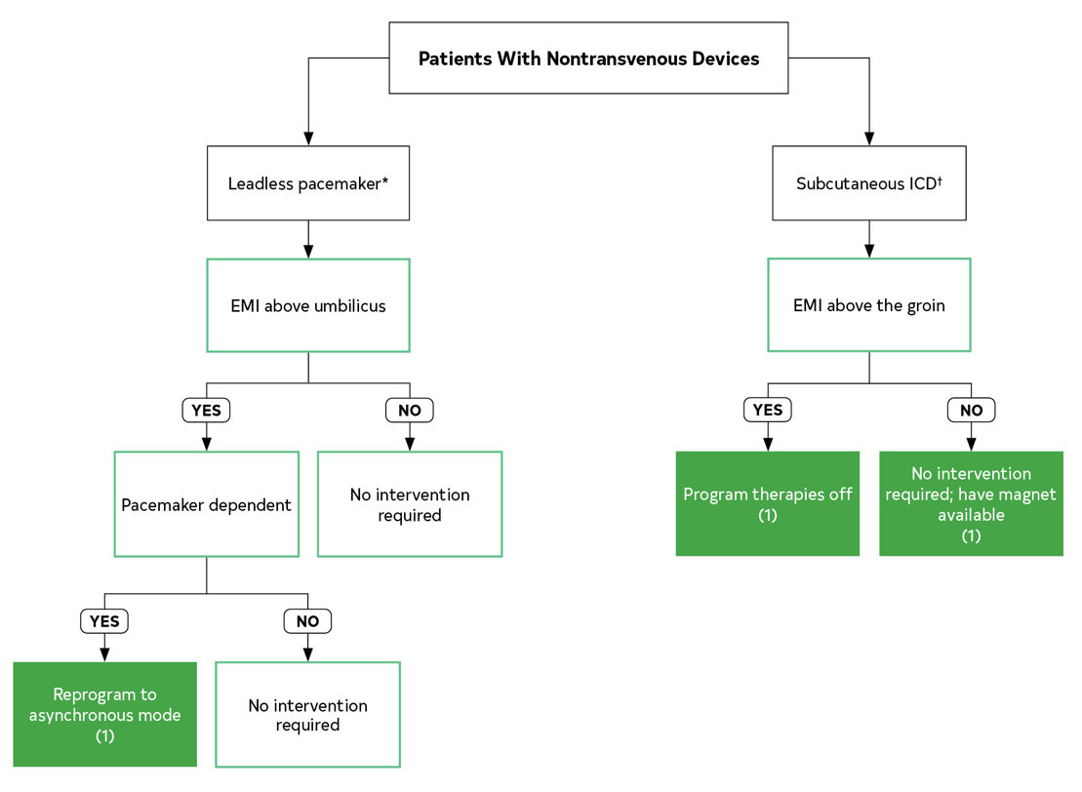
Figure 4. Patients With Nontransvenous Devices.
Colors correspond to Class of Recommendation in Table 3.
EMI indicates electromagnetic interference; and ICD, implantable cardioverter-defibrillator.
*For patients with a leadless pacemaker, a magnet will not force asynchronous pacing.
†A subcutaneous ICD does not currently provide pacing. A magnet, if used, should be secured with adhesive tape. If the patient is in a position other than supine, or extensive EMI is anticipated when performing the surgery above the diaphragm, consider reprogramming.
A magnet placed over the subcutaneous ICD will emit an R wave synchronous beep, indicating that the magnet is correctly positioned. If the tone is not audible, reprogramming is necessary.

Slide 66
Previous Stroke or Transient Ischemic Attack
Recommendation for Previous Stroke or Transient Ischemic Attack Referenced studies that support the recommendation are summarized in the Online Data Supplement.
COR | LOE | Recommendation
2a | B-NR | In patients with a history of stroke or transient ischemic attack, it is reasonable to delay elective NCS for ≥3 months after the most recent cerebrovascular event to reduce the incidence of recurrent stroke, MACE, or both.

Slide 67
Obstructive Sleep Apnea
Recommendation for Obstructive Sleep Apnea Referenced studies that support the recommendation are summarized in the Online Data Supplement.
COR | LOE | Recommendation
2a | B-NR | In patients scheduled for NCS, obstructive sleep apnea (OSA) screening using validated questionnaires is reasonable to assess the risk of perioperative complications.

Slide 68
Perioperative Medical Therapy

Slide 69
Statins
Recommendations for Statins Referenced studies that support the recommendations are summarized in the Online Data Supplement.
COR | LOE | Recommendations
1 | B-NR | In patients currently on statins and scheduled for NCS, continuation of statin therapy is recommended to reduce the risk of MACE.
1 | B-R | In statin-naïve adult patients who meet criteria for statin use based on ASCVD history or 10-year risk assessment and are scheduled for NCS, perioperative initiation of statin is recommended with intention of long-term use.

Slide 70
Renin-Angiotensin-Aldosterone System Inhibitors
Recommendations for Perioperative Renin-Angiotensin-Aldosterone System Inhibitors Referenced studies that support the recommendations are summarized in the Online Data Supplement.
COR | LOE | Recommendations
2b | B-R | In select* patients on chronic renin-angiotensin-aldosterone system inhibitors (RAASi) for HTN undergoing elevated-risk NCS, omission 24 hours before surgery may be beneficial to limit intraoperative hypotension.
2a | C-EO | In patients on chronic RAASi for HFrEF, perioperative continuation is reasonable.†
*Patients with controlled BP and undergoing elevated-risk surgical procedures.
†Modified from the “2022 AHA/ACC/HFSA Guideline for the Management of Heart Failure.”

Slide 71
Alpha-2 Receptor Agonists
Recommendation for Perioperative Alpha-2 Receptor Agonists Management Referenced studies that support the recommendation are summarized in the Online Data Supplement.
COR | LOE | Recommendation
3: No benefit | B-R | In patients undergoing NCS, initiation of low-dose clonidine perioperatively is not recommended to reduce cardiovascular risk.

Slide 72
Antiplatelet Therapy and Timing of Noncardiac Surgery in Patients With Coronary Artery Disease
Recommendations for Antiplatelet Therapy and Timing of Noncardiac Surgery in Patients With Coronary Artery Disease Referenced studies that support the recommendations are summarized in the Online Data Supplement.
COR | LOE | Recommendations
1 | B-NR | For patients with CAD undergoing elective NCS, management of perioperative antiplatelet therapy and timing of surgery should be determined by a multidisciplinary team with shared decision-making to weigh the risks of bleeding, thrombosis, and consequences of delayed surgery.

Slide 73
Antiplatelet Therapy and Timing of Noncardiac Surgery in Patients With Coronary Artery Disease (con’t.)
Timing of NCS After PCI
1 | C-LD | In patients with recent coronary artery balloon angioplasty without stent placement, elective NCS should be delayed for a minimum of 14 days to minimize perioperative MACE.
1 | B-NR | In patients with DES-PCI placed for ACS who require elective NCS with interruption of ≥1 antiplatelet agents, surgery should ideally be delayed ≥12 months to minimize perioperative MACE.
2a | B-NR | In patients with DES-PCI placed for CCD who require elective NCS with interruption of ≥1 antiplatelet agents, it is reasonable to delay surgery for ≥6 months after PCI to minimize perioperative MACE.

Slide 74
Antiplatelet Therapy and Timing of Noncardiac Surgery in Patients With Coronary Artery Disease (con’t.)
2b | B-NR | In patients with DES-PCI who require time-sensitive NCS with interruption of ≥1 antiplatelet agents, NCS may be considered ≥3 months after PCI if the risk of delaying surgery outweighs the risk of MACE.
3: Harm | B-NR | In patients with a recent (≤30 days) bare-metal stent (BMS) or DES-PCI, elective NCS requiring interruption of ≥1 antiplatelet agents is potentially harmful due to a high risk of stent thrombosis and ischemic complications.
Perioperative Antiplatelet Management Post PCI
1 | B-R | In patients with prior PCI undergoing NCS, it is recommended to continue aspirin* (75-100 mg), if possible, to reduce the risk of cardiac events.
1 | B-NR | In patients with CAD who require time-sensitive NCS within 30 days of PCI with BMS or <3 months of PCI with DES, DAPT should be continued unless the risk of bleeding outweighs the benefit of the prevention of stent thrombosis.
*Platelet adenosine diphosphate receptor (P2Y12) monotherapy may be considered if surgical bleeding risks are acceptable or if aspirin is not tolerated.

Slide 75
Antiplatelet Therapy and Timing of Noncardiac Surgery in Patients With Coronary Artery Disease (con’t.)
1 | B-NR | In patients with prior PCI in whom OAC monotherapy must be discontinued before NCS, aspirin should be substituted when feasible in the perioperative period until OAC can be safely reinitiated.
2b | B-NR | In select patients after PCI who have a high thrombotic risk, perioperative bridging with intravenous antiplatelet therapy may be considered <6 months after DES or <30 days after BMS if NCS cannot be deferred.
Perioperative Antiplatelet Management in Patients Without Prior PCI
2b | B-R | In patients with CCD without prior PCI undergoing elective NCS, it may be reasonable to continue aspirin in selected patients when the risk of cardiac events outweighs the risk of bleeding.
3: No Benefit | B-R | In patients with CAD but without prior PCI who are undergoing elective noncarotid NCS, routine initiation of aspirin is not beneficial.

Slide 76
Table 12. Duration of Antiplatelet Therapy Effect
Antiplatelet Agent | Minimum Time From Drug Interruption to Restoration of Platelet Function
Aspirin | 4 d
Clopidogrel | 5-7 d
Prasugrel | 7-10 d
Ticagrelor | 3-5 d
Minimum times from drug interruption to noncardiac surgery should be guided by pharmacokinetic data, restoration of platelet function after drug withdrawal, and drug-specific FDA-prescribing information.

Slide 77
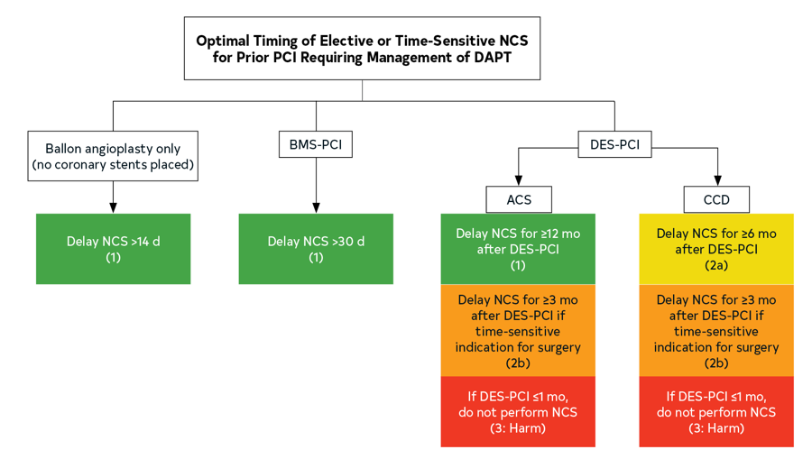
Figure 5. Optimal Timing of Elective or Time-Sensitive NCS for Prior PCI Requiring Management of DAPT.
Colors correspond to Class of Recommendation in Table 3.
BMS indicates bare-metal stent; DAPT, dual antiplatelet therapy; DES, drug-eluting stent; NCS, noncardiac surgery; and PCI, percutaneous coronary intervention.

Slide 78
Oral Anticoagulants
Recommendations for Oral Anticoagulants Management Referenced studies that support the recommendations are summarized in the Online Data Supplement.
COR | LOE | Recommendations
OAC Management
1 | B-NR | For patients with CVD receiving OAC who require elective NCS, a multidisciplinary team-based approach to time-based* interruption is recommended to balance the competing risks of thromboembolism and perioperative bleeding (Tables 13 and 14).
*Timing of preoperative interruption is based on patient-specific factors (eg, thrombotic risk,
age, sex, body weight, renal clearance), surgical bleeding risk, and drug factors (eg, pharmacokinetics, dosing, drug interactions).

Slide 79
Oral Anticoagulants (con’t.)
OAC Bridging
2a | C-LD | In patients with CVD and high thrombotic risk (Table 14) undergoing NCS where interruption of vitamin K antagonist (VKA) is required, preoperative bridging with parenteral heparin can be effective to reduce thromboembolic risk.
3: Harm | C-LD | In most patients with CVD who are undergoing elective NCS where OAC interruption is warranted, routine periprocedural bridging is not recommended due to increased bleeding risk.
OAC Resumption
2a | C-LD | In patients with preoperative OAC interruption, resumption of OAC is reasonable after hemostasis is achieved.

Slide 80
Table 13. Perioperative Management of Direct Oral Anticoagulants and Vitamin K Antagonists
Preoperative DOAC Schedule
 | Procedure Bleeding Risk | Preoperative Interruption |  |  |  |  |  | Surgery/ Procedure | Postoperative Resumption
 |  | Day -6 | Day -5 | Day -4 | Day -3 | Day -2 | Day -1 | Day 0 | Day +1 | Day +2 | Day +3 | Day +4
Apixaban, edoxaban, rivaroxaban | High | * | * | * | * | † | † | † | † | † | * | *
 | Low/Moderate | * | * | * | * | * | † | † | * | * | * | *
 | Minimal | * | * | * | * | * | * | * | * | * | * | *
Apixaban, edoxaban, rivaroxaban with renal impairment (CrCl <30 mL/min) | High | * | * | * | † | † | † | † | † | † | * | *
 | Low/Moderate | * | * | * | * | † | † | † | * | * | * | *
 | Minimal | * | * | * | * | * | * | * | * | * | * | *
Dabigatran CrCl ≥50 mL/min | High | * | * | * | * | † | † | † | † | † | * | *
 | Low/Moderate | * | * | * | * | * | † | † | * | * | * | *
 | Minimal | * | * | * | * | * | * | * | * | * | * | *
Dabigatran CrCl <50 mL/min | High | * | * | † | † | † | † | † | † | † | * | *
 | Low/ Moderate | * | * | * | * | † | † | † | * | * | * | *
 | Minimal | * | * | * | * | * | * | * | * | * | * | *
CrCl indicates creatinine clearance; DOAC, direct oral anticoagulants; GI, gastrointestinal; INR, international normalized ratio; LMWH, low-molecular-weight heparin; and VKA, vitamin K agonist.

Slide 81
Table 13. Perioperative Management of Direct Oral Anticoagulants and Vitamin K Antagonists (con’t.)
VKA Schedule
 | Procedure Bleeding Risk | Preoperative Interruption |  |  |  |  |  | Surgery/ Procedure | Postoperative Resumption
 |  | Day -6 | Day -5 | Day -4 | Day -3 | Day -2 | Day -1 | Day 0 | Day +1 | Day +2 | Day +3 | Day +4
Warfarin in low/moderate thrombotic risk | High | * | † | † | † | † | † | † | * | * | * | *
 | Low/ Moderate | * | † | † | † | † | † | † | * | * | * | *
 | Minimal | * | * | * | * | * | * | * | * | * | * | *
Warfarin in high thrombotic risk | High | * | † | † | ‡ | ‡ | ‡ | † | * | * | *# | *#
 | Low/ Moderate | * | † | † | ‡ | ‡ | ‡ | † | * | *# | *# | *#
 | Minimal | * | * | * | * | * | * | * | * | * | * | *
CrCl indicates creatinine clearance; DOAC, direct oral anticoagulants; GI, gastrointestinal; INR, international normalized ratio; LMWH, low-molecular-weight heparin; and VKA, vitamin K agonist.

Slide 82
Table 13. Perioperative Management of Direct Oral Anticoagulants and Vitamin K Antagonists (con’t.)
*Administer DOAC or VKA.
†Withhold DOAC or VKA.
‡While withholding VKA in select very high thrombotic risk patients, preoperative bridging with parenteral heparin once INR less than desired therapeutic range.
#Resuming postoperative LMWH bridge at either full dose or prophylaxis dose until INR within therapeutic range is a team-based decision that weighs the risks and benefits.
Management for perioperative bleeding risk and DOAC or VKA schedule should incorporate team-based decision-making, especially in high thrombotic risk patients or when undergoing procedures with higher risks of adverse outcome, should bleeding occur (eg, neuraxial anesthesia).
Minimal bleeding risk = 30-day risk of major bleeding 0% (eg, cataract surgery, minor dental/dermatological procedures).
Low/moderate bleeding risk = 30-day risk of major bleeding <2% (eg, complex dental, GI, breast surgery, procedures using large-bore needles).
High bleeding risk = 30-day risk of major bleeding ≥2%.

Slide 83
Table 14. Thromboembolic Risk for Common OAC Indications
Risk Category | Venous Thromboembolism | Atrial Fibrillation | Mechanical Valve | Other Anticoagulation Indications
Low | VTE >12 mo | CHA₂DS₂-VASc 1-4 (without prior history of stroke) | Bileaflet mechanical AVR without major risk factors for stroke*
Moderate | VTE ≤3-12 mo Recurrent VTE | CHA₂DS₂-VASc 5-6 | Bileaflet mechanical AVR with major risk factors for stroke* Mitral valve without major risk factors for stroke* | Nonsevere coagulopathy (heterozygous factor V Leiden or prothrombin gene G20210A mutation) Active cancer
*Major risk factors for stroke include AF, multiple prior strokes/TIAs (>3 months), prior perioperative stroke, or prior valve thrombosis.
AVR indicates aortic valve replacement; LV, left ventricular; MHV, mechanical heart valve; TIA, transient ischemic attack; and VTE, venous thromboembolism.

Slide 84
Table 14. Thromboembolic Risk for Common OAC Indications (con’t.)
Risk Category | Venous Thromboembolism | Atrial Fibrillation | Mechanical Valve | Other Anticoagulation Indications
High | Recent VTE (<1 mo or <3 mo) | CHA₂DS₂-VASc ≥7 (or 5-6 with recent stroke or TIA) AF with rheumatic valvular heart disease | Mechanical mitral valve Caged ball or tilting-disk valve Mechanical heart valve in any position with recent stroke or TIA (<3 mo) | Recent cardioembolic stroke (<3 mo)‡ Active cancer associated with high VTE risk LV thrombus (within last 3 mo) Severe thrombophilia‡ Antiphospholipid antibodies
‡Deficiency of protein C, protein S, or antithrombin; homozygous factor V Leiden or prothrombin gene G20210A mutation or double heterozygous for each mutation, multiple thrombophilias.
AVR indicates aortic valve replacement; LV, left ventricular; MHV, mechanical heart valve; TIA, transient ischemic attack; and VTE, venous thromboembolism.

Slide 85
Table 15. Pharmacokinetic Characteristics, Monitoring, and Reversal of VKA and DOACs
 | Warfarin | Apixaban | Rivaroxaban | Edoxaban | Dabigatran
Mechanism of Action | VKORC1 (vitamin K-dependent factors) | Factor Xa inhibitor | Factor Xa inhibitor | Factor Xa inhibitor | Factor IIa inhibitor (direct thrombin inhibitor)
Bioavailability | >95% | 50% | 100% (66% without food) | 62% | 3-7%
Time to Cmax | 2-6 h | 3-4 h | 2-4 h | 1-2 h | 1.25-3 h
Plasma Half-Life (t_{1/2}) | 36-48 h | 9-14 h | 6-9 h (11-13 h in older persons) | 10-14 h | 12-15 h
Duration of Action | ~5 d (beyond normalization of INR) | 24 h | 24 h | 24 h | 24 h
ACT indicates activated clotting time; Anti-Xa, assay to measure anticoagulation activity; aPCC, activated prothrombin complex concentrate; aPTT, activated partial thromboplastin time; CYP, cytochrome; DOAC, direct oral anticoagulant; DTT, diluted thrombin time; ECT, ecarin clotting time; FFP, fresh frozen plasma; INR, international normalized ratio; PT, prothrombin; and 4F-PCC, 4-factor prothrombin complex concentrate.

Slide 86
Table 15. Pharmacokinetic Characteristics, Monitoring, and Reversal of VKA and DOACs (con’t.)
Renal Clearance (%) | 0% | 27% | 33% | 37-59% | 85% (partially dialyzable)
Drug Interaction |  | CYP p450 3A4, p-glycoprotein | CYP 450 3A4/2J2, p-glycoprotein | CYP 450 3A4 (<5%), p-glycoprotein | p-glycoprotein
Altered Anticoagulation Parameters |  | PT, aPTT, ACT | PT, aPTT, ACT | PT, aPTT, ACT | aPTT, ACT, PT/INR, DTT
Monitor for Presence of Drug Effect | PT/INR | Anti-Xa* (DOAC) | Anti-Xa* (DOAC) | Anti-Xa* (DOAC) | ECT (DOAC)
Antidote/ Reversal | Vitamin K, 4F-PPC, FFP | 4F-PCC, andexanet alfa | 4F-PCC, andexanet alfa | 4F-PCC, andexanet alfa | 4F-PCC, idarucizumab
*Quantitative assessment requires drug-specific calibrators. With no therapeutic levels, use can indicate ongoing drug effect.
ACT indicates activated clotting time; Anti-Xa, assay to measure anticoagulation activity; aPCC, activated prothrombin complex concentrate; aPTT, activated partial thromboplastin time; CYP, cytochrome; DOAC, direct oral anticoagulant; DTT, diluted thrombin time; ECT, ecarin clotting time; FFP, fresh frozen plasma; INR, international normalized ratio; PT, prothrombin; and 4F-PCC, 4-factor prothrombin complex concentrate.

Slide 87
Perioperative Beta Blockers
Recommendations for Perioperative Beta Blockers Referenced studies that support the recommendations are summarized in the Online Data Supplement.
COR | LOE | Recommendations
1 | B-NR | In patients on stable doses of beta blockers undergoing NCS, beta blockers should be continued through the perioperative period as appropriate based on the clinical circumstances.
2b | B-NR | In patients scheduled for elective NCS who have a new indication for beta blockade, beta blockers may be initiated far enough before surgery (optimally >7 days) to permit assessments of tolerability and drug titration if needed.
3: Harm | B-R | In patients undergoing NCS and with no immediate need for beta blockers, beta blockers should not be initiated on the day of surgery due to increased risk for postoperative mortality.

Slide 88
Perioperative Management of Blood Glucose
Recommendations for Perioperative Management of Blood Glucose Referenced studies that support the recommendations are summarized in the Online Data Supplement.
COR | LOE | Recommendations
2a | B-NR | In patients with or at risk for diabetes who are scheduled for elective NCS, preoperative hemoglobin A1c (HbA1C) testing is reasonable if it has not been performed in ≤3 months.
1 | C-LD | In patients scheduled for NCS, SGLT2i should be discontinued 3 to 4 days* days before surgery to reduce the risk of perioperative metabolic acidosis.
2a | C-LD | In patients with diabetes or impaired glucose tolerance, continuation of metformin during the perioperative period is reasonable to maintain glycemic control.
*Canagliflozin, dapagliflozin, and empagliflozin should be stopped ≥3 days and ertugliflozin ≥4 days before scheduled surgery.

Slide 89
Anesthetic Considerations and Intraoperative Management

Slide 90
Choice of Anesthetic Technique and Agent
Recommendations for Choice of Anesthetic Technique and Agent Referenced studies that support the recommendations are summarized in the Online Data Supplement.
COR | LOE | Recommendations
2a | A | In patients undergoing NCS, use of a volatile-based anesthetic agent or total intravenous anesthesia is reasonable for general anesthesia with no apparent difference in associated cardiovascular events (eg, MI, ischemia).
2a | B-R | In patients undergoing NCS where neuraxial is feasible, either neuraxial or general anesthesia is reasonable with no apparent difference in associated cardiovascular events.

Slide 91
Perioperative Pain Management
Recommendations for Perioperative Pain Management Referenced studies that support the recommendations are summarized in the Online Data Supplement.
COR | LOE | Recommendations
2a | B-R | For patients undergoing major abdominal surgery, the use of epidural analgesia for postoperative pain relief is reasonable to decrease the incidence of perioperative cardiac events.
2b | B-R | For patients with a hip fracture waiting for surgical repair, epidural analgesia may be considered to decrease the incidence of preoperative cardiac events.

Slide 92
Echocardiography
Recommendations for Echocardiography Referenced studies that support the recommendations are summarized in the Online Data Supplement.
2a | C-LD | In patients with unexplained hemodynamic instability undergoing NCS, the emergency use of perioperative TEE or FoCUS is reasonable to determine the cause if expertise is readily available.
3: No benefit | C-LD | In patients undergoing NCS without risk factors or procedural risks for significant hemodynamic compromise, the routine use of intraoperative TEE is not recommended to screen for cardiac abnormalities or to monitor for myocardial ischemia.

Slide 93
Body Temperature
Recommendation for Body Temperature Referenced studies that support the recommendation are summarized in the Online Data Supplement.
COR | LOE | Recommendation
2a | B-R | In patients with CVD undergoing NCS, maintenance of normothermia is reasonable to avoid perioperative complications overall.

Slide 94
Temporary Mechanical Circulatory Support
Recommendation for Temporary Mechanical Circulatory Support
COR | LOE | Recommendation
2b | C-LD | In patients with acute, severe hemodynamic instability and cardiopulmonary dysfunction undergoing urgent or emergency NCS, temporary MCS devices may be used preemptively or as rescue therapy.

Slide 95
Pulmonary Artery Catheters
Recommendations for Pulmonary Artery Catheters Referenced studies that support the recommendations are summarized in the Online Data Supplement.
COR | LOE | Recommendations
2b | C-LD | In patients with CVD undergoing NCS, the use of PA catheterization may be considered when underlying medical conditions that significantly affect hemodynamics (eg, decompensated HF, severe valvular disease, combined shock states, pulmonary HTN) cannot be corrected before surgery.
3: No benefit | A | In patients with CVD undergoing NCS, routine use of PA catheterization is not recommended to reduce morbidity or mortality.

Slide 96
Perioperative Anemia Management
Recommendations for Perioperative Anemia Management Referenced studies that support the recommendations are summarized in the Online Data Supplement.
COR | LOE | Recommendations
2a | A | In patients having NCS with expected blood loss, tranexamic acid is reasonable to reduce intraoperative blood loss, reduce transfusions, and avoid anemia.
2a | B-R | In patients with iron deficiency anemia having elective NCS, iron therapy (either oral or intravenous) administered preoperatively is reasonable to reduce blood transfusions and to increase Hgb.

Slide 97
Perioperative Surveillance and Management of Myocardial Injury and Infarction

Slide 98
Myocardial Injury After Noncardiac Surgery Surveillance and Management
Recommendations for Myocardial Injury After Noncardiac Surgery Referenced studies that support the recommendations are summarized in the Online Data Supplement.
COR | LOE | Recommendations
MINS Surveillance
2b | B-NR | In patients with known CVD, symptoms of CVD, or age ≥65 years with cardiovascular risk factors undergoing elevated-risk NCS, it may be reasonable to measure cTn at 24 and 48 hours after surgery to identify myocardial injury.
3: No benefit | B-NR | In patients undergoing low-risk NCS, routine postoperative screening with cTn levels is not indicated without signs or symptoms suggestive of myocardial ischemia or MI.

Slide 99
Myocardial Injury After Noncardiac Surgery Surveillance and Management (con’t.)
MINS Management
2a | B-NR | In patients who develop MINS, especially in those not previously known to have excess cardiovascular risk, outpatient follow-up is reasonable for optimization of cardiovascular risk factors.
2b | C-LD | In patients who develop MINS, antithrombotic therapy may be considered to reduce thromboembolic events.

Slide 100
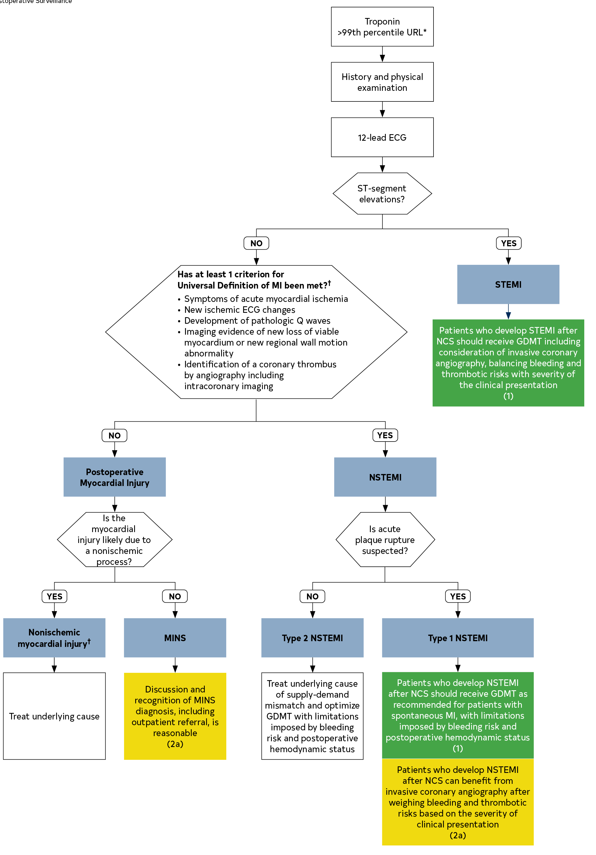
Figure 6. Evaluation of an Abnormal Troponin Obtained for Postoperative Surveillance.
Colors correspond to Class of Recommendation in Table 3.
*Presumes a rise and fall of troponin consistent with acute myocardial injury. Troponin may be measured using a conventional fourth-generation or a high-sensitivity assay.
†Nonischemic myocardial injury encompasses pulmonary embolism, sepsis, acute decompensated heart failure, or acute stroke.
ECG indicates electrocardiogram; GDMT, guideline-directed management and therapy; MI, myocardial infarction; NCS, noncardiac surgery; NSTEMI, non ST-segment-elevation myocardial infarction; STEMI, ST-segment-elevation myocardial infarction; and URL, upper reference limit.

Slide 101
Management of Postoperative ST-Segment-Elevation Myocardial Infarction/Non ST-Segment-Elevation Myocardial Infarction
Recommendations for Management of Postoperative ST-Segment-Elevation Myocardial Infarction/Non ST-Segment-Elevation Myocardial Infarction Referenced studies that support the recommendations are summarized in the Online Data Supplement.
COR | LOE | Recommendations
1 | B-NR | Patients who develop STEMI after NCS should be considered for GDMT, including consideration of ICA, balancing bleeding and thrombotic risks with the severity of the clinical presentation.
1 | C-EO | Patients who develop NSTEMI after NCS should receive medical therapy as recommended for patients with spontaneous MI but after consideration of postoperative bleeding risks and hemodynamic status.
2a | C-LD | Patients who develop NSTEMI after NCS can be considered for ICA, balancing bleeding and thrombotic risks with the severity of clinical presentation.

Slide 102
Abbreviations
Abbreviations | Meaning/Phrase
ACEi | angiotensin-converting enzyme inhibitors
ACHD | adult congenital heart disease
ACS | acute coronary syndrome
AF | atrial fibrillation
ARB | angiotensin receptor blocker
ARR | absolute risk reduction
AS | aortic stenosis
ASCVD | atherosclerotic cardiovascular disease
AV | atrioventricular
AVR | aortic valve replacement

Slide 103
Abbreviations (con’t.)
Abbreviations | Meaning/Phrase
BMS | bare-metal stent
BNP | B-type natriuretic peptide
BP | blood pressure
CAD | coronary artery disease
CCD | chronic coronary disease
CCB | calcium channel blocker
CHD | congenital heart disease
CIED | cardiovascular implantable electronic device
CKD | chronic kidney disease
CPET | cardiopulmonary exercise testing

Slide 104
Abbreviations (con’t.)
Abbreviations | Meaning/Phrase
CT | coronary tomography
cTn | cardiac troponin
CVD | cardiovascular disease
DAPT | dual antiplatelet therapy
DASI | Duke Activity Status Index
DBP | diastolic blood pressure
DOAC | direct oral anticoagulants
ECG | electrocardiogram

Slide 105
Abbreviations (con’t.)
Abbreviations | Meaning/Phrase
EMI | electromagnetic interference
ESU | electrosurgery units
FDA | Food and Drug Administration, US
FoCUS | focused cardiac ultrasound
GDMT | guideline-directed management and therapy
GLP-1 | glucagon-like polypeptide-1
HbA1c | hemoglobin A1c
HCM | hypertrophic cardiomyopathy
Hgb | hemoglobin
HF | heart failure

Slide 106
Abbreviations (con’t.)
Abbreviations | Meaning/Phrase
HFrEF | heart failure with reduced ejection fraction
HTN | hypertension
HR | hazard ratio
ICA | invasive coronary angiography
ICD | implantable cardioverter-defibrillator
LDL | low-density lipoproteins
LV | left ventricular
LVAD | left ventricular assist device
LVOT | left ventricular outflow tract
LVEF | left ventricular ejection fraction
MACE | major adverse cardiovascular event

Slide 107
Abbreviations (con’t.)
Abbreviations | Meaning/Phrase
MACCE | major adverse cardiac and cerebral event
MAP | mean arterial pressure
MCS | mechanical circulatory support
METs | metabolic equivalents
MR | mitral regurgitation
MI | myocardial infarction
MICA | myocardial infarction and cardiac arrest
MINS | myocardial injury after noncardiac surgery
MS | mitral stenosis
MV | mitral valve
NCS | noncardiac surgery

Slide 108
Abbreviations (con’t.)
Abbreviations | Meaning/Phrase
NSQIP | National Surgical Quality Improvement Program
NSTEMI | non ST-segment elevation myocardial infarction
NT-proBNP | N-terminal pro-B-type natriuretic peptide
NYHA | New York Heart Association
OAC | oral anticoagulant
OR | odds ratio
OSA | obstructive sleep apnea
PA | pulmonary artery
PAH | pulmonary arterial hypertension
P2Y12 | platelet adenosine diphosphate receptor

Slide 109
Abbreviations (con’t.)
Abbreviations | Meaning/Phrase
PCI | percutaneous coronary intervention
POAF | perioperative/postoperative atrial fibrillation
QOL | quality of life
RAASi | renin-angiotensin-aldosterone system inhibitors
RCT | randomized controlled trial
RCRI | Revised Cardiac Risk Index
RR | relative risk
RV | right ventricular
SBP | systolic blood pressure
SGLT2i | Sodium-glucose cotransporter-2 inhibitors
STEMI | ST-segment elevation myocardial infarction

Slide 110
Abbreviations (con’t.)
Abbreviations | Meaning/Phrase
TAVI | transcatheter aortic valve implantation
TEA | thoracic epidural analgesia
TEE | transesophageal echocardiography
TEER | transcatheter edge-to-edge repair
TTE | transthoracic echocardiogram
VHD | valvular heart disease
VKA | vitamin K antagonist

