Slide 1
The PROspective Multicenter Imaging Study for Evaluation of Chest Pain (PROMISE) Trial: Economic Outcomes
Daniel B. Mark, MD, MPH
Professor of Medicine
Vice Chief for Academic Affairs, Cardiology Division
Duke University Medical Center
Director, Outcomes Research
Duke Clinical Research Institute
Co-Investigators/Econ Team
Kevin Anstrom
Patricia Cowper
Linda Davidson Ray
Udo Hoffmann
Manesh Patel
Lawton Cooper
Kerry Lee
Pamela Douglas
Jeff Federspiel
Melanie Daniels
Financial Disclosures
Consulting
Milestone
Medtronic
CardioDx
St Jude Medical
Research Grants
NIH
Eli Lilly & Company
AstraZeneca
Gilead
AGA Medical
Bristol Myers Squibb
March 15, 2015

Slide 2
Additional PROMISE Trial Background:
Moving From Controversy to Evidence
Noninvasive ability to directly visualize the coronary arteries of patients with chest pain has long been on Cardiology’s Wish List
As coronary CT angiography evolved into a test that might actually be able to fulfill this wish, controversy broke out
The PRO side: CTA would allow precision care - only the patients who needed revascularization would actually go to cath and the rest would avoid it – ↓ invasive testing, ↓ unneeded revascularization, ↓ false positives, ↓ $$
The CON side: CTA would: ↑ non-invasive and invasive testing to clarify ambiguous findings, ↑ radiation exposure, ↑↑ $$

Slide 3
PROMISE Economic Substudy:
Estimation of Initial Dx Testing Costs
Dx Test
CTA
Echo w/ exercise stress
Echo w/ pharmacologic stress
ECG only Stress
Nuclear w/ exercise stress
Nuclear w/ pharmacologic stress
Mean Cost*
$285
$428
$415
$137
$829
$1015
MD Fees**
$119
$86
$86
$37
$117
$117
Total
$404
$514
$501
$174
$946
$1132
*based on costs in Premier database
**based on Medicare Fee Schedule

Slide 4
PROMISE Secondary Endpoints:
90-Day Catheterization and Revascularization Rates
Invasive cath
Revascularization
No CAD on cath
CTA
(n=4996)
609 (12.2%)
311 (6.2%)
(51% of cath patients)
170 (3.4%)
(28% of cath patients)
Functional
(n=5007)
406 (8.1%)
158 (3.2%)
(39% of cath patients)
213 (4.3%)
(52% of cath patients)

Slide 5
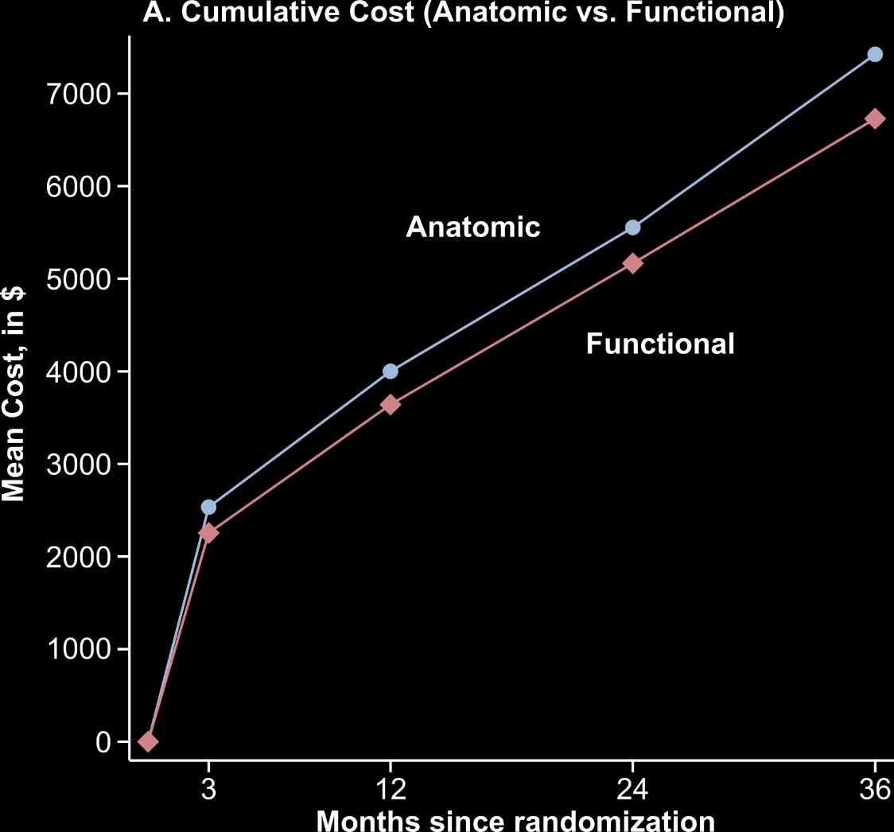

PROMISE Economic Substudy:
Cumulative Total Costs by ITT and Mean Cost Difference (95%CI)
Cumulative Cost
Difference in Cost
(Anatomic – Functional)
$694
$358
$388
$279

Slide 6
PROMISE Economic Substudy:
Conclusions
CTA ↑ costs by small (<$500), statistically non-significant amount over a median 2-year follow-up relative to a functional diagnostic testing strategy in stable patients with new chest pain
CTA improved efficiency of use of invasive cath (fewer normal caths, higher proportion of caths also getting revasc)
Exposure to radiation was ↓ for CTA compared with nuclear stress testing after taking into account subsequent tests and procedures
Coronary CTA may not be the “holy grail” of diagnostic testing once hoped for, but its more liberal use following PROMISE standards will improve some aspects of care without causing a major new economic burden on the health care system

