Slide 1



RADIATION EXPOSURE AND VASCULAR ACCESS IN ACUTE CORONARY SYNDROMES:
THE
RAD-MATRIX STUDY
Alessandro Sciahbasi, MD, PhD
Sandro Pertini Hospital, Rome
Frigoli E, Sarandrea A, Rothenbühler M, Calabrò P, Lupi A, Tomassini F, Cortese B, Rigattieri S, Cerrato E, Zavalloni D, Zingarelli A,Calabria P, Rubartelli P, Sardella G, Tebaldi M, Windecker S, Jüni P, Heg D, Valgimigli M
RAD
NCT01433627

Slide 2



DISCLOSURES
RAD
I, Alessandro Sciahbasi, have no disclosures
The MATRIX was made possible thanks to unrestricted grants from The Medicines Company and Terumo to GISE
The RAD MATRIX substudy was self supported and received no external funding

Slide 3
BACKGROUND
RAD
Radial access reduces vascular and bleeding complications
The use of the radial approach is increasing worldwide
Only a minority of randomized controlled studies evaluated radiation doses, especially in ACS patients and none used dedicated dosimeters to assess operator exposure

Slide 4
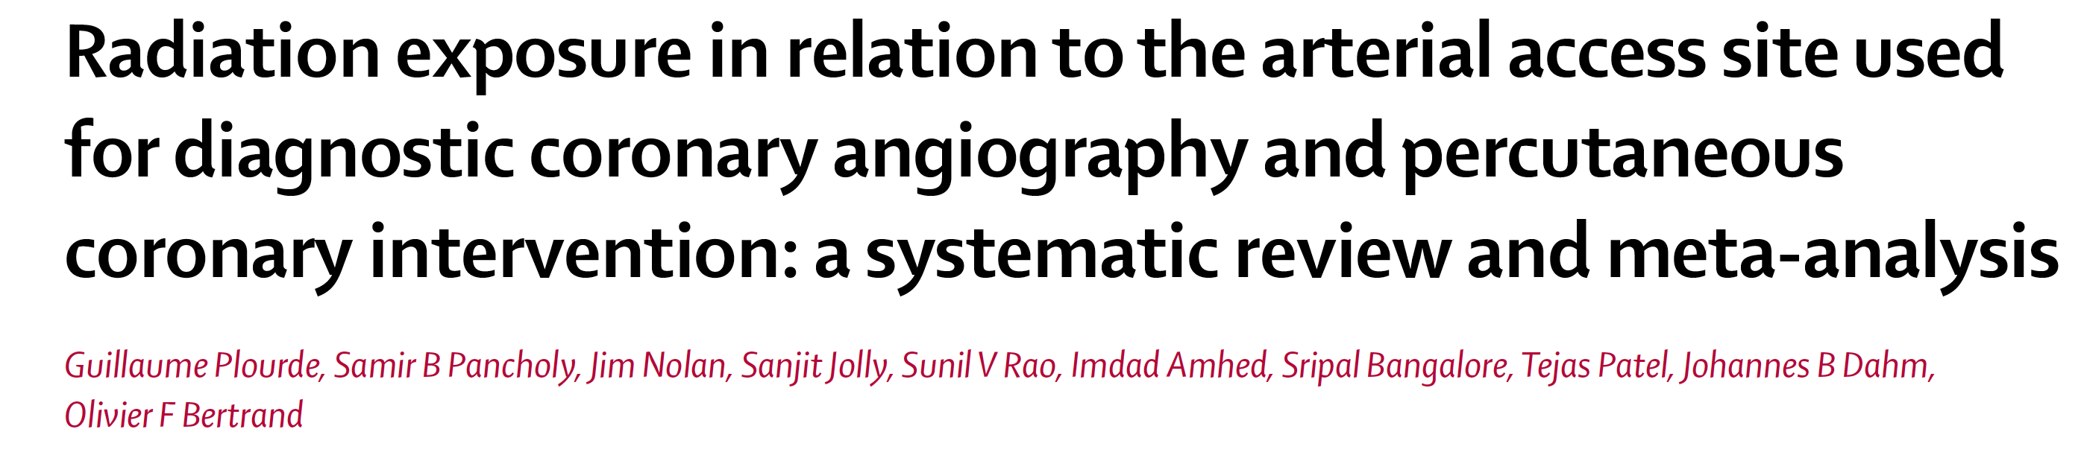
BACKGROUND
RAD
Transradial access was associated with a small but significant increase in
radiation exposure…
Differences in radiation exposure narrow over time…
The clinical significance of this small increase is uncertain…

Slide 5
MATRIX-ACCESS STUDY
RAD
NSTEACS or STEMI patients
with invasive management
Aspirin+P2Y12 blocker
1:1
Trans-Radial Access
Trans-Femoral Access
Radial Access
Net clinical events
Mortality and bleeding

Slide 6
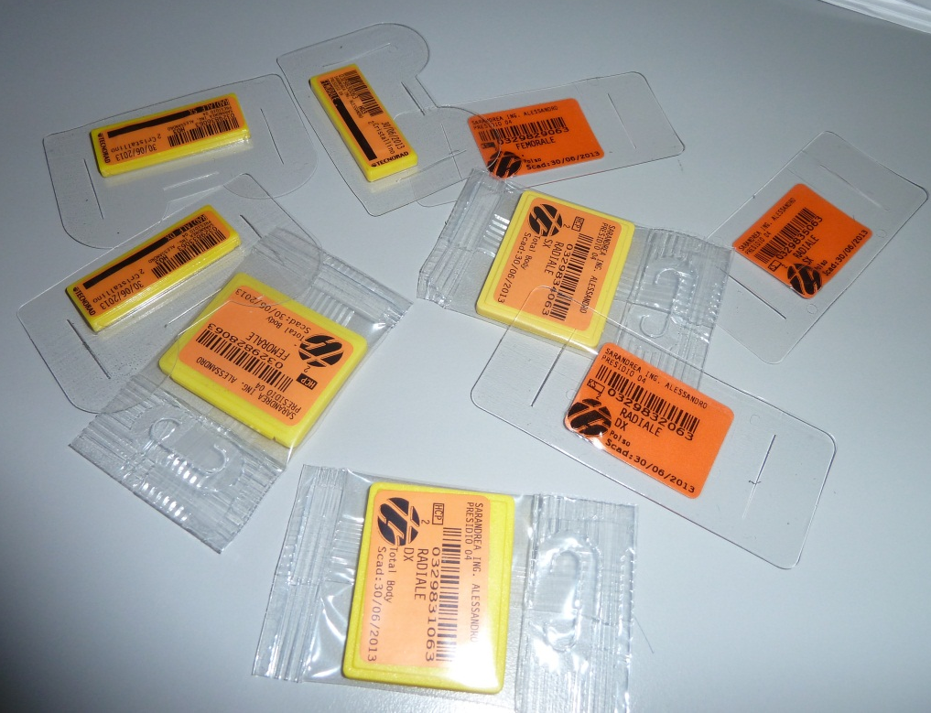
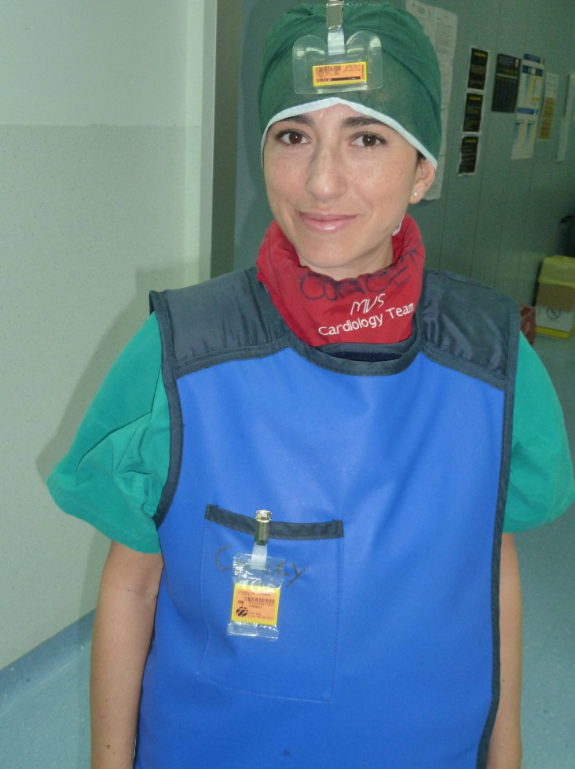
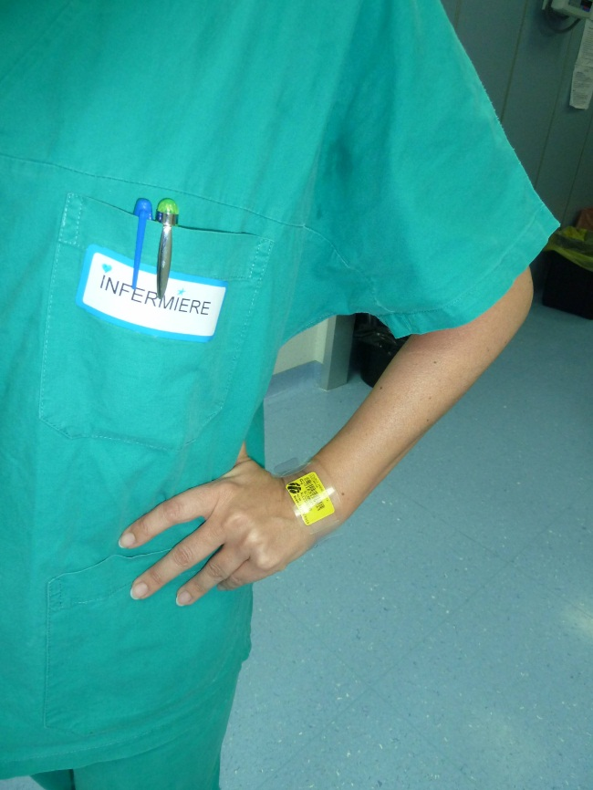

RAD-MATRIX
RAD
Thermoluminescent dosimeters
Eye
Thorax
Patient dose evaluated by Dose Area Product (DAP) in full Matrix population
Left wrist

Slide 7

END POINT
RAD
Non inferiority of radial vs femoral access for operator radiation dose at thorax
Setting non inferiority margin at 25 µSv, at least 13 operators would provide 80% power at one-sided alpha of 0.05
An arbitrary minimum of 13 procedures per operator and per main access site was
mandated to minimize the risks of imbalances due to variation in the complexity
of the diagnostic or therapeutic procedures within each operator.

Slide 8
FLOW CHART
RAD
18 operators
766 patients - 777 procedures
Patient radiation dose in
8404 patients-Matrix Access
Femoral
Radial
7570 procedures with DAP available
373 patients - 379 procedures
393 patients - 398 procedures
4 operators excluded
14 operators
Femoral
Radial
3448 patients - 3773 procedures
3554 patients - 3797 procedures
Right
Left
120 patients - 121 procedures
130 patients - 131 procedures

Slide 9
CLINICAL CHARACTERISTICS
RAD
 | MATRIX |  |  | RAD-MATRIX
 | Radial | Femoral | p | Radial | Femoral | p
Patients/Procedures (n) | 3448 / 3773 | 3454 / 3797 |  | 373 / 379 | 393 / 398
Male (%) | 74 | 73 | 0.180 | 77 | 71 | 0.035
Age | 66 ± 12 | 66 ± 12 | 0.239 | 66 ± 12 | 66 ± 12 | 0.944
Body mass index | 27 ± 4 | 27 ± 4 | 0.825 | 27 ± 4 | 27 ± 4 | 0.228
Hypertension (%) | 64 | 65 | 0.338 | 64 | 65 | 0.760
Diabetes (%) | 23 | 23 | 0.599 | 24 | 26 | 0.616
Vascular disease (%) | 9 | 9 | 0.340 | 11 | 10 | 0.964
Previous MI (%) | 14 | 15 | 0.152 | 15 | 17 | 0.494
Previous PCI (%) | 15 | 14 | 0.751 | 14 | 16 | 0.351
STEMI at admission (%) | 47 | 47 | 0.977 | 48 | 45 | 0.558

Slide 10
PROCEDURAL CHARACTERISTICS
RAD
 | MATRIX |  |  | RAD-MATRIX
 | Radial | Femoral | p | Radial | Femoral | p
Patients/Procedures (n) | 3448 / 3773 | 3454 / 3797 |  | 373 / 379 | 393 / 398
PCI Attempted (%) | 81 | 82 | 0.971 | 84 | 81 | 0.284
Staged procedure | 17 | 17 | 0.675 | 21 | 19 | 0.619
Total stent length (mm) | 68 ± 44 | 67 ± 43 | 0.276 | 75 ± 46 | 68 ± 43 | 0.131
Thromboaspiration (%) | 26 | 27 | 0.498 | 30 | 27 | 0.681
Crossover (%) | 7 | 5 | 0.0002 | 3 | 4 | 0.764
Fluoro Time (min) | 10 (6-16) | 9 (5-15) | <0.0001 | 10 (6-16) | 8 (5-14) | 0.0004

Slide 11
OPERATOR DOSE
RAD
400
457.5
Superiorityp= 0.125
Radial
Non-inf
P= 0.843
300
Femoral
Superiority
P= 0.019
Procedural Operator Equivalent Dose (μSv)
200
117
Superiority
p= 0.146
100
77
75
41
34
21
0
THORAX
WRIST
EYE

Slide 12
NORMALIZED DOSES
RAD
 | Radial | Femoral | p
Operator Dose normalized by fluoro time
Thorax | 6 (4-10) | 4 (3-5) | 0.029
Wrist | 9 (7-14) | 5 (5-9) | 0.195
Eye | 2 (2-3) | 2 (1-2) | 0.242
Operator Dose normalized by DAP
Thorax | 0.8 (0.6-1.1) | 0.5 (0.3-0.6) | 0.015
Wrist | 1.2 (0.9-2.3) | 0.9 (0.6-1.3) | 0.129
Eye | 0.3 (0.2-0.5) | 0.3 (0.1-0.4) | 0.217

Slide 13
INDIVIDUAL OPERATOR DOSE
RAD
Radial
Femoral
200
150
100
50
0
50
100
150
200
Procedural Operator Equivalent Dose - Thorax (μSv)

Slide 14
LEFT VS RIGHT RADIAL
RAD
400
456; 815
p= 0.154
p= 0.108
Left Radial
300
Right Radial
Procedural Operator Equivalent Dose (μSv)
200
153
p= 0.077
100
84
87
52
39
15
0
THORAX
WRIST
EYE

Slide 15
NORMALIZED DOSES
RAD
 | Left Radial | Right Radial | p
Operator Dose normalized by fluoro time
Thorax | 4 (2-7) | 7 (4-11) | 0.093
Wrist | 9 (5-11) | 12 (6-15) | 0.168
Eye | 1 (1-3) | 3 (1-4) | 0.141
Operator Dose normalized by DAP
Thorax | 0.6 (0.4-0.8) | 0.7 (0.5-1.1) | 0.215
Wrist | 1 (0.6-1.2) | 1.2 (0.9-2.3) | 0.241
Eye | 0.2 (0.1-0.5) | 0.3 (0.2-0.5) | 0.435

Slide 16
LEFT vs RIGHT vs FEMORAL
RAD
 | Left Radial | Femoral | p | Right Radial | Femoral | p
Procedures (n) | 131 | 239 |  | 121 | 239
Thorax dose (μSv) | 52 (33-92) | 38 (23-78) | 0.335 | 84 (47-146) | 38 (23-78) | 0.027
Wrist dose (μSv) | 87 (53-140) | 109 (44-129) | 0.927 | 153 (89-215) | 109 (44-129) | 0.141
Eye dose (μSv) | 15 (11-35) | 19 (10-28) | 0.713 | 39 (21-50) | 19 (10-28) | 0.154

Slide 17
PATIENT DOSE
RAD
 | MATRIX |  |  | RAD-MATRIX
 | Radial | Femoral | p | Radial | Femoral | p
Patients/Procedures (n) | 3448 / 3773 | 3454 / 3797 |  | 373 / 379 | 393 / 398
Fluoro Time (min) | 10 (6-16) | 9 (5-15) | <0.0001 | 10 (6-16) | 8 (5-14) | 0.0004
DAP (Gy*cm²) | 65 (29-120) | 59 (26-110) | 0.0001 | 74 (34-130) | 68 (25-115) | 0.751
6 Gy*cm²
6 Gy*cm²

Slide 18
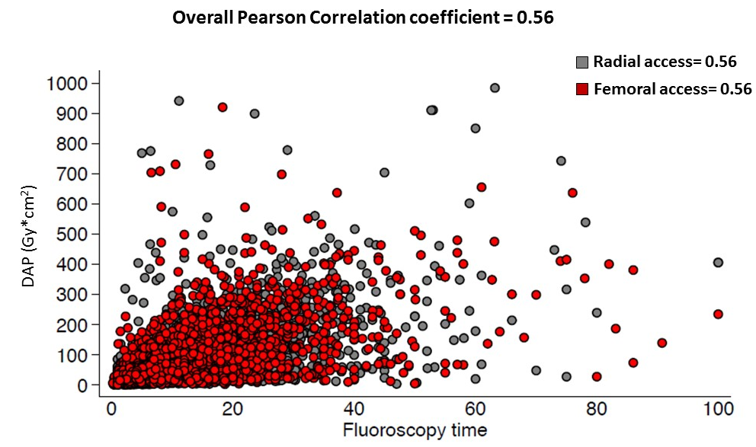
DAP vs FLUORO
RAD

Slide 19

EFFECTIVE DOSE
RAD
PATIENTS | Radial | Femoral | p
EFFECTIVE DOSE (mSV) | 13 (6-24) | 12 (5-22) | <0.0001
Cancer
Mortality
1:35,714
procedures
1:166
procedures

Slide 20

EFFECTIVE DOSE
RAD
Operators | Radial | Femoral | p
EFFECTIVE DOSE (μSV) | 2.3 (1.2-3.4) | 1.2 (0.7-1.8) | 0.019
Radial Operator
Femoral Operator
100 Procedures
11.5 Chest x-Rays
6 Chest x-Rays

Slide 21
CONCLUSIONS
RAD
Our study is to date the largest study comparing patients and operators radiation exposure during PCI with radial or femoral access
Radial access is associated with higher operator and patient radiation exposure compared to femoral access
Radial operators should be engaged towards reduction of radiation doses and adopt adjunctive radio-protective measures

