Slide 1



Digoxin And Mortality in Patients With Atrial Fibrillation With and Without Heart Failure: Does Serum Digoxin Concentration Matter?
Renato D. Lopes, MD, PhD, FACC on behalf of the ARISTOTLE Investigators

Slide 2
Disclosures
The ARISTOTLE trial was sponsored by Bristol-Myers Squibb and Pfizer.
The present analysis was sponsored by the Duke Clinical Research Institute.
The serum digoxin measurements were performed in blood samples stored in the Uppsala Biobank (UCR, Uppsala).

Slide 3
Background
Digoxin is used in ≈ 30% of patients with atrial fibrillation (AF) worldwide, despite the lack of randomized clinical trials to assess its efficacy and safety in this setting.^{1–3}
Current AF guidelines recommend digoxin for rate control in patients with AF with and without heart failure (HF).^{4,5}
There are no specific recommendations about serum digoxin concentration monitoring in the AF guidelines.
1Allen LA, et al. J Am Coll Cardiol 2015;65:2691-8. 2Washam JB, et al. Lancet 2015;385:2363-70. 3Granger CB, et al. N Engl J Med 2011;365:981-92. 4January CT, et al. Circulation 2014;130:2071-104. 5Kirchof P, et al. Eur Heart J 2016;37:2893-962.

Slide 4
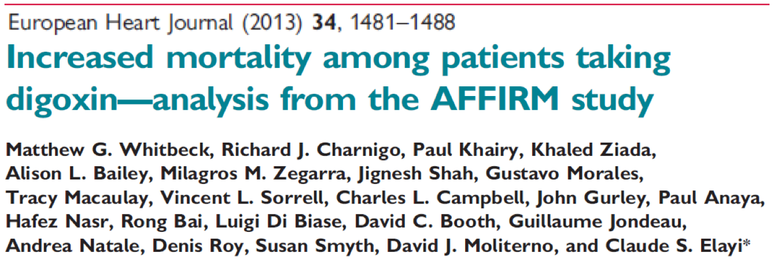
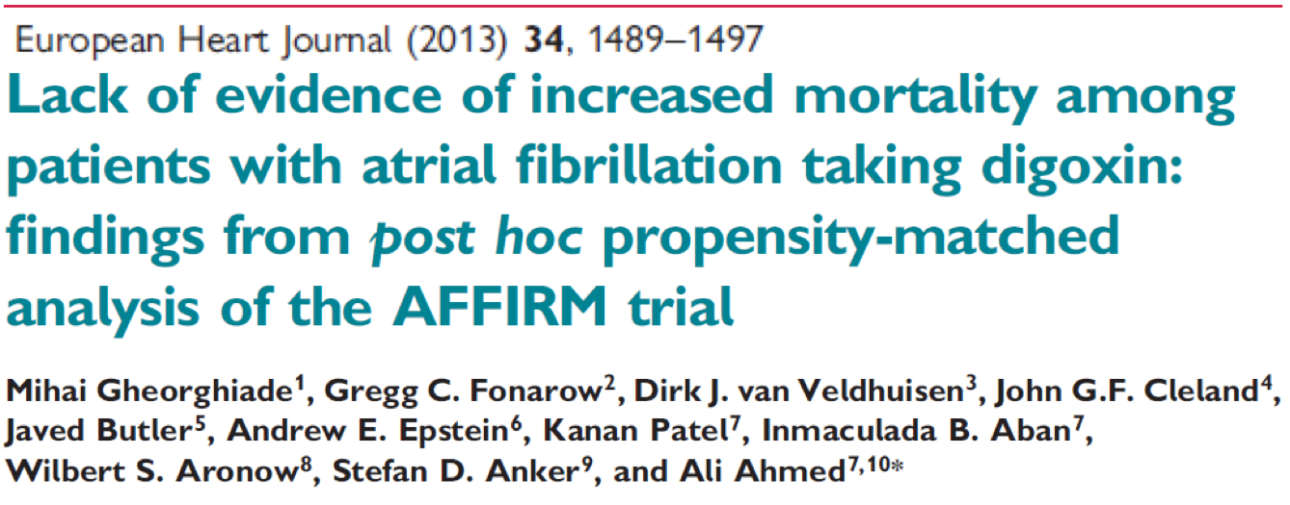
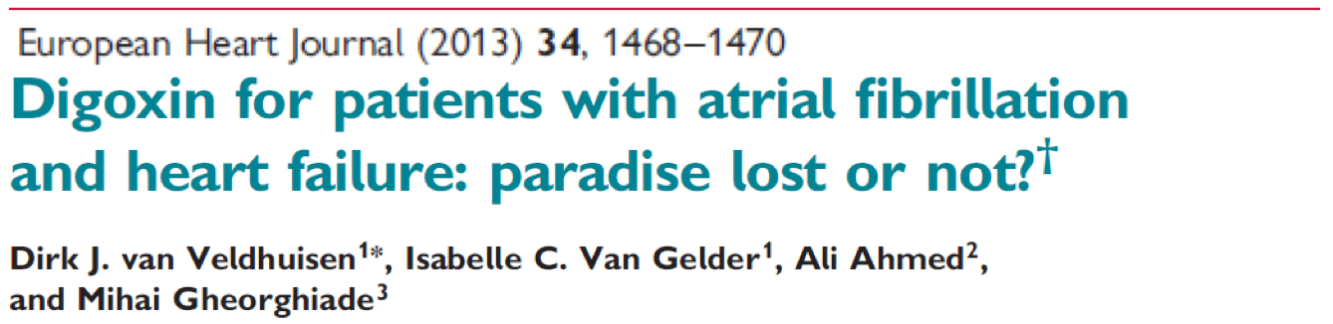
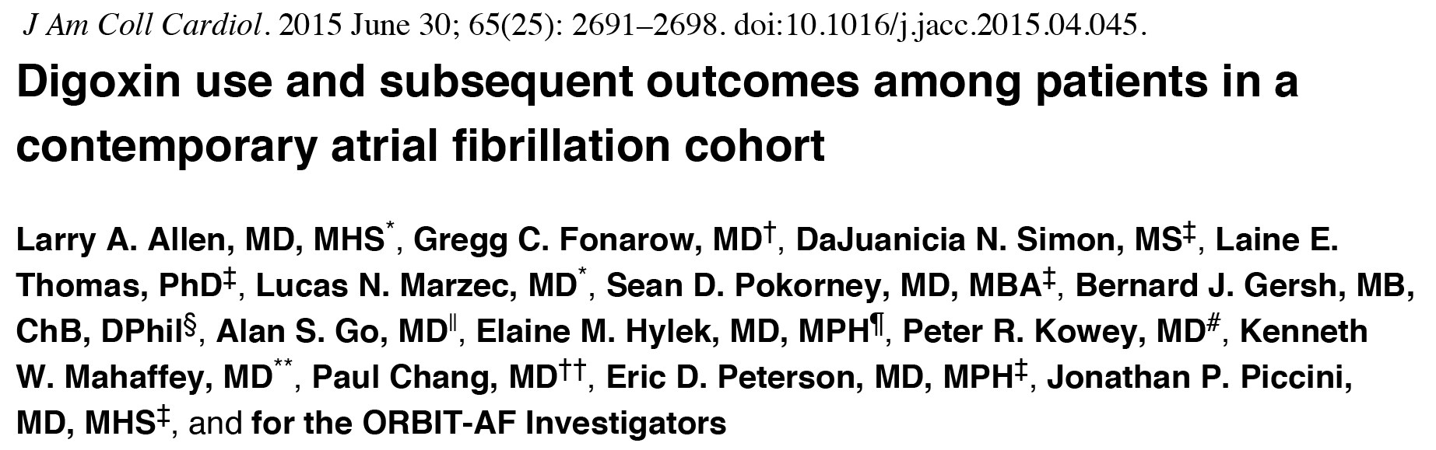
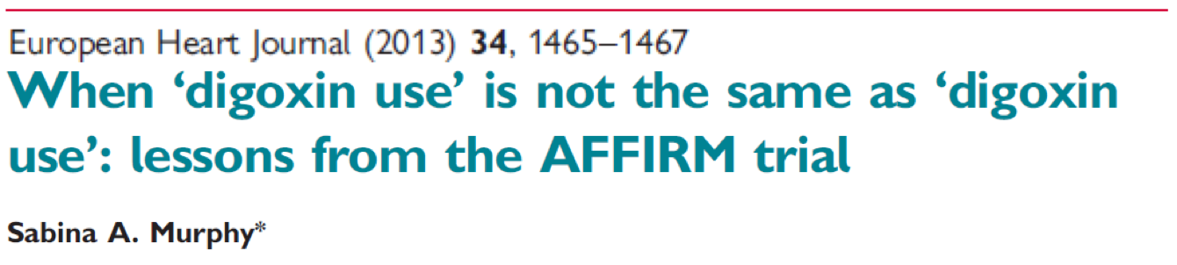
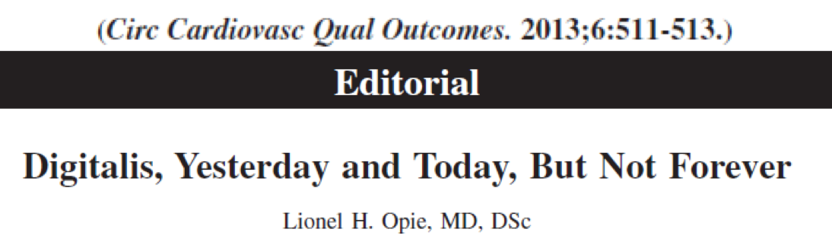
Research Context: ‘’A Controversial Topic’’

Slide 5
Atrial Fibrillation with at Least One Additional Risk Factor for Stroke
Inclusion risk factors
Age ≥ 75 years
Prior stroke, TIA, or SE
HF or LVEF ≤ 40%
Diabetes mellitus
Hypertension
Randomize
double blind, double dummy
(n = 18,201)
Exclusion
Mechanical prosthetic valve
Severe renal insufficiency
Need for aspirin plus thienopyridine
Biomarker substudy (n=14,892)
Blood samples at baseline
Plasma aliquots stored at -70ºC
Apixaban 5 mg oral twice daily
(2.5 mg BID in selected patients)
Warfarin
(target INR 2–3)
Warfarin/warfarin placebo adjusted by INR/sham INR
based on encrypted point-of-care testing device
Primary outcome: stroke or systemic embolism
Lopes RD, et al. Am Heart J 2010;159:331–9.
Granger CB, et al. N Engl J Med 2011;365:981–92.

Slide 6
Objectives
Using data from the ARISTOTLE trial, we aimed to:
Explore the association between digoxin use and mortality
According to serum digoxin concentration
In patients with and without HF
Assess the efficacy and safety of apixaban versus warfarin in patients taking and not taking digoxin.

Slide 7
Unique Features of Our Study
Detailed serial assessment of concomitant medications, including digoxin.
Two types of analyses: prevalence (baseline digoxin) and incidence (new digoxin users).
Measurement of serum digoxin concentration at baseline.
Comprehensive covariate adjustment, including for biomarker levels (NT-proBNP, troponin, GDF-15).

Slide 8
Digoxin Use at Baseline (Prevalence analysis)
Mortality in patients taking or not taking digoxin at baseline was compared using a Cox model with propensity weighting.
The propensity model included sociodemographic characteristics, medical history, vital signs, AF characteristics, concomitant medications, labs, and biomarkers.
The association between baseline digoxin concentration and mortality after multivariable adjustment was explored.

Slide 9
Digoxin Started During the Study (Incidence analysis: “new digoxin users”)
Risk-set matching was used to identify controls for each patient who started digoxin (3:1).
Matches were based on a time-dependent propensity score including baseline and post-baseline covariates measured prior to the time of matching.
Baseline covariates were updated during follow-up.
Matching was performed within region, clinical setting, and HF status.

Slide 10
Main Results
Digoxin and Mortality

Slide 11
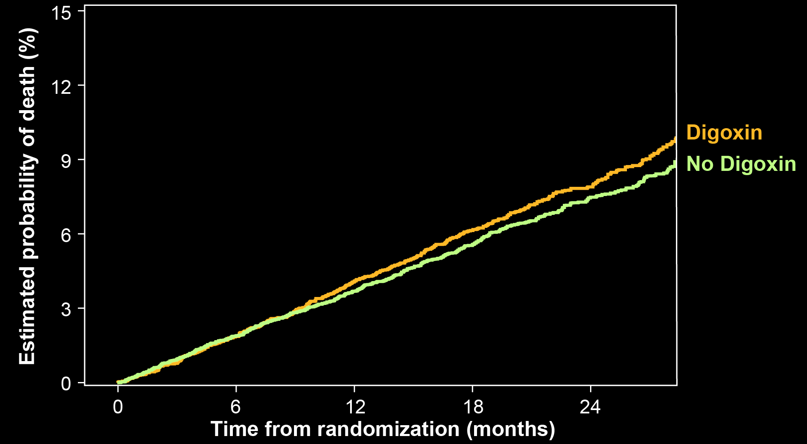
Baseline Digoxin and Adjusted Mortality
Baseline Serum Digoxin Concentration and Adjusted Mortality
<0.9 ng/mL N=3373 (76%)
Adj. HR (95% CI): 1.00 (0.85–1.16)
P=0.956
≥0.9 to <1.2 ng/mL N=559 (12.6%)
Adj. HR (95% CI): 1.16 (0.87–1.55)
P=0.322
≥1.2 ng/mL N=499 (11.4%)
Adj. HR (95% CI): 1.56 (1.20–2.04)
P=0.001
Adj. HR (95% CI): 1.09 (0.96–1.23)
P=0.191

Slide 12

Adjusted Mortality by Digoxin Concentration
Adj. HR (95% CI): 1.19 (1.07–1.32)
P=0.001 for each 0.5 ng/mL increase in baseline digoxin concentrations

Slide 13
Characteristics of New Digoxin Users and Matched Controls
Characteristic |  | Digoxin (N=781) | Matched Control (N=2,343)
Age, median (25th, 75th), yrs |  | 70 (63, 76) | 70 (63, 76)
Female sex (%) |  | 40.3 | 40.5
Prior stroke, TIA, or SE (%) |  | 23.9 | 23.0
Heart failure/Left ventricular dysfunction (%) |  | 42.9 | 42.9
LVEF, median (25th, 75th), % |  | 55 (47, 64) | 56 (45, 63)
NYHA class (%): | I | 46.3 | 50.5
 | II | 42.1 | 39.4
 | III | 11.4 | 9.7
 | IV | 0.8 | 0.3
Type of AF (%): | Paroxysmal | 15.9 | 14.5
 | Persistent / Permanent | 84.1 | 85.5

Slide 14
Biomarkers and Antiarrhythmic Medications in New Digoxin Users and Matched Controls
Characteristic | Digoxin (N=781) | Matched Control (N=2,343)
Creatinine clearance, median (25th, 75th), mL/min | 69.8 (52.9, 90.4) | 69.8 (52.7, 91.7)
NT-proBNP, median (25th, 75th), ng/L | 838 (413, 1492) | 834 (414, 1520)
Troponin I, median (25th, 75th), ng/L | 5.4 (3.2, 10.4) | 5.4 (3.1, 11.0)
Troponin T, median (25th, 75th), ng/L | 10.8 (7.3, 16.4) | 10.6 (7.3, 16.6)
GDF-15, median (25th, 75th), pg/mL | 1466 (987, 2196) | 1447 (981, 2138)
Class I antiarrhythmic drugs (%) | 5.4 | 5.3
Beta blockers (%) | 74.0 | 73.6
Sotalol (%) | 3.6 | 3.5
Amiodarone (%) | 13.6 | 13.8
Calcium channel blockers (%) | 32.1 | 30.6

Slide 15
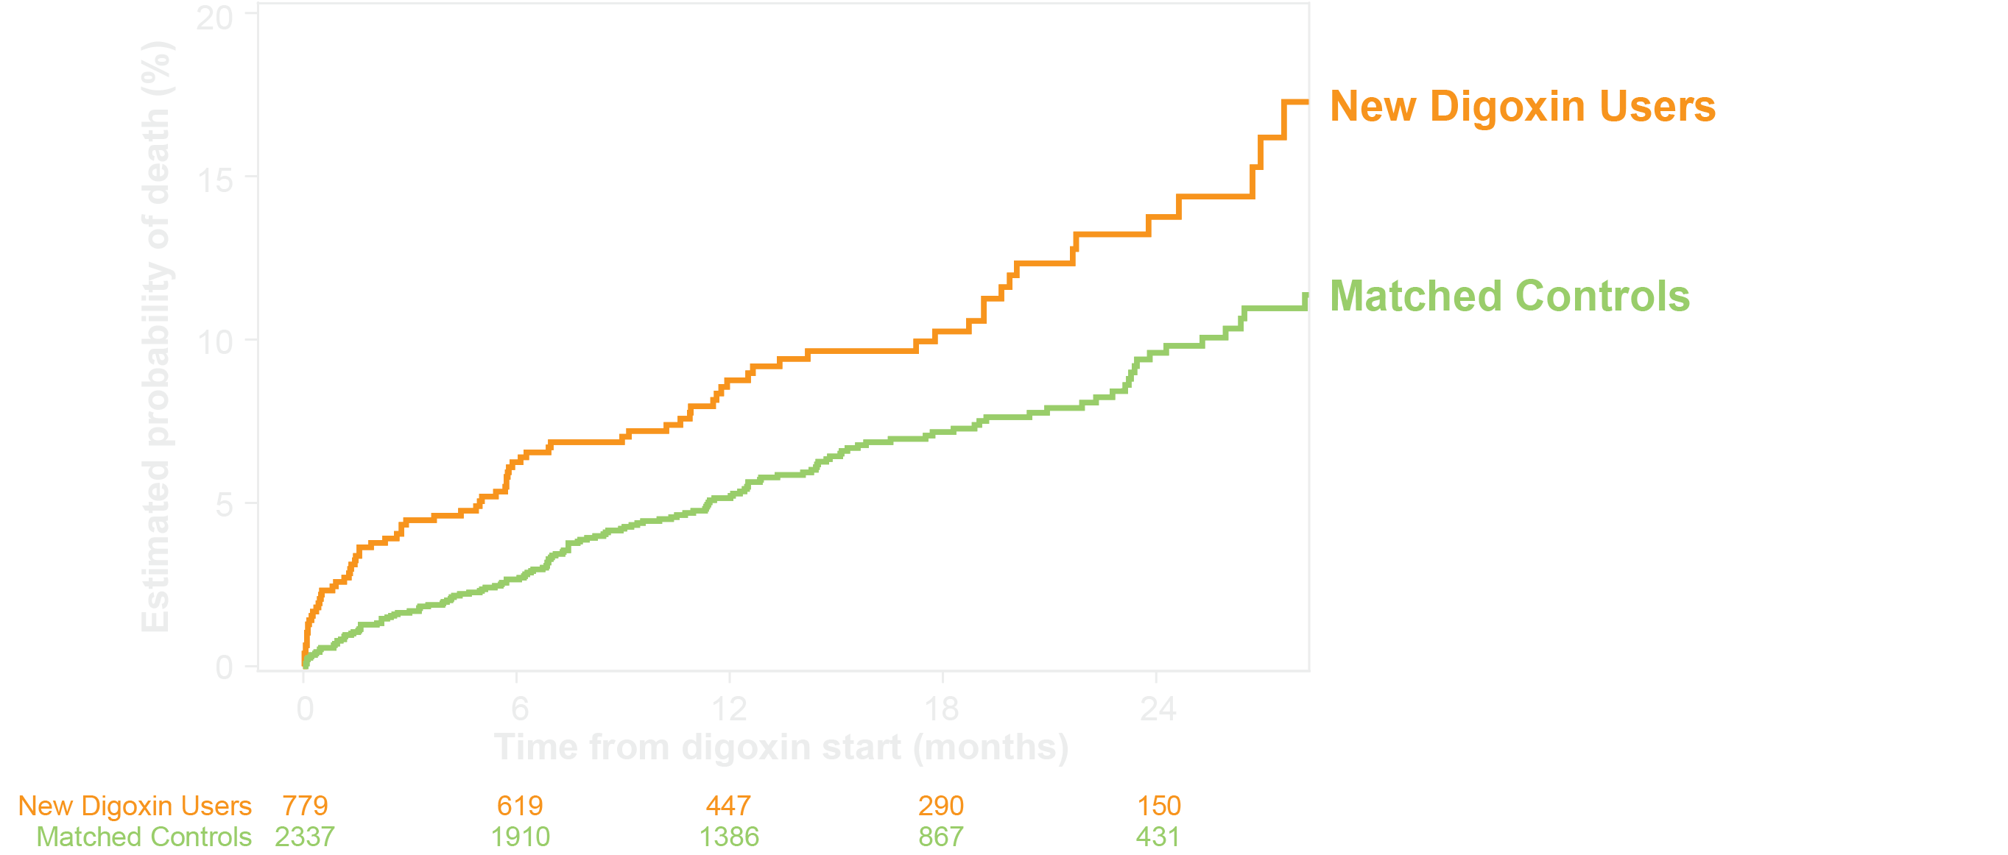
Adjusted Mortality in New Digoxin Users versus Matched Controls
Adj. HR (95% CI): 1.78 (1.37–2.31)
P<0.001

Slide 16
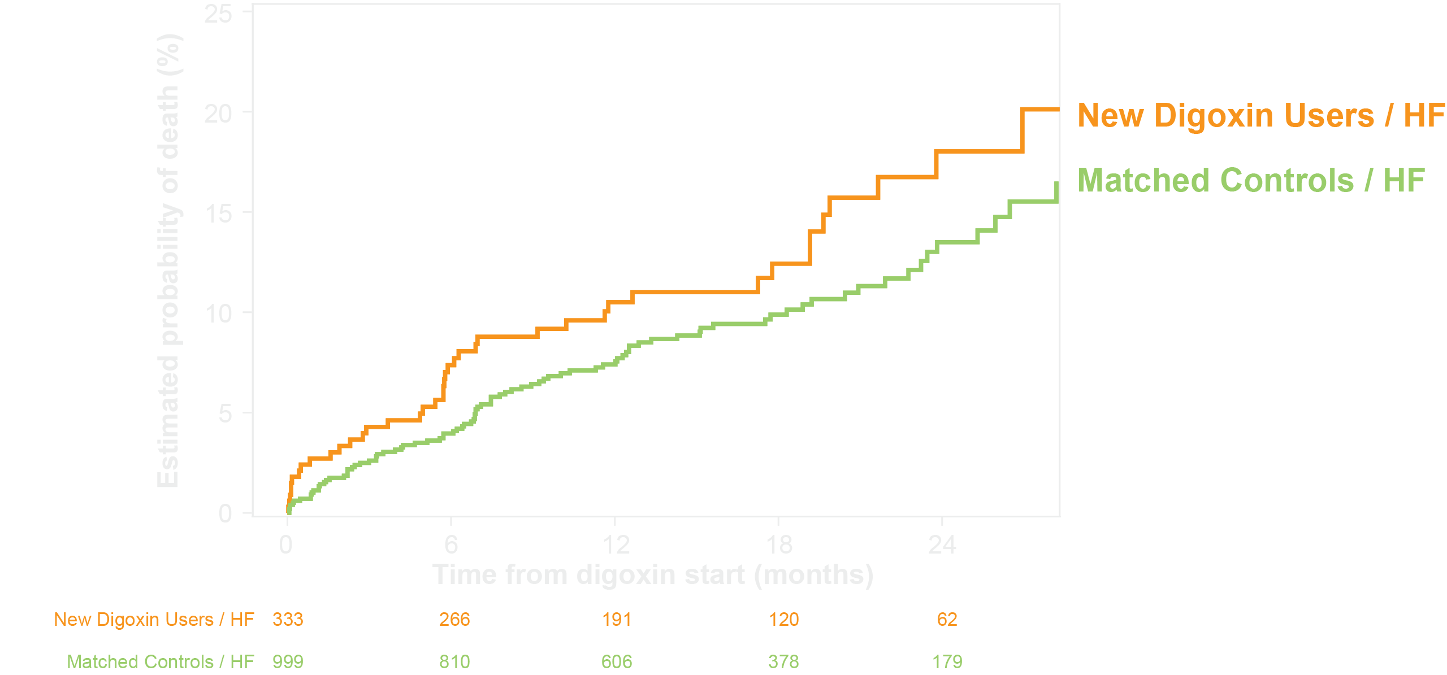
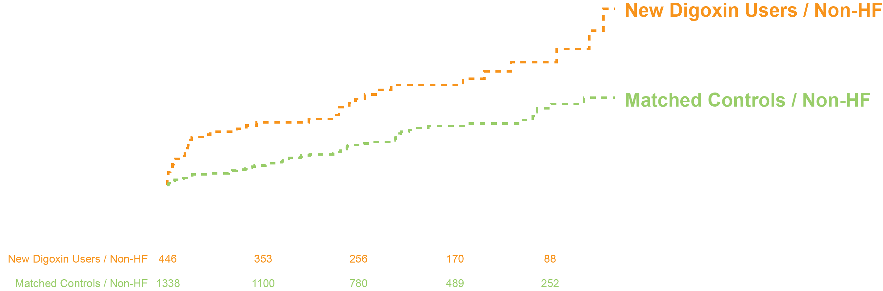
Adjusted Mortality in New Digoxin Users versus Matched Controls With and Without Heart Failure
HF: Adj. HR (95% CI): 1.58 (1.12-2.24) P=0.01
Non-HF: Adj. HR (95% CI): 2.07 (1.39-3.08)
P=0.0003

Slide 17
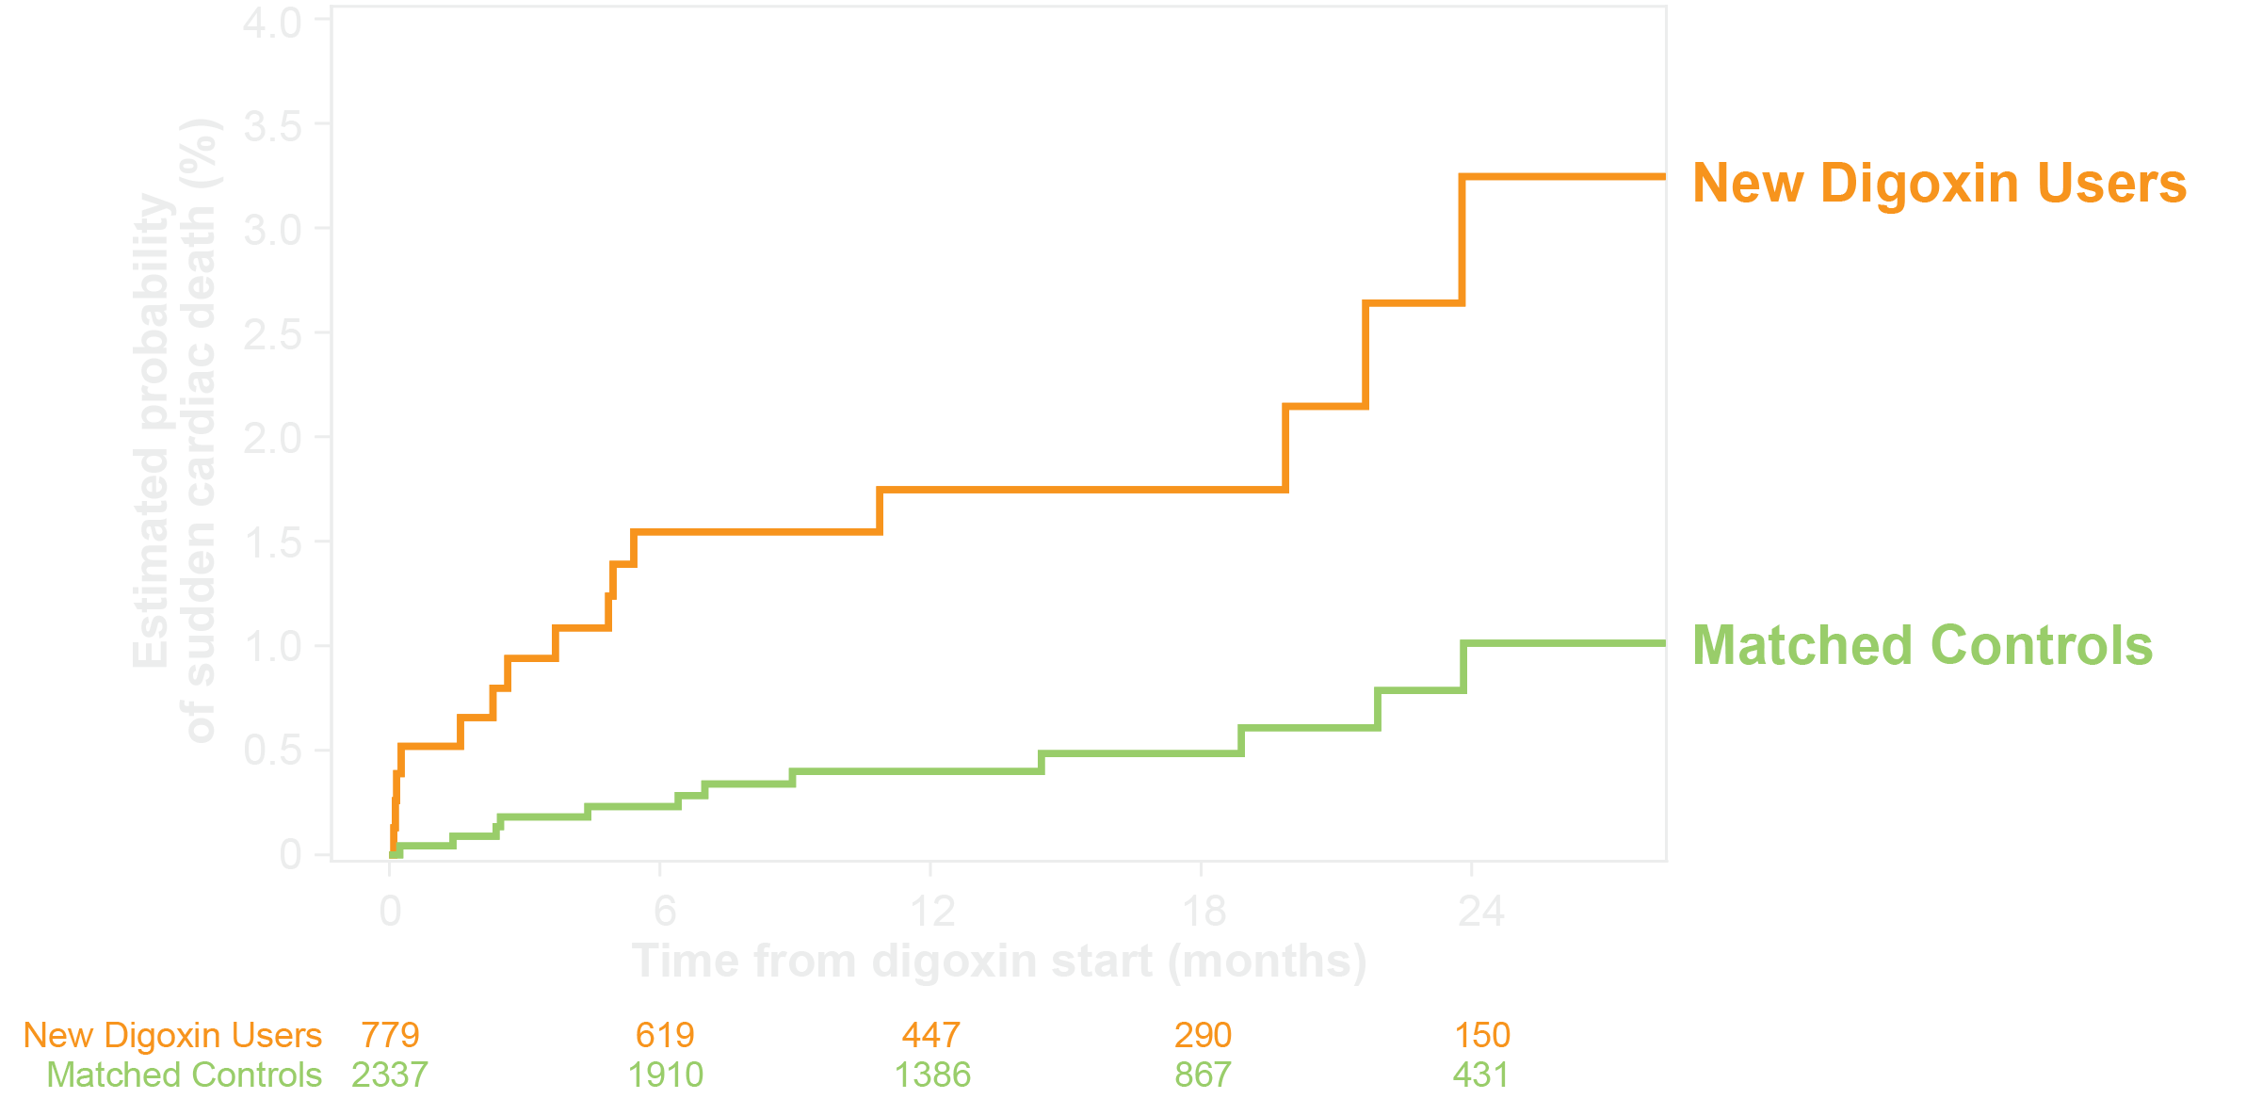
Adjusted Sudden Death in New Digoxin Users versus Matched Controls
Adj. HR (95% CI): 4.01 (1.90–8.47) P<0.001

Slide 18
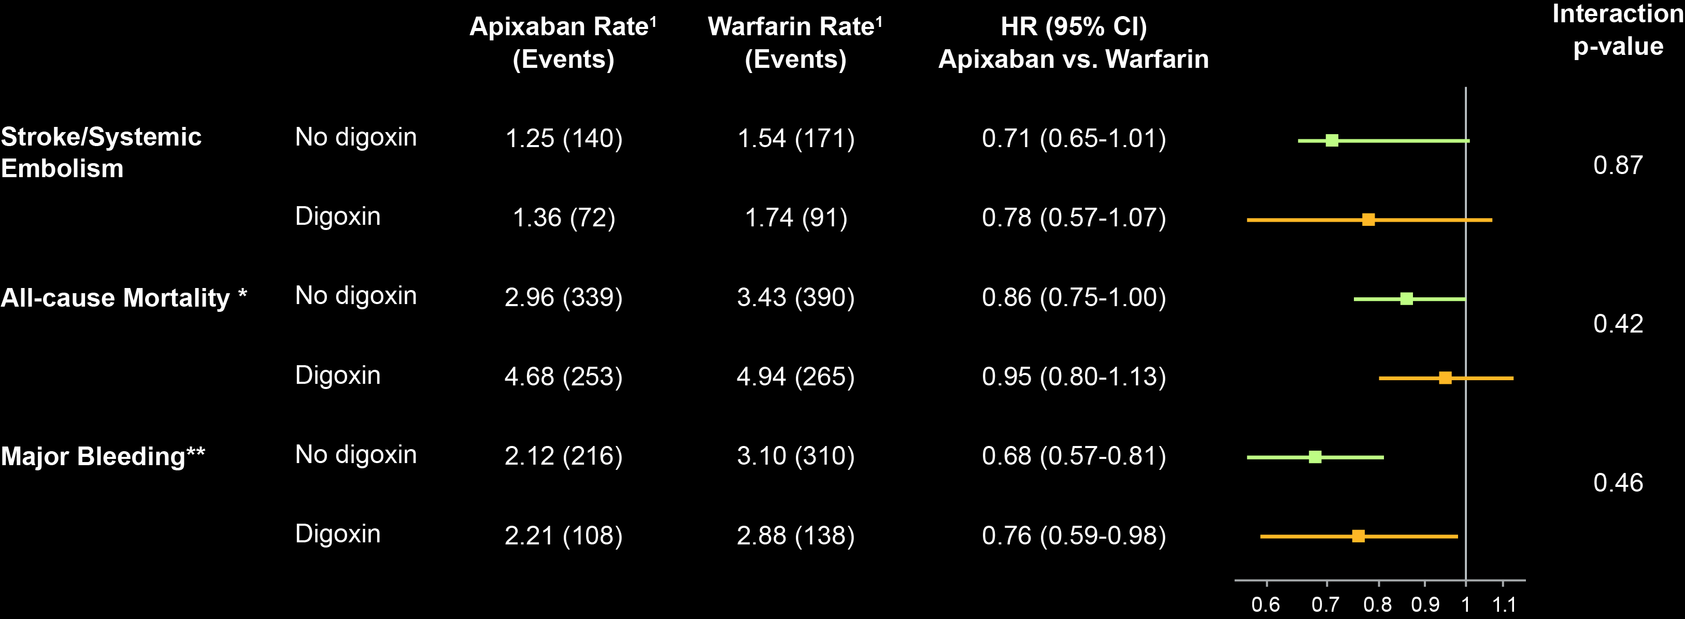
Apixaban versus Warfarin in Patients Using Digoxin and Not Using Digoxin at Baseline
Apixaban Better
Warfarin Better
¹Rate per 100 patient-years of follow-up. * Apixaban (n=8963), Warfarin (n=8944). **Apixaban (n=8934), Warfarin (n=8919).

Slide 19
Conclusions
In patients with AF currently taking digoxin, the risk of death is independently related to digoxin serum concentration and is highest in patients with concentrations ≥1.2 ng/mL.
Initiating digoxin is independently associated with higher mortality in patients with AF, regardless of HF.
The benefits of apixaban over warfarin are consistent in digoxin users and non-users.

Slide 20
Clinical Implication
In the absence of randomized trial data showing its safety and efficacy, digoxin should not be prescribed for patients with AF, particularly if symptoms can be alleviated with other treatments.
In patients with AF already taking digoxin, monitoring its serum concentration may be important, targeting blood levels <1.2 ng/mL.

Slide 21
THANKS TO ALL ARISTOTLE Investigators and Patients

