Slide 1

An International Cluster Randomized Trial of a Multifaceted Intervention to Improve Treatment with Oral Anticoagulants in Atrial Fibrillation: The IMPACT-AF trial
Christopher B. Granger, MD
On behalf of the IMPACT-AF Steering Committee and Investigators

Slide 2
Background
AF is common (34 million people worldwide)
AF is associated with a 5-fold increased risk of stroke
2/3rds of those strokes can be prevented with oral anticoagulation
About half of patients with AF and risk factors for stroke are treated with anticoagulants
There is a need to develop interventions proven to improve the proportion of patients treated with anticoagulants

Slide 3
Cluster Randomized Trial Argentina, Brazil, China, India, Romania
Patients (plan 40–70 per center)
AF
CHADS-VASc ≥ 2
No absolute contraindication to oral anticoagulation
Able to give consent
Randomize
48 centers
Cluster randomized design
Multifaceted patient and provider education with data monitoring and feedback
One-year follow-up
Control
Intervention
Primary outcome: change in the proportion of patients treated with oral anticoagulation, from baseline to one year
Secondary clinical outcomes of death, stroke, bleeding
Rao M et al. Am Heart J. 2016;176:107-13.
ClinicalTrials.gov Identifier: NCT02082548

Slide 4
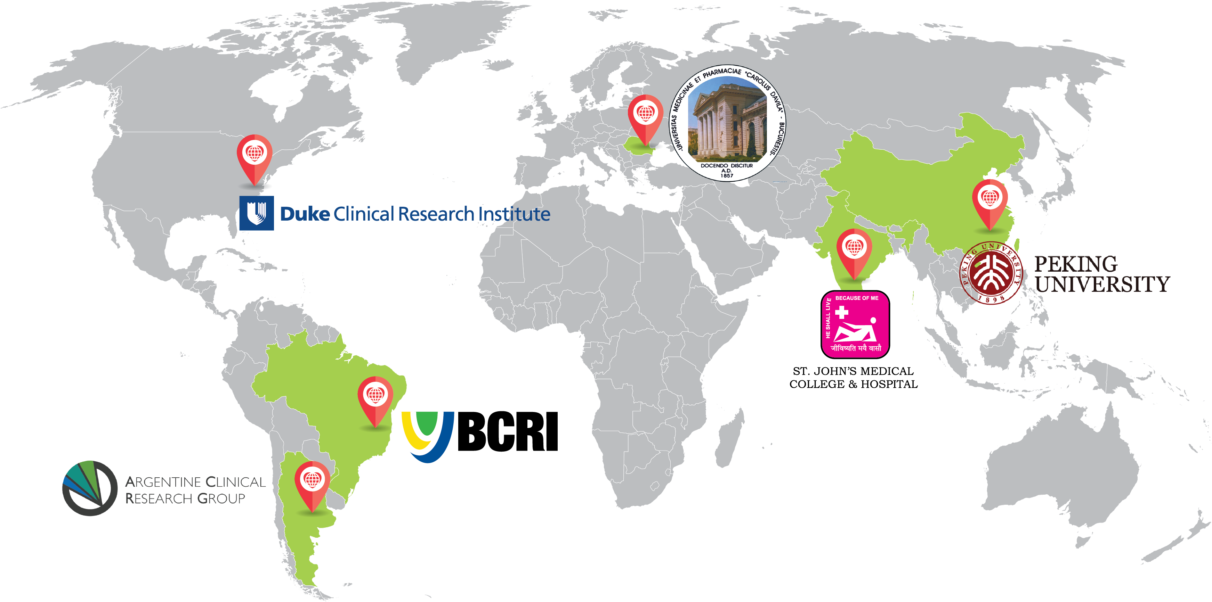
2,281 patients from 48 sites in Argentina, Brazil, China, India, Romania
Argentina Cecilia Bahit Argentine Clinical Research Group
Brazil Renato Lopes Federal University, Sao Paulo
India Denis Xavier St. John’s, Bangalore
China Huo Yong Peking University, Beijing
Romania Dragos Vinereanu Carol Davila University, Bucharest

Slide 5
Patient Eligibility Criteria
Inclusion Criteria:
Age greater than 18
Atrial fibrillation not due to reversible cause
CHA₂DS₂-VASc ≥ 2 (or rheumatic valvular disease)
12-lead EKG or rhythm strip at enrolment, or 2 EKGs or rhythm strips showing AF, at least 2 weeks apart
Exclusion Criteria:
Mechanical prosthetic valve
Clinically unstable
Life expectancy less than 6 months
Significant cognitive dysfunction
Unable to have one-year follow-up
Absolute contraindication (e.g., ongoing active bleeding)

Slide 6

Study Timeline and Methods
6- and 12-month visits: clinical event assessment
1, 3, 6, 9, and 12-month telephone calls or visits: assessment of anticoagulant use and continuation
Site
randomization
INTERVENTION SITES
✔
✔
✔
✔
✔
R
B 1mo 3mo 6mo 9mo 12mo
Patient Inclusion
✔
✔
✔
Patient screening; Site matching
CONTROL SITES
6- and 12-month visits: Clinical event assessment

Slide 7
Intervention
Education (patient and provider)
Clinical monograph
3 background webinars
Monthly site calls with national coordinating center
Focus on common reasons for withholding anticoagulation
Also promoted adherence for patients on treatment
Customized in each country
Measurement and feedback
Reasons for non-treatment collected
National coordinating center reviewed data on treatment each month
Each patient reviewed by site and questions reviewed with national coordinating center

Slide 8
Methods: Statistics
For primary outcome:
Logistic regression model using generalized estimating equation to control for clustering nature of the study design
Model was adjusted for baseline OAC status, country, and baseline risk factors
≥ 88% power given baseline oral anticoagulant use 60%, 10% absolute improvement, intra-cluster correlation of 0.02
For major clinical outcomes (stroke, death, major bleeding):
Time-to-event outcomes were analyzed using Kaplan-Meier estimates and Cox proportional hazards model

Slide 9
Baseline Characteristics
Characteristic | Intervention group (n=1187) | Control group (n=1094)
Age (years; median, IQR) | 70 (63, 77) | 70 (62, 78)
Sex (female) | 48% | 46%
AF < 3 months duration | 30% | 32%
Paroxysmal AF | 19% | 19%
Rheumatic valvular heart disease | 8% | 12%
CHADS-VASc (mean, SD) | 3.6 (1.5) | 3.7 (1.6)
Prior stroke | 18% | 16%
Hypertension | 77% | 78%
Diabetes | 25% | 29%
Heart failure or LVEF ≤ 40% | 29% | 35%
Of those on anticoagulant, use of VKA | 87% | 78%

Slide 10
Baseline Anticoagulation, and Follow-up
34% of patients were not on an oral anticoagulant at baseline (ranging from 62% in China to 9% in Brazil)
78% of those not on anticoagulants were on antiplatelet agents
The three main reasons for not being on baseline anticoagulants were patient preference or refusal (26%), risks outweigh benefits, as assessed by physician (15%), and concomitant antiplatelet therapy (13%)¹
5 patients (<1%) lost to follow-up
1. Vinereanu D et al, Am Heart J 2017; 192: 38–47.

Slide 11
Primary results

Slide 12
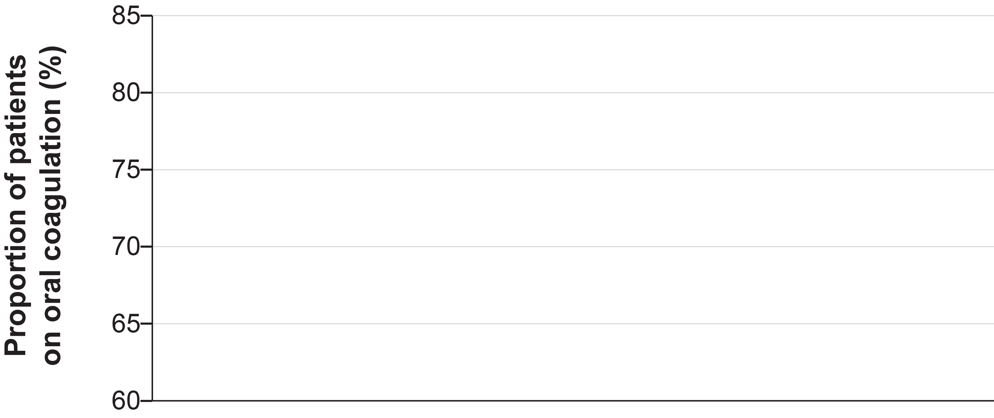
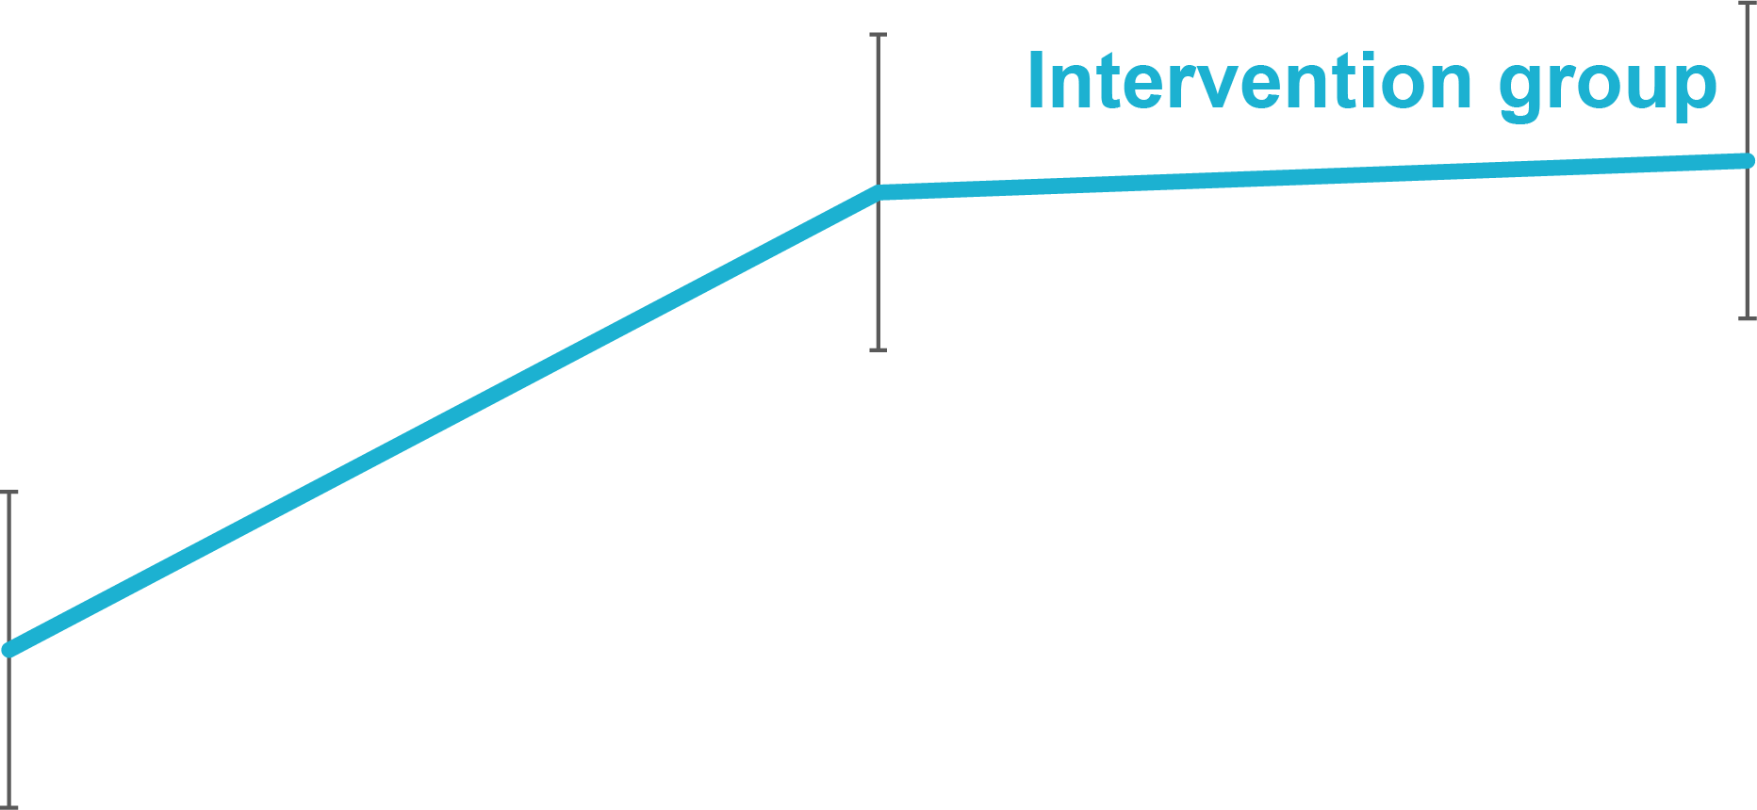
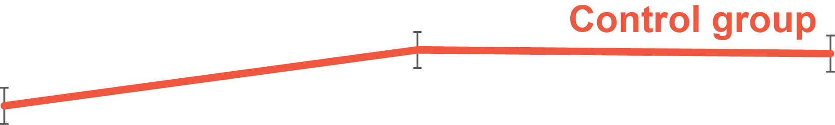
Primary Results (anticoagulation status over one year)
1-year adjusted OR (95% CI): 3.28 (1.67, 6.44); P=0.0002
Δ_{12-month}
= 9.1%
Baseline 6 months 12 months
Intervention group 68% 79% 80%
Control group 64% 67% 67%

Slide 13
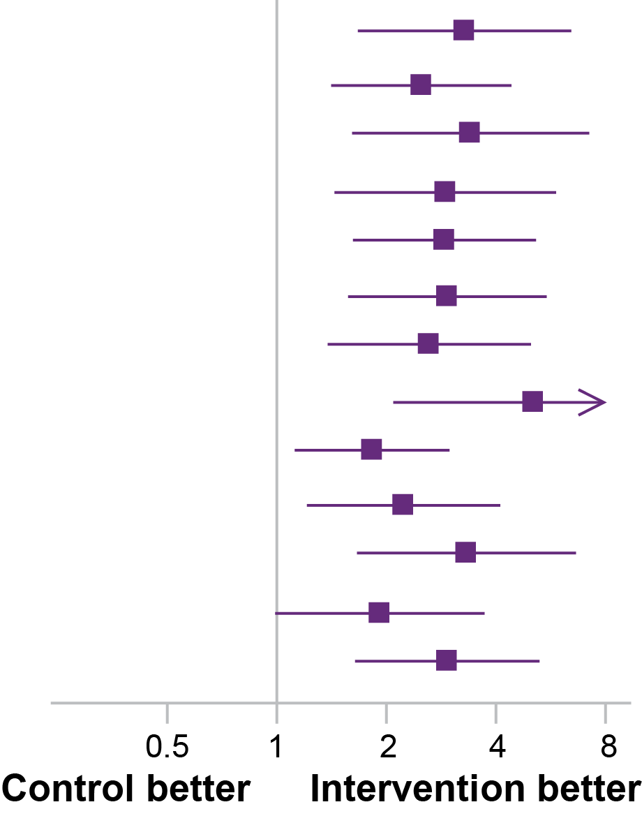
Primary Results (subgroups)
Group |  | No. of Patients | Intervention (%) | Control (%) | Odds Ratio (95% CI) |  | Interaction p-value
Overall |  | 2276 | 79.6% | 67.0% |  | 3.28 (1.67, 6.44)
Age | ≥65y | 1615 | 77.2% | 66.7% |  | 2.50 (1.41, 4.41) | 0.48
 | <65y | 661 | 85.6% | 67.8% |  | 3.40 (1.61, 7.21)
Sex | Female | 1075 | 79.4% | 65.0% |  | 2.91 (1.44, 5.85) | 0.98
 | Male | 1201 | 79.8% | 68.8% |  | 2.89 (1.62, 5.15)
New or recent AF | Yes | 703 | 75.8% | 52.4% |  | 2.94 (1.57, 5.51) | 0.23
 | No | 1553 | 81.1% | 73.8% |  | 2.62 (1.38, 4.99)
On aspirin | Yes | 678 | 61.9% | 36.0% |  | 5.07 (2.09, 12.28) | 0.01
 | No | 1598 | 86.5% | 81.7% |  | 1.83 (1.12, 2.98)
CHA2DS2 VASc | >3 | 1108 | 76.5% | 66.6% |  | 2.23 (1.21, 4.11) | 0.71
 | ≤3 | 1168 | 82.3% | 67.5% |  | 3.32 (1.66, 6.63)
Prior MI | Yes | 555 | 70.0% | 65.9% |  | 1.92 (0.99, 3.72) | 0.92
 | No | 1708 | 82.0% | 67.6% |  | 2.94 (1.64, 5.27)

Slide 14
Results Persistence and new treatment
 | Intervention group (n=1184) | Control group (n=1092) | Adjusted odds ratio (95% CI) | p value
Patients who were on oral anticoagulation at baseline, and were on oral anticoagulation at 1 year | 761/804 (95%) | 661/703 (94%) | 1.68 (0.90, 3.12) | 0.10
Patients who were not on oral anticoagulation at baseline, but were on oral anticoagulation at 1 year | 182/380 (48%) | 71/389 (18%) | 4.60 (2.20, 9.63) | <0.0001

Slide 15
Secondary clinical outcomes

Slide 16
Clinical outcomes
Outcome | Intervention | Control | HR/OR (95% CI) | P value
Death | 62 (5%) | 56 (5%) | 1.03 (0.72–1.48) | 0.88
Stroke | 11 (1%) | 21 (2%) | 0.48 (0.23–0.99) | 0.043
Major bleeding | 9 (1%) | 7 (1%) | 1.22 (0.45–3.27) | 0.69
Clinically relevant non-major bleeding | 40 (3.5%) | 31 (3%) | 1.21 (0.75–1.95) | 0.43
Composite (stroke, SE, major bleeding) | 22 (2%) | 29 (3%) | 0.70 (0.40–1.22) | 0.21

Slide 17
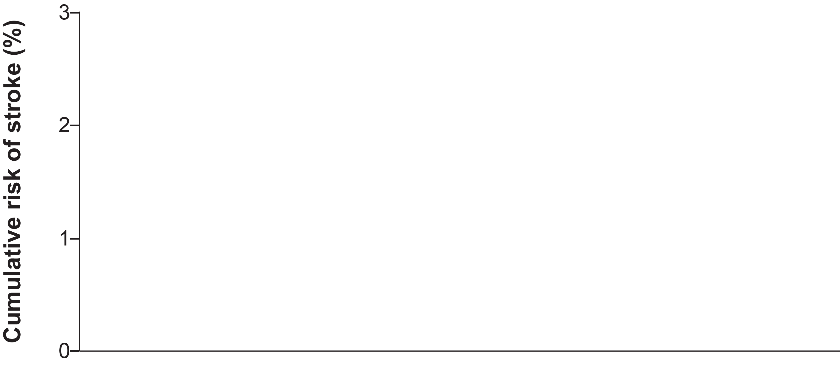
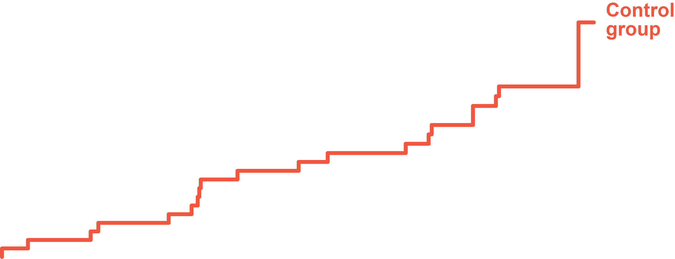

Stroke
HR (95% CI): 0.48 (0.23,0.99) log-rank p=0.043
0 3 6 9 12
Number at risk: Months from baseline visit
Intervention group 1176 1156 1124 1019 653
Control group 1090 1071 1044 976 615

Slide 18
Conclusions
A customized, multifaceted, and multilevel intervention involving education of patients with atrial fibrillation and their providers, with regular monitoring and feedback, resulted in a significant increase in the proportion of patients treated with anticoagulation.
In this trial, in the intervention group, about half of patients not on anticoagulants at baseline were treated at one year.
The nominally significant reduction in stroke underscores the potential impact of such an intervention to improve the use of anticoagulants for stroke prevention around the world.

Slide 19
IMPACT-AF Investigators and Coordinators: Argentina, Brazil, China, India, and Romania
ARGENTINA
Justo Carbajales
Javier Neri Ceferino Gómez
Mario Bruno Principato
María Alejandra Von Wulffen
Jorge Galperín
Rafael Salvador Acunzo
Ricardo Renato Bonato
Natalia Ciampi
Alberto Babil Marani
Cristian Gustavo Panigadi
Silvia Gabriela Pastura
Leonardo Martín Onetto
Cecilia Rafaela Moya
Nadia Budassi
Marisol Valle
Daniel Camerini
Enrique Monjes
Federico Zabala
Juan Pablo Ricart
Luis Medesani
Eduardo Noe Ortuño Campos
Fabián Ferroni
Mariana Foa Torres
Daniel Omar Fassi
Fernando Javier Díaz Bosio
Gabriel Edgardo Pérez Baztarrica
Teresa Zúñiga Infantas
Daniela Perlo
Celso Fernando García
Rubén García Durán
Luisina García Durán
Cecilia Alejandra Pettinari
Marisa Liliana Vico
Paulina Virginia Lanchiotti
Mariela Soledad Gómez
Carlos Alberto Poy
Franco Sebastián Grazziani
Marcela Julieta Laspina
María Laura Poy
María Cecilia Bahit
Carlos Tajer
Marilia García
BRAZIL
Renato D. Lopes
Pedro Gabriel Melo de Barros e Silva
Otavio Berwanger
Flávia Egydio
Elissa Restelli
Anelise Kawakami
Tamara Colaiácovo Soares
Mayara Vioto Valois
Tauane Bello Duarte
Lilian Mazza Barbosa
Angelo Amato Vicenzo de Paola
Thiago Librelon Pimenta
Gabriela Dal Moro Jeronimo
Bruna S. Fernandes da Costa
Enia Lucia Coutinho
Andressa Zulmira A. Guerrero
Lilia Nigro Maia
Marcelo Arruda Nakazone
Maria Angelica Teixeira Lemos
Osana Maria Coelho Costa
Ana Paula Demore
Roberta Parra Brito
Camila Dal Bon Melo
Nadielly Codonho Góes
Osvaldo Lorenço
Luiz Otavio Maia Gonçalves
Kátia Nishiama
Tiago Aparecido Maschio de Lima
Luciano Marcelo Backes
Keyla Liliana Alves de Lima Deucher
Milena Pozzatto Rodrigues
Dunnia Monisa Baldissera
José Basileu Caos Reolão
Tais Alves dos Santos
Fernanda Michel Birck Freisleben
Níncia Lucca da Silveira Kaross
Jéssika Tzervieczenski Montovani
Maiara Cantarelli
Aline Lucion
Luciano do Amarante
Priscila Foscarini
Claudia de Mello Perez
Fernanda Ribeiro França
Lisa Fialho
Helena Cramer Veiga Rey
Epotamenides Maria Good God
Estêvão Lanna Figueiredo
Gustavo Fonseca Werner
Jose Carlos de Faria Garcia
Bruna Azevedo
Luiz Carlos Vianna Barbosa
Ernaldo Pardi
Márcia Domingos Oliveira
Toshie Martinelli
Roseli Gomes Cavalini
Michele Santos Montoni de Moraes
Adalberto Menezes Lorga Filho
Eduardo Palmegiani
Thiago Baccilli Cury Megid
Clotildes S. P. Queirantes
Thamyres Santini Arroyo Cruz
INDIA
Johny Joseph
Deepak Davidson
Joby K. Thomas
Tony V. Kunjumon
Tibin Stephen
Kamlesh Fatania
Gaurav Rathi
Kinjal Garala
Dhruval Doshi
Kiron Varghese
Srilakshmi M A
Lumin Sheeba
Shantha Kumar
Malipeddi Bhaskara Rao
Kodem Damodara Rao
Anjan Kumar Vuriya
Mandula Padma Kumari
Bidita Khandelwal
Mona Dhakal
Nitin Srivastava
Dheeraj Khatri
Shova Moktan
Rajeev Gupta
Sanjeeb Roy
Kapil Kumawat
Mukesh Sharma
K.K. Sharma
Narendra Jathappa
Lokesh B.H.
Shilpa Kariyappa
Leela A.C
Someshwara K.C
Soaham Desai
Devangi Desai
Kunj Patel
Sujal Patel
Maulik Bhartiya
Bhupendra Narayan Mahanta
Dibya Jyoti Dutta
Ghanashyam Rajkonwer
Sandeep Kumar Gupta
Ashok Kumar Mishra
Akansha Singh
Naveen Kesarwani
Shivendra Kumar​
ROMANIA
Ovidiu Chioncel
Adriana Balan
Nicolae Carstea
Gabriel Tatu Chitoiu
Stelian Cornaciu
Mircea Cinteza
Roxana C. Rimbas
Doina Dimulescu
Luminita Ionescu
Ana Fruntelata
Nicoleta Dumitru
Dan Gaita
Roxana Pleava
Adriana Iliesiu
Gabriela Uscoiu
Daniel Lighezan
Roxana Buzas
Crina J. Sinescu
Ana-Maria Avram
Sorina Baldea
Ruxandra Dragoi Galrinho
Stefania L. Magda
Lavinia Mate
CHINA
Pengkang He
Xiaolan Zhou
Na Zhou
Mingzhong Zhao
Juan Yu
Yong Cheng
Lijun Wang
Lili Liu
Shuwang Liu
Lei Li
Aihua Li
Xiaochen Yuan
Guangwei Xia
Zhirong Wang
Chengzong Li
Wensu Chen
Qiang Tang
Qunzhong Tang
Weiting Xu
Xinyi Zhu
Bin Hou
Wenjian Ma
Chongquan Wang
Qiaoyun Jin
Jianan Wang
Xiaojie Xie

Slide 20
Acknowledgement and appreciation
Data Monitoring Committee
Bernard J. Gersh and Jeff Healey
Grant Support
This study was supported by educational and research grants from Boehringer Ingelheim Pharmaceuticals Inc., Boehringer Ingelheim SA Argentina, Daiichi Sankyo, Bristol-Myers Squibb, Pfizer, and Bayer Pharmaceuticals.
Thank you to the patients whose engagement was essential to the success of the trial!

Slide 21
The Lancet, published online, August 28, 2017

