Slide 1







Randomized Comparison of a CrossBoss First vs. Standard Wire Escalation Strategy for Crossing Coronary Chronic Total Occlusions: the “CrossBoss First” trial
Emmanouil S. Brilakis, MD, PhD
on behalf of the CrossBoss First Trial Investigators

Slide 2
Disclosure Statement of Financial Interest
Consulting/speaker honoraria: Abbott Vascular, Amgen, Asahi, CSI, Elsevier, GE Healthcare, Medicure
Employment (spouse): Medtronic
Grants: Boston Scientific, Osprey
VA CSP#571

Slide 3
Investigators
Judit Karacsonyi, MD;
Peter Tajti, MD;
Bavana V. Rangan, BDS, MPH;
Sean C. Halligan, MD;
Raymond H. Allen, MD;
William J. Nicholson, MD;
James E. Harvey, MD, MSc;
Anthony J. Spaedy, MD;
Farouc A. Jaffer, MD, PhD;
J. Aaron Grantham, MD;
Adam Salisbury, MD;
Anthony J. Hart, MD;
David M. Safley, MD;
William L. Lombardi, MD;
Ravi Hira, MD;
Creighton Don, MD;
James M. McCabe, MD;
M. Nicholas Burke, MD;
Khaldoon Alaswad, MD;
Gerald C. Koenig, MD, PhD;
Kintur A. Sanghvi, MD;
Daniel Ice, MD;
Richard C. Kovach, MD;
Vincent Varghese, DO;
Bilal Murad, MD;
Kenneth W. Baran, MD;
Erica Resendes, MS;
Jose R. Martinez-Parachini, MD;
Aris Karatasakis, MD;
Barbara A. Danek, MD;
Rahel Iwnetu, MD;
Michele Roesle, RN, BSN;
Houman Khalili, MD;
Subhash Banerjee, MD;
Emmanouil S. Brilakis, MD, PhD
Notes:
2
This is the Bulleted List slide.
To create this particular slide, click the NEW SLIDE button on your toolbar and choose the BULLETED LIST format. (Top row, second from left)
The Sub-Heading and footnote will not appear when you insert a new slide. If you need either one, copy and paste it from the sample slide.
If you choose not to use a Sub-Heading, let us know when you hand in your presentation for clean-up and we’ll adjust where the bullets begin on your master page.
Also, be sure to insert the presentation title onto the BULLETED LIST MASTER as follows:
Choose View / Master / Slide Master from your menu.
Select the text at the bottom of the slide and type in a short version of your presentation title.
Click the SLIDE VIEW button in the lower left hand part of your screen to return to the slide show. (Small white rectangle)

Slide 4
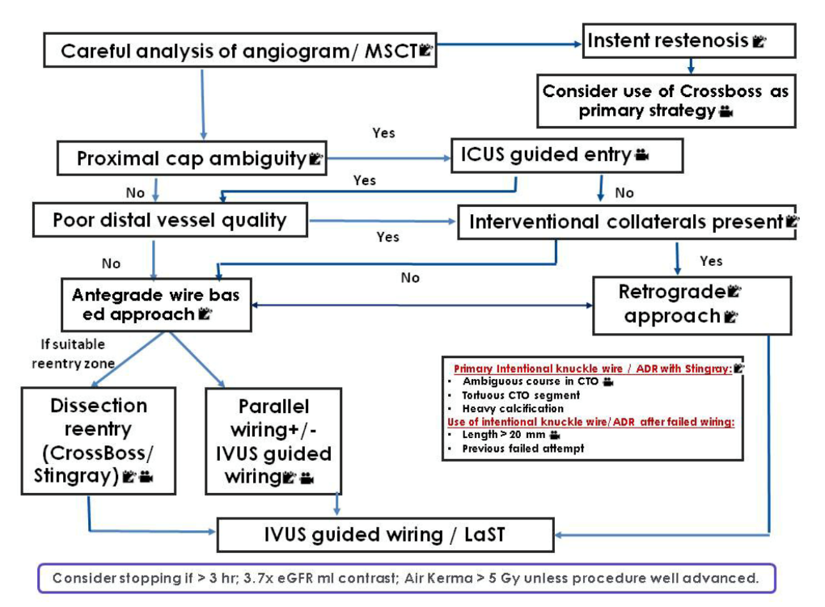
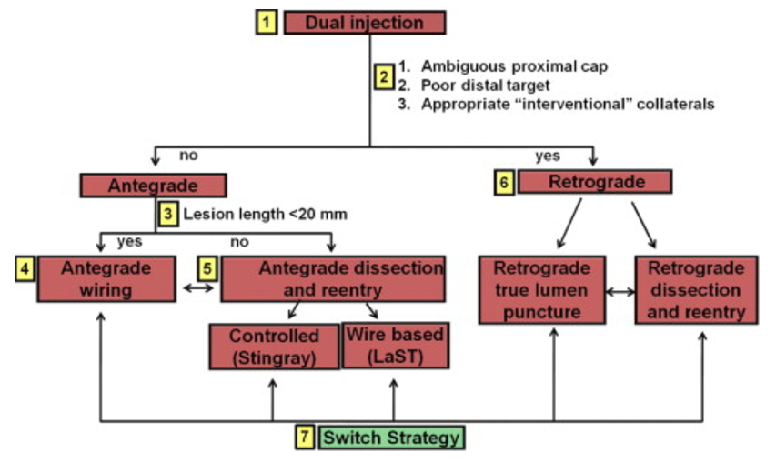
Background
Hybrid algorithm
ADR as the initial crossing strategy
≥20 mm in length; clearly defined proximal cap; large size distal vessel
Asia-Pacific algorithm
parallel wiring and intravascular ultrasound-guided crossing
Brilakis et al. JACC Cardiovascular Interventions 2012;5:367-79.; http://apcto.club/apcto-algorithm/
Notes:
3
This is the Bulleted List slide.
To create this particular slide, click the NEW SLIDE button on your toolbar and choose the BULLETED LIST format. (Top row, second from left)
The Sub-Heading and footnote will not appear when you insert a new slide. If you need either one, copy and paste it from the sample slide.
If you choose not to use a Sub-Heading, let us know when you hand in your presentation for clean-up and we’ll adjust where the bullets begin on your master page.
Also, be sure to insert the presentation title onto the BULLETED LIST MASTER as follows:
Choose View / Master / Slide Master from your menu.
Select the text at the bottom of the slide and type in a short version of your presentation title.
Click the SLIDE VIEW button in the lower left hand part of your screen to return to the slide show. (Small white rectangle)

Slide 5
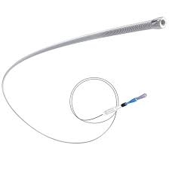
Study design
DESIGN: Investigator-Initiated, multicenter, randomized-controlled, clinical trial.
OBJECTIVE: To compare the upfront use of the CrossBoss catheter vs. antegrade wire escalation for antegrade crossing of coronary chronic total occlusions.
SAMPLE SIZE: 246
SITES: 11 US centers
FUNDING: Boston Scientific Corporation
PRINCIPAL INVESTIGATOR Emmanouil S. Brilakis, MD, PhD

Slide 6
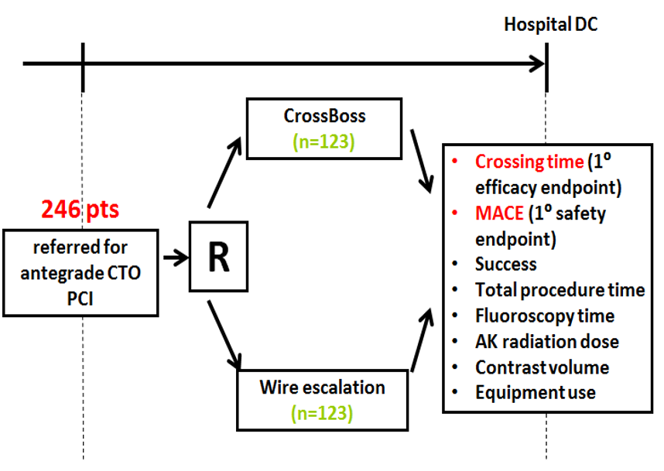
Study design
Notes:
5
This is the Bulleted List slide.
To create this particular slide, click the NEW SLIDE button on your toolbar and choose the BULLETED LIST format. (Top row, second from left)
The Sub-Heading and footnote will not appear when you insert a new slide. If you need either one, copy and paste it from the sample slide.
If you choose not to use a Sub-Heading, let us know when you hand in your presentation for clean-up and we’ll adjust where the bullets begin on your master page.
Also, be sure to insert the presentation title onto the BULLETED LIST MASTER as follows:
Choose View / Master / Slide Master from your menu.
Select the text at the bottom of the slide and type in a short version of your presentation title.
Click the SLIDE VIEW button in the lower left hand part of your screen to return to the slide show. (Small white rectangle)

Slide 7
Sample size calculation
t_{t} = 66.0 ± 55 minutes
t_{c} = 46.2 ± 55 minutes
(30% relative reduction)
α = 0.05 (2-sided)
Power = 0.80
n per group = 123
total N = 246

Slide 8
Study flowchart
Notes:
7
This is the Bulleted List slide.
To create this particular slide, click the NEW SLIDE button on your toolbar and choose the BULLETED LIST format. (Top row, second from left)
The Sub-Heading and footnote will not appear when you insert a new slide. If you need either one, copy and paste it from the sample slide.
If you choose not to use a Sub-Heading, let us know when you hand in your presentation for clean-up and we’ll adjust where the bullets begin on your master page.
Also, be sure to insert the presentation title onto the BULLETED LIST MASTER as follows:
Choose View / Master / Slide Master from your menu.
Select the text at the bottom of the slide and type in a short version of your presentation title.
Click the SLIDE VIEW button in the lower left hand part of your screen to return to the slide show. (Small white rectangle)

Slide 9
Participating centers
Massachusetts General Hospital, MA,
F. Jaffer
University of Washington Medical Center, WA,
W. Lombardi
Minneapolis Heart Institute, MN,
N Burke
United Heart and Vascular Clinic, MN
B Murad
Henry Ford, MI,
K Alaswad
Deborah Heart and Lung Center, NJ
KA Sanghvi
North Central Heart/Avera Heart Hospital, SD
SC Halligan
Mid America Heart Institute, MO,
JA Grantham
Wellspan Heart and Vascular, PA
WJ Nicholson
Missouri Heart Center, MO
AJ Speady
UT Southwestern and Dallas VAMC, TX,
ES. Brilakis

Slide 10
Enrollment by centers
 | Site PI | Randomized
North Central Heart/ Avera Heart Hospital | Dr. Halligan | 32
Wellspan Heart and Vascular | Dr. Nicholson | 29
Missouri Heart Center | Dr. Spaedy | 28
Massachusetts General Hospital | Dr. Jaffer | 25
St. Luke's Mid America Heart Institute | Dr. Grantham | 24
University of Washington Medical Center | Dr. Lombardi | 21
Minneapolis Heart Institute | Dr. Burke | 19
Henry Ford Hospital | Dr. Alaswad | 16
Deborah Heart and Lung Center | Dr. Sanghvi | 9
United Heart and Vascular Clinic | Dr. Murad | 7
Dallas VA Medical Center (Coordinating Center) | Dr. Brilakis | 36
Total Randomized |  | 246

Slide 11
Baseline clinical characteristics I
Variable | CrossBoss | Guidewire | P value
 | (n=122) | (n=124)
Age (years) | 65±11 | 66±10 | 0.269
Men, % | 85 | 79 | 0.244
BMI (kg/m2)ª | 31±7 | 31±7 | 0.792
Diabetes Mellitus, % | 37 | 36 | 1.000
Hypertension, % | 87 | 89 | 0.701

Slide 12
Baseline clinical characteristics II
Variable | CrossBoss | Guidewire | P value
 | (n=122) | (n=124)
LVEF (%)ª | 52±10 | 52±14 | 0.885
Congestive Heart Failure, % | 30 | 20 | 0.101
Prior Myocardial Infarction, % | 44 | 42 | 0.796
Prior CABG, % | 28 | 23 | 0.466
Prior CVD, % | 7 | 10 | 0.649
Prior PAD, % | 12 | 14 | 0.850
Baseline creatinine (mg/dL)^{b} | 1.0 (0.9, 1.2) | 1.0 (0.9, 1,2) | 0.511
a: mean ± standard deviation, b: median (interquartile ranges)

Slide 13
Angiographic characteristics I
Variable | CrossBoss | Guidewire | P value
 | (n=122) | (n=124)
CTO Target Vessel, % |  |  | 0.735
▪ RCA | 65 | 64
▪ LAD | 18 | 20
▪ LCX | 17 | 15
▪ Other (LM) | 0 | 0.8
Calcification (moderate/severe), % | 42 | 46 | 0.523
Proximal vessel tortuosity (moderate/severe), % | 26 | 23 | 0.553

Slide 14
Angiographic characteristics II
Variable | CrossBoss | Guidewire | P value
 | (n=122) | (n=124)
Proximal cap ambiguity, % | 16 | 15 | 1.000
In-stent restenosis, % | 23 | 23 | 1.000
Proximal vessel diameter (mm)^{b} | 2.6 (2.3, 3.1) | 2.6 (2.2, 2.9) | 0.384
Occlusion length (mm)^{b} | 23 (12, 35) | 20 (11, 37) | 0.799
J-CTO scoreª | 2.02±1.10 | 2.12±1.22 | 0.511
Progress CTO scoreª | 0.91±0.94 | 0.95±0.96 | 0.731
a: mean ± standard deviation, b: median (interquartile ranges)

Slide 15
Crossing strategies
Variable | CrossBoss | Guidewire | P value
 | (n=122) | (n=124)
Technical Success, % | 88.5 | 87.1 | 0.846
First Crossing Strategy, % |  |  | <.0001
▪ Antegrade wire escalation | 22 | 98
▪ Antegrade dissection and re-entry | 77 | 1
▪ Retrograde | 1 | 1
Successful Crossing Strategy, % |  |  | <.0001
▪ Antegrade wire escalation | 24 | 51
▪ Antegrade dissection and re-entry | 50 | 22
▪ Retrograde | 18 | 17
▪ None | 8 | 10

Slide 16
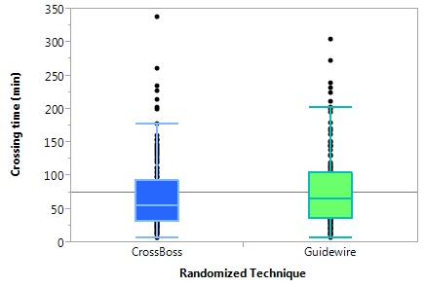
Primary endpoints
Crossing time
Procedural MACE
p= 0.323
p= 1.000
Variable | CrossBoss | Guidewire | P value
 | (n=122) | (n=124)
Crossing time (min)^{b} | 56 (33, 93) | 66 (36, 105) | 0.323
Standardized mean difference: 0.094
b: median (interquartile ranges)

Slide 17

Primary endpoints: ISR cases
Crossing time
Procedural MACE
p= 0.046
p= 0.302
Variable | CrossBoss | Guidewire | P value
 | (n=25) | (n=24)
Crossing time (min)^{b} | 41 (23, 58) | 66 (32, 111) | 0.046
Standardized mean difference: 0.534

Slide 18
Procedural characteristics and outcomes
Variable | CrossBoss | Guidewire | P value
 | (n=122) | (n=124)
Procedural Success, % | 85.3 | 83.1 | 0.634
Total procedural time (min) ^{b} | 109 (78, 185) | 109 (75, 161) | 0.670
Total fluoroscopy time (min) ^{b} | 40 (28, 66) | 37 (24, 65) | 0.339
Total AK radiation dose | 2.18 (1.23, 3.56) | 2.34 (1.23, 3.91) | 0.752
Contrast volume^{b} | 260 (168, 350) | 250 (155, 329) | 0.492
Fluoroscopy time (min)^{b} at crossing | 20 (11, 44) | 25 (12, 48) | 0.638
AK radiation dose at crossing | 0.88 (0.48, 1.97) | 1.08 (0.33, 2.44) | 0.644
b: median (interquartile ranges)

Slide 19
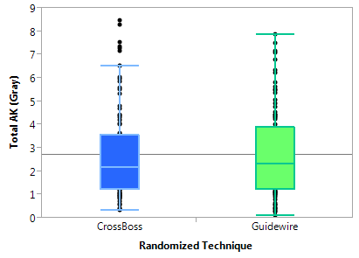
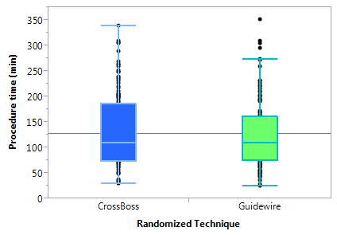
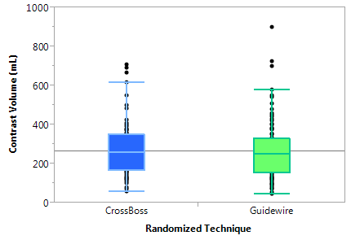
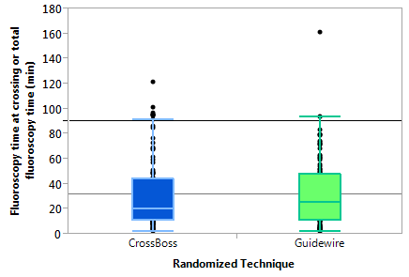
Secondary endpoints
Total air kerma radiation dose
Total procedure time
p=0.752
p=0.670
Fluoroscopy time at crossing or total fluoroscopy time
Contrast volume
p=0.638
p=0.492

Slide 20
Procedural MACE
Variable, % | CrossBoss | Guidewire | P value
 | (n=122) | (n=124)
Procedural MACE | 3.28 | 4.03 | 1.000
Death | 1.64 | 0.81 | 0.620
Acute Q wave MI | 0.82 | 0 | 0.496
Acute MI | 2.46 | 0.81 | 0.368
Re-PCI | 0.00 | 0.81 | 1.000
Stroke | 0.00 | 0.81 | 1.000
Emergency CABG | 0 | 0
Pericardiocentesis | 0.00 | 3.23 | 0.060
Perforation | 1.64 | 7.26 | 0.122

Slide 21
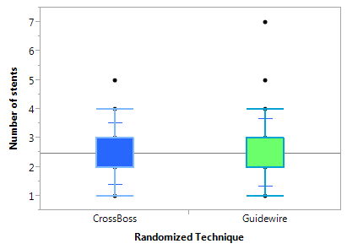
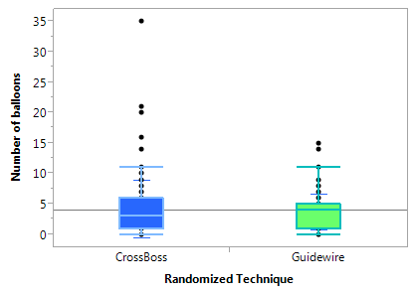
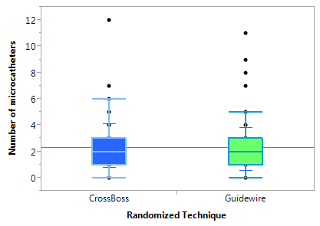
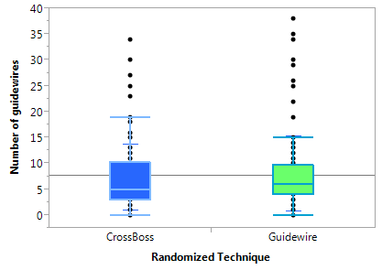
Equipment utilization
Number of stents used
Number of balloons used
p=0.761
p= 0.274
Number of microcatheters used
Number of guidewires used
p=0.122
p= 0.465

Slide 22
Equipment costs

Slide 23
Limitations
Operators experienced in CTO PCI
In 22% of patients randomized to the CrossBoss group crossing was achieved by advancing a guidewire through the CrossBoss catheter
Initially selected strategy was not used in 3 cases of the CrossBoss group and 2 cases of the guidewire group (repeat angiographic assessment with dual injection)
Subject to both type I and type II error – not powered for primary safety endpoint

Slide 24
Conclusions
As compared with a primary wire escalation strategy, upfront use of the CrossBoss catheter for crossing CTOs was associated with:
  similar crossing time
  similar success and procedural MACE rates
  similar equipment costs
Further studies are needed to determine whether some subgroups (such as in-stent occlusions) are better suited for crossing using the CrossBoss catheter.

