Slide 1
Effect of Exenatide Once-Weekly on Clinical Outcomes in Patients with Type 2 Diabetes Mellitus and Cardiovascular Disease: Insights from the EXSCEL Trial
Robert J. Mentz, M. Angelyn Bethel, Peter Merrill, Yuliya Lokhnygina, John B. Buse, Juliana C. Chan, Jasmine Choi, Stephanie M. Gustavson, Nayyar Iqbal, Aldo P. Maggioni, Steven P. Marso, Peter Öhman, Neha J. Pagidipati, Neil Poulter, Ambady Ramachandran, Bernard Zinman, Rury R. Holman and Adrian F. Hernandez
On behalf of the EXSCEL Study Group
American Heart Association Session 2017 – Anaheim, CA
Monday, November 13, 2017

Slide 2
EXSCEL
Large, pragmatic, international trial (N=14,752; 687 sites in 35 countries)
Investigated the effects of once weekly GLP-1 receptor agonist, exenatide 2mg injection, on CV-related outcomes in patients with T2DM
Double-blind, placebo-controlled
Academically led by the Diabetes Trials Unit, University of Oxford and the Duke Clinical Research Institute in collaboration with industry sponsorship
ClinicalTrials.gov number: NCT01144338
Mentz RJ, et al. Am Heart J 2017;187:1-9.
Holman RR, et al. NEJM 2017;377:1228-1239.

Slide 3
EXSCEL: Study Design
EXENATIDE ONCE WEEKLY
~14,000 Patients
Safety Follow-up
(70-days)
PLACEBO ONCE WEEKLY
Randomization
(double blind)
1w 2m 6m 1y
Visits every 6 months
End of Treatment
Minimum 1360 primary events
Key Inclusion Criteria
T2DM, HbA1c 6.5-10%
Any level of CV risk
~70% with prior CV event
  Prior coronary, cerebrovascular or peripheral vascular event or stenosis
Key Exclusion Criteria
T1DM
≥2 episodes severe hypoglycemia prior 12 mos
eGFR <30mL/min/1.73m²
Prior pancreatitis

Slide 4
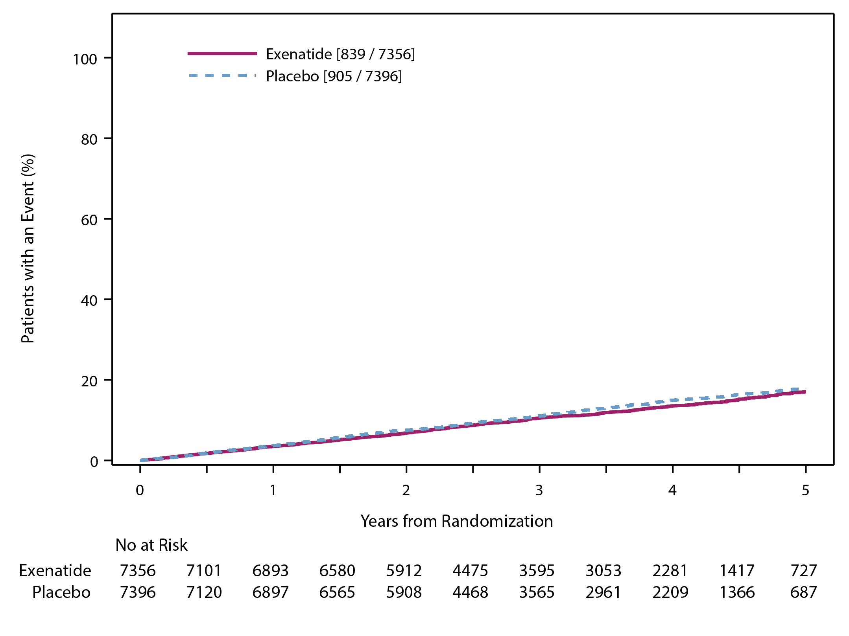
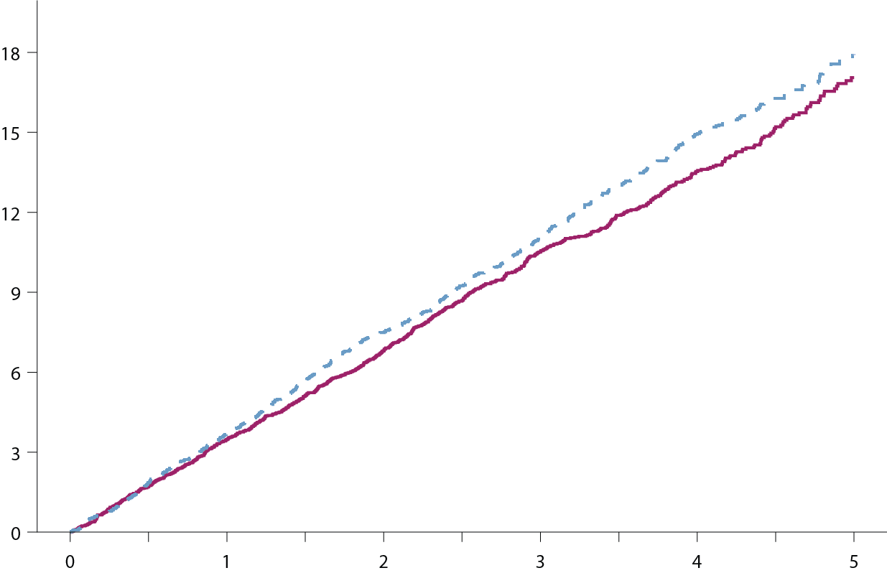
Primary Endpoint: CV Death, Non-fatal MI and Non-fatal stroke (MACE)
HR (95% CI) 0.91 (0.83, 1.00)
P value (non-inferiority) <.001
P value (superiority) 0.061
Placebo
(905/7396; 12.2%)
Exenatide
(839/7356; 11.4%)
Median
Follow-up=
3.2 yr (2.2-4.4)
Holman RR, et al. NEJM 2017;377(13):1228-1239.

Slide 5
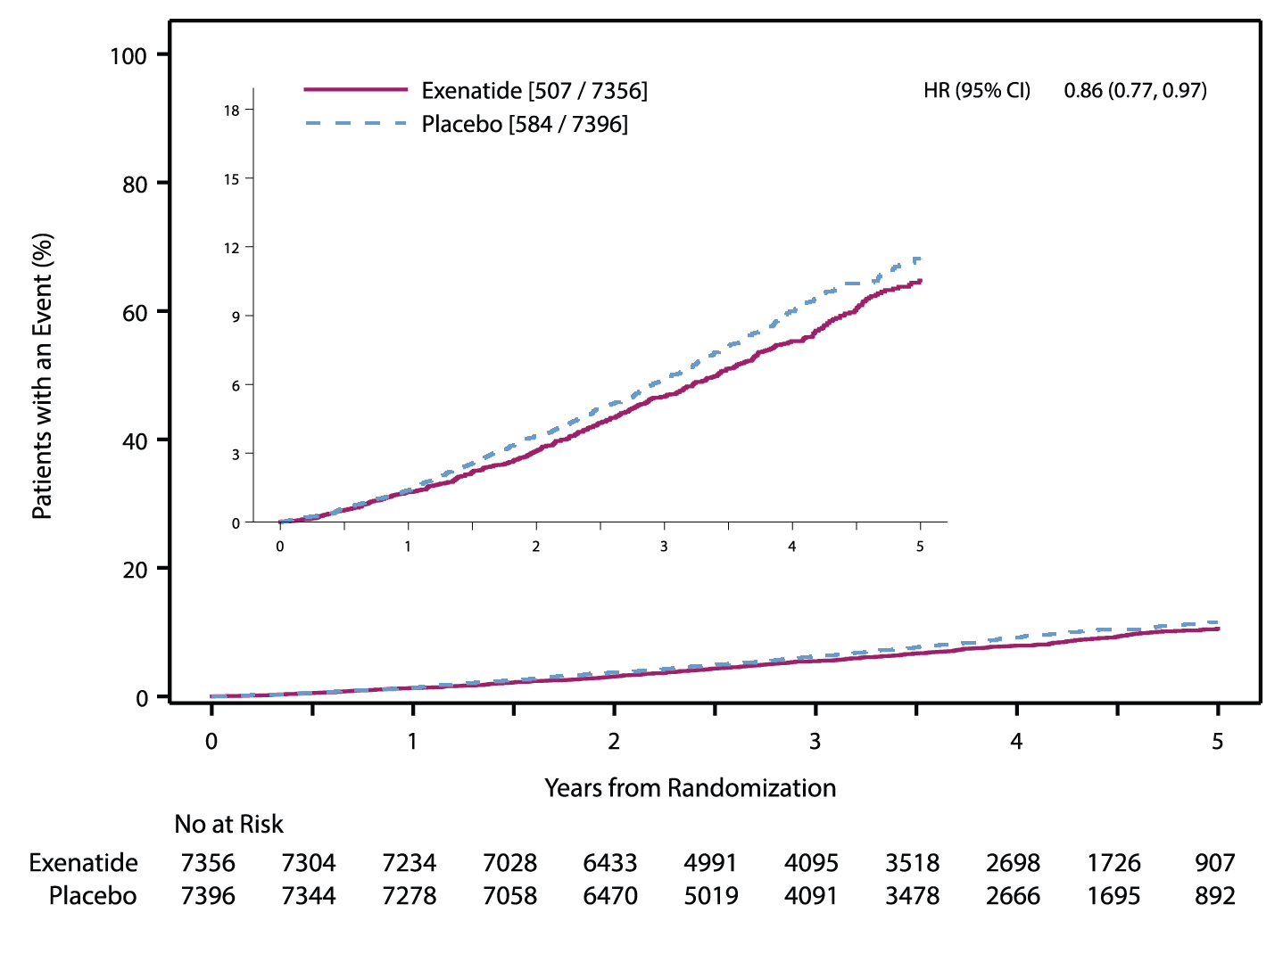
All-Cause Mortality
HR (95% CI) 0.86 (0.77, 0.97)
Nominal P value 0.016
Placebo
(584/7396; 7.9%)
Exenatide
(507/7356; 6.9%)
Holman RR, et al. NEJM 2017;377(13):1228-1239.

Slide 6
Unanswered Question and Aims
Does the magnitude of the treatment effect depend on a patient’s baseline risk?
Create a risk score for the endpoints of all-cause mortality and MACE based on baseline characteristics
Evaluate whether the magnitude of the treatment effect depends on a patient’s risk profile

Slide 7
Hypothesis
Patients at increased risk for mortality and MACE experience a comparatively greater treatment benefit with exenatide than those at lower risk.

Slide 8
Methods
Predictive model using stepwise selection of baseline characteristics
  Wald p-value <0.05 was used for both forward and backward steps
  Model validated using an optimism-corrected c-index statistic
Risk analysis
  A risk score was calculate for each patient
  A new time to event model for each endpoint was developed including calculated risk score, treatment assignment and their interaction
  Interaction p-values reported
  HR and 95% CI for treatment as a function of the risk score

Slide 9
Baseline Characteristics by Mortality Status (1/2)
Characteristic | All-cause Death N=1091 (7.4%) | No Death n=13661 (92.6%)
Age (years) | 67 (61, 73) | 62 (56, 68)
Women | 29.4% | 38.7%
Region Europe North America Latin America Asia Pacific | 46.7% 32.6% 14.4% 6.2% | 46.0% 24.5% 18.8% 10.7%
Diabetes Duration (years) | 13 (8, 20) | 11 (7, 17)
Prior CV Event | 85.0% | 72.1%
Prior MI | 45.6% | 30.6%
Prior coronary revascularization | 48.7% | 39.3%
Current/Former Smoker | 58.0% | 50.4%
Values are median (IQR) for continuous variables or % for categorical variables.

Slide 10
Baseline Characteristics by Mortality Status (2/2)
Characteristic | All-cause Death N=1091 | No Death n=13661
Hypertension | 91.2% | 83.3%
Cerebrovascular disease | 26.1% | 17.8%
Heart Failure | 32.3% | 14.9%
Atrial Fibrillation | 14.4% | 6.2%
Chronic Respiratory Disease | 13.7% | 7.8%
Body Mass Index (kg/m²) | 32.0 (28.0, 36.8) | 31.8 (28.3, 36.1)
Systolic Blood Pressure (mmHg) | 135 (123, 146) | 135 (124, 145)
HbA1c (%) | 8.1 (7.4, 8.9) | 8.0 (7.3, 8.9)
eGFR (mL/min/1.73 m²) | 66.7 (53.0, 85.0) | 77.0 (62.0, 92.5)

Slide 11
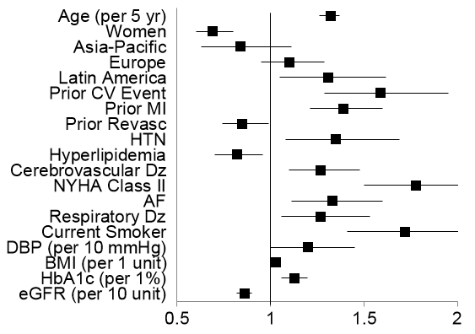
Multivariable Model for Mortality
Demographics
PMH
Exam and Labs
Adjusted OR (95% CI)

Slide 12
Mortality Model Performance
Uncorrected C-index = 0.74
Optimism Corrected C-index = 0.73
Calibration Plot for All-cause Death
Predicted probability matches what observed
Notes:
C-statistic: Discrimination of Case vs control – DISCRIMINATION is FAIR
Calibration: How well predicts risk

Slide 13
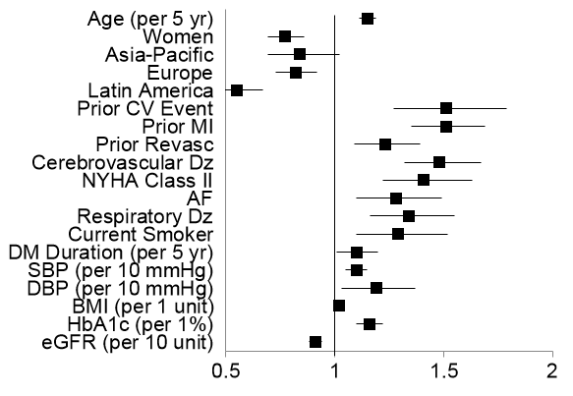
Multivariable Model for MACE
Demographics
PMH
Exam and Labs
Adjusted OR (95% CI)
Notes:
No HTN or HLD vs. ACM

Slide 14
MACE Model Performance
Uncorrected C-index = 0.72
Optimism Corrected C-index = 0.71
Calibration Plot for MACE
Overestimates
Observed Risk

Slide 15
Primary Results
Interaction Effect between Treatment Assignment and Risk Profile
Endpoint | Interaction p-value
All-cause mortality | 0.20
MACE | 0.79
No evidence of an interaction between
treatment and hazard profile for either endpoint

Slide 16
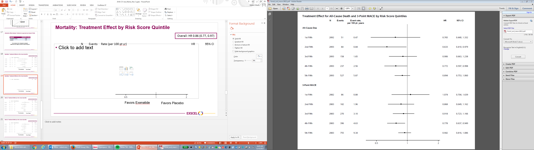
Mortality: Treatment Effect by Risk Score Quintile
Overall: HR 0.86 (0.77, 0.97)
N Events Rate (per 100 pt yr) HR 95% CI
Favors Exenatide
Favors Placebo

Slide 17
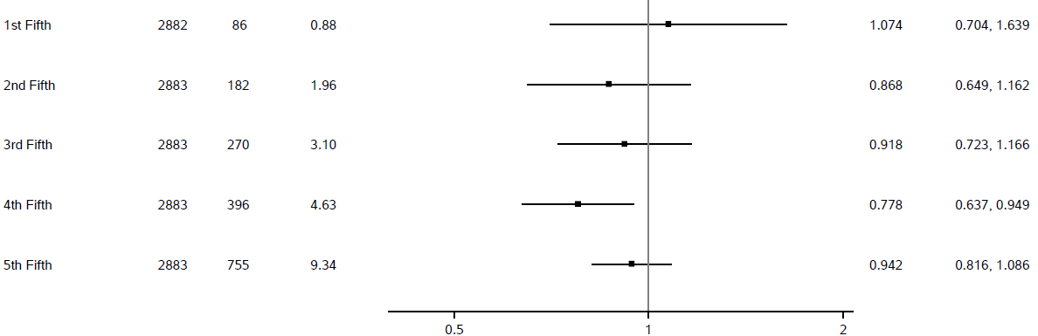
MACE: Treatment Effect by Risk Score Quintile
Overall: HR 0.91 (0.83, 1.00)
N Events Rate (per 100 pt yr) HR 95% CI
Favors Exenatide
Favors Placebo

Slide 18
Summary
Independent predictors of risk included demographic features, CV and non-CV comorbidities, exam parameters (BMI, DBP) and laboratories (A1c, eGFR)
Risk models with modest discrimination for mortality and MACE
There was no evidence of a differential effect of exenatide on clinical outcomes based on baseline risk

Slide 19
Conclusions
Baseline characteristics including age, prior CV events, comorbidity burden and laboratories provided prognostic value for mortality and MACE in the EXSCEL trial population
The effects of exenatide on mortality and MACE were consistent across the spectrum of baseline risk

