Slide 1
A DIGITAL, END-TO-END, NATIONWIDE, PRAGMATIC TRIAL OF SCREENING FOR UNDIAGNOSED ATRIAL FIBRILLATION: PRIMARY RESULTS OF THE mSToPS TRIAL
Steven R. Steinhubl, MD
@stevesteinhubl
Scripps Translational Science Institute

Slide 2
Background – Atrial Fibrillation (AF)
For adults >55, 37% lifetime risk of developing AF
AF is associated with a 2-fold increased risk in mortality & 5-fold increase for stroke.
Once recognized, therapeutic anticoagulation can decrease the risk of stroke by 2/3rds, mortality by 30%.
Weng L-C. Circulation 2017;CIRCULATIONAHA.117.031431 Lin HJ. Stroke 1995;26:1527-30
Aguilar MI. The Cochrane database of systematic reviews. 2005;3:Cd001927

Slide 3
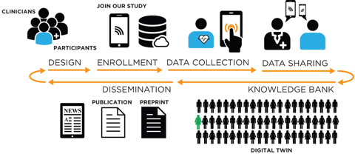
Background – Transforming Clinical Trials
Only 1.7% of eligible patients are enrolled in clinical trials
< 1/3 of RCTs meet their original recruitment targets.
88% of US adults use the internet and 77% own a smartphone
McDonald AM. Trials 2006;7:9 https://doi.org/10.1186/1745-6215-7-9 Murthy VH. JAMA 2004;291:2720-2726 Steinhubl SR. Lancet 2017;390:2135

Slide 4

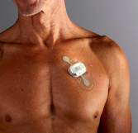




mHealth Screening To Prevent Strokes (mSToPS) Overview
Members

Slide 5

Primary Objective
In the context of a digital clinical trial, determine if participant-generated data available through a wearable ECG patch can improve the identification of AF relative to routine care.

Slide 6
359,161 Aetna members meeting eligibility criteria
52,553 invited by email
50,000 invited by direct mail
2,655 consented & confirmed eligible
R
Main Inclusion Criteria | Main Exclusion Criteria
Age ≥ 75 years old, OR | History of atrial fibrillation or flutter, or atrial tachycardia
Males age >55, females >65 AND | Chronic Anticoagulation
Prior CVA, OR | Implantable Pacemaker or ICD
Heart Failure Diagnosis, OR
Diagnosis of Diabetes and HTN, OR
Obstructive Sleep Apnea, OR
1,364 randomized to immediate monitoring
1,291 randomized to delayed monitoring
456 never wore a patch
457 never wore a patch
908 actively monitored
Primary Endpoint
New Diagnosis of AF after 4 months
834 actively monitored
Additional Study Endpoints

Slide 7
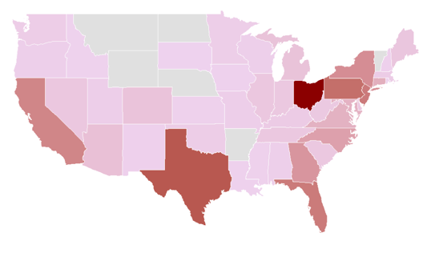

Baseline Demographics
 | Immediate n=1364 | Delayed n=1291 | p-value
Age (mean, SD) | 73.5 (7.3) | 73.1 (7.1) | 0.12
% Female | 38.2 | 39.0 | 0.66
CHA₂DS₂-VASc (median, Q1-Q3)) | 3 (2-4) | 3 (2-4) | 0.82
Prior Stroke (%) | 13.7 | 14.0 | 0.82
Heart Failure (%) | 5.1 | 4.6 | 0.56
Hypertension (%) | 77.1 | 76.8 | 0.86
Diabetes (%) | 38.7 | 36.5 | 0.24
Sleep Apnea (%) | 24.9 | 29.0 | 0.02
Hx of MI (%) | 5.5 | 5.6 | 0.93
Obesity (%) | 17.3 | 18.4 | 0.45
Chronic Renal Failure (%) | 10.9 | 9.6 | 0.29

Slide 8
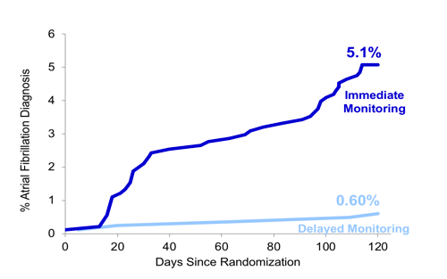
Primary 4-Month Endpoint – New Diagnosis AF
Definition of Atrial Fibrillation
> 30 consecutive seconds of AF by ECG. (CEC adjudicated), or
A new diagnosis of AF through claims data. (A single new ICD9 or ICD10 code)
OR 8.8
95%CI 3.5-22.4
P<0.0001
For ITT population
OR 9.0
95%CI 3.6-22.7
P<0.0001

Slide 9
359,161 Aetna members meeting eligibility criteria
5,310 observational controls matched for age, sex and CHADS-VASc score
2,655 consented & confirmed eligible
R
1,364 randomized to immediate monitoring
1,291 randomized to delayed monitoring
456 never wore a patch
457 never wore a patch
908 actively monitored
Primary Endpoint
New Diagnosis of AF after 4 months
834 actively monitored
1,738 actively monitored participants with 12 months follow-up
New Diagnosis of AF 12 months
3,476 matched observational controls with 12 months follow-up

Slide 10
1-Year New Diagnosis of AF
Unadjusted OR 2.8
95%CI 2.1 – 3.7
P<0.0001
Actively Monitored
Adjusted OR 3.0
95%CI 2.2 – 4.0
P<0.0001
Observational, Matched Controls

Slide 11
Characteristics of Sensor-Detected AF
Median duration of longest AF episode 185.5 minutes
92.8% > 5 minutes
37.7% > 6 hours
Median total AF burden during monitoring was 0.9%
Average patch wear time 11.7 days
Median time until first AF detection 2 days (IQR 1-5)

Slide 12
Clinical Outcomes & Resource Use of ECG Monitoring
 | Actively Monitored (n=1,738) | Matched Controls (n=3,476) | p-value | Actively Monitored with AF (n=109) | Matched Controls with AF (n=81) | p-value
Stroke | 33 (1.9%) | 71 (2.0%) | 0.73 | 2 (1.8%) | 11 (13.6%) | 0.002
Myocardial Infarction | 31 (1.78%) | 64 (1.84%) | 0.88 | 7 (6.4%) | 15 (18.5%) | 0.01
Systemic thromboembolism | 0 (0.00%) | 1 (0.03%) | 1.00 | 0 (0.0%) | 1 (1.2%) | 0.43
All-cause Outpatient Office Visit to a PCP, n (%) | 1,368 (78.7%) | 2,606 (75.0%) | 0.003 | 89 (81.7%) | 69 (85.2%) | 0.52
All-cause Outpatient Office Visit to a Cardiologist, n (%) | 549 (31.6%) | 819 (23.6%) | <0.0001 | 76 (69.7%) | 53 (65.4%) | 0.53
All-cause ER or inpatient stays, median (Q1-Q3) | 369 (21.2%) | 748 (21.5%) | 0.81 | 38 (34.9%) | 53 (65.4%) | <0.0001
Placement of a pacemaker/defibrillator, n (%) | 13 (0.7%) | 0 (0.0%) | <0.0001 | 6 (5.5%) | 0 (0.0%) | 0.04
Pharmacy fill for an anticoagulant, n (%) | 94 (5.4%) | 117 (3.4%) | 0.0004 | 39 (35.8%) | 40 (49.4%) | 0.06

Slide 13
Limitations
The clinical significance of ‘short’ episodes of AF, especially in terms of stroke risk, requires greater clarity.
Only 5.4% of individuals receiving an email invitation enrolled, although this is in a population with an average age of ~74.
A substantial proportion (38%) of individuals who initially consented never wore a monitoring patch.

Slide 14
Conclusions
Through remote digital enrollment and use of participant-generated data, we observed a markedly improved rate of AF diagnosis (~9-fold short term, ~3-fold long-term) relative to routine care.
Monitoring was associated with greater initiation of guideline-recommended therapies
But also increased healthcare resource utilization at 1 year.

Slide 15




Thank you
To all of the mSToPS participants
& co-investigators:
Jill Waalen, Alison M. Edwards, Lauren M. Ariniello, Rajesh R. Mehta, Gail S. Ebner, Chureen Carter, Katie Baca-Motes, Elsie Felicione, Troy Sarich,
Eric J. Topol

