Slide 1
A Randomized Trial Comparing a Polymer-Free Coronary Drug-Eluting Stent With an Ultra-Thin Strut Bioresorbable Polymer-Based Drug-Eluting Stent in an All-Comers Patient Population
Lisette Okkels Jensen
Lisette Okkels Jensen, Michael Maeng, Bent Raungaard, Johnny Kahlert, Julia Ellert, Lars Jakobsen, Anton Villadsen, Karsten Tange Veien, Steen Dalby Kristensen, Ole Ahlehoff, Steen Carstensen, Martin Kirk Christensen, Christian Juhl Terkelsen, Thomas Engstroem, Knud Nørregaard Hansen, Hans Erik Botker, Jens Aaroee, Troels Thim, Leif Thuesen, Philip Freeman, Ahmed Aziz, Ashkan Eftekhari, Anders Junker, Jens Flensted Lassen, Svend Eggert Jensen, Henrik Steen Hansen, Evald Hoej Christiansen
ODENSE UNIVERSITY HOSPITAL, AARHUS UNIVERSITY HOSPITAL, AALBORG UNIVERSITY HOSPITAL, COPENHAGEN UNIVERSITY HOSPITAL
DENMARK
SORT OUT IX

Slide 2
Disclosure Statement of Financial Interest
Speaker's name: Lisette Okkels Jensen, professor MD DMSci PhD
I have the following potential conflicts of interest to report:
Honorarium:
BIOTRONIK
Institutional grant/research support:
BIOSENSORS INTERNATIONAL, BIOTRONIK, TERUMO
SORT OUT IX

Slide 3
Background
Persistence of polymer material on first and second generation drug-eluting stent after completion of drug release has been suggested to be a trigger of a chronic inflammatory response
Drug-eluting stents with biodegradable polymers have been designed to improve safety and efficacy
In patients with increased bleeding risk during dual antiplatelet therapy, the biolimus A9-coated BioFreedom stent devoid of polymer, has shown superiority compared to a bare metal stent
SORT OUT IX
Notes:
2
This is the Bulleted List slide.
To create this particular slide, click the NEW SLIDE button on your toolbar and choose the BULLETED LIST format. (Top row, second from left)
The Sub-Heading and footnote will not appear when you insert a new slide. If you need either one, copy and paste it from the sample slide.
If you choose not to use a Sub-Heading, let us know when you hand in your presentation for clean-up and we’ll adjust where the bullets begin on your master page.
Also, be sure to insert the presentation title onto the BULLETED LIST MASTER as follows:
Choose View / Master / Slide Master from your menu.
Select the text at the bottom of the slide and type in a short version of your presentation title.
Click the SLIDE VIEW button in the lower left hand part of your screen to return to the slide show. (Small white rectangle)

Slide 4
Design
SORT OUT IX is a randomized, multicenter, single-blind, all-comers, two-arm, non-inferiority trial comparing the polymer free biolimus A9-coated BioFreedom stent to the biodegradable polymer cobalt-chromium sirolimus-eluting Orsiro stent in patients treated with PCI at 4 hospitals in Denmark
Enrollment December 2015 to April 2017
Clinically driven event detection based on Danish registries
Dual antiplatelet treatment:
Stable angina pectoris 6 months (aspirin + clopidogrel)
Acute coronary syndroms 12 months (aspirin + ticagrelor/prasugrel)
SORT OUT IX

Slide 5
Clinically driven event detection
Enrollment
Primary Endpoint: 12 months
Yearly follow-up through 5 years
CLINICALLY DRIVEN EVENT DETECTION
Danish Civial Registration System
National Patient Registry
Danish Heart Registry
Western Denmark Heart Registry
Death
Hospital admission
Revascularization
Cardiac
Non-cardiac
Cardiac
Non-cardiac
Non-target vessel
Target vessel
Myocardial
infarction
Unstable angina
Stable angina
Target lesion
In-stent restenosis
Stent thrombosis
SORT OUT IX

Slide 6
Objective
Objective: To compare the safety and efficacy of the polymer free biolimus A9-coated BioFreedom stent and the thin strut biodegradable polymer sirolimus-eluting Orsiro stent in an all-comer population
Primary Endpoint: Target lesion failure: a composite of cardiac death, myocardial infarction (not related to other than index lesion) or target lesion revascularization within 1 year
SORT OUT IX

Slide 7
Patient population
Criteria of inclusion
18 years of age or older
Chronic stable coronary artery disease or acute coronary syndromes
Criteria of exclusion
Life expectancy less than one year
Allergy to aspirin, clopidogrel, ticagrelor, sirolimus, or biolimus
Participation in another randomized trial
Unable to provide written informed consent
No restrictions were placed on number of treated lesions, treated vessels or lesion length
SORT OUT IX

Slide 8
Sample size
The trial is powered for assessing non-inferiority of the polymer free biolimus A9-coated BioFreedom stent to the thin strut biodegradable polymer cobalt-chromium sirolimus-eluting Orsiro stent with respect to the primary endpoint at 12 months
An event rate of 4.2% was assumed in each stent group
With a sample size of 1,563 patients in each treatment arm, a two-group large-sample normal approximation test of proportions with a one-sided 0.050 significance level will have 90% power to detect non-inferiority with a non-inferiority margin of 2.1%
SORT OUT IX
Notes:
With a sample size of 1,563 patients in each treatment arm, a two-group large-sample normal approximation test of proportions with a one-sided 0.050 significance level will have 90% power to detect non-inferiority with a predetermined non-inferiority margin of 2.1%

Slide 9
Study stents
ORSIRO |  | BIOFREEDOM
Cobalt-Chromium | Stent material | Stainless steel
60 µm (2.25-3.0 mm stents) 80 µm (>3.0 mm stents) | Strut thickness | 120µm
Poly-L-lactic acid (PLLA) | Polymer material | -
Bioresorbable, circumferential coating, completely degraded in 12-24 months | Polymer type | Polymer- and carrier-free
Amourphous silicon carbide | Passive coating | -
Sirolimus (1.4µg/mm²) 3 months | Antiproliferative drug relase | Biolimus (A9) (15.6µg/mm²) 98% released after 28 days
SORT OUT IX
Notes:
8

Slide 10
Study flow
ENROLLED AND RANDOMIZED (n=3151)
BIOLIMUS-ELUTING STENT BIOFREEDOM (N=1572)
Study stent not implanted n=47
SIROLIMUS-ELUTING STENT ORSIRO (N=1579)
Study stent not implanted n=40
Index PCI
Lost to follow-up
n=2 (emigration)
Lost to follow-up
n=3 (emigration)
Follow-Up
1-year clinical follow-up
n=1570 patients
1-year clinical follow-up
n=1576 patients
Analysis
SORT OUT IX
Notes:
9

Slide 11
Patient characteristics
 |  |  | BIOFREEDOM STENT |  |  | ORSIRO STENT | p
No. of patients |  |  | 1,572 |  |  | 1,579
Age (years) |  |  | 66.4 ± 10.7 |  |  | 66.1 ± 11.1 | 0.35
Male gender |  |  | 77.5 % |  |  | 77.3 % | 0.88
Diabetes |  |  | 19.3 % |  |  | 19.2 % | 0.92
Current smoker |  |  | 29.8 % |  |  | 29.3 % | 0.78
Prior PCI |  |  | 20.9 % |  |  | 20.9 % | 0.59
Prior CABG |  |  | 8.4 % |  |  | 7.0 % | 0.13
Prior myocardial infarction |  |  | 14.7 % |  |  | 15.2 % | 0.53
Body mass Index (kg/m²) |  |  | 27.8 ± 7.5 |  |  | 27.6 ± 8.0 | 0.47
Indication for PCI |  |  |  |  |  |  | 0.62
Stable angina pectoris |  |  | 42.7 % |  |  | 40.8 %
NSTEMI / Unstable angina pectoris |  |  | 28.9 % |  |  | 28.7%
STEMI |  |  | 23.3 % |  |  | 25.1 %
Other |  |  | 5.1 % |  |  | 5.3 %
SORT OUT IX
Notes:
The patients caracteristics were welle balanced.
The mean age was 65 years.
The proportion of males were 75%
The proportion with diabetes was low as in other Nordic trials.
Prior CABG was slightly higher in the Biolimus group.

Slide 12
Lesion characteristics
 |  | BIOFREEDOM STENT | ORSIRO STENT | p
No. of lesions |  | 1,966 | 1,985
No. of lesions per patient |  | 1.3 ± 0.6 | 1.3 ± 0.6 | 0.70
Lesion type B2/C |  | 60.6 | 58.1 | 0.40
Reference vessel size (mm) |  | 3.3 ± 0.6 | 3.3 ± 0.6 | 0.83
No. of stents
 | Per patient | 1.6 ± 0.9 | 1.6 ± 0.9 | 0.28
 | Per lesion | 1.3 ± 0.6 | 1.2 ± 0.6 | 0.13
Total stent length (mm)
 | Per patient | 31.1 ± 21.9 | 30.6 ± 19.8 | 0.48
 | Per lesion | 24.7 ± 16.0 | 24.3 ± 13.6 | 0.32
Direct stenting |  | 8.2 % | 9.8% | 0.21
Stent delivery failure |  | 2.3% | 2.0 % | 0.48
SORT OUT IX
Notes:
The patients caracteristics were welle balanced.
The mean age was 65 years.
The proportion of males were 75%
The proportion with diabetes was low as in other Nordic trials.
Prior CABG was slightly higher in the Biolimus group.

Slide 13
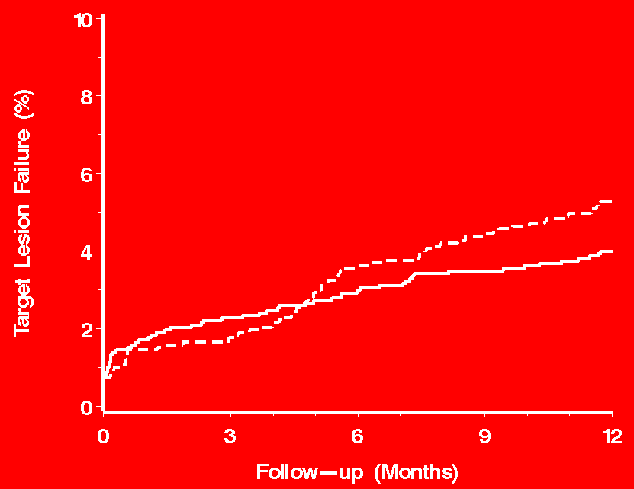
1º Endpoint: Target Lesion Failure
(Cardiac death, myocardial infarction_{index lesion related}, target lesion revascularization)
1Y: BIOFREEDOM 5.3% vs. ORSIRO 4.0% P_{non-inferiority} = 0.010
5.3%
BIOFREEDOM
4.0%
ORSIRO
SORT OUT IX
Notes:
This is the Sample Column Chart slide.
To create this particular slide, copy and paste the sample in the Slide Sorter view as follows:
Select View / Slide Sorter
Highlight the Sample Column Chart page and select Edit / Copy
Place the courser where you want the new slide to be and select Edit / Paste
Double-click on the pasted-in slide to return to Slide view
To access the column chart, right/click on the chart and select chart object / open from the menu. This will open the chart in Microsoft Graph. You can make any changes to the chart and spreadsheet here.
When you are finished making your changes, select File / Exit and return to… from the menu bar.
THIS METHOD IS PREFERRED TO DOUBLE-CLICKING THE GRAPH AND OPENING IT IN POWERPOINT. Double-clicking the graph can sometimes reformat the sizes, colors, animations and fonts in your graph.

Slide 14
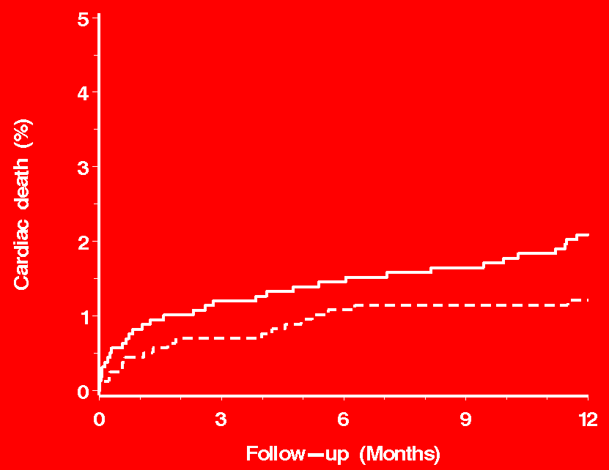
Cardiac death
Rate Ratio 0.57 95% CI 0.33-1.01; p=0.055
ORSIRO
2.1%
1.2%
BIOFREEDOM
SORT OUT IX
Notes:
This is the Sample Column Chart slide.
To create this particular slide, copy and paste the sample in the Slide Sorter view as follows:
Select View / Slide Sorter
Highlight the Sample Column Chart page and select Edit / Copy
Place the courser where you want the new slide to be and select Edit / Paste
Double-click on the pasted-in slide to return to Slide view
To access the column chart, right/click on the chart and select chart object / open from the menu. This will open the chart in Microsoft Graph. You can make any changes to the chart and spreadsheet here.
When you are finished making your changes, select File / Exit and return to… from the menu bar.
THIS METHOD IS PREFERRED TO DOUBLE-CLICKING THE GRAPH AND OPENING IT IN POWERPOINT. Double-clicking the graph can sometimes reformat the sizes, colors, animations and fonts in your graph.

Slide 15
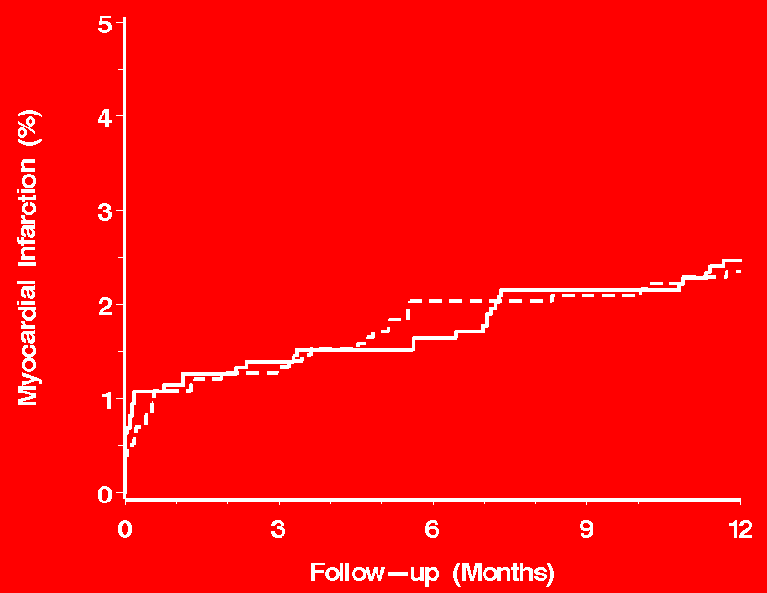
Myocardial infarction
Rate Ratio 0.95 95% CI 0.60-1.49; p=0.81
2.5%
ORSIRO
2.4%
BIOFREEDOM
SORT OUT IX
Notes:
This is the Sample Column Chart slide.
To create this particular slide, copy and paste the sample in the Slide Sorter view as follows:
Select View / Slide Sorter
Highlight the Sample Column Chart page and select Edit / Copy
Place the courser where you want the new slide to be and select Edit / Paste
Double-click on the pasted-in slide to return to Slide view
To access the column chart, right/click on the chart and select chart object / open from the menu. This will open the chart in Microsoft Graph. You can make any changes to the chart and spreadsheet here.
When you are finished making your changes, select File / Exit and return to… from the menu bar.
THIS METHOD IS PREFERRED TO DOUBLE-CLICKING THE GRAPH AND OPENING IT IN POWERPOINT. Double-clicking the graph can sometimes reformat the sizes, colors, animations and fonts in your graph.

Slide 16
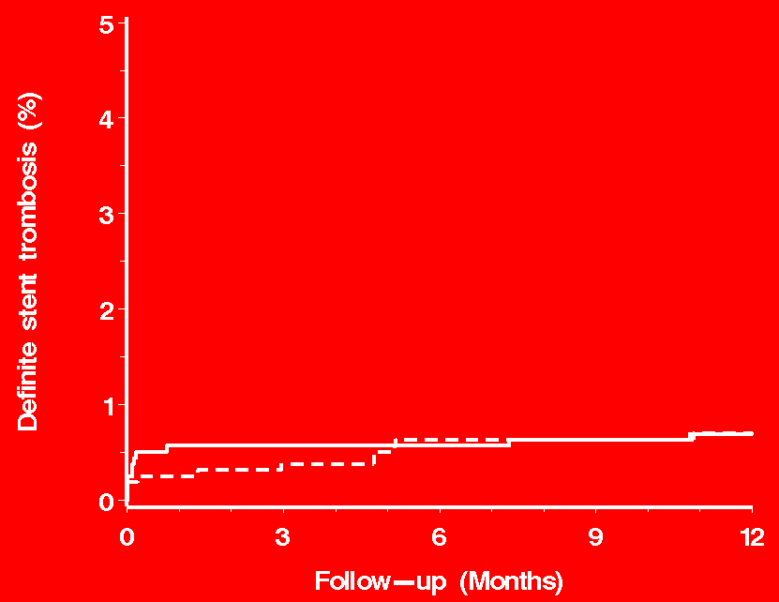
Definite stent thrombosis
Rate Ratio 1.00 95% CI 0.43-2.30; p=0.99
BIOFREEDOM
0.7%
0.7%
ORSIRO
SORT OUT IX
Notes:
This is the Sample Column Chart slide.
To create this particular slide, copy and paste the sample in the Slide Sorter view as follows:
Select View / Slide Sorter
Highlight the Sample Column Chart page and select Edit / Copy
Place the courser where you want the new slide to be and select Edit / Paste
Double-click on the pasted-in slide to return to Slide view
To access the column chart, right/click on the chart and select chart object / open from the menu. This will open the chart in Microsoft Graph. You can make any changes to the chart and spreadsheet here.
When you are finished making your changes, select File / Exit and return to… from the menu bar.
THIS METHOD IS PREFERRED TO DOUBLE-CLICKING THE GRAPH AND OPENING IT IN POWERPOINT. Double-clicking the graph can sometimes reformat the sizes, colors, animations and fonts in your graph.

Slide 17
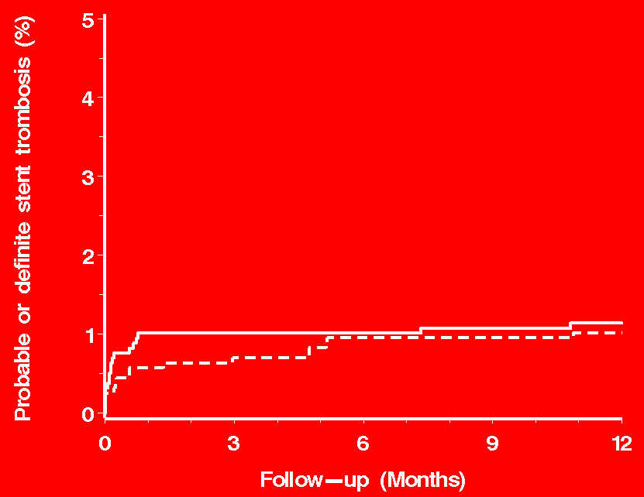
Definite/Probable stent thrombosis
Rate Ratio 0.89 95% CI 0.45-1.74; p=0.73
ORSIRO
1.1%
BIOFREEDOM
1.0%
SORT OUT IX
Notes:
This is the Sample Column Chart slide.
To create this particular slide, copy and paste the sample in the Slide Sorter view as follows:
Select View / Slide Sorter
Highlight the Sample Column Chart page and select Edit / Copy
Place the courser where you want the new slide to be and select Edit / Paste
Double-click on the pasted-in slide to return to Slide view
To access the column chart, right/click on the chart and select chart object / open from the menu. This will open the chart in Microsoft Graph. You can make any changes to the chart and spreadsheet here.
When you are finished making your changes, select File / Exit and return to… from the menu bar.
THIS METHOD IS PREFERRED TO DOUBLE-CLICKING THE GRAPH AND OPENING IT IN POWERPOINT. Double-clicking the graph can sometimes reformat the sizes, colors, animations and fonts in your graph.

Slide 18
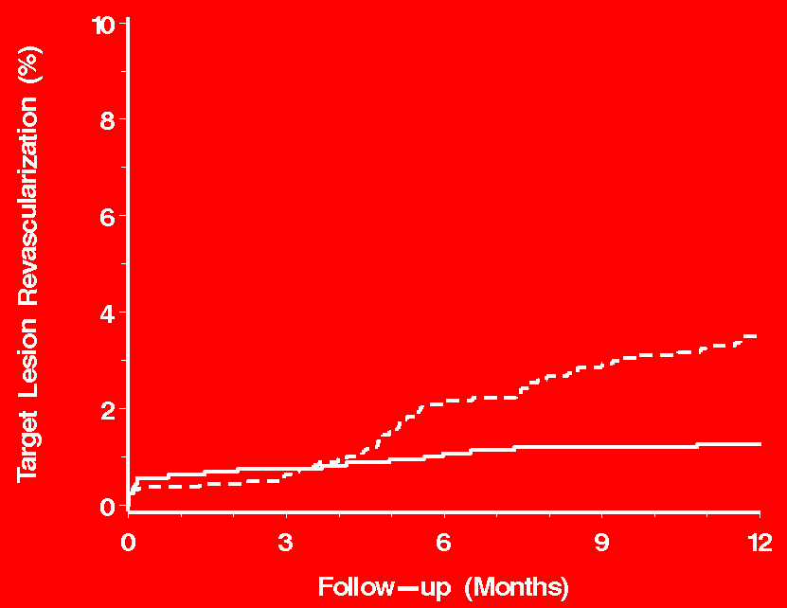
Target lesion revascularization
Rate Ratio 2.77 95% CI 1.66-4.62; p<0.0001
BIOFREEDOM
3.5%
1.3%
ORSIRO
SORT OUT IX
Notes:
This is the Sample Column Chart slide.
To create this particular slide, copy and paste the sample in the Slide Sorter view as follows:
Select View / Slide Sorter
Highlight the Sample Column Chart page and select Edit / Copy
Place the courser where you want the new slide to be and select Edit / Paste
Double-click on the pasted-in slide to return to Slide view
To access the column chart, right/click on the chart and select chart object / open from the menu. This will open the chart in Microsoft Graph. You can make any changes to the chart and spreadsheet here.
When you are finished making your changes, select File / Exit and return to… from the menu bar.
THIS METHOD IS PREFERRED TO DOUBLE-CLICKING THE GRAPH AND OPENING IT IN POWERPOINT. Double-clicking the graph can sometimes reformat the sizes, colors, animations and fonts in your graph.

Slide 19
Target lesion failure
SORT OUT IX
Notes:
This is the Sample Column Chart slide.
To create this particular slide, copy and paste the sample in the Slide Sorter view as follows:
Select View / Slide Sorter
Highlight the Sample Column Chart page and select Edit / Copy
Place the courser where you want the new slide to be and select Edit / Paste
Double-click on the pasted-in slide to return to Slide view
To access the column chart, right/click on the chart and select chart object / open from the menu. This will open the chart in Microsoft Graph. You can make any changes to the chart and spreadsheet here.
When you are finished making your changes, select File / Exit and return to… from the menu bar.
THIS METHOD IS PREFERRED TO DOUBLE-CLICKING THE GRAPH AND OPENING IT IN POWERPOINT. Double-clicking the graph can sometimes reformat the sizes, colors, animations and fonts in your graph.

Slide 20
Conclusion
The polymer free biolimus A9-coated BioFreedom stent was non-inferior to the thin strut, biodegradable polymer sirolimus-eluting Orsiro stent in an all-comer population
The BioFreedom stent had similar safety and risk of definite stent thrombosis as the Orsiro stent
Efficacy was lower in the BioFreedom stent compared to the Orsiro
SORT OUT IX

