Slide 1



The Door to Unload (DTU) STEMI Safety & Feasibility Pilot Trial
2018 American Heart Association
Late Breaking Clinical Science
CONFIDENTIAL DRAFT
  Navin K. Kapur, MD FAHA, FACC, FSCAI
  On Behalf of the DTU-STEMI Investigators
Notes:
1

Slide 2
Background: From Heart Attack to Heart Failure
By the year 2030, 1:33 individuals in the US will have heart failure (HF) and total costs for HF will reach $70 Billion per year.
Despite the contemporary Door to Balloon Strategy, every 5% increase in myocardial infarct size is associated with an increase in 1-year HF hospitalization by 20%
In 1971, Maroko and Braunwald suggested, “that measures designed for reduction of myocardial oxygen demands and improvement of coronary perfusion, when effected promptly might reduce the ultimate size of (a myocardial) infarction.”
Heidenreich et al Circ HF 2013; Stone, Selker, Udelson et al. JACC 2016; Maroko and Braunwald et al Circulation 1971

Slide 3
Background: From Heart Attack to Heart Failure
Since 1978, multiple preclinical studies have tested whether reducing myocardial oxygen consumption by implementing a circulatory support pump limits myocardial damage in an AMI.
Coronary Occlusion
Multi-vessel Disease
Microvascular Function
Heart Rate
LV Wall Stress
LV Stroke Work
Myocardial
Oxygen Supply
Myocardial
Oxygen Demand

Slide 4
40 Years of LV Unloading Science (1978-2018)
Animal Model | Year | Duration of Ischemia (min) | Duration of Reperfusion (min) | Mechanical Support Before or After Reperfusion | Occluded Vessel | Method of Occlusion | Device | Reduction in Infarct Size? | Reference
Canine | 1978 | 480 | X | Before | LAD | Ligation | IABP | Yes | Roberts & Gay [6]
Baboons | 1979 | 1440 | X | Before | LAD | Ligation | IABP | No | Haston & McNamara [7]
Porcine | 1980 | 1440 | X | Before | LAD | Ligation | IABP | No | Laas & Replogle [8]
Porcine | 2008 | 60 | 240 | Before vs After | LAD | Ligation | IABP | Yes / No | Ledoux & Smalling [9]
Canine | 1983 | 240 | X | Before | LAD | Ligation | LA-FA Bypass | Yes | Catinella & Spencer [12]
Porcine | 2013 | 120 | 120 | Before | LAD | Balloon angioplasty | TandemHeart | Yes | Kapur & Karas [13]
Canine | 1989 | 120 | 60 | Before | LAD | Ligation | Hemopump | Yes | Mehrige &Wampler [14]
Canine | 1992 | 120 | 60 | Before | LAD | Snare ligation | Hemopump/IABP | Yes | Smalling & Amirian [15]
Canine | 2005 | 120 | 240 | Before vs After | LAD | Snare ligation | Hemopump | Yes / No | Achour & Smalling [16]
Sheep | 2003 | 60 | 120 | Before vs After | LAD | Ligation | Impella 5.0 | Yes | Meyns & Flameng [17]
Porcine | 2015 | 90 | 120 | Before | LAD | Balloon angioplasty | Impella CP | Yes | Kapur & Karas [18]
Porcine | 2015 | 120 | 120 | Before | LCx | Ligation | Impella LD | Yes | Sun & Wang [20]
Porcine | 2018 | 90 | 120 | Before | LAD | Balloon angioplasty | Impella CP | Yes | Esposito & Kapur [21]
Unloading before not after Reperfusion is required to reduce infarct size
Kapur NK et al JCTR In Press 2018

Slide 5
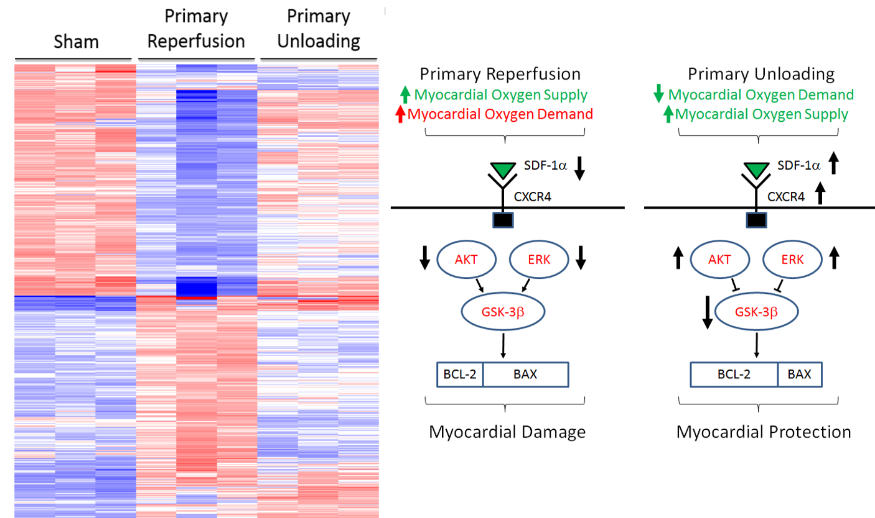
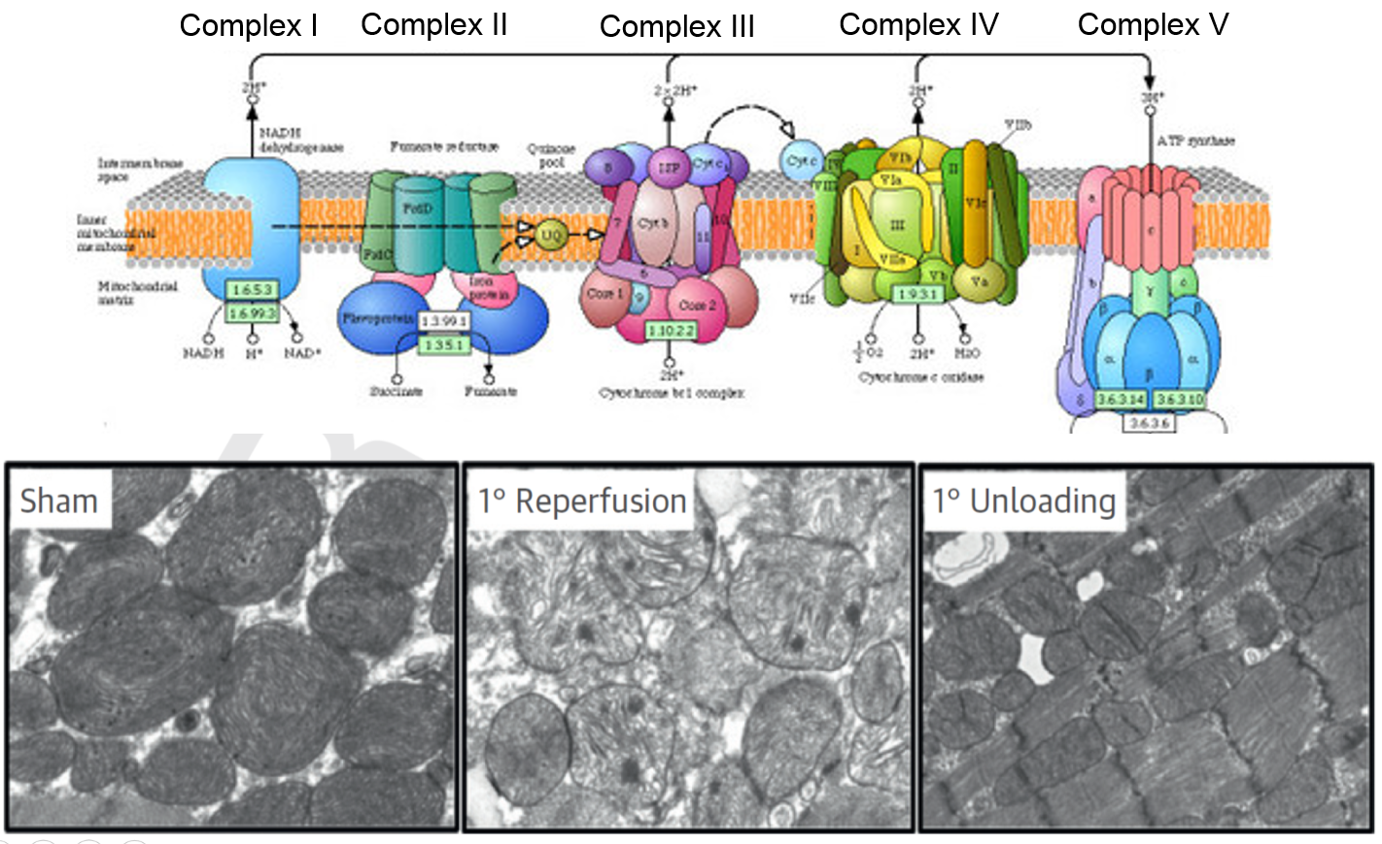
Preclinical Development of the DTU Concept
2012
2018
TandemHeart
Delayed Reperfusion
(Circulation 2013)
Impella CP
Delayed Reperfusion
(JACC HF 2015)
Impella CP
Cardioprotective Biology
(JACC 2018)
Impella CP
Preclinical Pilot
(JACC 2018)
Impella CP
DTU-STEMI Pilot Trial
(Circulation 2018)
Trans-valvular LV Unloading Limits Myocardial Ischemia and Promotes a Cardioprotective Shift in Myocardial Biology
Esposito, Zhang, Qiao and Kapur et al JACC 2018

Slide 6
The Rationale for the DTU Pilot Before the Pivotal
DTU Pivotal
100
DTU
Pilot
?
80
60
Infarct Size / Area at Risk (%)
40
20
0
Reperfusion
Alone
15 min
30 min
Unloading After
Reperfusion
Unloading + Delayed
Reperfusion
Esposito, Zhang, Qiao and Kapur et al JACC 2018

Slide 7
Door To Unload: STEMI Pilot Trial: Central Hypothesis
Compared to LV unloading and immediate reperfusion,
LV unloading followed by a 30 minute delay to reperfusion is feasible and safe as defined by:
Successful enrollment and protocol completion (Feasibility)
No increase in major adverse cardiovascular or cerebral events (MACCE Safety)
No increase in infarct size between groups (Safety)

Slide 8
Door To Unload: STEMI Pilot Trial: Study Design
Door To Unload: STEMI Pilot Trial: Study Design
Phase 1 safety and feasibility multi-center pilot trial
1:1 randomization to either:
LV unloading + immediate reperfusion (U-IR) or
LV unloading + a 30 minute delay before reperfusion (U-DR)
Independent Data Safety Monitor, Electrocardiographic, Angiographic, and Cardiac Magnetic Resonance Imaging Core Labs

Slide 9
Door To Unload: STEMI Pilot Trial: Study Design
Anterior STEMI Referred for Primary PCI
Electrocardiographic Confirmation
Informed Consent and Enrollment
Patient preparation, draping, anti-coagulation, anti-platelet therapy, ultrasound guided femoral access, vascular angiogram, left ventriculography, 14 French sheath insertion, then
Randomization to U-IR or U-DR
Time is Muscle
Impella CP Insertion + Activation
U-IR Group
Radial (or femoral access), coronary angiography, coronary wiring and angioplasty
U-DR Group
30 minutes of Unloading
Radial (or femoral access), coronary angiography, coronary wiring and angioplasty
Explant Impella CP after a minimum of 3 hours support

Slide 10
Door To Unload: STEMI Pilot Trial: Study Outcomes
Primary Safety Outcome:
No difference in a composite of Major Adverse Cardiovascular and Cerebrovascular Events (MACCE) including cardiovascular mortality, reinfarction, stroke, and major vascular events at 30 days between groups
Additional Safety and Early Efficacy Outcome:
No difference in Infarct size normalized as a percent of total LV mass at 30 days between groups

Slide 11
Door To Unload: STEMI Pilot Trial: Inclusion/Exclusion
Inclusion Criteria:
Age 18-75
Anterior STEMI [sum ST-segment elevation (∑STE) > 4mm]
Chest pain onset > 1 hour and < 6 hours
Eligible for Primary PCI
Exclusion Criteria:
Cardiogenic shock
Out of hospital cardiac arrest requiring cardiopulmonary resuscitation
Prior myocardial infarction or pre-existing heart failure
Unable to undergo Cardiac MRI

Slide 12
Door To Unload: STEMI Pilot Trial: Patient Disposition
50 patients enrolled randomized and Unloaded
U-IR (n=25)
U-DR (n=25)
No CMR Completed (n=5)
1 expired
1 metallic prosthesis
2 large body mass index
1 outside time window
No CMR Completed (n=4)
1 expired
2 claustrophobic
1 chronic kidney disease
3-5 Day CMR
(n=20)
(n=21)
No CMR Completed (n=1)
1 outside time window
30 Day CMR
(n=19)
(n=21)
(n=25)
30 Day MACCE
(n=25)

Slide 13
Results: Pre-Randomization Patient Characteristics
Clinical Variable | U-IR (n=25) | U-DR (n=25) | p-value
Age (mean±SD) | 59±11 | 61±11 | NS
Male, n (%) | 17 (68%) | 21 (84%) | NS
White/Caucasian Race, n (%) | 16 (64) | 18 (72) | NS
Body Mass Index (mean±SD), kg/m² | 30±10 | 30±6 | NS
Hypertension, n (%) | 12 (48) | 14 (56) | NS
Dyslipidemia, n (%) | 14 (56) | 9 (36) | NS
Renal Insufficiency, n (%) | 0 | 0 | NS
Diabetes, n (%) | 4 (29) | 6 (24) | NS
History of Stroke, n (%) | 1 (4) | 0 | NS
Active nicotine use, n (%) | 5 (20) | 8 (32) | NS

Slide 14
Results: Pre-Randomization Patient Characteristics
Clinical Variable | U-IR (n=25) | U-DR (n=25) | p-value
Anterior ∑STE > 4 mm, n (%) | 21 (84) | 24 (96) | NS
Anterior ∑STE > 6 mm, n (%) | 19 (76) | 20 (80) | NS
Anterior ∑STE 4-6 mm, n (%) | 2 (8) | 4 (16) | NS
LVEF, % (mean±SD) | 42±12 | 33±13 | p<0.05
LVEDP, mmHg (mean±SD) | 24±8 | 25±10 | NS
MAP, mmHg (mean±SD) | 116±20 | 108±20 | NS
Heart rate, BPM (mean±SD) | 77±14 | 88±20 | NS
Anterior ∑STE = ST-segment Elevation Sum in Leads V1-V4 (mm)
LVEF = LV Ejection Fraction (ventriculography)
LVEDP = LV End-diastolic pressure
MAP = Mean arterial pressure
BPM = beats per minute

Slide 15
Results: Procedural Characteristics
Clinical Variable | U-IR (n=25) | U-DR (n=25)* | U-DR (n=25)* | p-value
LAD Culprit, n (%) | 25 (100) | 24 (100) | 24 (100) | NS
Proximal LAD Lesion Location, n (%) | 17 (68) | 19 (76) | 19 (76) | NS
Mid LAD Lesion Location, n (%) | 8 (32) | 5 (21) | 5 (21) | NS
Successful Impella CP Implant, n (%) | 25 (100) | 25 (100) | 25 (100) | NS
Pre-PCI TIMI Flow (After Impella CP Activation) |  |  |  | NS
Pre-Intervention TIMI Flow 0-1, n (%) | 16 (64) | 10 (40) | 10 (40) | NS
Pre-Intervention TIMI Flow 2-3, n (%) | 9 (36) | 15 (60) | 15 (60) | NS
Post-Intervention TIMI Flow |  |  |  | NS
Post-Intervention TIMI Flow 3, n (%) | 25 (100) | 24 (100) |  | NS
* 1 patient had no coronary obstruction
LAD = Left anterior descending artery
TIMI = Thrombolysis In Myocardial Infaction

Slide 16
Results: Procedural Characteristics
Clinical Variable | U-IR (n=25) | U-DR (n=25)* | p-value
Door to Balloon Time, Min (mean_SD) | 73±24 | 97±26 | <0.01
Door to Unload Time, Min (mean_SD) | 62±24 | 65±26 | NS
Symptom to Unload Time, Min (mean_SD) | 200±152 | 176±73 | NS
Lab Arrival to Unload Time, Min (mean_SD) | 16±9 | 15±8 | NS
Unload to First PTCA Time, Min (mean_SD) | 11±7 | 34±3 | <0.01
Total Impella Support Time, Hrs (mean_SD) | 5±4 | 8±8 | NS
* 1 patient had no coronary obstruction
Min = minutes
Hrs = hours
PTCA = Percutaneous trans-coronary angioplasty

Slide 17
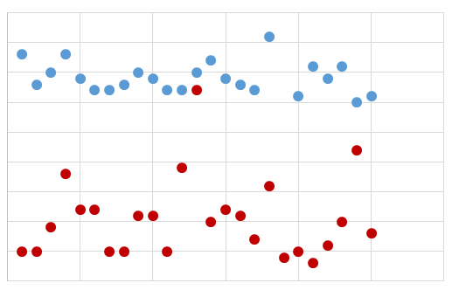
Results: Successful enrollment & protocol completion Zero Bailout PCI in the U-DR Group
45
U-DR
40
U-IR
35
30
30 minutes of
LV Unloading
25
Unload to Balloon Time (Minutes)
20
15
10
5
0
Enrolled Patients

Slide 18
DTU-STEMI Results: Primary Safety Outcome
Clinical Variable | U-IR (n=25) | U-DR (n=25) | p-value
CV mortality, n (%) | 1 (4%) | 1 (4%) | NS
Reinfarction, n (%) | 0 | 0 | NS
Stroke or TIA, n (%) | 1 (4%) | 0 | NS
Traditional 30-Day MACCE, n (%) | 2 (8%) | 1 (4%) | NS
Major Vascular Events, n (%) | 0 | 2 (8%) | NS
Total Composite 30-Day MACCE, n (%) | 2 (8%) | 3 (12%) | NS
CV Mortality:
1 mortality on day 28 due to chronic lung disease and 1 on day 1 due to shock on admission
Major Vascular Events:
2 iliofemoral dissections at the time of device removal
TIA = transient ischemic attack
MACCE = Major Adverse Cardiovascular and Cerebrovascular Events

Slide 19
DTU-STEMI Results: Primary Efficacy Outcome
30-day Infarct Size (CMR)
NS
% Infarct / Total LV Mass
15±11
13±11
Compared to U-IR, unloading first then delaying reperfusion for 30 minutes did not increase infarct size

Slide 20
DTU-STEMI Results: 3-5 Day CMR Parameters
Infarct Size vs
Total LV Mass (%)
Myocardial Salvage
Index (%)
Microvascular Obstruction (%)
U-IR
U-DR
CRISP
AMI
U-IR
U-DR
CRISP
AMI
U-IR
U-DR
CRISP
AMI
Compared to U-IR, unloading first then delaying reperfusion for 30 minutes did not increase infarct size

Slide 21
DTU-STEMI Results: Exploratory Subgroup Analysis
U-IR
U-DR
Infarct Size / Total LV Mass (%)
Infarct Size / Area at Risk (%)
40
100
*
30
80
60
20
15
40
19
16
10
20
0
0
Total
STE>4
STE>5
STE>6
Total
STE>4
STE>5
STE>6

Slide 22
What did we learn from this Pilot Study?
The Door-To-Unload in STEMI Pilot Trial demonstrates for the first time that LV unloading using the Impella CP device with a 30-minute delay before reperfusion is safe and feasible within a relatively short DTB Time.
No prohibitive safety signals that would preclude proceeding to a larger pivotal study of LV unloading and delaying reperfusion for 30 minutes were identified.
Compared to LV unloading and immediate reperfusion, LV unloading and delaying reperfusion for 30 minutes does not increase infarct size.
Among patients with sum STE>6mm, infarct size normalized to the area at risk was significantly lower with 30 minutes of LV unloading before reperfusion compared to LV unloading and immediate reperfusion.

Slide 23
Door To Unload: STEMI PIVOTAL Trial
Anterior STEMI Referred for Primary PCI
INCLUSION CRITERIA
Age 21-80 years
First Myocardial Infarction
Acute STEMI (anterior ST elevation ≥2 mm in ≥2 contiguous or ≥4 mm ST-sum)
Within 1 to 6 hours of symptom onset
Informed Consent
Enrollment and Randomization
Impella CP Insertion + Activation
Immediate PCI Reperfusion
No LV Unloading
(DTB Group)
LV Unloading for 30 minutes,
Then Delayed Reperfusion
(DTU Group)

Slide 24
Acknowledgements: DTU STEMI Trial Investigators
National Principal Investigators: Navin Kapur, MD and William O’Neill, MD
Mohamad Alkhouli | West Virginia University
Tony DeMartini | Advocate Heart Institute
Haroon Faraz | Hackensack University Med Ctr
Zachary George | Greenville Memorial Hospital
Mark Goodwin | Advocate Heart Institute
Jaime Hernandez-Montfort | Baystate Medical Center
Vijay Iyer | University of Buffalo
Noam Josephy | Abiomed Inc.
Sanjog Kalra | Einstein Medical Center
Amir Kaki | Detroit Medical Center
Richard Karas | Tufts Medical Center
Carey Kimmelstiel | Tufts Medical Center
Gerald Koeing | Henry Ford Medical Center
Evan Lau | Baystate Medical Center
Kapil Lotun | University of Arizona
Ryan Madder | Spectrum Health
Salvatore Mannino | WellStar Kennestone Hospital
Perwaiz Meraj | Northwell Health
Jason Moreland | West Virginia University
Jeffrey Moses | Columbia University
Raymond Kim | Duke University Medical Center
Theodore Schreiber | Detroit Medical Center
James Udelson | Tufts Medical Center
Christian Witzke | Einstein Medical Center
David Wohns | Spectrum Health

Slide 25
The Door to Unload (DTU) STEMI Safety & Feasibility Pilot Trial
2018 American Heart Association Late Breaking Clinical Science
  Thank you
  nkapur@tuftsmedicalcenter.org
Notes:
25
Moderated panel questions & discussion after each of the three key parts of the presentation

