Slide 1

The New Era of LDL-C Lowering:
Evolving therapies, evolving evidence, evolving guidance
Your Name, Credentials, Titles
Institution/Center

Slide 2
Thank you
This program was made possible with
Amgen’s support
for the ACC.

Slide 3
Disclosures
Your disclosures

Slide 4
Objectives
Discuss residual cardiovascular risk evaluation and management
Review recent CV outcomes trials with addition of non-statin medication to statin therapy
Identify groups of patients who have demonstrated benefit with non-statin therapies

Slide 5
Case 1
68-year-old man with prior MI 3 years ago, 3-vessel CABG 2 years ago, and symptomatic peripheral arterial disease presents for follow up claudication and ASCVD risk reduction
Past medical history:
  Essential hypertension
  Type 2 diabetes mellitus
Lifestyle: participates in maintenance cardiac rehabilitation program, Mediterranean-style diet

Slide 6
Case 1 (cont’d)
Substance use:
  Discontinued tobacco use at time of MI
  No alcohol or other substance use
Allergies: no known drug allergies
Current medications:
  Aspirin 81 mg daily
  Atorvastatin 80 mg daily
  Carvedilol 25 mg twice daily
  Lisinopril 20 mg daily
  Metformin 1 g twice daily
  Empagliflozin 10 mg daily

Slide 7
Laboratory Results
  LFTs, TSH: normal
  A1C: 6.9%
  Total cholesterol: 152 mg/dl
  HDL-C: 44 mg/dL
  LDL-C: 84 mg/dL
  TG: 118 mg/dL
  Percent reduction LDL-C from baseline: 48%

Slide 8
Case 1- Key Questions
As you prepare for his visit, you ask yourself a few key questions:
  What is his residual cardiovascular risk?
  Would he benefit from non-statin therapies targeting LDL-C?
  Is it safe to continue lowering his LDL-C with additional therapies?

Slide 9
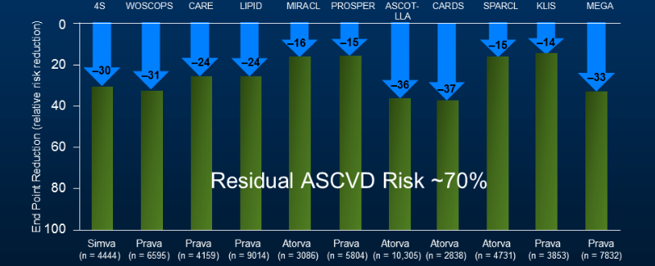
Residual Risk Persists Despite Statins
Lancet. 2005;366:1267-1278
Notes:
Key Concept: Residual risk (~70%) + high rates of statin intolerance in clinical practice generated significant interest in alternative pathways and mechanisms to lower lipoproteins

Slide 10
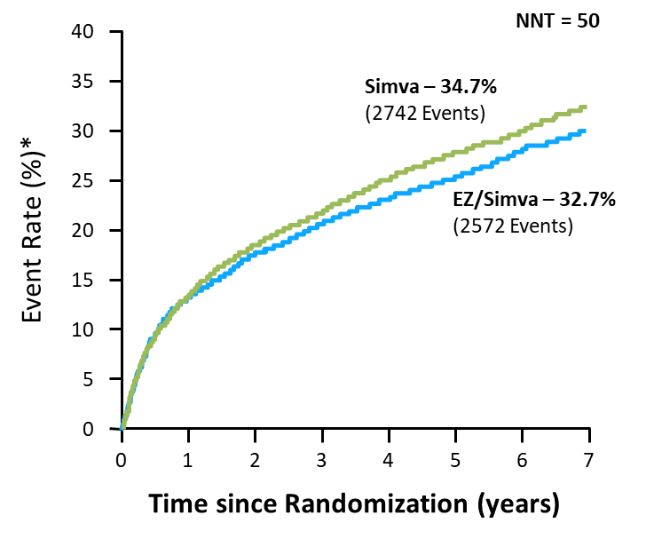
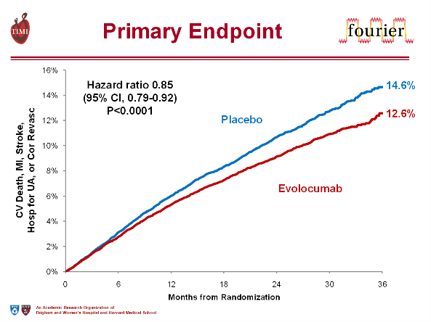
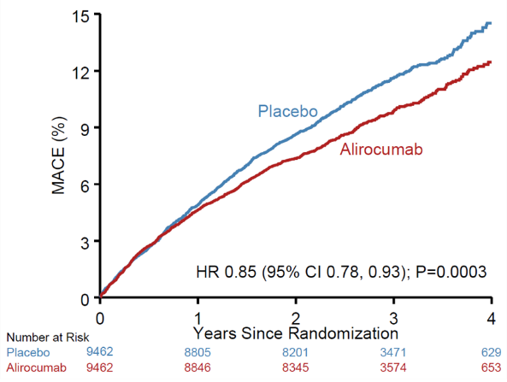
Evolving Evidence, Evolving Guidance
IMPROVE-IT¹
FOURIER²
ODYSSEY Outcomes³
Notes:
Key Concept: At the time of publication of the 2013 ACC/AHA guidelines there were no available large RCTs of non-statin therapies for LDL-C lowering. However, recent evidence with ezetimibe, evolocumab, and alirocumab support the benefits of the addition of non-statin therapies to maximally tolerated statin in appropriate high-risk patients.

Slide 11
Impact of Ezetimibe in ACS
IMPROVE-IT Study
18,144 ACS patients randomized to simvastatin (40 mg QHS) or simvastatin/ezetimibe (40 mg/10 mg QHS) for 7 years
100
40
Simvastatin
35
Simvastatin
90
Ezetimibe/simvastatin
Ezetimibe/simvastatin
30
80
25
Mean LDL-C (mg/dL)
Event Rateª (%)
70
20
60
Median time average
69.5 (1.8) vs 53.7 (1.4) [mg/dL (mmol/L)]
15
10
50
5
HR 0.936, P=.016
40
0
QE
R
1
4
8
12
16
24
36
48
60
72
84
96
0
1
2
3
4
5
6
7
Time Since Randomization (Months)
Years

Slide 12
Key PCSK9 Inhibitor CV Outcomes Trials
 | Evolocumab (AMG 145) | Alirocumab (SAR236553 / REGN727)
Trial | FOURIER | ODYSSEY Outcomes
Sample size | 27,564 | 18,924
Patients | Stable ASCVD (MI, stroke, or PAD) with high-risk features | 4-52 weeks post-ACS
Age | 63 | 58
Statin High-intensity statin No statin | Atorvastatin ≥20 mg or equivalent 69% 0.2% | Evidence-based medical Rx 89% 2.5%
LDL-C mg/dL (mmol/L): inclusion Baseline LDL-C mg/dL (mmol/L) | ≥70 (≥1.8) 92 (2.4) | >70 (<1.8) 87 (2.3)
PCSK9 inhibitor dosing | Q2W or Q4W | Q2W
Endpoint | 1°: CV death, MI, stroke, revascularization, or hospitalization for UA Key 2°: CV death, MI, or stroke | CHD death, MI, ischemic stroke, or hospitalization for UA
Follow-up | 26 months | 34 months
CHD = coronary heart disease; CV = cardiovascular; PAD = peripheral arterial disease; Q2W/Q4W = every 2 weeks/every 4 weeks; UA = unstable angina.
www.clinicaltrials.gov
Notes:
Key Concepts: differences in patient populations (ASCVD with high-risk features vs ACS within 4-12 months), both studies required maximally tolerated statin therapy, similar LDL-C >1.8 mmol/L or 70 mg/dL, duration of follow-up slightly less in FOURIER.

Slide 13

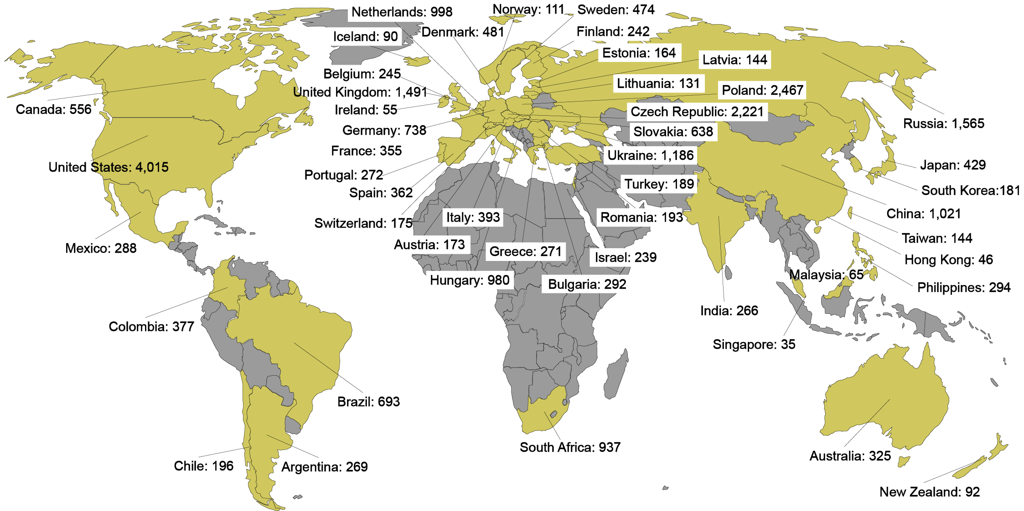
Global Enrollment
27,564 patients randomized (evolocumab vs. placebo) at 1242 sites in 49 countries between 2/2013 – 6/2015
Notes:
MAY HIDE THIS SLIDE FOR SAUDI ARABIA

Slide 14
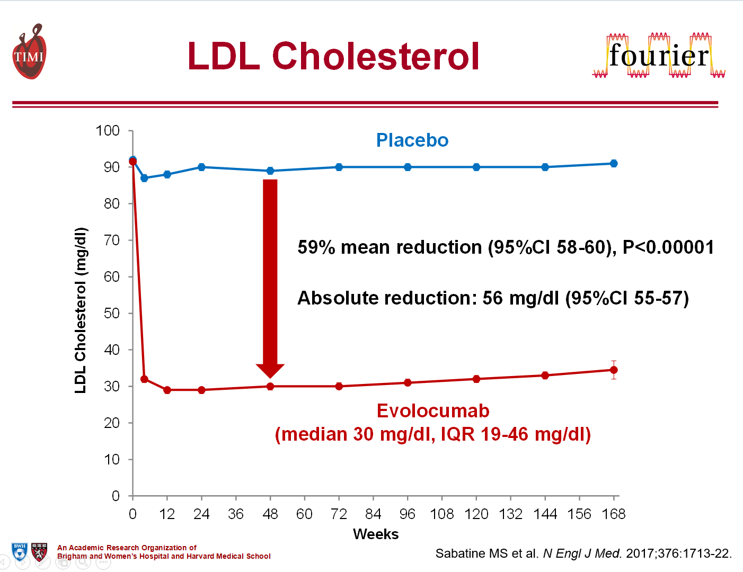
Evolocumab in Stable, High-Risk ASCVD
(1.45 mmol/L)
(0.78 mmol/L)

Slide 15
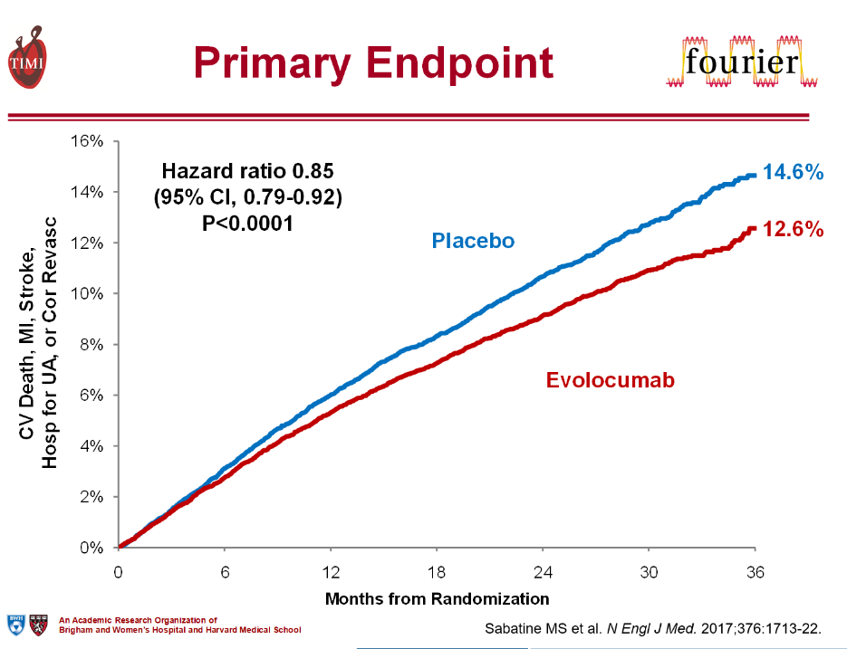
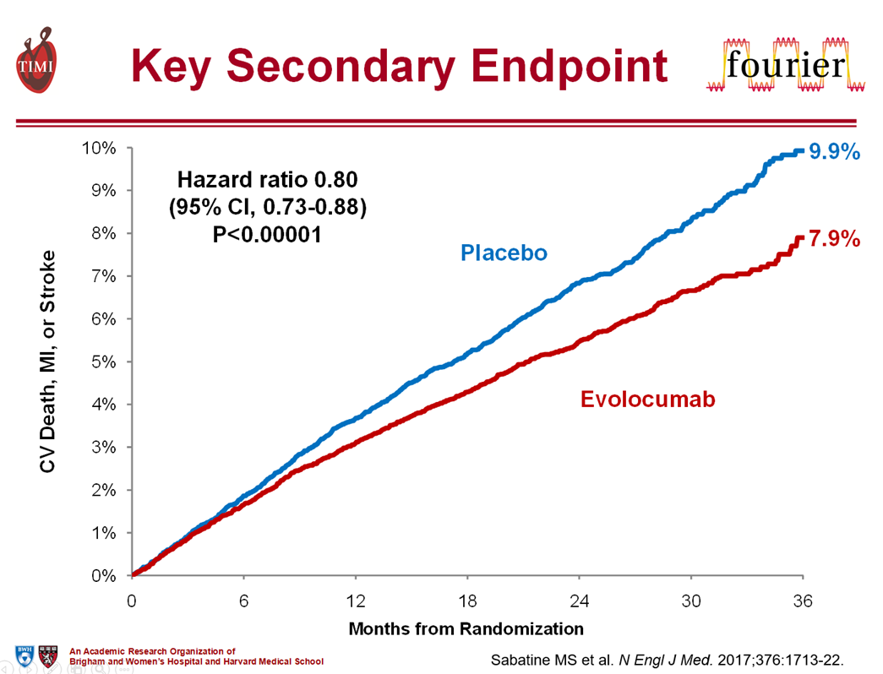
Evolocumab in Stable, High-Risk ASCVD
-15%

Slide 16
Reduction in Stroke with Evolocumab
Giugliano et al. Stroke 2020;51:1546-54

Slide 17
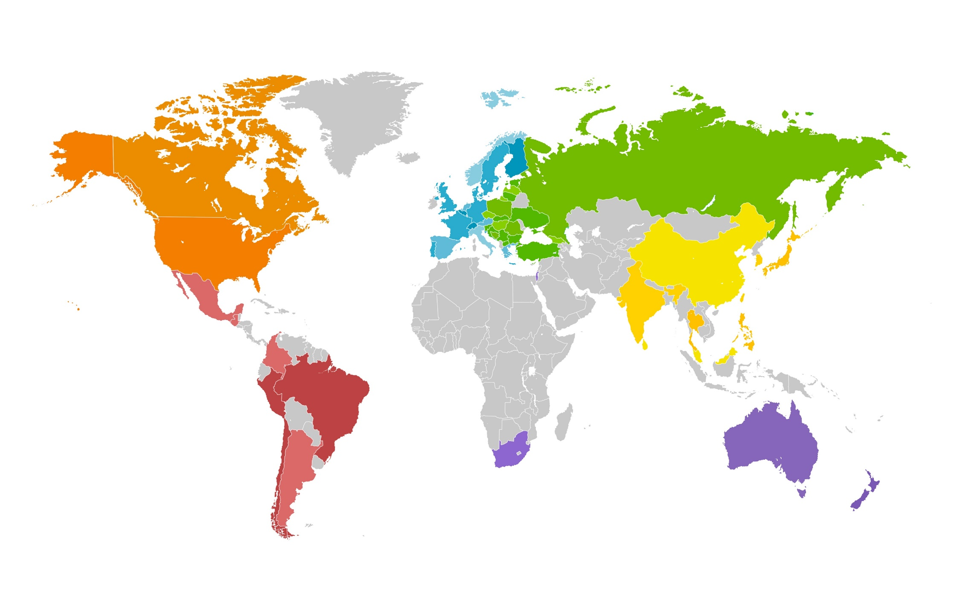

ODYSSEY OUTCOMES:
18,924 patients randomized (alirocumab vs. placebo) at 1315 sites in 57 countries
Canada/USA
Canada 361
US 2511
Central/Eastern Europe
Bosnia–Herzegovina 156 Macedonia 132
Bulgaria 333 Poland 926
Croatia 70 Romania 145
Czech Republic 381 Russian Federation 1109
Estonia 216 Serbia 255
Georgia 131 Slovakia 340
Hungary 224 Slovenia 36
Latvia 80 Turkey 78
Lithuania 188 Ukraine 639
Western Europe
Austria 58
Belgium 197
Denmark 352
Finland 116
France 185 Germany 509
Greece 70
Italy 275
Netherlands 686
Norway 97
Portugal 174
Spain 826
Sweden 250
Switzerland 88
UK 292
Asia
China 614
Hong Kong 17
India 521
Japan 204
Korea 94
Malaysia 110
Philippines 116
Singapore 49
Sri Lanka 314
Taiwan 93
Thailand 161
Latin America
Argentina 592
Brazil 928
Chile 132
Colombia 354
Guatemala 25
Mexico 349
Peru 208
Rest of World
Australia 216
Israel 582
New Zealand 257
South Africa 505
Notes:
MAY HIDE THIS SLIDE FOR SAUDI ARABIA

Slide 18
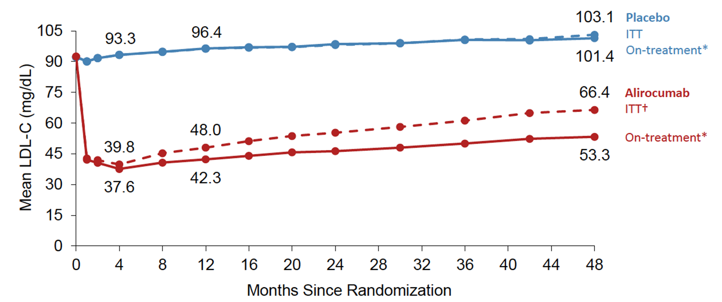

LDL-C: Intent-to-Treat and On-Treatment Analyses
(2.41 mmol/L)
(2.62 mmol/L)
53% reduction
in LDL-C
60% reduction
in LDL-C
(1.38 mmol/L)
(0.97 mmol/L)
DOI: 10.1056/NEJMoa1801174
ªExcludes LDL-C values after premature treatment discontinuation or blinded switch to placebo
^{b}All LDL-C values, including those after premature treatment discontinuation, blinded down titration, or blinded switch to placebo
DOI: 10.1056/NEJMoa1801174
Notes:
Includes all LDL-C values, regardless of blinded down titration or switch to placebo or premature treatment discontinuation
discontinuation, or blinded down titration or switch to placebo
Includes all LDL-C values, regardless of discontinuation or blinded down titration or switch to placebo

Slide 19
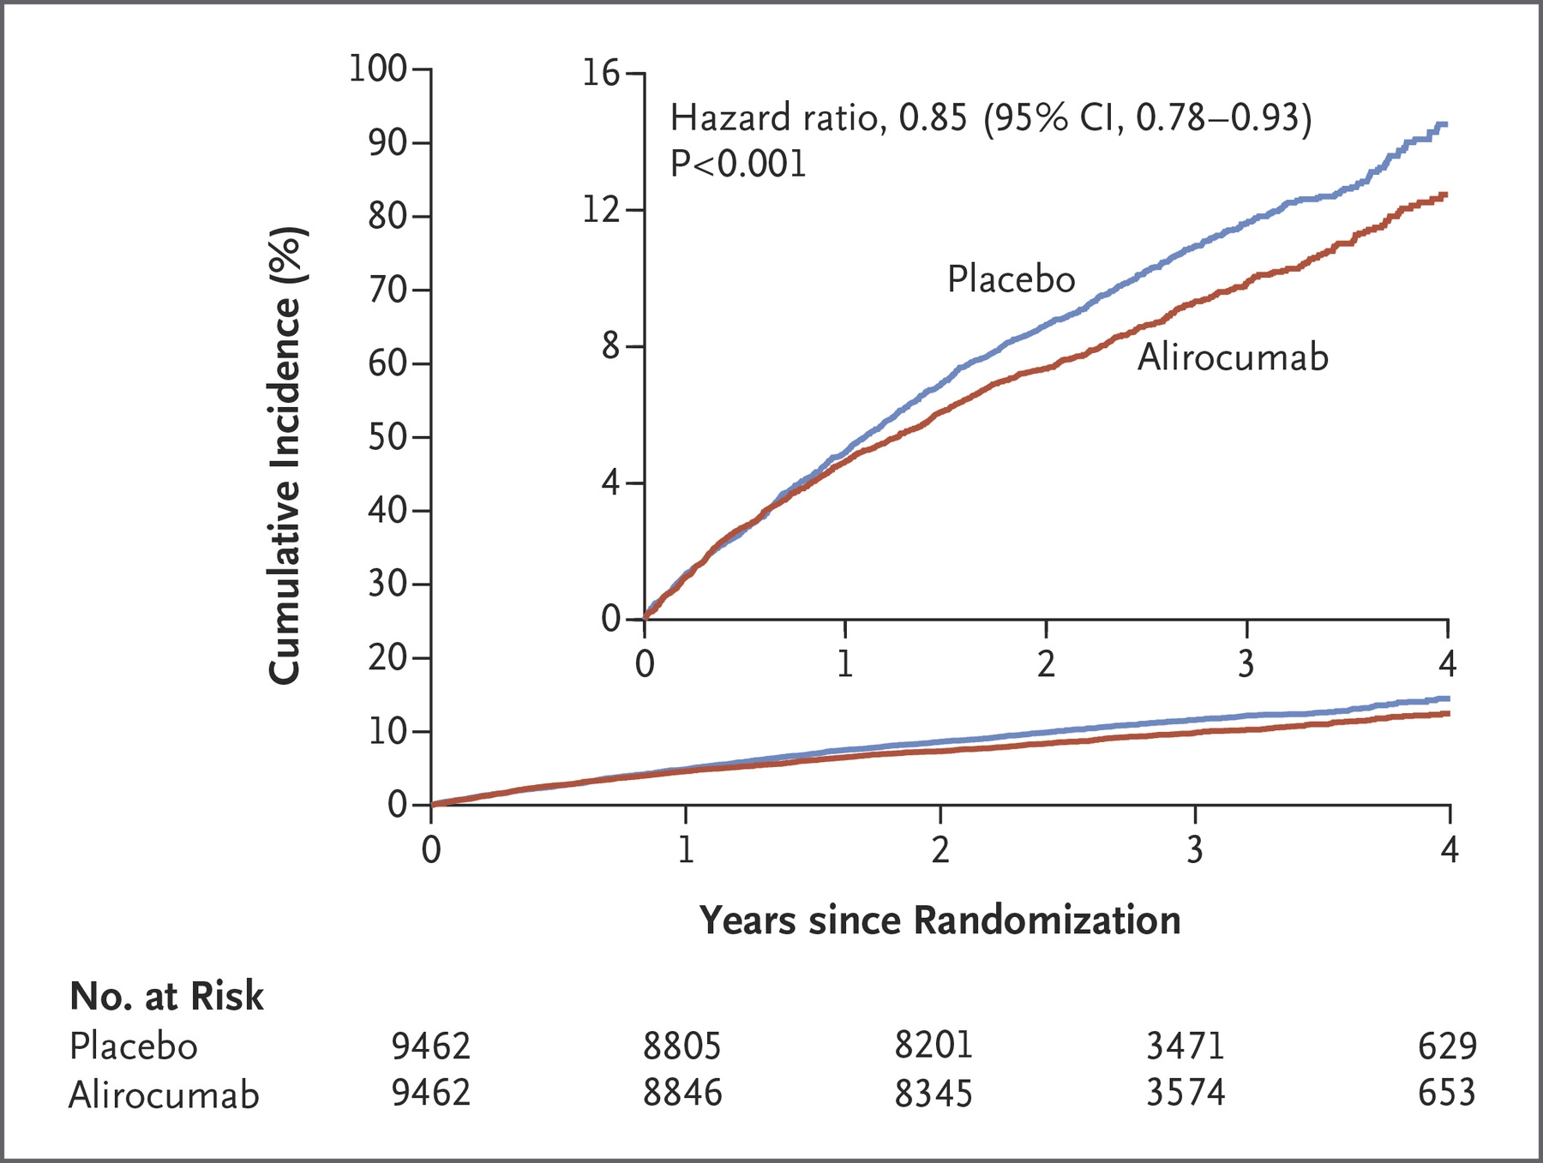
ODYSSEY: Cumulative incidence of primary composite endpoint
14.5%
12.5%
  MACE: CHD death,
  non-fatal MI,
  ischemic stroke, or
  unstable angina requiring
  hospitalization
DOI: 10.1056/NEJMoa1801174

Slide 20
Reduction in Stroke with Alirocumab
Years post randomization
Jukema et al. Circ 2019;140:2054-62

Slide 21
Patient Case: Summary
68-year-old man with prior MI 3 years ago, 3-vessel CABG 2 years ago, and symptomatic peripheral arterial disease presents for follow up claudication and ASCVD risk reduction
Past medical history:
  Essential hypertension
  Type 2 diabetes mellitus
Lipid lowering therapy
  Atorvastatin 80 mg
Labs
  LDL-C 84 mg/dL, A1c 6.9%
  % reduction in LDL-C 48%
Characteristics of patients
in FOURIER Trial

Slide 22
What we have learned from subsequent analyses of non-statin outcomes trials?
Reduction in total/recurrent CV events
Safety of very low levels of LDL-C
Subgroup analyses regarding outcomes benefits
  Identify higher-risk patients who have demonstrated benefit with non-statin therapies
LDL-C = low-density lipoprotein cholesterol; PCSK9 = proprotein convertase subtilisin/kexin type 9 serine protease.

Slide 23
What we have learned from subsequent analyses of non-statin outcomes trials?
Reduction in total/recurrent CV events
Safety of very low levels of LDL-C
Subgroup analyses regarding outcomes benefits
  Identify higher-risk patients who have demonstrated benefit with non-statin therapies
LDL-C = low-density lipoprotein cholesterol; PCSK9 = proprotein convertase subtilisin/kexin type 9 serine protease.

Slide 24
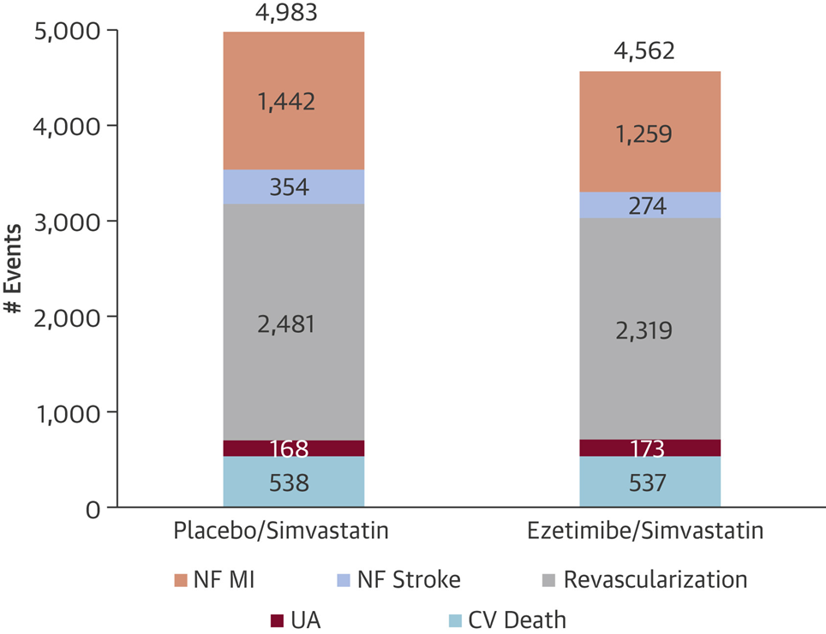
IMPROVE-IT: Total Events During Follow-Up by Randomization Group for Components of the Primary Endpoint
Reduction in total primary endpoint events
(incidence-rate ratio [RR]: 0.91;
95% confidence interval [CI]: 0.85 to 0.97; p = 0.007)
Largely driven by reductions in NF MI, NF stroke, and revascularization
J Am Coll Cardiol. 2016;67:353-61

Slide 25
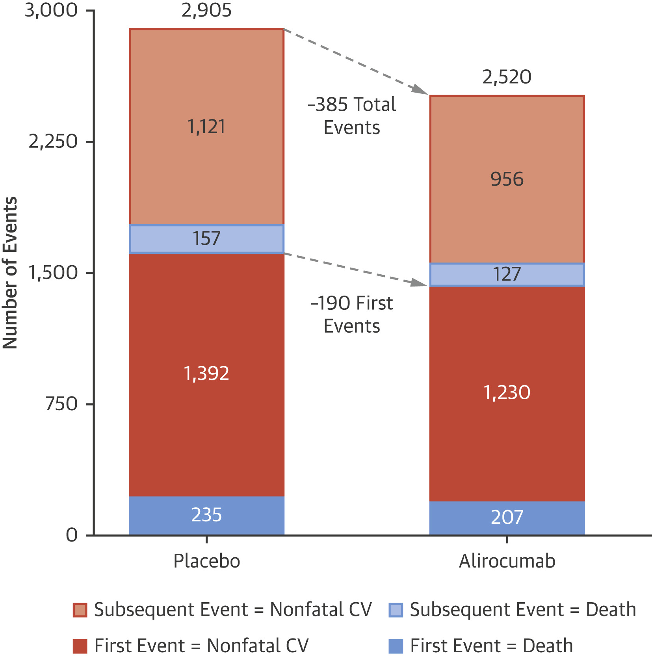
First, Subsequent, and Total Nonfatal CV Events and Death by Treatment Group: ODYSSEY Outcomes
Alirocumab reduced total nonfatal cardiovascular events
HR: 0.87
  (95% confidence interval: 0.82 to 0.93)
J Am Coll Cardiol. 2019;73:387-*9

Slide 26

Total Key Secondary Endpoint
Events: CV Death / MI / Stroke
1268
Additional Events
RR 0.79
(0.61-1.02)
1014
-254
-57
Total Events
RR 0.81
(95% CI 0.73-0.90)
P<.001
# Events
-197
1st Event
HR 0.80
(0.73-0.88)
Placebo
Evolocumab
Notes:
http://circ.ahajournals.org/content/136/Suppl_1/A15100

Slide 27
For the Future: What we have learned from subsequent analyses of non-statin outcomes trials?
Reduction in total/recurrent CV events
Safety of very low levels of LDL-C
Subgroup analyses regarding outcomes benefits
  Identify higher-risk patients who have demonstrated benefit with non-statin therapies
LDL-C = low-density lipoprotein cholesterol; PCSK9 = proprotein convertase subtilisin/kexin type 9 serine protease.

Slide 28
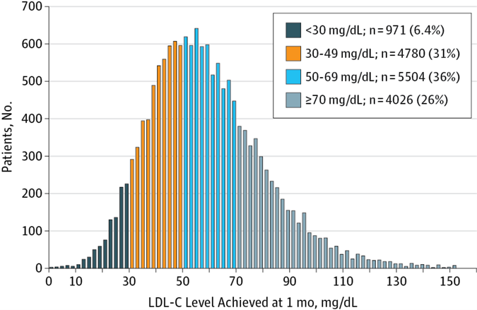
Long-term Safety and Efficacy of Achieving Very Low Levels of LDL-C
A Prespecified Analysis of the IMPROVE-IT Trial
37%
No significant difference in adverse events by achieved LDL-C level
JAMA Cardiol. 2017;2(5):547-555. doi:10.1001/jamacardio.2017.0083

Slide 29
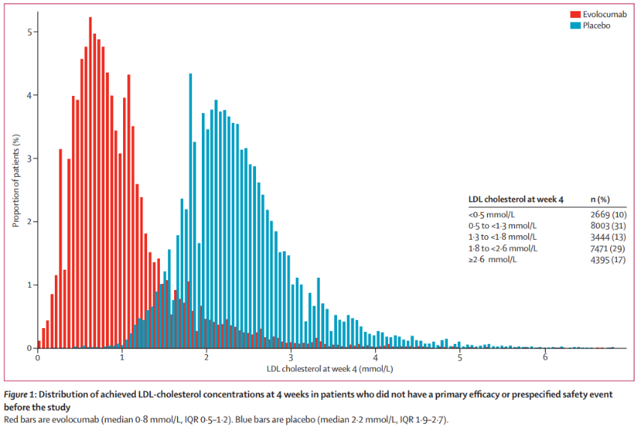
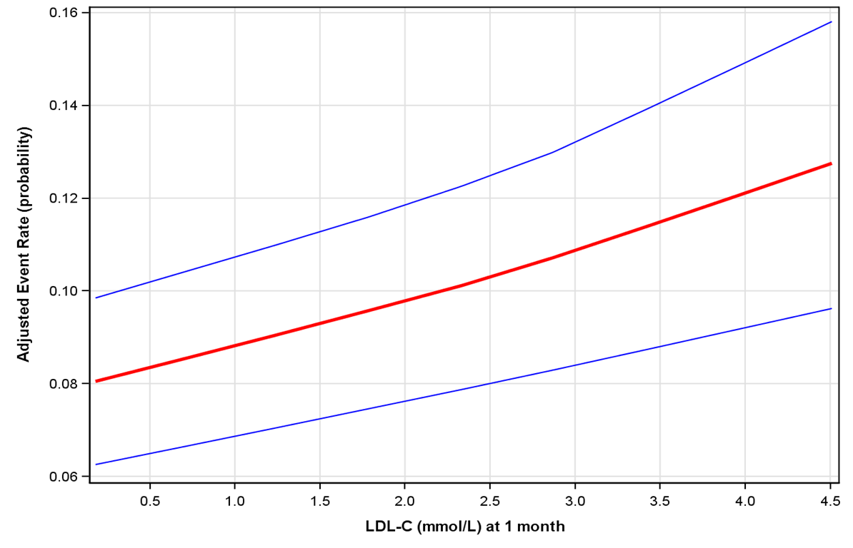
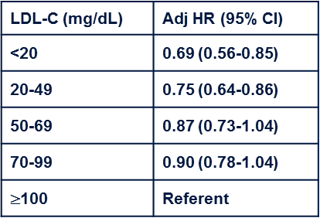
FOURIER: Efficacy and safety of very low levels of LDL-C with evolocumab
41% achieved LDL-C <1.3 mmol/L or 50 mg/dL
No safety concerns with very low LDL-C levels over a median of 2.2 years.
Lower achieved LDL-C associated with greater reduction MACE down to LDL-C <0.2 mmol/L (<10 mg/dL).
Giugliano RP, et al. Lancet. 2017;390(10106):1962-71.
Notes:
2669 (10%) of 25982 patients achieved LDL-cholesterol concentrations of less than 0·5 mmol/L (20 mg/dl), 8003 (31%) patients achieved concentrations between 0·5 and less than 1·3 mmol/L (20-50 mg/dl), 3444 (13%) patients achieved concentrations between 1·3 and less than 1·8 mmol/L 50-70 mg/dl), 7471 (29%) patients achieved concentrations between 1·8 to less than 2·6 mmol/L 70-100 mg/dl), and 4395 (17%) patients achieved concentrations of 2·6 mmol/L or higher (>100 mg/dl).
There was a highly significant monotonic relationship between low LDL-cholesterol concentrations and lower risk of the primary and secondary efficacy composite endpoints extending to the bottom first percentile (LDL-cholesterol concentrations of less than 0·2 mmol/L; p=0·0012 for the primary endpoint, p=0·0001 for the secondary endpoint). Conversely, no significant association was observed between achieved LDL cholesterol and safety outcomes, either for all serious adverse events or any of the other nine prespecified safety events.

Slide 30
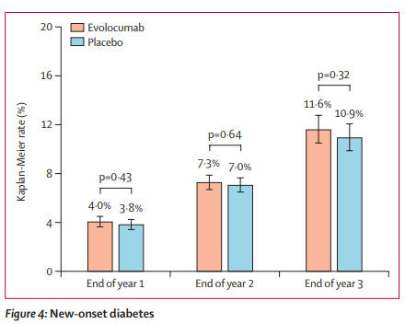
CV safety and efficacy of evolocumab in patients with and without diabetes: FOURIER
No increase in new-onset diabetes
Notes:
In this prespecified analysis of FOURIER, we investigated the efficacy and safety of evolocumab by diabetes status and the effect of evolocumab on glycaemia and risk of developing diabetes.
At study baseline, 11031 patients (40%) had diabetes and 16533 (60%) did not have diabetes (of whom 10344 had prediabetes [63%] and 6189 had normoglycaemia [37%]).
In this prespecified analysis, we investigated the effect of evolocumab on cardiovascular events by diabetes status at baseline, defined on the basis of patient history, clinical events committee review of medical records, or baseline HbA1c of 6·5% (48 mmol/mol) or greater or fasting plasma glucose (FPG) of 7·0 mmol/L or greater.
The primary endpoint was a composite of cardiovascular death, myocardial infarction, stroke, hospital admission for unstable angina, or coronary revascularisation. The key secondary endpoint was a composite of cardiovascular death, myocardial infarction, or stroke.
We also assessed the effect of evolocumab on glycaemia, and on the risk of new-onset diabetes among patients without diabetes at baseline.
HbA1c was measured at baseline then every 24 weeks and FPG was measured at baseline, week 12, week 24, and every 24 weeks thereafter, and potential cases of new-onset diabetes were adjudicated centrally.
In a post-hoc analysis, we also investigated the effects on glycaemia and diabetes risk in patients with prediabetes (HbA1c 5·7–6·4% [39–46 mmol/mol] or FPG 5·6–6·9 mmol/L) at baseline.

Slide 31
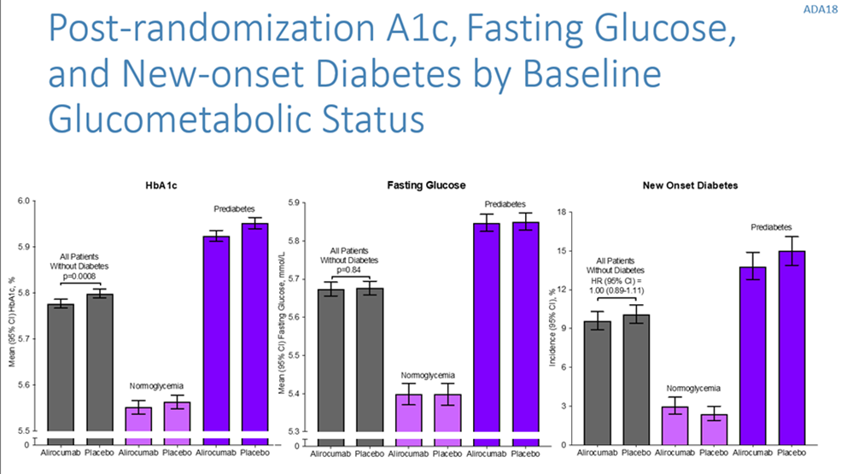
Efficacy and safety of alirocumab in DM: Pooled analyses from phase 3 trials
Alirocumab was NOT associated with worsening glycemic control or new onset diabetes.
Diabetes Therap 2018;9:1317-1334; Ray KK, American Diabetes Association 2018 (Orlando, FL)

Slide 32
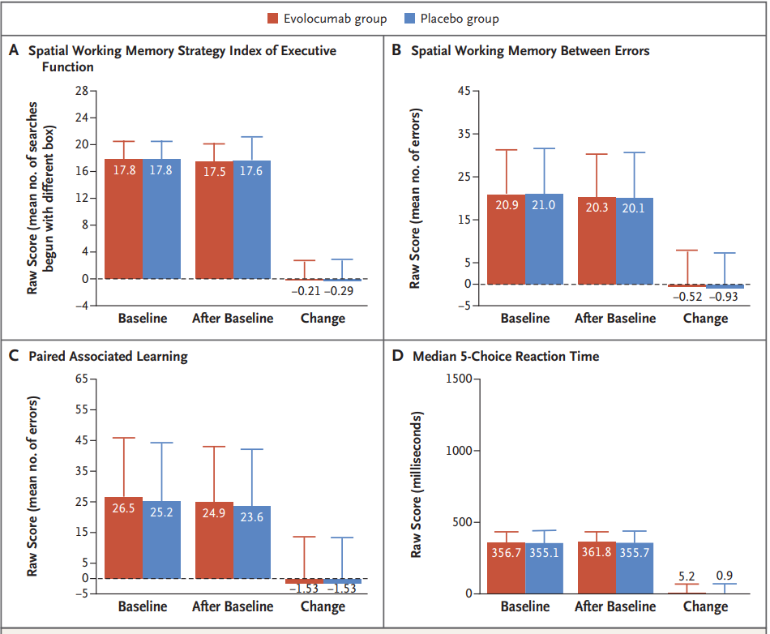
EBBINGHAUS Study of cognitive function during treatment with evolocumab
Subgroup of FOURIER
1204 patients, 19 months
Assessed cognitive function during treatment
  Cambridge Neuropsychological Test Automated Battery
No significant differences
N Engl J Med 2017;377:633-43.
Notes:
BACKGROUND Findings from clinical trials of proprotein convertase subtilisin–kexin type 9 (PCSK9) inhibitors have led to concern that these drugs or the low levels of low-density lipoprotein (LDL) cholesterol that result from their use are associated with cognitive deficits.
METHODS In a subgroup of patients from a randomized, placebo-controlled trial of evolocumab added to statin therapy, we prospectively assessed cognitive function using the Cambridge Neuropsychological Test Automated Battery. The primary end point was the score on the spatial working memory strategy index of executive function (scores range from 4 to 28, with lower scores indicating a more efficient use of strategy and planning). Secondary end points were the scores for working memory (scores range from 0 to 279, with lower scores indicating fewer errors), episodic memory (scores range from 0 to 70, with lower scores indicating fewer errors), and psychomotor speed (scores range from 100 to 5100 msec, with faster times representing better performance). Assessments of cognitive function were performed at baseline, week 24, yearly, and at the end of the trial. The primary analysis was a noninferiority comparison of the mean change from baseline in the score on the spatial working memory strategy index of executive function between the patients who received evolocumab and those who received placebo; the noninferiority margin was set at 20% of the standard deviation of the score in the placebo group.
RESULTS A total of 1204 patients were followed for a median of 19 months; the mean (±SD) change from baseline over time in the raw score for the spatial working memory strategy index of executive function (primary end point) was −0.21±2.62 in the evolocumab group and −0.29±2.81 in the placebo group (P=0.85) for superiority). There were no significant between-group differences in the secondary end points of scores for working memory (change in raw score, −0.52 in the evolocumab group and −0.93 in the placebo group), episodic memory (change in raw score, −1.53 and −1.53, respectively), or psychomotor speed (change in raw score, 5.2 msec and 0.9 msec, respectively). In an exploratory analysis, there were no associations between LDL cholesterol levels and cognitive changes.
CONCLUSIONS In a randomized trial involving patients who received either evolocumab or placebo in addition to statin therapy, no significant between-group difference in cognitive function was observed over a median of 19 months. (Funded by Amgen; EBBINGHAUS ClinicalTrials.gov number, NCT02207634.)

Slide 33
For the Future: What we have learned from subsequent analyses of non-statin outcomes trials?
Reduction in total/recurrent CV events
Safety of very low levels of LDL-C
Subgroup analyses regarding outcomes benefits
  Identify higher-risk patients who have demonstrated benefit with non-statin therapies
LDL-C = low-density lipoprotein cholesterol; PCSK9 = proprotein convertase subtilisin/kexin type 9 serine protease.

Slide 34
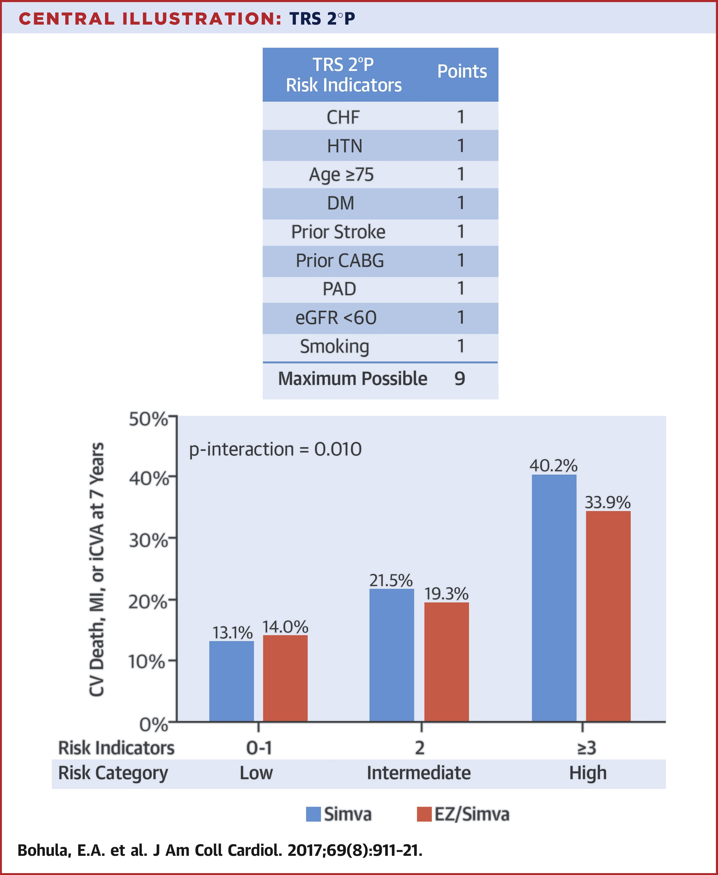
IMPROVE-IT: Addition of ezetimibe to moderate-intensity statin post-ACS
9 characteristics that identified patients most likely to benefit
  History of CHF
  HTN
  Age >75 yrs
  Diabetes
  Prior stroke
  Prior CABG
  PAD
  eGFR <60
  Smoking

Slide 35
IMPROVE-IT: Addition of ezetimibe to moderate-intensity statin post-ACS
9 characteristics that identified patients most likely to benefit
  History of CHF
  HTN
  Age >75 yrs
  Diabetes
  Prior stroke
  Prior CABG
  PAD
  eGFR <60
  Smoking
Patient Case

Slide 36
Effect of Evolocumab by Universal MI Type
HR 0.73
P<.001
HR 0.68
P<.001
Greatest benefit in patients with Type 1 MI
HR 1.09
P=NS
HR 0.65
P=.004
Wiviott SD, et al. Circulation 2017;136:A16714.
Due to small numbers, Types 3 and 5 are not presented individually

Slide 37


Effect of Evolocumab by MI Type:
NSTEMI and STEMI
NSTEMI
STEMI
HR 0.77
(95% CI 0.68-0.88)
P<.001
HR 0.64
(95% CI 0.49-0.84)
P<.001
3-Year KM Rate
Days from Randomization
Wiviott SD, et al. Circulation 2017;136:A16714.

Slide 38
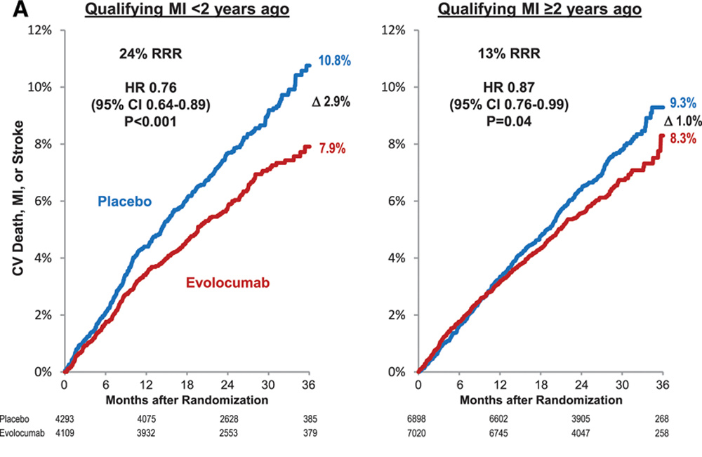
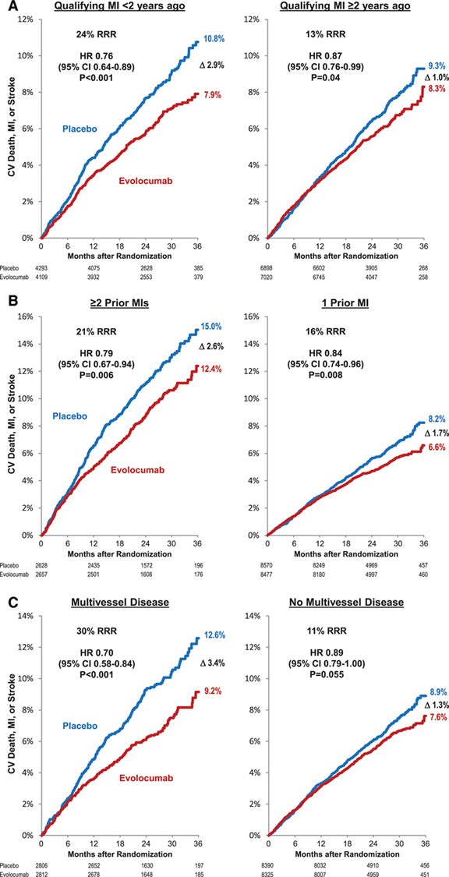
Clinical Benefit of Evolocumab by Extent of CAD
Greater benefit among patients with MI <2 years ago
Greater benefit among patients with multiple MIs
Sabatine MS, et al. Circulation. 2018 Apr 6. pii: CIRCULATIONAHA.118.034309.
Notes:
Background -The FOURIER trial recently showed that the PCSK9 inhibitor evolocumab significantly reduced major vascular events in patients with stable atherosclerotic cardiovascular disease, including patients with prior MI. Within the broad group of patients with prior MI, we hypothesized that readily ascertainable features would identify subsets that derive greater clinical risk reduction with evolocumab.
Methods -The 22,351 patients with a prior MI were characterized based on time from most recent MI, number of prior MIs, and presence of residual multivessel coronary artery disease (≥40% stenosis in ≥2 large vessels). The relative and absolute risk reductions in major vascular events including the primary endpoint (CV death, MI, stroke, hospitalization for unstable angina, or coronary revascularization) and the key secondary endpoint (CV death, MI or stroke) with evolocumab in these subgroups were compared.
Results -A total of 8402 patients (38%) were within 2 years of their most recent MI, 5285 patients (24%) had ≥2 prior MIs, and 5618 patients (25%) had residual multivessel CAD. In a multivariable adjusted model that simultaneously included all three high-risk features as well as other baseline covariates, more recent MI, multiple prior MIs, and residual multivessel coronary disease remained independent predictors of cardiovascular outcomes, with adjusted HRs for the primary endpoint of 1.37 (1.22-1.53), 1.78 (1.59-1.99) and 1.39 (1.24-1.56), all P<0.001. The relative risk reductions with evolocumab for the primary endpoint tended to be greater in the high-risk subgroups and were 20% (HR 0.80, 0.71-0.91), 18% (HR 0.82, 0.72-0.93), and 21% (HR 0.79, 0.69-0.91) for those with more recent MI, multiple prior MIs, and residual multivessel CAD, whereas they were 5% (HR 0.95, 0.85-1.05), 8% (HR 0.92, 0.84-1.02), and 7% (HR 0.93, 0.85-1.02) in those without, respectively. Given the higher baseline risk, the respective absolute risk reductions at 3 years exceeded 3% in the high-risk groups (3.4%, 3.7%, and 3.6%) vs. approximately 1% in the low-risk groups (0.8%, 1.3%, and 1.2%). Conclusions -Patients closer to their most recent MI, with multiple prior MIs or with residual multivessel CAD are at high risk for major vascular events and experience substantial risk reductions with LDL-C lowering with evolocumab.

Slide 39
Clinical Benefit of Evolocumab by Extent of CAD
Greater benefit among patients with multivessel disease versus single vessel disease
Sabatine MS, et al. Circulation. 2018 Apr 6. pii: CIRCULATIONAHA.118.034309.
Notes:
Background -The FOURIER trial recently showed that the PCSK9 inhibitor evolocumab significantly reduced major vascular events in patients with stable atherosclerotic cardiovascular disease, including patients with prior MI. Within the broad group of patients with prior MI, we hypothesized that readily ascertainable features would identify subsets that derive greater clinical risk reduction with evolocumab.
Methods -The 22,351 patients with a prior MI were characterized based on time from most recent MI, number of prior MIs, and presence of residual multivessel coronary artery disease (≥40% stenosis in ≥2 large vessels). The relative and absolute risk reductions in major vascular events including the primary endpoint (CV death, MI, stroke, hospitalization for unstable angina, or coronary revascularization) and the key secondary endpoint (CV death, MI or stroke) with evolocumab in these subgroups were compared.
Results -A total of 8402 patients (38%) were within 2 years of their most recent MI, 5285 patients (24%) had ≥2 prior MIs, and 5618 patients (25%) had residual multivessel CAD. In a multivariable adjusted model that simultaneously included all three high-risk features as well as other baseline covariates, more recent MI, multiple prior MIs, and residual multivessel coronary disease remained independent predictors of cardiovascular outcomes, with adjusted HRs for the primary endpoint of 1.37 (1.22-1.53), 1.78 (1.59-1.99) and 1.39 (1.24-1.56), all P<0.001. The relative risk reductions with evolocumab for the primary endpoint tended to be greater in the high-risk subgroups and were 20% (HR 0.80, 0.71-0.91), 18% (HR 0.82, 0.72-0.93), and 21% (HR 0.79, 0.69-0.91) for those with more recent MI, multiple prior MIs, and residual multivessel CAD, whereas they were 5% (HR 0.95, 0.85-1.05), 8% (HR 0.92, 0.84-1.02), and 7% (HR 0.93, 0.85-1.02) in those without, respectively. Given the higher baseline risk, the respective absolute risk reductions at 3 years exceeded 3% in the high-risk groups (3.4%, 3.7%, and 3.6%) vs. approximately 1% in the low-risk groups (0.8%, 1.3%, and 1.2%). Conclusions -Patients closer to their most recent MI, with multiple prior MIs or with residual multivessel CAD are at high risk for major vascular events and experience substantial risk reductions with LDL-C lowering with evolocumab.

Slide 40

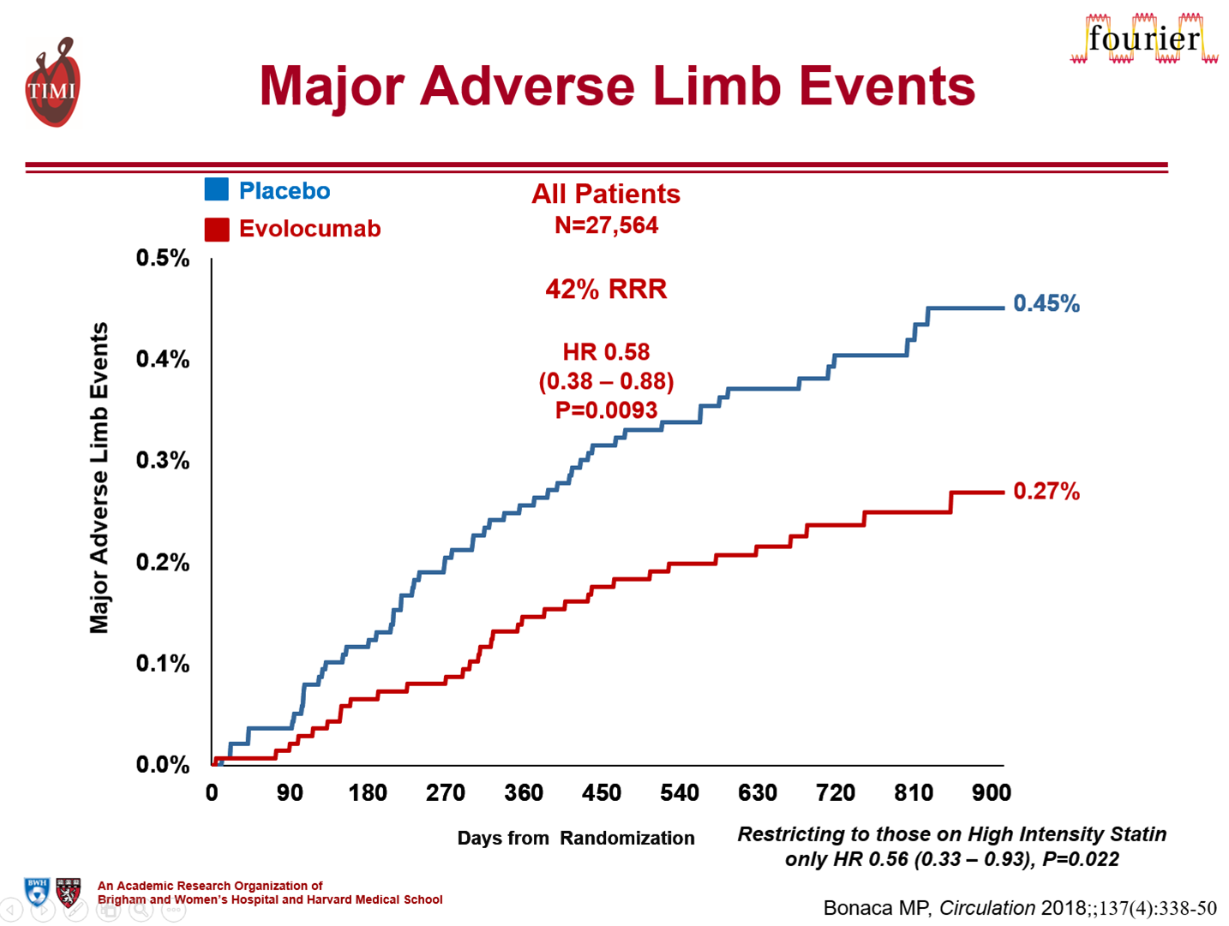
CV Death, MI or Stroke in Patients With and Without Peripheral Artery Disease
Placebo
14%
Evolocumab
PAD
N=3642
27% RRR
HR 0.73
(0.59-0.91)
P=.0040
13.0%
12%
PAD
3.5% ARR
NNT_{2.5y} 29
10%
9.5%
8%
7.6%
No PAD
1.4% ARR
NNT_{2.5y} 72
CV Death, MI, or Stroke
6%
6.2%
No PAD
N=23,922
HR 0.81
95% CI (0.73-0.90)
P<.001
4%
2%
P_{interaction} =0.41
0%
0
90
180
270
360
450
540
630
720
810
900
Days from Randomization

Slide 41
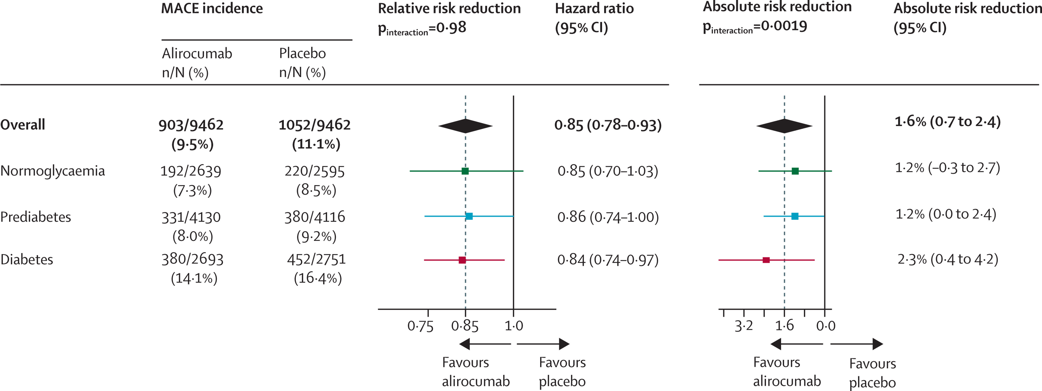
ODYSSEY Outcomes: Diabetes Mellitus
Alirocumab produced twice the ARR in CV events among patients with diabetes as in those without diabetes.
Lancet Diabetes Endocrinol. 2019; 7: 618–28

Slide 42
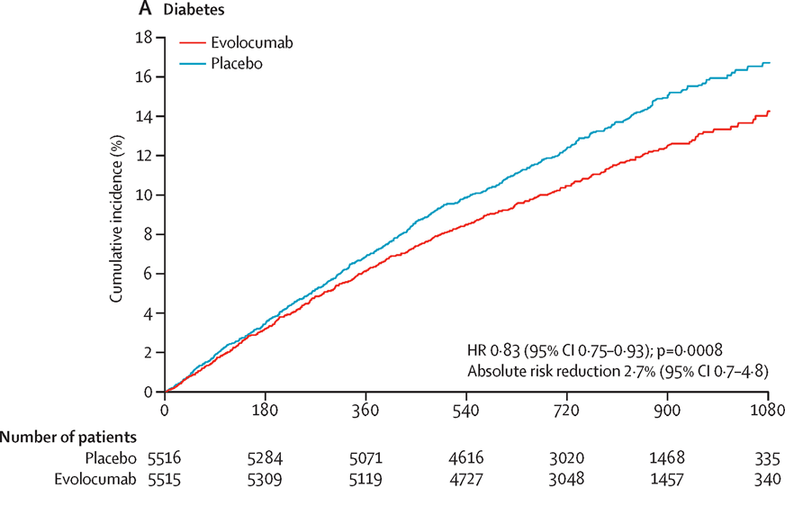
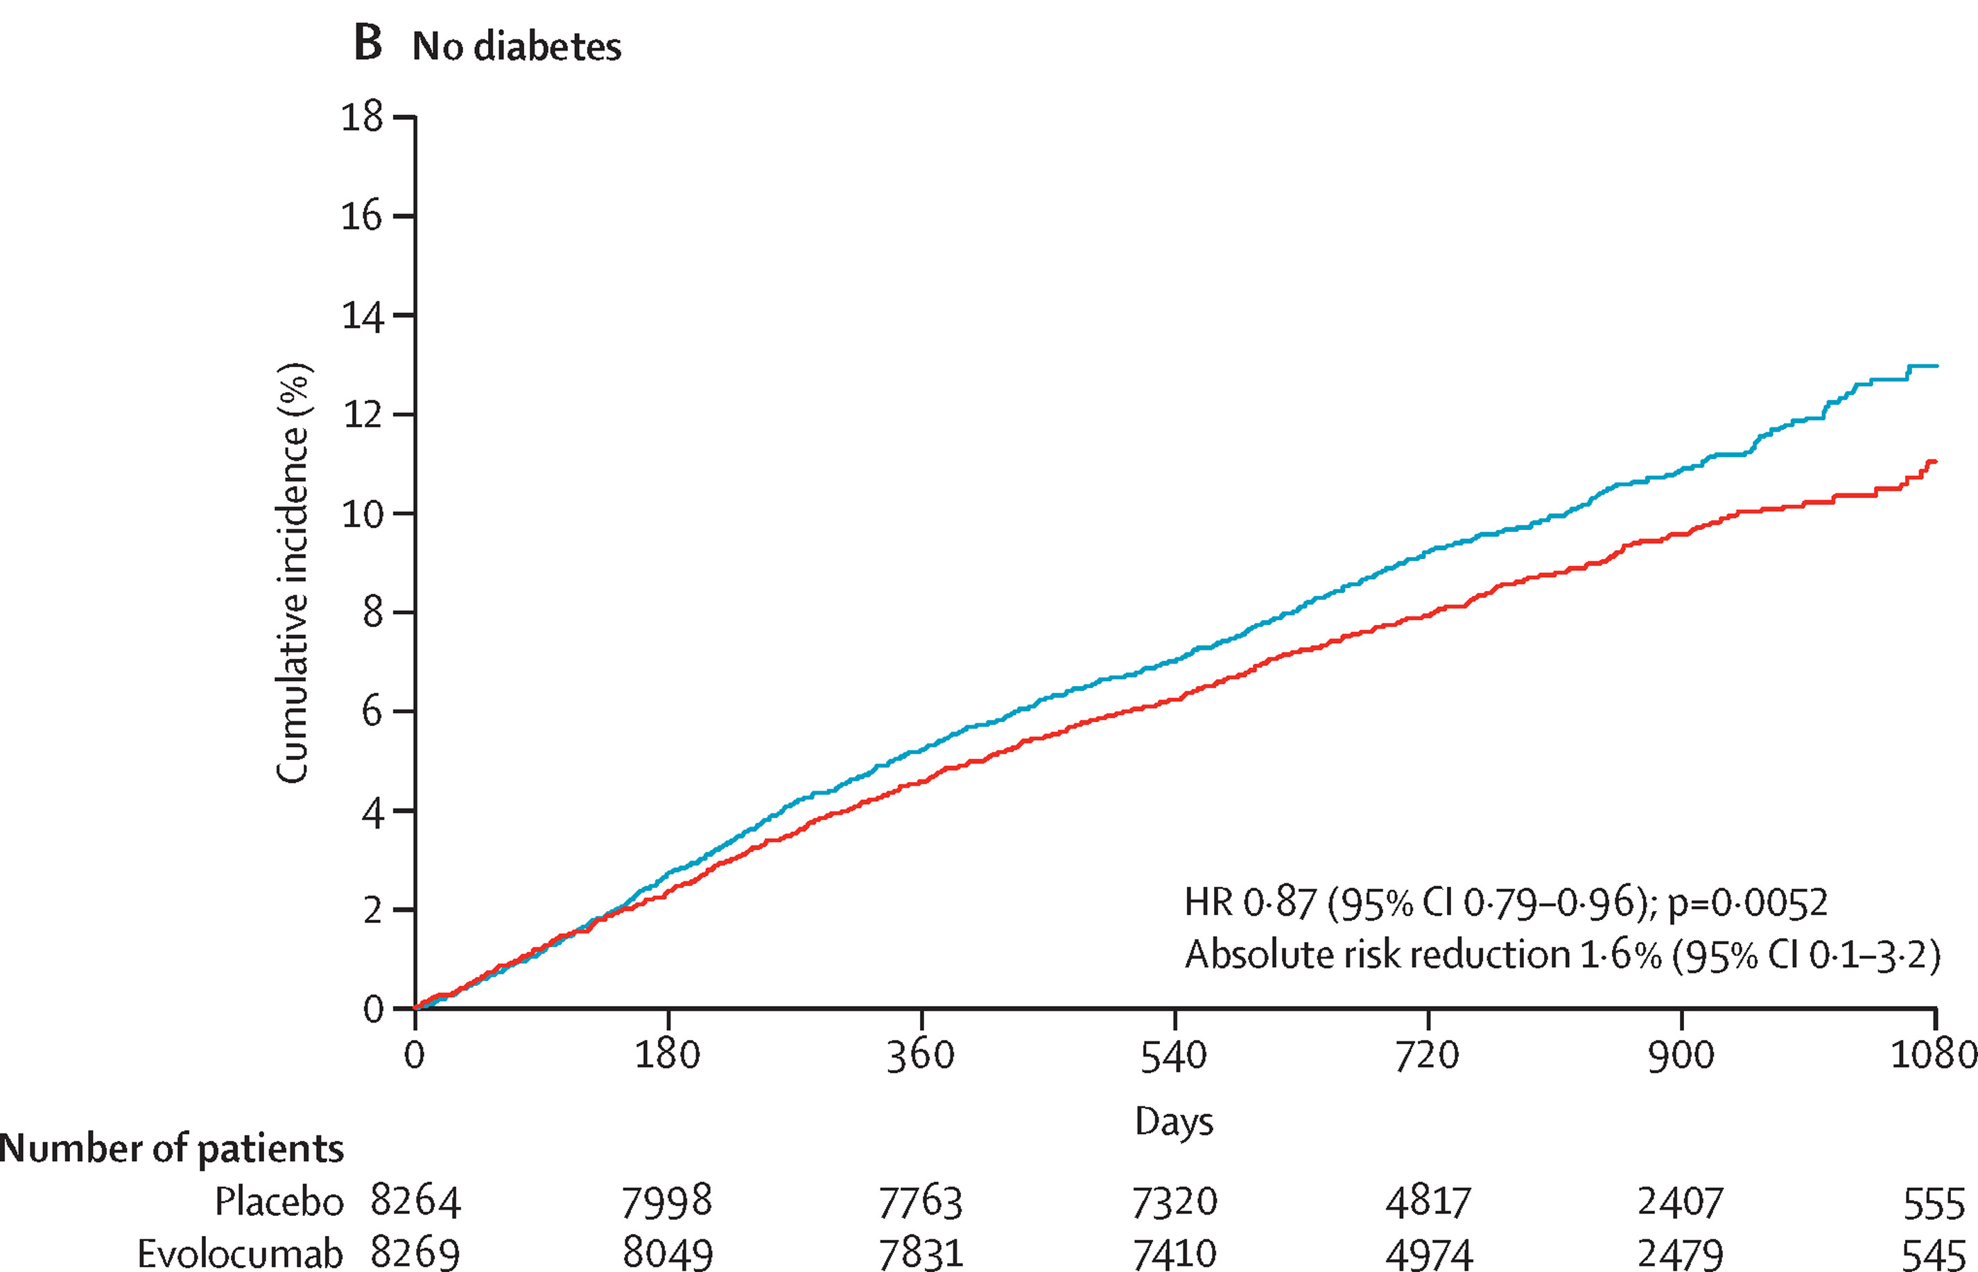
Effect of Evolocumab on Primary Endpoint in patients w/ and w/o Diabetes
NNT 37
NNT 62
Lancet Diabetes Endocrinol. 2017;5(12):941-950

Slide 43
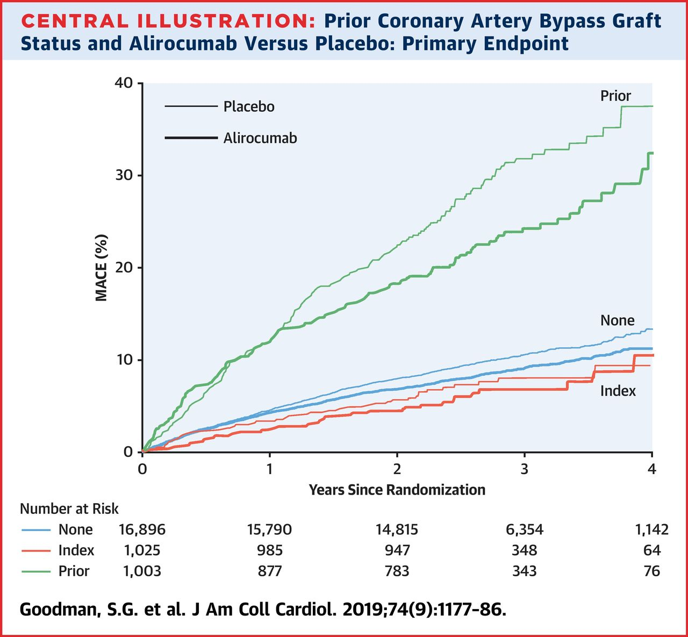
ODYSSEY Outcomes: alirocumab in ACS
Prior CABG Status

Slide 44
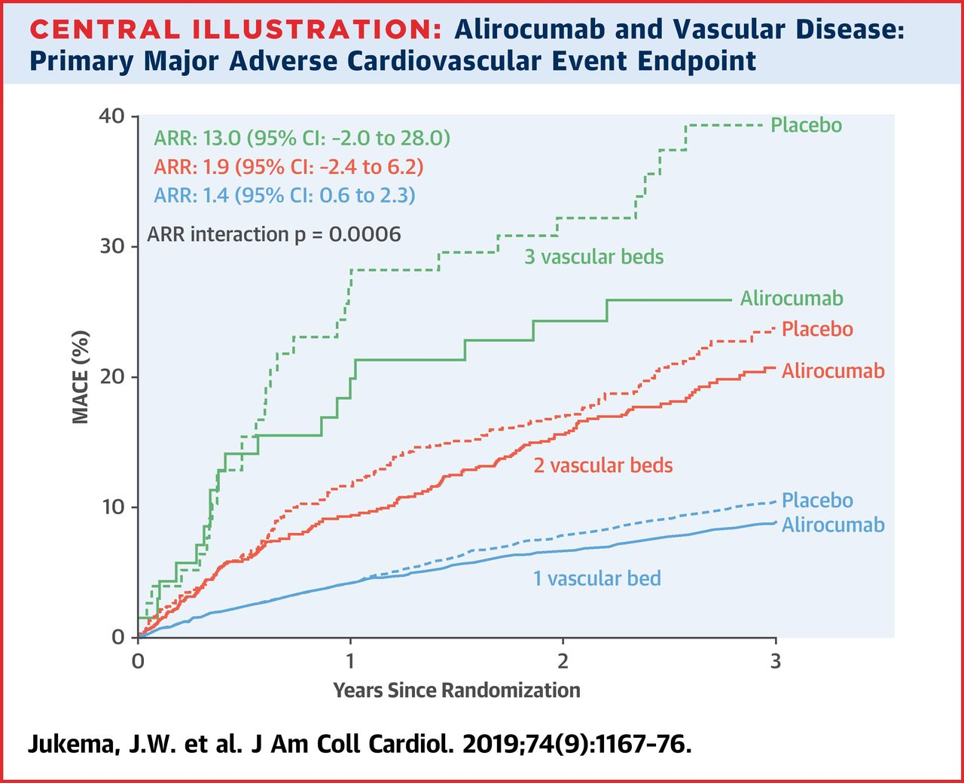
ODYSSEY Outcomes: alirocumab in ACS
Extent of Vascular Disease

Slide 45
Clinical Practice Guidelines

Slide 46
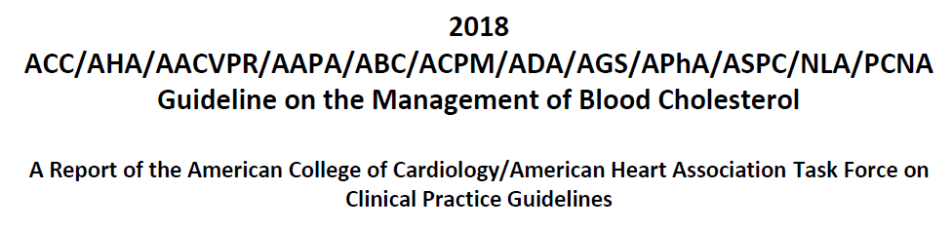
2018 ACC/AHA Blood cholesterol Guidelines
Classify ASCVD patients into 2 categories
  ASCVD not at very high-risk
  ASCVD at very high-risk
Based on RCTs, categories identify patients more likely to benefit from PCSK9i
https://www.ahajournals.org/doi/pdf/10.1161/CIR.0000000000000624

Slide 47

Question 1
According to the 2018 AHA/ACC cholesterol guidelines, which ONE of the following is a “high-risk condition”?
  eGFR <90 ml/min/1.73 m²
  Persistent atrial fibrillation
  History of tobacco use
  History of prior CABG or PCI

Slide 48
Question 1
According to the 2018 AHA/ACC cholesterol guidelines, which ONE of the following is a “high-risk condition”?
  eGFR <90 ml/min/1.73 m²
  Persistent atrial fibrillation
  History of tobacco use
  History of prior CABG or PCI

Slide 49
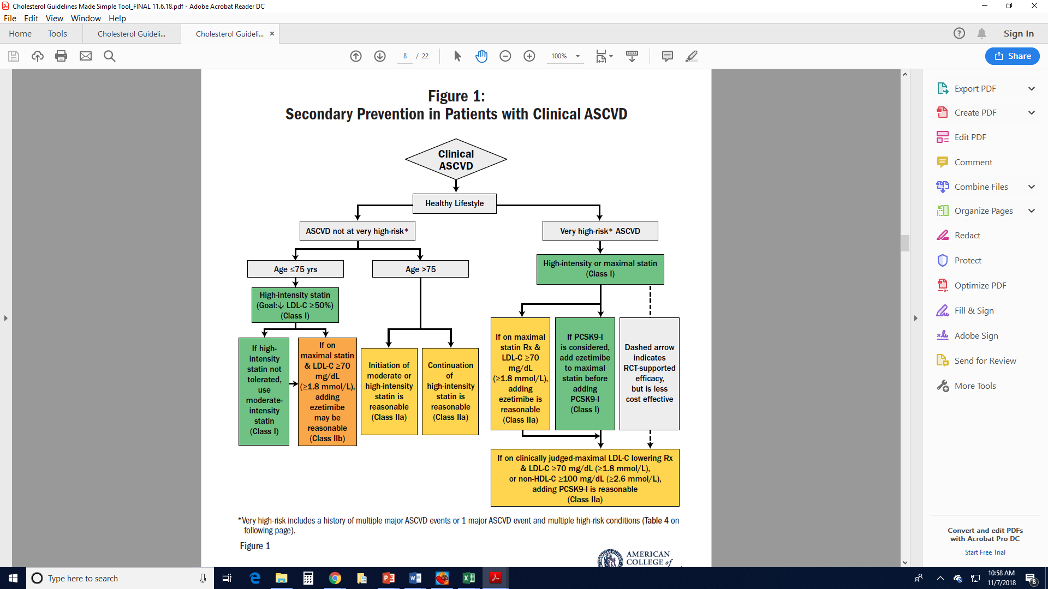
2018 AHA/ACC Cholesterol Guidelines:
Patient Risk Factors for ASCVD
Very high-risk features:
Major ASCVD events
  Recent ACS
  History of prior MI
  History of ischemic stroke
  Symptomatic PAD
High-risk conditions
  Age ≥65 years
  HeFH
  Prior CABG or PCI
  Diabetes
  Hypertension
  Chronic kidney disease
  Current smoking
  LDL-C ≥2.6 mmol/L (100 mg/dL) despite maximally tolerated statin and ezetimibe
  History of HF
  Recurrent ASCVD events
  Major ASCVD event with >1 risk conditions
Notes:
Figure legend from source: Figure 1. Secondary prevention in patients with clinical ASCVD. Colors correspond to Class of Recommendation in Table 2. Clinical ASCVD consists of acute coronary syndrome (ACS), those with history of myocardial infarction (MI), stable or unstable angina or coronary other arterial revascularization, stroke, transient ischemic attack (TIA), or peripheral artery disease (PAD) including aortic aneurysm, all of atherosclerotic origin. Very high-risk includes a history of multiple major ASCVD events or 1 major ASCVD event and multiple high-risk conditions (Table 4). ACS indicates acute coronary syndrome; ASCVD, atherosclerotic cardiovascular disease; LDL-C, low-density lipoprotein cholesterol; HDL-C, high-density lipoprotein cholesterol; MI, myocardial infarction; and PCSK9i, PCSK9 inhibitor.

Slide 50
2018 AHA/ACC Cholesterol Guidelines:
Patient Risk Factors for ASCVD
Very high-risk features:
Major ASCVD events
  Recent ACS
  History of prior MI
  History of ischemic stroke
  Symptomatic PAD
High-risk conditions
  Age ≥65 years
  HeFH
  Prior CABG or PCI
  Diabetes
  Hypertension
  Chronic kidney disease
  Current smoking
  LDL-C ≥2.6 mmol/L (100 mg/dL) despite maximally tolerated statin and ezetimibe
  History of HF
  Recurrent ASCVD events
  Major ASCVD event with >1 risk conditions
*Very high-risk includes a history of multiple major ASCVD events
or
1 major ASCVD event and multiple high-risk conditions.
Notes:
Figure legend from source: Figure 1. Secondary prevention in patients with clinical ASCVD. Colors correspond to Class of Recommendation in Table 2. Clinical ASCVD consists of acute coronary syndrome (ACS), those with history of myocardial infarction (MI), stable or unstable angina or coronary other arterial revascularization, stroke, transient ischemic attack (TIA), or peripheral artery disease (PAD) including aortic aneurysm, all of atherosclerotic origin. Very high-risk includes a history of multiple major ASCVD events or 1 major ASCVD event and multiple high-risk conditions (Table 4). ACS indicates acute coronary syndrome; ASCVD, atherosclerotic cardiovascular disease; LDL-C, low-density lipoprotein cholesterol; HDL-C, high-density lipoprotein cholesterol; MI, myocardial infarction; and PCSK9i, PCSK9 inhibitor.

Slide 51
2018 AHA/ACC Cholesterol Guidelines:
Patient Risk Factors for ASCVD
Very high-risk features:
Major ASCVD events
  Recent ACS
  History of prior MI
  History of ischemic stroke
  Symptomatic PAD
High-risk conditions
  Age ≥65 years
  HeFH
  Prior CABG or PCI
  Diabetes
  Hypertension
  Chronic kidney disease
  Current smoking
  LDL-C ≥2.6 mmol/L (100 mg/dL) despite maximally tolerated statin and ezetimibe
  History of HF
  Recurrent ASCVD events
  Major ASCVD event with >1 risk conditions
*Very high-risk includes a history of multiple major ASCVD events
or
1 major ASCVD event and multiple high-risk conditions.
Patient Case
Notes:
Figure legend from source: Figure 1. Secondary prevention in patients with clinical ASCVD. Colors correspond to Class of Recommendation in Table 2. Clinical ASCVD consists of acute coronary syndrome (ACS), those with history of myocardial infarction (MI), stable or unstable angina or coronary other arterial revascularization, stroke, transient ischemic attack (TIA), or peripheral artery disease (PAD) including aortic aneurysm, all of atherosclerotic origin. Very high-risk includes a history of multiple major ASCVD events or 1 major ASCVD event and multiple high-risk conditions (Table 4). ACS indicates acute coronary syndrome; ASCVD, atherosclerotic cardiovascular disease; LDL-C, low-density lipoprotein cholesterol; HDL-C, high-density lipoprotein cholesterol; MI, myocardial infarction; and PCSK9i, PCSK9 inhibitor.

Slide 52
Laboratory Results
  LFTs, TSH: normal
  A1C: 6.9%
  Total cholesterol: 152 mg/dl
  HDL-C: 44 mg/dL
  LDL-C: 84 mg/dL
  TG: 118 mg/dL
  Percent reduction LDL-C from baseline: 48%

Slide 53
Question 2
According to the 2018 AHA/ACC cholesterol guidelines, which ONE of the following management strategies is indicated as next step?
  The addition of a PCSK9 inhibitor is reasonable.
  No change in his regimen is indicated.
  The addition of ezetimibe 10 mg daily is reasonable.
  The addition of fenofibrate should be considered.

Slide 54
Question 2
According to the 2018 AHA/ACC cholesterol guidelines, which ONE of the following management strategies is indicated as next step?
  The addition of a PCSK9 inhibitor is reasonable.
  No change in his regimen is indicated.
  The addition of ezetimibe 10 mg daily is reasonable.
  The addition of fenofibrate should be considered.

Slide 55
In ASCVD patients at VERY high risk, initiate ezetimibe prior to consideration of PCSK9i if inadequate lowering of LDL-C on maximally tolerated statin therapy
https://www.ahajournals.org/doi/pdf/10.1161/CIR.0000000000000624

Slide 56
Question 3
According to the 2019 ESC/EAS dyslipidemia guidelines, which ONE of the following management strategies is indicated?
  The addition of a PCSK9 inhibitor should be considered.
  No change in his regimen is indicated.
  The addition of fenofibrate should be considered.
  The addition of ezetimibe 10 mg daily should be considered.
Eur Heart J. 2020;41:111-188

Slide 57
Question 3
According to the 2019 ESC/EAS dyslipidemia guidelines, which ONE of the following management strategies is indicated?
  The addition of a PCSK9 inhibitor should be considered.
  No change in his regimen is indicated.
  The addition of fenofibrate should be considered.
  The addition of ezetimibe 10 mg daily should be considered.
Eur Heart J. 2020;41:111-188

Slide 58
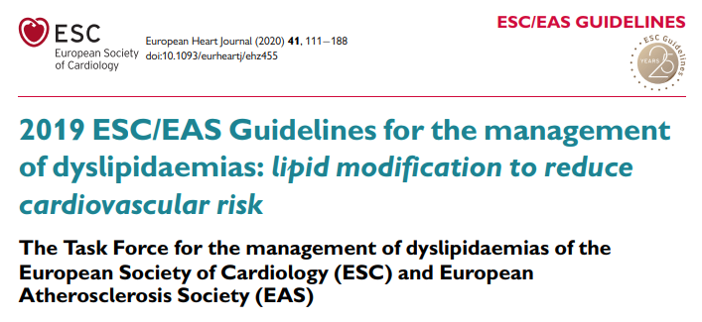
European Heart Journal (2016) 37, 2999–3058

Slide 59
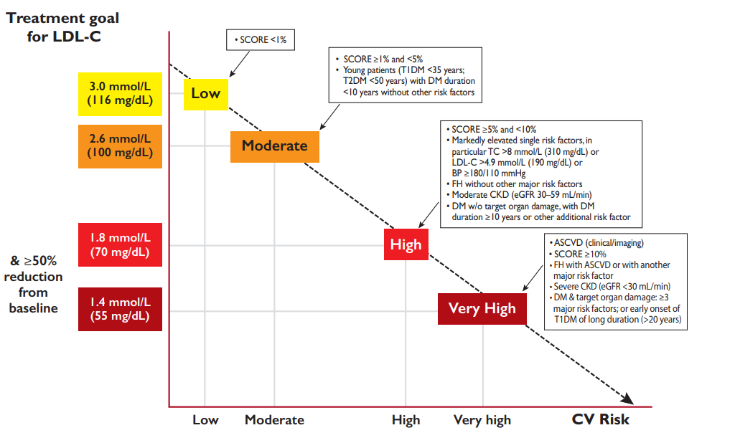
ESC/EAS and Risk Assessment in Secondary Prevention
1.0 mmol/L
(40 mg/dL)
Recurrent vascular events <2 years
EHJ doi:10.1093/eurheartj/ehz455

Slide 60
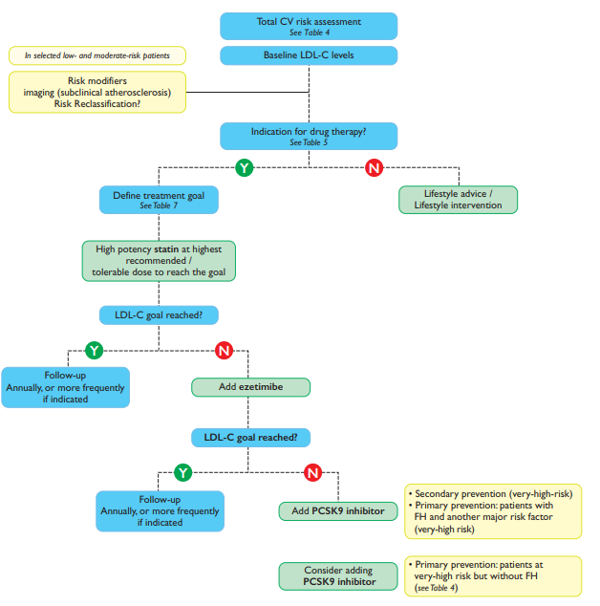
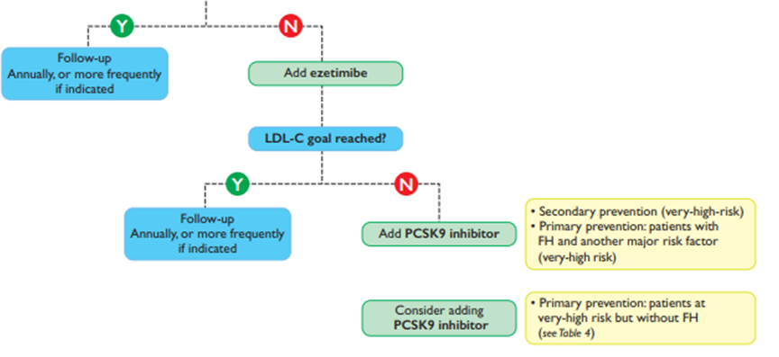
ESC: Implications for therapy
Eur Heart J. 2020;41:111-188

Slide 61
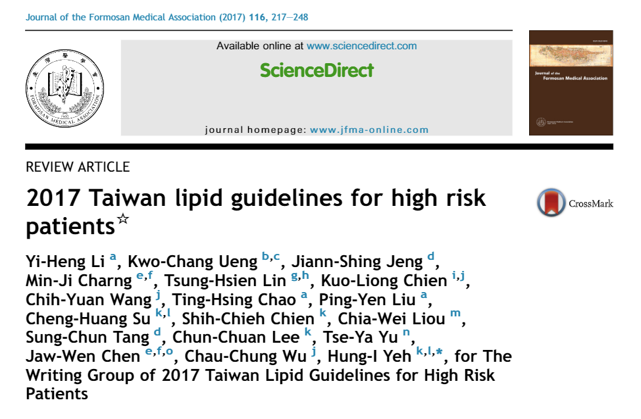
J Formos Med Assoc. 2017 Apr;116(4):217-248.

Slide 62
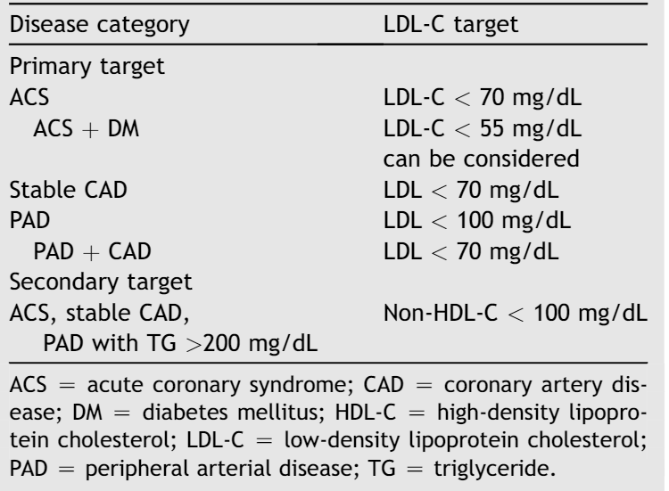
2017 Taiwan Lipid Guidelines
Use absolute LDL-C goals
J Formos Med Assoc. 2017 Apr;116(4):217-248.

Slide 63
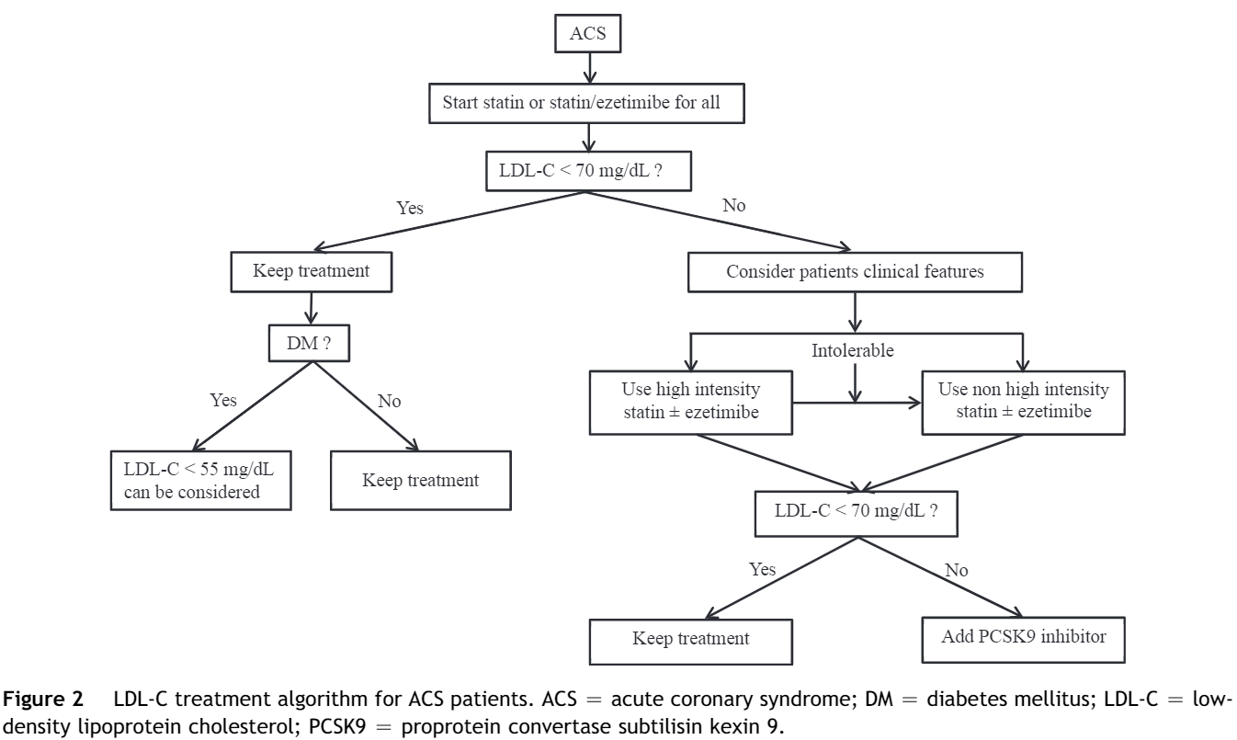
2017 Taiwan Lipid Guidelines
J Formos Med Assoc. 2017 Apr;116(4):217-248.

Slide 64
2017 Taiwan Lipid Guidelines
Ezetimibe alone can be considered an alternative to statins in patients who have statin contraindications or intolerance. (COR IIa, LOE C)
Ezetimibe can be used in combination with statins when the therapeutic target is not achieved at maximal tolerated statin dose. (COR IIa, LOE B)
For patients with ACS, routine use of the moderate intensity statin combined with ezetimibe may be an alternative. (COR IIa, LOE B)/
PCSK9 inhibitors should be considered in highly selected patients with
  FH (COR I, LOE A)
  Statin resistance (patients with CV disease not at LDL-C goal despite maximally tolerated statin + ezetimibe) (COR IIa, LOE B)
  Statin intolerance (COR IIa, LOE B)
J Formos Med Assoc. 2017 Apr;116(4):217-248.

Slide 65
Patient Case: Summary
68-year-old man with prior MI 3 years ago, 3-vessel CABG 2 years ago, and symptomatic peripheral arterial disease presents for follow up claudication and ASCVD risk reduction
Past medical history:
  Essential hypertension
  Type 2 diabetes mellitus
Lipid lowering therapy
  Atorvastatin 80 mg
Labs
  LDL-C 84 mg/dL, A1c 6.9%
  % reduction in LDL-C 48%
Multiple high-risk features identified in IMPROVE-IT
Type 2 diabetes mellitus
Hypertension
Peripheral arterial disease
Prior CABG

Slide 66
Patient Case: Summary
68-year-old man with prior MI 3 years ago, 3-vessel CABG 2 years ago, and symptomatic peripheral arterial disease presents for follow up claudication and ASCVD risk reduction
Past medical history:
  Essential hypertension
  Type 2 diabetes mellitus
Lipid lowering therapy
  Atorvastatin 80 mg
Labs
  LDL-C 84 mg/dL, A1c 6.9%
  % reduction in LDL-C 48%
Characteristics of patients
in FOURIER Trial
Type 2 diabetes mellitus
Peripheral arterial disease
Multivessel disease
Prior CABG
Polyvascular disease

Slide 67
Patient Case: Summary
68-year-old man with prior MI 3 years ago, 3-vessel CABG 2 years ago, and symptomatic peripheral arterial disease presents for follow up claudication and ASCVD risk reduction
Past medical history:
  Essential hypertension
  Type 2 diabetes mellitus
Lipid lowering therapy
  Atorvastatin 80 mg
Labs
  LDL-C 84 mg/dL, A1c 6.9%
  % reduction in LDL-C 48%
Guidelines support addition of ezetimibe and/or PCSK9 inhibitor

Slide 68
Summary:
Non-statin Therapies in Clinical Practice
Low levels of LDL-C appear to be safe based on short-term data
Reduce first and recurrent CV events
PCSK9i
  Not associated with new onset diabetes or worsening diabetes control
  Greater benefit in patients with recent MI, multivessel disease, type 1 MI
  PAD
    Reduce MACE in patients with symptomatic PAD
    Reduce major adverse limb events
  Lp(a)
    Lower Lp(a) and greater reductions in patients with higher baseline levels
    Greater CV risk reduction in patients with high Lp(a)

Slide 69
Thank you!

Slide 70
Back Up/Resource Slides

Slide 71
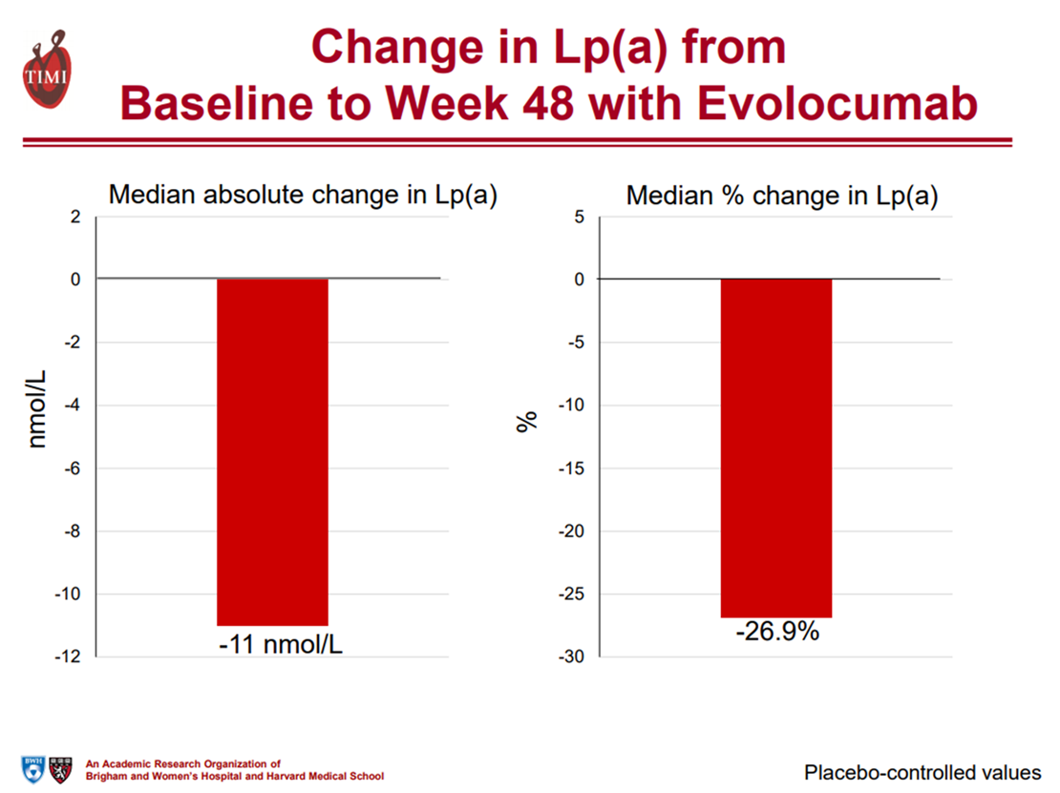
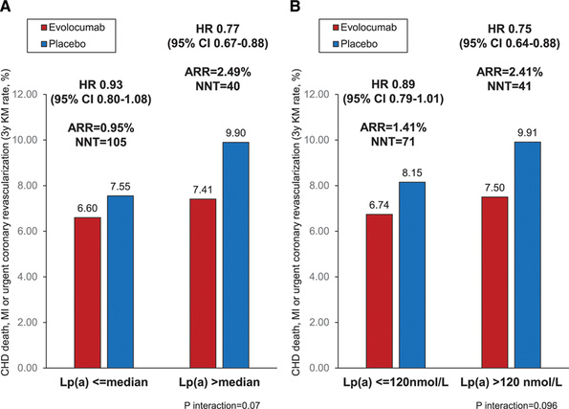
Lp(a), PCSK9 Inhibition, and CV Risk: Insights From the FOURIER Trial by Baseline Lp(a)
Circulation. 2019;139(12):1483-1492

Slide 72
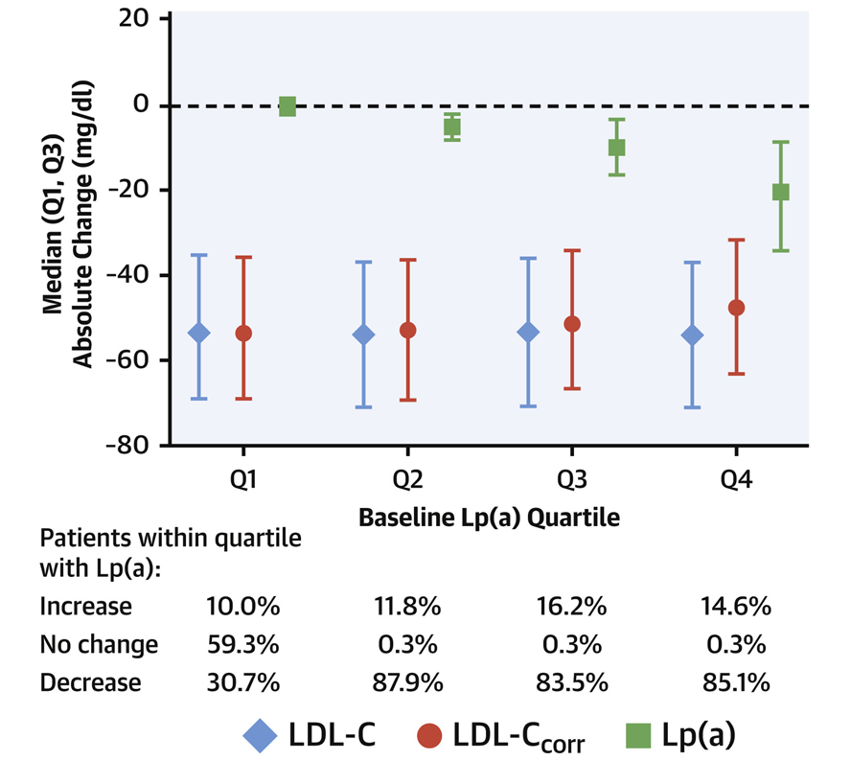
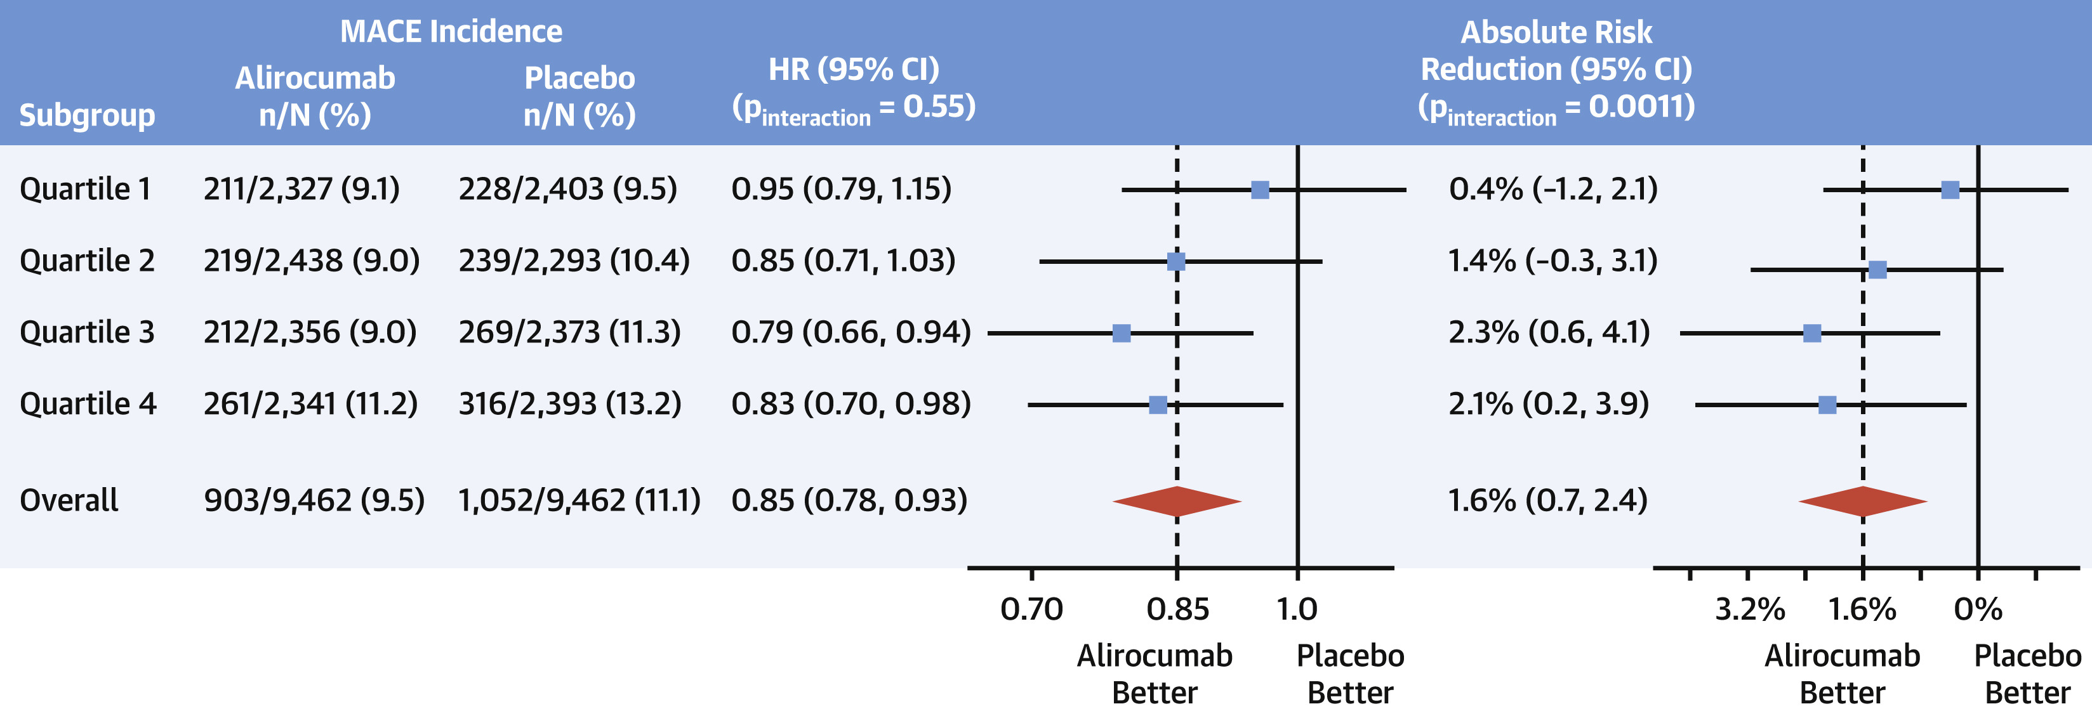
Effect of Alirocumab on Lp(a) and CV Risk After ACS
Absolute Change From Baseline to Month 4 in LDL-C,
LDL-Ccorr, and Lipoprotein(a) Levels
Absolute Treatment Effect on MACE by Baseline Lipoprotein(a) Quartile
J Am Coll Cardiol. 2020;75:145-147

Slide 73
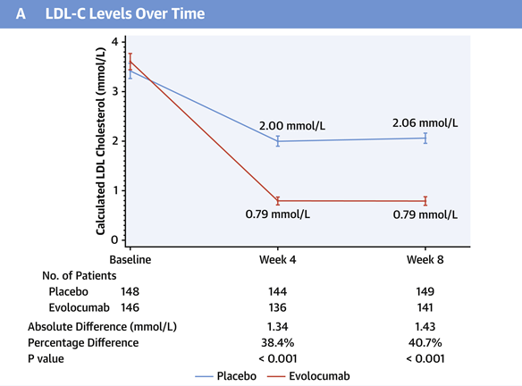
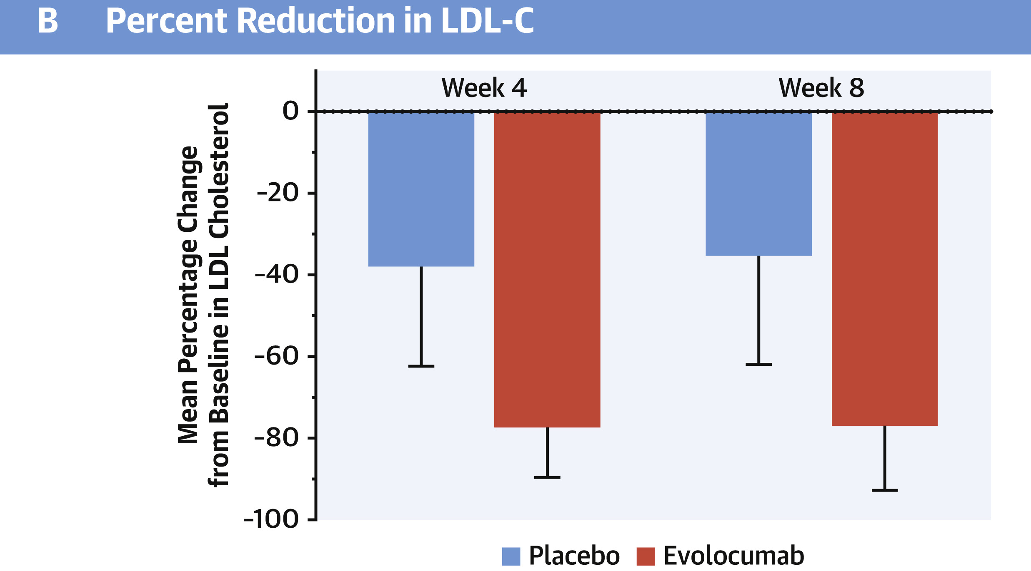
Evolocumab for Early Reduction of LDL Cholesterol Levels in Patients With Acute Coronary Syndromes (EVOPACS)
J Am Coll Cardiol 2019;74:2452–62
-52 mg/dL
-55 mg/dL
Difference in mean percentage change from baseline: 40.7%
308 patients hospitalized for ACS with elevated LDL-C levels
Most patients (78.2%) had not been on previous statin treatment.
Randomized to atorvastatin 40 mg + evolocumab vs. atorvastatin 40 mg + placebo
LDL-C levels <1.8 mmol/l (70 mg/dL) were achieved at week 8 by 95.7% of patients in the evolocumab group versus 37.6% in the placebo group.

Slide 74
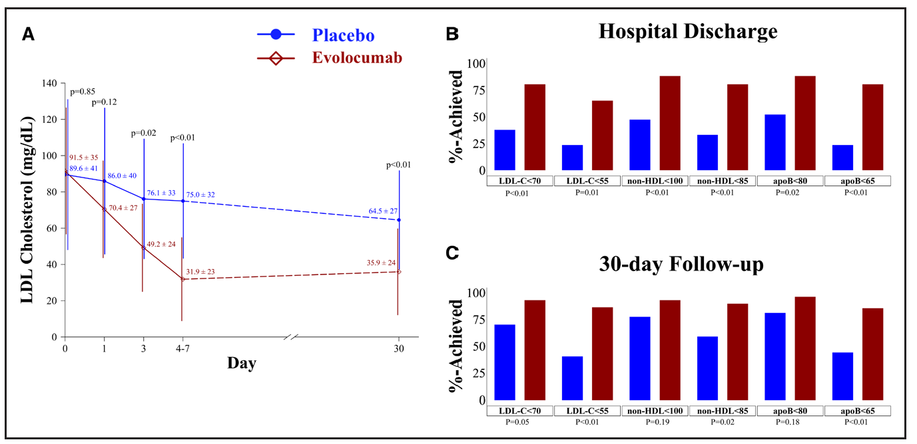
Effect of Evolocumab on Atherogenic Lipoproteins During the Peri- and Early Post-infarction Period (EVACS)
57 patients with NSTEMI randomly assigned to a single dose of evolocumab SQ 420 mg or matching placebo within 24 hours of presentation
LDL-C in evolocumab group was on average 28.6 mg/dL (0.74 mmol/L) lower than in placebo group at 30 days (P<0.0001).
Circulation. 2020;142:419–421

Slide 75
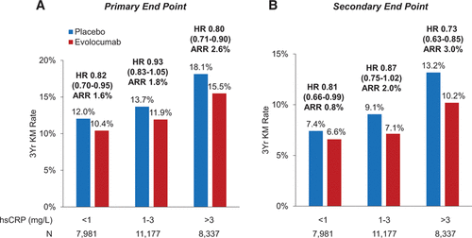
Inflammatory and Cholesterol Risk in the FOURIER Trial
LDL-C reduction with evolocumab reduced CV events across hs-CRP strata with greater absolute risk reductions in patients with higher-baseline hs-CRP.
Event rates were lowest in patients with the lowest hsCRP and LDL-C.
Erin A. Bohula. Circulation. 2018;138:131-140

