Slide 1
2019 Train-the-Trainer Workshop: The Key Components to Creating Engaging Educational Sessions
Clinical Case Study
Maria Cristina Izar, M.D., Ph.D.
Assistant Professor of Medicine, Universidade Federal de São Paulo
President of the Department of Atherosclerosis, Brazilian Society of Cardiology 2018-2019

Slide 2
Disclosures
Advisory board participation
Amgen

Slide 3
Main Objectives
Discuss residual cardiovascular risk evaluation and management
Review recent CV outcomes trials with addition of non-statin medication to statin therapy
Compare and contrast 2 major RCTs with PCSK9 inhibitors (PCSK9i)
Identify groups of patients who have demonstrated benefit with PCSK9i

Slide 4
ACC, male, 14 years old, student
High cholesterol diagnosed in 2016
Pediatrician noticed high blood cholesterol in routine exam at age 14
Secondary causes of hypercholesterolemia were ruled out
Prescribed simvastatin 20 mg, with poor response
Previous history not relevant
Father aged 46 has high cholesterol, mother aged 45, apparently healthy; brother (26) apparently healthy. Grandfather had AMI at age 51
Lebanese descent
Exercises 4 days per week; non-smoker, does not take alcohol or drugs

Slide 5
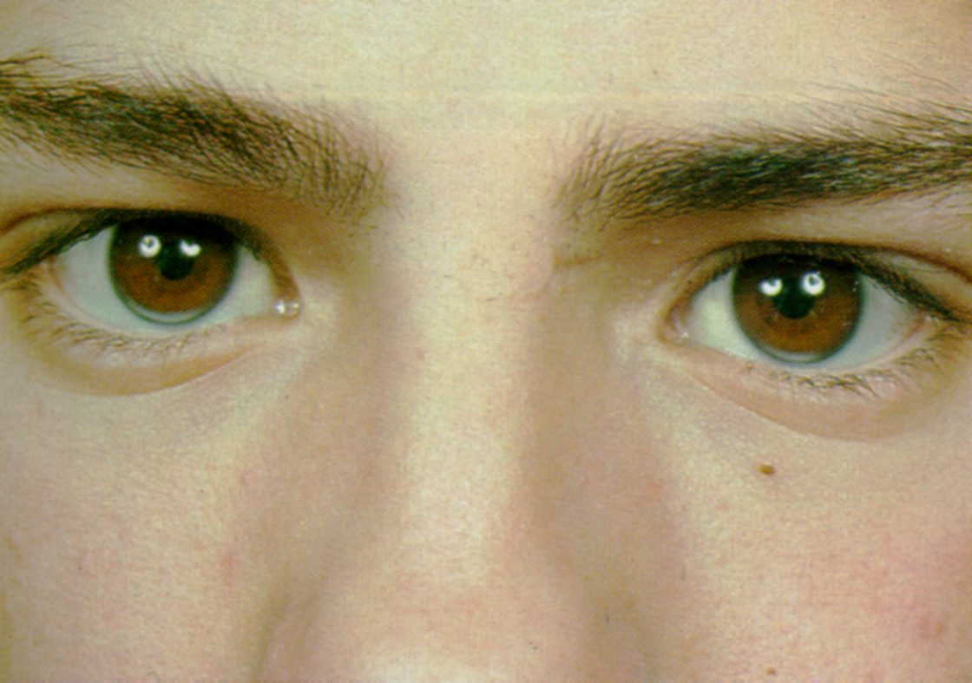
ACC, male, 14 years old, student

Slide 6
ACC, male, 14 years old, student
Genetic test using NGS (LDLR, PCSK9, APOB, LDLRAP-1, LIPA)
LDLR: NM_000527:exon 14: c.2043C>A:p.C681* heterozygous (described, premature stop codon, pathogenic.
This mutation has been associated with FH by Stenson, PD, Mort, M, Ball, EV, Howells, K, Phillips, AD, Thomas, NS, Cooper, DN (2009). The human mutation database: 2008 update. Genome Med, 1,1:13 (http://www.hgmd.cf.ac.uk)

Slide 7
Child-parent cascade
High TC
High TC +
Fatal AMI age 51 yo
AMCS
Healthy
RC, High TC + early CHD
EKC
healthy
JCC, 28 anos??
ACC
High TC+ FH early CHD

Slide 8
RC, male, 46 years old, divorced, lawyer
High cholesterol since age 36
Irregularly treated with simvastatin 20 mg/d.
Asymptomatic
FH – father died at age 51 of AMI. Son has high blood cholesterol
Habits – exercises irregularly, current smoking , 29 years-pack.
Medication: Simvastatin 20 mg
Corneal arcus
Tendon thickening
81 kg 1,71 m BMI 23,9
BP 120/80 mm Hg HR: 58bpm

Slide 9
ECG: inferior and lateral q waves
Notes:
Ritmo sinusal
Área Eletro Inativa Inferior e Lateral
ARV

Slide 10
Angio-CT
RCA totally occluded with collaterals from LCX
LAD calcified, with 2 moderate lesions
LCX with moderate lesion
CAD-RADS score - 5
Normal LV

Slide 11
Coronary angiogram
Dominant RCA
LMCA with no obstructions
LAD calcified 60% stenosis on medium portion
1st septal branch with 80% ostial stenosis
1st marginal with diffuse moderate atherosclerosis and 80% ostial stenosis
RCA occluded in ostium
Collaterals from LCA to RCA, Rentrop III (complete filling)
LV with preserved global systolic function and mild inferior-basal hypocinesia

Slide 12
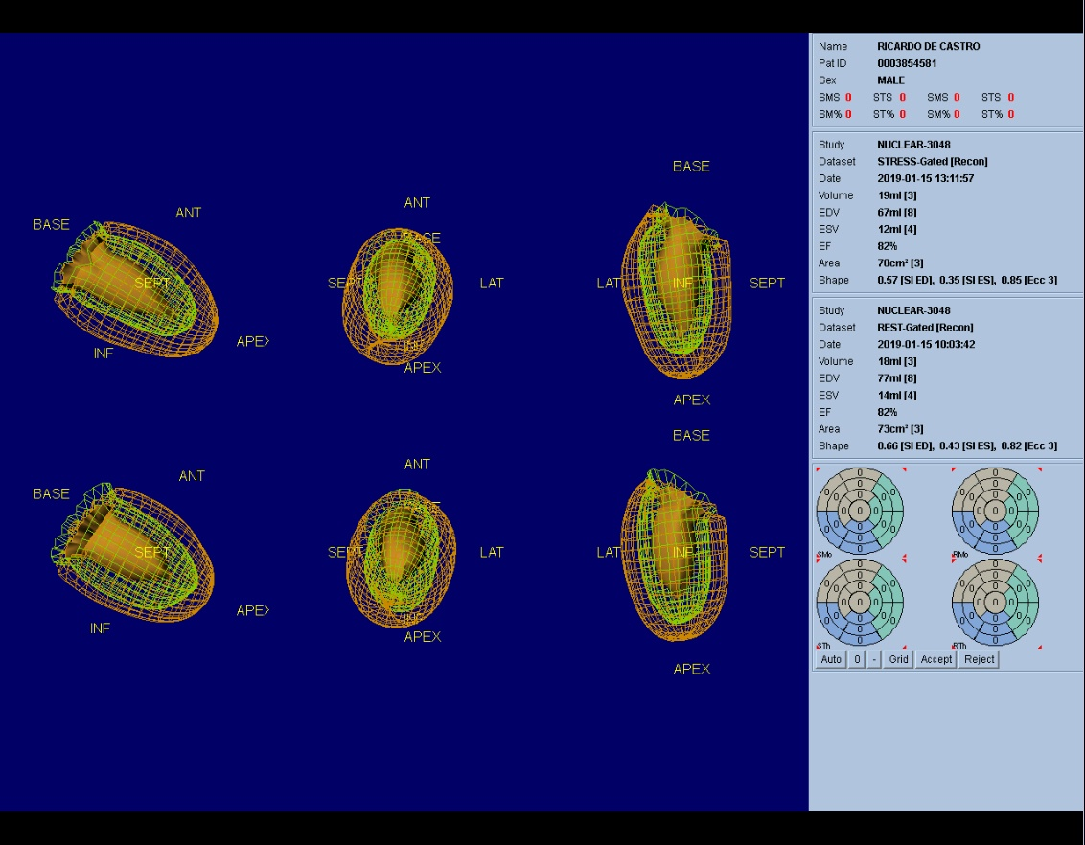
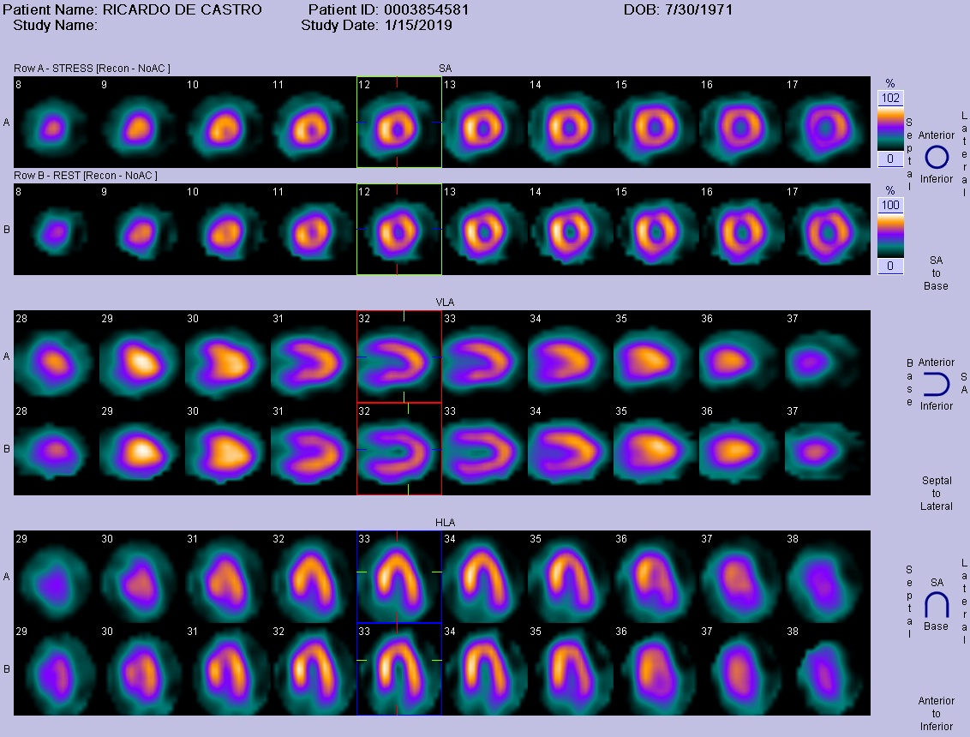
Myocardial perfusion scintigraphy
EF: 82% before and after stress
No myocardial ischemia detected

Slide 13
Laboratory
 | CT | HDL-C | LDL-C | non-HDL-C | TG | APO A1 | APO B | Lp(a)
baseline | 485 | 31 | 376 | 454 | 390
Simvastatin 20 mg/d | 333 | 31 | 265 | 302 | 195 | 133 | 277 | 43,7
Atorvastatin 80 mg/d | 288 | 38 | 228 | 250 | 110
Atorvastatin 80 mg/d + Ezetimibe | 221,5 | 43,8 | 156,24 | 177,7 | 107,3
Atorvastatin 80 mg/d + Ezetimibe | 180,4 | 43,2 | 119,59 | 137,2 | 88,3

Slide 14
Dutch Lipid Clinic Network criteria for diagnosis of heterozygous familial hypercholesterolaemia in adults
A ‘definite FH’ diagnosis can be made if the subject scores 8 points.
A ‘probable FH’ diagnosis can be made if the subject scores 6 to 8 points.
A ‘possible FH’ diagnosis can be made if the subject scores 3 to 5 points.
An ‘unlikely FH’ diagnosis can be made if the subject scores 0 to 2 points.
21 points!!!

Slide 15
Definition of severe FH
Defesche J et al. Nat Rev Dis Primers. 2017 Dec 7;3:17093. doi: 10.1038/nrdp.2017.93.

Slide 16
Criteria for severity
Age> 40 without treatment;
Smoking;
Male sex;
Lipoprotein(a) >50 mg/dl;
HDL-C < 40 mg/dL;
Hipertension;
Diabetes mellitus;
Family history of premature ASCVD in 1o degree relatives (men < 55 and women < 60 years old);
CKD (TFG <60 ml/min);
BMI > 30 kg/m2
Defesche J et al. Nat Rev Dis Primers. 2017 Dec 7;3:17093. doi: 10.1038/nrdp.2017.93.

Slide 17
Treatment
Discussion:
Stopped smoking;
No indication for coronary revascularization;
Maximally treated
Indication for PCSK9 inhibitors??
This patient has unmet needs!!
Fits clinical trials??
Glagov, Fourier??

