Slide 1
The Dreaded R-Word……….. Remediation!
John McPherson, MD FACC
Professor of Medicine
Vice-Chair for Education
Vanderbilt University Medical Center

Slide 2


Disclosures
I am an IM residency director
Many of our residents (>10/year) apply to your fellowship programs

Slide 3

Dr. Beth Ann Yakes

Slide 4
Learning Objectives
Demonstrate a structured, consistent approach to problem trainees
Design a system for documentation
Discuss available tools to address remediation needs in all core competency domains
Address liability concerns/questions related to remediating learners in medical education

Slide 5
Outline
Describe the magnitude of the problem
Present a stepwise approach to creating a remediation program
Use a sample case to practice constructing a remediation plan
Discuss best practices to avoid liability

Slide 6
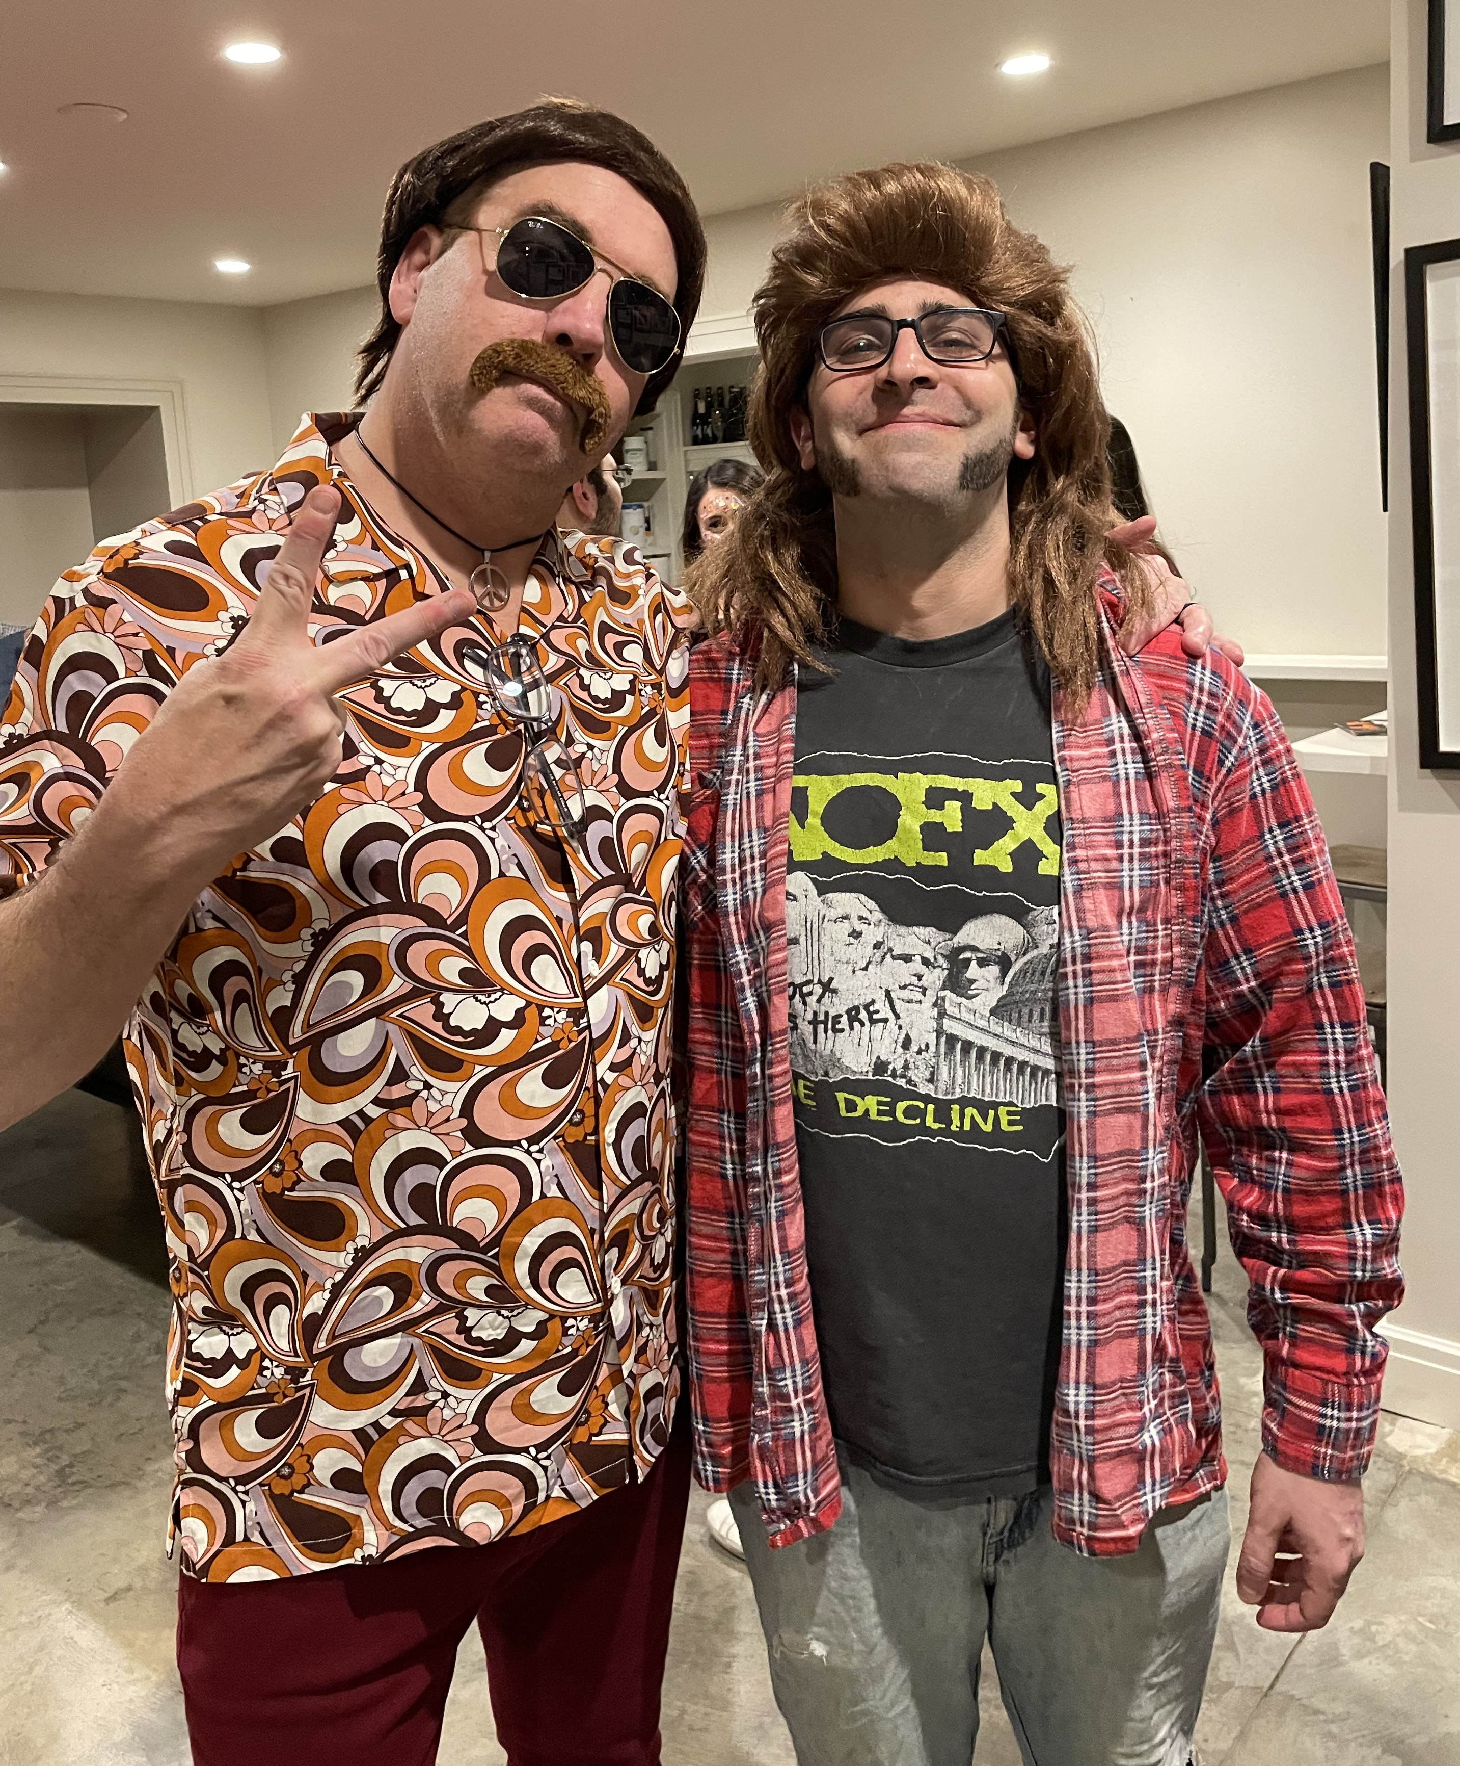

The Problem Fellow
Notes:
So, what do problem residents look like at your institution?
In a few words or phrases, describe to the group what you all are currently dealing with or have dealt with
Definition of the “Problem Resident”
As early as 1988, medical educators described the problem resident as “a learner whose academic performance is significantly below performance because of a specific affective, cognitive, structural, or interpersonal difficulty” (2).
With the transition to competency based assessment, a problem resident can now be described as “one who fails to meet the standard of performance in one or more ACGME competencies” (3).

Slide 7
Why does it matter?
Struggles in fellowship can predict struggles in future practice
Working with learners is both an honor and a responsibility
Hidden costs of problem fellows
Problem fellows are everywhere
Notes:
Why is it important to identify struggling residents?
Papadakis Annals, 2008: Looked at 66K physicians entering residency in 10 year period; looked at annual evals and ABIM scores and future unprofessional behavior
Low Professionalism score in residency + poor exam score predicted twice the risk of unprofessional behavior (31% related to substandard care)
Papadakis 2005 – med students: Strong association between unprof. behavior and future disciplinary action
Case control study : Association of disciplinary action against practicing physicans with prior unprofessional behavior in medical school
235 graduates of 3 medical school disciplined by state boards 1990-2003 compared to 469 control
Strong association (OR 3.0, attributable risk of 26%) between prior bad behavior and future problems.
2. Therefore it isn’t just our honor to work with learners, it is our responsibility to turn out a qualified workforce.
3. Hidden costs: affect patient care in your own institution; affect morale of residents and students
Problem Residents are Everywhere: This likely affects , or will affect, or has affected, everyone in this room. I am not going to review the data on how common it is to have struggling learners, but the reference list is available to you if you need some data to go back to your institutions.
The real question: So, What are we doing about all these problem residents who are demonstrating deficiencies in multiple areas?
Programs have been trying to remediate residents with varying levels of success:

Slide 8
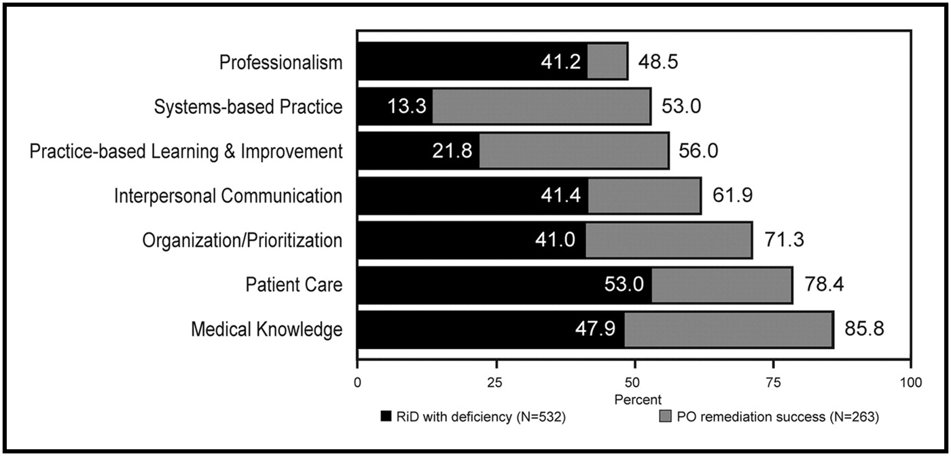
IM Residencies 2008
Dupras. Am J Med 2012
Notes:
IM Chart:
In 2008 a group from Mayo did Survey of IM Program Directors. 72% of 372 programs responded.
73.5% reported having residents in difficulty.
BLACK BARS represent percent of residents with deficiency in that area. GRAY represents perceived likelihood of successful remediation of those residents.
IM residents requiring remediation often have deficiencies in multiple competencies.
Program directors reported variable success: most successful for MK (86%); least successful for Prof (41.2%).
Application materials rarely identify individuals at risk.
Deficiencies rarely (5.6%) self-identified.

Slide 9
Prognosis
Insight
Ability to incorporate feedback (receptiveness)
Professionalism

Slide 10
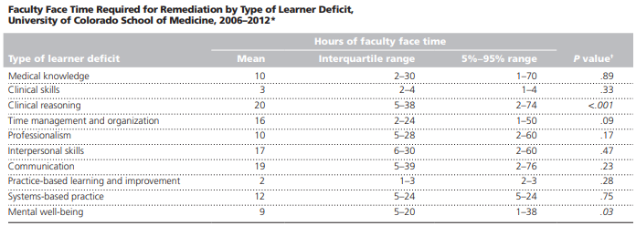
Acad Med. 2014;89:352–58
Notes:
But all that work takes a lot of faculty time – so you might be interested in this data if you go back and try to convince leadership to invest faculty time and support in this process.
Our approach here at Vanderbilt is actually modeled off the approach described by Jeanneate Guerrasio in her book and in her writings.
Her prospective study is the closest thing we’ve got to a best-practice guideline, and while our numbers here at Vanderbilt have been small, I think I can say that we have demonstrated similar outcomes.

Slide 11
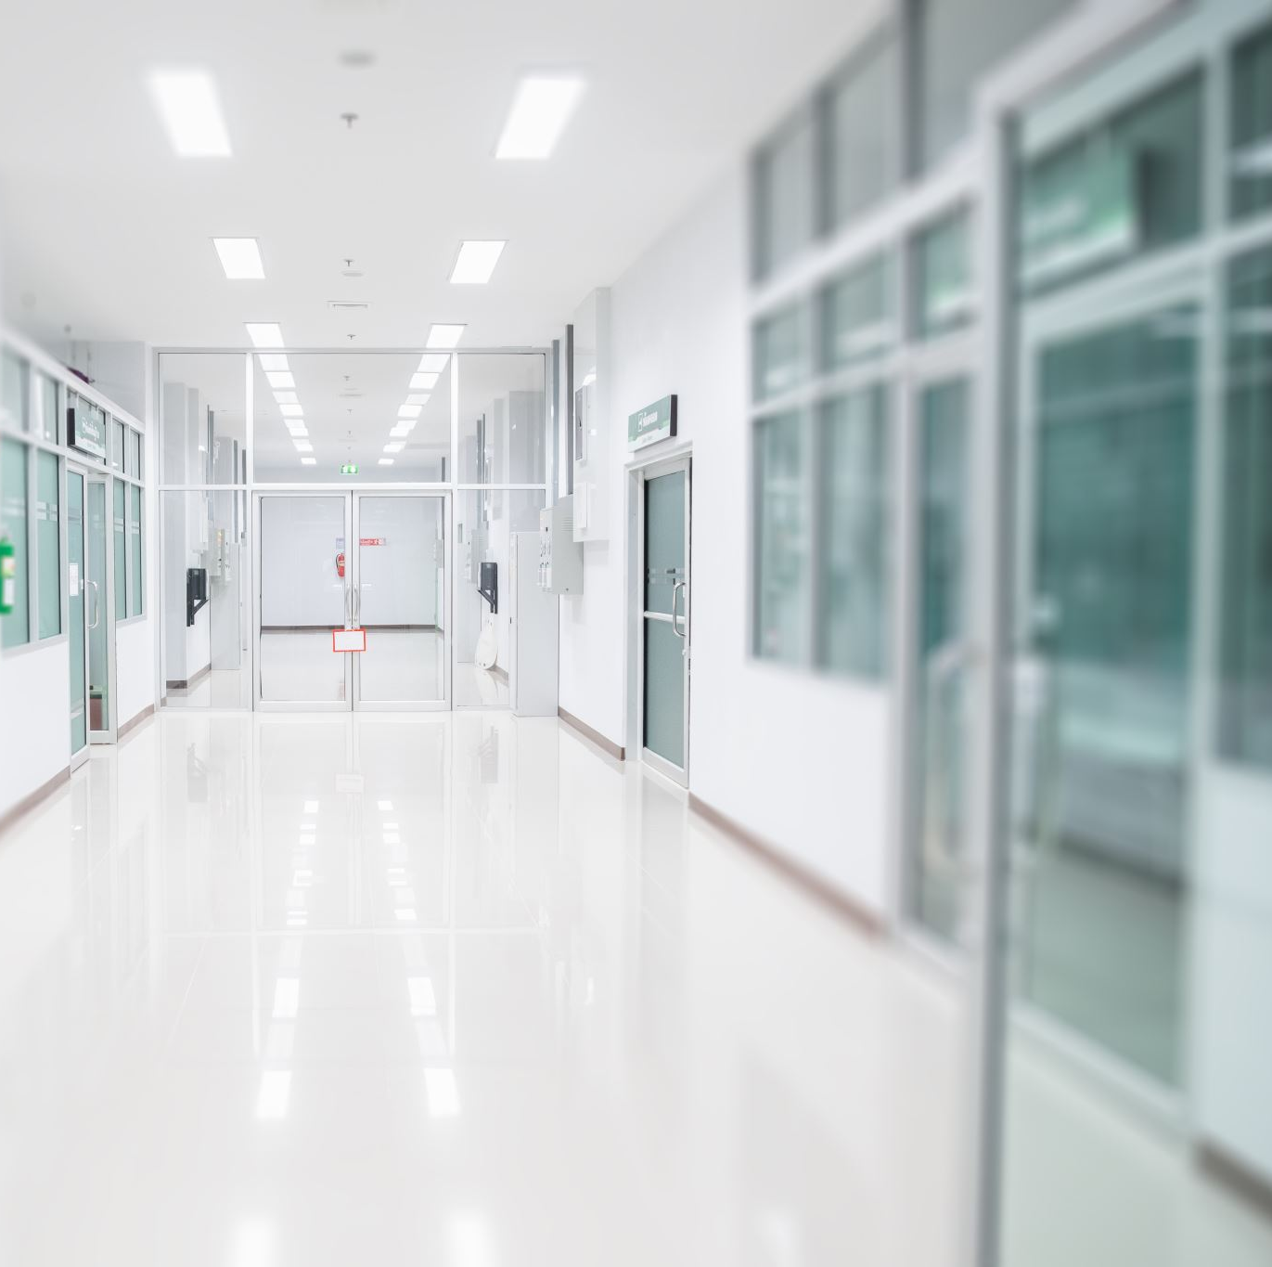
We are gatekeepers for patient safety.

Slide 12

Verification:
Dr. X has satisfactorily completed the requirements of the ACGME-approved fellowship program here at Ivory Tower University Medical Center and has demonstrated the knowledge, skills and behaviors necessary to enter autonomous practice.
Signature: _____________________________________________________

Slide 13
Approach to Evaluation and Remediation
1 Identify & Define the Problem
2 Engage Fellow in Self-reflection
3 Outline the Improvement Plan
4 Implement the Improvement Plan
5 Follow-up and Decision-making

Slide 14
Our Problem Fellow
Dr. X is the gregarious and outgoing unofficial social chair of his cardiology fellowship. His evaluations consistently comment on his warm personality, his empathy to patients, and his concern for his colleagues. However, recent evaluations have hinted at slow clinical reasoning in the CCU setting and inability to perform basic procedures. During a recent fellow-led QI project, Dr. X was noted to have worse patient outcomes compared to his colleagues.

Slide 15

How do PDs become aware of problem fellows?
Notes:
Use flip-chart here…..

Slide 16
Problem Identification
Most common event:
Direct observation
Critical incident/complaint
Poor performance (conferences/ITE)
Neglecting patient care responsibilities
Most common individuals:
Chief residents/fellows
Attending thru verbal comments
Other fellows
^{Yao and Wright, 2000}
Notes:
Problem Identification: ASK AUDIENCE
…. So there are a variety of ways in which a potential problem by come to our attention,
GO THROUGH SLIDE
vague - NOT in the context of a specific competency; NOT framed in terms of failure to meet objectives
it may be only a subjective impression - a “gut feeling“
it may be potentially explainable/excusable or even defensible
at this point - there is some uncertainty about the nature of the problem OR if there really is a problem
at this point its prudent to proceed to the next step, perhaps with the benefit of doubt favoring the resident

Slide 17
Problem Identification
Not common:
Written comments from attendings
Self reporting
Patient concerns
^{Yao and Wright, 2000}
Notes:
Problem Identification: ASK AUDIENCE
…. So there are a variety of ways in which a potential problem by come to our attention,
GO THROUGH SLIDE
vague - NOT in the context of a specific competency; NOT framed in terms of failure to meet objectives
it may be only a subjective impression - a “gut feeling“
it may be potentially explainable/excusable or even defensible
at this point - there is some uncertainty about the nature of the problem OR if there really is a problem
at this point its prudent to proceed to the next step, perhaps with the benefit of doubt favoring the resident

Slide 18

Warning Signs
Disorganization (arrives late, drops notes, etc)
Distracted (poor follow through on tasks)
Disheveled (substance use?)
Decreased Knowledge
Disability (trouble synthesizing information)
Despondent
Dependent on senior fellows (or others)
Disordered personality (ADHD, borderline)
Direct about-face
Notes:
Sometimes our gut feeling that something is wrong is because we notice some of these behaviors on the slide.
These may be warning signs that something MIGHT be wrong.
But it takes some more investigation to be sure….

Slide 19

Problem Investigation
Preliminary data gathering
Contributing factors
Look for patterns
List the observable deficiencies
Check for bias!
Notes:
Once a potential problem comes to our attention, we should engage in some sort of preliminary inquiry to determine if there is indeed a problem and cause for action, either academic (remediation) or administrative.
While egregious behavior or patient safety concerns must be addressed immediately, more often the problem is less urgent and time can be taken to look for patterns of behavior that arise in a variety of scenarios.
This involves gathering more data, clarifying the observations, obtaining examples, - talking to involved parties including faculty, CR and obtain the perspective of the resident him/herself. Speak to other staff who have worked with this individual - is there corroborating information -(perhaps the expectations of the individual supervisor are not reasonable) Our preliminary inquiry may tell us exactly what the problem is and how to remediate it, or perhaps more likely will provide us with some guidance for further evaluation or observation
Think about contributing factors: are there system problems that either explain or contribute to the problem - personality differences, carrying too many patients, being on call too frequently, having a busy service and an off-service intern and a nonsupportive attending.
Once you have collected more information, look for patterns that arise rather than individual instances. Especially for professionalism, focus on the PATTERN, not individual instances. Residents will try to explain away individual instances but focusing them back on the pattern that is being observed may help them gain insight
The program director should define those specific patterns of observable deficiencies that, optimally, show up in a number of different places, making sure to focus solely on observed behaviors that can be explicitly described rather than focusing on personality traits or personal characteristics. FOR EXAMPLE: Describe the behavior: “Has to be asked 2-3 times to complete a task. Arrives late to rounds. Uses accusatory language in daily progress note. Left for home prior to getting afternoon lab results back.”

Slide 20
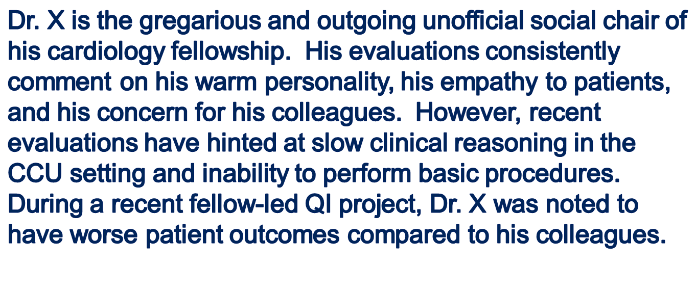
Our Problem Fellow
Further investigation shows that he is still unable to perform uncomplicated procedures without assistance and he leans heavily on his colleagues during critical care rotations.

Slide 21
CCC Fellow Improvement Plan: Dr. X
What is the deficiency | Competency | Action Plan | Measures | Determination of Success | Timeline
1. Unable to care for complex critically care patients without assistance from colleagues | PC, MK | 1. Assigned reading/textbooks (reviewed by Improvement Coach) 2. Metacognition skills to improve clinical reasoning (SNAPPS, Reverse Presentations, Illness Scripts, Persuade the MD, Chart-stimulated Recall etc) 3. Improvement Coach will discuss goals with his CCU and procedure teams | 1. Direct observations by Peer Coach, CCU team, surgical team 2. Indirect observations by Improvement coach 3. Inpatient evaluations (multisource evals) | Milestone evaluations of 3.0 with rare 2.5 in the areas of PC, MK | 0/0/00
2. Unable to perform basic procedures competently w/out assistance | PC, MK | 1. Simulation exercises arranged by Coach. | Inpatient evaluations (multisource evals) | Milestone evaluations of 3.0 with rare 2.5 in the area of PC | 0/0/00
3. Unable to accept constructive feedback and utilize patient-care data/outcomes to improve patient care | PBLI, Prof | 1. Reflection exercises arranged by Improvement Coach centered on acceptance of feedback as a component of Emotional Intelligence 2. Improvement Coach will oversee a second PBLI project and measure outcomes | 1. Q2-week meetings and assessment of readiness to change as evaluated by Improvement Coach 2. Outcome of second PBLI project | Improvement in PBLI and Prof assessment done by Improvement Coach at meetings | 0/0/00
Notes:
Action Plan: Should be specific to the behavior you described. Should be able to be done in a short time period. Don’t try to pick an action plan for every single item you observe – picking one at a time and doing it well is more effective than biting off more than you can chew.
For example: knowledge deficits need additional assigned reading. But clinical reasoning deficits may benefit from faculty facilitated tools such as the ones listed here on the screen. Procedural deficits may benefit from a Sim Center, while professionalism issues require more intensive observation and reflection opportunities with guidance from faculty observers.
Optimally they will describe the Action Plan so that you have their buy-in, focus on the goal being about the patient (or about their own career depending on how much insight they showed).
Select measures that will be monitored to see if the plan is working. And then select specific goals that must be met to know that the remediation plan has been successful.
BE sure to define what successful remediation will look like – this includes what you will measure to see if you’ve been successful
For example: We will measure the number of nursing complaints and Success is no further veritas or nursing complaints in the next 12 months.
How do you know what action items to assign?

Slide 22
Sample Action Items
Medical Knowledge | Patient Care | Communication | Professionalism
ACCSAP questions | Review pre-rounding & presentation templates | Standardized patient scenarios in OSCE format | Assigned readings on Emotional Intelligence
ACCSAP Reading Plan | Work with peer coach to increase efficiency | Chart/Note review | Coaching on Feedback (giving/receiving)
Chart-Stimulated Recall | CardioNerds Podcast: clinical reasoning | Direct Observation on inpatient rounds w/ immediate feedback | Journal writing/Reflection exercises
Build Illness Scripts https://clinicalproblemsolving.com/ | Direct Observation on rounds w/ immediate feedback | Direct Observation in family meetings w/ immediate feedback | Metacognition activities
Build diagnostic frameworks/schema: CardioNerds | Bedside Exam Skills: Stanford 25 videos | Direct Observation in clinic w/ immediate feedback | Referral to EAP for individualized coaching
Utilize ITE report, focus on content w/ lowest percentile | Human Dx App: participate in Global Morning Report | Attend Crucial Conversations conference submit summary (or read book) | Complete institutional modules for reminders on specific content (ie. sexual harrassment)
Notes:
It’s worth building a toolkit of remediation resources ahead of time so that you are prepared to tackle a variety of competency deficits.
I am an internist and so this chart is understandably medicine-centric, but it can serve as an example of how you can begin to build a toolkit within your own field and specialty specific to the types of deficits that you see in your learners.

Slide 23
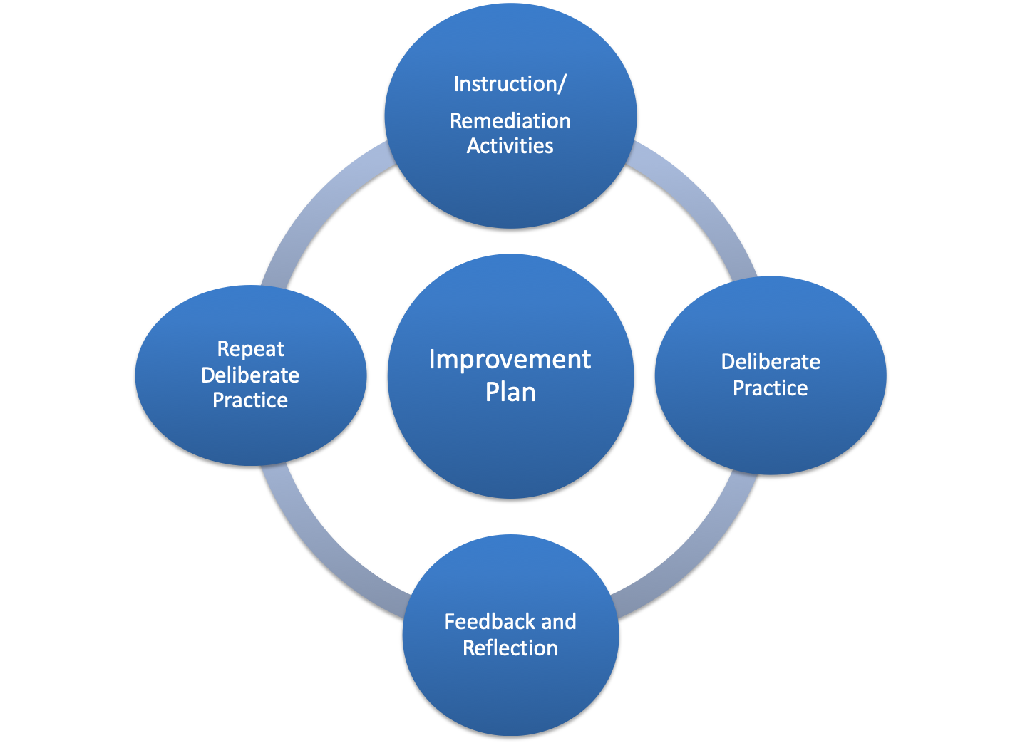
Notes:
Once you have decided on the specific action plan, you have to engage the Learner in deliberate practice, give them immediate feedback, walk them through the process of reflecting on that feedback and deciding how they can change their behavior, then allow them deliberate practice again with feedback and reflection and the cycle repeats itself periodically throughout the remediation period.
This process will look very different depending on the milestone and deficiencies that are being remediated.
Organization -- real-time feedback during a busy day on the wards may be needed
Clinical reasoning - review H&Ps, chart-stimulated recall →show bias & reasoning gaps
Professionalism -- sitting down with a faculty member → EI, how to take feedback

Slide 24

Implement the Plan
Get fellow buy-in
Assign mentor/advocate
Document everything
Protect fellow confidentiality
Notes:
Resident buy-in
FRAME as continuous education, opportunity for improvement rather than PUNITIVE. We want to send the message that we are trying to help the resident improve and reach program objectives – if it feels disciplinary, we jeopardize our ability to work constructively with the resident to reach our mutual goals... Our program we call it an “improvement plan” – not remediation plan.
We need to emphasize however, that it is ultimately the resident’s responsibility to improve.
if the resident can help define the action plan or have a say in it, they are more likely to buy into the process. For example, if you want to assign the resident a peer coach to help them work on organizational skills, allow them to pick the coach.
We need to decide at what level the resident will be functioning during the remediation period - from the clinical standpoint related to patient safety concerns and from the training standpoint - it the resident currently able to continue training or is a leave of absence or reduced work load (noncredited) appropriate at this time.
Consider assigning a mentor. Peer mentor, a facutly mentor, or both. Walk the resident through the action plans, who can meet with them regularly to observe them, give them feedback, and then observe them again.
Documents every step of the path, each meeting with the resident, each follow up. We are going to circle back to this idea later, but document each meeting, each action item that is observed and the feedback that is given, each opportunity that you give the learner to remediate and improve.
Consider picking mentors who might naturally be seen observing that resident so was to help protect resident confidentiality. For example, chief residents may be able to say that they are joining rounds to give students feedback when, in reality, they can be called upon to observe and give feedback to your problem resident.

Slide 25
Our Problem Fellow
Dr. X kept up with his additional reading assignments. He was paired with a faculty member in the CCU that directly observed his presentations and gave immediate feedback. He met regularly with his coach for Chart Stimulated Recall work.
He also worked through the assigned Professionalism curriculum and completed journal reflections related to feedback. This was discussed with his coach at regular meetings.
Finally, his elective time was switched to a procedural elective in the sim center.
His evaluations were reassessed at 3 and 6 months.

Slide 26
Challenges to Implementing the Improvement Plan
Notes:
Does portend a poor prognosis, there are some strategies for working with this sub-type of problem learner
Redirecting the learner to focusing on the pattern of behavior rather than perseverate on each individual instance
For this to work well, the learner should be presented multiple examples of the observed behavioral deficiency obtained from a variety of observers (faculty, peers, staff, etc) in a variety of settings.
An additional strategy is teaching the learner the process of metacognition and self-reflection.
Guiding the learner through the process of perspective-taking (ie, considering the perspective of all other parties involved) can teach the doubting learner to to more thoughtfully consider the impact of their behavior on others.
For some learners, however, attaining true insight may not be possible.
Focusing on the potential impact of their perceived behavior on their professional goals can be helpful
While learners may never arrive at the point of admitting that their behavior is problematic, if they can acknowledge that how others perceive that behavior may negatively impact their future medical career and prevent them from meeting professional goals, this alone may encourage sustainable behavior changes.

Slide 27
Approach to Evaluation and Remediation
1 Identify & Define the Problem
2 Engage Fellow in Self-reflection
3 Outline the Improvement Plan
4 Implement the Improvement Plan
5 Follow-up and Decision-making

Slide 28
CCC Fellow Improvement Plan: Dr. X
What is the deficiency | Competency | Action Plan | Measures | Determination of Success | Timeline
1. Unable to care for complex critically care patients without assistance from colleagues | PC, MK | 1. Assigned reading/textbooks (reviewed by Improvement Coach) 2. Metacognition skills to improve clinical reasoning (SNAPPS, Reverse Presentations, Illness Scripts, Persuade the MD, Chart-stimulated Recall etc) 3. Improvement Coach will discuss goals with his CCU and procedure teams | 1. Direct observations by Peer Coach, CCU team, surgical team 2. Indirect observations by Improvement coach 3. Inpatient evaluations (multisource evals) | Milestone evaluations of 3.0 with rare 2.5 in the areas of PC, MK | 0/0/00
2. Unable to perform basic procedures competently w/out assistance | PC, MK | 1. Simulation exercises arranged by Coach. | Inpatient evaluations (multisource evals) | Milestone evaluations of 3.0 with rare 2.5 in the area of PC | 0/0/00
3. Unable to accept constructive feedback and utilize patient-care data/outcomes to improve patient care | PBLI, Prof | 1. Reflection exercises arranged by Improvement Coach centered on acceptance of feedback as a component of Emotional Intelligence 2. Improvement Coach will oversee a second PBLI project and measure outcomes | 1. Q2-week meetings and assessment of readiness to change as evaluated by Improvement Coach 2. Outcome of second PBLI project | Improvement in PBLI and Prof assessment done by Improvement Coach at meetings | 0/0/00
Notes:
Action Plan: Should be specific to the behavior you described. Should be able to be done in a short time period. Don’t try to pick an action plan for every single item you observe – picking one at a time and doing it well is more effective than biting off more than you can chew.
For example: knowledge deficits need additional assigned reading. But clinical reasoning deficits may benefit from faculty facilitated tools such as the ones listed here on the screen. Procedural deficits may benefit from a Sim Center, while professionalism issues require more intensive observation and reflection opportunities with guidance from faculty observers.
Optimally they will describe the Action Plan so that you have their buy-in, focus on the goal being about the patient (or about their own career depending on how much insight they showed).
Select measures that will be monitored to see if the plan is working. And then select specific goals that must be met to know that the remediation plan has been successful.
BE sure to define what successful remediation will look like – this includes what you will measure to see if you’ve been successful
For example: We will measure the number of nursing complaints and Success is no further veritas or nursing complaints in the next 12 months.
How do you know what action items to assign?

Slide 29

Pearls
Structure and consistency!
Document everything
Focus on PATTERN, not individual instances
Require significant improvements
Enlist your DIO/GME early when remediation fails
Notes:
There may be secondary causes that need to be addressed as part of the program
Always maintain a consistent approach. This preserves fairness to every resident, helps protect legal concerns
Document, Document, Document!
Especially for issues of professionalism, try to focus on the PATTERn and not individual instances. Residents will try to explain away individual instances but focusing them back on the pattern that is being observed may help them gain insight into the concerns
Don’t allow small nudges forward to be mistaken for signfiicant improvements in the right direction. It is our responsibility and right to protect future patients from physicians that are unfit to practice medicine

Slide 30

What happens if a fellow is not performing as expected?

Slide 31
Ask why. Ask why EARLY.

Slide 32
Ask why. Ask why EARLY.
Is there appropriate support available to address the why?

Slide 33
Ask why. Ask why EARLY.
Is there appropriate support available to address the why?
Have they been directly informed?

Slide 34
Ask why. Ask why EARLY.
Is there appropriate support available to address the why?
Have they been directly informed?
Have they been told of the expectations?

Slide 35
Ask why. Ask why EARLY.
Is there appropriate support available to address the why?
Have they been directly informed?
Have they been told of the expectations?
Have they been given objective examples of them not meeting expectations?

Slide 36
Ask why. Ask why EARLY.
Is there appropriate support available to address the why?
Have they been directly informed?
Have they been told of the expectations?
Have they been given objective examples of them not meeting expectations?
Are their evaluations specific enough, and not arbitrary?

Slide 37
Ask why. Ask why EARLY.
Is there appropriate support available to address the why?
Have they been directly informed?
Have they been told of the expectations?
Have they been given objective examples of them not meeting expectations?
Are their evaluations specific enough, and not arbitrary?
Have they been given adequate time to show improvement?

Slide 38
Ask why. Ask why EARLY.
Is there appropriate support available to address the why?
Have they been directly informed?
Have they been told of the expectations?
Have they been given objective examples of them not meeting expectations?
Are their evaluations specific enough, and not arbitrary?
Have they been given adequate time to show improvement?
Are we following our own policies and processes?

Slide 39

Facilitate Communication.
Facilitate Documentation.

Slide 40
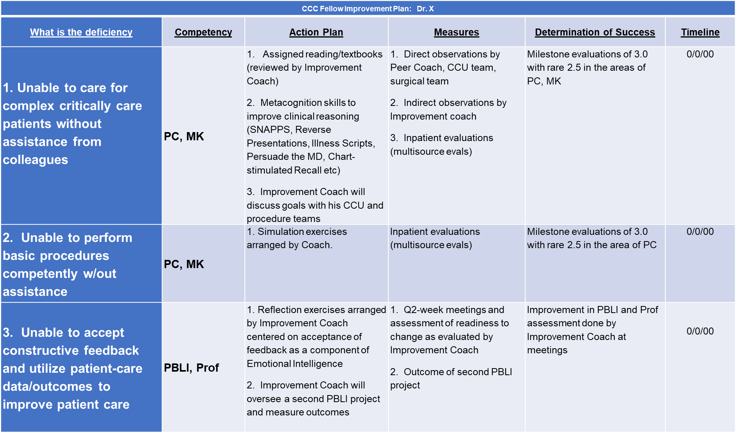
Observation
Documentation
Feedback
Documentation
Action
Documentation
What
Who
Where
When
Why

Slide 41
Take Home Points
Create a uniform and consistent approach to remediation for all trainees
Develop an early warning system for struggling fellows
Focus on observable, objective behaviors
Did I mention consistency?
Document everything
Develop specific resources for improvement in all core competencies
Ensure clear communication to fellows and faculty about expectations

Slide 42

Thank you!
john.mcpherson@vumc.org

