Slide 1
Class I Medical Therapies for CAD and PAD
CAD
PAD
Aspirin alone
DAPT after PCI or ACS
Statin therapy
Anti-HTN therapy
Tobacco cessation/avoidance
Diabetes management
Influenza Vaccine
Home-based exercise
Cardiac Rehabilitation after ACS, CABG, or PCI
Weight loss
Aspirin alone or Clopidogrel alone
Statin therapy
Anti-HTN therapy
Tobacco cessation/avoidance
Diabetes management
Influenza vaccine
Supervised exercise program
JACC 2017;69:e71-126 JACC 2011;58:2432-46

Slide 2
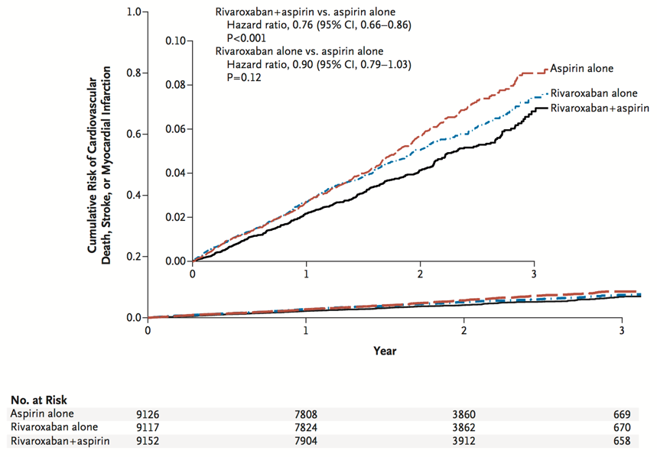
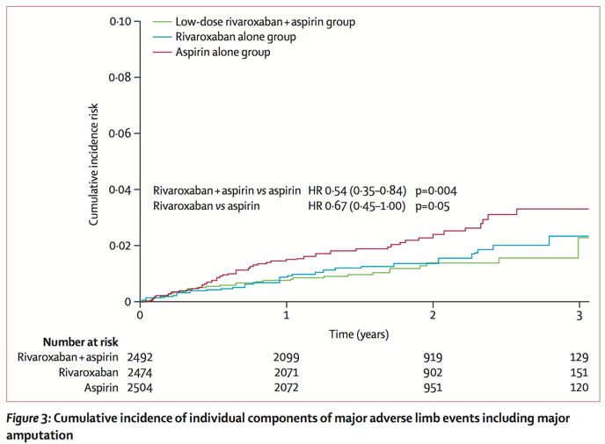
COMPASS: Rivaroxaban in stable CAD and PAD
All Patients
PAD Patients Only
NEJM 2017; 377:1319-1330
Lancet 2017; 391:219-229

Slide 3
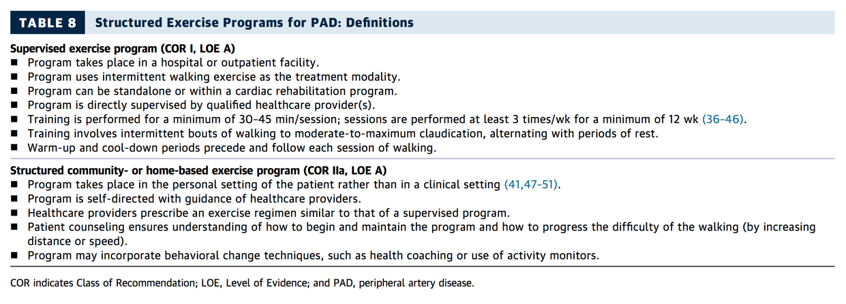
Exercise for PAD vs. Cardiac Rehabilitation
JACC 2017;69:e71-126

