Slide 1



Top 10 Reasons to Onboard to Heartbeat Health
Ami Bhatt, MD, FACC
Andrew M. Freeman, MD, FACC

Slide 2
Reason #1
It’s telemedicine built for cardiologists by cardiologists.

Slide 3
Reason #2
It’s the easiest telemedicine app available.

Slide 4
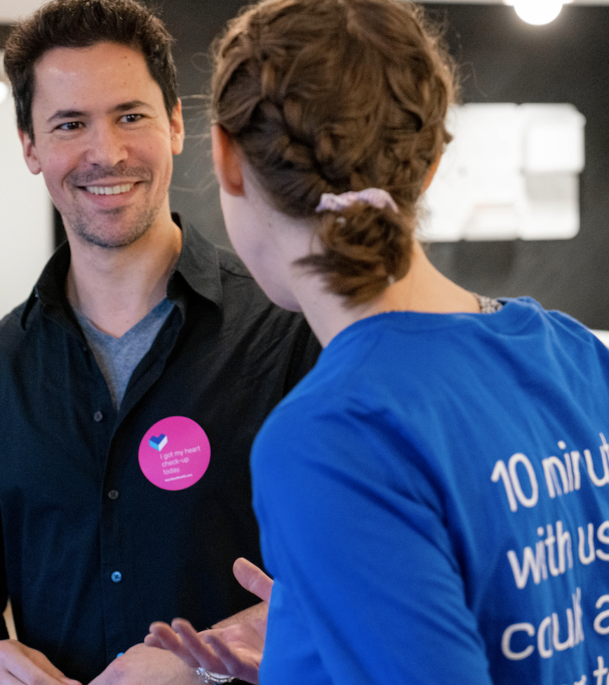
The solution
Reason #3
There’s no cost for ACC members through 2020.

Slide 5
Reason #4
Virtual care is the new normal.

Slide 6
Reason #5
Easy onboarding for patients and practice staff.

Slide 7
Reason #6
Build your practice in new ways.

Slide 8
Reason #7
Be part of new payer models.

Slide 9
Reason #8
Increase patient satisfaction.

Slide 10
Reason #9
Remote patient monitoring build in (coming soon!)

Slide 11
Reason #10
Billing
Coding
Auditing
All in the app!
(Coming soon)

Slide 12
To learn more, visit:
heartbeathealth.com/acc

