Slide 1



Recent Breakthroughs in Cardiovascular Outcomes Trials in T2DM
Benjamin M. Scirica, MD MPH FACC
Cardiovascular Division, Brigham and Women's Hospital Senior Investigator, TIMI Study Group Associate Professor of Medicine, Harvard Medical School

Slide 2
Disclosures
Dr. Scirica reports research grants via the TIMI Study and Brigham and Women’s Hospital from AstraZeneca, Eisai, Merck, and Poxel. Consulting fees from AstraZeneca, Biogen Idec, Boehringer Ingelheim, Covance, Dr. Reddy’s Laboratory, Elsevier Practice Update Cardiology, GlaxoSmithKline, Lexicon, Merck, NovoNordisk, Sanofi, St. Jude's Medical, and equity in Health [at] Scale.

Slide 3
Glycemic Control Improves Microvascular Endpoints
 | Microvascular |  | Cardiovascular Disease |  | Mortality
UKPDS | ↓ | ↓ | ↔ | ↓ | ↔ | ↓
ACCORD | ↓ |  | ↔ |  | ↑ ?
ADVANCE | ↓ | ↓ | ↔ |  | ↔
VADT | ↓ |  | ↔ |  | ↔
Initial Trial
Long Term Follow-up
Adapted from Bergenstal et al. Am J Med 2010;123:374e9-e18; updated 2015.

Slide 4
Cardiovascular Benefits: UKPDS Metformin Sub-Study
Myocardial infarction
Coronary deaths
20
P = 0.01
10
P = 0.02
NS
⬇
39%
8
15
⬇
50%
6
Incidence per 1,000 patient-years
10
4
5
2
0
0
Conventional Insulin Metformin Conventional Metformin diet SU’s diet
N = 411 951 342 411 342
Events (n) 73 139 39 36 16
UKPDS Group. Lancet. 1998;352:854-865.
Notes:
4
4
Slide 29. UKPDS: Myocardial Infarction in Metformin Study.
Improving the Prognosis of Patients with Type 2 Diabetes

Slide 5
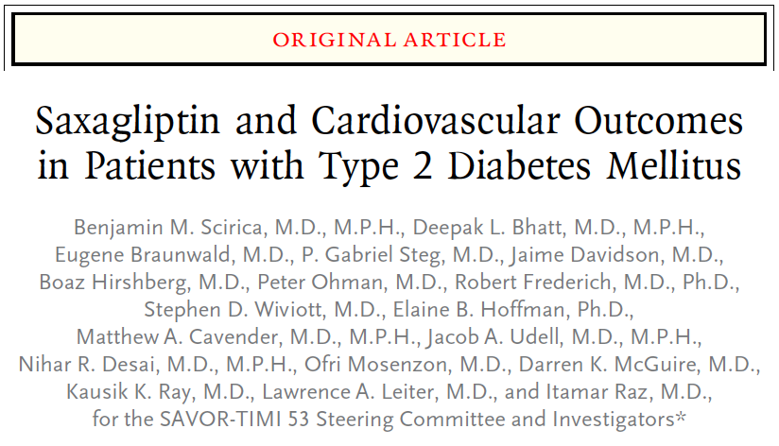
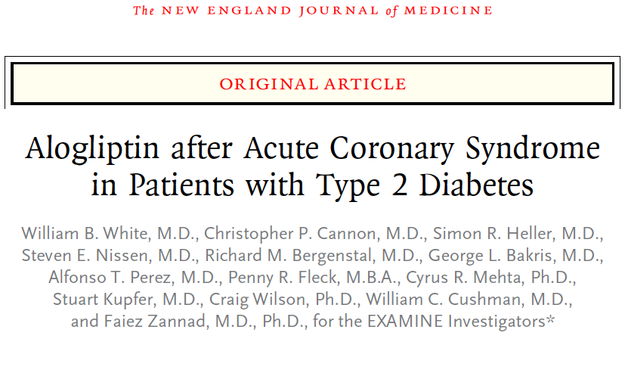
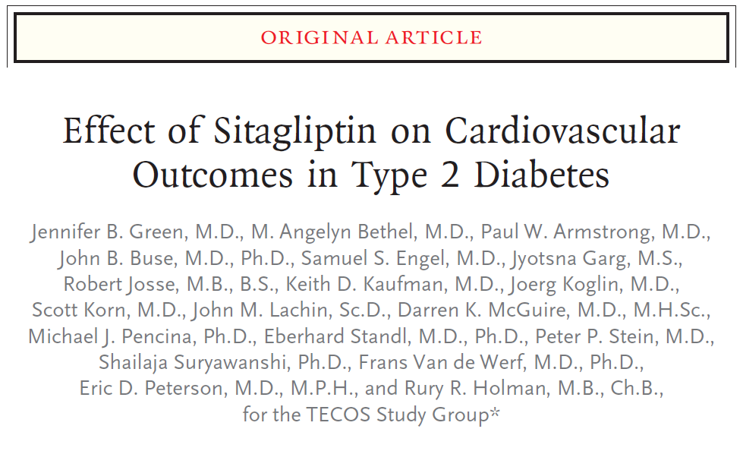
The DPP4i Studies

Slide 6
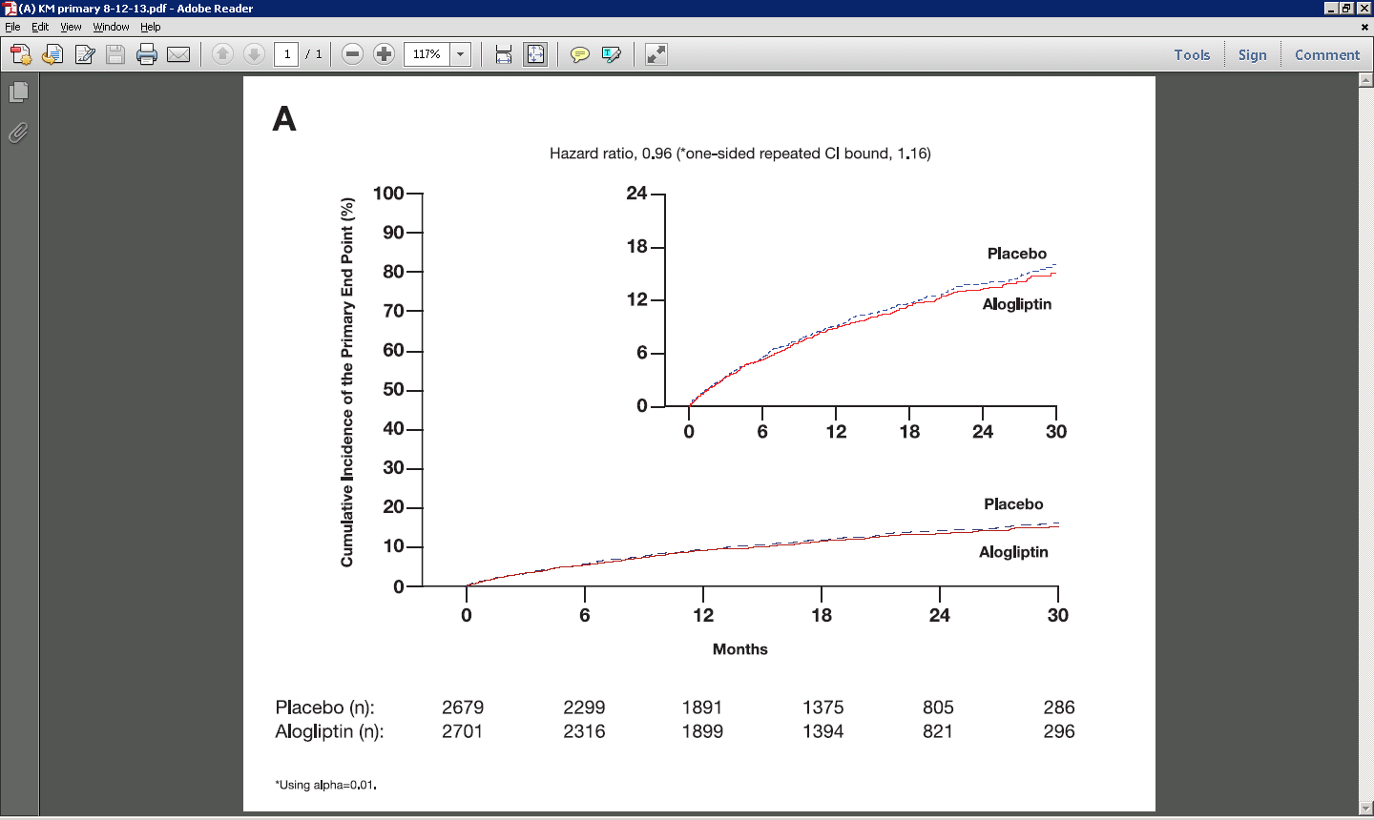


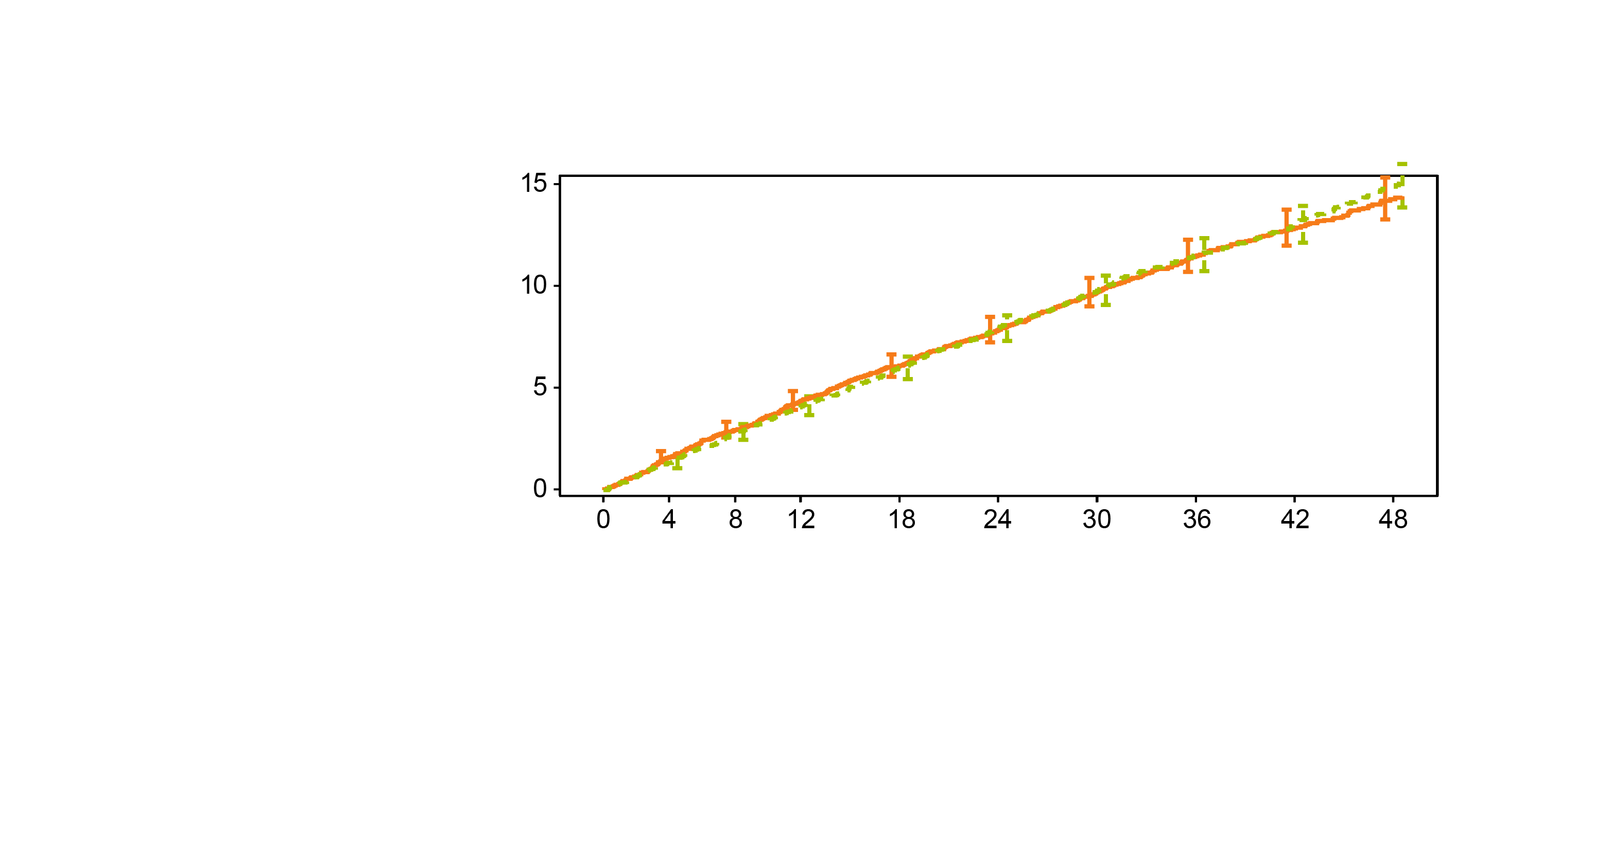
Comparison of Primary Endpoint Rates
All Trials met non-inferiority boundary of <1.3
11.5%
11.6%
Scirica BM, et al. NEJM 2013; 369:1317-1326
Green JB et al. NEJM 2015; DOI: 10.1056/NEJMoa1501352
White WB et al, NEJM 2013; 369:1327-35

Slide 7
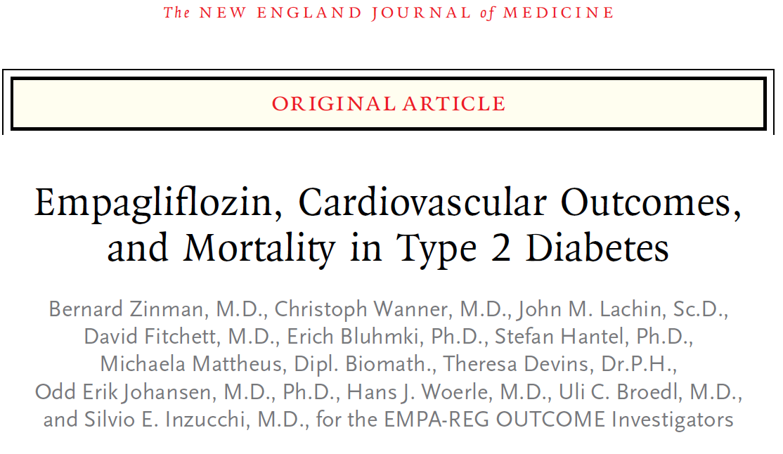
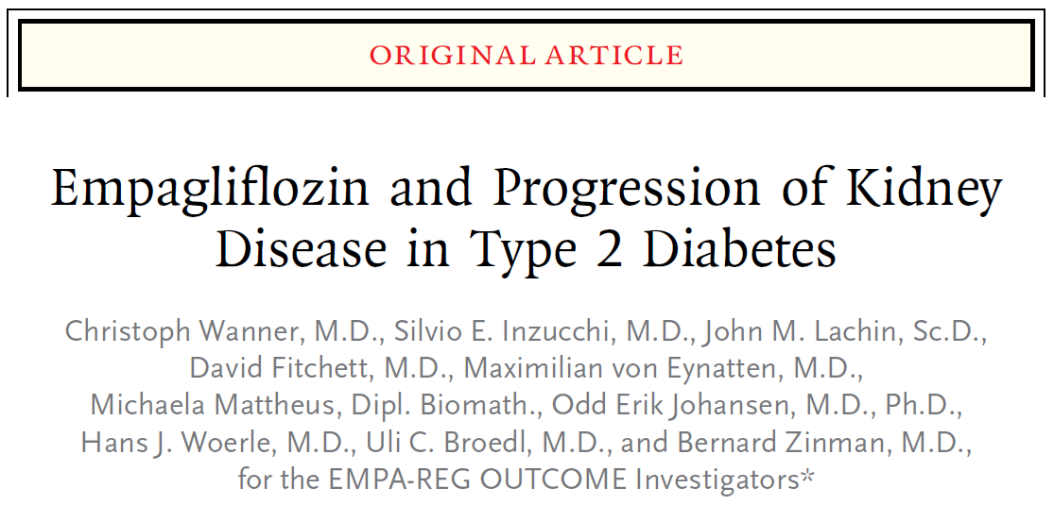
The SGLTi Studies

Slide 8
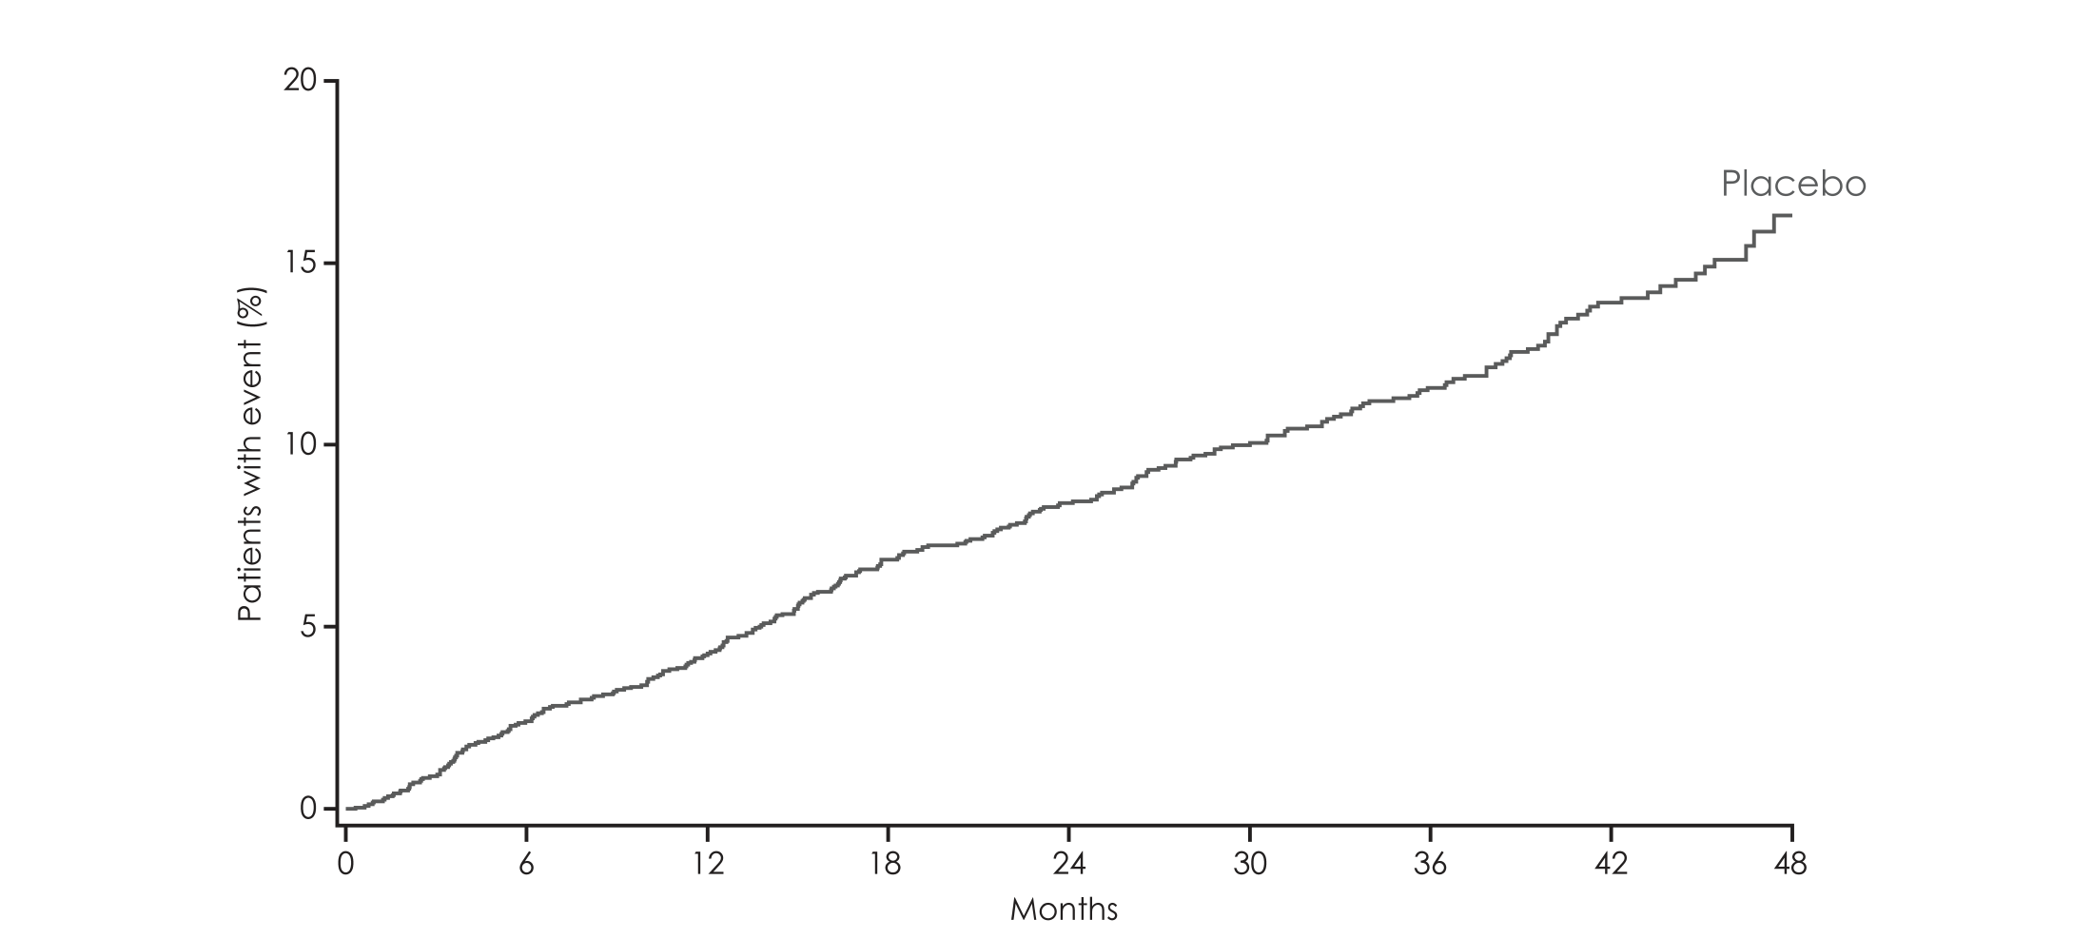
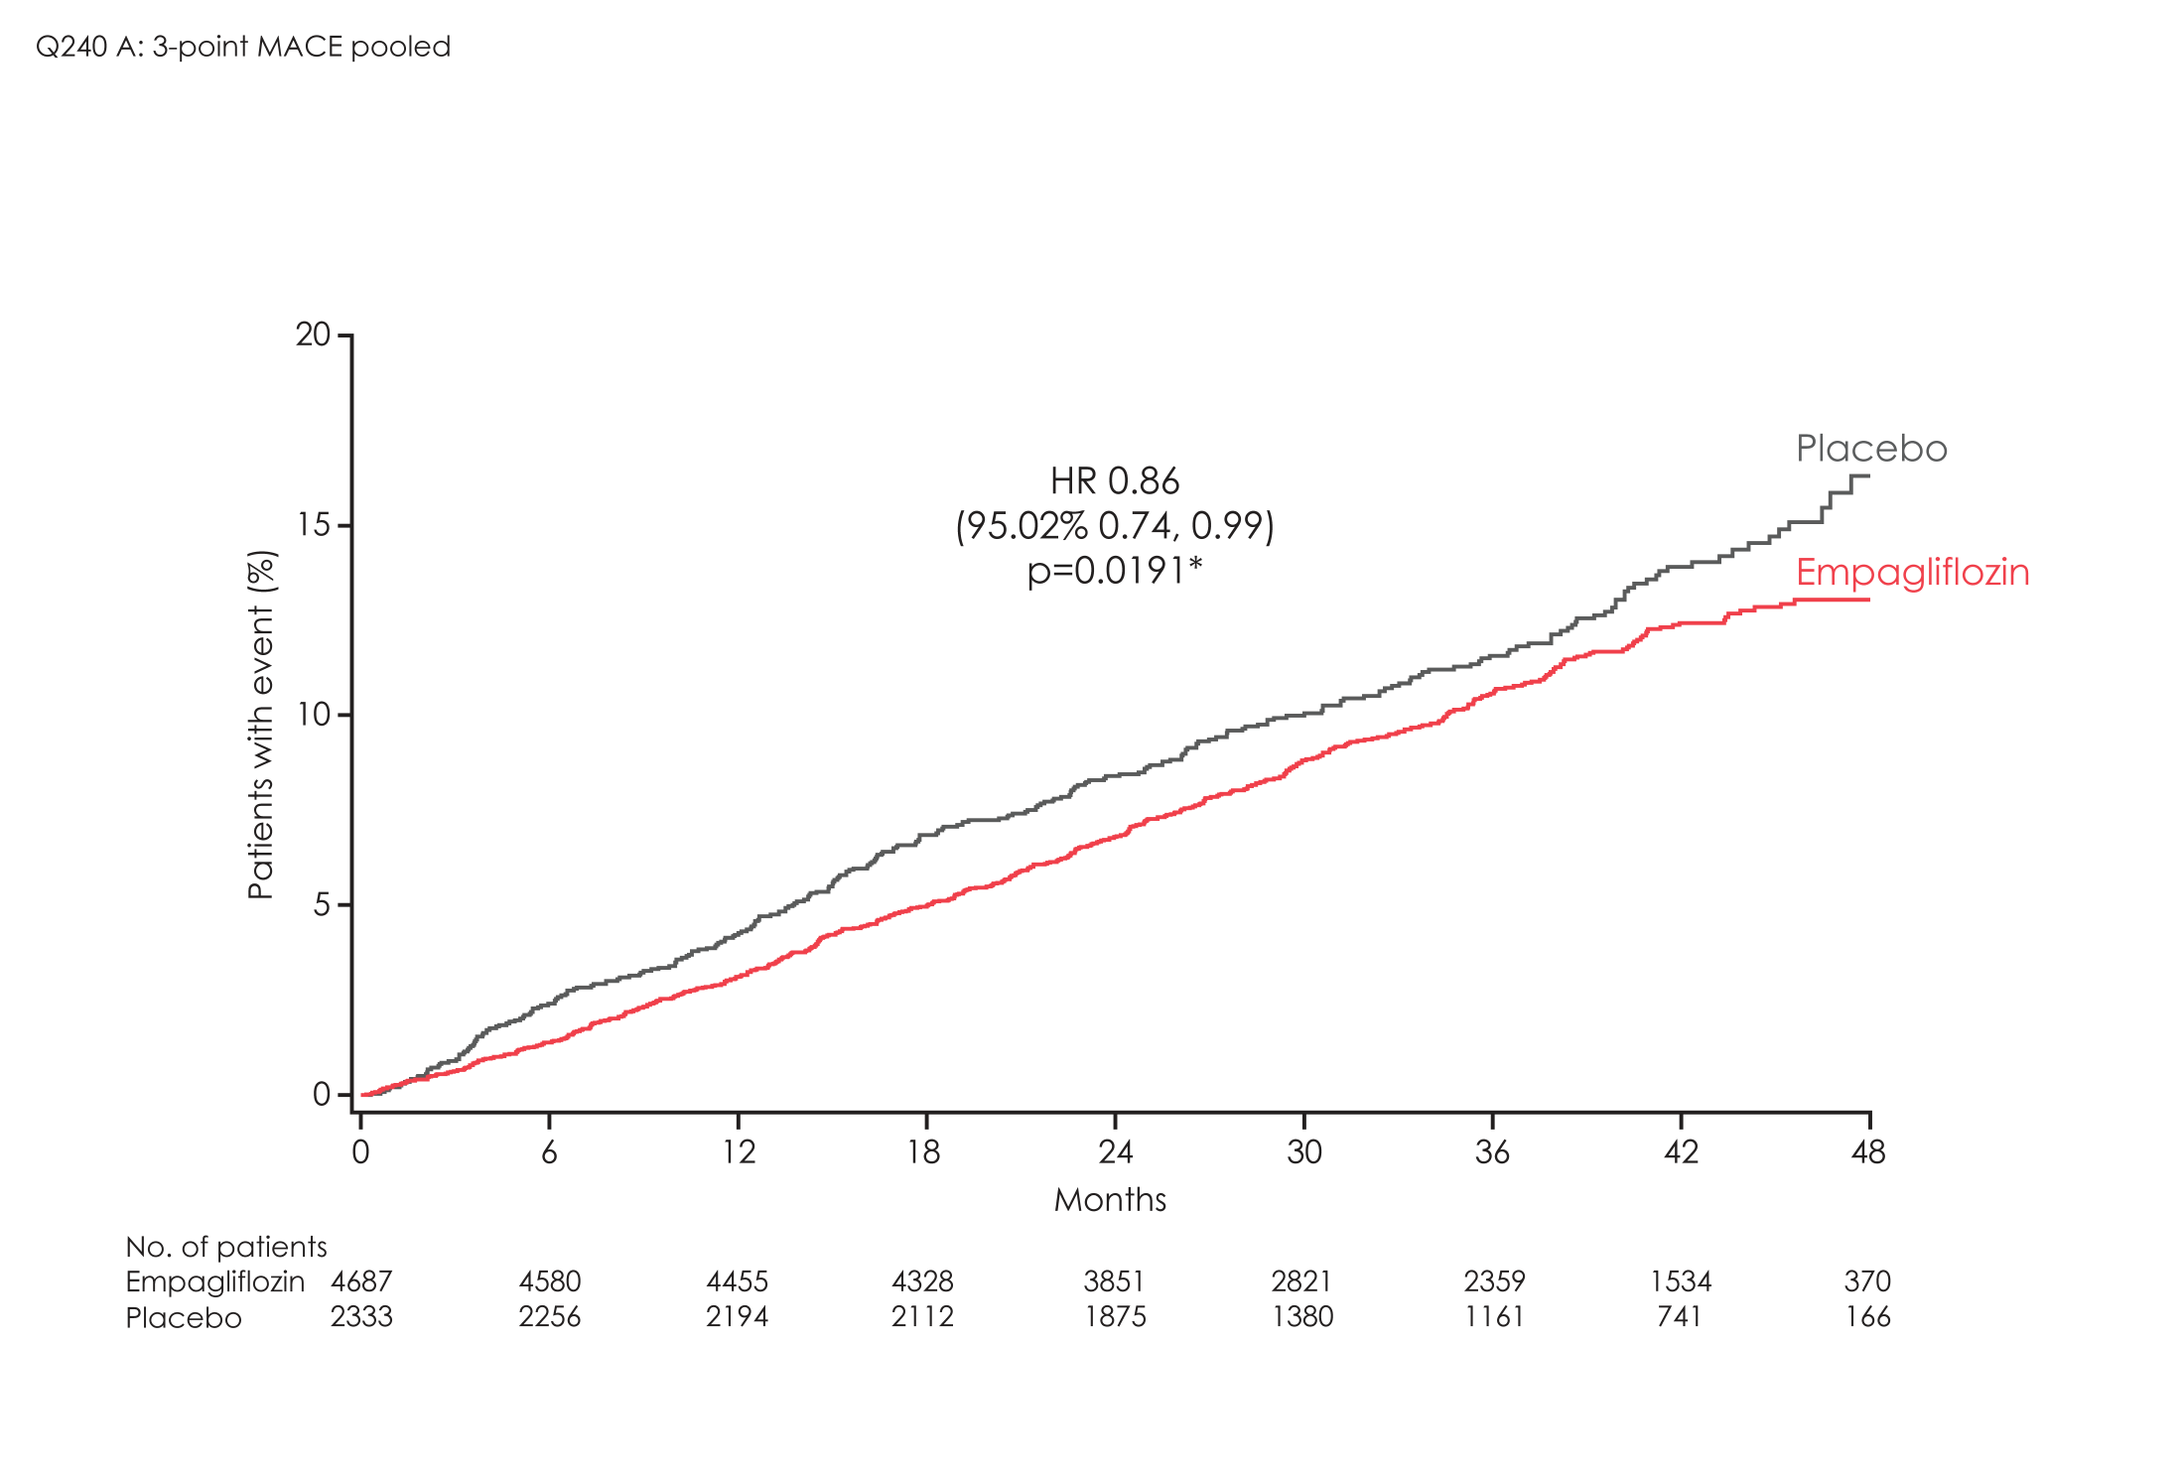
EMPA-REG OUTCOME Primary outcome: 3-point MACE
HR 0.86
(95.02% CI 0.74, 0.99)
p=0.0382*
772 Events
Zinman B et al. N Engl J Med 2015; 373: 2117-28

Slide 9
Neal B et al. N Engl J Med 2017. DOI: 10.1056/NEJMoa1611925

Slide 10
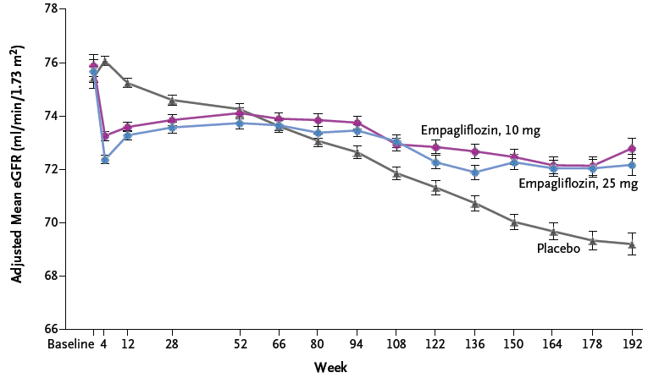
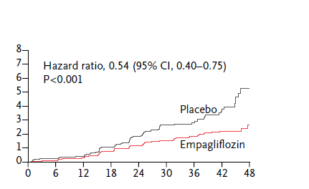
EMPA-REG OUTCOME and CANVAS: Renal Outcomes
Doubling SCre, RRT, Renal Death
40%↓ eGFR, RRT, Renal Death
Months
Weeks
Zinman B et al. N Engl J Med 2016; DOI: 10.1056/NEJMoa1515920
Neal B et al. N Engl J Med 2017. DOI: 10.1056/NEJMoa1611925

Slide 11
David Mathews, ADA 2017

Slide 12
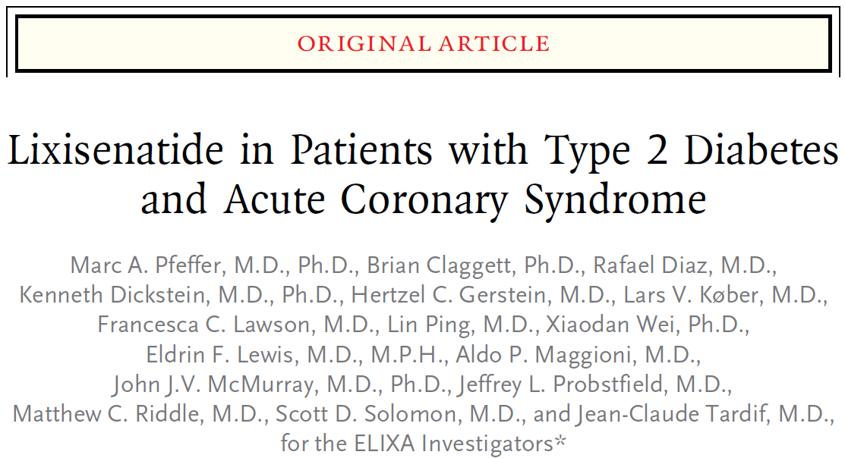
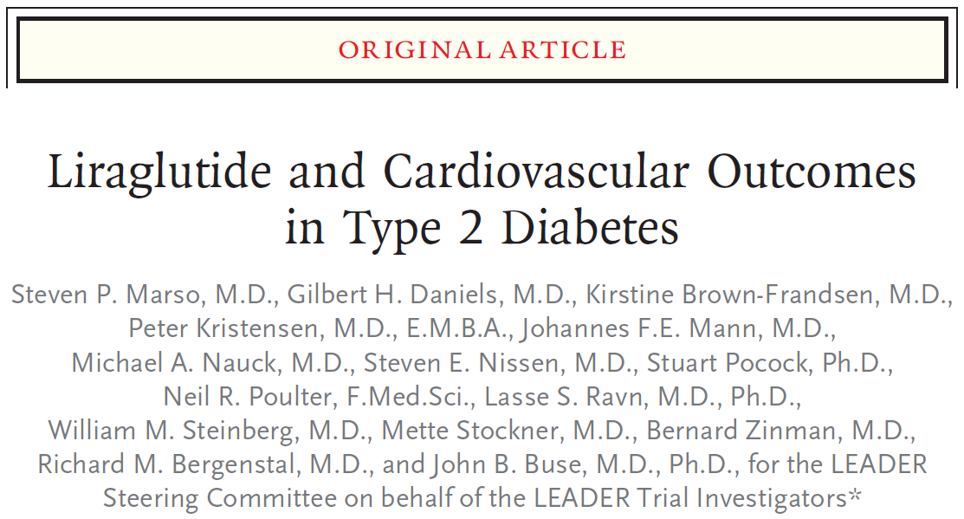
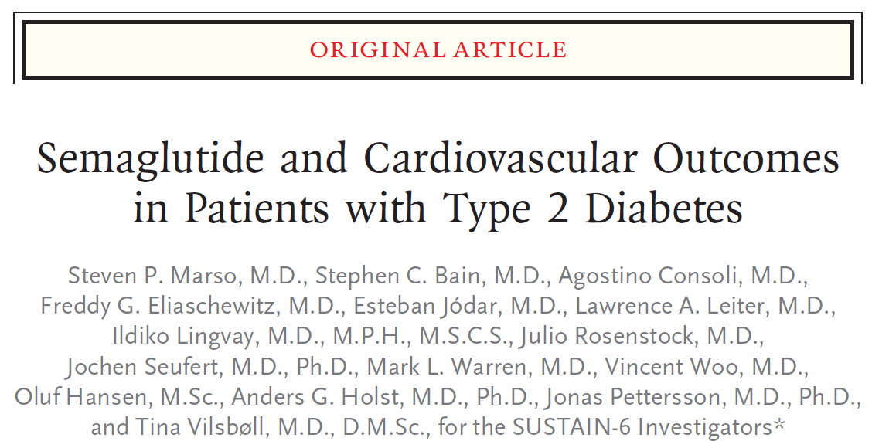
The GLP1 Studies

Slide 13
GLP -1: ELIXA TRIAL
Population:
6,068 pts with T2DM ≤180d post-ACS
PEP:
Non-inferiority (upper bound of 1.3) for CV death, MI, stroke, or UA hosp
Results:
Median f/u: 25 months
HR 1.02; 95% CI 0.89-1.17 with 406 (13.4%) vs 399 (13.2%) PEP events
Pfeffer et al. NEJM. 2015;373(23):2247-57

Slide 14
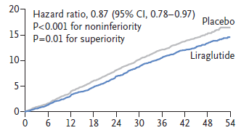
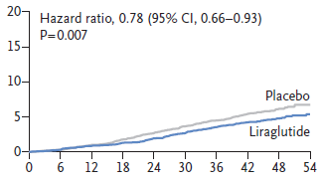
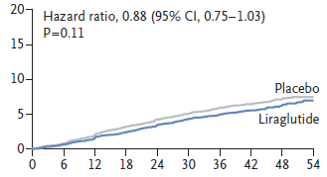
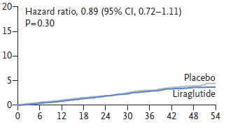
LEADER Trial
Primary EP
CV Death
1302 Events
Myocardial Infarction
Stroke

Slide 15
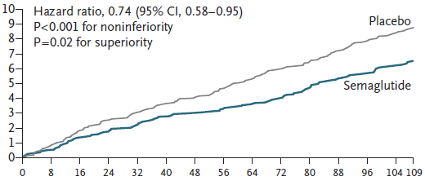
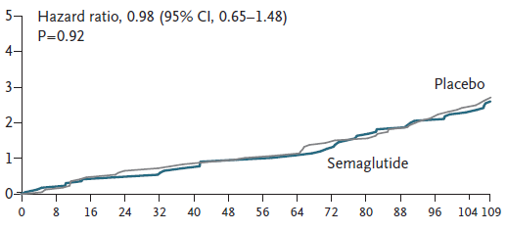
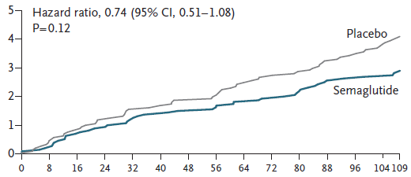
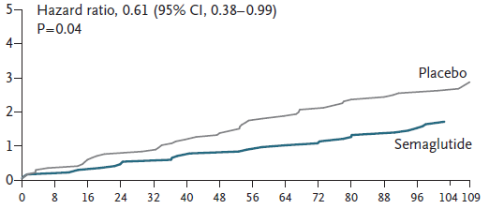
SUSTAIN 6 Trial
CV Death
Primary EP
254 Events
Myocardial Infarction
Stroke

Slide 16
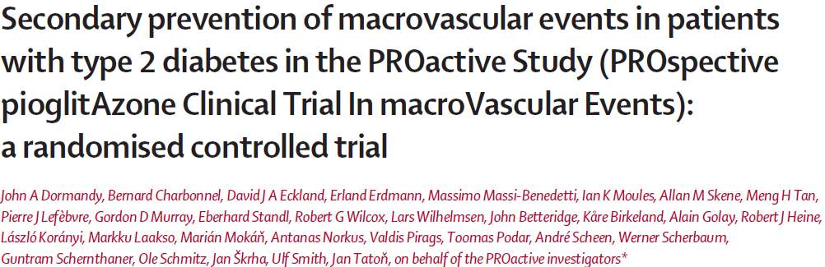
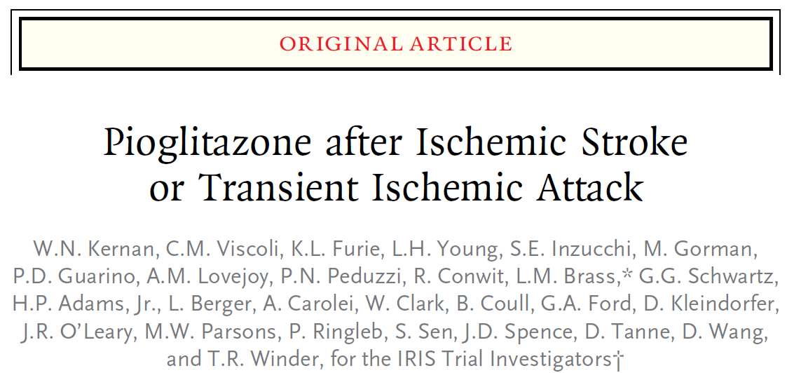
The TZD Studies

Slide 17
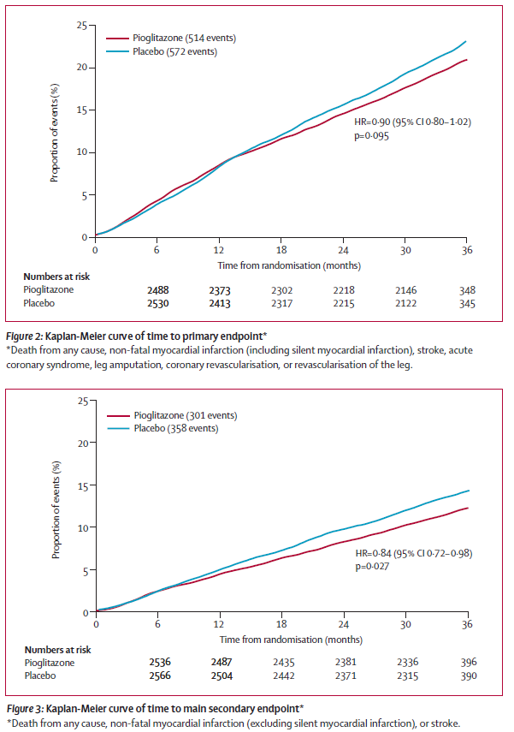

PROACTIVE Study
Primary Endpoint
All-cause mortality, MI, stroke, ACS, endovascular or surgical intervention in the coronary or leg arteries, and amputation above the ankle
Secondary Endpoint
All-cause mortality, MI, stroke, ACS,
HR 0·84
95% CI 0·72–0·98
p=0·027
HR 0·90
95% CI 0·80–1·02
p=0·095

Slide 18

IRIS Study
Eligibility:
Ischemic stroke or TIA w/in 6m
Age ≥ 40 years
Insulin resistance
No diabetes
No heart failure
No bladder cancer

Slide 19
Conclusions
These results challenge many practice dogmas
Role of glucose control in CVD risk mitigation remains uncertain
How should these agents be integrated into care
Despite unclear MOA, role of SGLT2i and GLP1 analogues in T2DM treatment algorithms likely to be elevated above DPP4i and “older” agents
While T2DM many not be an ”MI equivalent”, all MDs, in particular cardiologist, need to know how to treat T2DM with the most effective cardioprotective therapy

