Slide 1
Evolving Role of the CV Clinician in Managing CV Risk in Type 2 Diabetes: Rationale and Opportunities
Nathan D. Wong, PhD, FACC, FAHA, FNLA, FASPC Professor and Director Heart Disease Prevention Program Division of Cardiology University of California, Irvine Editorial Lead, ACC Diabetes and Cardiometabolic Clinical Topic Collection Past President, American Society for Preventive Cardiology President-Elect, Pacific Lipid Association

Slide 2
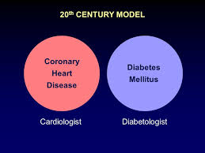


Is it time for a change?
ACC CME Program 2007-2009

Slide 3
Parallels with the Lipid Story
Lipids were originally the domain of the endocrinologists until randomized trials demonstrated treating those with CVD benefitted.
Now it is a standard for CV clinicians to prescribe lipid-lowering agents for their CV patients.
Now as we see certain diabetes drugs showing CV benefits, the CV clinician should understand where it may be appropriate for them to consider these to reduce CV risk.
Also, like with lipid-lowering medications, certain diabetic medications shown to have CV benefit should be addressed in future CV treatment guidelines.

Slide 4
Roles / Opportunities of the CV Clinician in Diabetes
Should collaborate closely with a multispecialty team caring for the patient’s CVD and DM concerns together

Slide 5

Better Collaboration of the Cardiologist with Others Needed
With atherosclerotic cardiovascular disease (ASCVD) and its complications (i.e. heart attacks, strokes, chronic kidney disease and heart failure) among the principal causes of death in persons with type 2 diabetes mellitus (T2DM), a close collaboration between the practicing endocrinologist and cardiologist is essential
Wong ND, Rosenblit PD, Lepor N, ACC.ORG 12/16 and Cardiovasc Endocrinol 2016

Slide 6

In addition, it is important to have other diabetes treatment experts, including:
nephrologists
exercise physiologists
nutrition experts (i.e. registered dieticians)
podiatrists
cardio-thoracic and other vascular surgeons
along with primary care physicians and nurse practitioners, to be part of the team aimed to improve patient outcomes, longevity and quality of care
Wong ND, Rosenblit PD, Lepor N, Acc.org 12/16
and Cardiovasc Endocrinol 2016

Slide 7
Roles / Opportunities of the CV Clinician in Diabetes
Should collaborate closely with a multispecialty team caring for the patient’s CVD and DM concerns together.
Should make sure all patients with CVD are routinely screened for diabetes and its accompanying CV risks, doing a proper CV risk assessment
Help educate those with diabetes that CVD is their leading concern and hence diabetes is a major CVD-related condition

Slide 8
Most Cardiovascular Patients Have Abnormal Glucose Metabolism
GAMI
n = 164
EHS
n = 1920
CHS
n = 2263
18%
27%
35%
31%
37%
37%
34%
45%
36%
Normoglycemia
Prediabetes
Type 2 Diabetes
GAMI = Glucose Tolerance in Patients with Acute Myocardial Infarction study; EHS = Euro Heart Survey; CHS = China Heart Survey
Anselmino M, et al. Rev Cardiovasc Med. 2008;9:29-38.
Notes:
8

Slide 9
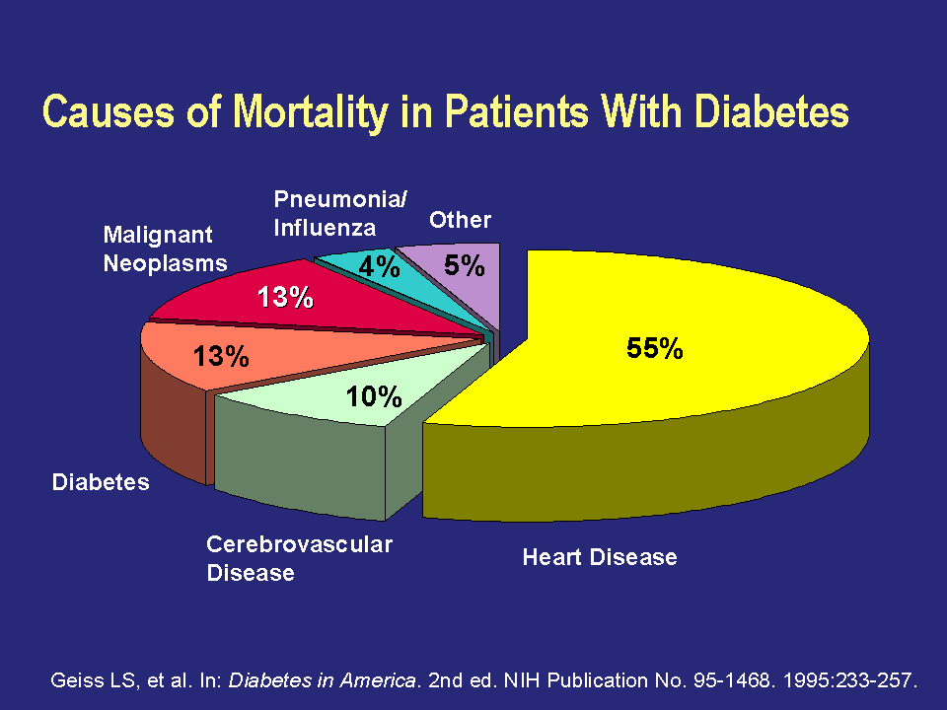
Causes of Mortality in Patients With Diabetes
Notes:
Cardiovascular disease is the most common cause of death among patients with diabetes, according to data from death certificates. Heart disease accounts for approximately 55% of all deaths and cerebrovascular disease is responsible for another 10% of deaths.
Acute diabetes-related complications are the next most common cause of death, accounting for 13% of deaths. Pneumonia/influenza, malignant neoplasms, and other causes account for the remaining deaths.
Renal disease is not listed as a separate category, because dialysis and transplantation have made renal failure an uncommon immediate cause of death. However, cardiovascular disease is a common cause of death in patients on long-term dialysis.
In patients with type 2 diabetes, the relative contribution of cardiovascular disease as a cause of death is greater in younger-age and younger-age-at-onset patients than in older-age and older-age-at-onset patients.
Geiss LS, et al. Mortality in non-insulin-dependent diabetes. In: Diabetes in America. 2nd ed. Bethesda, Md: National Institute of Diabetes and Digestive and Kidney Diseases, National Institutes of Health; 1995:233-257. NIH Publication No. 95-1468.

Slide 10
Metabolic Syndrome and Diabetes in Relation to CHD, CVD, and Total Mortality: U.S. Men and Women Ages 30-74
(Risk-factor Adjusted Cox Regression) NHANES II
Follow-up (n=6255)
***
***
***
***
***
***
***
***
*
**
***
***
Malik and Wong, et al., Circulation 2004.
* p<.05, ** p<.01, **** p<.0001 compared to none
Notes:
10

Slide 11
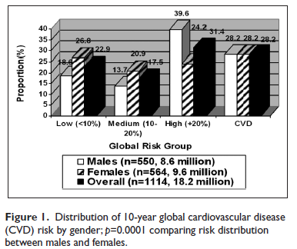
Global Risk Assessment in DM: 10-year Total CVD Risk by Gender (Wong ND et al., Diab Vas Dis Res 2012)
Nearly half of women and a third of men are not at a “CVD Risk Equivalent”

Slide 12
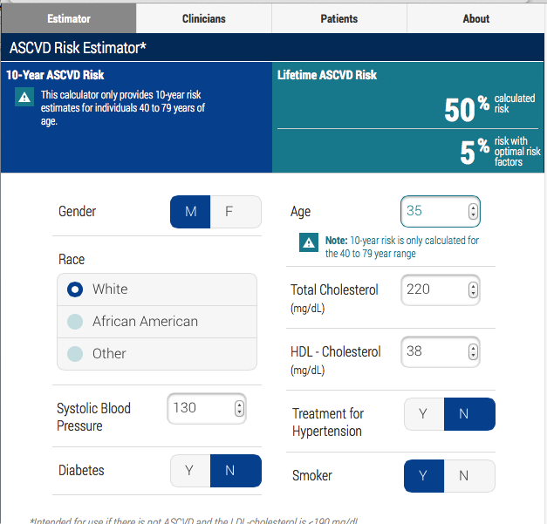
ACC / AHA 2014 Guidelines: ASCVD Risk Estimator and Statin Treatment
Provides 10-year ASCVD risk for persons aged 40-79 years and lifetime risk for people aged 20-59 years without known ASCVD
Those with diabetes with >=7.5% 10-year risk may be considered for a high intensity statin, otherwise moderate intensity statin
Most importantly, intended to drive a “risk discussion” with the patient encouraging a greater adherence to heart-healthy lifestyle
Goff DC, et al. J Am Coll Cardiol 2014;63:2935-59
Newer US population-based diabetes risk scores are needed
Notes:
Notes
Diabetes as a predictor rather than CHD risk equivalent.
How best to identify those at risk of CVD and most likely to benefit from therapy?
Global risk assessment (e.g., with the Pooled Cohort Risk Calculator) can help discriminate those with DM who are at higher versus lower risk. The Pooled Cohort Equations were developed and validated among Caucasian and African American men and women who did not have clinical ASCVD. There are inadequate data in other racial groups, such as Hispanics, Asians, and American-Indian populations. Given the lack of data, current guidelines suggest to use the "Caucasian" race to estimate 10-year ASCVD risk with the knowledge that further research is needed to stratify these patients' risk. Compared to Caucasians, the risk of ASCVD is generally lower among Hispanic and Asian populations and generally higher among American-Indian populations.
Other risk calculators include UKPDS Risk Engine.
Source
Goff DC Jr, Lloyd-Jones DM, Bennett G, et al. ACC/AHA guideline on the assessment of cardiovascular risk: a report of the American college of cardiology/ American heart association task force on practice guidelines. J Am Coll Cardiol 2014;63:2935-59.

Slide 13
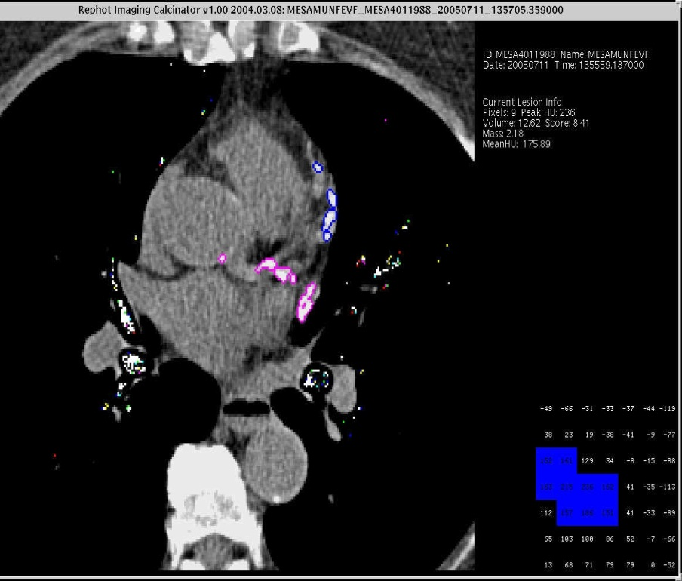
Annual CHD Event Rates (in %) by Calcium Score Events by CAC Categories in Subjects with DM, MetS, or Neither Disease (Malik and Wong et al., Diabetes Care 2011)
Coronary Heart Disease
CHD event risk varies 10X depending on the level of CAC
Coronary Artery Calcium Score
ACCF/AHA 2010 Guideline: CAC Scoring for CV risk assessment in asymptomatic adults aged 40 and over with diabetes (Class IIa-B)
ACC/AHA 2014 Guideline: If treatment decision uncertain from global risk assessment, consider evaluation of premature family history, hs-CRP, ABI, or CAC scoring.

Slide 14
Roles / Opportunities of the CV Clinician in Diabetes
Should collaborate closely with a multispecialty team caring for the patient’s CVD and DM concerns together.
Should make sure all patients with CVD are routinely screened for diabetes and its accompanying CV risks, doing a proper CV risk assessment
Help educate those with diabetes that CVD is their leading concern and hence diabetes is a major CVD-related condition
Help identify those needing further CV diagnostic testing and/or procedures
Should provide comprehensive management, including but extending beyond glucose control to include lipid and BP management, lifestyle counselling, and antiplatelet therapy

Slide 15

LIPIDS
BLOOD PRESSURE
ANTIPLATELET THERAPY
DIABETES / HbA1C ??

Slide 16
Treating ABCs Reduces Diabetes Complications
A = Assess risk
Antiplatelet therapy
Atrial fibrillation
B = BP
C = Cholesterol
Cigarette cessation
D = Diet + weight management
Diabetes prevention + treatment
E = Exercise
F = Heart failure
Strategy | Complication | Reduction of Complication
Blood glucose control | Heart attack | ↓ 37%¹
Blood pressure control | Cardiovascular disease Heart failure Stroke Diabetes-related deaths | ↓ 51%² ↓ 56%³ ↓ 44%³ ↓ 32%³
Lipid control | Coronary heart disease mortality Major coronary heart disease event Any atherosclerotic event Cerebrovascular disease event | ↓35%⁴ ↓55%⁵ ↓37%⁵ ↓53%⁴
¹ UKPDS Study Group (UKPDS 33). Lancet. 1998;352:837-853. ² Hansson L, et al. Lancet. 1998;351:1755-1762. ³ UKPDS Study Group (UKPDS 38). BMJ. 1998;317:703-713. ⁴ Grover SA, et al. Circulation. 2000;102:722-727. ⁵ Pyŏrälä K, et al. Diabetes Care. 1997;20:614-620.
Newer antidiabetic medications showing benefits on cardiovascular outcomes and mortality provide further evidence
Notes:
Notes
The burden of ASCVD can be reduced by preventing or reducing the onset of modifiable risk factors. For instance, in the INTERHEART (A Study Of Risk Factors For First Myocardial Infarction In 52 Countries And Over 27 000 Subjects) study, for example, 9 modifiable risk factors—smoking, dyslipidemia, diabetes mellitus (DM), hypertension, abdominal obesity, stress, poor diet, physical inactivity, and excess alcohol consumption—were responsible for >90% of the risk for a first MI.[Yusuf 2004]
Sources
Yusuf S, Hawken S, Ounpuu S, et al. Effect of potentially modifiable risk factors associated with myocardial infarction in 52 countries (the INTERHEART study): case-control study. Lancet. 2004; 364:937-952.

Slide 17
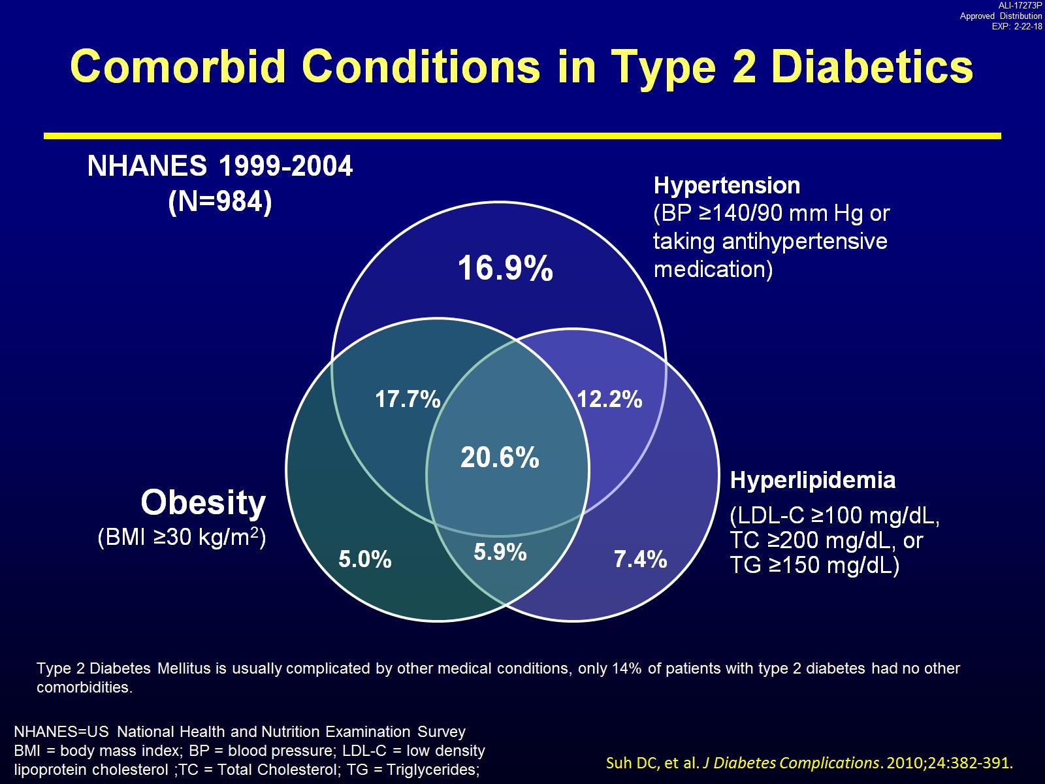
Comorbid Conditions in Type 2 Diabetics

Slide 18
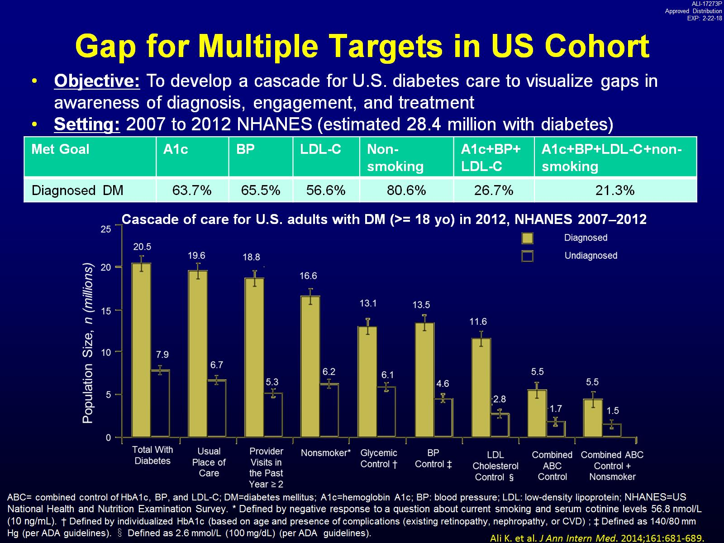
Gap for Multiple Targets in US Cohort
Blacks and Hispanics have lower proportions at composite risk factor control than Whites

Slide 19
Steno-2: Effects of Multifactorial Intervention on CV Outcomes
N = 160 with type 2 diabetes and microalbuminuria
60
50
Conventional
Primary composite outcome* (%)
40
53% risk reduction P = 0.01
30
20
Intensive
10
0
0
12
24
36
48
60
72
84
96
Follow-up (months)
*CV death, MI, stroke, revascularization, amputation
Gæde P et al. N Engl J Med. 2003;348:383-93.
Gaede P et al. N Engl J Med 2008;358:580-591
Notes:
• The Behavioral Risk Factor Surveillance System (BRFSS) is an annual, state-wide telephone survey of randomly selected households. Reeves et al used BRFSS data from 153,805 respondents, ages 18 to 74 years, surveyed in 2000.¹
• In all, 24% to 78% of respondents smoked, had a body mass index (BMI) ≥25 kg/m², did not consume fruits and vegetables regularly, or did not engage in physical activity of moderate intensity on a regular basis.
• The data illustrate that the majority of Americans do not follow a healthy lifestyle. In contrast, only 16.8% of respondents (data not shown) included all four healthy lifestyle characteristics in their lifestyles:
o Nonsmoking
o Healthy weight (BMI ≤25 kg/m²)
o Regular consumption of fruits and vegetables (≥5 times daily)
o Regular exercise (≥5 times weekly)
1. Reeves MJ, Rafferty AP. Healthy lifestyle characteristics among adults in the United States, 2000. Arch Intern Med. 2005;165:854-857.

Slide 20
CVD and CHD Event Rates by Number of Risk Factors (HbA1c, BP, LDL-C) At Target:
Pooling of ARIC, MESA, and JACKSON Heart Studies
Multivariable adjusted risks of CVD events 62% lower and CHD events 60% lower with all 3 risk factors controlled (versus none at control)
Wong ND, et al. Diabetes Care. 2016;39:668-676

Slide 21
Conclusions
Many cardiovascular patients have diabetes and do not fully appreciate the cardiovascular risks associated with this condition.
Optimal care of CV patients with diabetes requires collaboration between the cardiologist and with other members of the healthcare team for ensuring comprehensive management and prevention of CV complications.
The cardiologist should ensure proper risk assessment of the patient with diabetes, identify those needing further testing or intervention, and ensure adequate treatment plans to optimize CV risk reduction.
The cardiologist working with other members of the healthcare team has the potential to make a dramatic impact on reducing the significant CV complications in those with diabetes.

Slide 22



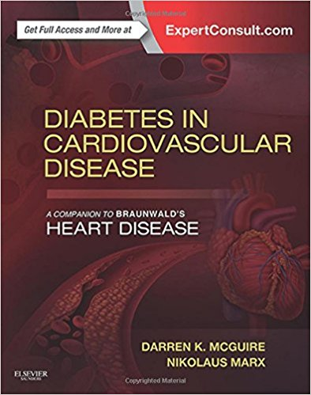
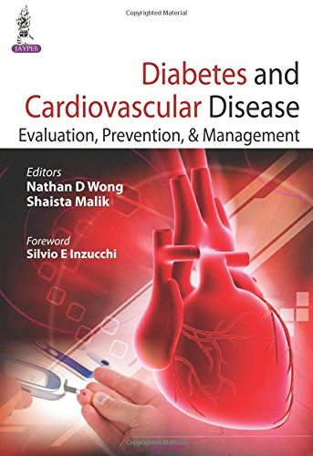
Connecting DM and CVD: The Future is Now

Slide 23
Discussion Questions
In your practice, what is the current approach for a CV clinician in managing blood glucose and CV disease risk associated with T2DM?
What should be best practices for the CV clinician in the management of blood glucose and CV disease risk associated with T2DM (i.e. lifestyle modifications, checking HbA1c levels, prescribing medications, patient instructions on medications)

Slide 24
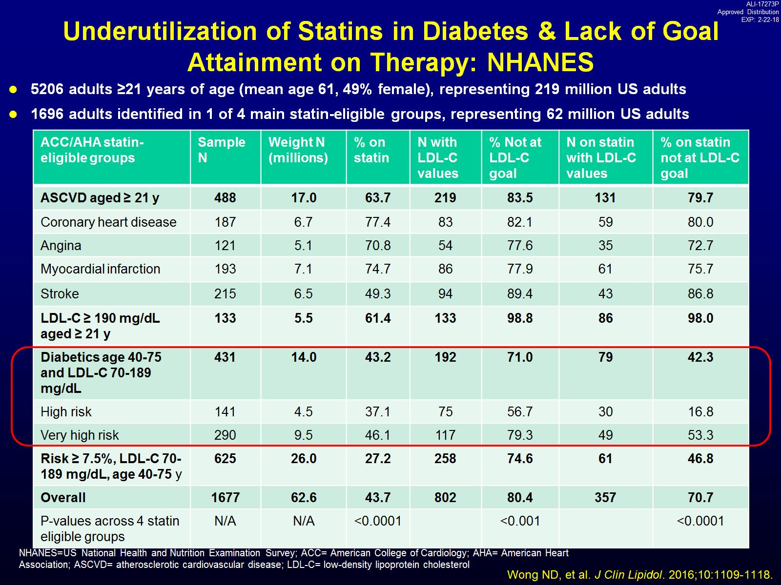
Underutilization of Statins in Diabetes & Lack of Goal Attainment on Therapy: NHANES

Slide 25
Necessity of a Multidisciplinary Approach
Especially important in the secondary prevention setting when the cardiologist is most often initially involved in patient care.
Few patients with T2DM, even in the US, despite its sophisticated healthcare systems, attain guideline directed goals for the conventional cardiovascular risk factors including lipids, blood pressure, blood glucose, and weight
These multiple risk factors when inadequately controlled, lead to significant residual risk for cardiovascular complications
From Wong ND, Rosenblit PD, Lepor N, ACC.ORG 12/16
and Cardiovasc Endocrinol 2016

