Slide 1
Redefining Quality Care in T2DM Patients with CV Disease
Melissa L. Magwire RN CDE
Heart House Round Table
June 20, 2017

Slide 2
Potential Conflict of Interest and Position
* No potential conflicts of interest with this program
* Endocrine Clinic Coordinator, Registered Nurse, Diabetes Educator-
  Shawnee Mission Endocrinology & Diabetes
  Shawnee Mission Health- Overland Park, KS

Slide 3
Diabetes Standards of Care for Practice and Payment
Main Influence on Practice Standards:
American Diabetes Association ( ADA)
    American Academy of Clinical Endocrinologist (AACE)
    * Payor Influences: CMS, NCQA, ACO (Primary Care)

Slide 4
Differences in Opinion of DM Standard of Care…..
ADA | AACE
<7.0%* (<53 mmol/mol) | ≤ 6.5 % For those without concurrent serious illness and at low risk of hypoglycemia
 | ≥ 6.5% with concurrent serious illness and at high risk of hypoglycemia

Slide 5
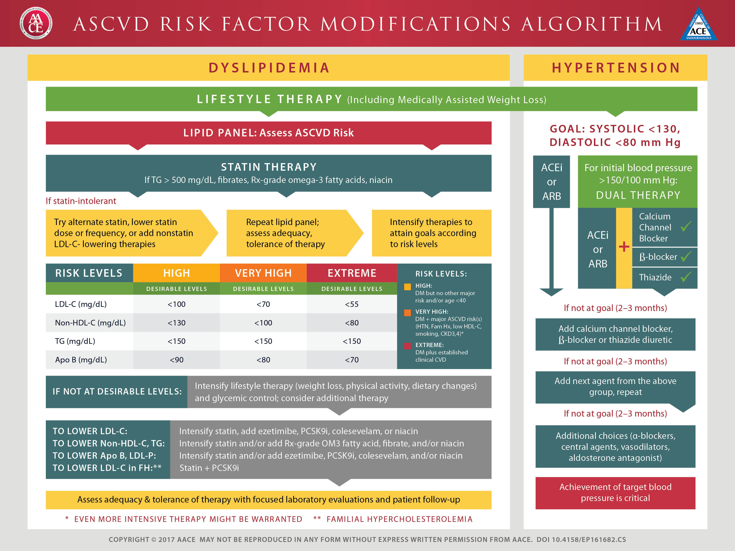

Slide 6
Recommendations: Hypertension/ Blood Pressure Control (2)
Systolic Targets:
People with diabetes and hypertension should be
treated to a systolic blood pressure goal of <140
mmHg. A
Lower systolic targets, such as <130 mmHg, may be appropriate for certain individuals at high risk of CVD, if they can be achieved without undue treatment burden. C
Diastolic Targets:
Patients with diabetes should be treated to a
diastolic blood pressure <90 mmHg. A
Lower diastolic targets, such as <80 mmHg, may be appropriate for certain individuals at high risk for CVD if they can be achieved without undue treatment burden. C
American Diabetes Association Standards of Medical Care in Diabetes.
Cardiovascular disease and risk management. Diabetes Care 2017; 40 (Suppl. 1): S75-S87
Notes:
People with diabetes and hypertension should be treated to a systolic blood pressure goal of <140 mmHg. There is strong evidence that systolic BP greater than 140 is harmful, and suggests clinicians should promptly initiate and titrate therapy in an ongoing fashion to achieve and maintain SBP <140 mmHg in most patients; We’ll talk about your older adult patients shortly;
Lower systolic targets, such as <130 mmHg, may be appropriate for certain individuals at high risk of cardiovascular disease if they can be achieved without undue treatment burden.
[SLIDE]
6
Reference
American Diabetes Association. Standards of medical care in diabetes—2014. Diabetes Care 2014;37(suppl 1):S36

Slide 7
ADA Recommendations for Statin Treatment in People with Diabetes
Age | Risk Factors | Statin Intensity*
<40 years | None | None
 | ASCVD risk factor(s) | Moderate or high
 | ASCVD | High
40–75 years | None | Moderate
 | ASCVD risk factors | High
 | ACS & LDL ≥50 or in patients with history of ASCVD who can’t tolerate high dose statin | Moderate + ezetimibe
>75 years | None | Moderate
 | ASCVD risk factors | Moderate or high
 | ASCVD | High
 | ACS & LDL ≥50 or in patients with history of ASCVD who can’t tolerate high dose statin | Moderate + ezetimibe
American Diabetes Association Standards of Medical Care in Diabetes.
Cardiovascular disease and risk management. Diabetes Care 2017; 40 (Suppl. 1): S75-S87
Notes:
Here is a summary of recommendations for statin treatment in people with diabetes. All of these recommendations are in addition to lifestyle therapy, as indicated by the asterisk by Recommended Statin Intensity. ASCVD risk factors include LDL cholesterol ≥100 mg/dL (2.6 mmol/L), high blood pressure, smoking, chronic kidney disease, albuminuria, and family history of premature ASCVD.
For your patients less than 40 years old without ASCVD risk factors, no statins are recommended. If they do have risk factors, moderate or high dose statin therapy is recommended. For patients with overt ASCVD, a high dose is recommended.
For your patients aged 40-75 with no risk factors, moderate dose statin therapy is recommended in addition to lifestyle. For patients in this age group with ASCVD risk factors, a high dose is recommended, and for your patients with acute coronary syndrome and LDL greater than or equal to 50, a moderate dose plus ezetimibe is recommended (along with lifestyle intervention). This treatment is also recommended for patients with a history of ASCVD who can’t tolerate high dose statin.
And finally, for your patients over 75 years old with no risk factors, a moderate dose is recommended. With ASCVD risk factors, a moderate or high dose, and with overt ASCVD, a high dose along with that lifestyle therapy. And again for your patients in this age group with acute coronary syndrome and LDL greater than or equal to 50 or who can’t tolerate high dose statin therapy, moderate dose plus ezetimibe is recommended.
[SLIDE]
*In addition to lifestyle therapy.
**ASCVD risk factors include LDL cholesterol ≥100 mg/dL (2.6 mmol/L), high blood pressure, smoking, overweight and obesity, and family history of premature ASCVD.
7
Reference
American Diabetes Association. Standards of medical care in diabetes—2014. Diabetes Care 2014;37(suppl 1):S38

Slide 8
NCQA DM Recognition Program eCQMs
Clinical Measures
HbA1c Poor Control -9%
HbA1c control – 8%
HbA1c control - < 7 %
Blood Pressure Control - ≥ 140/90 mm Hg
Blood Pressure Control - ≥ 130/80 mm Hg
Eye Examination
Smoking Status/Cessation of Smoking Advice or Treatment
LDL Control - ≥ 130 mg/dl
LDL Control - ≥ 100 mg/dl
Nephropathy Assessment
Foot Examination

Slide 9
ACO Accreditation for Primary Care-
Non-biometric measures assessed:
ACO Structure and Operations
Access to Needed Providers
Patient –Centered Primary Care
Care Management *
Care Coordination and Transitions- *
Patients Rights and Responsibility's
Performance Reporting and Quality Improvement(includes biometric measures)*

Slide 10
What’s Missing in Relationship of CVD in the Setting of T2DM? New Measures and Standards needed ?
* Association of diabetes with heart failure independent of :
      Hypertension
        Atherosclerosis
        Coronary Artery Disease
        Valvular Heart Disease
        * Dilated Cardiomyopathy and DM
        * What else should be considered as Standard of Care in this setting?

