Slide 1
2020 Prevention Clinical Topic Collection Key Graphics

Slide 2
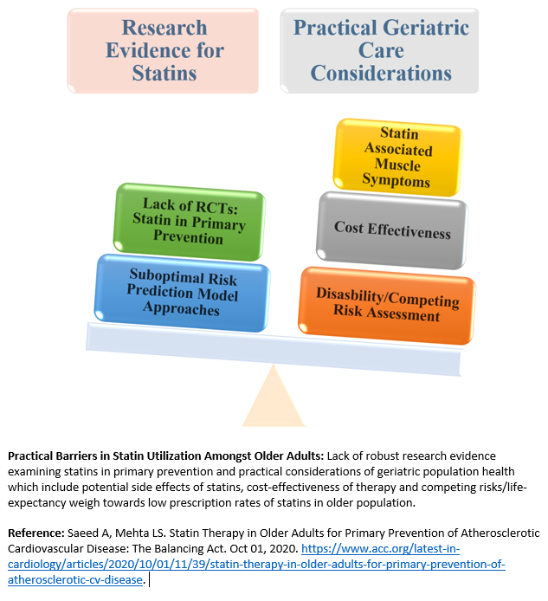
Notes:
Reference: Saeed A, Mehta LS. Statin Therapy in Older Adults for Primary Prevention of Atherosclerotic Cardiovascular Disease: The Balancing Act. Oct 01, 2020. https://www.acc.org/latest-in-cardiology/articles/2020/10/01/11/39/statin-therapy-in-older-adults-for-primary-prevention-of-atherosclerotic-cv-disease.

Slide 3
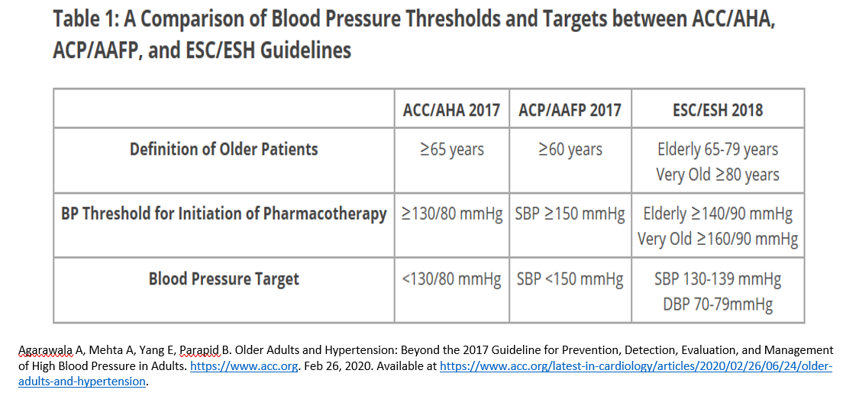
Notes:
Reference: Agarawala A, Mehta A, Yang E, Parapid B. Older Adults and Hypertension: Beyond the 2017 Guideline for Prevention, Detection, Evaluation, and Management of High Blood Pressure in Adults. https://www.acc.org. Feb 26, 2020. Available at https://www.acc.org/latest-in-cardiology/articles/2020/02/26/06/24/older-adults-and-hypertension.

Slide 4
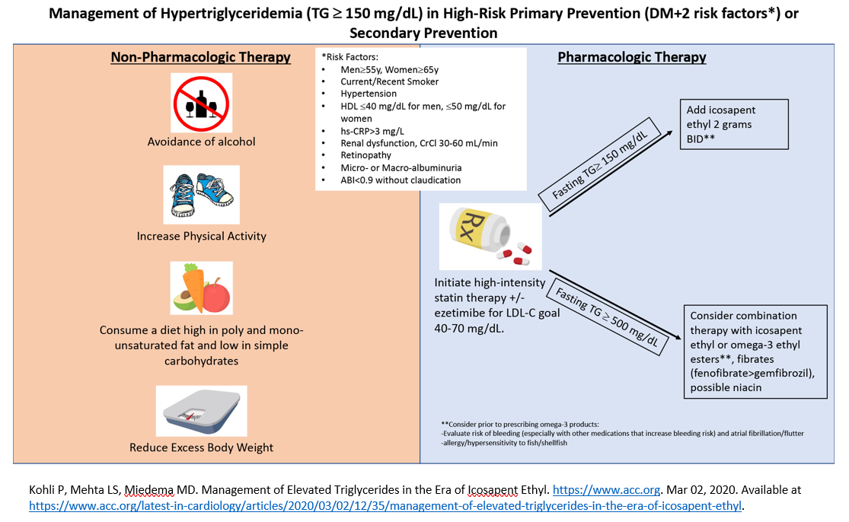
Notes:
Reference: Kohli P, Mehta LS, Miedema MD. Management of Elevated Triglycerides in the Era of Icosapent Ethyl. https://www.acc.org. Mar 02, 2020. Available at https://www.acc.org/latest-in-cardiology/articles/2020/03/02/12/35/management-of-elevated-triglycerides-in-the-era-of-icosapent-ethyl.

Slide 5
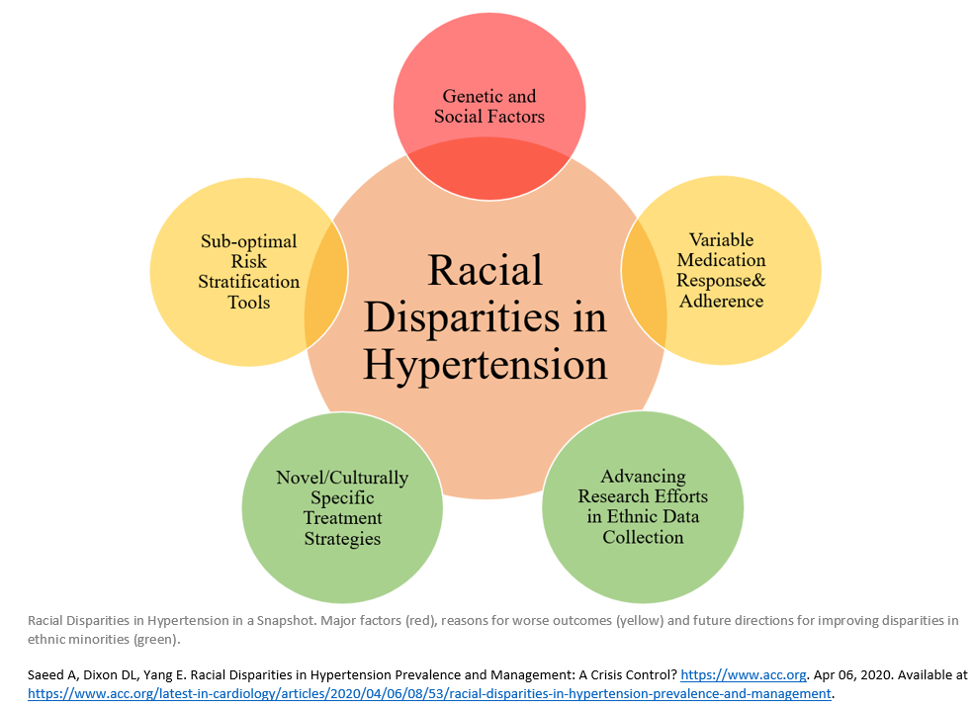
Notes:
Reference: Saeed A, Dixon DL, Yang E. Racial Disparities in Hypertension Prevalence and Management: A Crisis Control? https://www.acc.org. Apr 06, 2020. Available at https://www.acc.org/latest-in-cardiology/articles/2020/04/06/08/53/racial-disparities-in-hypertension-prevalence-and-management.

Slide 6
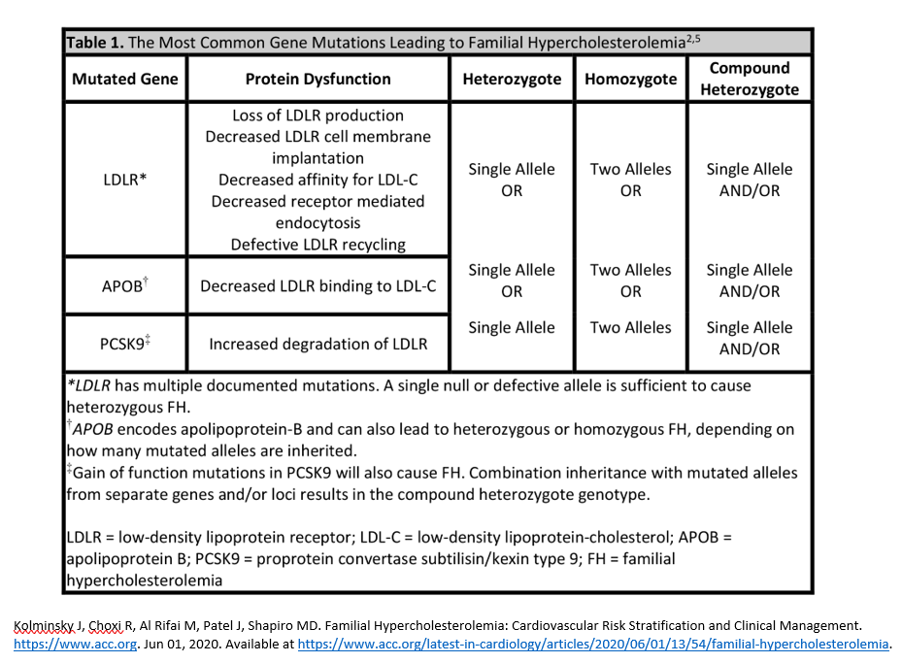
Notes:
Reference: Kolminsky J, Choxi R, Al Rifai M, Patel J, Shapiro MD. Familial Hypercholesterolemia: Cardiovascular Risk Stratification and Clinical Management. https://www.acc.org. Jun 01, 2020. Available at https://www.acc.org/latest-in-cardiology/articles/2020/06/01/13/54/familial-hypercholesterolemia.

Slide 7
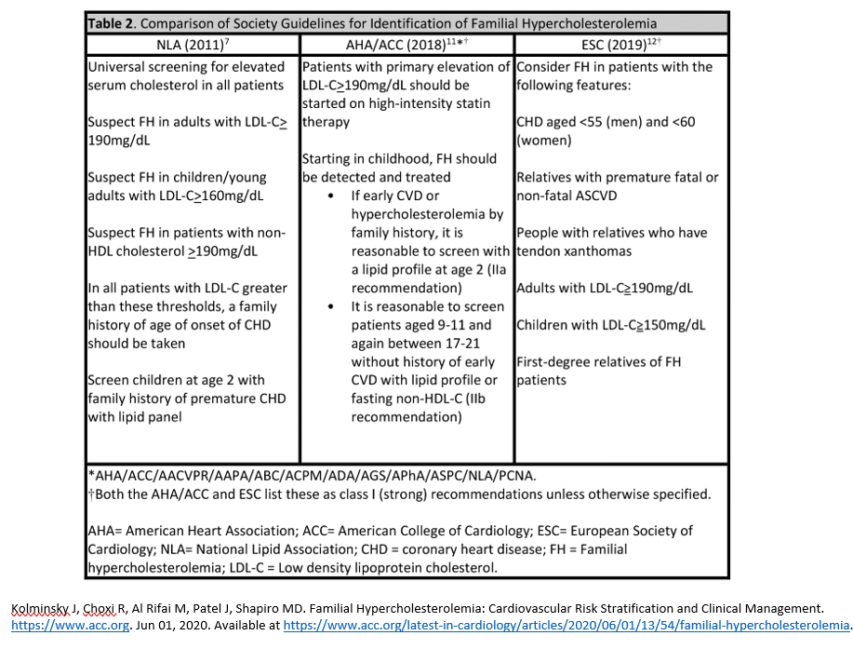
Notes:
Reference: Kolminsky J, Choxi R, Al Rifai M, Patel J, Shapiro MD. Familial Hypercholesterolemia: Cardiovascular Risk Stratification and Clinical Management. https://www.acc.org. Jun 01, 2020. Available at https://www.acc.org/latest-in-cardiology/articles/2020/06/01/13/54/familial-hypercholesterolemia.

Slide 8
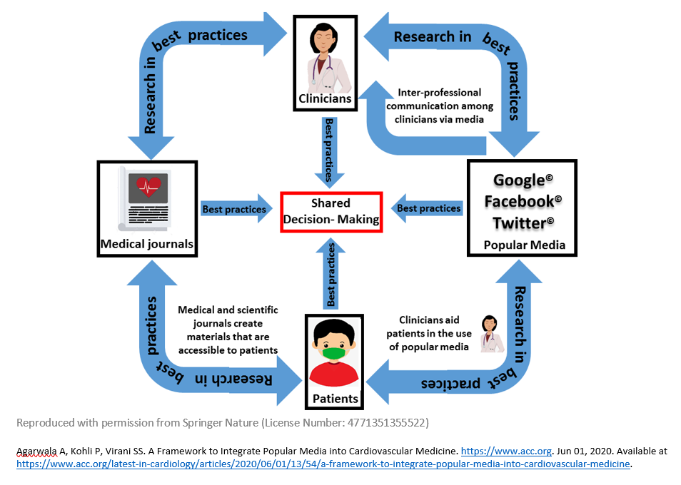
Notes:
Reference: Agarwala A, Kohli P, Virani SS. A Framework to Integrate Popular Media into Cardiovascular Medicine. https://www.acc.org. Jun 01, 2020. Available at https://www.acc.org/latest-in-cardiology/articles/2020/06/01/13/54/a-framework-to-integrate-popular-media-into-cardiovascular-medicine.

Slide 9
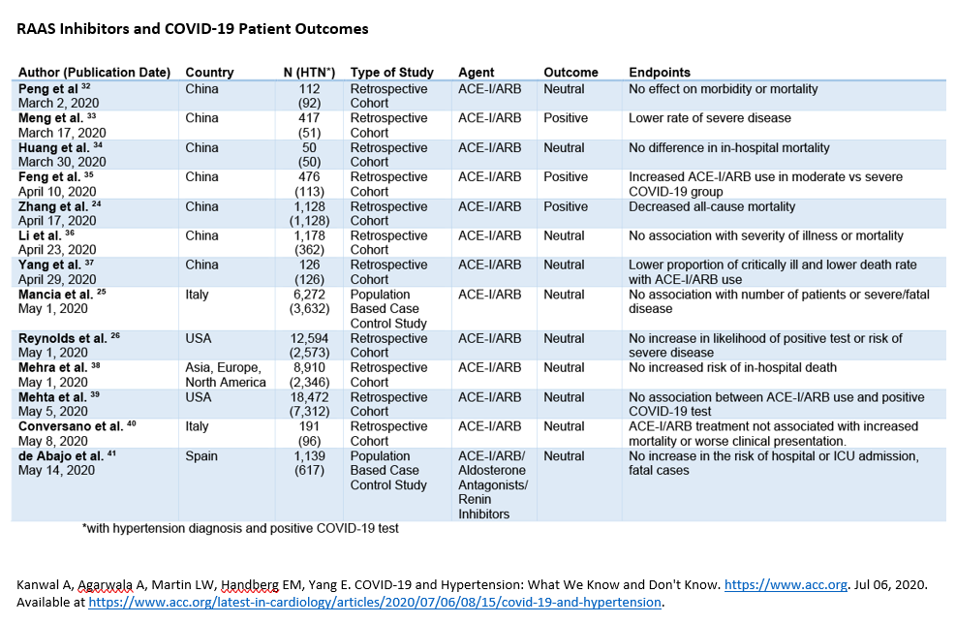
Notes:
Reference: Kanwal A, Agarwala A, Martin LW, Handberg EM, Yang E. COVID-19 and Hypertension: What We Know and Don't Know. https://www.acc.org. Jul 06, 2020. Available at https://www.acc.org/latest-in-cardiology/articles/2020/07/06/08/15/covid-19-and-hypertension.

Slide 10
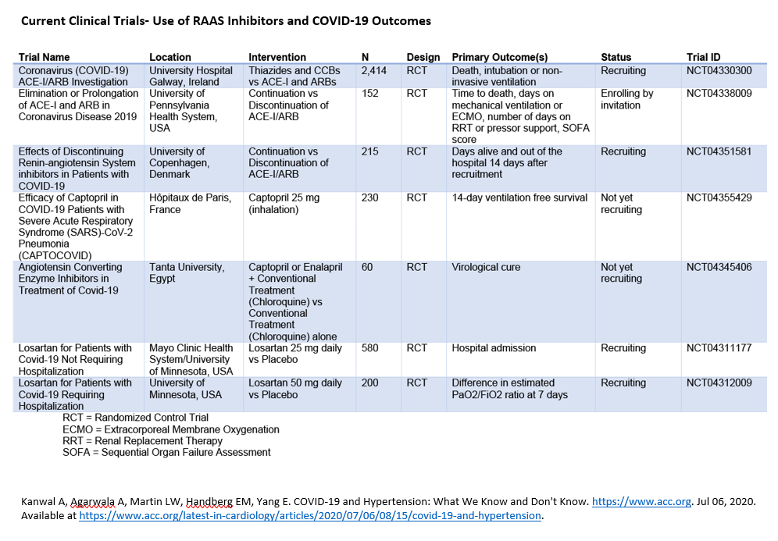
Notes:
Reference: Kanwal A, Agarwala A, Martin LW, Handberg EM, Yang E. COVID-19 and Hypertension: What We Know and Don't Know. https://www.acc.org. Jul 06, 2020. Available at https://www.acc.org/latest-in-cardiology/articles/2020/07/06/08/15/covid-19-and-hypertension.

Slide 11
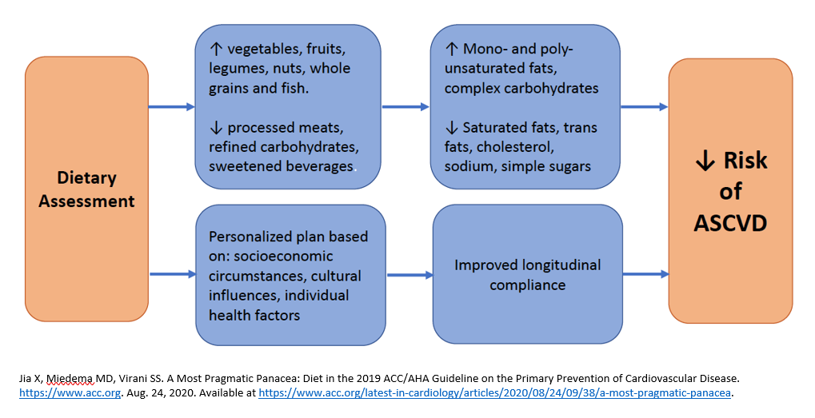
Notes:
Reference: Jia X, Miedema MD, Virani SS. A Most Pragmatic Panacea: Diet in the 2019 ACC/AHA Guideline on the Primary Prevention of Cardiovascular Disease. https://www.acc.org. Aug. 24, 2020. Available at https://www.acc.org/latest-in-cardiology/articles/2020/08/24/09/38/a-most-pragmatic-panacea.

Slide 12
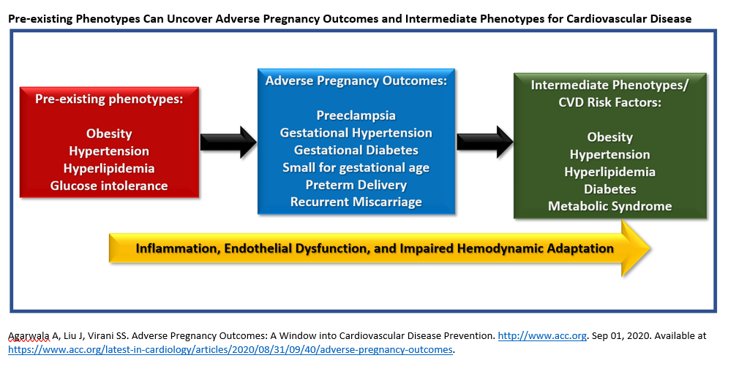
Notes:
Reference: Agarwala A, Liu J, Virani SS. Adverse Pregnancy Outcomes: A Window into Cardiovascular Disease Prevention. http://www.acc.org. Sep 01, 2020. Available at https://www.acc.org/latest-in-cardiology/articles/2020/08/31/09/40/adverse-pregnancy-outcomes.

Slide 13
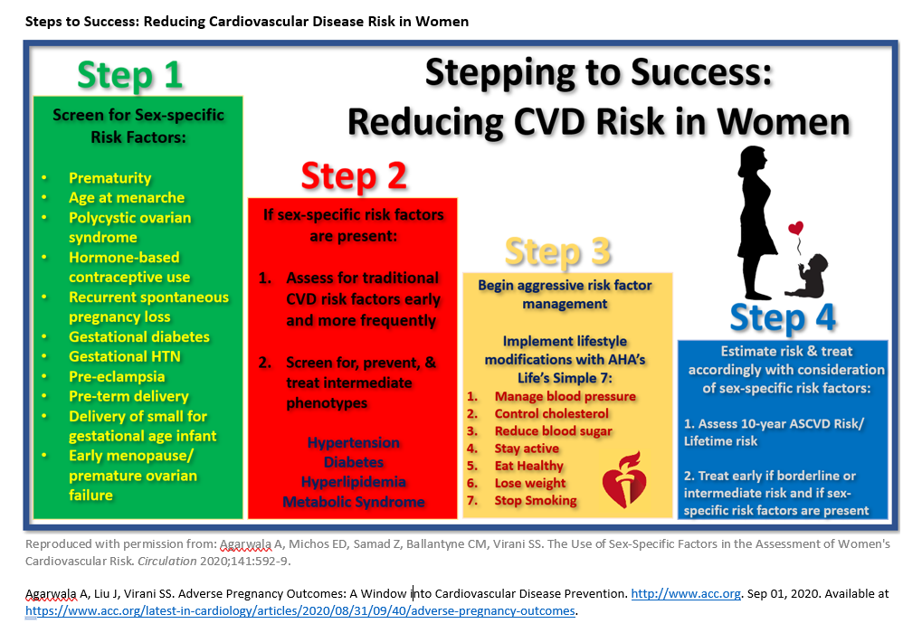
Notes:
Reference: Agarwala A, Liu J, Virani SS. Adverse Pregnancy Outcomes: A Window into Cardiovascular Disease Prevention. http://www.acc.org. Sep 01, 2020. Available at https://www.acc.org/latest-in-cardiology/articles/2020/08/31/09/40/adverse-pregnancy-outcomes.

Slide 14
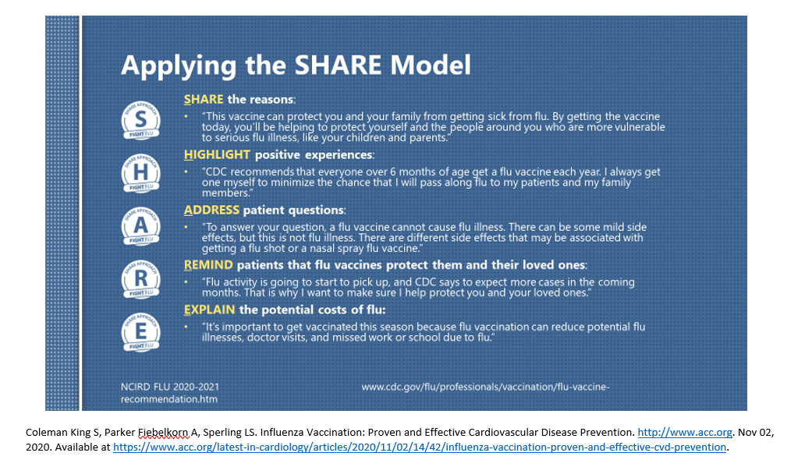
Notes:
Reference: Coleman King S, Parker Fiebelkorn A, Sperling LS. Influenza Vaccination: Proven and Effective Cardiovascular Disease Prevention. http://www.acc.org. Nov 02, 2020. Available at https://www.acc.org/latest-in-cardiology/articles/2020/11/02/14/42/influenza-vaccination-proven-and-effective-cvd-prevention.

