Slide 1
2021 Clinical Topic Collection Key Graphics
Prevention, Dyslipidemia and
Diabetes & Cardiometabolic Disease Collections

Slide 2
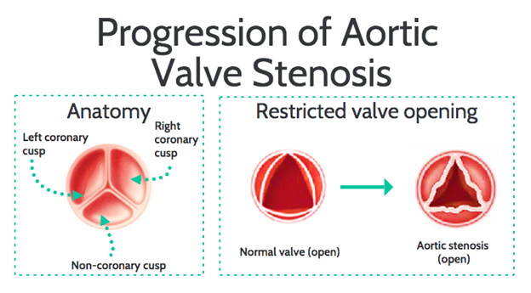
Bekele N, Szerlip N, Agarwala A. Elevated Lipoprotein(a) in Familial Hypercholesterolemia and its Role in the Progression of Calcific Aortic Stenosis. https://www.acc.org. Apr 05, 2021. https://www.acc.org/latest-in-cardiology/articles/2021/03/19/11/59/one-pill-for-them-all

Slide 3
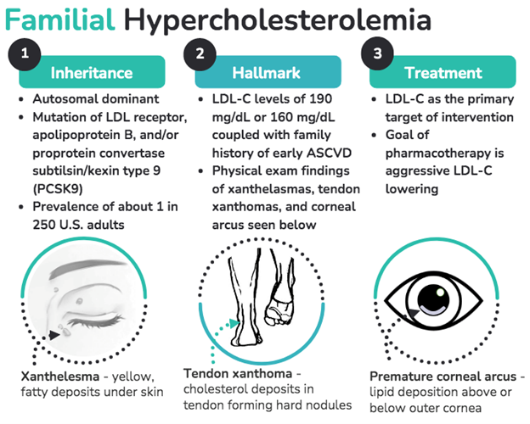
Bekele N, Szerlip N, Agarwala A. Elevated Lipoprotein(a) in Familial Hypercholesterolemia and its Role in the Progression of Calcific Aortic Stenosis. https://www.acc.org. Apr 05, 2021. https://www.acc.org/latest-in-cardiology/articles/2021/03/19/11/59/one-pill-for-them-all

Slide 4
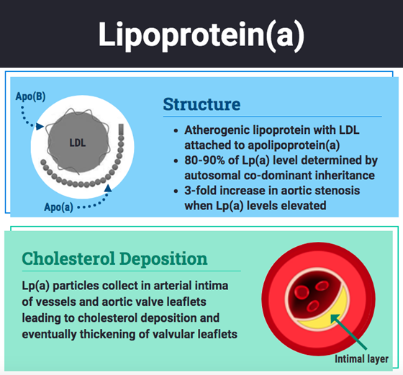
Bekele N, Szerlip N, Agarwala A. Elevated Lipoprotein(a) in Familial Hypercholesterolemia and its Role in the Progression of Calcific Aortic Stenosis. https://www.acc.org. Apr 05, 2021. https://www.acc.org/latest-in-cardiology/articles/2021/03/19/11/59/one-pill-for-them-all

Slide 5
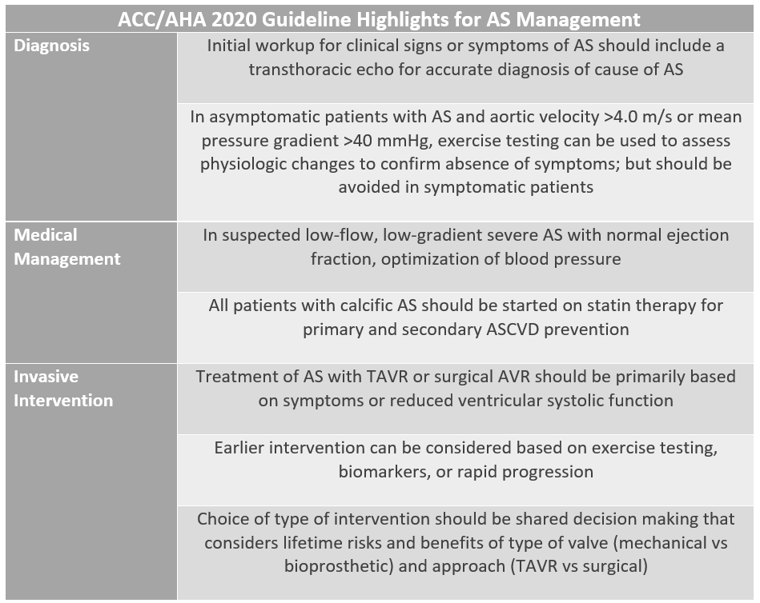

Slide 6
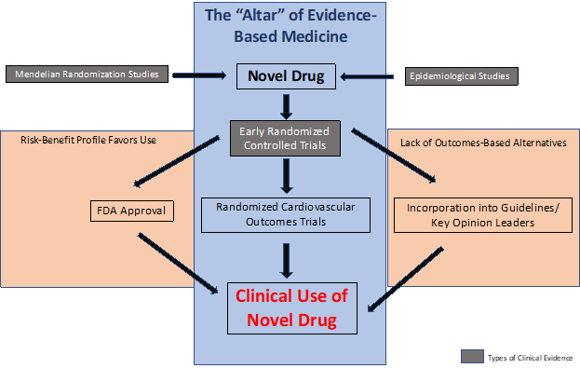
Kohli P. Worshipping at the Altar of Evidence-Based Medicine: Should Clinicians Wait for Outcomes Data Before Prescribing? https://acc.org. May 04. 2021. https://www.acc.org/Latest-in-Cardiology/Articles/2021/05/04/11/57/Worshipping-at-the-Altar-of-Evidence-Based-Medicine

Slide 7
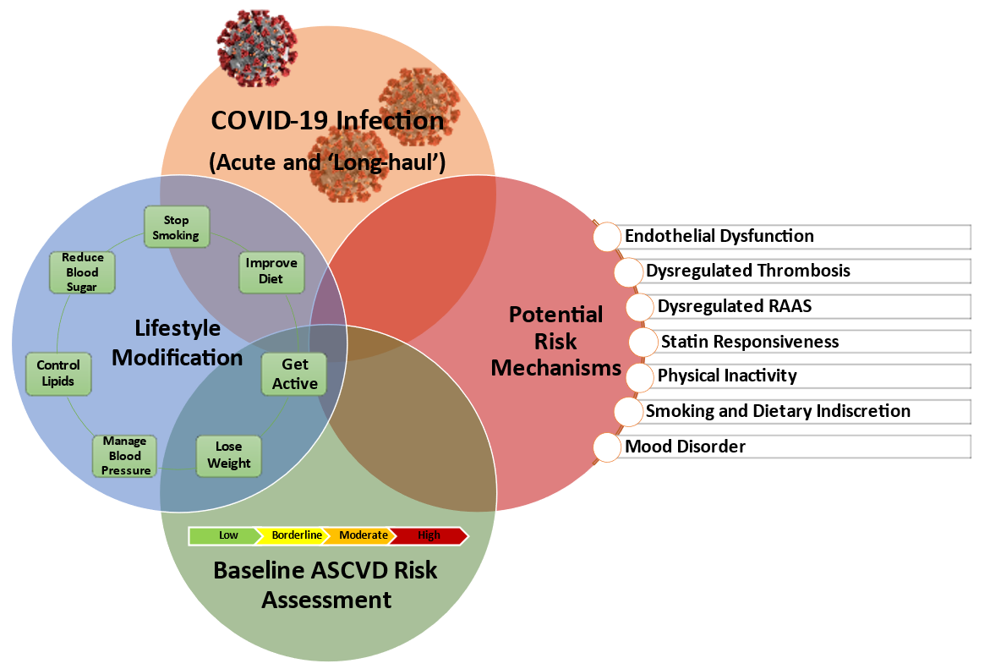
Naz NA, Patel J, Al Rifai M, Turlington JS, Shapiro MD. Mitigating ASCVD Risk Among Those Previously Infected with COVID-19. https://acc.org. Jun 01, 2021. https://www.acc.org/latest-in-cardiology/articles/2021/06/01/12/48/mitigating-ascvd-risk-among-those-previously-infected-with-covid-19

Slide 8
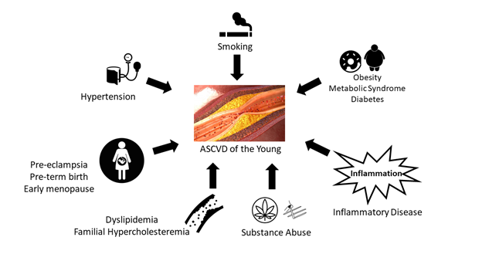
Weber B, Blankenstein R. What We Have Learned from Young Patients with ASCVD. https://acc.org. Jul 13, 2021. https://www.acc.org/latest-in-cardiology/articles/2021/07/12/12/31/what-we-have-learned-from-young-patients-with-ascvd

Slide 9
Lakshmanan S, Hritani R, Budoff MJ, Agarwala A. Cardiac CT: A New Frontier in Advocating for Women's Cardiovascular Health. https://acc.org. Sep 01, 2021. https://author-www.acc.org/latest-in-cardiology/articles/2021/09/01/17/29/cardiac-ct

Slide 10
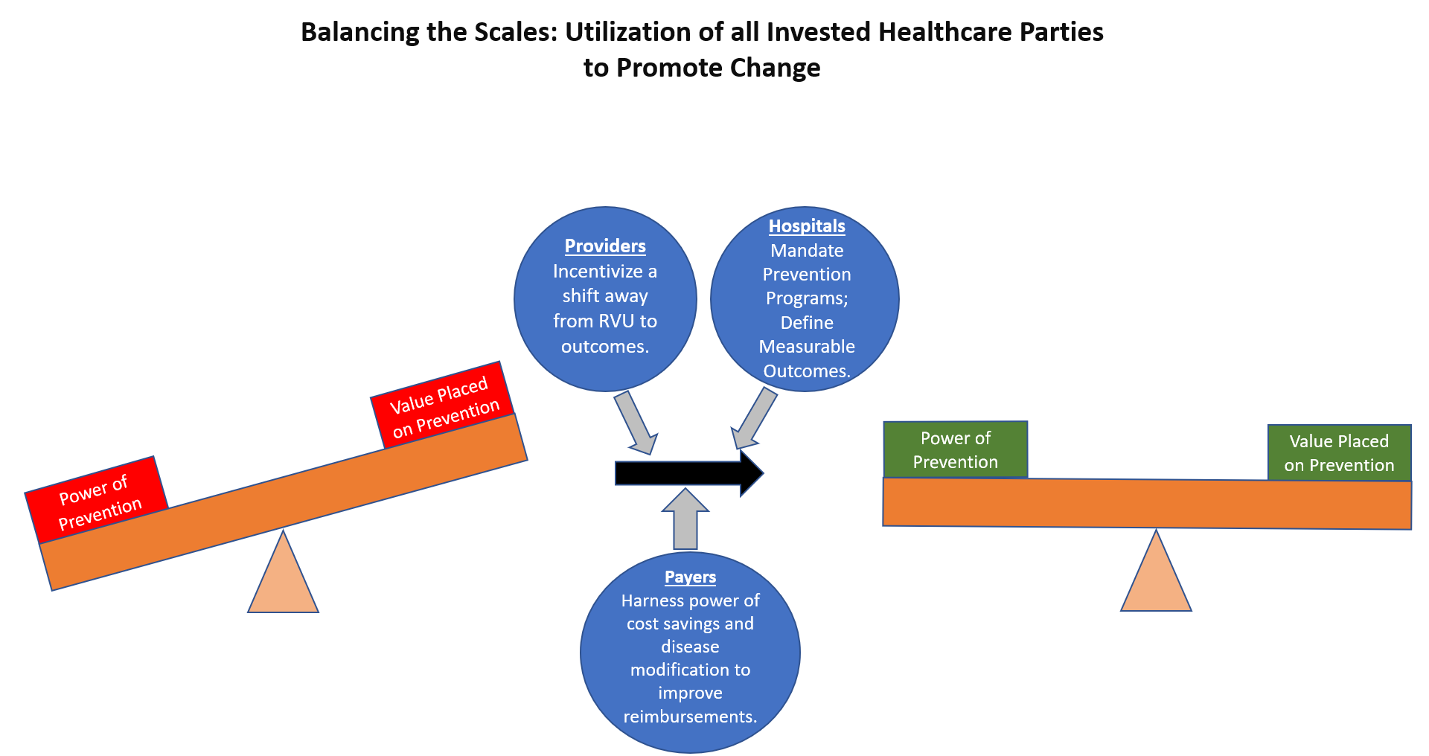
Kohli P. Expert Opinion: The Value Placed on Prevention versus the Impact of Prevention. https://www.acc.org. Oct 05, 2021. https://www.acc.org/latest-in-cardiology/articles/2021/10/05/12/01/expert-opinion-the-value-placed-on-prevention

Slide 11
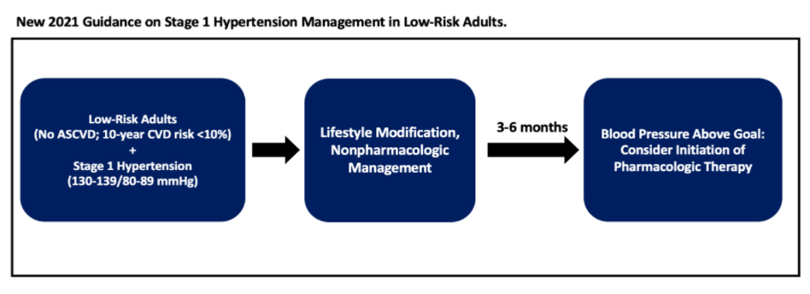
Goetsch MR, Tumarkin E, Blumenthal RS, Whelton SP. New Guidance on Blood Pressure Management in Low-Risk Adults with Stage 1 Hypertension. https://www.acc.org. Jun 21, 2021. https://www.acc.org/latest-in-cardiology/articles/2021/06/21/13/05/new-guidance-on-bp-management-in-low-risk-adults-with-stage-1-htn

Slide 12
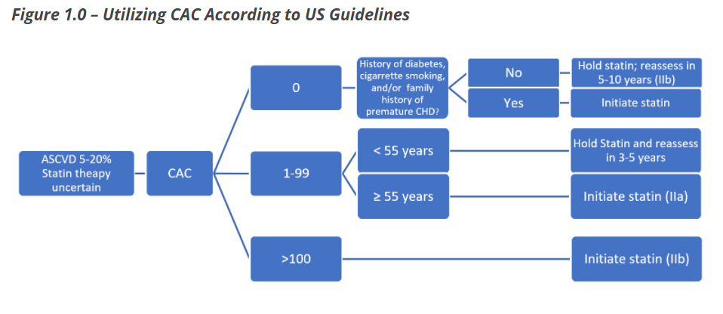
Gagel AC, Blumenthal RS, Cainzos-Achirica M. The Ever-Growing Role of Coronary Artery Calcium in Primary Prevention. https://www.acc.org. Jun 21, 2021. https://www.acc.org/latest-in-cardiology/articles/2021/06/21/13/05/the-ever-growing-role-of-cac-in-primary-prevention

Slide 13
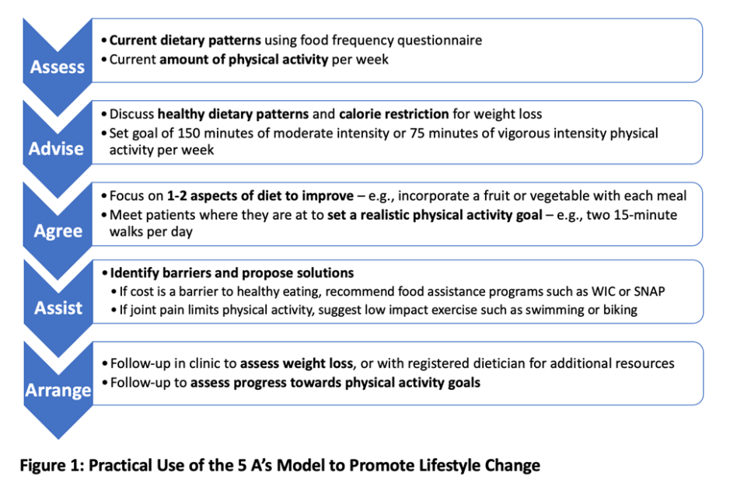
Duvall C, Jha K, Blumenthal RS, Florido R. The Myriad Cardiovascular Effects of Obesity. https://www.acc.org. Jul 16, 2021. https://www.acc.org/latest-in-cardiology/articles/2021/07/15/19/32/the-myriad-cardiovascular-effects-of-obesity

Slide 14
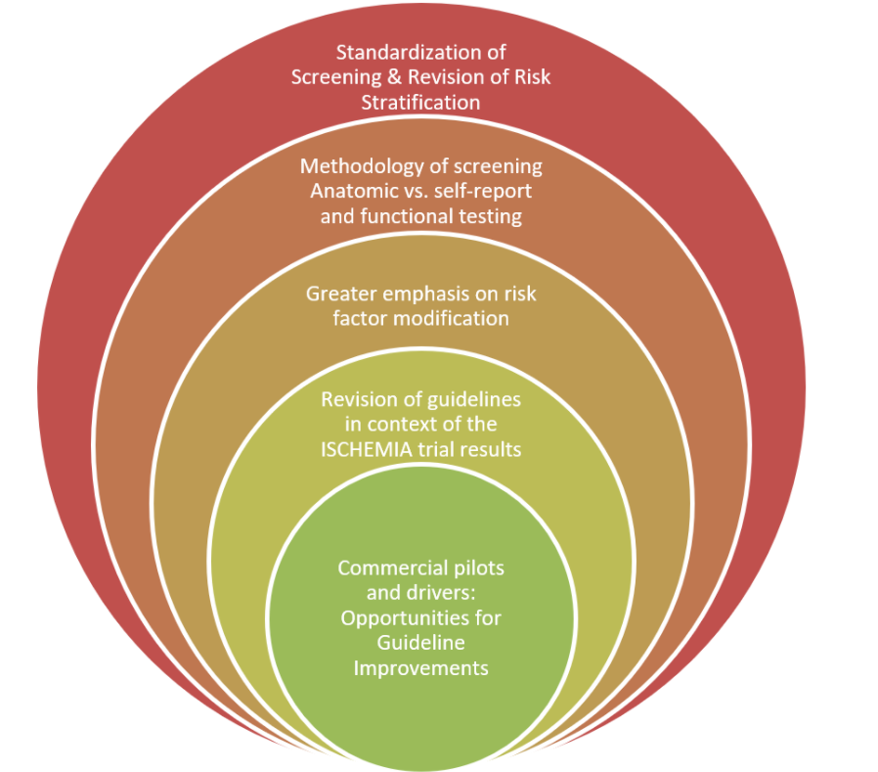
Brown C, Blumenthal RS, Razaq Sutton N. Management of Coronary Artery Disease in High-Risk Occupations. https://www.acc.org. Jul 19, 2021. https://www.acc.org/latest-in-cardiology/articles/2021/07/16/11/56/management-of-coronary-artery-disease-in-high-risk-occupations

Slide 15
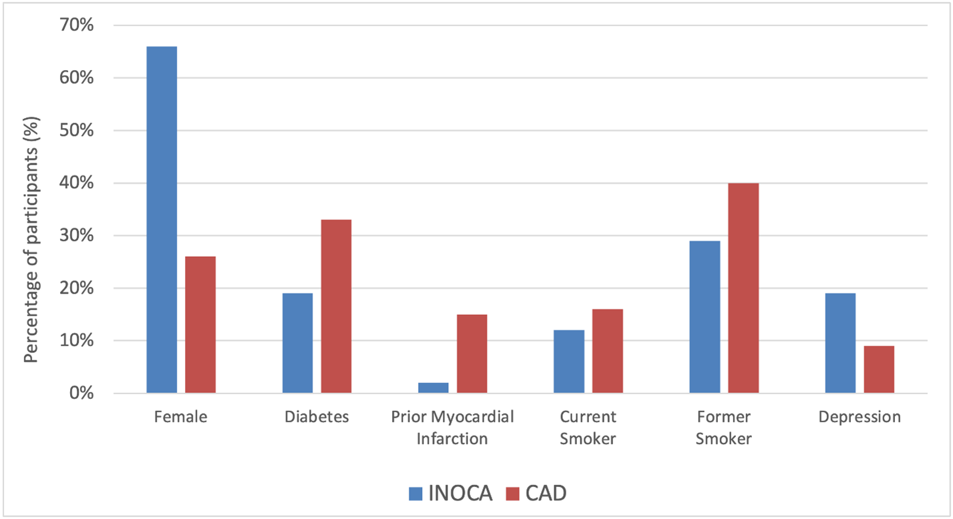
Figure 1. Notable demographics and clinical history in INOCA participants in CIAO-ISCHEMIA, and in ISCHEMIA stress echocardiography participants with obstructive CAD on CCTA.
Rao SJ, Wand A, Blumenthal RS, Sharma G. New Insights into the Complex Nature of Ischemia with No Obstructive Coronary Artery Disease. https://www.acc.org. Jul 27, 2021. https://www.acc.org/latest-in-cardiology/articles/2021/07/26/17/08/new-insights-into-the-complex-nature-of-ischemia-with-no-obstructive-cad

Slide 16
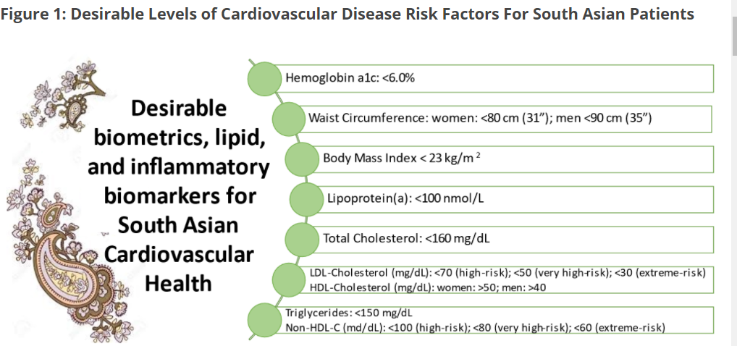
Agarwala A, Mancini GBJ, Deedwania PC, Patel J. South Asian Cardiovascular Health: Lessons Learned from the National Lipid Association Scientific Statement. https://www.acc.org. Aug 02, 2021. https://www.acc.org/Latest-in-Cardiology/Articles/2021/08/02/14/16/South-Asian-Cardiovascular-Health

Slide 17
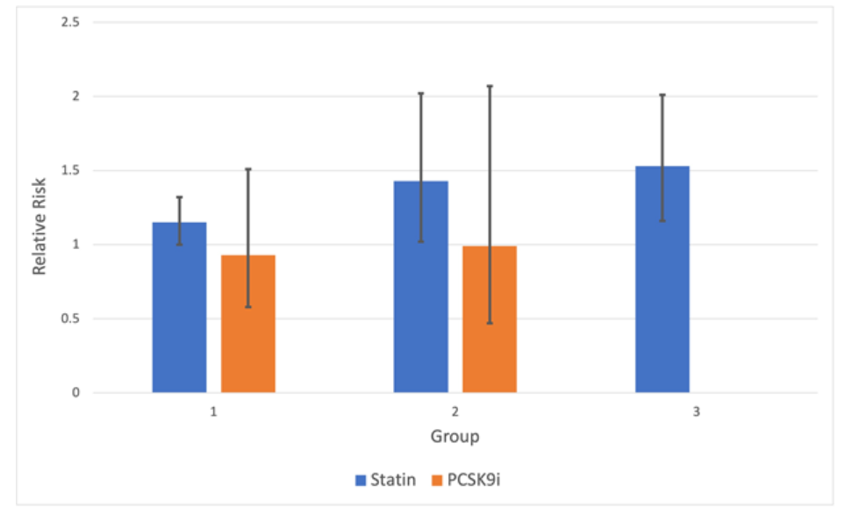
Figure 1: Relative risk of HS with statin or PCSK9i therapy in certain study groups. Error bars denote the 95% confidence interval.
Rao SJ, Martin SS, Sharma G. Fact or Fiction: Statins Increase the Risk of Hemorrhagic Stroke. https://www.acc.org. Aug 25, 2021. https://www.acc.org/latest-in-cardiology/articles/2021/08/25/13/00/fact-or-fiction-statins-increase-the-risk-of-hemorrhagic-stroke

Slide 18
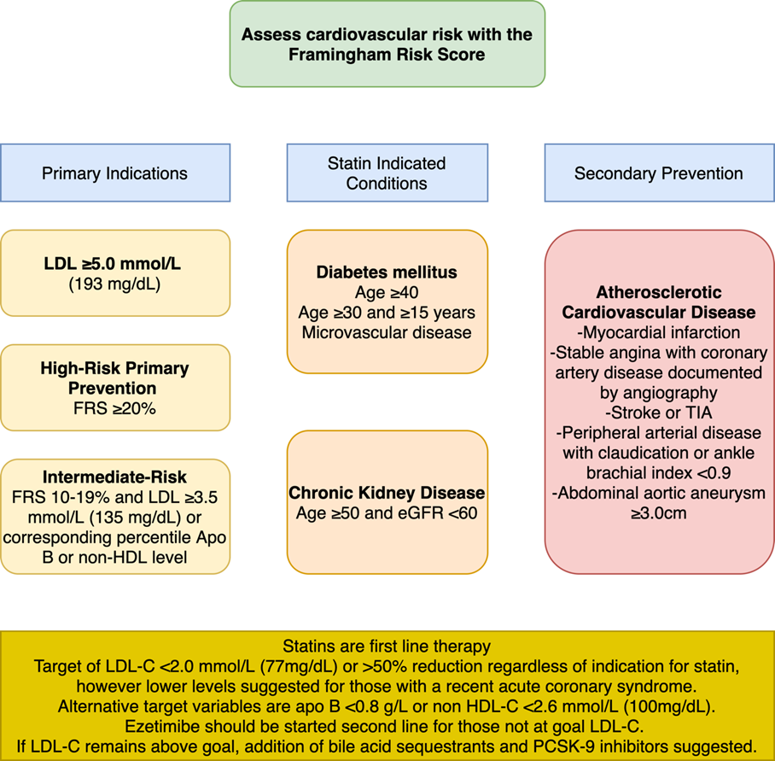
Gudenkauf BM, Jacobsen A, Blumenthal RS, Stone NJ, Martin SS. Update in Prevention: 2021 Canadian Cardiovascular Society Dyslipidemia Guidelines. https://www.acc.org. Sep 07, 2021. https://www.acc.org/latest-in-cardiology/articles/2021/09/07/12/46/update-in-prevention-2021-canadian-cv-society-dyslipidemia-guidelines

Slide 19
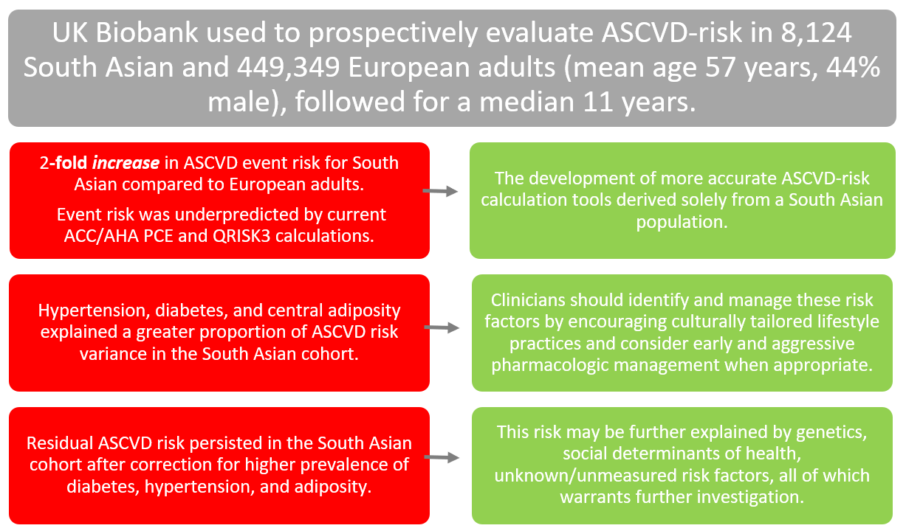
Franke J, Gagel AC, Jacobsen A, Blumenthal RB, Patel J. Quantifying and Understanding the Higher Risk of ASCVD Among South Asians. https://www.acc.org. Sep 13, 2021. https://www.acc.org/latest-in-cardiology/articles/2021/09/13/14/42/quantifying-and-understanding-the-higher-risk-of-ascvd-among-south-asians

Slide 20
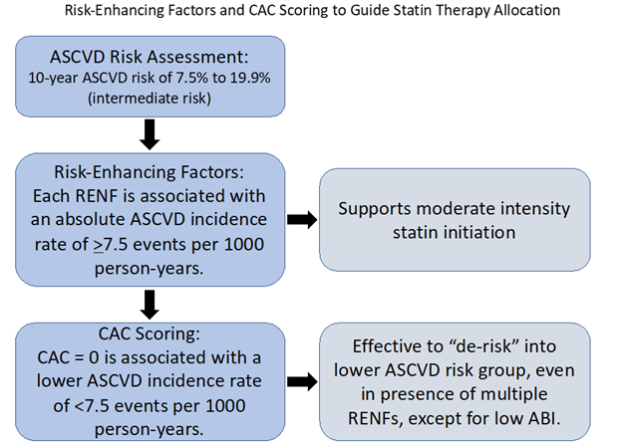
Abovich A, Cardoso R, Blankstein R, Blumenthal RS. Statin Therapy Allocation in Intermediate Risk Population. https://www.acc.org. Sep 20, 2021. https://www.acc.org/latest-in-cardiology/articles/2021/09/20/13/19/statin-therapy-allocation-in-intermediate-risk-population

Slide 21
Figure 1: Absolute Event Rates for CVD and CHD mortality among adults with ASCVD risk.
Rajan T, Blumenthal RS. New Evidence Supporting Selective Use of Coronary Artery Calcium Scoring for Adults at Borderline 10-Year ASCVD Risk. https://www.acc.org. Oct 12, 2021. https://www.acc.org/latest-in-cardiology/articles/2021/10/12/12/46/new-evidence-supporting-selective-use-of-coronary-artery-calcium-scoring

Slide 22
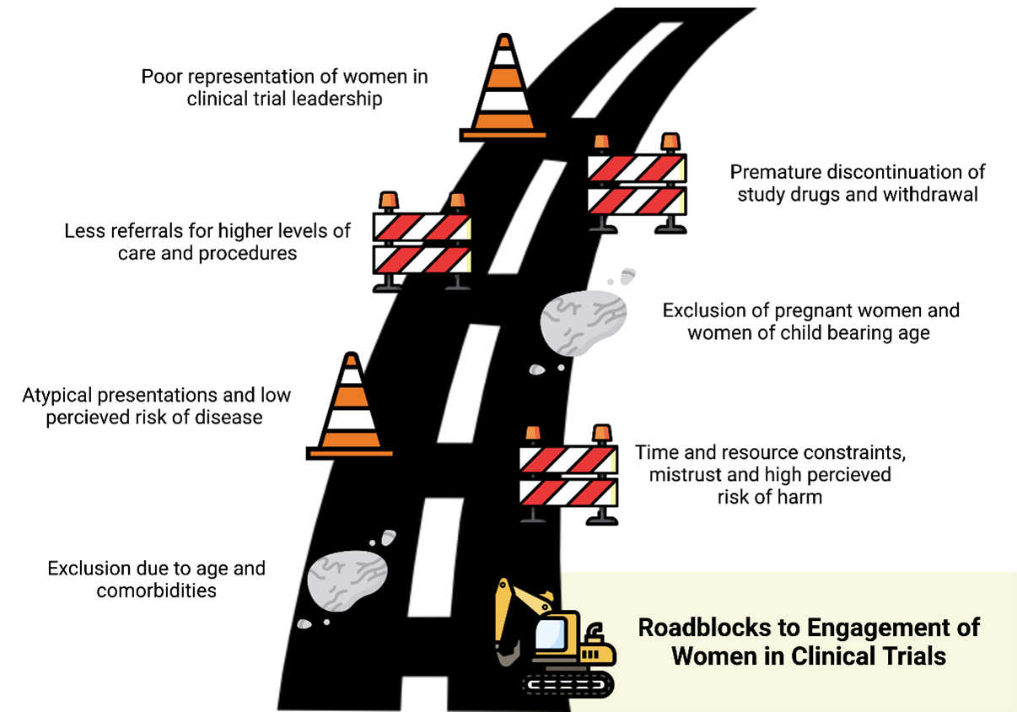
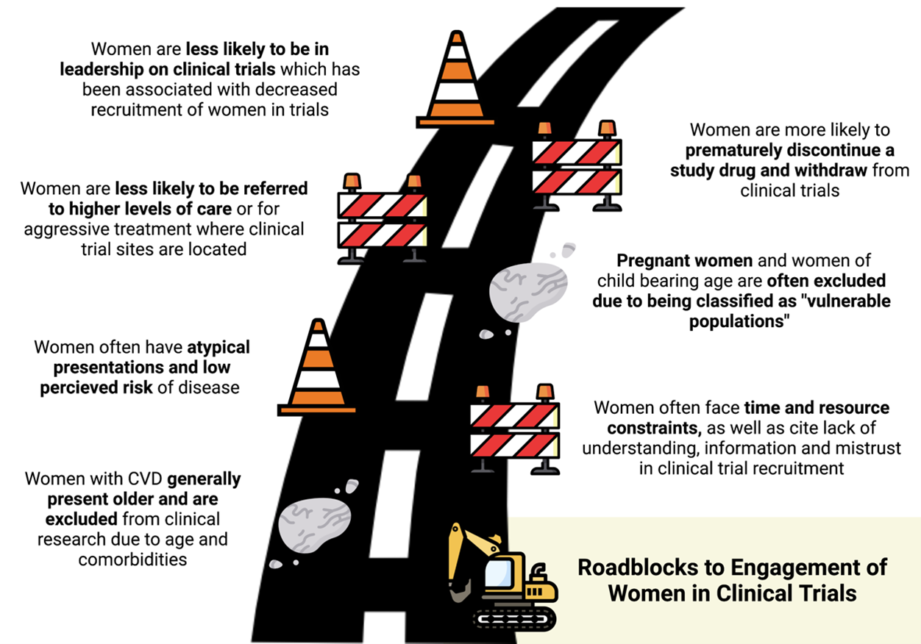
Thakkar A, Blumenthal RS, Sharma G. Identifying the Roadblocks to Engagement of Women in Clinical Trials. https://www.acc.org. Oct 18, 2021. https://www.acc.org/latest-in-cardiology/articles/2021/10/18/12/35/identifying-the-roadblocks-to-engagement-of-women-in-clinical-trials

Slide 23
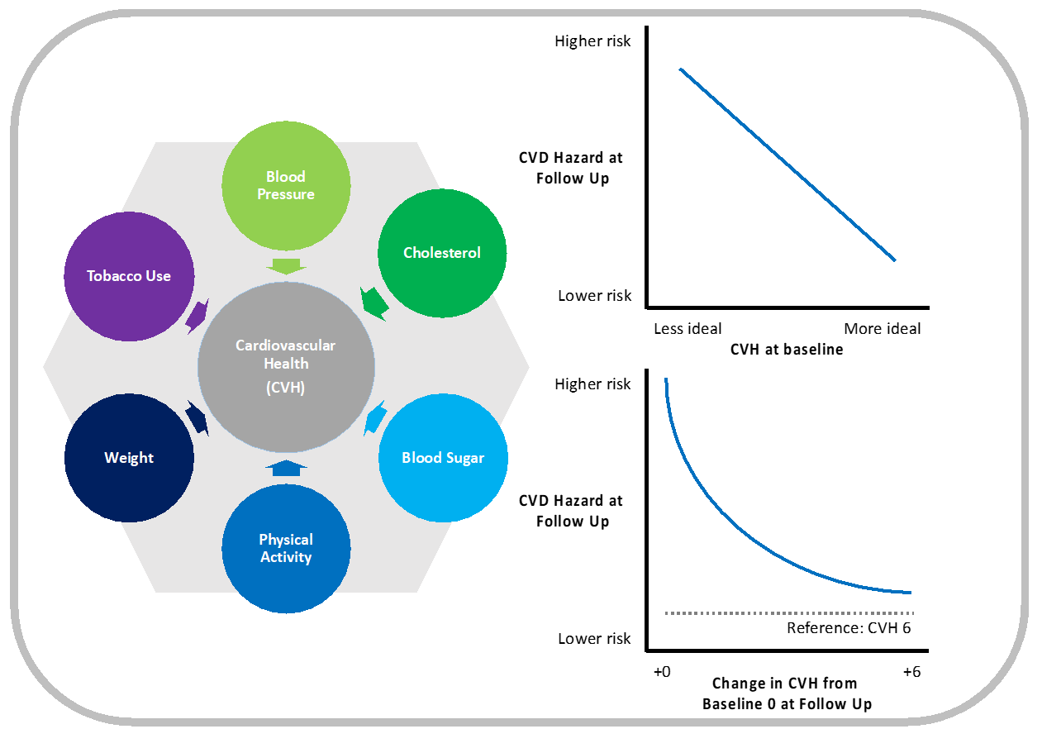
Sweeney T, Vasquez N, Blumenthal RS. Cardiovascular Health in Early Life: Sign of What's to Come? https://www.acc.org. Oct 26, 2021. https://www.acc.org/latest-in-cardiology/articles/2021/10/26/12/31/cardiovascular-health-in-early-life

Slide 24
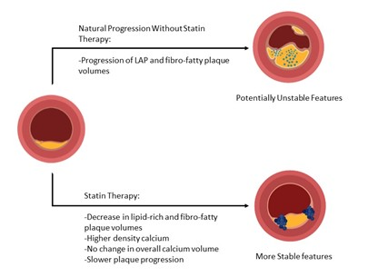
Kazzi B, Feldman DI, Blumenthal RS, Zadeh AA. The Effect of Statin Therapy on the Progression and Composition of Coronary Atherosclerotic Plaque Identified on Coronary CTA. https://www.acc.org. Nov 12, 2021. https://www.acc.org/Latest-in-Cardiology/Articles/2021/11/10/19/50/The-Effect-of-Statin-Therapy-on-the-Progression-and-Composition-of-Coronary-Atherosclerotic-Plaque

Slide 25
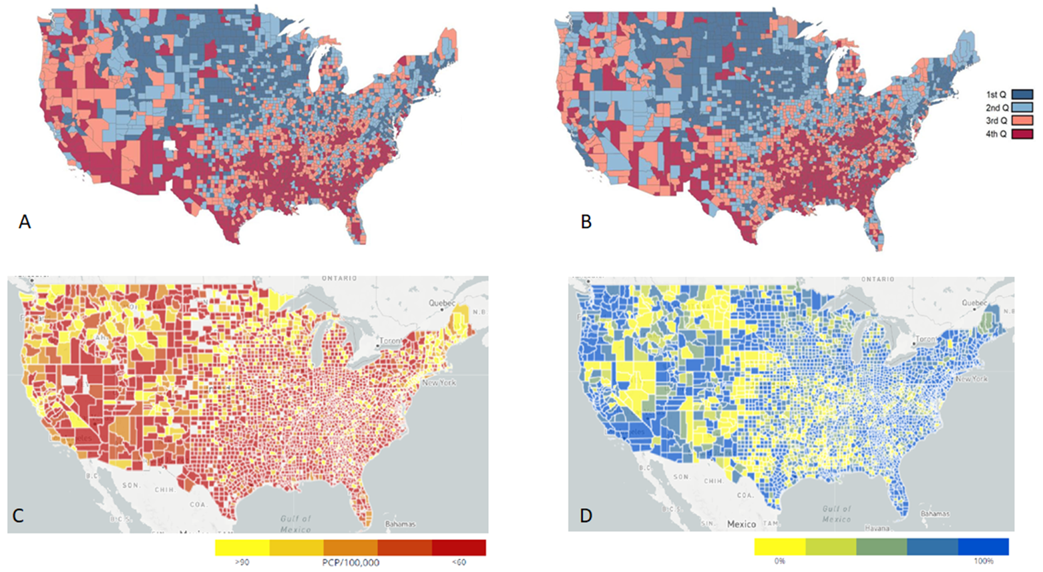
Figure 1: Counties by social vulnerability index quartiles (A), by premature cardiovascular disease mortality quartiles (B), with access to primary care physicians (C), and access to broadband internet (D).^{7,14} There is significant regional overlap between social vulnerability, access to healthcare and information infrastructure, and CVD mortality.
Patel K, Blumenthal RS, Sharma G. Social Vulnerability Index Highlights the Most Vulnerable Among US to Cardiovascular Disease. https://www.acc.org. Dec 01, 2021. https://www.acc.org/Latest-in-Cardiology/Articles/2021/12/01/18/26/Social-Vulnerability-Index-Highlights-the-Most-Vulnerable-Among-US-to-CVD

Slide 26
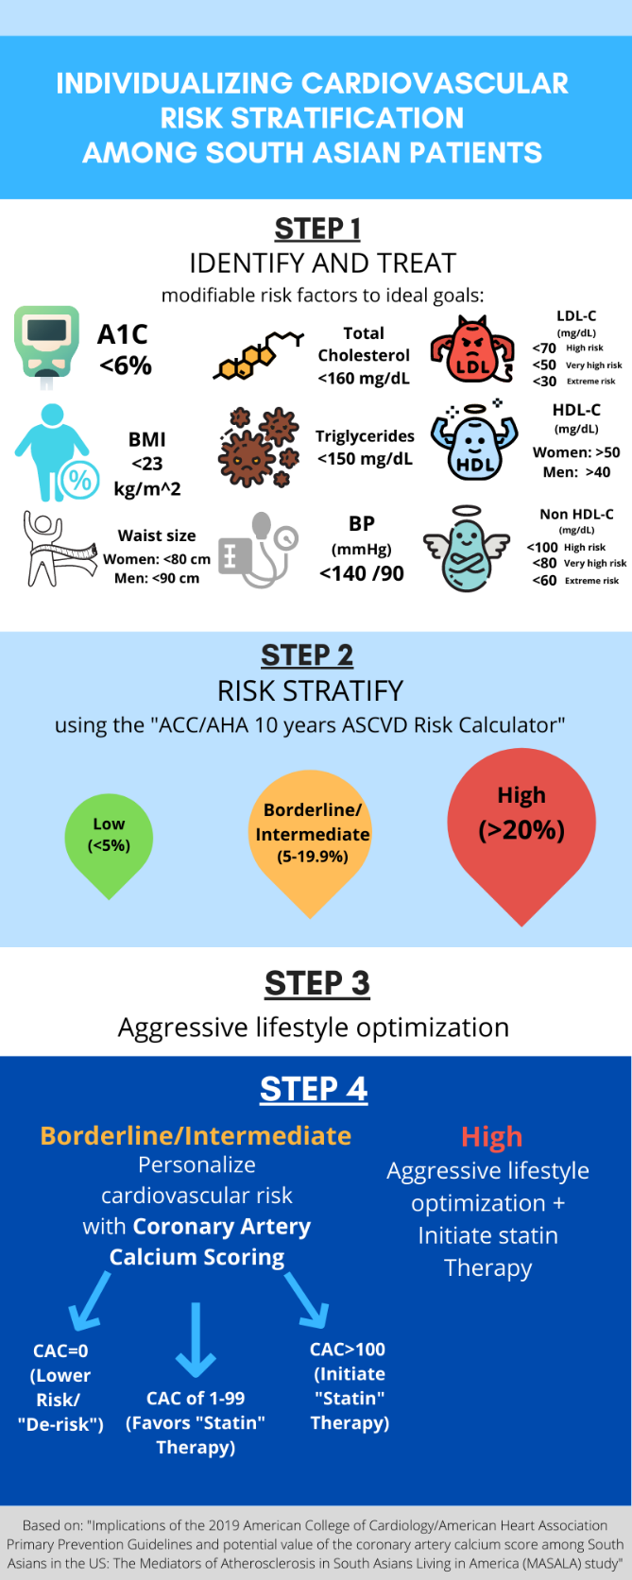
Figure 1: Individualizing Cardiovascular Risk Stratification Among SAUS Patients.
Koneru SC, Zachariah B, Gaine S, Patel J, Agarwala A. How Many South Asians Does It Take? Coronary Artery Calcium to Refine Statin Allocation in a High-Risk Ethnicity . https://www.acc.org. Dec 06, 2021. https://www.acc.org/Latest-in-Cardiology/Articles/2021/12/06/13/32/How-Many-South-Asians-Does-It-Take

Slide 27
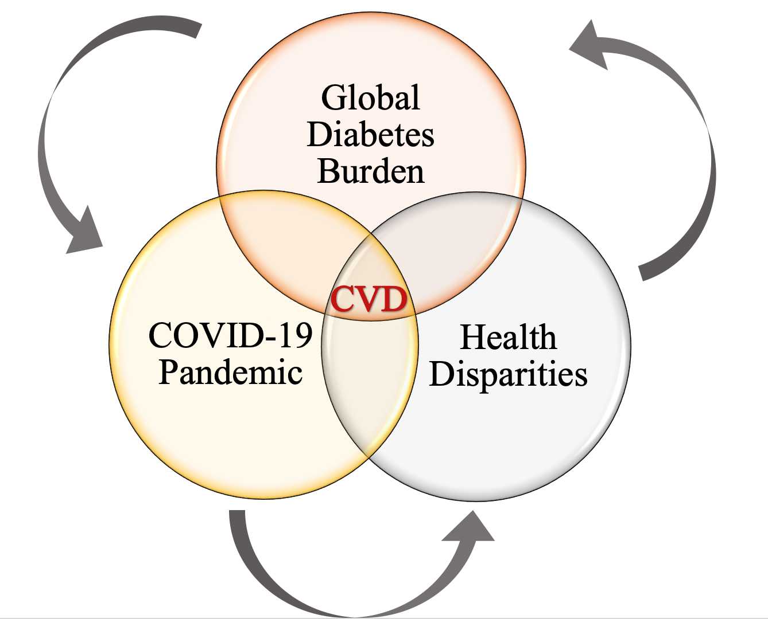
Thobani A, McLaughlin TJ, Sperling LS. The Global Prevention of Cardiovascular Disease Among People Living with Diabetes: Leading with Heart. https://www.acc.org. Jun 21, 2021. https://www.acc.org/latest-in-cardiology/articles/2021/06/21/13/05/the-global-prevention-of-cvd-among-people-living-with-diabetes

Slide 28
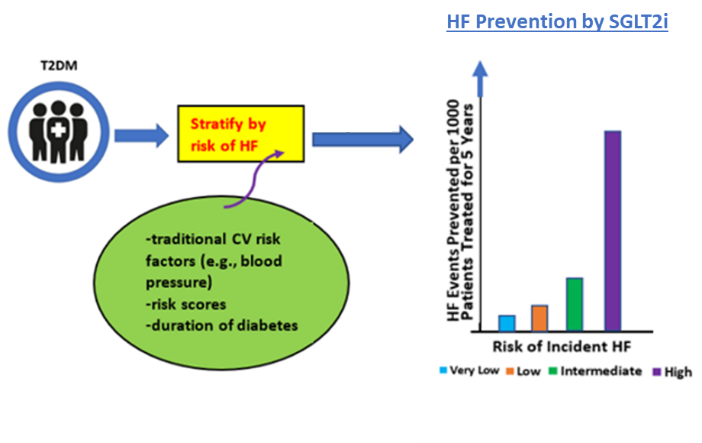
Siddiqi TJ, Khan MS, Pandey A, Greene S. Duration of Diabetes and Risk of Incident Heart Failure: Using the Past to Predict the Future . https://www.acc.org. Dec 01, 2021. https://www.acc.org/Latest-in-Cardiology/Articles/2021/12/01/13/34/Duration-of-Diabetes-and-Risk-of-Incident-Heart-Failure

