Slide 1

Clinician Burnout & Wellness

Slide 2
Slides Courtesy of:
Tami Atkinson, MD
Scott Lilly, MD, PhD, FACC
Laxmi Mehta, MD, FACC
Garima Sharma, MD, FACC
Poonam Velagapudi, MD, FACC
BOG Task Force on Wellness
Early Career Section
Membership Committee Well-Being Work Group

Slide 3
Outline
Introduction & background on clinician burnout
Domains of physician well-being
Tools to prevent burnout and promote wellness
Guide for chapter-based activities

Slide 4
Introduction & Background
Define clinician burnout and consequences
Identify risk factors for burnout
Data to support high rates of burnout and suicide rates
Define clinician wellness
ACC quadruple aim

Slide 5
Defining Burnout
Adapted from the World Health Organization’s definition of burnout:
The three key dimensions of burnout are overwhelming exhaustion, feelings of cynicism and detachment from the job, and a sense of ineffectiveness and lack of accomplishment.
Exhaustion is the physical and emotional response of stress. Emotions associated with exhaustion include feeling overextended by work demands and depleted of emotional and physical resources that support replenishment and recovery.
Cynicism represents the interpersonal aspect of burnout and refers to a negative, callous, or excessively detached response to various aspects of the job, usually resulting in a negative reaction to people, loss of idealism, and the dehumanization of others.
Inefficacy refers to feelings of incompetence and a lack of achievement and productivity in work and represents the self-evaluation aspect of burnout.
National Academy of Medicine: Taking Action Against Clinician Burnout: A Systems Approach to Professional Well-Being (October 2019)

Slide 6

Prevalence of Burnout Among Cardiologists
26.8% Burned Out
23.7% Enjoyed Work
49.5% Stressed
Laxmi S. Mehta et al. JACC 2019;73:3345-3348

Slide 7
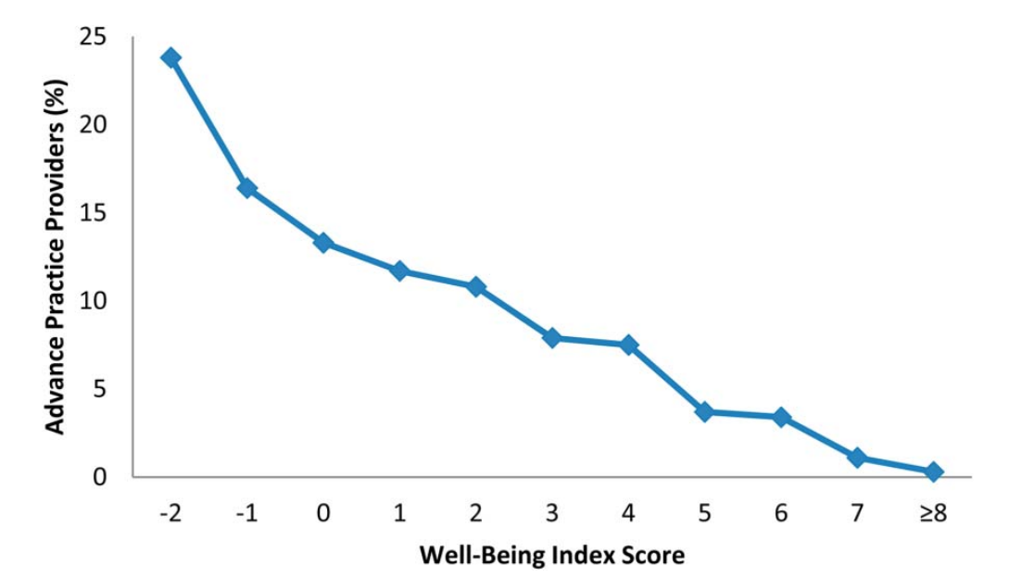
Well-Being Index Score: NPs & PAs
38.5% had substantial symptoms of burnout and nearly one-third were considering a job change.
Total WBI total score -2 to 9, higher scores indicating greater degree of distress, lower meaning in work, and less satisfaction with work–life integration.
Liselotte N. Dyrbye et al. JAANP 2018; 1-10

Slide 8
Consequences of Burnout
Physician
Patient Care
Family/Friends
Personal Health
Hospital/Health Care Organization
2018 Medscape Physician Lifestyle Report
  40% of cardiologists experienced burnout
  12% of cardiologists felt depressed
  3% of cardiologists had clinical depression
  Cardiology had one of the higher rates of burnout and lowest happiness rate
  17% of cardiologists considered professional health (least likely of all medical specialties)
Coping Mechanisms
  Alcohol consumption
  Binge/unhealthy eating
  Self-isolation
Suicide Rates
  Double that of general population
  Women 130% higher than general female population
  Men 40% higher than general population
Notes:
Patient care – suboptimal care, lower patient satisfaction, medical errors, malpractice suits
Health Care organizations/Hospital – decreased productivity, increased physician turnover
Personal – depression, suicidal ideation, substance abuse, early retirement
Family/Friends – relationship difficulties

Slide 9
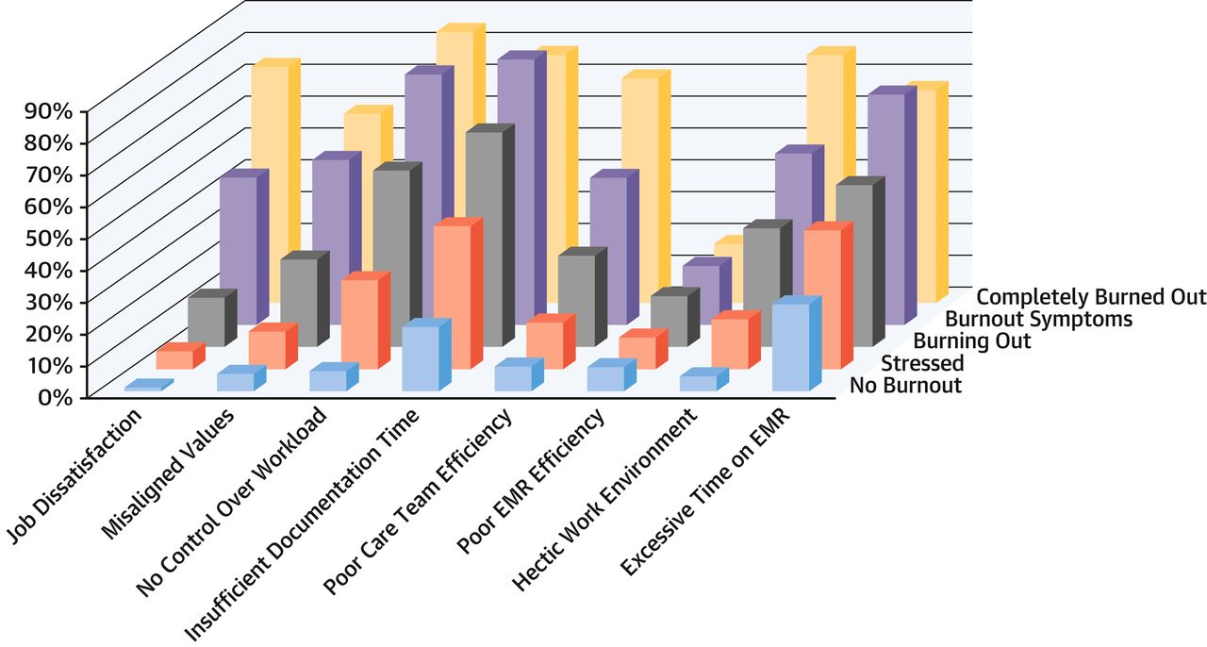
Work Environment and Burnout
Laxmi S. Mehta et al. JACC 2019;73:3345-3348
Notes:
Work Environment and Burnout Association of stress and burnout with work environment factors from the Mini Z survey. Adverse work environment was less common in no burnout physicians compared with stressed and burned out physicians. EMR = electronic medical record.

Slide 10
Potential Risk Factors For Burnout
Administrative burden
Long duration of training – especially subspecialization
Financial responsibilities
  Raising a family
  Student loan debt
  New mortgage
  Retirement planning
Supply-demand mismatch
  A shortage of more than 4000 cardiologists was predicted by a 2009 survey including general cardiologists, interventional cardiologists, electrophysiologists and pediatric cardiologists
  Increase in number of patients seen and work hours
Academic dissatisfaction
  Increased clinical duties and less time for research, educational and scholarly activities

Slide 11
Definition of Wellness
Wellness is an active process through which people become aware of, and make choices toward, a more successful existence.
– National Wellness Institute
Wellness is a state of complete physical, mental, and social well-being, and not merely the absence of disease or infirmity.
– World Health Organization

Slide 12
Quadruple Aim
Improve Work Life of Health Care Providers
Reduce Costs
Enhance Patient Experience
Improve Population Health
Clinician burnout is counterproductive to the goals of the triple aim
This has added a fourth aim – “improve work life of health care clinicians”
Improving clinician well-being has been incorporated into ACC’s 2019-2023 strategic plan

Slide 13
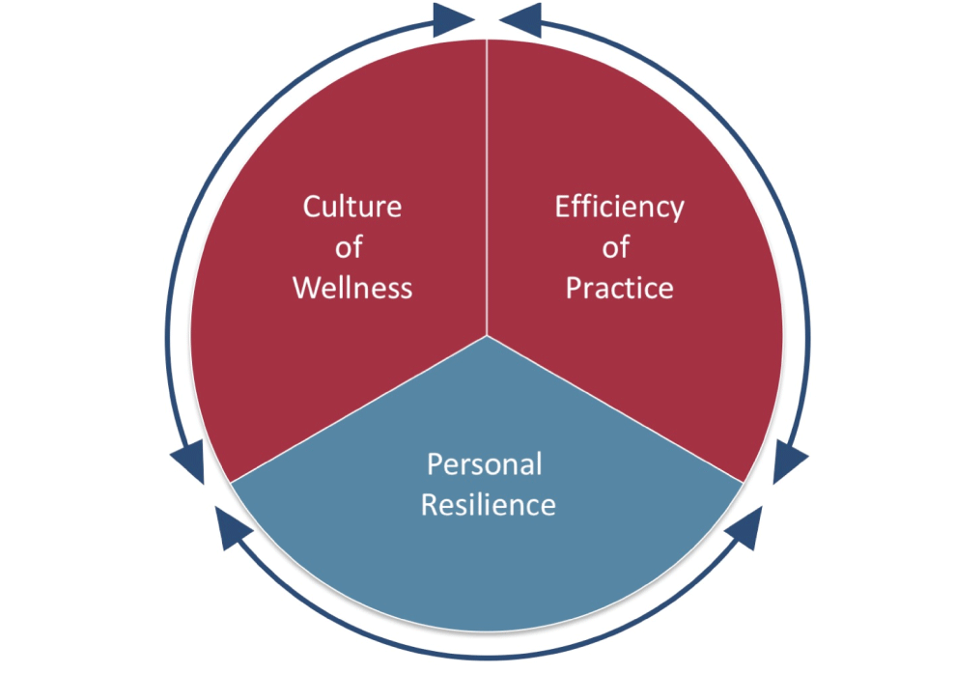
A Potential Model: Reciprocal Domains of Physician Well-Being
Culture of Wellness
Leadership engagement and accountability
Communication and public relations
Organizational infrastructure
Measurement and scholarship
Recognition
Efficiency of Practice
Technical solutions
Balance of job demands with job resources
Empowering clinicians in developing clinic flows/processes
Personal Resilience
Mindfulness classes
Schwartz Center Rounds
Community and connection
Bohman, B, et al NEJM Catalyst (2017)

Slide 14
Potential Burnout Interventions
Workplace Efficiency
  Reduce administrative burden
    Hire and train medical scribes
    Schedule dedicated administrative time in clinician schedule
  Designated health care teams, team huddles, medical scribes
  Involve clinicians in developing clinic flows/processes
Culture of Wellness
  Establish a wellness program
    Recruit wellness committee
    Identify designated wellness champions within an organization/institution
  Mental health support programs
    Dedicated wellness centers with counselors/therapists available to trainees/faculty members
  Invest in clinicians
    Provide onsite childcare at hospitals/institutions and conferences
Personal Resilience
  Provide coaching to assist with stress management, mindfulness training and techniques to promote wellness
  Small group discussions, share stories about how burnout was managed
  Provide financial counselors for ECPS
  Discuss financial planning, retirement, mortgage resources and family planning

Slide 15
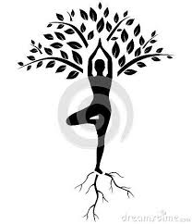
Self-Care & Wellness
Sleep Hygiene
Mindfulness & Meditation
  Meditation apps
  Mindfulness – practice of being completely aware and present in the current moment
  Promote self-awareness & reduce stress
Yoga
Regular Exercise
Relaxation
US Department of Health and Human Services
(SAMHSA) Substance Abuse and Mental Health Services Administration

Slide 16
Self-Care Strategies
Elements of a self-care plan to prevent burnout: journaling, meditation, massage, yoga, reading, music, mindfulness, stretching, tai chi, dancing, breath techniques, etc.
Educating membership to detect early signs of deteriorating health and take action:
  Encouraging members to became more connected with friends, family or the community
  Encouraging members to make a personal vision plan and prioritize goals

Slide 17
Work-Life Integration
Set goals
Define work-life boundaries and adhere to them
Prioritize and schedule time for self-care, hobbies and family/friends

Slide 18
Self Leadership
Be Real
  Know what matters
  Embody values consistently
  Align actions with values
Be Whole
  Clarify expectations
  Help others
  Build supportive networks
  Manage boundaries
Be Innovative
  Focus on results
  Resolve conflicts among domains
  Challenge the status quo
  See new ways of doing things
  Embrace change courageously
Friedman, S. People and Strategy, The Professional Journal of HR People and Strategy (2018) Vol 41, Issue 4 pp. 12 – 19

Slide 19
Potential Chapter-Level Activities:
Build social networks
Celebrate successes
Identify areas of discussion
Share self-care practices
Host listening sessions
Share best practices for team-level processes
Communicate your “why” (I love what I do…)

Slide 20
Potential Chapter-Level Activities:
Develop a chapter-level “Wellness Plan” that initiates and implements practical strategies to support clinicians who may be experiencing burnout.
This can be done by formally meeting at frequent intervals and/or soliciting feedback from their state members on what has individually and institutionally worked.
Charge a workgroup at the chapter-level to formulate a local plan to address burnout at a grassroots level.

Slide 21
Need Help?

Slide 22
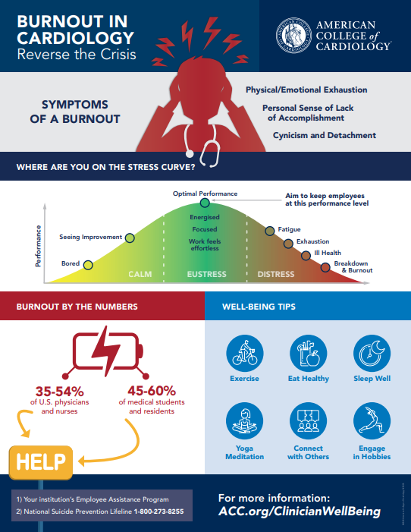
ACC Infographic on Well-Being
First infographic available for download at www.acc.org/clinicianwellbeing
Post it in breakrooms and make it available to colleagues
Other ideas for infographics? Email memberengage@acc.org

Slide 23
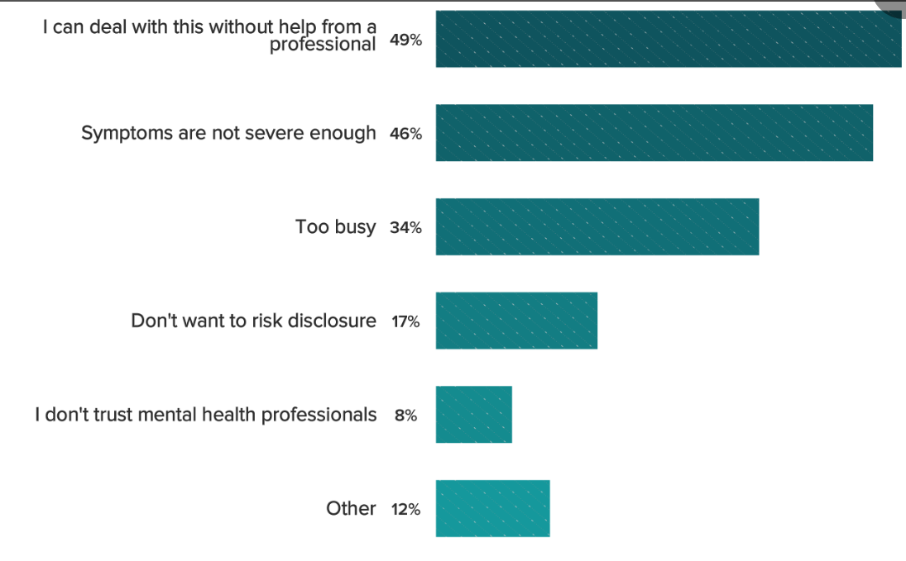
Cardiologists Seeking Help for Burnout
79% of cardiologists said they would not seek help for burnout
45% of cardiologists responded they are unlikely to participate in a workplace program
Primary reasons for not seeking help:
  Can deal with this without
  professional help
  Symptoms are not severe enough
  Too busy
  Don’t want to risk disclosure
  Don’t trust mental health professionals
  Other
Medscape’s Cardiologist Lifestyle, Happiness & Burnout Report 2020

Slide 24
Employee Assistance Programs
Work-based intervention program designed to assist employees with personal problems
Staffed by licensed professionals, including clinical social workers, mental health counselors and substance abuse professionals
Typically a variety of services offered, such as counseling to find resources for childcare, eldercare, legal, financial, well-being coaching and career development
Counseling sessions can be via phone or in-person
Typically a limited number of counseling sessions available
EAP sessions are subject to HIPAA rules
Contact your Human Resources Office to learn more about your institution’s EAP program

Slide 25
You Are Not Alone
National Suicide Prevention Lifeline
1-800-273-TALK
1-800-273-8255

Slide 26
Want to Help?

Slide 27
American Hospital Association Resources
Webinars
  Michael Myers, MD, discusses the causes of physician suicide, and an understanding of physician traits such as perfectionism shed light on the tragedy of physician suicide.
  Michael Weinstein, MD, shares his personal struggle to practice medicine while battling depression and thoughts of suicide. Weinstein’s story is heart wrenching — and provides a needed window into the experiences of physicians who struggle with mental illness.
  Heather Farley, MD, discusses what hospitals can do to promote connectedness and well-being among physicians. She notes that the repetitive trauma of practicing medicine can often cause physicians to lose the joy that inspired them to pursue the field and speaks openly about some of the isolation she felt at different points in her medical career.
AHA Physician Alliance Well-Being Playbook

Slide 28
Suicide Prevention Resource Center
The only federally supported resource center devoted to advancing the implementation of the National Strategy for Suicide Prevention.
Online resources include:
  Resources to build or expand a suicide prevention program
  Resources about assessing and managing risk
  Micro-learning activities
  Catalog of resources by state
www.sprc.org

Slide 29
Additional Well-Being Resources
ACC’s Clinician Well-Being Portal: www.acc.org/clinicianwellbeing
National Academy of Medicine Action Collaborative: https://nam.edu/initiatives/clinician-resilience-and-well-being/
Friedman, S. Total Leadership: Improving Performance in All Parts of Life, PEOPLE + STRATEGY Vol 41, Issue 4 (2018) pp. 12 – 19
B Bohman, L Dyrbye, C A Sinsky, M Linzer, K Olson, S Babbott, Physician Well-Being: The Reciprocity of Practice Efficiency, Culture of Wellness, and Personal Resilience NEJM Catalyst (2017) (subscription required)
Self assessments – AMA Mini Z, Oldenburg Inventory, Maslach Burnout Inventory

