Slide 1
2019 CV Training Program Directors Omnibus Research September 2019

Slide 2
Methodology
This research was designed to develop a general understanding from CV Training Program Directors of the following:
Profiles of their CV training programs overall
Profiles of the CV training program director respondents
Perceptions of diversity and inclusion in CV training programs
Perceptions of parental and medical leave in CV training programs
An email invitation and four reminders were sent to 240 US-based CV training program directors.
The survey fielded from May 30 – July 15, 2019.
A total of 138 CV training program directors completed the survey for an overall response rate of 58%. The following is a breakout of programs by US four-point geographic regions:
Total | Northeast | Midwest | South | West
n=138 | n=41 | n=34 | n=45 | n=18
100% | 30% | 25% | 33% | 13%

Slide 3
Cardiovascular Training Program Profile

Slide 4
General Cardiovascular Program Profile
 | Total Number of Fellows | Total Number of Female Fellows | Total Number of Underrepresented in Medicine Fellows* | Total Number of International Medical Graduate Fellows | Total Number of Fellows Graduating General CV Disease Fellowship (2018-2019)
Mean Number of Fellows | 14.59 | 3.93 | 1.79 | 4.02 | 4.81
Median Number of Fellows | 14.00 | 3.00 | 1.00 | 3.00 | 5.00
Std. Deviation | 7.51 | 2.74 | 1.92 | 3.65 | 2.48
Number of Programs (N-Size) | 138 | 138 | 138 | 138 | 138
* - The AAMC definition of underrepresented in medicine is: "Underrepresented in medicine means those racial and ethnic populations that are underrepresented in the medical profession relative to their numbers in the general population.“ (https://www.aamc.org/initiatives/urm/)
Q: Thinking about the Fellows in your general cardiovascular training program, please provide a count of the following: (n=138)

Slide 5
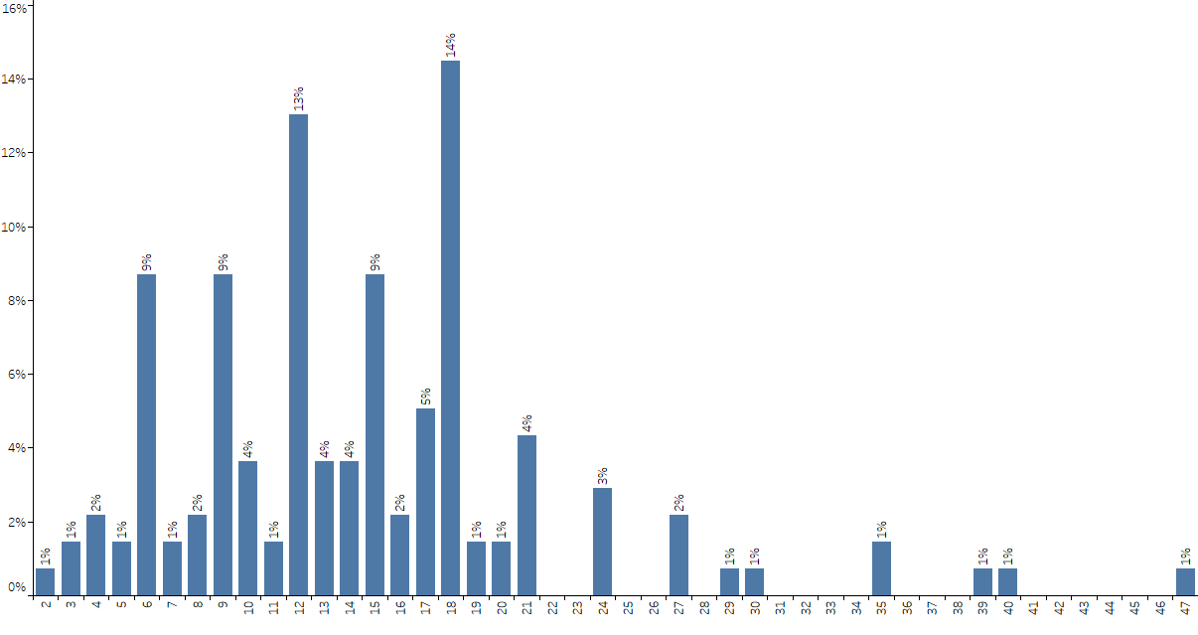
Total Number of Fellows Per Cardiovascular Program
(n=138)
Q: Thinking about the Fellows in your general cardiovascular training program, please provide a count of the following: Total Number of Fellows (n=138)

Slide 6
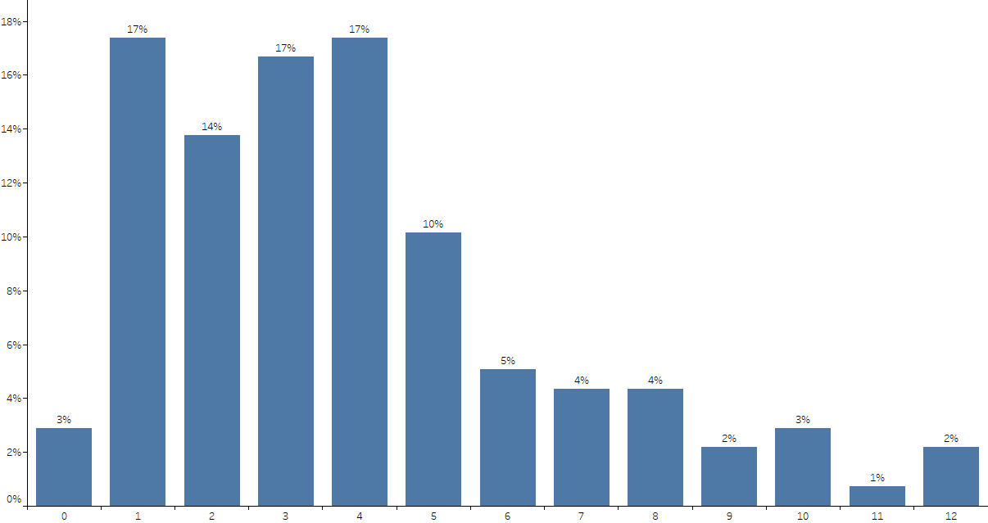
Total Number of Female Fellows Per Cardiovascular Program
(n=138)
Q: Thinking about the Fellows in your general cardiovascular training program, please provide a count of the following: Total Number of female Fellows (n=138)

Slide 7
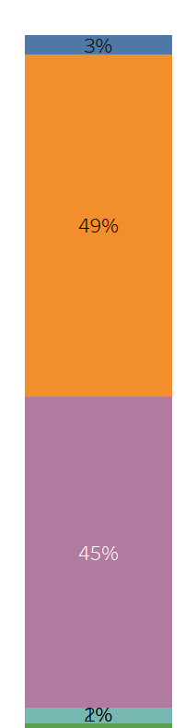
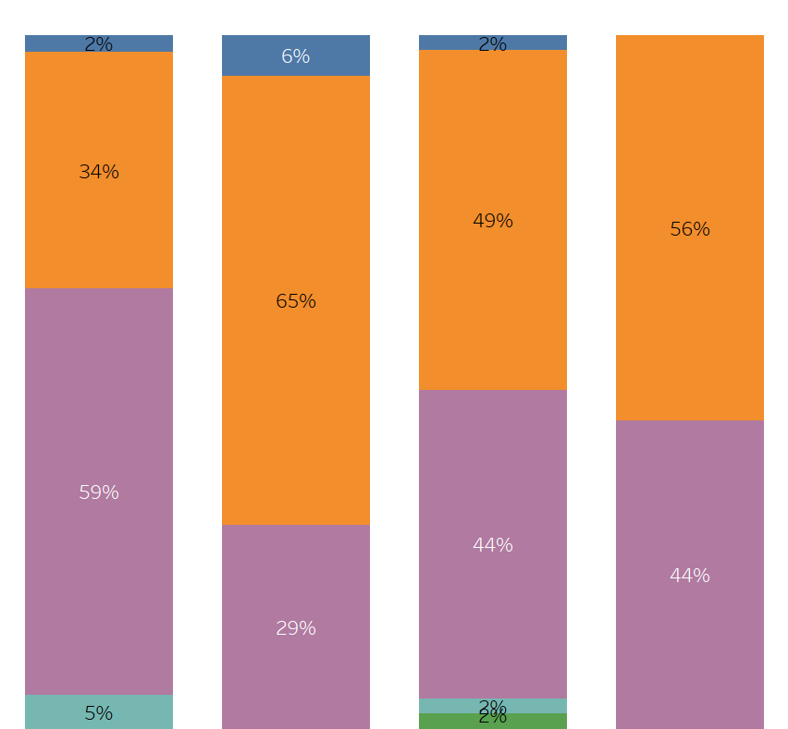
Percentage of Female Fellows Per Cardiovascular Program by Region
Total
Northeast
Midwest
South
West
0%
1% - 25%
26% - 50%
51% - 75%
> 75%
(n=138)
(n=41)
(n=34)
(n=45)
(n=18)
Q: Thinking about the Fellows in your general cardiovascular training program, please provide a count of the following: Total Number of female Fellows (n=138)

Slide 8
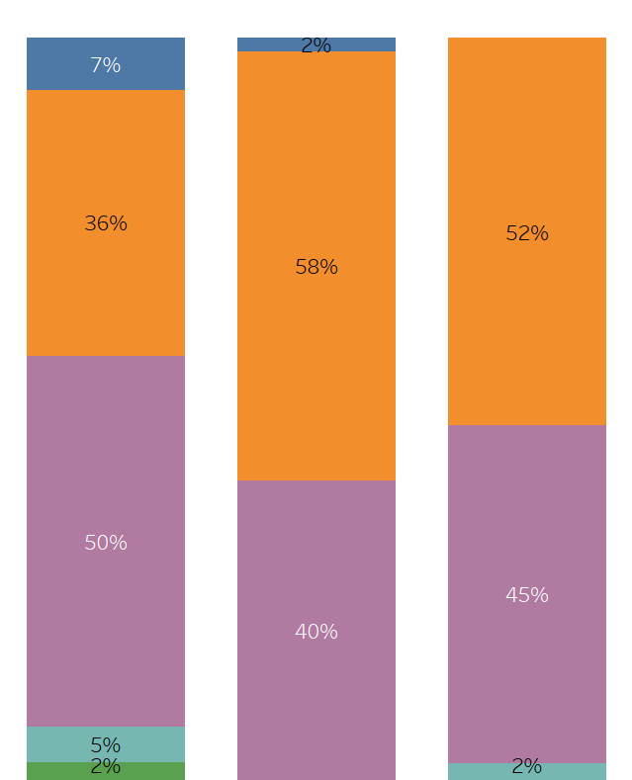
Percentage of Female Fellows Per Cardiovascular Program by Program Size
Program Size*
Total
Small
Medium
Large
0%
1% - 25%
26% - 50%
* - Program Size is defined as follows:
- small = 1-10 fellows
- medium=11-17
- large=18 or more
51% - 75%
> 75%
(n=138)
(n=42)
(n=52)
(n=44)
Q: Thinking about the Fellows in your general cardiovascular training program, please provide a count of the following: Total Number of female Fellows (n=138)

Slide 9
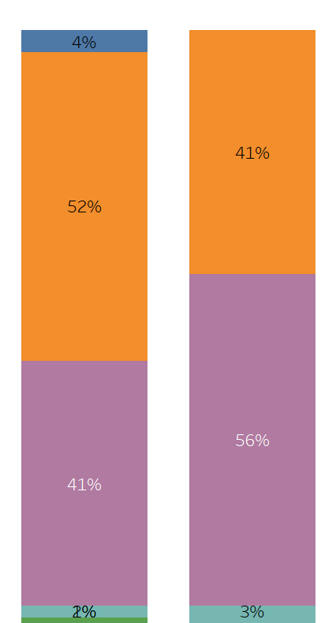
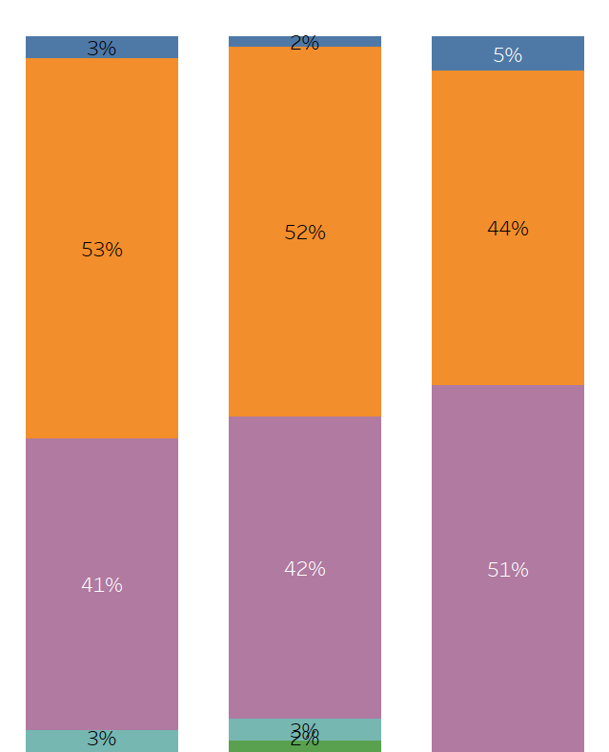
Percentage of Female Fellows Per Cardiovascular Program by PD Gender /Age
Program Director - Gender
Program Director - Age
Total
Male
Female
Early Career
(36 – 45 years)
Mid Career
(46 – 55 years)
Late Career
(> 55 years)
0%
1% - 25%
26% - 50%
51% - 75%
> 75%
(n=138)
(n=104)
(n=34)
(n=32)
(n=64)
(n=41)
Q: Thinking about the Fellows in your general cardiovascular training program, please provide a count of the following: Total Number of female Fellows (n=138)

Slide 10
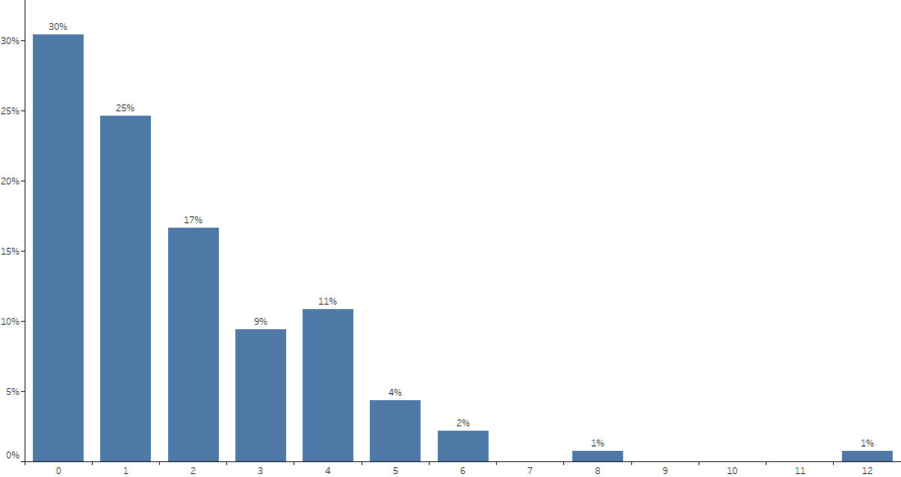
Total Number of Underrepresented in Medicine Fellows Per Cardiovascular Program
(n=138)
Q: Thinking about the Fellows in your general cardiovascular training program, please provide a count of the following: Total Number of underrepresented in
medicine Fellows (n=138)

Slide 11
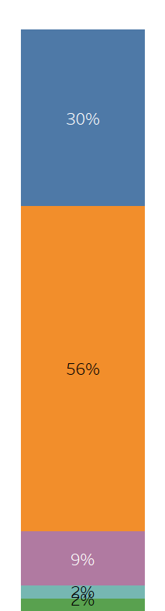
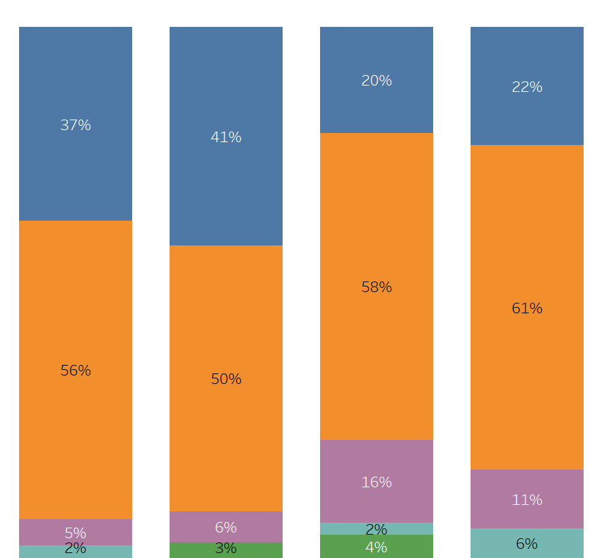
Percentage of Underrepresented in Medicine Fellows Per Cardiovascular Program by Region
Total
Northeast
Midwest
South
West
0%
1% - 25%
26% - 50%
51% - 75%
> 75%
(n=138)
(n=41)
(n=34)
(n=45)
(n=18)
Q: Thinking about the Fellows in your general cardiovascular training program, please provide a count of the following: Total Number of underrepresented in
medicine Fellows (n=138)

Slide 12
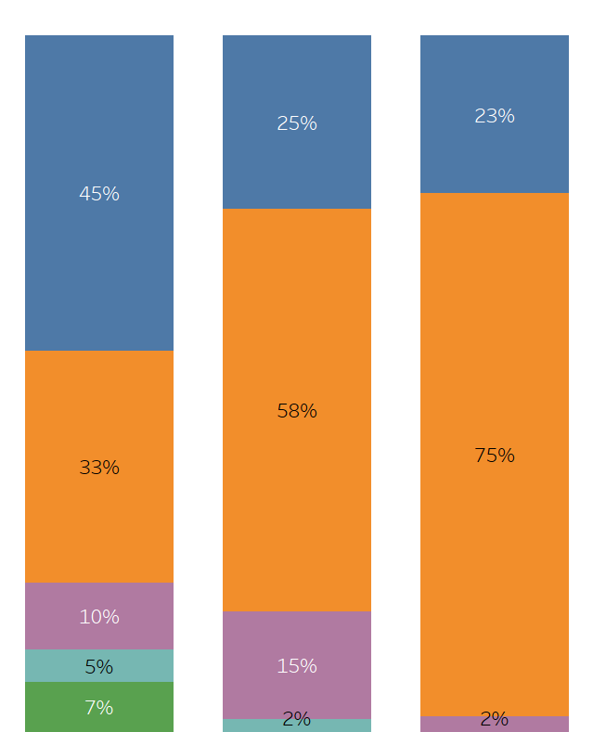
Percentage of Underrepresented in Medicine Fellows Per CV Program by Program Size
Program Size
Total
Small
Medium
Large
0%
1% - 25%
26% - 50%
51% - 75%
> 75%
(n=138)
(n=42)
(n=52)
(n=44)
Q: Thinking about the Fellows in your general cardiovascular training program, please provide a count of the following: Total Number of underrepresented in
medicine Fellows (n=138)

Slide 13
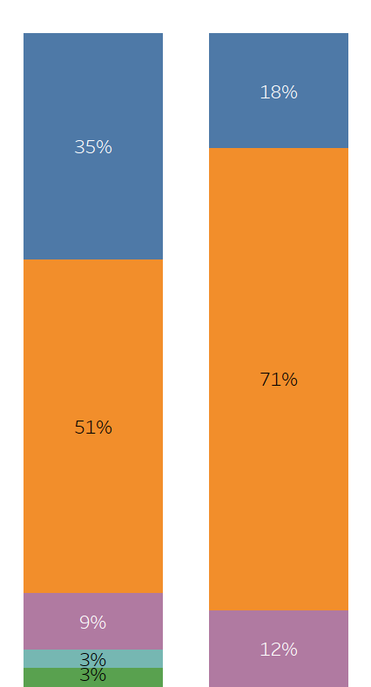
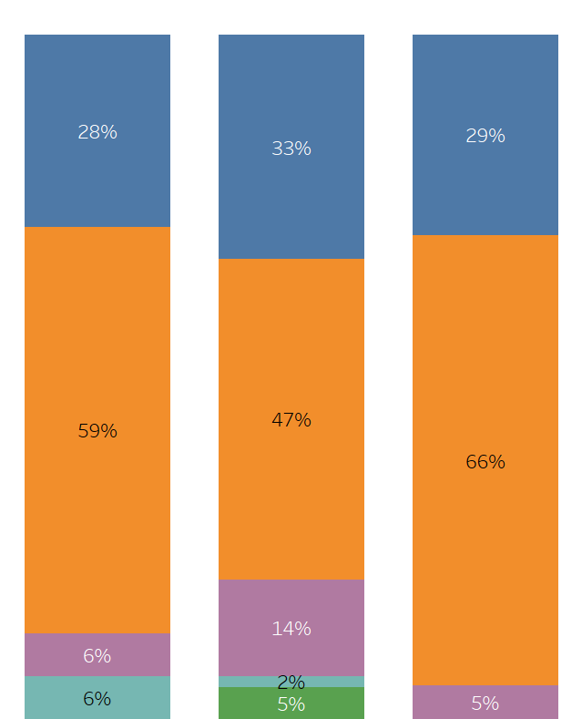
Percentage of Underrepresented in Medicine Fellows Per CV Program by PD Gender/Age
Program Director - Gender
Program Director - Age
Total
Male
Female
Early Career
(36 – 45 years)
Mid Career
(46 – 55 years)
Late Career
(> 55 years)
0%
1% - 25%
26% - 50%
51% - 75%
> 75%
(n=138)
(n=104)
(n=34)
(n=32)
(n=64)
(n=41)
Q: Thinking about the Fellows in your general cv program, please provide a count of the following: Total Number of underrepresented in medicine Fellows (n=138)

Slide 14
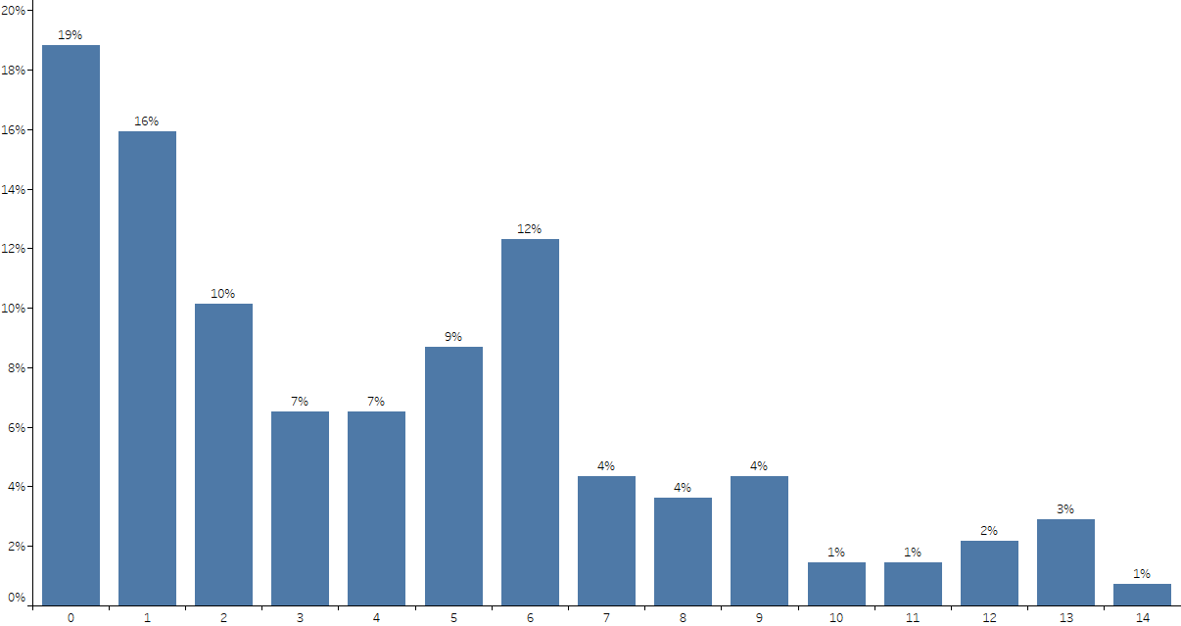
Total Number of International Medical Graduate Fellows Per CV Program
(n=138)
Q: Thinking about the Fellows in your general cv program, please provide a count of the following: Total Number of international medical graduate Fellows (n=138)

Slide 15
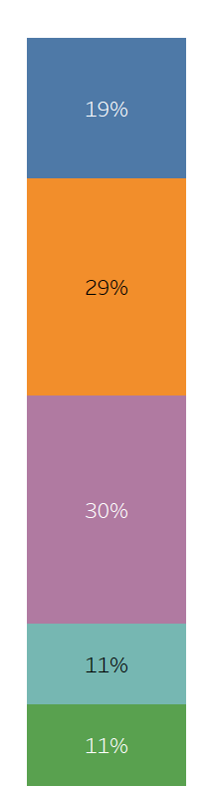
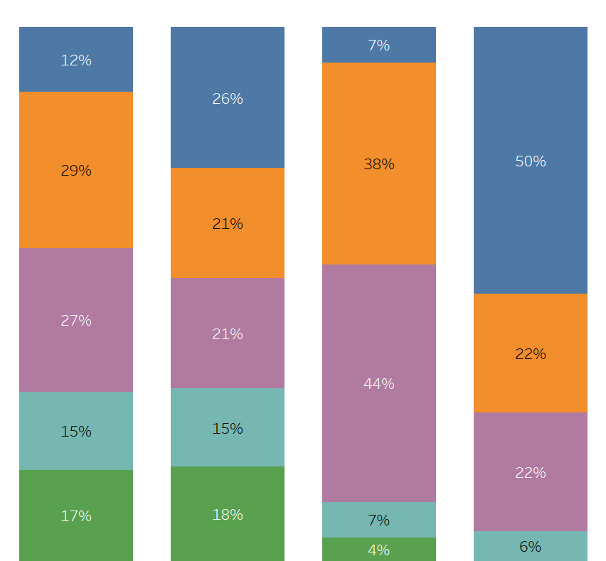
Percentage of International Medical Graduate Fellows Per CV Program by Region
Total
Northeast
Midwest
South
West
0%
1% - 25%
26% - 50%
51% - 75%
> 75%
(n=138)
(n=41)
(n=34)
(n=45)
(n=18)
Q: Thinking about the Fellows in your general cv program, please provide a count of the following: Total Number of international medical graduate Fellows (n=138)

Slide 16
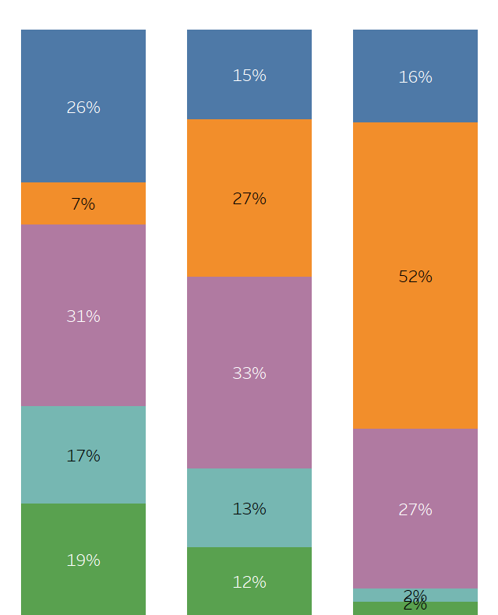
Percentage of International Medical Graduate Fellows Per CV Program by Program Size
Program Size
Total
Small
Medium
Large
0%
1% - 25%
26% - 50%
51% - 75%
> 75%
(n=138)
(n=42)
(n=52)
(n=44)
Q: Thinking about the Fellows in your general cv program, please provide a count of the following: Total Number of international medical graduate Fellows (n=138)

Slide 17
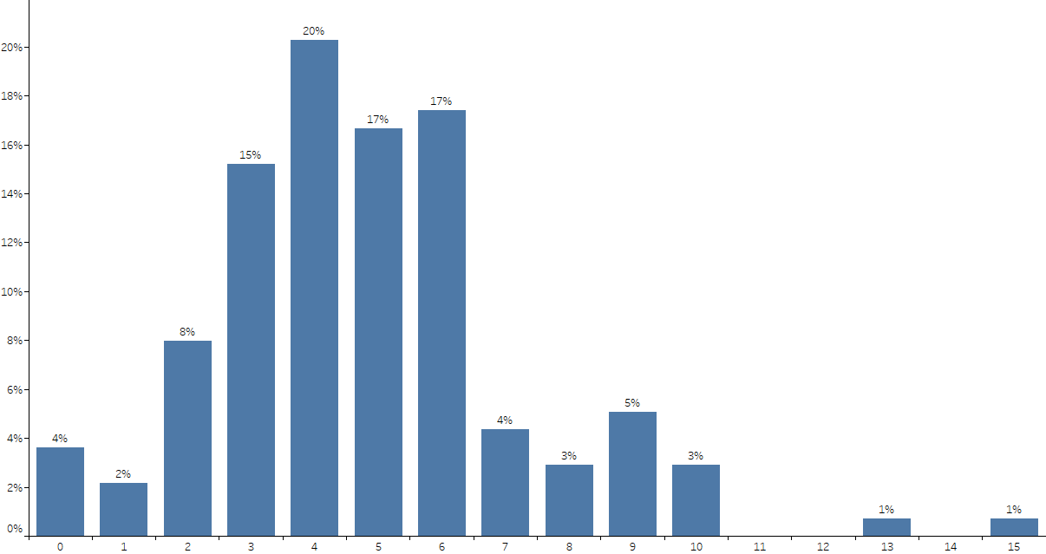
Total Number of Fellows Graduating CV Disease Fellowship Per CV Program
(n=138)
Q: Thinking about the Fellows in your general cv training program, please provide a count of the following: Total Number of Fellows Graduating CV
Disease Fellowship (n=138)

Slide 18
Number of Fellows in Advanced Fellowships
 | Interventional Cardiology | Structural Interventional Cardiology | Vascular Interventional Cardiology | Electrophysiology (EP) | Advanced Heart Failure (HF)
Mean Number of Fellows | 1.84 | 0.46 | 0.11 | 1.46 | 0.71
Median Number of Fellows | 2.00 | 0.00 | 0.00 | 1.00 | 0.00
Std. Deviation | 1.88 | 0.86 | 0.52 | 1.86 | 1.04
Number of Programs (N-Size) | 138 | 138 | 138 | 138 | 138
 | ACHD | Advanced Imaging Training | Preventive Cardiology Training | Vascular Medicine Training | Research | Other
Mean Number of Fellows | 0.20 | 0.62 | 0.09 | 0.09 | 0.91 | 0.08
Median Number of Fellows | 0.00 | 0.00 | 0.00 | 0.00 | 0.00 | 0.00
Std. Deviation | 0.53 | 1.28 | 0.34 | 0.36 | 2.07 | 0.55
Number of Programs (N-Size) | 138 | 138 | 138 | 138 | 138 | 138
Q: How many fellows does your institution have in each of the following advanced fellowships? (n=138)

Slide 19
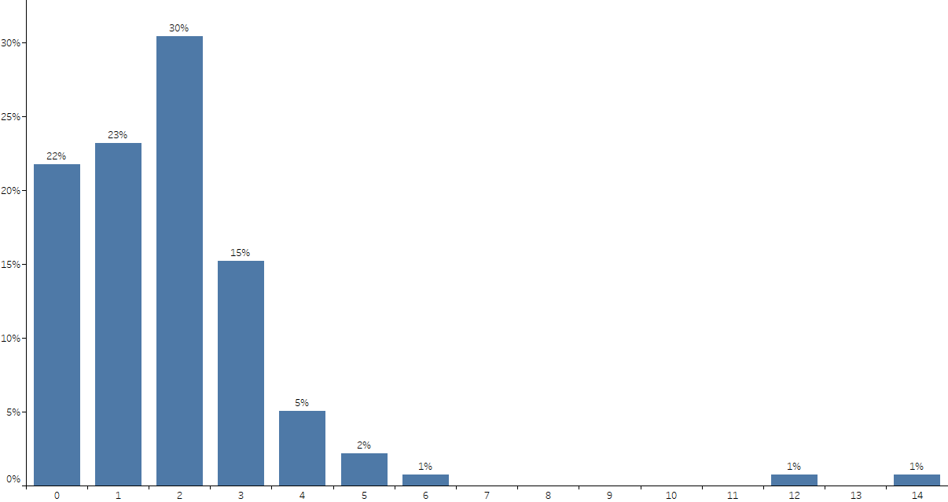
Total Number of Fellows in Advanced Fellowships Per CV Program – Interventional Cardiology
(n=138)
Q: How many fellows does your institution have in each of the following advanced fellowships? Interventional Cardiology (n=138)

Slide 20
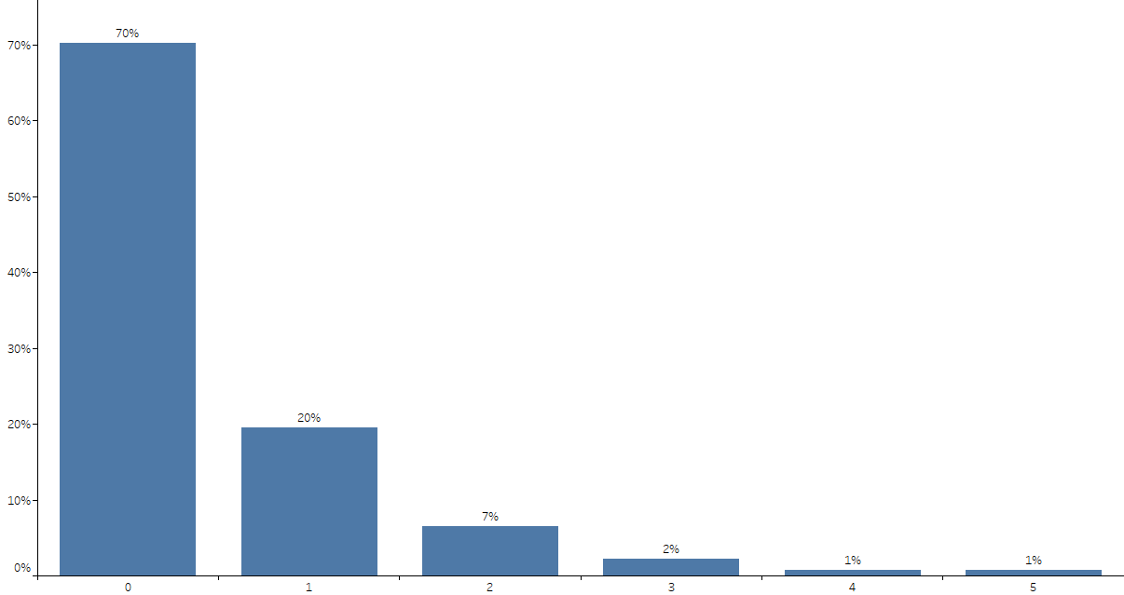
Total Number of Fellows in Advanced Fellowships Per CV Program – Structural Interventional Cardiology
(n=138)
Q: How many fellows does your institution have in each of the following advanced fellowships? Structural Interventional Cardiology (n=138)

Slide 21
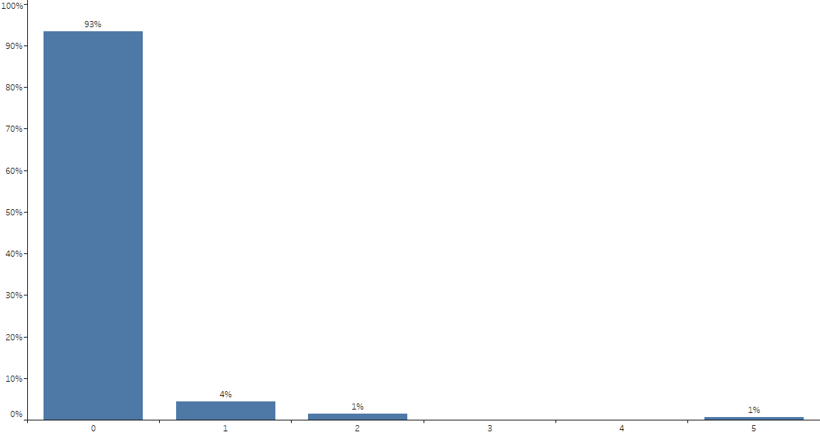
Total Number of Fellows in Advanced Fellowships Per CV Program – Vascular Interventional Cardiology
(n=138)
Q: How many fellows does your institution have in each of the following advanced fellowships? Vascular Interventional Cardiology (n=138)

Slide 22
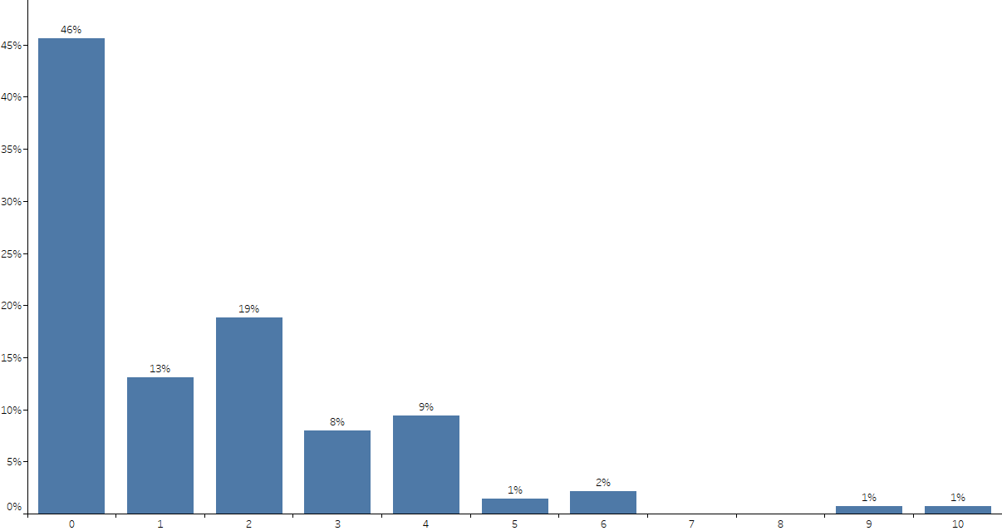
Total Number of Fellows in Advanced Fellowships Per CV Program – Electrophysiology
(n=138)
Q: How many fellows does your institution have in each of the following advanced fellowships? Electrophysiology (n=138)

Slide 23
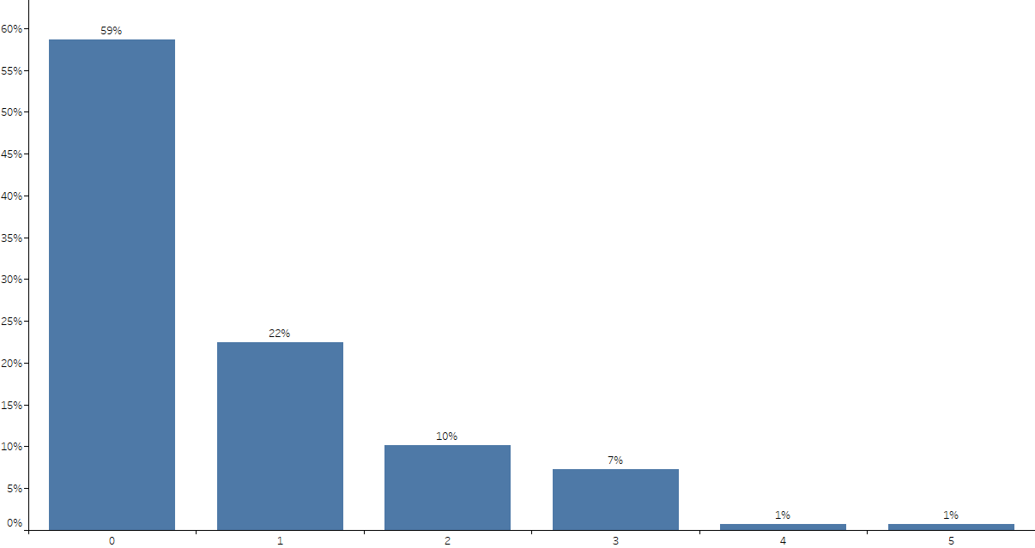
Total Number of Fellows in Advanced Fellowships Per CV Program – Advanced Heart Failure
(n=138)
Q: How many fellows does your institution have in each of the following advanced fellowships? Advanced Heart Failure (n=138)

Slide 24
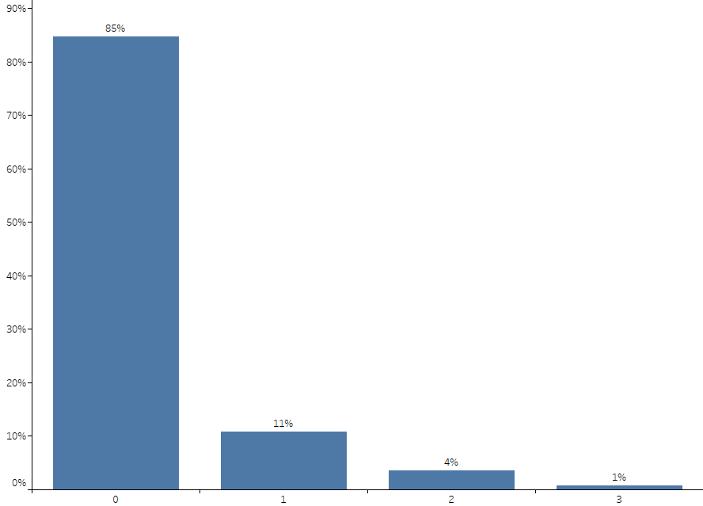
Total Number of Fellows in Advanced Fellowships Per CV Program – ACHD
(n=138)
Q: How many fellows does your institution have in each of the following advanced fellowships? ACHD (n=138)

Slide 25
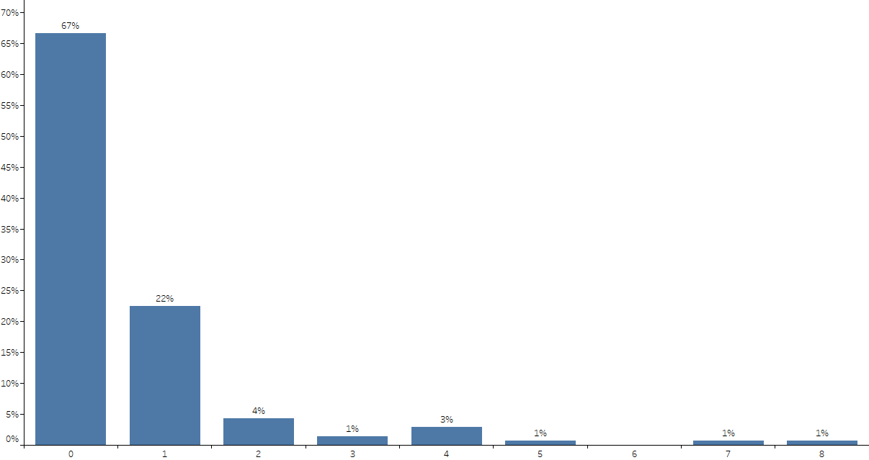
Total Number of Fellows in Advanced Fellowships Per CV Program – Advanced Imaging Training
(n=138)
Q: How many fellows does your institution have in each of the following advanced fellowships? Advanced Imaging Training Programs (n=138)

Slide 26
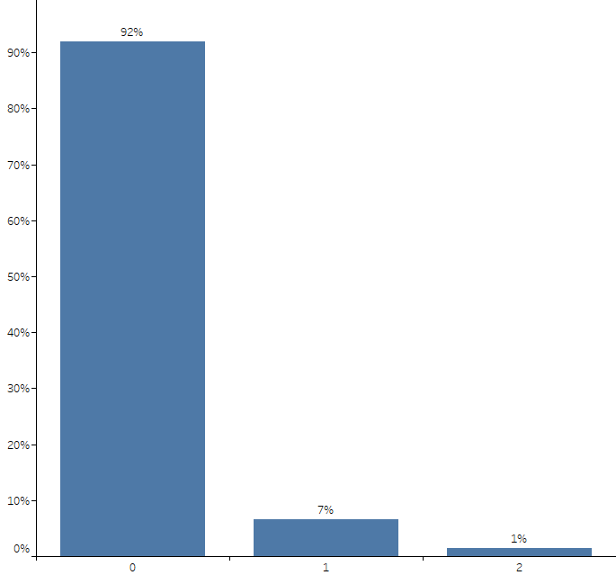
Total Number of Fellows in Advanced Fellowships Per CV Program – Preventive Cardiology Training
(n=138)
Q: How many fellows does your institution have in each of the following advanced fellowships? Preventive Cardiology Training Programs (n=138)

Slide 27
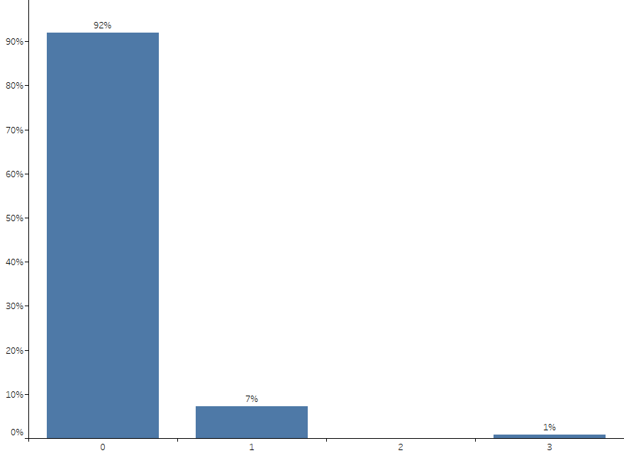
Total Number of Fellows in Advanced Fellowships Per CV Program – Vascular Medicine Training
(n=138)
Q: How many fellows does your institution have in each of the following advanced fellowships? Vascular Medicine Training Programs (n=138)

Slide 28
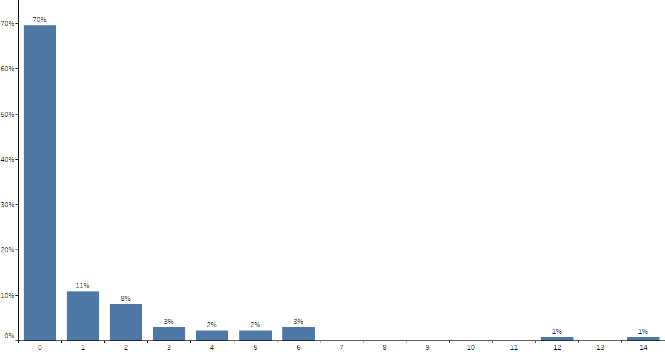
Total Number of Fellows in Advanced Fellowships Per CV Program – Research
(n=138)
Q: How many fellows does your institution have in each of the following advanced fellowships? Research (n=138)

Slide 29
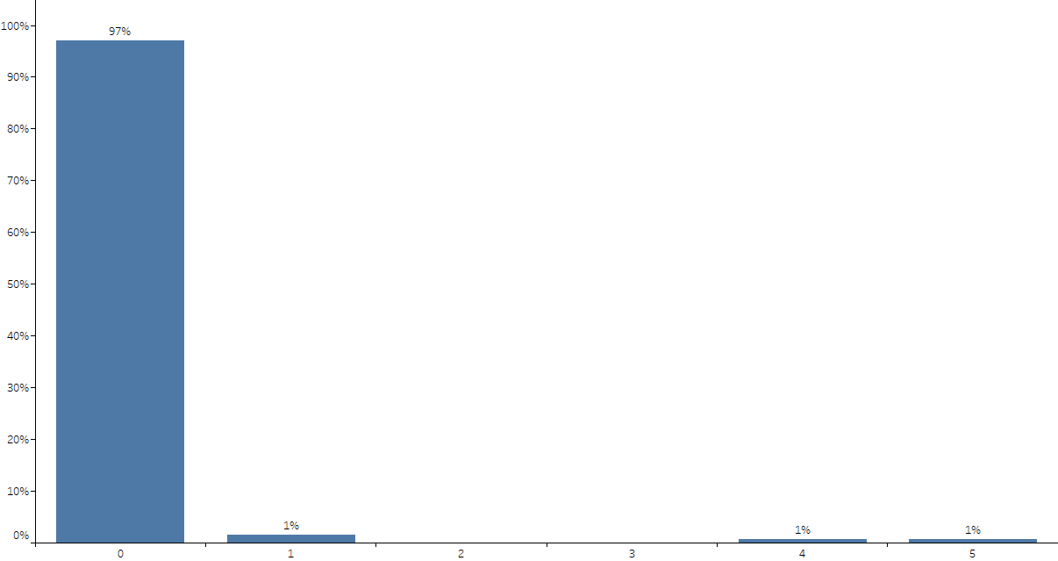
Total Number of Fellows in Advanced Fellowships Per CV Program – Other
(n=138)
Q: How many fellows does your institution have in each of the following advanced fellowships? Other (n=138)

Slide 30
Estimated Number of Graduating Fellows in Various Work Settings
 | Entering accredited advanced fellowship | Entering unaccredited advanced fellowship | Entering community-based clinical practice | Entering academic-based clinical practice | Entering academic-based research practice | Entering non-clinical position | Other
Mean Number of Fellows | 2.75 | 0.30 | 1.13 | 0.54 | 0.13 | 0.01 | 0.09
Median Number of Fellows | 3.00 | 0.00 | 1.00 | 0.00 | 0.00 | 0.00 | 0.00
Std. Deviation | 1.71 | 0.68 | 1.20 | 0.91 | 0.47 | 0.12 | 0.41
Number of Programs (N-Size) | 138 | 138 | 138 | 138 | 138 | 138 | 138
Q: In the current graduating class, to your best estimate how many fellows are … (n=138)

Slide 31
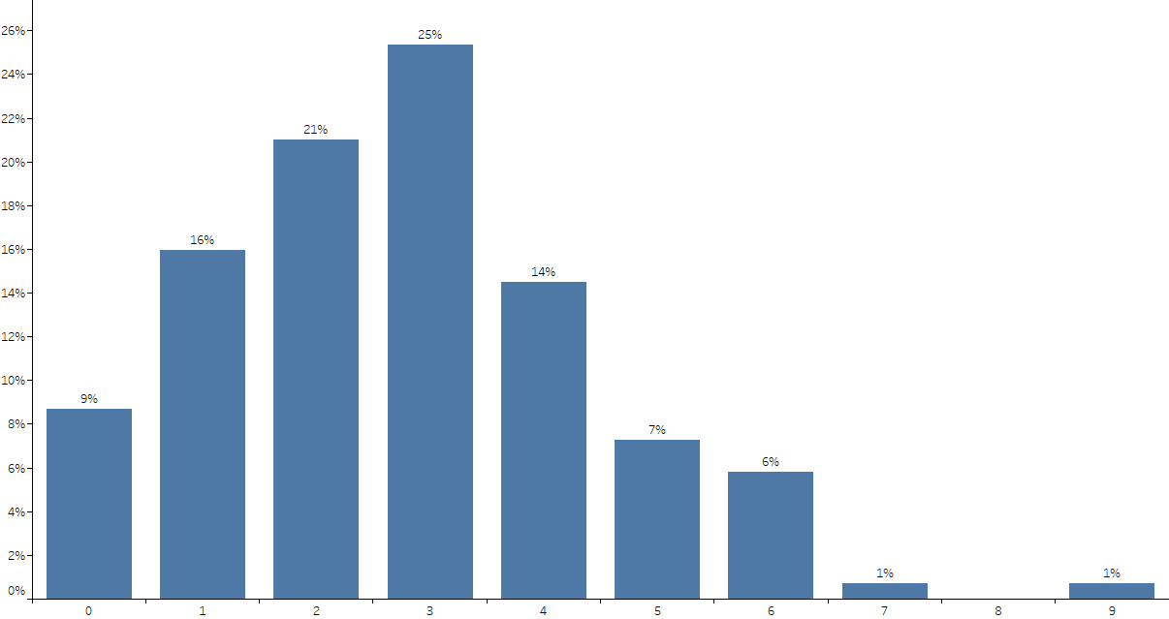
Estimated Number of Graduating Fellows in Various Work Settings - Entering an Accredited Advanced Fellowship
(n=138)
Q: In the current graduating class, to your best estimate how many fellows are … (n=138)

Slide 32
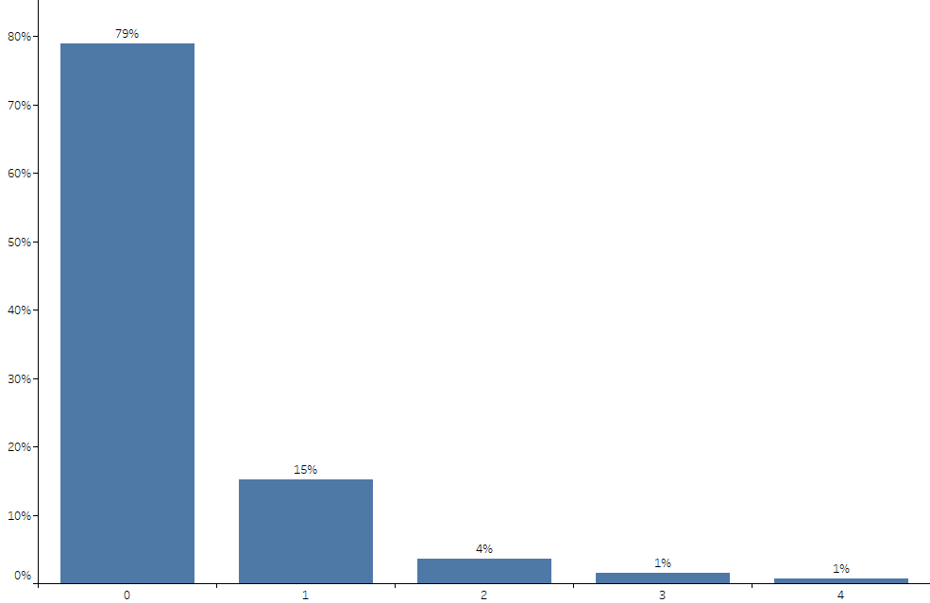
Estimated Number of Graduating Fellows in Various Work Settings - Entering an Unaccredited Advanced Fellowship
(n=138)
Q: In the current graduating class, to your best estimate how many fellows are … (n=138)

Slide 33
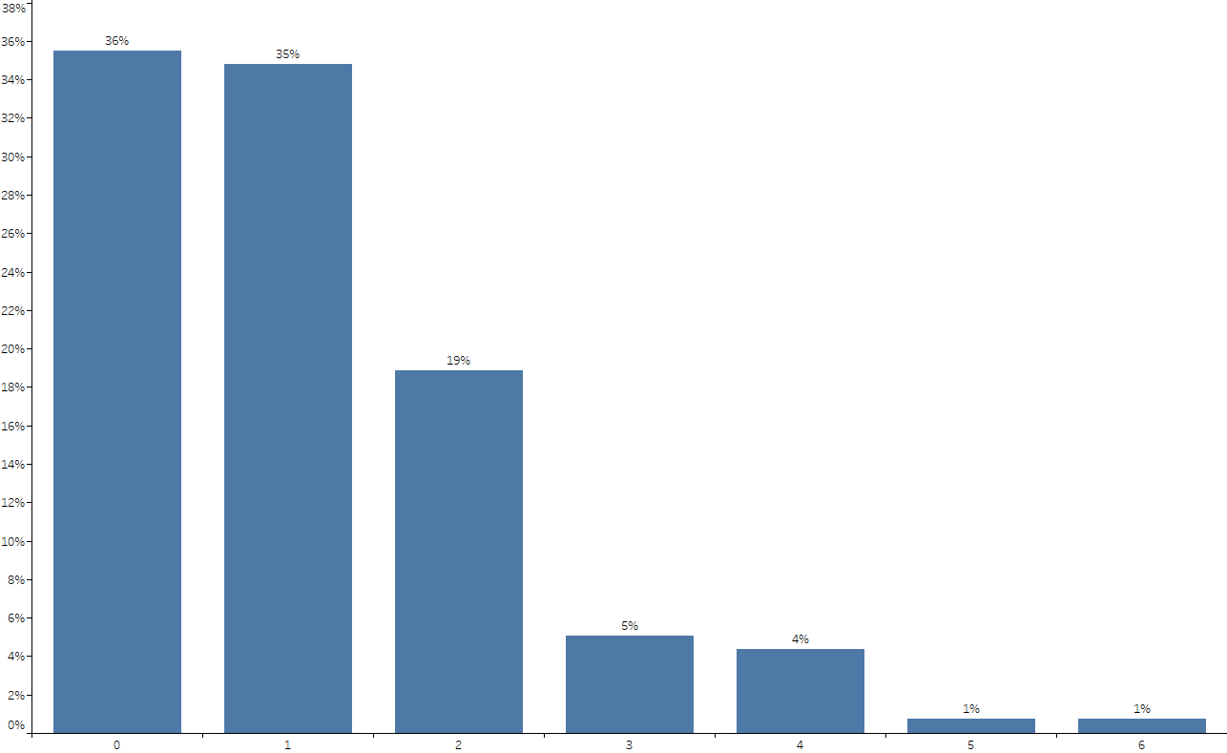
Estimated Number of Graduating Fellows in Various Work Settings - Entering a Community-Based Clinical Practice
(n=138)
Q: In the current graduating class, to your best estimate how many fellows are … (n=138)

Slide 34
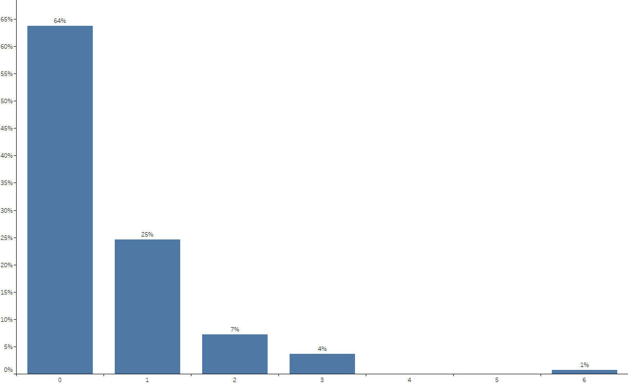
Estimated Number of Graduating Fellows in Various Work Settings - Entering an Academic-Based Clinical Practice
(n=138)
Q: In the current graduating class, to your best estimate how many fellows are … (n=138)

Slide 35
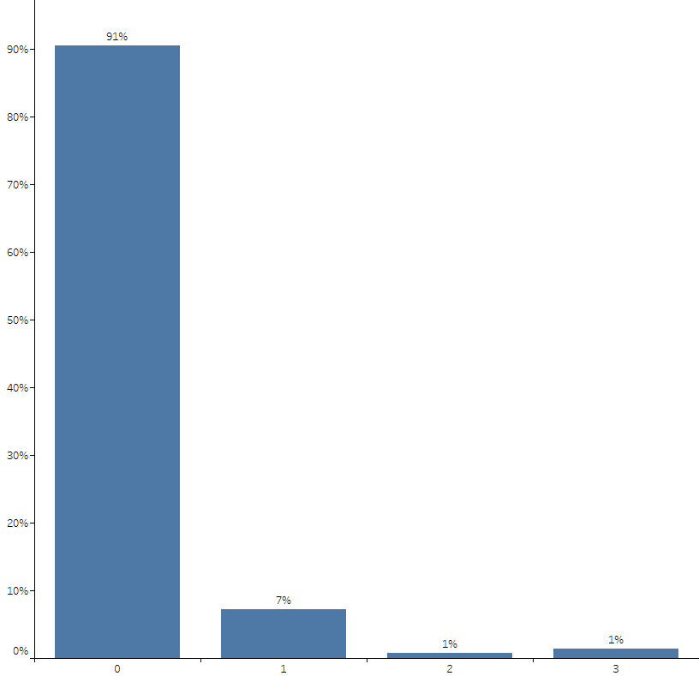
Estimated Number of Graduating Fellows in Various Work Settings - Entering an Academic-Based Research Practice
(n=138)
Q: In the current graduating class, to your best estimate how many fellows are … (n=138)

Slide 36
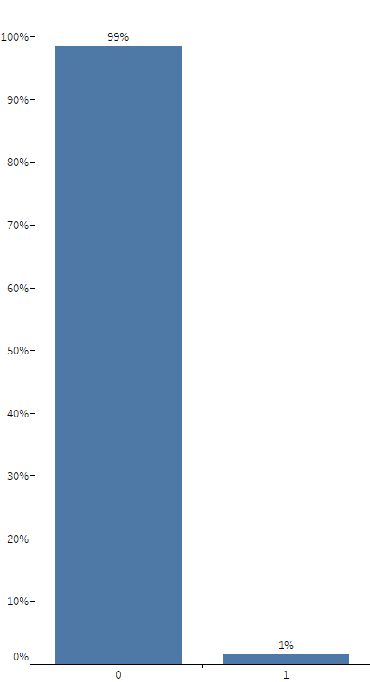
Estimated Number of Graduating Fellows in Various Work Settings - Entering a Non-Clinical Position
(n=138)
Q: In the current graduating class, to your best estimate how many fellows are … (n=138)

Slide 37
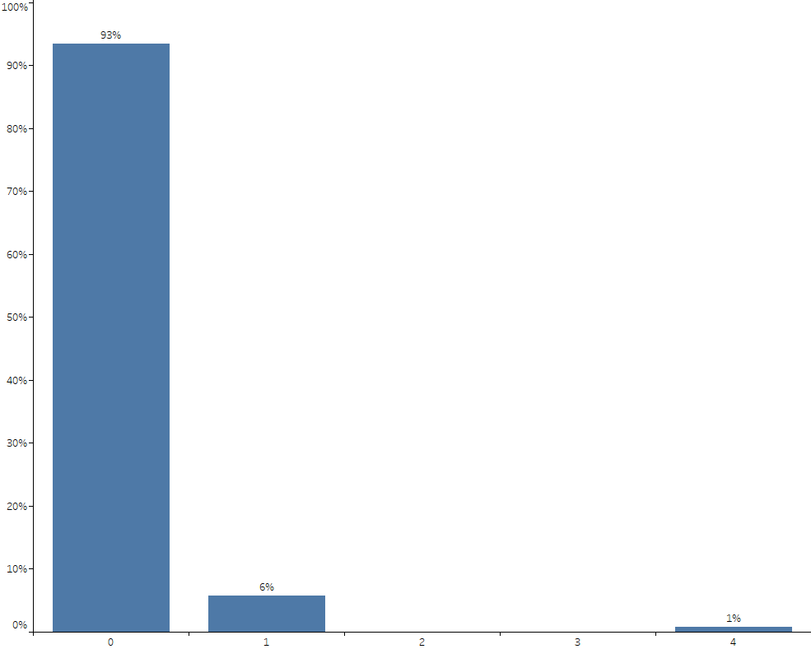
Estimated Number of Graduating Fellows in Various Work Settings - Other
(n=138)
Q: In the current graduating class, to your best estimate how many fellows are … (n=138)

Slide 38
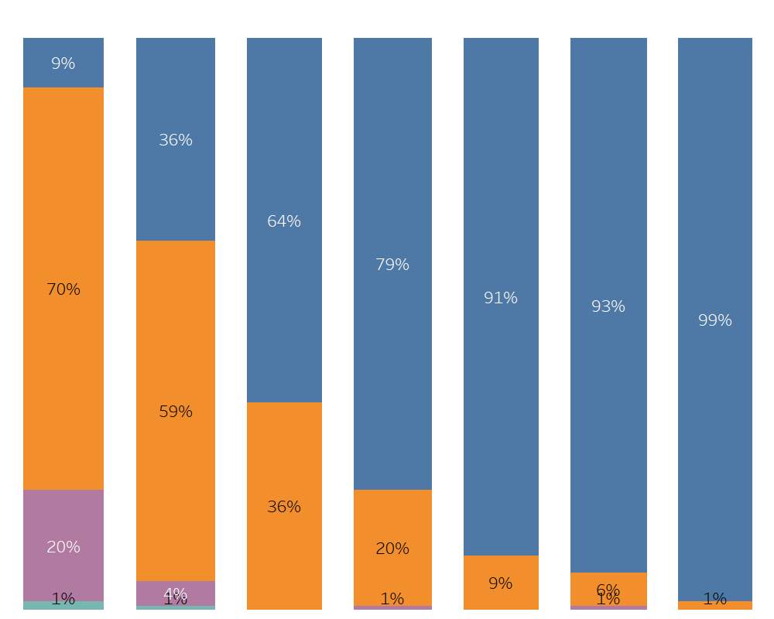
Estimated Number of Graduating Fellows in Various Work Settings –
Percentage Per CV Program
Entering
accredited
advanced
fellowship
Entering
unaccredited
advanced
fellowship
Entering
community- based
clinical practice
Entering
academic-based
clinical practice
Entering
academic-based
research practice
Entering
Non-Clinical Position
Other
0%
1% - 25%
26%
- 50%
> 75%
(n=138)
(n=138)
(n=138)
(n=138)
(n=138)
(n=138)
(n=138)
Q: In the current graduating class, to your best estimate how many fellows are … (n=138)

Slide 39
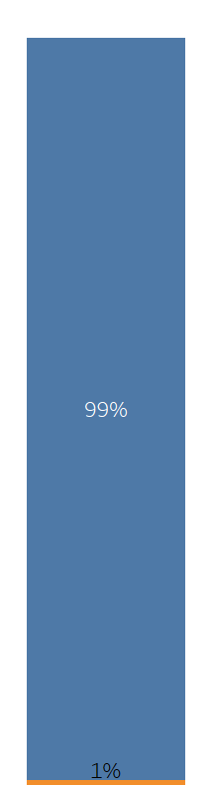
Number of Mandatory Training Years for General CV Fellowship
3 years
Mean # of years = 3.0
Median # of yeas = 3.0
Std. Deviation = 0.085
4 years
(n=138)
Q: Number of mandatory years of training for the general cardiovascular fellowship: (n=138)

Slide 40
CV Training Program Director Profile

Slide 41
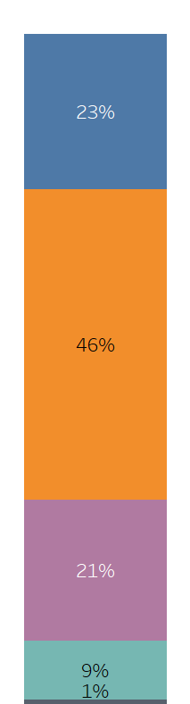
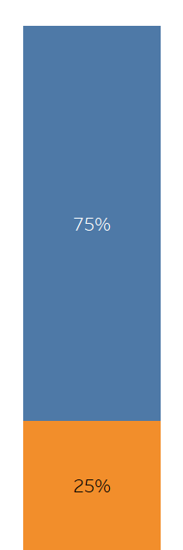
Age and Gender of CV Training Program Directors
Age
Gender
36 – 45 years old
Male
Mean age = 52.0 years
Median age = 51.0 years
Std. Deviation = 8.561
46 – 55 years old
56 – 65 years old
Female
66 – 75 years old
No answer
(n=138)
(n=138)
Q: What is your age? (n=138)
Q: What is your gender? (n=138)

Slide 42
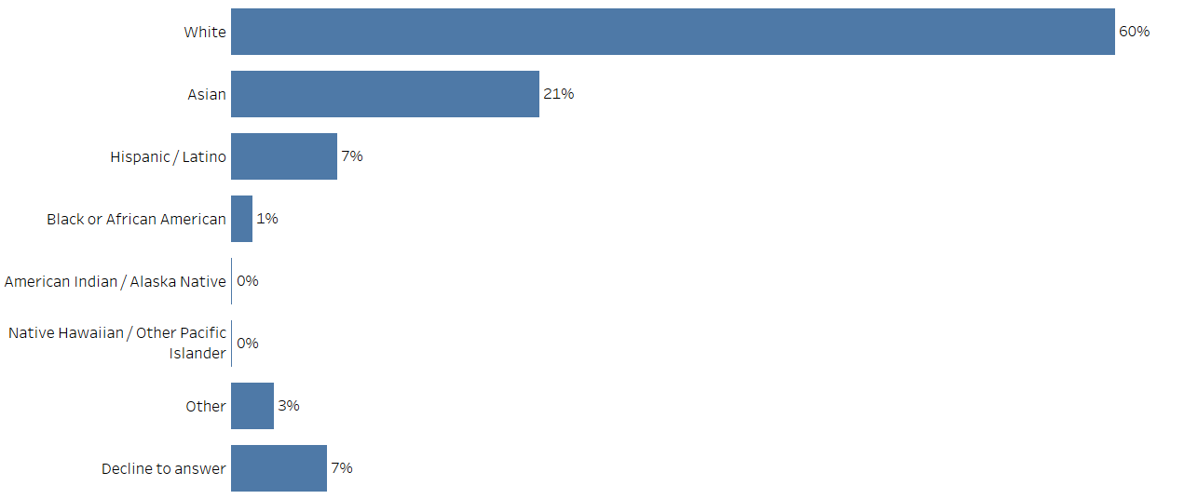
Ethnicity of CV Training Program Directors
(n=138)
Q: Which category describes your race/ethnicity? Please select all that apply. (n=138)

Slide 43
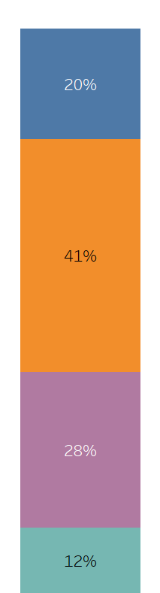
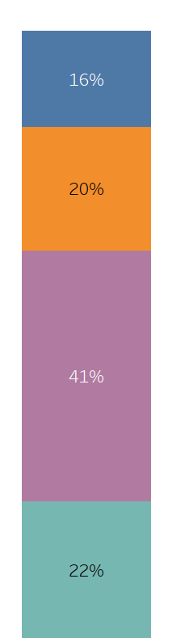
Number of Years: Since Training Completion / At Current Institution
Number of Years Since
Training Completion
Number of Years
at Current Institution
5 - 10 years
1 - 5 years
6 - 10 years
11 – 20 years
Mean years = 18.8 years
Median years = 17.0 years
Std. Deviation = 8.871
Mean years = 14.7 years
Median years = 13.0 years
Std. Deviation = 9.266
11 - 20 years
21 – 30 years
21 or more
years
31 or more
years
(n=138)
(n=138)
Q: Please indicate the number of years for each of the following: (n=138)

Slide 44
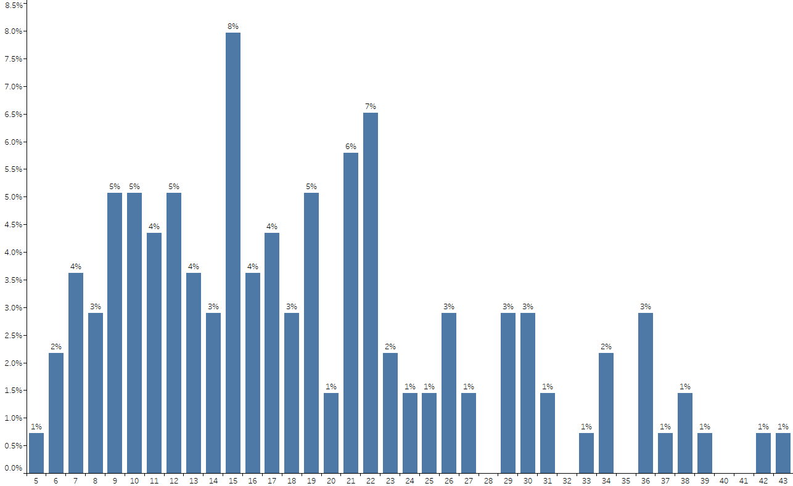
Number of Years: Since Training Completion Per CV Program
(n=138)
Q: Please indicate the number of years for each of the following: (n=138)

Slide 45
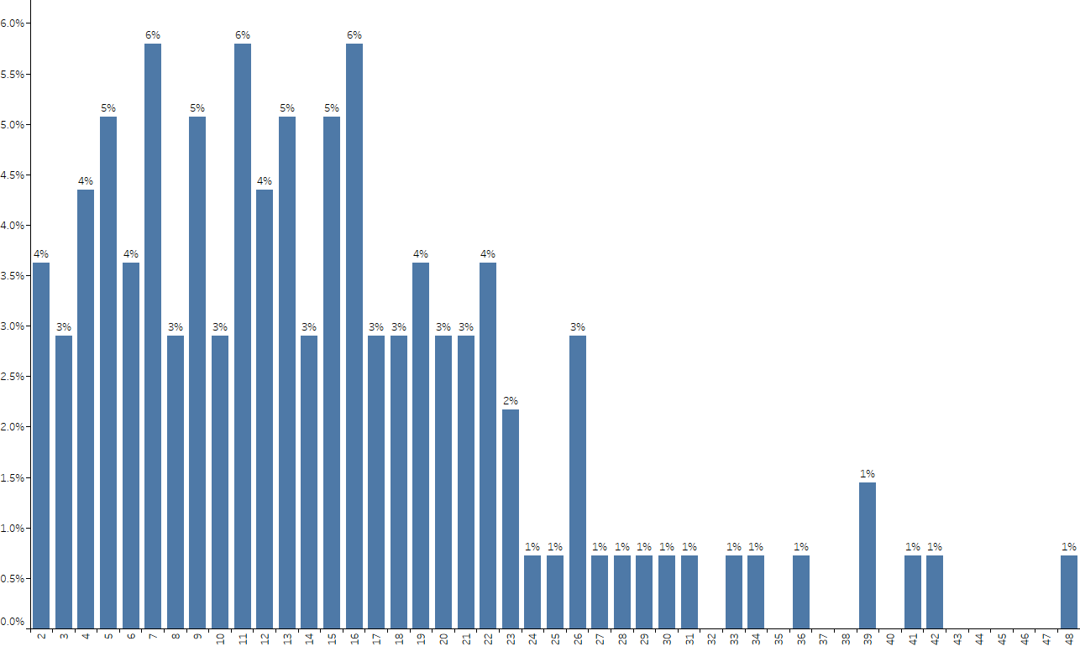
Number of Years: At Current Institution Per CV Program
(n=138)
Q: Please indicate the number of years for each of the following: (n=138)

Slide 46
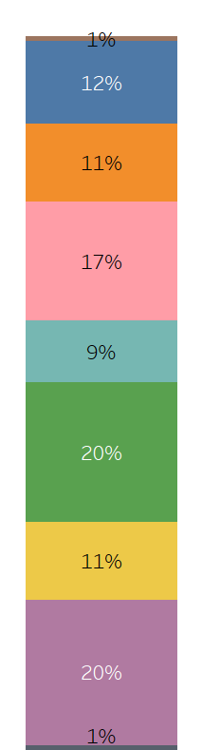
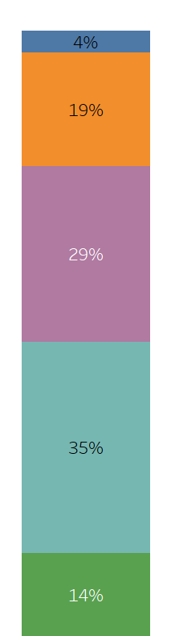
Number of Years: Program Director At Current Institution / Estimated Percentage of Non-Clinical Time for Program Director Activity
Number of Years
Program Director at Current Institution
Estimated Percentage of Non-Clinical
Time for Program Director Activity
Less than a year
0%
1 year
Mean years = 6.69 years
Median years = 5.00 years
Std. Deviation = 6.208
1% - 10%
2 years
3 years
11% - 20%
4 years
5 – 7 years
21% - 30%
8 – 10 years
Mean percentage of time = 22.1%
Median percentage of time = 20.0%
Std. Deviation = 11.349
11 or more
years
More than 30%
No answer
(n=138)
(n=138)
Q: Please indicate the number of years for each of the following: (n=138)
Q: To your best estimate what is the current percentage of non-clinical time, you receive for program director activity, not including inpatient or outpatient
supervisory assignments of fellows? (n=138)

Slide 47
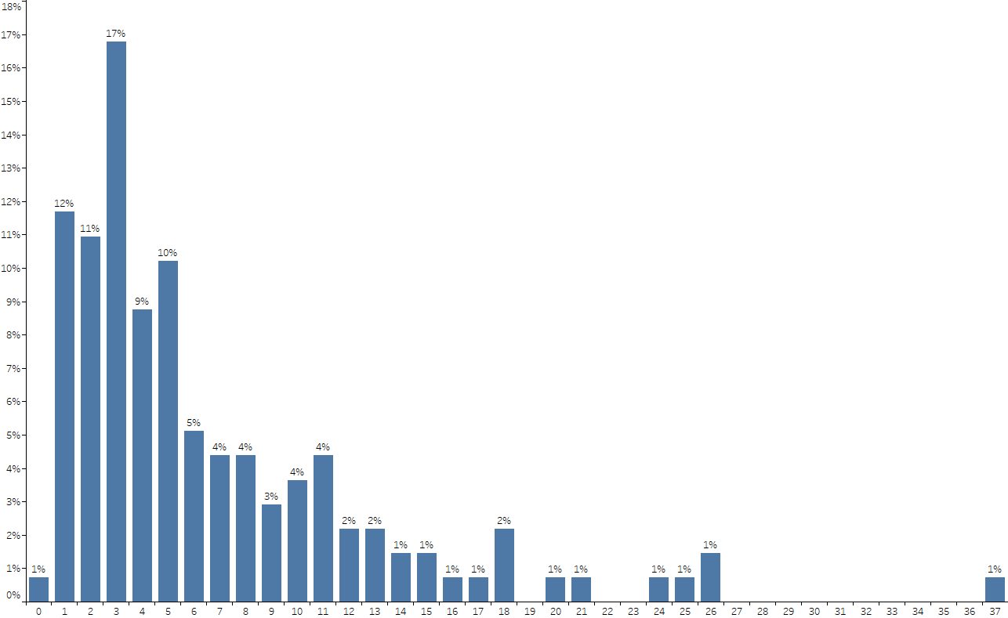
Number of Years: Program Director At Current Institution Per CV Program
(n=138)
Q: Please indicate the number of years for each of the following: (n=138)

Slide 48
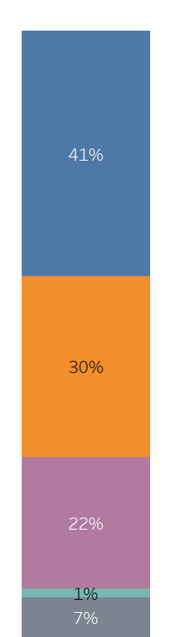
Current Academic Rank
Associate Professor
Professor
Assistant Professor
Other
“Assistant Clinical Professor”
“ Vice -Chair of Academic Affairs”
None
(n=138)
Q: What is your current academic rank? (n=138)

Slide 49
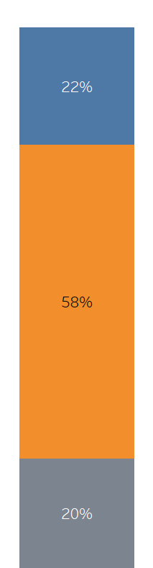
Planning to Step Down as PD in Next Two Years
Almost 1 out of 5 CV Training Program Directors surveyed (18%) plan to step down from their role within the next two years.
Planning to Step Down as PD
in Next Two Years
Why do you plan on stepping down as PD in the next two years?
“Additional administrative responsibilities”
“Age”
“Change of clinical needs”
“Conflicts with administration”
“Early discussions are underway with my chief. Likely some type of Educational Director or Faculty Development Role.”
“Have been doing it for 14 years”
“Have done for 38 years: 1) Hard to get faculty to prioritize teaching versus wRVU's 2) Increased ACGME demands with incorporation of CLER initiatives into regulations 3) Emergence of Millennial trainees who want to have multiple certifications but difficult to get them to "walk the walk" and do all the required elements to attain”
“I am anticipating that I will retire from the military in 2021 and leave military service at that time.”
“I did not ask for this position. They requested I do it since I was the most qualified”
“I'm burnt out. The rewarding parts of the job are dwindling, and the worst parts of the job are eclipsing them.”
“I've done this for over 11 years. It's time for a new person with new ideas and time for me to move on to something else.”
“It's time for younger leadership”
“Lack of support”
“Moving to other leadership position in Division, focusing on research program”
“Multiple other academic endeavors…make continuing as PD not feasible.”
“Natural Transition, I enjoy the activity”
“Need for transition”
“Potential retirement”
“Pursuing other program development activities and also due to burnout”
“Retirement”
“Started program in 2018 and was planning to hand off after several years to APD, younger faculty”
“Thankless job, Feel very unappreciated, Face too much immaturity from trainees”
“Time for a change”
“Time issues. We already have good succession planning with 2 young doctors who are interested in teaching. By setting up a transition we bring more stability to the program and also encourage the younger doctors to strive to these types of positions.”
“To do the PD job correctly, it monopolizes most of your time making other clinical and research commitments difficult.”
Yes
No
Not sure
(n=138)
Q: Are you planning to step down as PD in the next two years? (n=138)
Q: Why do you plan on stepping down as PD in the next two years? (n=29)

Slide 50


Number of Associate Program Directors (APDs) / Average Percentage for APDs of Non-Clinical Time for Fellowship Administration
Number of Associate Program Directors
Average % of APD Non-Clinical Time
for Fellowship Administration
Mean # of APDs = 1.3 APDs
Median # of APDs = 1.0 APDs
Std. Deviation = 1.313
0 APDs
0%
1 APD
1 – 10%
Mean % of APD time = 10.1%
Median % of APD time = 10.0%
Std. Deviation = 8.249
2 APDs
11 – 20%
3 APDs
4 or more
APDs
21 – 30%
No answer
(n=138)
More than 30%
(n=104)
Q: How many Associate Program Directors (APDs) does your program have? (n=138)
Q: What is the average amount of non-clinical time, as a percentage of FTE, your program’s APDs receive for fellowship administration, not including inpatient or
outpatient supervisory assignment of fellows? (n=104)

Slide 51
CV Training Program Director Perception of
Diversity and Inclusion

Slide 52

Important Criteria for Development of Fellowship “Match List”
According to PDs the top criteria for the fellowship “match list” are the overall fit for the program, perceived clinical skills/acumen, and communication skills. The least important criteria are the candidate’s future potential as an academic leader, USMLE scores, and research productivity.
Overall
fit for
program
Perceived
clinical skills/
acumen
Strength of residency
PD letter
Humanitarian/
Compassion/
Commitment
Reputation of
med school/
residency
Future potential
as academic leader
(n=138)
Communication
skills
Diversity
USMLE
scores
Research
productivity
Extremely
Important
(10)
(9)
(8)
(7)
(6)
Not sure
(3)
(5)
(2)
(4)
No
answer
(Mean=9.02)
(8.91)
(8.80)
(7.81)
(7.76)
(7.65)
(7.47)
(7.12)
(7.00)
(6.91)
Not important at all (1)
Q: Using the following scale, please indicate the importance of each of these criteria to your program when it develops its fellowship “match list”. (n=138)

Slide 53

Important Criteria for Development of Fellowship “Match List” by Audience
The top three criteria are consistent among the different audiences: overall fit for your program, perceived clinical skills/acumen, and communication skills.
Interestingly, large programs also highly value the reputation of the medical school and/or residency, diversity, and future potential of the candidate as an academic leader.
URMs In Program
PD - Gender
Program Size
 | Total | No URMs | Have URMs | Male | Female | Small | Medium | Large
Overall fit for your program | 9.02 | 9.02 | 9.02 | 8.97 | 9.18 | 8.57 | 9.28 | 9.16
Perceived clinical skills/acumen | 8.91 | 8.83 | 8.95 | 8.87 | 9.06 | 8.88 | 8.88 | 8.98
Communication skills | 8.80 | 8.85 | 8.78 | 8.74 | 9.00 | 8.81 | 8.76 | 8.84
Strength of the residency PD letter or phone call | 7.81 | 7.83 | 7.80 | 7.80 | 7.82 | 8.02 | 7.61 | 7.81
Humanitarian/compassion/evidence of commitment to society | 7.76 | 7.34 | 7.94 | 7.76 | 7.76 | 7.50 | 7.92 | 7.82
Reputation of medical school and/or residency | 7.65 | 6.90 | 7.99 | 7.69 | 7.55 | 7.00 | 7.73 | 8.21
Diversity | 7.47 | 7.05 | 7.66 | 7.39 | 7.71 | 6.78 | 7.43 | 8.19
Future potential as an academic leader | 7.12 | 6.88 | 7.22 | 7.17 | 6.97 | 6.15 | 7.00 | 8.16
USMLE scores | 7.00 | 7.08 | 6.97 | 7.05 | 6.85 | 7.03 | 7.08 | 6.88
Research productivity | 6.91 | 6.59 | 7.05 | 6.97 | 6.74 | 6.54 | 6.75 | 7.45
(n=138)
(n=42)
(n=96)
(n=104)
(n=34)
(n=42)
(n=52)
(n=44)
Heat Map Legend
Less important
More important
Q: Using the following scale, please indicate the importance of each of these criteria to your program when it develops its fellowship “match list”. (n=138)

Slide 54
Other Criteria for Development of Fellowship “Match List”
“2019-2020 class was our first ‘match’ class. Desire to stay/relocate to Florida came into play when doing the list”
“Academic potential and clinical skills are critical”
“Additional training: fellowship (eg research, imaging, preventive, etc..), master's degree (MPH, MSCI, MBA, etc..), PhD; hospitalist year.”
“AOA, Chief Resident(4th yr) in IM program, Top 40 ranking of program”
“Attempt to interview underrepresented in medicine minorities and women, but the applicant pool of these individuals is small.”
“CASPER test - an emotional intelligence test administered by Altus assessments”
“Chief residency”
“Chief resident is an important metric for us; definitely moves you up the list.”
“Experience with patient complexity and procedural skills”
“Expresses some interest in our program Has cited specific individuals who would serve as good career mentors. Academic interests aligned with an area where we are particularly strong and where we can provide great mentorship”
“Feeling that he would be team player”
“Geographic location of applicants Birthplace of an applicant”
“Geographical distribution”
“Leadership skills (chief resident)”
“Medical School Grades”
“Mix of candidates who have potential for physician-scientist track as we want to further develop this in our program.”
“Our fellowship program is restricted to military senior internal medicine residents and internists who are applying for cardiology fellowship.”
“Overall diversity in terms of sex, specialty interest (if known) and the balance between internal and external applicants.”
“Perceived drive. Overall interaction/communication skills with other applicants, fellows, faculty, nursing, program staff.”
“Prior rotation at our program LOR”
“Professionalism Down to earth humble character”
“Self awareness and thoughtfulness about their contribution to our division and system locally as well as the field of cardiology generally”
“Subspecialty interest”
“Ties to the area”
“We look for applicants who see to train in an environment like Maine which is a combination of urban and rural settings. We consider applicants who have connections or prior experience living in Maine.”
“We respect academic achievement in candidates the most, regardless of sex, race, etc.”
Q: Please describe any other criteria that your program uses to develop the “match list” that is not included in the list above. (n=26)

Slide 55




Perception of Diversity and Inclusion in Cardiology
The majority of PDs feel that diversity in cardiology needs to be increased, and that cardiology training programs are able to play a significant role in bringing this about, especially PDs in large programs (84%), female PDs (74%), and those PDs with URMs currently in their programs (74%).
Interestingly, almost one-fourth of small programs (24%) feel that cardiology as a field is diverse enough and welcoming to all.
URMs In Program
PD - Gender
Program Size
Total
No URMs
Have URMs
Male
Female
Small
Medium
Large
Cardiology as a field is diverse enough and welcoming to all
Diversity needs to be increased, and cardiology training programs are able to play a significant role in bringing this about
Diversity needs to be increased, and cardiology training programs are not able to play a significant role in bringing this about
Not sure
(n=138)
Other
(n=42)
(n=96)
(n=104)
(n=34)
(n=42)
(n=52)
(n=44)
Q: Which statement most accurately describes your position with respect to diversity and inclusion in cardiology as a specialty? (n=138)

Slide 56




Current Plans Regarding Diversity of Trainees in Program
PDs are divided in terms of their current plans regarding diversity in their programs. About one-third (35%) aim to increase diversity and have a plan to do so. This is true especially among large programs (48%) and programs with URMs currently (41%). Interestingly, about one-third (36%) want to increase diversity but are uncertain how to accomplish it. This is more commonly felt by female PDs (47%) and programs that currently do not have URMs (48%).
URMs In Program
PD - Gender
Program Size
Total
No URMs
Have URMs
Male
Female
Small
Medium
Large
We aim to increase the diversity of the fellows in our program, and we have a plan to do so
We aim to increase diversity in our program, but are unsure how to accomplish it
The current makeup of trainees in our program is diverse enough, and therefore no changes are planned
We do not believe that diversity should play a role in thinking about program composition
Other
(n=138)
(n=42)
(n=96)
(n=104)
(n=34)
(n=42)
(n=52)
(n=44)
Not sure
No answer
Q: Which statement most accurately describes the current plans regarding diversity of trainees in your program? (n=138)

Slide 57
Description of Plans to Increase Diversity of Fellows in Program
“1. Diverse interview panel 2. Changed how we interview (panel interview to control bias) 3. Cultural competence score as part of grading of applicant 4. Bias Training for selection committee”
“10% of interviews are offered to URMs - goal is to match one URM per fellowship class of 6. over-represent women in our interview pool - goal is at least 2/6 women each year”
“Attracting women to the program specifically in imaging”
“Better recruitment mentoring and retention of women and UIM candidates”
“Broaden selection committee”
“Changing who is interviewing candidates.”
“Core philosophy: The program is interested in training the highest quality fellows. If the program highlights the opportunities and support for a diverse group of fellows, then our fellowship will be comprised of high quality diverse fellows. 1. Development of a diversity leader 2. Showcase the diversity that currently exists in the faculty and staff 3. Highlight opportunities for career development and mentorship for fellows 4. Highlight opportunities for fellows to be involved in improving diversity or addressing areas of improvement for diversity”
“Diversity is openly discussed and targeted in our match list generation process”
“Diversity training for all selection committee members (full day retreat) Focus on diversity as a key component of the selection process Use of our office of diversity for outreach Discussing diversity on interview day as an important criteria Highlighting out commitment to diversity and having a diverse group of faculty meet with applicants. We can apply for additional funding for underrepresented in cardiology interested in research within our program”
“Each year as PD, I closely review all applicants and I favor diversity, particularly with regard to race. I and my division chief believe that we do not have adequate numbers of African American faculty or fellows.”
“Enhance interviewing of underserved minorities”
“Enlisting URM and female faculty to directly engage with appropriate candidates.”
“Gradually, increase the number of female fellows and fellows from underrepresented segments.”
“Have our current trainees network as to our emphasis on diversity and inclusion and the culture and environment that they have experienced that supports that.”
“Identify historically underrepresented group members during the application process to invite for interview and have them meet with faculty members and fellows that are also members of historically underrepresented groups.”
“More women needed in cardiology, need active recruitment”
“Multi-faceted : 1. Develop the pipeline at our institution by mentoring residents that we ideally recruit to stay as fellows (most success with this strategy) 2. Interview day activities: A. Highlight that the leadership at all levels of our institution is diverse and committed to increasing and mentoring diverse applicants (chancellor, dean, chief) B. Describe specific opportunities for URM fellows during the interview day intro in both education and research (NIH diversity supplement, institutional reach equity funding mechanism, etc.), C. Ask the applicants who they would like to meet with during their interview day and make every attempt to make it happen either that day or via a skype interview later.”
“Outreach to traditional black colleges/universities medical training programs, second looks, support through Dept of Medicine Diversity office”
“Outreach to underrepresented medical students and medical trainees.”
“Pipeline programs, implicit bias training, reach out efforts, diversity officer in division, increase number of interviews for URM and women.”
“Primary focus is to increase the number of female trainees in our program. Over the last 2 years we have increased the number of female interviewees. More female faculty have also been hired, during this time period.”
“Recruit more female fellows and minority groups Make the program more female friendly especially understanding the needs of a pregnant or a mother with a newborn/infant at home.”
Q: Please describe your plans to increase the diversity of fellows in your program. (n=37)

Slide 58
Description of Plans to Increase Diversity of Fellows in Program (ctd.)
“Screening scores for interviews assign extra points for underrepresented minorities. We previously did the same for women but we have not had trouble in the past several years recruiting qualified women. Our incoming class of 3 fellows will include 1 woman and 1 underrepresented minority. This approach enriches the pool of diverse applicants at the time of interviews. The applicants are then ranked purely on their own merits. This seems to work fairly well. Of the 25 fellows we have recruited over the past 10 years we have successfully recruited 5 underrepresented minorities and 8 women.”
“The majority of our faculty have bias training - including all of the interviewing faculty. We do not limit interviews to only "a few" schools but spend significant time reviewing all candidates from all schools. We review those fellows who are invited and assess whether it is representative of the diversity present in the application pool in general - same with rank list.”
“We actively discuss diversity at recruitment, offering various system wide, department wide and division specific efforts focused on this; we will also have our diversity officer from the DOM speak at our recruitment days”
“We actively seek and give special consideration first to women, then to underrepresented minorities. we feel the bigger issue is women in cardiology.”
“We are continuing to promote women and diverse cultures in cardiology at the medical school and resident level with purpose driven lectures, panels, and outreach.”
“We carefully review all URM applicants to assure that we are being inclusive of all in the interview selection process. All of URM applicants meet with our Dean of Diversity or appointed representative during their interview. We also sponsor a Second Look Weekend for all our URMs sponsored by the Department of Medicine and Office of Diversity”
“We do adjust our rank list with the hope that at least one female is expected to match with us each year”
“We have a dedicated URM recruiting and dinner, with a specific focus on addressing the needs/concerns/questions of URM”
“We have excellent gender/sex diversity, but unsatisfactory URM diversity. We work with our institutions office of Minority Recruitment to increase recruitment of Black and Hispanic IM graduates.”
“We have increased the number of women and under-represented minorities that we interview. We have included a more diverse faculty panel for interview day. We highlight the increasing immigrant and refugee population of Portland and highlight the unique role fellows have in their care in both the inpatient and ambulatory setting.”
“We interview as many URMs as possible.”
“We mandate implicit bias training for all involved in fellowship recruitment. We work closely with our center for diversity and inclusion (CDI) to ensure that we are screening, interviewing and matching the maximal number of eligible URM applicants-- we have done a re-review of all URM applications screened. We have a member of our CDI attending our meetings. I personally sit on the Diversity and Inclusion Board at the MGH. We very strongly support structured mentorship for our URM residents, fellows and faculty. Diversity is a critical focus of our recruitment.”
“We pay attention to applicant review including women and underrepresented minorities. The standards for our program are consistent overall.”
“We want to continue looking at diversity characteristics in our recruitment process”
“We will make an effort to promote women's health and women in cardiology to IM residents throughout our region to involve female MDs in our program and encourage them to apply.”
Q: Please describe your plans to increase the diversity of fellows in your program. (n=37)

Slide 59

Strategies for Diversity in Fellowship Recruitment
Almost 9 out of 10 PDs (89%) have used a strategy for diversity in fellowship recruitment to their programs. The top three strategies are highlighting diversity of faculty or fellows during interview day (46%), the prioritization of diversity in the “match list” (46%), and the prioritization of diversity in interview invitations (41%).
(n=138)
Q: What strategies for diversity have you used in recruitment for fellowship? (n=138)

Slide 60

Strategies for Diversity in Fellowship Recruitment by Audience
The top strategies for diversity in fellowship recruitment vary by audience type. Highlighting the diversity of faculty or fellows during interview day is a strategy more commonly used by female PDs (53%), while male PDs are more likely to prioritize diversity in the match list (49%). The primary strategy for small programs is to use objective criteria in ranking candidates (50%). Large programs are more likely to implement a wide variety of diversity strategies compared to other programs.
URMs In Program
PD - Gender
Program Size
(n=42)
(n=96)
(n=104)
(n=34)
(n=42)
(n=52)
(n=44)
Q: What strategies for diversity have you used in recruitment for fellowship? (n=138)

Slide 61




Female Faculty Presence at Discussion/Ranking of Fellowship Candidates
For the majority of all programs (86%) female faculty members are present at the discussion and/or ranking of fellowship candidates for inclusion in the program. This is consistent across all program types.
URMs In Program
PD - Gender
Program Size
Total
No URMs
Have URMs
Male
Female
Small
Medium
Large
Female
Faculty
Presence
Typically are present at the meeting(s)
Typically are not present at the meeting(s)
Not applicable
(n=138)
(n=42)
(n=96)
(n=104)
(n=34)
(n=42)
(n=52)
(n=44)
Q: Thinking about the meeting(s) with faculty in which you discuss and/or rank your fellowship candidates for inclusion into your program, which of the
following most commonly occurs… (n=138)

Slide 62




URM Faculty Presence at Discussion/Ranking of Fellowship Candidates
For more than half of all programs (54%) URM faculty members are present at the discussion and/or ranking of fellowship candidates for inclusion in the program. Interestingly, more than one-fourth of programs (27%) do not have URM faculty in place to be a part of the discussion.
URM faculty participation in this discussion varies by program type.
URMs In Program
PD - Gender
Program Size
Total
No URMs
Have URMs
Male
Female
Small
Medium
Large
URM
Faculty
Presence
Typically are present at the meeting(s)
Typically are not present at the meeting(s)
Not applicable
Not sure
No answer
(n=138)
(n=42)
(n=96)
(n=104)
(n=34)
(n=42)
(n=52)
(n=44)
Q: Thinking about the meeting(s) with faculty in which you discuss and/or rank your fellowship candidates for inclusion into your program, which of the
following most commonly occurs… (n=138)

Slide 63

Perceived Barriers Toward Diversity of Fellows in Program
The majority of PDs do not perceive any of the barriers to be very significant in impeding their aim of achieving diversity of fellows in their program. The two most impactful barriers they perceive are having a lack of qualified diverse applicants in the applicant pool (mean of 5.70 on a 10-point scale) and the overall culture of cardiology as a specialty (mean of 5.10).
Lack of qualified diverse applicants in applicant pool
Overall culture of cardiology as a specialty
Lack of diversity among current cardiology faculty
Lack of diversity among current faculty at institution
Geographical location/lack diversity in community
Lack diversity among current fellows
Lack resources for support of URMs/women fellows
Overall culture
of program
(n=138)
Significant barrier
(10)
(9)
(8)
(7)
(6)
(5)
(4)
(3)
(2)
Not a barrier
at all (1)
Not
applicable
No
answer
(Mean=5.70)
(5.10)
(4.81)
(4.30)
(4.26)
(4.04)
(3.52)
(3.22)
Q: Using the following scale please indicate how much of a barrier each of these items is toward having a diverse group of fellows in your program. (n=138)

Slide 64
Perceived Barriers Toward Diversity of Fellows in Program by Audience
PD s from large programs (mean of 6.70) and female PDs (mean of 6.29) more strongly view a lack of qualified diverse applicants in the applicant pool as a significant barrier toward having a diverse group of fellows in their programs as compared to other PDs.
URMs In Program
PD - Gender
Program Size
 | Total | No URMs | Have URMs | Male | Female | Small | Medium | Large
Lack of qualified diverse applicants in the applicant pool | 5.70 | 5.75 | 5.68 | 5.50 | 6.29 | 4.63 | 5.69 | 6.70
Overall culture of cardiology as a specialty | 5.10 | 4.93 | 5.17 | 4.82 | 5.91 | 4.43 | 4.86 | 5.98
Lack of diversity among the current cardiology faculty | 4.81 | 4.88 | 4.79 | 4.83 | 4.76 | 3.78 | 5.08 | 5.49
Lack of diversity among the current faculty at the institution overall (outside of cardiology) | 4.30 | 3.95 | 4.45 | 4.10 | 4.91 | 3.29 | 4.51 | 5.02
Geographical location of program/lack of diversity in the community | 4.26 | 4.25 | 4.26 | 3.90 | 5.32 | 3.72 | 4.56 | 4.39
Lack of diversity among the current fellows | 4.04 | 4.10 | 4.01 | 3.88 | 4.50 | 3.23 | 4.14 | 4.67
Lack of resources for support of URMs or women fellows | 3.52 | 3.03 | 3.72 | 3.26 | 4.26 | 3.53 | 3.52 | 3.51
Overall culture of the program | 3.22 | 2.98 | 3.33 | 3.01 | 3.85 | 2.68 | 3.25 | 3.70
(n=138)
(n=42)
(n=96)
(n=104)
(n=34)
(n=42)
(n=52)
(n=44)
Heat Map Legend
More of a barrier
Less of a barrier
Q: Using the following scale please indicate how much of a barrier each of these items is toward having a diverse group of fellows in your program. (n=138)

Slide 65

Support Systems at Program for Minority or Gender Groups
Almost two-thirds of cardiology training programs (64%) have an Office of Diversity and Inclusion. Additionally, approximately half of programs have institutional resources to support minority or gender specific needs (54%) and/or peer support or mentoring groups (49%).
(n=138)
Q: What support systems are in place at your program/institution for minority or gender groups? (n=138)

Slide 66

Support Systems at Program for Minority or Gender Groups by Audience
Large programs (95%) and programs with a female PD (82%) are more likely to have an Office of Diversity and Inclusion as compared to other programs.
Not surprisingly, small programs are less likely to have support systems for minority/gender groups as compared to medium and large programs.
URMs In Program
PD - Gender
Program Size
(n=42)
(n=96)
(n=104)
(n=34)
(n=42)
(n=52)
(n=44)
Q: What support systems are in place at your program/institution for minority or gender groups? (n=138)

Slide 67
Most Important Challenge to Training Programs Concerning Diversity
“Addressing implicit biases and making practice of medicine more humane for providers.”
“Adequate number of qualified applicants”
“Applicant pool - we receive about 450 applications every year. 80% are FMGs, predominantly Asians and Indians. Our interview slots are at least 50% female applicants. We do rank them competitively but do not match at our place. Same issue for URMs.”
“Applicant pool, lack of role models among cardiology faculty”
“Assumptions that diversifying somehow means lowering the standards. Ignorance in general.”
“Balancing diversity, inclusion with candidate selection”
“Bias that is built into the application and training system prior to fellowship. The diverse applicant often (although not always) has had a longer road to reach fellowship training. A rapid review or only ranking applicants from select schools results in not even allowing those with a diverse background an opportunity to interview.”
“Competition among programs for well qualified URM applicants.”
“Culture of specialty and practice patterns. For instance a few female graduates of our program had to stay home for a few years as they could not find a part time position”
“Culture of cardiology has not created a pipeline of diverse applicants. For example, only 10% of our applicants last year were women (I believe overall 20% of cardiologists are women), and even fewer minority applicants. This lack of pipeline significantly affects our ability to recruit a diverse fellow population.”
“Culture, I hope to be part of the change as I am a new program director, and this is an area that I would like to focus on.”
“Diversity of applicant pool”
“Educating faculty”
“Education”
“Encouraging URM applicants that MGH is an extremely welcoming place! many come with a preconceived notion that it is not welcoming or is cold. This couldn't be farther from the truth, but we recognize that these myths persist and may limit the applicant pool.”
“Finding competitive applicants interested in our Program as we rank to include underrepresented minorities, but they tend to stay in Big City programs.”
“For female applications, the problem is at the residency to cardiology fellowship transition. There are many female IM residents and initiatives can be undertaken to recruit them. For URM candidates, there are very few in IM residency to even encourage to apply to cardiology. Steps need to be taken at the collegiate/medical school level.”
“For the last 5 years we have noted that highly qualified URM candidates often get plucked off during the interview season by programs which go outside the Match which is something that our program will not engage in.”
“Geographic location of program”
“Getting people to see its importance”
“Getting strong candidates who are diverse most of our applicants are not from URM”
“Growing the pool of applicants in cardiology to include more women and more URMs. Debt for education outweighing the interest and support for an academic career”
“Hiring females in cardiology”
“Historical lack of diversity”
“How to do it well”
“I think the pool of qualified URM applicants for CVD fellowship is relatively small. Efforts to increase diversity in medicine as a whole need to start at a much earlier level (High school and college) in order to increase URM representation in medicine and science.”
“Implicit bias. Fewer role models - lack of diversity among faculty.”
“It is a match. There are times when we have ranked highly minority or female applicants and they have not matched with us. Also we don't have a significant amount of diversity among our faculty.”
Q: What do you consider to be the most important challenge to training programs concerning diversity? (n=72)

Slide 68
Most Important Challenge to Training Programs Concerning Diversity (ctd.)
“Lack of diversity among cardiovascular faculty, lack of opportunities to engage and promote diverse candidates into and within cardiovascular specialty. Lack of recognition of importance of diversity among intermediate and long-term cardiovascular faculty.”
“Lack of diversity in qualified applicant pool; Concern for reverse bias”
“Lack of diversity of faculty members.”
“Lack of diversity of the existing faculty”
“Lack of qualified candidates in the applicant pool”
“Lack of qualified diverse applicants”
“Lack of qualified diverse candidates. We need to increase the pool of candidates!”
“Local culture of the sponsoring institution to adapt to diversified trainees.”
“Location”
“Low number of female applicants in the overall application pool”
“Misunderstanding”
“Mostly the applicant pool; and identifying institutional resources that can address this issue head on”
“Need to convince more IM residents to consider cards”
“Need to have more women and minority applicants! And more women and minority fellows and faculty. Current chief is a woman, one fellow currently a woman and one fellow a URM male. Will have 4 women next year and 1 URM. We want more of both. And hope we show that we welcome this. We will initiate a different scoring system to assess cultural competence/humility as part of scoring but would love if others share best practices.”
“Not enough candidates applying”
“Not sure there is one... measuring efforts is hard as the only hard outcome we have is if we have a diverse class, but the match is complicated and introduces many other factors that interfere with directly measuring recruitment efforts”
“Number of applicants”
“One cannot predict the vagaries of the match”
“Open discussion”
“Our challenge is location.”
“Our specific program is geographic location, locale culture.”
“Per above, the paucity of URM and women in the fellowship and faculty”
“Prioritization for URM applicants leads the very best to training programs that are objectively better than my program.”
“Prioritizing diversity over competence and program culture”
“Recognizing that increasing diversity is a key issue for our patients and specialty and that programs need to prioritize diversity if they want to improve.”
“Relative paucity of URM candidates (we need to stimulate more interest among URM candidates to apply for cardiology fellowship), lack of control over the Match process, geographical limitations which may disadvantage some programs compared to others”
“Resources”
“Shortage of URMs and women in our applicant pool”
“The most important challenge is to recognize the value of diversity in our specialty...beyond just lip service. Diversity should factor into the objective assessment of candidates in the same way that a USMLE score does.”
“The most important challenges start well-before application to a cardiology fellowship program. Efforts need to be made during primary education and college to encourage an increase in interest and self-efficacy in URM individuals that a cardiology career is not just attainable but readily achievable for them and an area in which they can excel.”
“The past few years it has been lack of qualified applicants; those that were qualified matched at top 10 programs; hard to compete when everyone is aiming to increase diversity.”
“The pipeline”
Q: What do you consider to be the most important challenge to training programs concerning diversity? (n=72)

Slide 69
Most Important Challenge to Training Programs Concerning Diversity (ctd.)
“There are no concerns. Our program is as diverse as it can possibly get.”
“There are only 75 African Americans who apply to cardiology out of 1100 applicants. The changes have to start earlier in the pipeline”
“To attract candidates from diverse backgrounds to this specific geographic location, predominantly Caucasian.”
“To change culture from the ground up. We have too many older white men on the faculty. We need to recruit and retain more women and URM but that means that they need to "take a chance on the culture" of our program in order to effect change. It is happening slowly.”
“Trying to increase the diverseness of the applicant pool that is present. This requires us to really start at the medical school level.”
“Trying to interview more female candidates and have them select our program.”
“URMs are not applying to medical school in adequate numbers.”
“We are such a new program--unclear at this point”
“We do not have enough applicants. Over the last 5 yrs I have received over 500 applicants for a program in an urban community. I only have about 5-8% of my applicant pool is either Hispanic of black and only 15-20% of my applicants are women despite a female PD”
“We try to rank URM and women high on our rank lists, but they get taken by other, more competitive programs. We are left to either: a) not get URM candidates or b) settle for less qualified candidates who do not pick other programs ahead of ours”
“We want qualified doctors. If you are qualified, you get offered a position. Diversity for the sake of diversity has no place in medicine.”
“Women are underrepresented in cardiology, both in faculty and the applicant pool.”
Q: What do you consider to be the most important challenge to training programs concerning diversity? (n=72)

Slide 70

Systems/Procedures to Identify Harassment/Unsafe Learning Environment Issues
Almost all programs (95%) have a procedure that allows the individual to report to the PD any issues of harassment or unsafe learning environment. More than 4 out of 5 programs (83%) also allow individuals to anonymously report to the institution any of these issues as well. About 3 out of 4 programs allow individuals to report issues to the division/department chief (76%) or to chief fellows (75%), have program surveys (76%), or have rotation evaluations (75%).
Average Number of
Systems/ Procedures in Place
Mean = 6.7
Median = 7.0
Std. Deviation = 2.019
(n=138)
Q: What systems or procedures are in place at your program to identify issues of harassment or an unsafe learning environment? (n=138)

Slide 71

Systems/Procedures to Identify Harassment/Unsafe Learning Environment Issues by Audience
Across the different audiences, all programs have multiple systems or procedures to identify issues of harassment or an unsafe learning environment.
Each program has on average between 6 and 7 of these systems or procedures in place.
URMs In Program
PD - Gender
Program Size
(n=42)
(n=96)
(n=104)
(n=34)
(n=42)
(n=52)
(n=44)
Mean Number of Systems/ Procedures
(Mean=6.8)
(6.6)
(6.7)
(6.6)
(6.3)
(6.9)
(6.7)
Q: What systems or procedures are in place at your program to identify issues of harassment or an unsafe learning environment? (n=138)

Slide 72



Educational Resources on Diversity/Harassment/Safe Learning Environment
At least 9 out of 10 training programs offer educational resources to fellows on the topic of diversity (90%), harassment (93%), or safe learning environment (94%).
About 3 out of 4 or more programs have institution specific modules or readings on the topic of diversity (74%), harassment (84%), or safe learning environment (76%).
Approximately 6 out of 10 offer institutional workshops, lectures, discussions on diversity (60%), harassment (65%), and safe learning environment (59%).
Diversity
Harassment
Safe Learning Environment
(n=138)
Q: What educational resources are available to fellows in your program regarding diversity, harassment, and a safe learning environment? (n=138)

Slide 73

Educational Resources on Diversity by Audience
Across the different audiences, training programs consistently offer educational resources on diversity in the form of institution specific modules or readings, institutional workshops, lectures, or discussions, or outside online modules or readings.
Diversity
URMs In Program
PD - Gender
Program Size
(n=42)
(n=96)
(n=104)
(n=34)
(n=42)
(n=52)
(n=44)
Q: What educational resources are available to fellows in your program regarding diversity, harassment, and a safe learning environment? (n=138)

Slide 74

Educational Resources on Harassment by Audience
Across the different audiences, more than 8 out of 10 training programs offer institution specific modules or readings on the topic of harassment. More than half offer institutional workshops, lectures, or discussions on the topic, especially small programs.
Harassment
URMs In Program
PD - Gender
Program Size
(n=42)
(n=96)
(n=104)
(n=34)
(n=42)
(n=52)
(n=44)
Q: What educational resources are available to fellows in your program regarding diversity, harassment, and a safe learning environment? (n=138)

Slide 75

Educational Resources on Safe Learning Environment by Audience
Across the different audiences, at least 7 out of 10 training programs offer institution specific modules or readings on the topic of safe learning environment, especially small programs. Half or more offer institutional workshops, lectures, or discussions on the topic,.
Safe Learning Environment
URMs In Program
PD - Gender
Program Size
(n=42)
(n=96)
(n=104)
(n=34)
(n=42)
(n=52)
(n=44)
Q: What educational resources are available to fellows in your program regarding diversity, harassment, and a safe learning environment? (n=138)

Slide 76

Procedures/Resources to Educate Faculty on Harassment/Safe Learning Environment
The most common resources for educating faculty on issues related to harassment and/or safe learning environment in training programs are institution- wide educational sessions for all faculty (74%), followed by PD meetings with individual faculty as needed (64%), and the referral of faculty to institutional support programs or resources (56%).
(n=138)
Q: What procedures/resources are in place at your institution to educate faculty on issues of harassment and/or safe learning environment? (n=138)

Slide 77

Procedures/Resources to Educate Faculty on Harassment/Safe Learning Environment by Audience
The most common resource for educating faculty on issues related to harassment and/or safe learning environments in training programs are institution wide educational sessions for all faculty, especially for programs that do not currently have URMs (90%).
URMs In Program
PD - Gender
Program Size
(n=42)
(n=96)
(n=104)
(n=34)
(n=42)
(n=52)
(n=44)
Q: What procedures/resources are in place at your institution to educate faculty on issues of harassment and/or safe learning environment? (n=138)

Slide 78

Procedures for Dealing with Harassment/Unsafe Learning Environment Incidents
The majority of all training programs manage incidents of harassment and/or unsafe learning environment by having the PD meet and discuss the issue with the fellow (91%) and/or referring the fellow to an institutional structure such as human resources (86%).
(n=138)
Q: If an incident of harassment and/or unsafe learning environment were to occur towards a fellow at your institution, what procedures are in place to deal
with those specific issues? (n=138)

Slide 79

Procedures for Dealing with Harassment/Unsafe Learning Environment Incidents by Audience
Across all training programs the top two procedures for dealing with incidents of harassment and/or unsafe learning environment are to have the PD meet and discuss the issue with the fellow followed by referring the fellow to an institutional structure such as human resources.
URMs In Program
PD - Gender
Program Size
(n=42)
(n=96)
(n=104)
(n=34)
(n=42)
(n=52)
(n=44)
Q: If an incident of harassment and/or unsafe learning environment were to occur towards a fellow at your institution, what procedures are in place to deal
with those specific issues? (n=138)

Slide 80

Most Useful Tools/Resources for Supporting Diversity and Inclusion Efforts
The top three most useful tools or resources to support Diversity and Inclusion efforts at training programs are interviewing – best practices tools (57%), ranking/selection – best practices (51%), and implicit bias training module/discussion guide (48%).
(n=138)
Q: What tools or resources supporting Diversity and Inclusion efforts would you find most useful in your role as PD? (n=138)

Slide 81

Most Useful Tools/Resources for Supporting Diversity and Inclusion Efforts by Audience
Some variation exists among PDs as to the most useful tools/resources for supporting their Diversity and Inclusion efforts. Medium (58%) and large (64%) programs are more interested in interviewing – best practices tools; however, small programs would prefer guidelines/best practices in establishing faculty or peer mentoring programs (52%). Female PDs (65%) are more interested in ranking/selection – best practices as compared to their male colleagues (46%). Female PDs (59%) also find guidelines/best practices in faculty or peer mentoring programs more useful than male PDs (39%).
URMs In Program
PD - Gender
Program Size
(n=42)
(n=96)
(n=104)
(n=34)
(n=42)
(n=52)
(n=44)
Q: What tools or resources supporting Diversity and Inclusion efforts would you find most useful in your role as PD? (n=138)

Slide 82

Preferred Access to Materials Supporting Diversity and Inclusion Efforts
The top two preferred ways that PDs would like to access materials supporting Diversity and Inclusion efforts at their program are through slide decks (60%) and the PD website (59%).
(n=129)
Q: How would you prefer to access these materials? (n=129)

Slide 83

Preferred Access to Materials Supporting Diversity and Inclusion Efforts by Audience
Across the training programs the top two preferred ways that PDs would like to access materials supporting Diversity and Inclusion efforts at their program are through slide decks and the PD website. Slightly more than half of programs with no URM fellows are also interested in videos (51%).
URMs In Program
PD - Gender
Program Size
(n=37)
(n=92)
(n=95)
(n=34)
(n=39)
(n=47)
(n=43)
Q: How would you prefer to access these materials? (n=129)

Slide 84
CV Training Program Director Perception of
Parental and Medical Leave

Slide 85


Paid / Unpaid Leave for Fellows Over an Academic Year
Training programs offer on average a little over 5 weeks of paid leave (5.3 weeks) and 8 weeks of unpaid leave (8.1 weeks) for fellows over the course of an academic year. On average large programs offer more paid leave (5.5 weeks) than do medium programs (5.2 weeks) and small programs (5.0 weeks). In terms of unpaid leave on average large programs offer more weeks (9.6 weeks) followed by small programs (7.8 weeks) and medium programs (6.9 weeks).
Paid Leave
Unpaid Leave
0 weeks
0 weeks
1 week
2 weeks
2 weeks
3 weeks
3 weeks
4 weeks
Paid Leave
Average Number of Weeks
Unpaid Leave
Average Number of Weeks
4 weeks
6 - 11 weeks
 | Mean | Median | Std. Dev.
Total | 5.3 | 4.0 | 3.08
Small Programs | 5.0 | 4.0 | 2.54
Medium Programs | 5.2 | 4.0 | 2.98
Large Programs | 5.5 | 4.0 | 3.63
 | Mean | Median | Std. Dev.
Total | 8.1 | 7.0 | 8.43
Small Programs | 7.8 | 6.0 | 10.22
Medium Programs | 6.9 | 5.0 | 4.67
Large Programs | 9.6 | 8.0 | 9.52
5 weeks
12 or more weeks
6 weeks
More than 6 weeks
Don’t know
Don’t know
(n=138)
(n=138)
Q: According to your institution’s policy, please answer the following: (n=138)

Slide 86


Does your Training Program’s Parental Leave Policy Differ from the Institutional Policy?
For the majority of training programs (80%) their parental leave policy matches their institution’s policy.
For approximately 1 out of 7 large programs (14%) their parental leave policy differs from the policy of their institution.
Program Size
Total
Small
Medium
Large
Yes
No
Do not know
my institution’s parental leave
policy
Not sure
(n=138)
(n=42)
(n=52)
(n=44)
Q: Does your training program’s parental leave policy differ from the institutional policy?(n=138)

Slide 87

How Does your Training Program’s Parental Leave Policy Differ from the Institutional Policy?
Among programs in which the training program’s policy differs from the institution’s policy for half of them (50%) the program offers more time and for one-fourth (25%) the program offers less time than the institution. One-fourth (25%) were unsure of the nature of the difference.
Please note that due to the low n-size the results are only directional in nature.
Total
How much more time?
“Up to 8 weeks”
“8 weeks”
“12 weeks”
“As per an individually requested circumstance”
“We have more flexibility and try to always accommodate the individual needs of the fellow”
Training program allows more time
How much less time?
Training program allows less time
“Based on ABIM requirements”
“Institution provides 8 weeks paid for faculty”
Not sure
(n=12)*
* - very low n-size results are only directional in nature
Q: How does your training program’s parental leave policy differ from the institutional policy?(n=12)

Slide 88


Maternal Leave Time Taken Per Childbirth Occurrence
For about half of programs (50%) female fellows have taken between 1 and 3 months of maternal leave. Of note, more than one-fourth of programs (28%) report than no female fellows took maternal leave in the last three years, predominantly the smaller programs (57%).
Program Size
Total
Small
Medium
Large
Less than 1 month of leave
1 month but less than 2 months
2 months but less than 3 months
3 months but less than 4 months
4 months of leave or more
No women have taken parental leave in the last 3 years
Not sure
(n=138)
(n=42)
(n=52)
(n=44)
Q: Thinking about the women in your program over the last three years who took parental leave, how much leave time did they typically use per childbirth
occurrence?(n=138)

Slide 89


Paternal Leave Time Taken Per Childbirth Occurrence
For almost two-thirds of programs (65%) male fellows have taken between 1 and 3 weeks of paternal leave. Of note, about 1 out of 7 programs (15%) report than no male fellows took paternal leave in the last three years, predominantly the smaller programs (38%).
Program Size
Total
Small
Medium
Large
Less than 1 week of leave
1 week but less than 2 weeks
2 weeks but less than 3 weeks
1 month but less than 2 months
2 months but less than 3 months
No men have
taken parental leave in the last 3 years
Not sure
(n=138)
(n=42)
(n=52)
(n=44)
Q: Thinking about the men in your program over the last three years who took parental leave, how much leave time did they typically use per childbirth
occurrence?(n=138)

Slide 90


Most Common Usage of Program’s Parental Leave Policy
For the majority of programs (55%) fellows take the maximum allowed or desired parental leave time with coverage arranged usually by the program (50%) but in some cases by the individual fellow (5%). This is very typical of large programs (71%).
For 3 out of 10 programs (29%) fellows take less than the maximum time with coverage arranged by the program (25%) or by the individual fellow (4%). This is more common in medium programs (43%) than in small (19%) or large (22%) programs.
Program Size
Total
Small
Medium
Large
Fellows take the maximum allowed or desired time with coverage arranged by the program (PD, chiefs, etc.)
Fellows take maximum allowed or desired time with coverage arranged by the individual fellow
Fellows take less than the maximum allowed time with coverage arranged by the program (PD, chiefs, etc.)
Fellows take less than the maximum allowed time with coverage arranged by the individual fellow
Other
Not sure
No answer
(n=138)
(n=42)
(n=52)
(n=44)
Q: Which of the following options is the most common usage of your program’s parental leave policy? (n=138)

Slide 91


Options for Flexible Scheduling, Reduced Call, or Work from Home After Parental Leave
Once fellows return from parental leave, almost 7 out of 10 programs (68%) offer them the ability to start a rotation that allows for one or more of the following options: flexible scheduling (62%), reduced call (24%), or work from home (e.g. research) (21%).
Total
(n=138)
Program Size
Small
Medium
Large
(n=42)
(n=52)
(n=44)
Q: Once they return from parental leave, does your program offer fellows the option to start a rotation that allows for flexible scheduling, reduced call, or work
from home options (e.g. research)? (n=138)

Slide 92


Coverage Management Options for Fellows on Medical Leave or Parental Leave
Overall almost half of programs utilize a fellow coverage system (49%) or pull fellows from other rotations (46%) to manage coverage while a fellow is on medical or paternity leave. Additionally, for small programs (43%) faculty are pulled into coverage more regularly than in medium (21%) or large programs (16%).
Total
(n=138)
Program Size
Small
Medium
Large
(n=42)
(n=52)
(n=44)
Q: How does your program manage coverage for a fellow who is on medical leave or parental leave? (n=138)

Slide 93


Perspective on ABIM’s Leave Policy
Although a spectrum of opinion exists among program directors concerning ABIM’s leave policy, more PDs (43%) tend to believe that a fellow should be eligible if they took no more than 3 months of total leave during their fellowship, regardless of the timing of the leave. This is true across programs of all sizes.
Program Size
Total
Small
Medium
Large
A fellow should be eligible no matter how much leave they took during fellowship
A fellow should be eligible if they took no more than
1 month of leave during each individual year of fellowship
A fellow should be eligible if they took no more than 3 months of total leave during their fellowship, regardless of the timing of the leave
A fellow should be eligible if they took up to 4 months of total leave if the PD submits a deficit in training attestation
Other
Not sure
No answer
(n=138)
(n=42)
(n=52)
(n=44)
Q: In your opinion, if a fellow is deemed competent by your program’s assessment, which of the following do you feel should be the policy in terms of their
ability to sit for the ABIM Board Certification Exam? (n=138)

Slide 94
Final Comments
"1. Fellows can take 1 month leave at full salary and 2 more months at reduced salary 2. Most women take 1 mo off if the want to go to sub sub training but they take 3 months of leave for childbirth if going directly into practice and then extend their training by 2 months at the end. 3. ABIM rules allow for 3 months off and 1 more month per PD discretion over the 3 years. This includes vacation and leave. So if they take leave alone, this works ok. But once you add vacation then we get into an issue with length of training.”
“Again, we are such a new program that many of these issues have not come up. I am open to getting ahead of the ball and being educated.”
“Diversity is an imperfect descriptor. My current fellows are 3 women and 6 men. Beginning in July the program will have 4 women and 5 men. One of the current fellows is from Sudan. Beginning in July 5 of the 9 fellows would be considered Arabic in origin (born in Jordan, Lebanon, Sudan, or Syria) and one would be considered Persian (born in Iran). Does that make this a "diverse" fellowship program?”
“Great survey, feel that these are issues that need further focus and research with results communicated to program directors and faculty of training institutions.”
“I find survey biased and misleading PD into answering unfair questions to possibly go use answers for political agenda. As physicians we should be above this.”
“Interesting that your survey doesn't touch on academics”
“No matter what parental leave does put a burden on other fellows”
“Parental leave is a ongoing problem and I feel one month of leave is not adequate for most new parents. Since we are shifting to competency-based training, parental leave should be adjusted to meet the trainee's needs and extension of training should be based on that trainee's competency.”
“There needs to be a balanced approach to fellow training objective, and their quality of life, PTO, vacation time, etc. Excess of one usually comes at the cost of the other.”
“This is an AOA program”
“This is an incredibly important topic. With regard to parental leave institutional policies are draconian and reflected in ABIM's policies. Fellowship programs particularly small programs have limited personnel to cover a leave of absence and often are not given sufficient resources (i.e. a physician extender who can adequately fill the role). With regard to diversity, we need diverse faculty and diverse leadership.”
“Very important topics. The questions can be a little confusing. Sharing best practices in these domains would be valuable.”
Q: Finally, do you have any final comments on any of the topics covered in this survey? (n=12)

