Slide 1
Fellow to Fellow ESC 2024 Clinical Trials Recap
Presented by University of Michigan Cardiology Fellows:
Colin Stomberski, MD, PhD, Anna Borton, MD, PhD, Lakotah Hardie, MD, Devang Amin, MD, PhD
Mentored by Kent Brummel, MD, FACC
Featuring commentary from Kim Eagle, MD, MACC

Slide 2
Trials
FINEARTS-HF
SCOFF*
SENIOR-RITA
OCEANIC AF
SHAM PVI*
ASSURE DES
Stop-or-Not*
RESHAPE-HF2
ABYSS
*Short form presentation

Slide 3
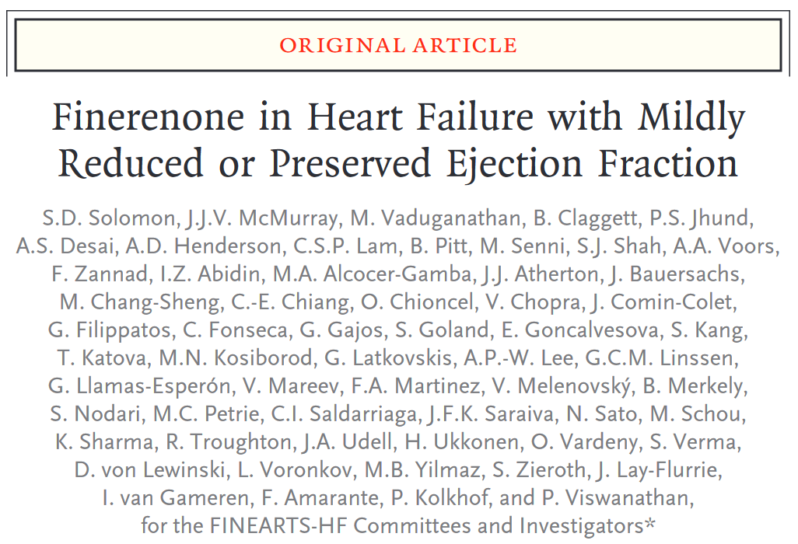
FINEARTS-HF
Solomon SD et al., NEJM, 2024, 10.1056.

Slide 4
FINEARTS-HF Background
MRA reduce mortality and HF hospitalizations in patients with NYHA Class III-IV symptoms and LVEF < 35% (RALES) and in patients with NYHA Class II symptoms and LVEF < 35% (EMPHASIS-HF)
MRA may reduce hospitalizations with no effect on mortality in patients with LVEF >45% (TOPCAT), though the results of this study are somewhat debated given significant regional disparities
Finerenone is a nonsteroidal MRA that binds to mineralocorticoid receptor with much greater affinity than to glucocorticoid, androgen, or progesterone receptors, potentially reducing unwanted side effects
Whether finerenone has efficacy in HF with LVEF > 40% is unknown
Solomon SD et al., NEJM, 2024, 10.1056.

Slide 5
Patient Selection and Study Design
Design: International, randomized, double-blind
Inclusion criteria:
Age > 40
NYHA Class II-IV
LVEF > 40% within 12 months
LA dilation or LV hypertrophy within 12 months
NT-proBNP > 300 pg/mL or BNP > 100pg/mL (900 and 300, respectively, if in AF)
Exclusion criteria:
EGFR < 25
K > 5
MI, CABG, or stroke in last 90 days
PCI in last 30 days
Comorbid conditions causing dyspnea (chronic hypoxic respiratory failure from lung disease, HGB < 10, BMI > 50)
Solomon SD et al., NEJM, 2024, 10.1056.

Slide 6
Patient Selection and Study Design
Enrolled 6001 patients of mean age 72 with 46% female
Followed for median 32 months
Key characteristics
Mean LVEF = 53%
36% w/ LVEF < 50%
44% w/ LVEF 50-60%
19% w/ LVEF > 60%
5% with prior LVEF < 40% (HFrecEF)
EGFR > 60 = 48%
Mean K 4.4
NYHA Class III-IV = 31%
60% had prior hospitalization
14% used SGLT2i
41% had T2DM
Solomon SD et al., NEJM, 2024, 10.1056.

Slide 7
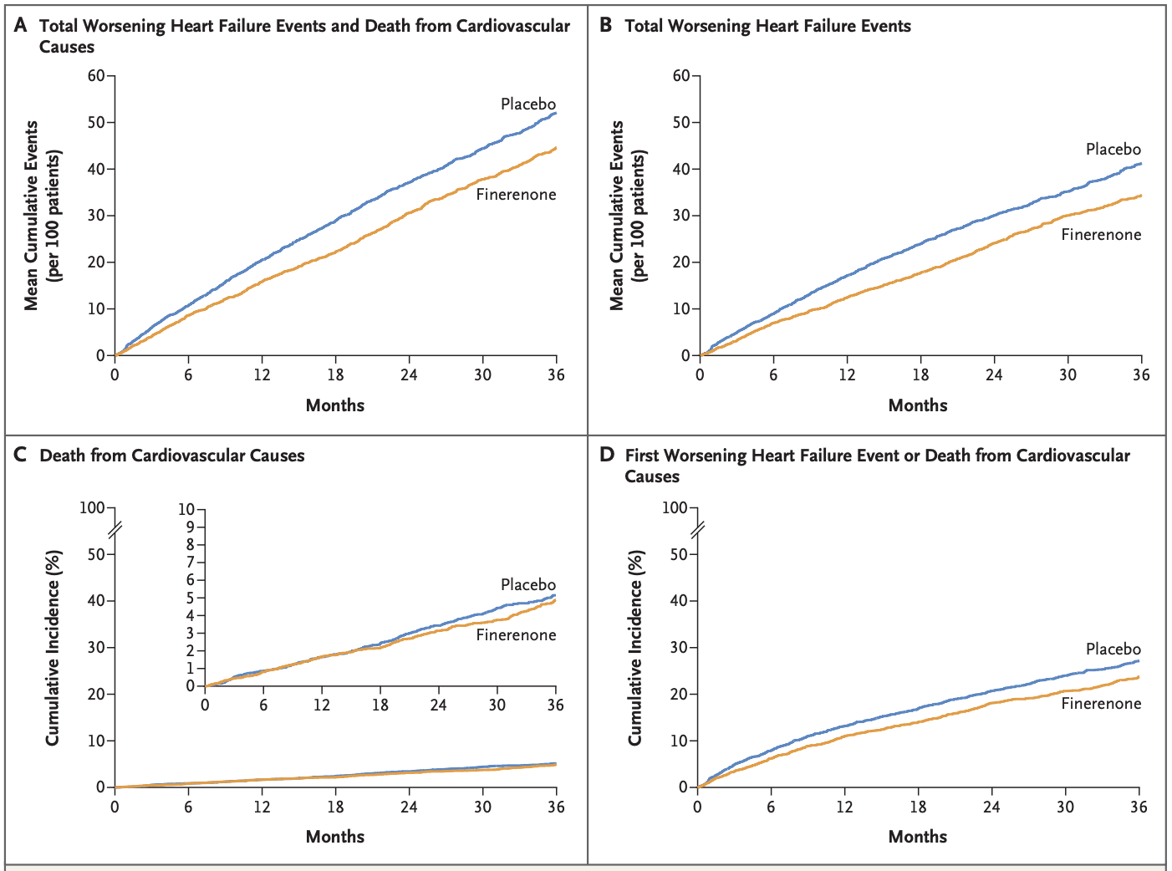
Primary Outcome Result
CV death and worsening HF events (first or recurrent hospitalization or urgent visit)
14.9 vs. 17.7 events per 100 patient-years
Rate ratio [RR] 0.84, 95% confidence interval [CI] 0.74-0.95, p = 0.007
Outcome was driven by worsening HF events
Worsening HF events: 842 vs. 1,024 events (RR 0.82, 95% CI 0.71-0.94, p = 0.007)
CV death: 8.1% vs. 8.7% (hazard ratio [HR] 0.93, 95% CI 0.78-1.11)
Solomon SD et al., NEJM, 2024, 10.1056.

Slide 8
Secondary Outcome Results
All-cause mortality:
16.4% vs. 17.4% (HR 0.93, 95% CI 0.83-1.06)
Change from baseline Kansas City Cardiomyopathy Questionnaire (KCCQ) score at 12 months:
+8.0 vs. +6.4, difference 1.6 (95% CI 0.8-2.3, p < 0.001)
Sustained eGFR decrease ≥50% or to <15 mL/min/1.73 m², new dialysis requirement, or kidney transplantation:
2.5% vs. 1.8% (HR 1.33, 95% CI 0.94-1.89)
Solomon SD et al., NEJM, 2024, 10.1056.

Slide 9
Select Pre-specified Subgroup Analyses
Solomon SD et al., NEJM, 2024, 10.1056.

Slide 10
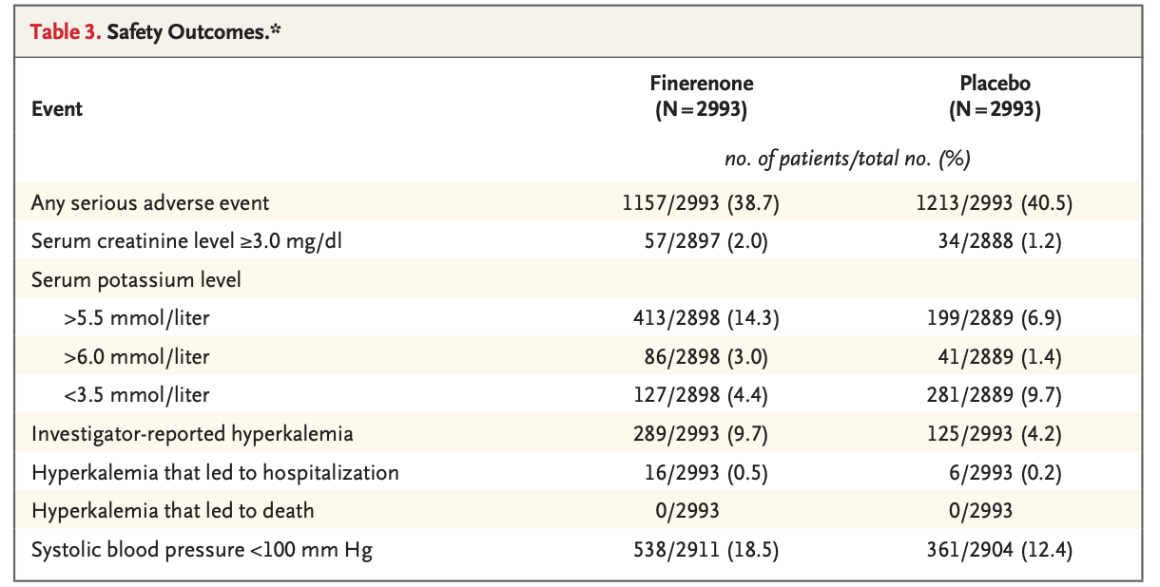
Safety Outcomes
Finerenone → more hyperkalemia and hypotension
Solomon SD et al., NEJM, 2024, 10.1056.

Slide 11
Conclusions
In patients with LVEF > 40%, finerenone reduces HF events (first hospitalization, recurrent hospitalizations, and urgent visits) without reducing CV death or all-cause mortality
Finerenone was associated with more hyperkalemia and SBP < 100
First trial to show that MRA have benefit in patients with LVEF > 40% (suggested by TOPCAT subgroup analyses)
Solomon SD et al., NEJM, 2024, 10.1056.

Slide 12
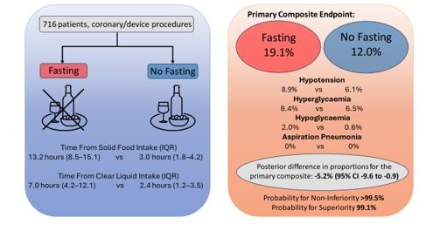
SCOFF Trial
Is it safe to remove fasting requirements prior to cardiac cath procedures requiring conscious sedation?
Multicentered RCT in Australia
No fasting was non-inferior to fasting prior to cardiac cath
Ferreira D et al, Euro. Heart Journal, 2024, 10.1093.

Slide 13
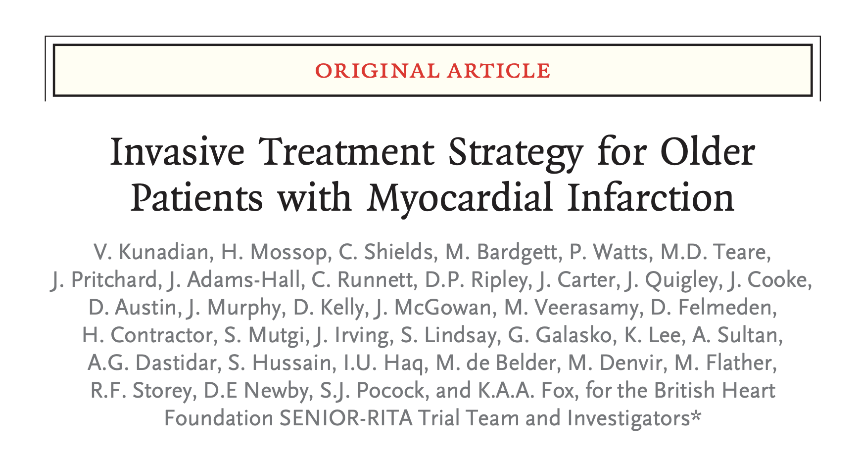
SENIOR-RITA
Kunadian V, Fox KAA, et al., NEJM, 2024, DOI: 10.1056/NEJMoa2407791

Slide 14
SENIOR-RITA Background
In higher risk patients, guidelines currently recommend invasive strategies over medical management alone.
However, older patients are less likely to receive this recommendation and have previously been underrepresented in previous NSTEMI clinical trials
Kunadian V, Fox KAA, et al., NEJM, 2024, DOI: 10.1056/NEJMoa2407791

Slide 15
SENIOR-RITA
Question:
Does an invasive strategy on top of optimal medical therapy vs. a conservative strategy of optimal medical therapy alone reduce the risk of cardiovascular death or non-fatal MI in patients aged ≥75 years admitted with a NSTEMI?
Kunadian V, Fox KAA, et al., NEJM, 2024, DOI: 10.1056/NEJMoa2407791
DOI: 10.1056/NEJMoa2407791

Slide 16
SENIOR-RITA Methods
Randomized open label control trial where 1500 patients across 48 NHS sites in England and Scotland aged 75 and older presenting with type 1 NSTEMI were randomly allocated to two treatment groups
Group 1- Conservative treatment with guideline direct medical therapy (GDMT) including antiplatelet, statin, ACEi, and beta blockers.
Group 2- Invasive treatment where in addition to GDMT patients also underwent coronary angiogram and where necessary coronary revascularization or bypass surgery.
All patients were assessed for frailty, cognition and co-morbidities at baseline and follow-up.
Kunadian V, Fox KAA, et al., NEJM, 2024, DOI: 10.1056/NEJMoa2407791
DOI: 10.1056/NEJMoa2407791

Slide 17
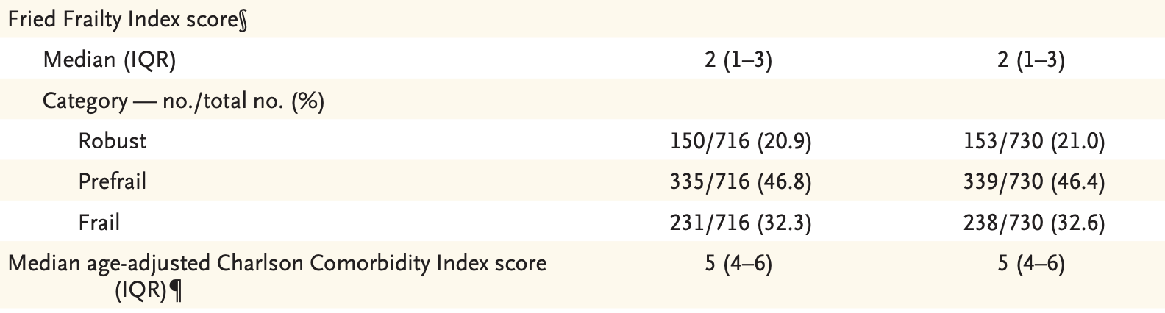
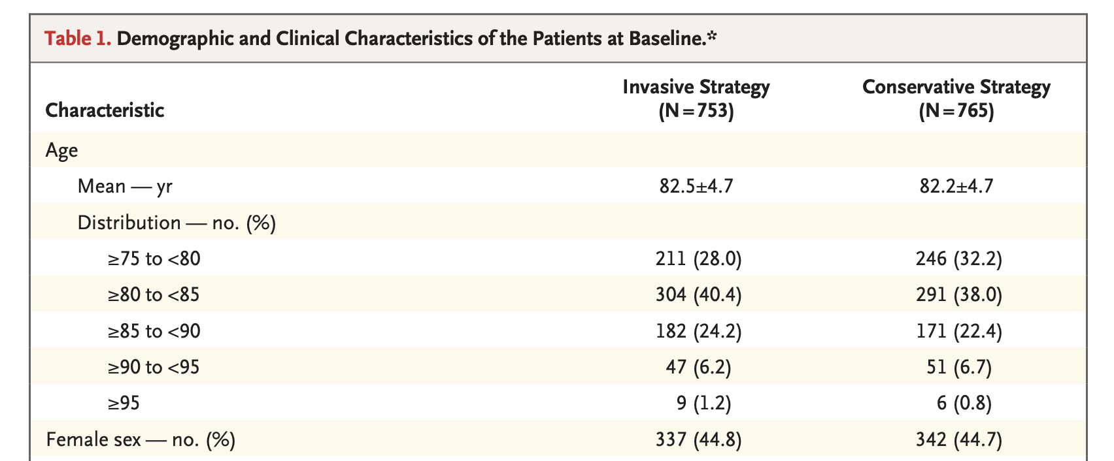
Baseline Characteristics
Mean overall age was 82.4 years with 72% being aged 80 or older.
80% of patients were classified as prefrail or frail and more than 60% were classified as cognitively impaired
Mean comorbidity index was 5 in both treatment groups.
Kunadian V, Fox KAA, et al., NEJM, 2024, DOI: 10.1056/NEJMoa2407791

Slide 18
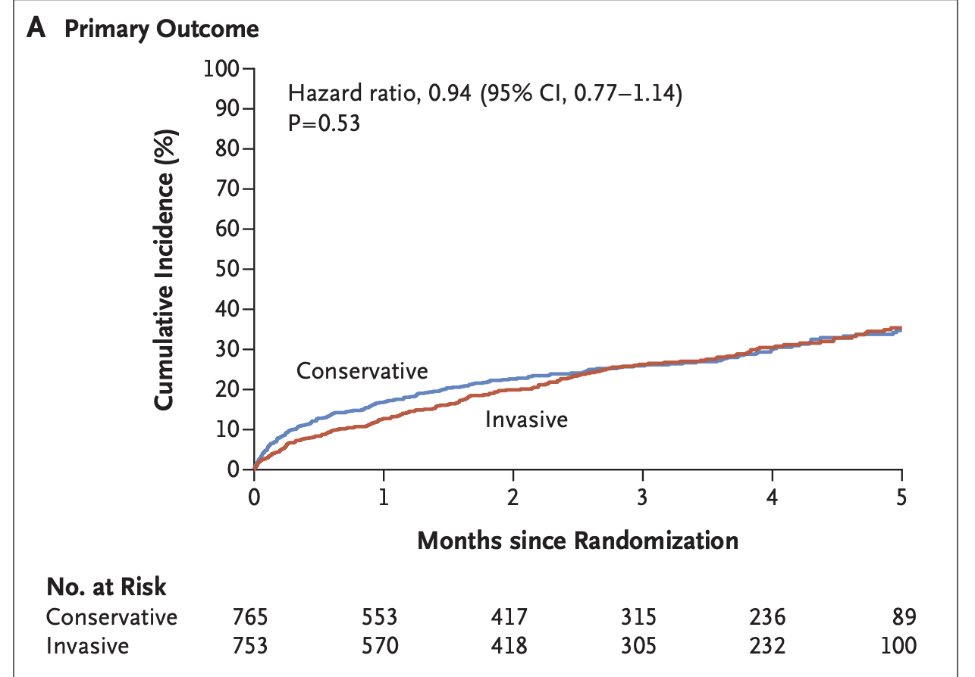
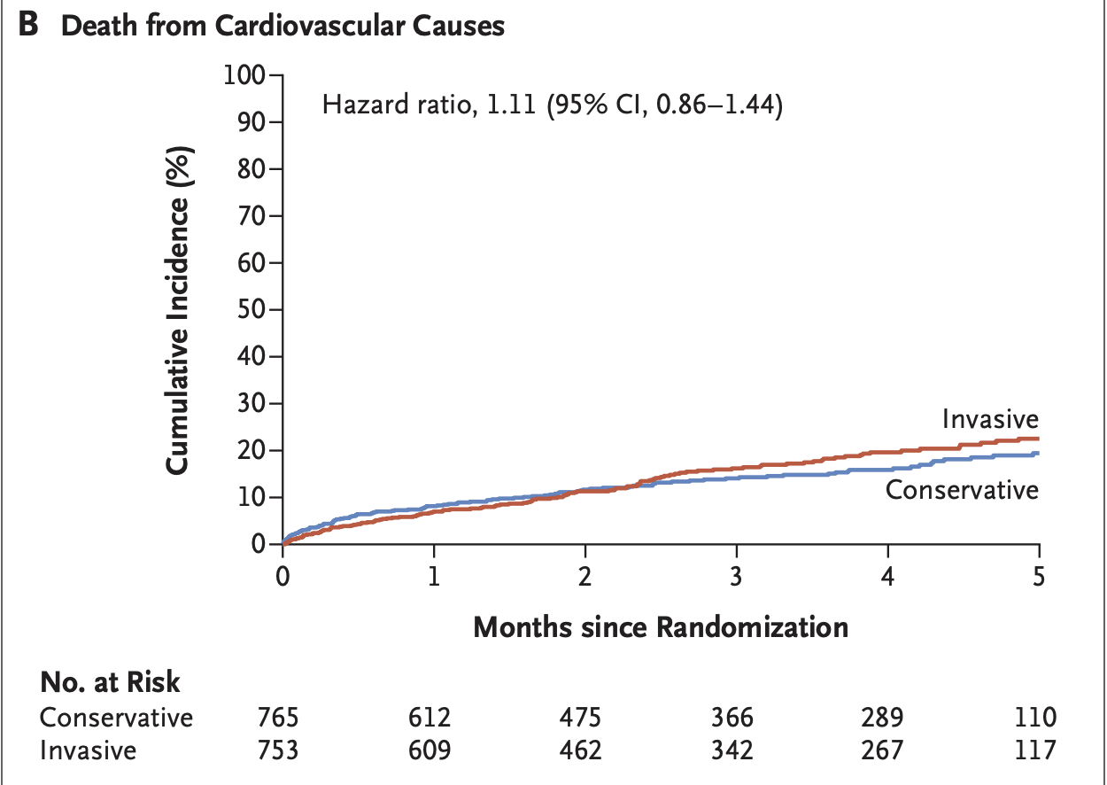
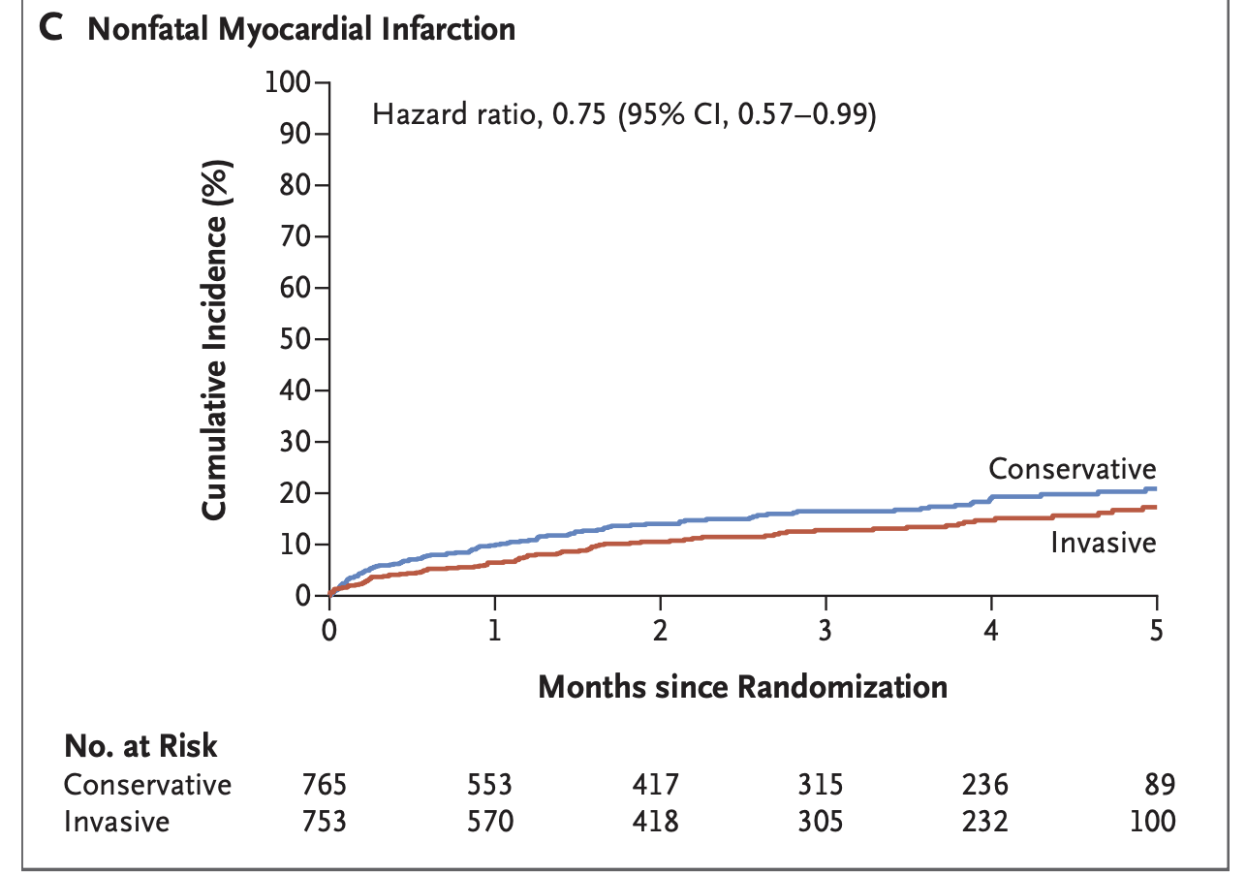
Results
Time to CV death and non-fatal MI
CV death
Non-fatal MI
Primary endpoints: time to cardiovascular death and non-fatal MI
Results: After 4.1 years, there was no difference in cardiovascular death or non-fatal MI between invasive (25.6%) and conservative strategy groups (26.3%; hazard ratio [HR] 0.94, 95% confidence interval [CI] 0.77–1.14; p=0.53)
Kunadian V, Fox KAA, et al., NEJM, 2024, DOI: 10.1056/NEJMoa2407791

Slide 19
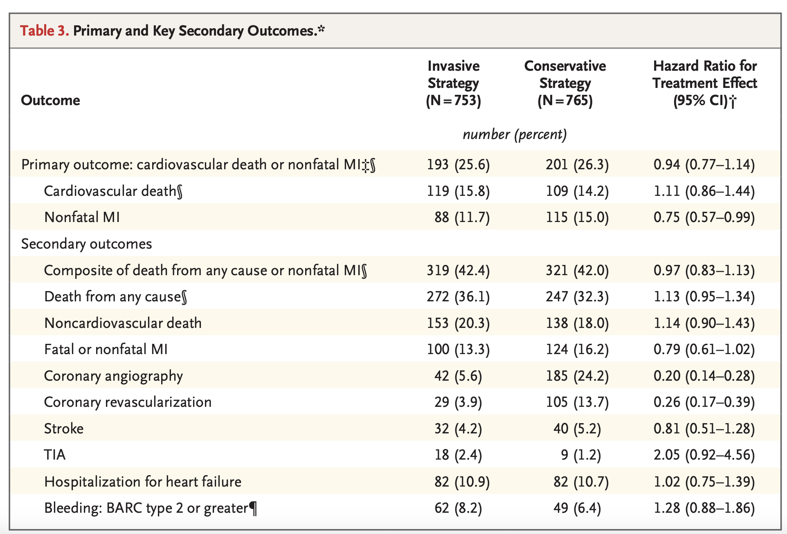
Secondary Outcome Results
Secondary endpoints: Components of the primary endpoint, all-cause death, subsequent coronary revascularisation and bleeding complications.
Reduction in non-fatal MI: 11.7% of patients in the invasive strategy group vs. 15.0% in the conservative strategy group (HR 0.75; 95% CI 0.57–0.99).
Invasive strategy group also required fewer subsequent revascularisation procedures than those in the conservative strategy group (3.9% vs. 13.7%; HR 0.26; 95% CI 0.17–0.39).
No differences in the other secondary outcomes, including all-cause death, all MIs combined, stroke, hospitalisation for heart failure or bleeding complications.
Kunadian V, Fox KAA, et al., NEJM, 2024, DOI: 10.1056/NEJMoa2407791
DOI: 10.1056/NEJMoa2407791

Slide 20
Conclusions
Among patients age 75 and older presenting with NSTEMI, invasive therapy failed to reduce CV death or MI compared with conservative therapy over a median follow-up of 4.1 years.
However, there was a reduction in non-fatal MI and rates of subsequent revascularization in patients with invasive strategies.
Kunadian V, Fox KAA, et al., NEJM, 2024, DOI: 10.1056/NEJMoa2407791

Slide 21
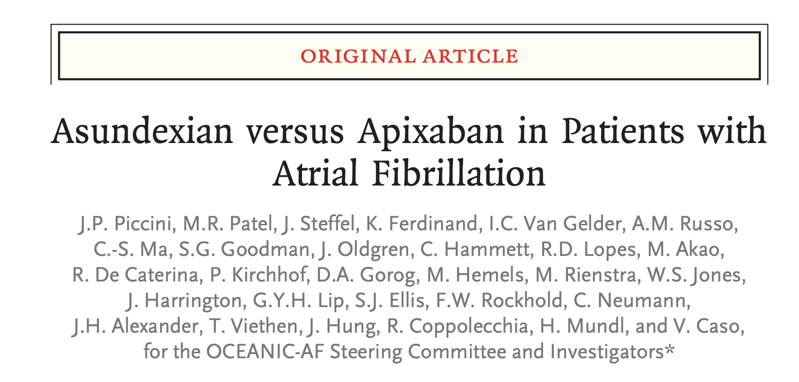
OCEANIC-AF
Piccini JP, Caso V, et al., NEJM, 2024, DOI: 10.1056/NEJMoa2407105

Slide 22
Background
Asundexian, a novel XIa inhibitor is an investigational new class of medication targeting zymogen factor XI and its activated serine protease form XIa.
Previous work published in Phase II trial PACIFIC-AF had argued asundexian to be safe and effective in reducing bleeding in AF patients.
Piccini JP, Caso V, et al., NEJM, 2024, DOI: 10.1056/NEJMoa2407105

Slide 23
OCEANIC-AF Question
Is the use of asundexian in a high risk Afib population non-inferior to apixaban in the prevention of stroke or systemic embolism?
Piccini JP, Caso V, et al., NEJM, 2024, DOI: 10.1056/NEJMoa2407105

Slide 24
OCEANIC-AF Methods
Phase III, international, double-blind trial
High risk patients with Afib were randomized 1:1 to receive asundexian or apixaban for prevention of stroke or systemic embolism
Primary outcomes: stroke or systemic embolism occurrences
Secondary outcomes: composite ischemic stroke, embolism, death by any cause, and composite stroke, MI or death
Secondary safety endpoints: major bleeding, clinically relevant non-major bleeding, fatal bleeding hemorrhagic stroke and intracranial hemorrhage
Piccini JP, Caso V, et al., NEJM, 2024, DOI: 10.1056/NEJMoa2407105

Slide 25
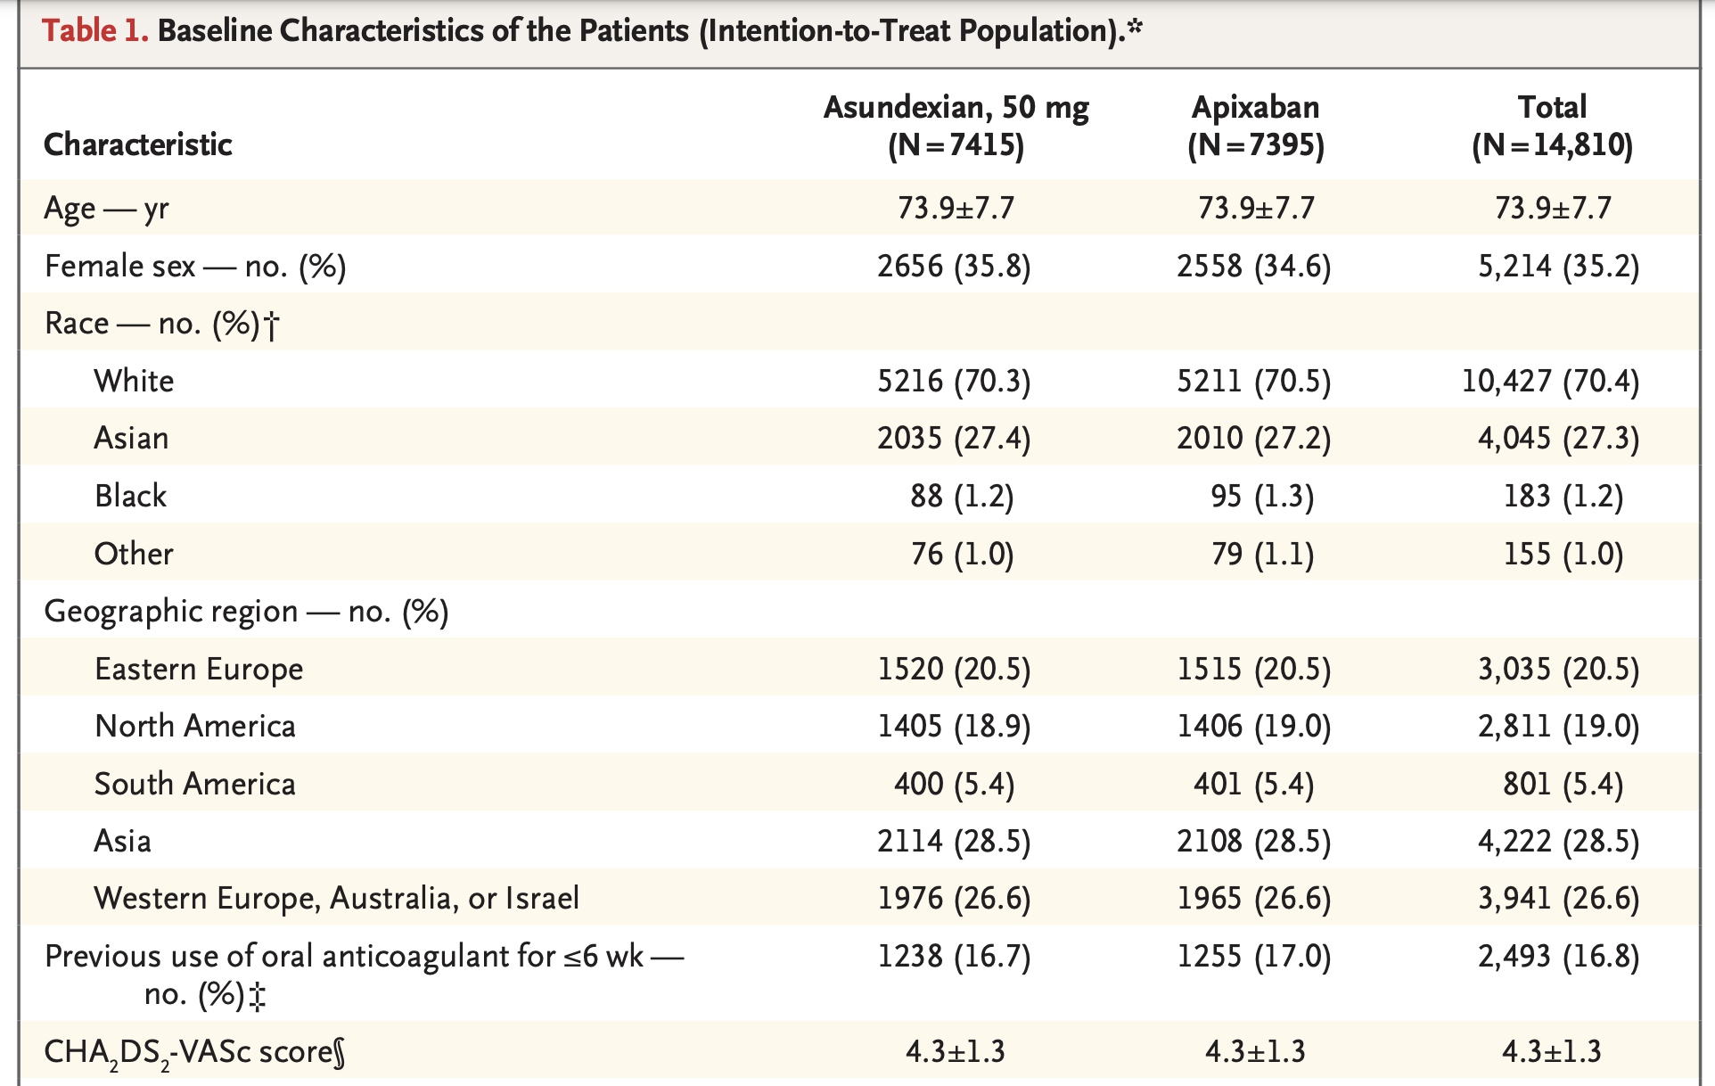
Enrollment and Baseline Characteristics
14,810 patients were randomized to received either asundexian or apixaban (18,000 intended)
35.2% women, 18.6% CKD, 18.2% with prior stroke or TIA
Inclusion criteria
>18 years of age with Afib.
CHADSVASC score 3 in men, 4 in women
Scores 2 for men or 3 for women were included if >70 yrs, prior stroke, prior TIA or embolism or CKD
Mean CHA2DS2-VASc score was 4.3±1.3.
Piccini JP, Caso V, et al., NEJM, 2024, DOI: 10.1056/NEJMoa2407105

Slide 26
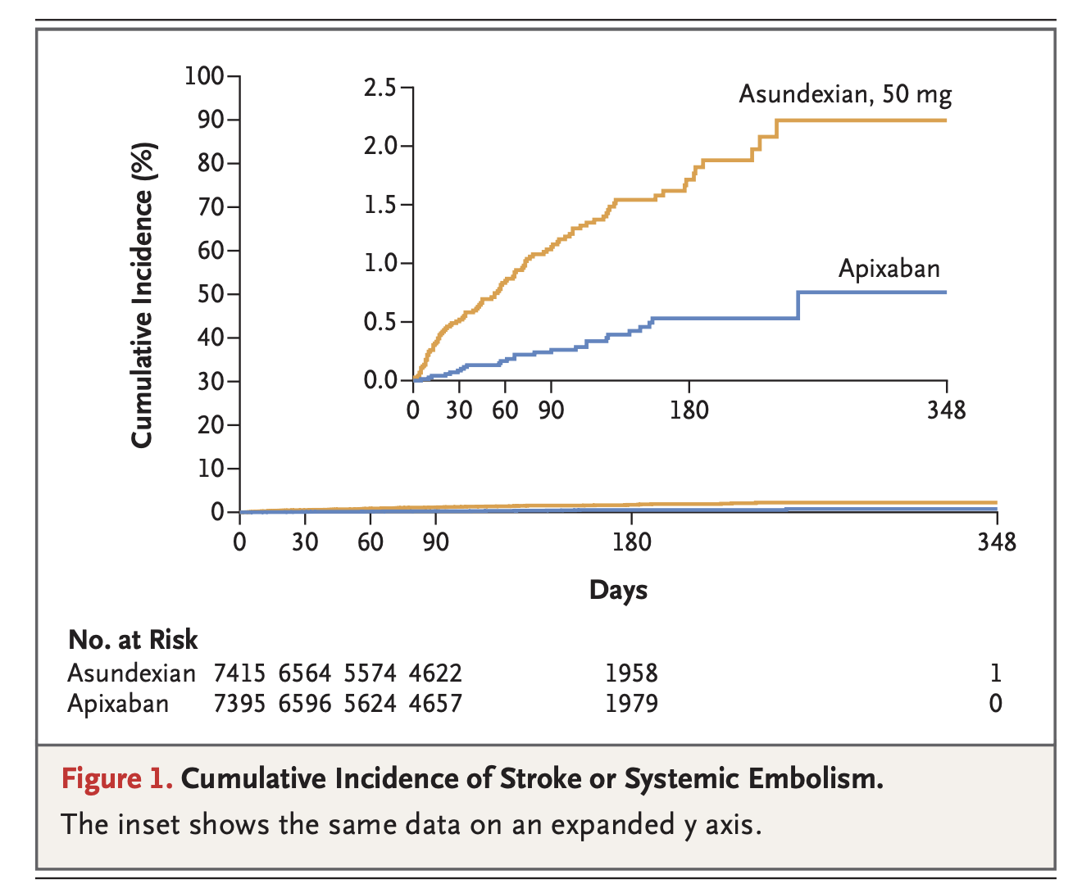
Primary Outcome Result: Early Termination
After 155 days the trial was terminated prematurely due to higher incidence of stroke or systemic embolism in the asundexian group
Primary outcome: 1.3% vs 0.4% (hazard ratio 3.79, 95% CI 2.46-5.83)
Piccini JP, Caso V, et al., NEJM, 2024, DOI: 10.1056/NEJMoa2407105

Slide 27
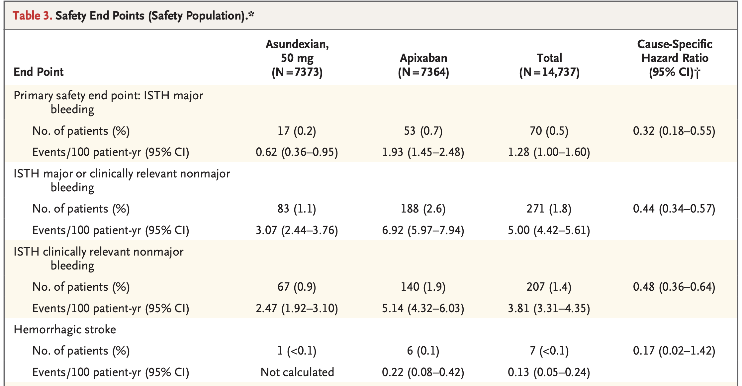
Safety Endpoints
Major bleeding occurred in 17 patients (0.2%) in the asundexian group and in 53 (0.7%) in the apixaban group. The incidence of any adverse event was similar in the two groups.
Piccini JP, Caso V, et al., NEJM, 2024, DOI: 10.1056/NEJMoa2407105

Slide 28
OCEANIC AF Conclusion
Treatment of patients with Afib with asundexian at a dose of 50 mg once daily was associated with a higher incidence of stroke or systemic embolism than treatment when compared to apixaban in the time period before the trial was stopped prematurely.
Piccini JP, Caso V, et al., NEJM, 2024, DOI: 10.1056/NEJMoa2407105

Slide 29
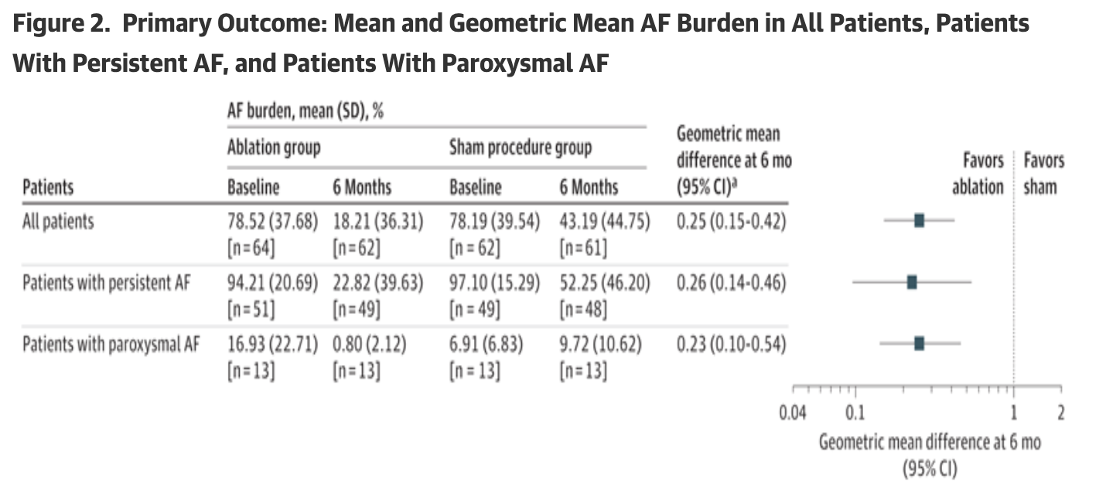
SHAM-PVI Trial
Design: RCT, Double-blind
Antiarrhythmics discontinued prior to procedure
N=126 adults with symptomatic Afib despite >1 class I or III AAD or BB or AAD intolerance
Follow-up: 6 months
Mean age: 67 yrs
Exclusion: prior ablation, persistent Afib >1 year, LA diameter >5.5cm, LVEF 35%
Findings: Change in AF burden baseline at 6 months
Ablation: 60.31% (78.52->18.21)
Sham: 35.0% (78.19-> 43.19)
Dulai R et al., JAMA, 2024, DOI:10.1001/jama.2024.17921

Slide 30
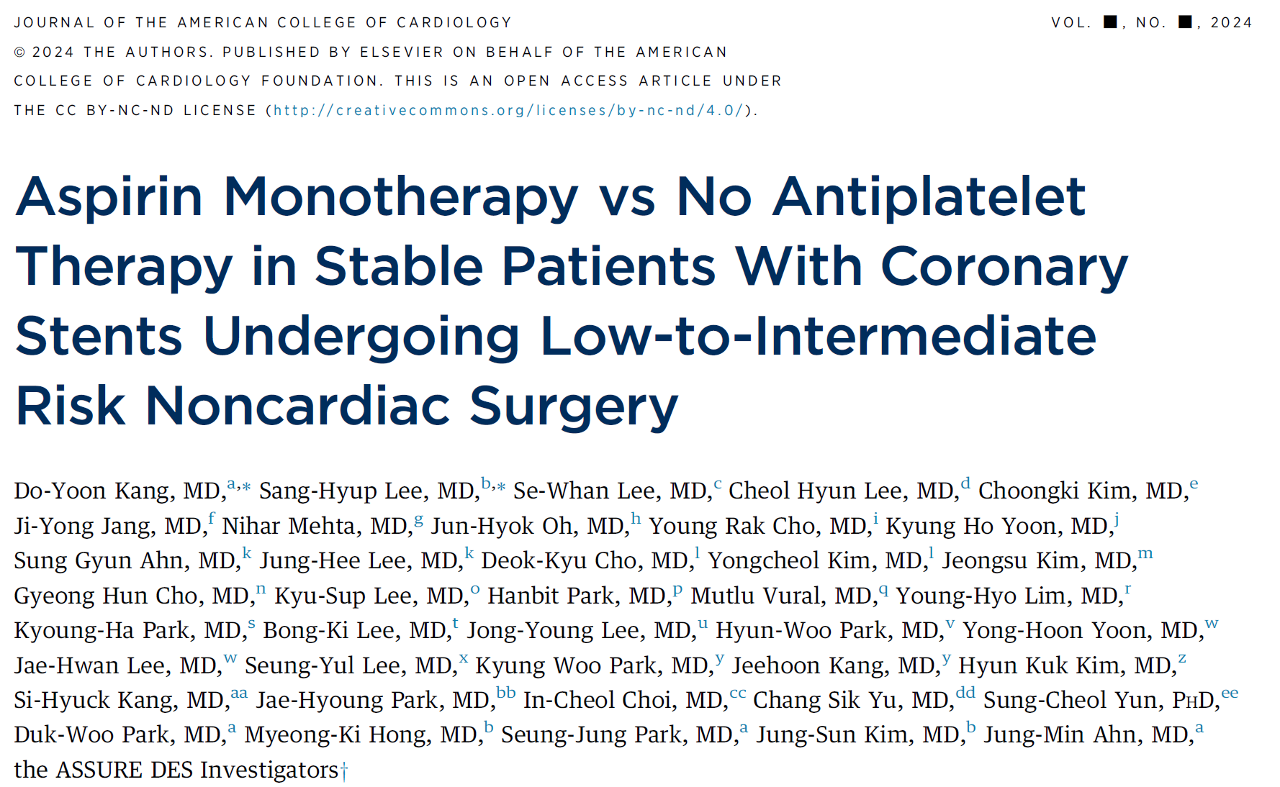
ASSURE DES
Kang, D et al. JACC. 2024; 10.1016
Notes:
Kang Engl J Med. 2024;10.1056
Kang, D et al. JACC. 2024, 10.1016

Slide 31
ASSURE DES Background
Current guidelines recommend the perioperative continuation of aspirin in patients with coronary DES undergoing noncardiac surgery
Supporting evidence is limited: observational studies; first-generation DES implantation.
Compare continuing aspirin monotherapy vs temporarily holding all antiplatelet
therapy before noncardiac surgery in patients at least 1 year after PCI with DES.
Kang, D et al. JACC. 2024; 10.1016
Notes:
Fatal stent thrombosis; (54.3%) in that study were bare-metal stents (POISE-2 trial; post hock)

Slide 32
Patient Selection and Methods
Investigator-initiated, multicenter, open-label, randomized, controlled trial conducted at 30 sites in 3 countries (Korea, India, and Türkiye)
1010 patients undergoing low- intermediate risk non-cardiac surgery
≥1 year after DES (median 5.1y; Q1-Q3: 2.7-9.0 years)
No Antiplatelet Therapy Group:
Discontinue antiplatelet therapy
5 days before surgery
resumed ≤48 hrs post-op
(N=464)
Aspirin Monotherapy Group:
Continue aspirin throughout the perioperative period
(N=462)
Kang, D et al. JACC. 2024; 10.1016
Notes:
-abdominal (39.8%), orthopedic (23.3%), and urological or gynecological (18.7%)
-Median time from PCI with DES to noncardiac surgery was 5.1 years (Q1-Q3: 2.7-9.0 years)
87.5% 2nd gen or newer DES (median 4.4 years), 11.4% 1st gen DES (median 13.9years).
39.3% ASA, 23.1% P2Y12, and 34.4% DAPT
resumed as soon as possible after surgery, but no later than 48 hours postoperatively

Slide 33
Patient Selection and Methods
Exclusions:
ACS or MI within 1 month
EF<30%
Valvular heart disease
Intolerance to aspirin
Need for anticoagulation
Emergent or cardiac surgery
Very high bleeding risk (eg, intracranial, spinal neurosurgery, or vitreoretinal eye surgery)
Noncardiac surgery was not performed
Kang, D et al. JACC. 2024; 10.1016
Notes:
(CT area ≤ 4.3 cm²)

Slide 34
Outcome Selection
Primary outcome composite:
Death, MI, definite stent thrombosis, stroke 5-30 days after surgery
Secondary outcome:
Individual components of primary outcome and major or minor bleeding
Kang, D et al. JACC. 2024; 10.1016
Notes:
Secondary outcomes included the individual components of the primary outcome and major or minor bleeding according to the TIMI (Thrombolysis
In Myocardial Infarction) definition.

Slide 35
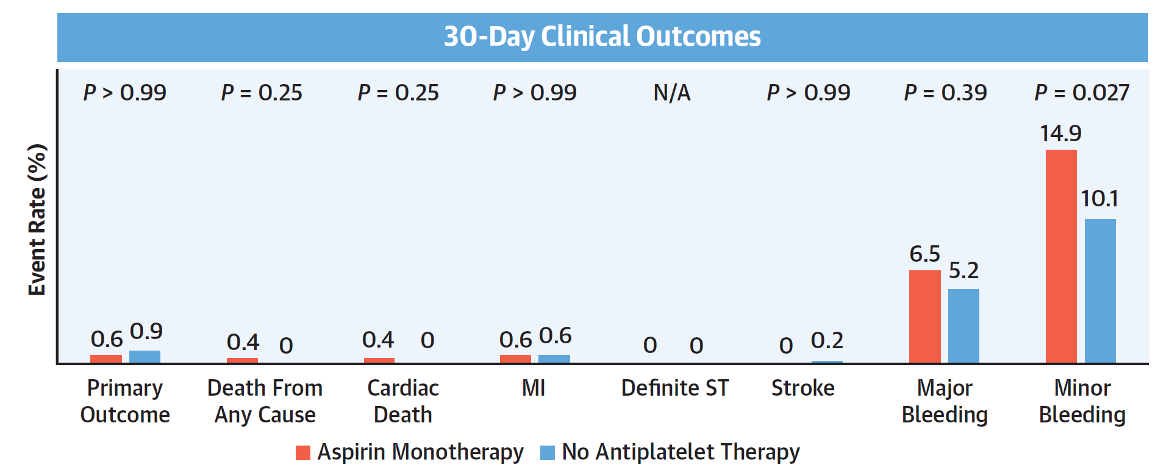
Results
Kang, D et al. JACC. 2024; 10.1016
Notes:
- Expected incidence of the primary composite outcome at 30 days would be 6.0% for the aspirin monotherapy group and 11.5% for
the no antiplatelet therapy group.
- primary composite outcome occurred in 3 patients (0.6%) in the aspirin monotherapy group and 4 patients (0.9%) in the no
antiplatelet therapy group
Study population included mostly East-Asian patients, which may have a lower risk of ischemic events and higher risk of bleeding complications.
Mostly IVUS guided PCI
patients within the second year after stenting were underrepresented in our study

Slide 36
ASSURE DES Conclusions
In patients undergoing noncardiac surgery >1 year after PCI with contemporary DES, a strategy of continuing aspirin monotherapy did not significantly reduce ischemic events compared with temporarily (5 days) holding all antiplatelet therapy
Kang, D et al. JACC. 2024; 10.1016
Notes:
continuing aspirin was associated with a modest increase in minor bleeding

Slide 37
STOP-or-NOT:
Continuation vs Discontinuation of Renin-Angiotensin System Inhibitors Before Major Noncardiac Surgery
Prospective, multicenter, randomized clinical trial: to evaluate whether a continuation strategy vs a discontinuation strategy of RASIs before major noncardiac surgery results in decreased complications at 28 days after surgery.
Primary Outcome: composite
all-cause mortality and major post-op complications ≤ 28 days after surgery.
Key Secondary Outcome:
hypotension during surgery
Continue RASIs until the day of surgery
(n = 1107)
22%
54%
2222 patients
RASI ≥ 3 months
major noncardiac surgery
risk ratio, 1.02
[95% CI, 0.87-1.19]
risk ratio, 1.31
[95% CI, 1.19-1.44]
Discontinue RASIs
48 hrs prior to surgery
(n = 1115)
22%
41%
Among patients who underwent major noncardiac surgery, continuation of RASIs before surgery
was not associated with a higher rate of postoperative complications than discontinuation.
Legrand, M et al. JAMA. 2024; 10.1001
Notes:
acute kidney injury, postoperative organ failure, and length of stay in the hospital and intensive care unit during the 28 days after surgery.
between January 2018 and April 2023 at 40 hospitals in France.
22% (245 of 1115 patients) in the RASI discontinuation group and 22% (247 of 1107 patients) in the RASI continuation group (risk ratio, 1.02 [95% CI, 0.87-1.19]; P = .85).

Slide 38
ABYSS Trial
Silvain J, Cayla G, et al, NEJM, 2024, 390;14.

Slide 39
ABYSS Background and Question
REDUCE-AMI showed that long-term beta-blocker treatment after an acute MI did not reduce the risk of death or new MI
In patients with a history of MI, is interruption of beta blocker therapy noninferior to continuation of beta blocker therapy?
Yndigegn T, et al, NEJM, 2024, 930:1372-1381.
Silvain J, Cayla G, et al, NEJM, 2024, 390;14.

Slide 40
Trial Design
Prospective, randomized, open-label
Multicentered study in France
N=3698 patients
Inclusion criteria: MI >6 months pre-randomization
Exclusion criteria: MI within 6 months of randomization, EF < 40%, other indication for beta blocker (e.g. arrhythmia, migraine, HTN)
Silvain J, Cayla G, et al, NEJM, 2024, 390;14.

Slide 41
End Points
Primary composite
Death
MI
Stroke
Hospitalization for CV cause
Secondary endpoints:
Quality of life (EQ-5D questionnaire)
Composite death, MI, stroke
Composite death, MI, stroke, hospitalization for CHF
Noninferiority analysis performed
Silvain J, Cayla G, et al, NEJM, 2024, 390;14.

Slide 42
Baseline Characteristics
Mean age: 63.5 years
83% male
63% h/o STEMI, 37% h/o NSTEMI
52% multivessel CAD
97% PCI
Median LVEF 60%
Silvain J, Cayla G, et al, NEJM, 2024, 390;14.

Slide 43
Results
Quality of life: no significant difference in EQ-5D score.
Beta blocker interruption was not non-inferior to continuation for primary composite end point.
Primary end point driven by hospitalization for cardiovascular reasons
Silvain J, Cayla G, et al, NEJM, 2024, 390;14.

Slide 44
But what about REDUCE-AMI?
Earlier this year, REDUCE-AMI demonstrated noninferiority for beta blocker use after MI with LVEF ≥ 50%
Why the difference?
 | ABYSS | REDUCE-AMI
Primary outcome | Composite death, MI, stroke, hospitalization for any CV cause | Composite death or MI (Secondary: hospitalization for AF or CHF)
LVEF | ≥ 40% | ≥ 50%
Intervention | Beta blocker interruption | Beta blocker initiation
Beta blocker choice | 72% bisoprolol | 62% metoprolol, 38% bisoprolol
ABYSS secondary endpoint for
death, MI, stroke, hospitalization for CHF: non-inferior (10.0% vs 8.9%)
Silvain J, Cayla G, et al, NEJM, 2024, 390;14.
Yndigegn T, et al, NEJM, 2024, 930:1372-1381.

Slide 45
Conclusions
Interruption of beta blockers >6 months post-MI is not non-inferior to continuation for patients with LVEF ≥ 40% in terms of composite death, MI, stroke, or hospitalization for a CV reason.
End point driven by hospitalization
Hospitalizations driven by admission for angiography
Quality of life was unaffected by beta blocker cessation.
In setting of REDUCE-AMI, more trial data (SMART-DECISION) will be meaningful
Silvain J, Cayla G, et al, NEJM, 2024, 390;14.

Slide 46
RESHAPE-HF2
Anker SD, Friede, T, et al. NEJM, 2024, 10.1056.

Slide 47
Background and Methods
Does transcatheter mitral valve repair improve outcomes in patients with heart failure and functional moderate to severe mitral regurgitation?
Background
MITRA-FR trial (NEJM 2018): negative for composite death or hospitalizations
COAPT trial (NEJM 2018): positive for CHF hospitalizations (and death)
RESHAPE-HF2 Methods
MitraClip
Multicenter study, 9 countries
Prospective, randomized, open-label
n=505 patients
Inclusion: on GDMT, 3+ to 4+ functional MR, CHF, LVEF 20-50%, hospitalization or BNP ≥ 300 pg/mL or NT-proBNP ≥ 1000 pg/mL within 90 days
Exclusion: MV surgery recommended, degenerative MV disease
Obadia JF, et al., NEJM, 2018; 379:2297-2306.
Stone GW, et al, NEJM, 2018, 379:2307-2318.
Anker SD, Friede, T, et al. NEJM, 2024, 10.1056.

Slide 48
End Points
Primary endpoints (24 months)
Composite first or recurrent hospitalization for CHF or CV death
First or recurrent hospitalization for CHF
Primary endpoint (12 months): change in KCCQ-OS score
Secondary endpoints
MR grade ≤ 2+, Change in 6 min walk distance, all cause death, NYHA I-II
Anker SD, Friede, T, et al. NEJM, 2024, 10.1056.

Slide 49
Baseline Characteristics
Mean age: 70 years
80% male
35% NICM
Median LVEF 30-31%
Median LVEDV 200-206 mL
60% NYHA III
66% with CHF hospitalization in past year
56% 3+ MR, 44% 4+ MR
Mean EROA 0.23 cm²
COAPT: mean 0.40 cm²
MITRA-FR: 0.31 cm²
Anker SD, Friede, T, et al. NEJM, 2024, 10.1056.

Slide 50
Results
Composite CHF Hospitalization
or CV Death (RR 0.64, p = 0.002)
CHF Hospitalization
(RR 0.59, p = 0.002)
KCCQ-OS Score
(+10.9 points, p < 0.001)
ARR 19.7% for hospitalization (NNT 5.1)
Safety: 1.6% rate of periprocedural adverse events
Overall event rates in control group lower than COAPT (mortality 29.6% vs 46.1% at 2 years)
Subgroups: lower EF (< 30%), 4+ MR, NYHA III-IV, LVEDV >227, EROA >0.27 cm² had greater benefit.
Anker SD, Friede, T, et al. NEJM, 2024, 10.1056.

Slide 51
Conclusions
In patients with symptomatic heart failure and moderate to severe functional MR despite GDMT, TMVR reduced the composite of death and heart failure admissions at 24 months. TMVR also improved quality of life.
Driven by CHF hospitalizations
Anker SD, Friede, T, et al. NEJM, 2024, 10.1056.

Slide 52
Thank you!

Slide 53
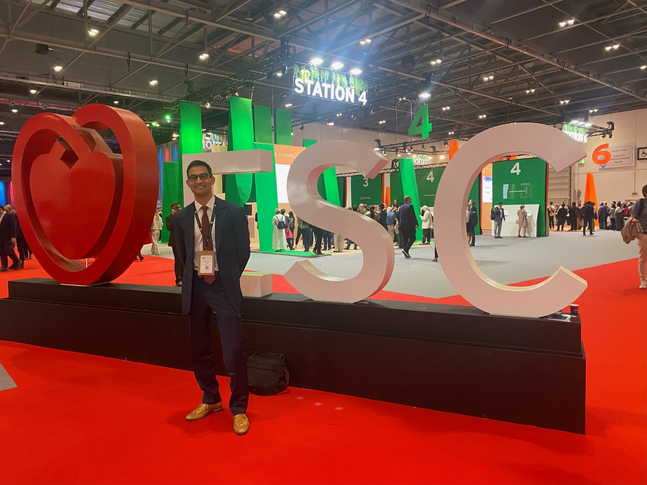
Dr. S. Nabeel Hyder, ESC 2024 Presenter

