Slide 1
Chronic Total Occlusion Angioplasty of Right Coronary Artery with “ROTATRIPSY”: Combination of Rotational Atherectomy and Intravascular Lithotripsy for Treatment of Severely Calcified Lesions

Slide 2
Patient Initials or Identifier Number
Patient initials: AKC
Identifier number: 001

Slide 3
Clinical Presentation
A 61 year-old non-diabetic gentleman on regular anti-hypertensives.
Since last one month patient had complaints of chest pain on exertion and uneasiness with perspiration and was admitted at our hospital.

Slide 4
Relevant Test Results Prior to Catheterization
Electrocardiogram (ECG) showed right bundle branch block (RBBB) with sinus rhythm.
2D Echocardiography (ECHO) showed normal LVEF with normal valves and no PAH.

Slide 5
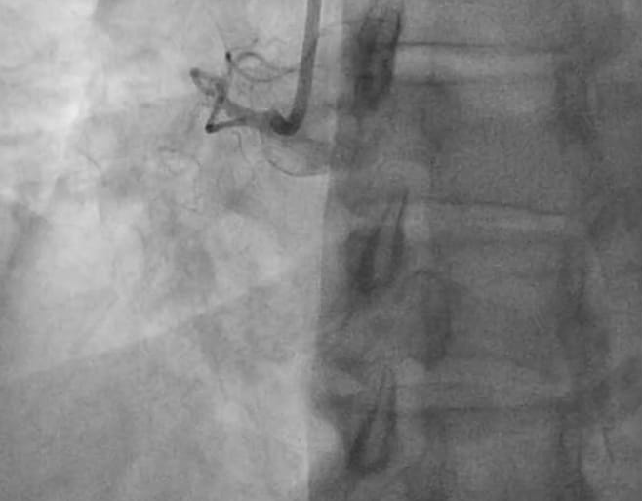
Relevant Catheterization Findings
1
Angiography showed 100% prox. Right Coronary Artery (RCA) Chronic Total Occlusion (CTO) with severe calcification, and moderate disease on left side (Figure 1).

Slide 6
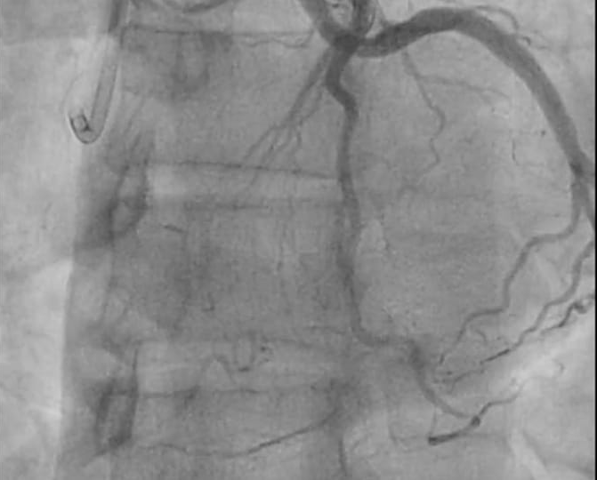
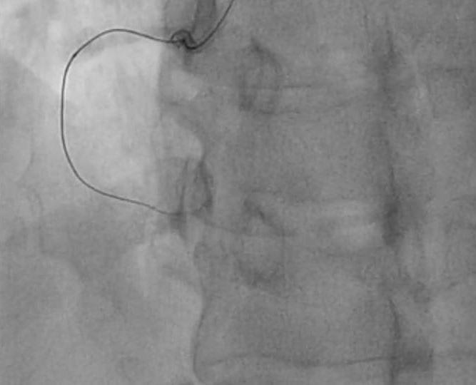
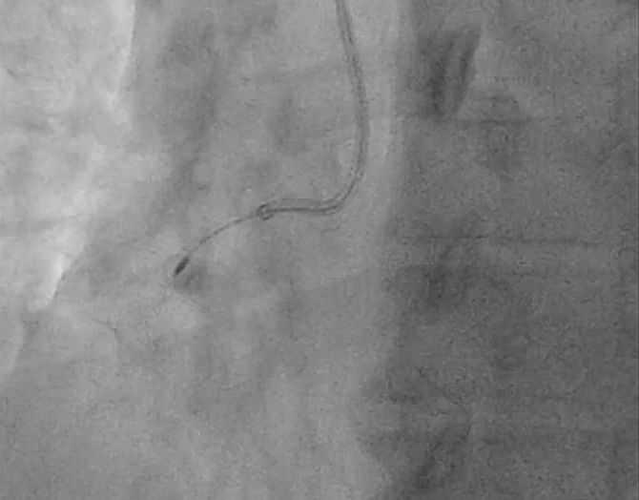
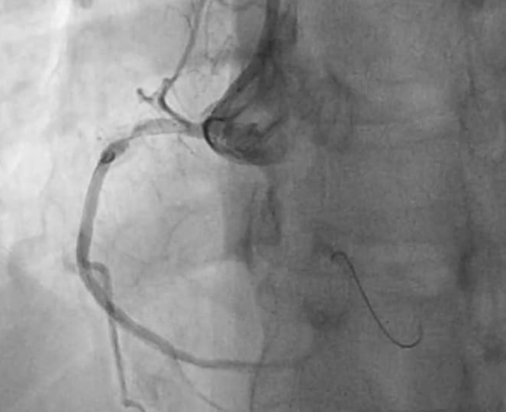
Interventional Management
Patient was planned for Optical Coherence Tomography (OCT) guided intervention to the RCA. Bilateral injection technique with radial approach with the use of 7F Transradial right Terumo slendersheath and AL1 guide and diagnostic left radial JL3.5 was used during RCA intervention (Figure 2).
2
3
4
5
With the use of FineCross Microcatheter and XT-A wire, extremely heavily calcified RCA CTO was crossed (Figure 3).
Despite using multiple noncompliant balloons and 2.0 mm OPN balloon at 40 atm, focal ring stenosis failed to open, so it was decided to do rotational atherectomy. 1.25 mm Rotaburr Rotablator ablation done successfully (Figures 4 & 5).

Slide 7
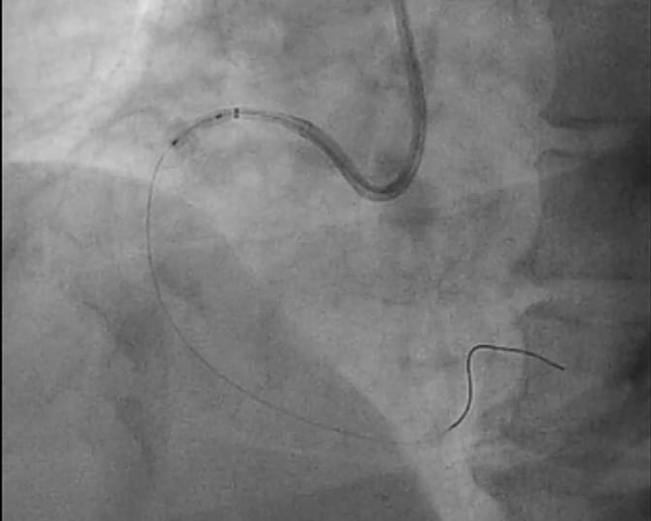
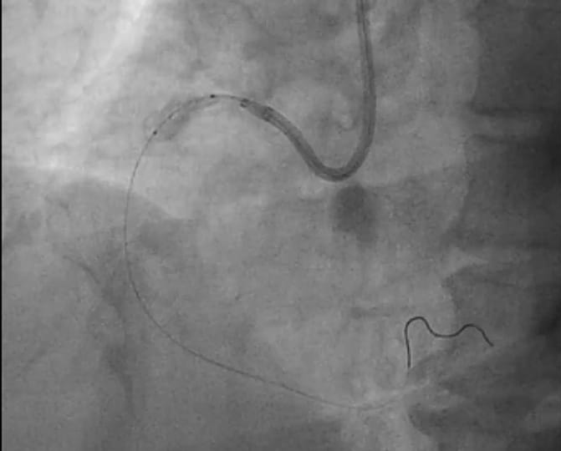
Interventional Management
6
Repeat use of 2, 2.5 mm noncompliant balloons and 2.0 mm OPN balloon at 40 atm, focal ring stenosis failed to open and showed “dog-bonning” of the lesion (Figure 6).
So decided to do Intravascular Lithotripsy (IVL) for the severely calcified lesion. Using mother child catheter-Guidzilla, 3.0 mm x 1 cm IVL balloon advanced and inflated at 4 mmHg - 2 cycles of IVL done (Figure 7).
7

Slide 8
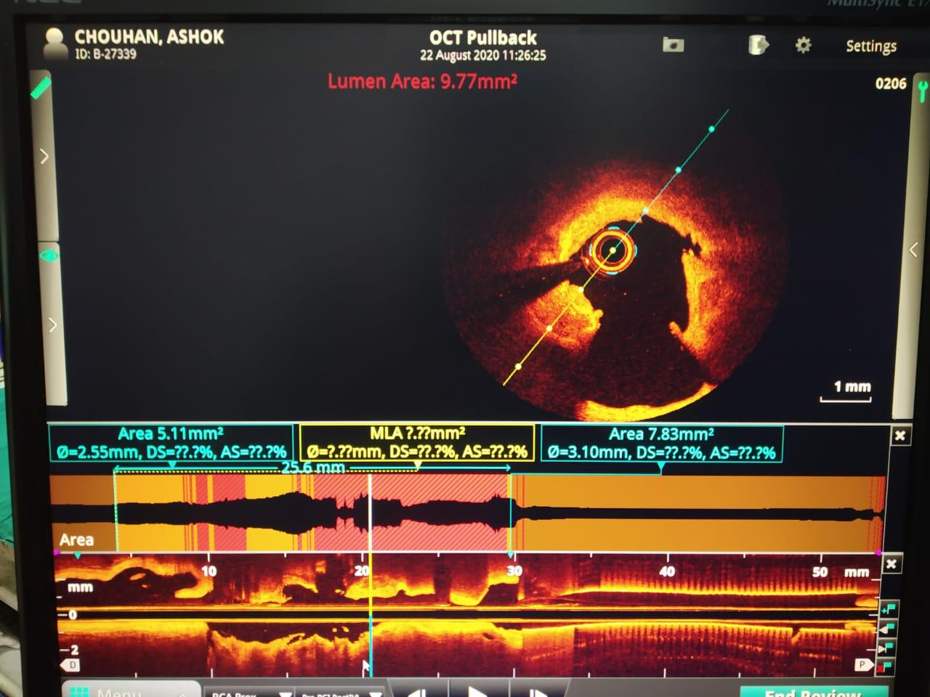
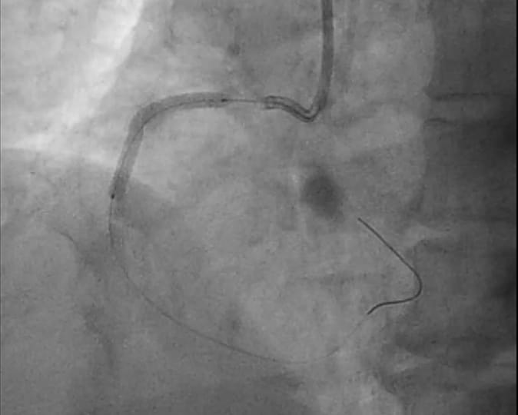
Interventional Management
Post IVL OCT showed both severe superficial and deep calcium within the lesion with calcium cracks and dissections in RCA and there was an area of ectasia with presence of intramural hematoma (Figure 8).
8
9
In view of this OCT result, 3.0 X 34 mm Resolute Onyx stent was deployed (Figure 9).

Slide 9
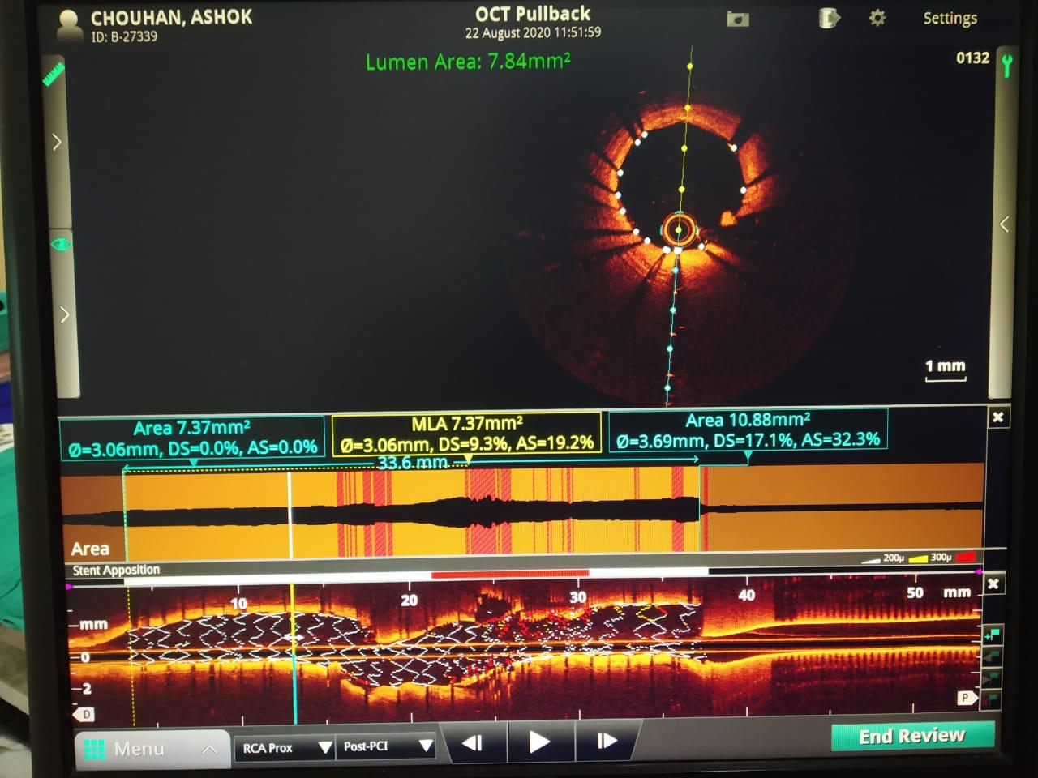
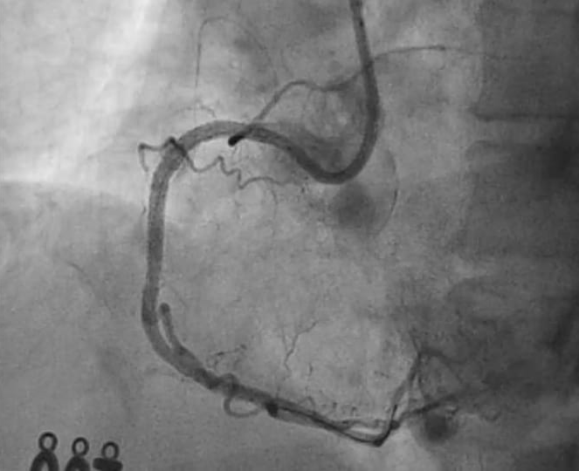
Intervention Outcomes
Post stenting OCT showed well apposed stent, no evidence of malapposition or edge dissection with Minimum Lumen Area (MLA) of 7.37 mm2 with diameter of 3.06 mm at distal part of stent and 3.69 mm diameter at proximal part of stent with excellent end result (Figures 10 & 11).
10
11

Slide 10
Conclusion
Use of ROTA-SHOCKWAVE/ROTA-LITHOTRIPSY showed excellent outcome.
Rotational atherectomy allows the treatment of intimal calcium and permits to cross balloons/stents through severe lesions however, it may not be enough to achieve adequate expansion of these devices if circumferential deep calcium plaques exist.
IVL poses a revolutionary tool to treat deep calcium and undilatable plaques.
Rotablation + Lithotripsy
ROTATRIPSY
Novel percutaneous treatment of severely de novo calcified lesions.

