Slide 1
First Report of Transfemoral JenaValve Implantation for Severe Aortic Regurgitation in a Patient with a HeartMate II LVAD

Slide 2
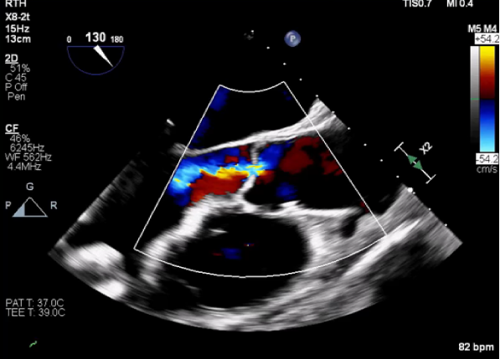
Clinical Presentation
A 80 year old male with ischemic cardiomyopathy s/p HeartMate II (10/2017) presented with worsening aortic regurgitation (AR), hemolysis, and increased power spikes.
TEE demonstrated a regurgitant volume of 59ml. AR was noted throughout the cardiac cycle in the setting of the LVAD.
CTA Chest showed no evidence of thrombosis in the outflow graft. It was hard to differentiate if pump thrombosis or AR caused the clinical syndrome and the working diagnosis was that both processes existed. The patient was scheduled for TAVR followed by subcostal pump exchange.
Given the pure AR without leaflet calcification and risk for ventricular embolization, compassionate use TAVR with a JenaValve device was considered.

Slide 3
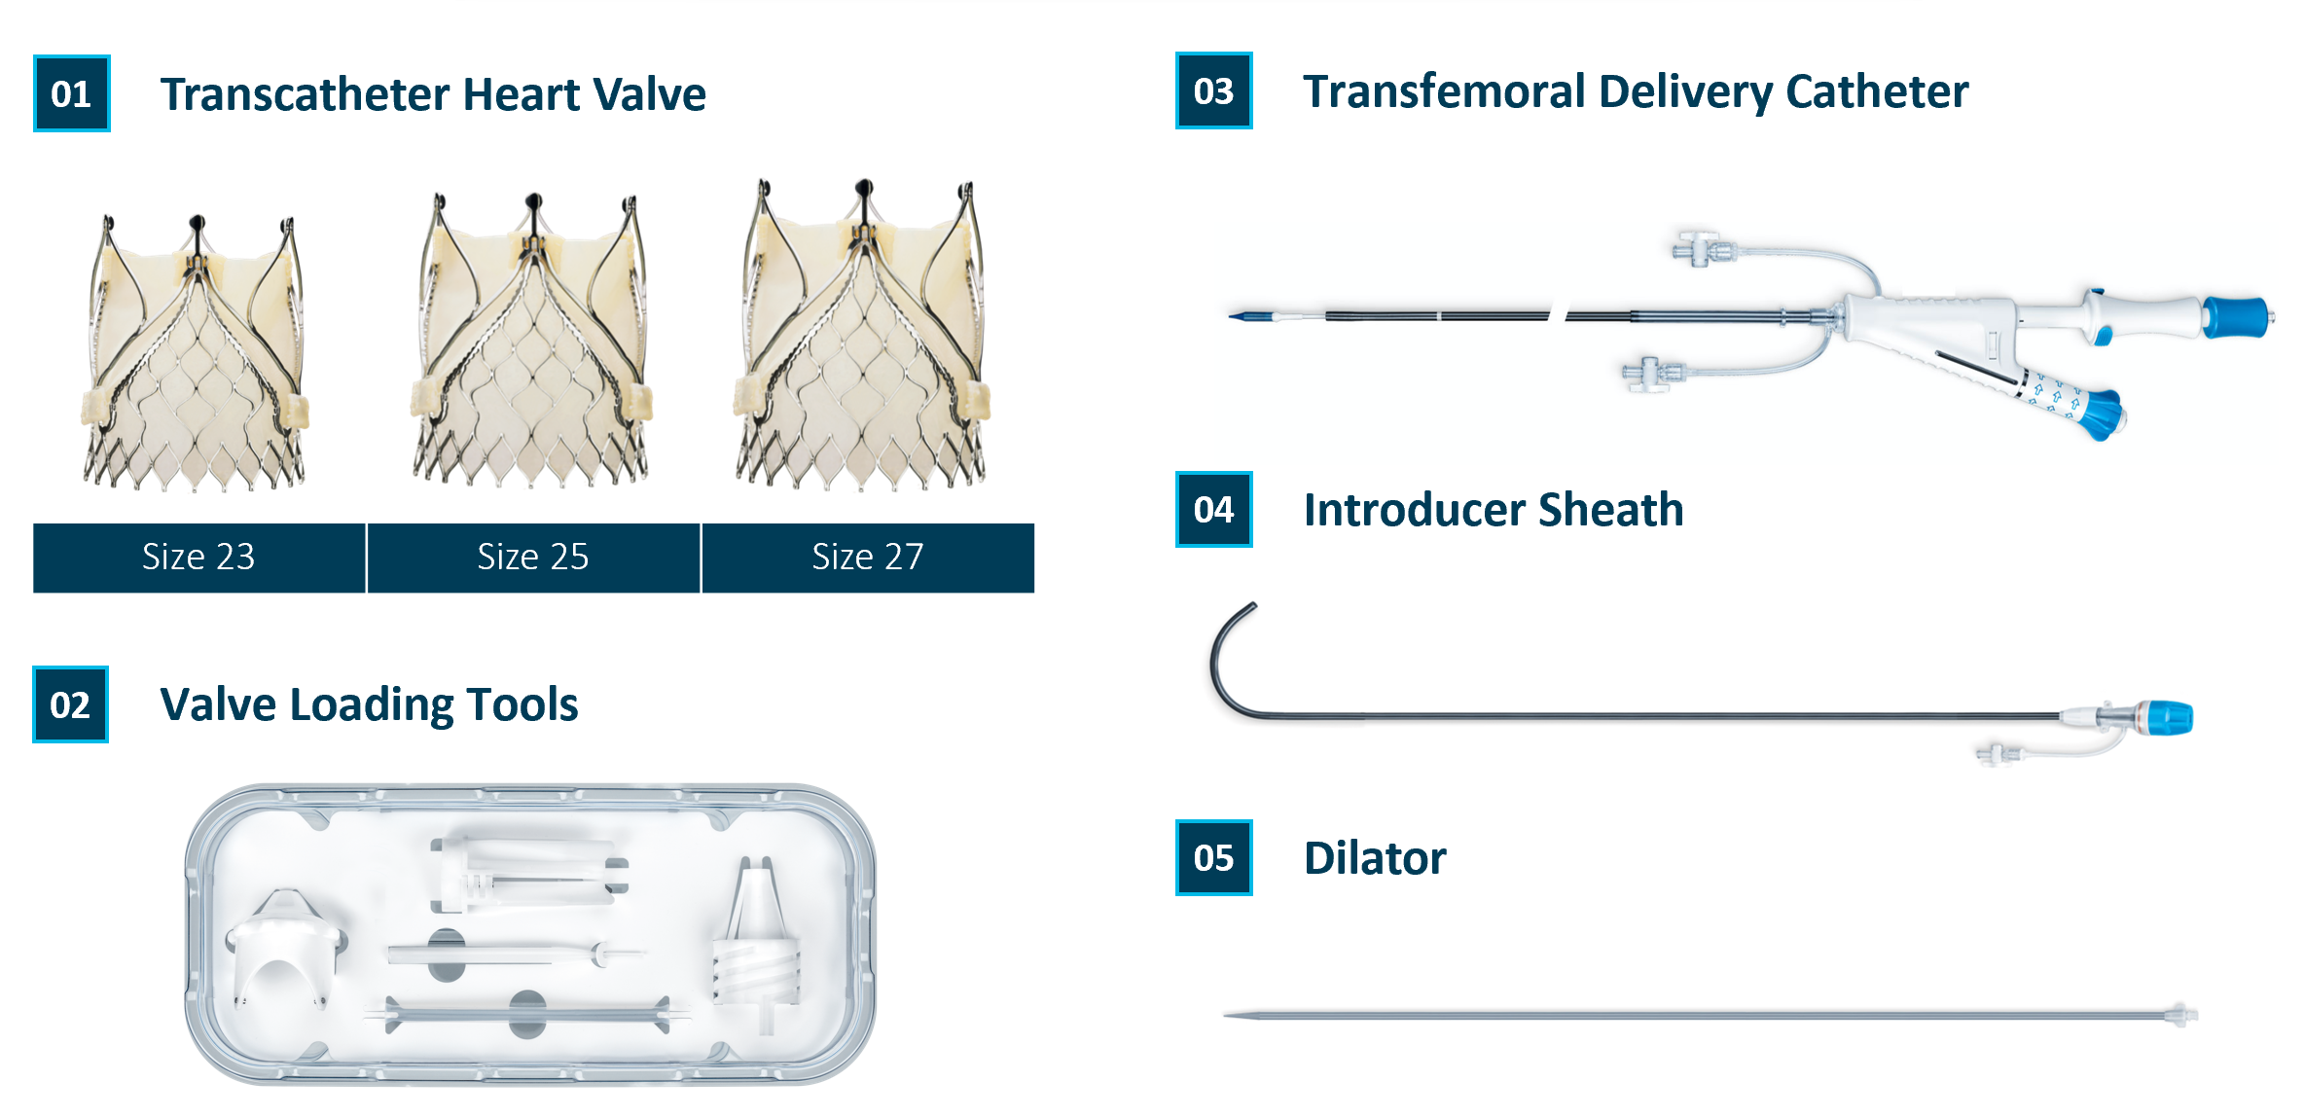
JenaValve

Slide 4
JenaValve – Implantation Steps
Locator Alignment
Valve Seated in Cusps
Valve Fully Deployed

Slide 5
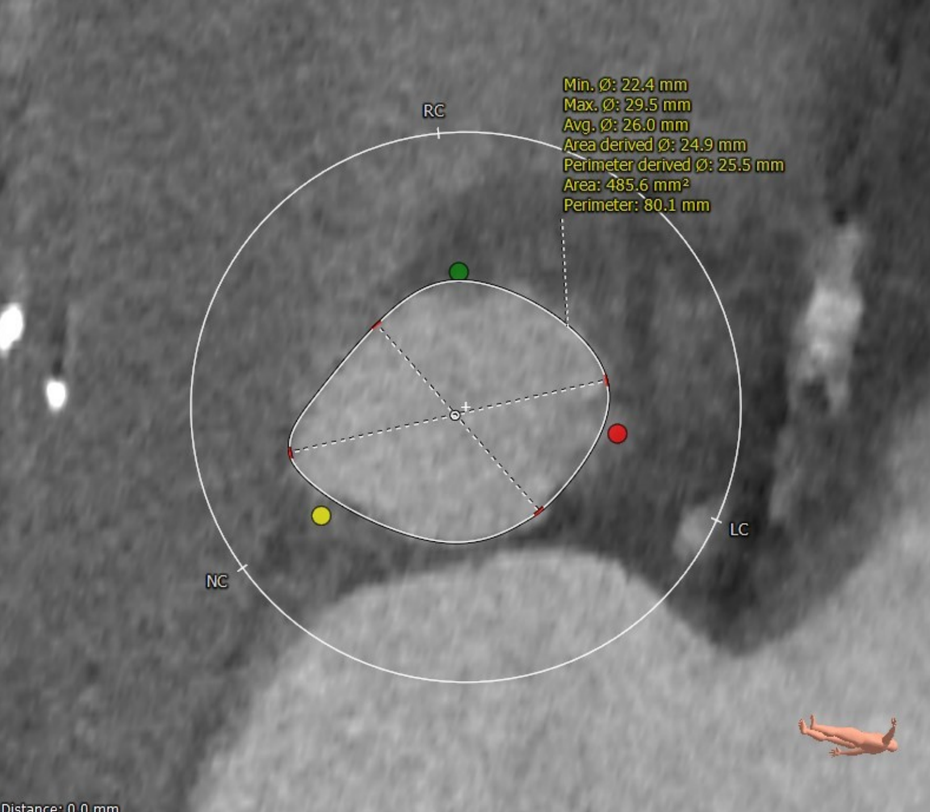
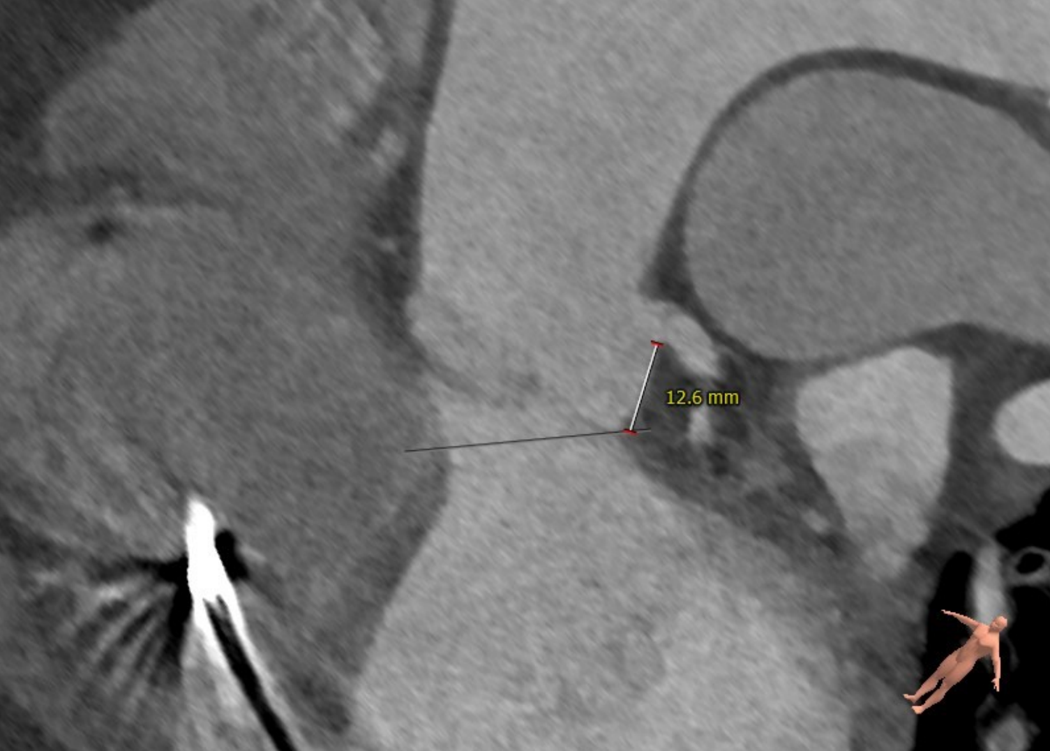
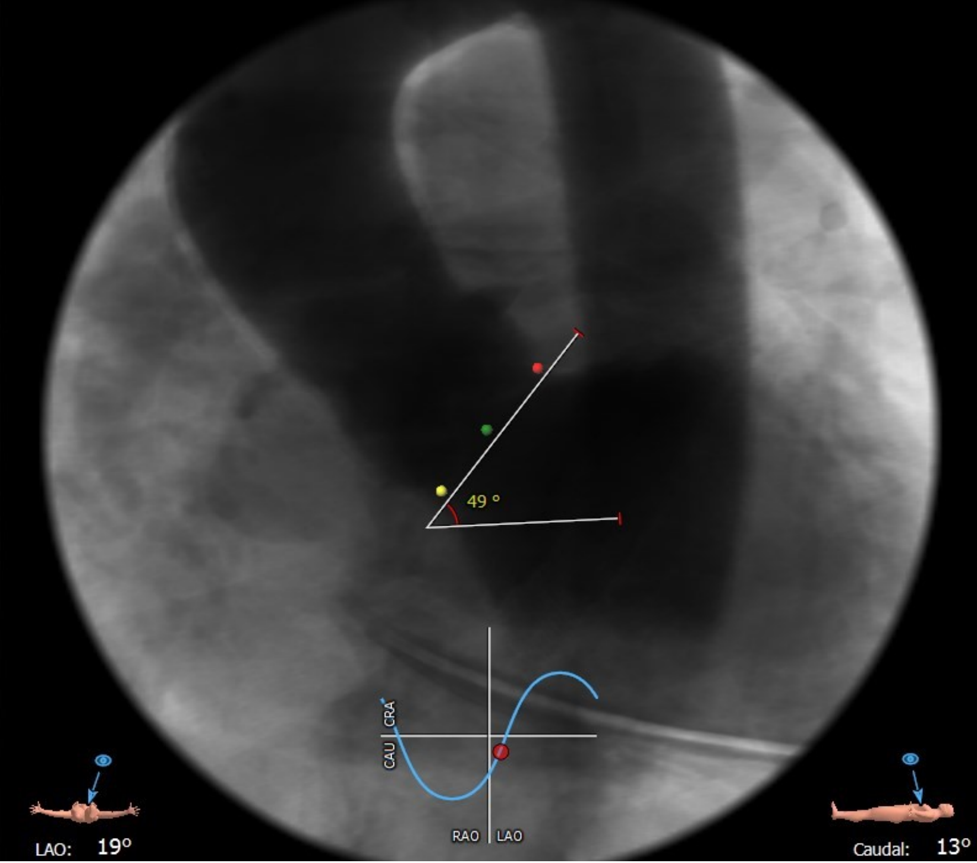
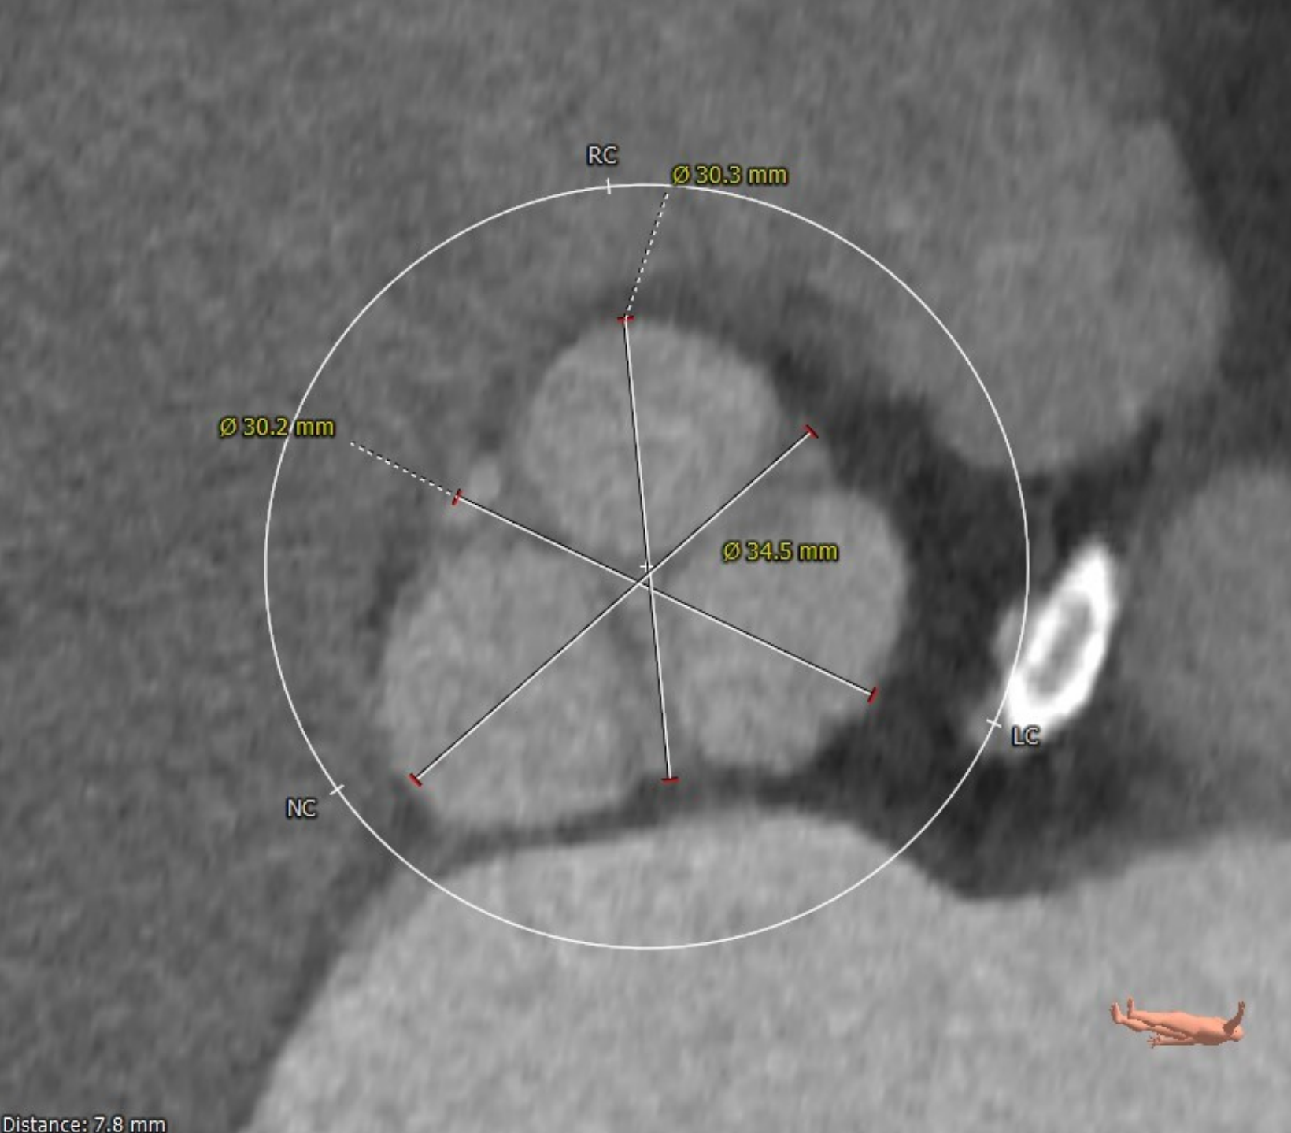
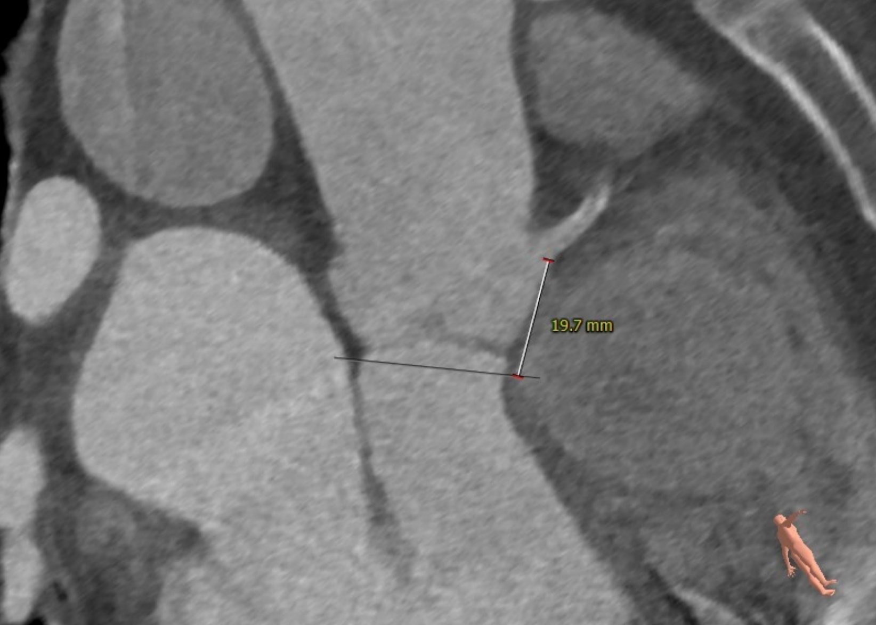
Preprocedural Planning
Aortic Annulus – Area 485mm² Permitter 80.1mm
Left Main Height – 12.6mm
Aortic Angulation and Coplanar View
Sinus of Valsalva
30.3mmx30.2mmx34.5mm
RCA Height -19.7mm

Slide 6
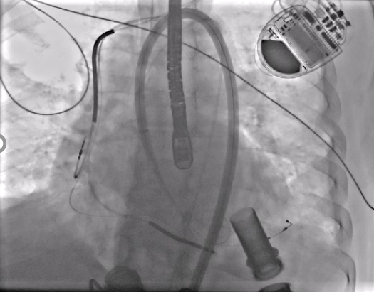
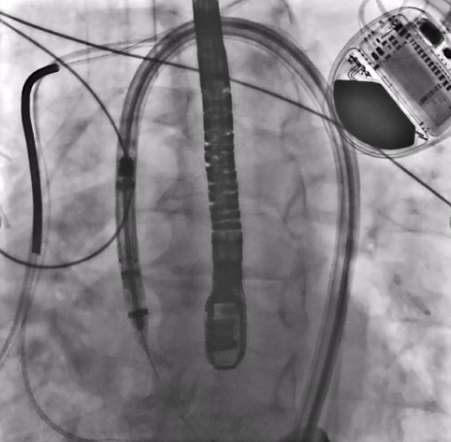
The 18Fr introducer sheath system was advanced to the level of the sinotubular junction, followed by advancement of the delivery catheter to align the sealing ring marker band with the sheath marker band

Slide 7
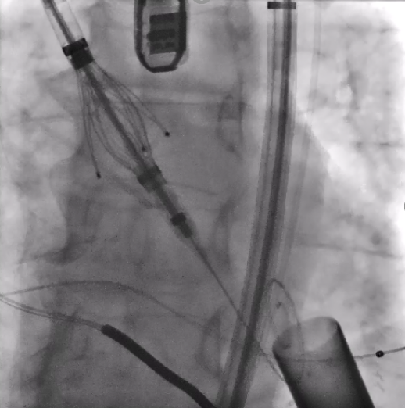
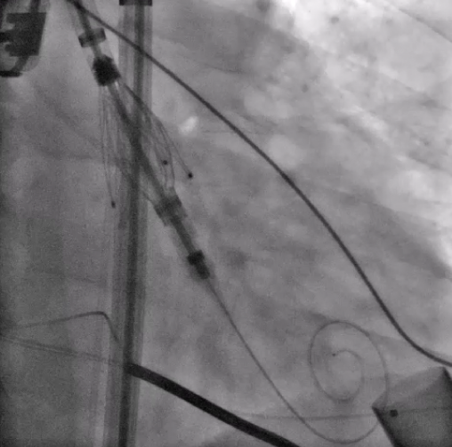
The sheath was retracted into the descending aorta exposing the valve. The catheter was deflected to allow coaxial alignment. A C-arm sweep was performed to ensure the locators aligned with the native cusp.

Slide 8
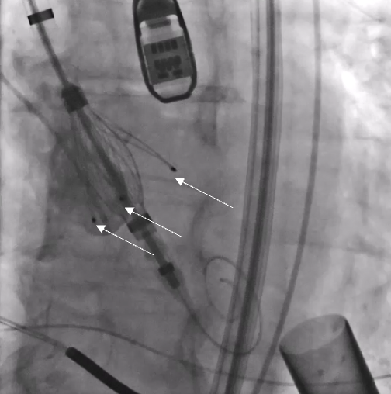
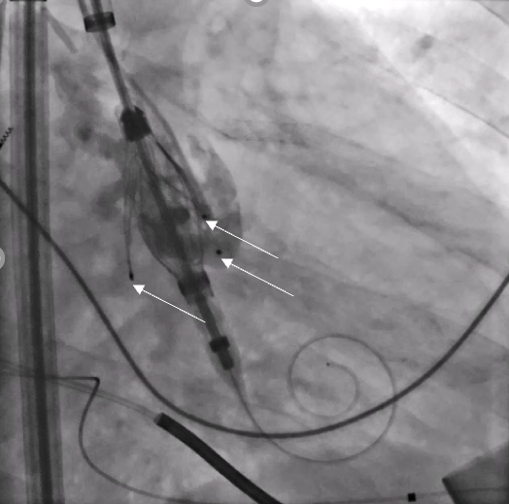
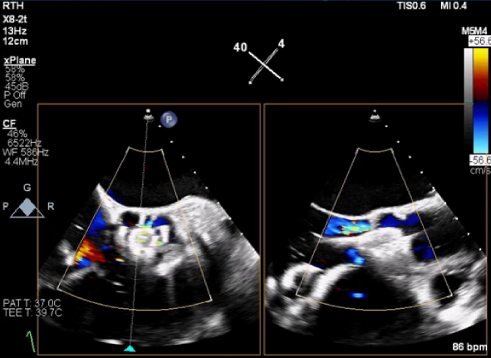
Locator alignment (arrows) was confirmed on TEE and aortogram
Notes:
Review TEE

Slide 9
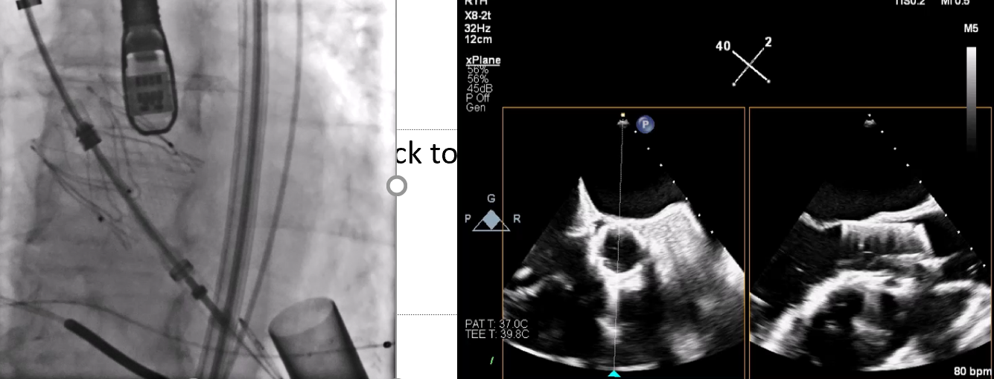
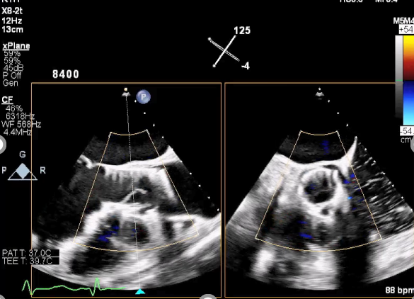
The valve was subsequently deployed and the delivery system removed. TEE revealed trace AR

Slide 10
Conclusions and Learning Points
AR is an increasingly common complication of LVAD support with severe AR associated with device dysfunction, increased hospitalization, and mortality.
TAVR with commercially available self expanding and balloon expandable valves have been limited to brief case series. These reports have highlighted the challenges with device anchoring leading to device migration due to the lack of calcium to anchor the valve as well as the forces of the AR jet and suction from the LVAD.
The JenaValve may be uniquely suited to reduce the risk of device migration as the locators prevent ventricular embolization and allow for anchoring of the valve to the native leaflets.

