Slide 1
Designing and Implementing a Cardiology Compensation Plan

Slide 2
Citation
This slide set was adapted from the ACC 2019 Health Policy Statement on Cardiologist Compensation and Opportunity Equity (Journal of the American College of Cardiology).
The Statement was published ahead of print on September 16, 2019, and is available at: http://www.onlinejacc.org/content/early/2019/09/12/j.jacc.2019.07.040
The published document is also available at: ACC.org/Guidelines

Slide 3
Special Thanks To
Slide Set Authors
Cathleen Biga, RN, MSN, FACC and Pamela S. Douglas, MD, MACC
2019 ACC Health Policy Statement on
Cardiologist Compensation and Opportunity Equity Writing Committee
Pamela S. Douglas, MD, MACC, Chair
Cathleen Biga, RN, MSN, FACC
Kristin M. Burns, MD, FACC
Richard A. Chazal, MD, MACC
Michael S. Cuffe, MD, MBA, FACC
James M. Daniel, Jr, JD, MBA
Catherine Garzio, MBA
Robert A. Harrington, MD, MACC
Hena N. Patel, MD
Mary Norine Walsh, MD, MACC
Michael J. Wolk, MD, MACC

Slide 4
Disclaimer
This slide set/presentation is provided for informational purposes only and does not provide legal advice; please consult with your own counsel for legal guidance on compliance with applicable laws and regulations. This slide set/presentation is not intended to be used for, and does not encourage any coordination, between competitors with respect to compensation practices. To comply with the antitrust laws, competitors should not discuss or agree on the salaries or other compensation.

Slide 5
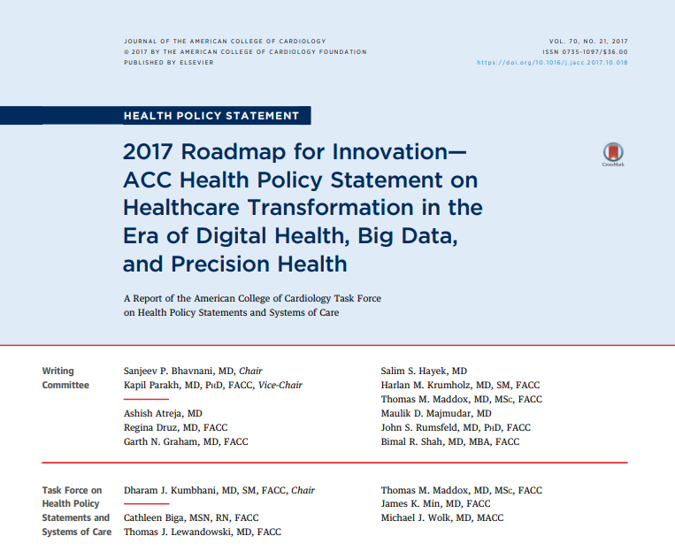
2019 Cardiologist Compensation and Opportunity Equity
PLACEHOLDER

Slide 6

Agenda
Setting the Stage: Definitions, etc.
Dissecting One Sample Plan
Compensation Trends
Regulatory Concerns
Hot Topics

Slide 7
Essential Design Elements
Fair, Equitable and Sustainable
Predictability, stability for physicians
Conducive to alignment with hospital/medical school
Relevant locally and benchmarked nationally
Ensures compensation and opportunity equity
Compensation model is not a distribution plan
Compensation evaluated and set annually
Plan reviewed periodically for validity, currency and opportunities to improve/refine

Slide 8
Key Compensation Model Design Questions
What do you value?
Sub-specialization, market dynamics, call/part-time, burnout
What do you want to incentivize?
How will you measure and reward?
Pooled compensation or individual?
How will you ensure compensation equity?
What will components of compensation be?
Base, call, productivity, quality, strategic, citizenship, operational efficiencies, research, teaching, etc.
How do you balance FFS/productivity with value?
Notes:
I don’t believe we will ever be 100% or even 60% value. Will always have some FFS underlying what we do. I think mistake to shift all to value because then we end up like we did in early ‘90’s w/ MD’s not working hard.

Slide 9

At Every Step of the Way …
How does the incentive plan align strategically?
Consider MDs as ‘business partners’
How does the plan align with the physicians’ philosophy and culture around compensation and work?
How does your hospital’s/school’s mission and particular view on legal and compensation risk square?
Is it accountable, transparent and manageable?
(Therefore) What are we trying to achieve?

Slide 10

Definitions: Compensation Has Both Cash and Non-Cash Components
Non-Cash: Insurance, Retirement, etc.
Cash can include (but not limited to):
Base: show up for work
Minimum threshold (# of clinics, min. panel size, Grand Rounds, etc.)
Call
May become more or less onerous in this new value world
See MIPS CPI for patient access
Non-billable work: administration, teaching, research
Will increase in the value world
MUST pay for intellectual property and non wRVU (care coordination)
Incentives
Value, productivity, etc.
Individual, group, pod/subspecialty, etc.
Notes:
Call may get better w/ fewer people in hospital. May get worse with more demand on being responsive off hours. More admin time as physicians will need to lead Value movement. More involvement in ACO, coordination of care, crossing service lines, development and monitoring of disease care pathways. Value incentives will be based on what items we choose to incent and meeting goals.

Slide 11
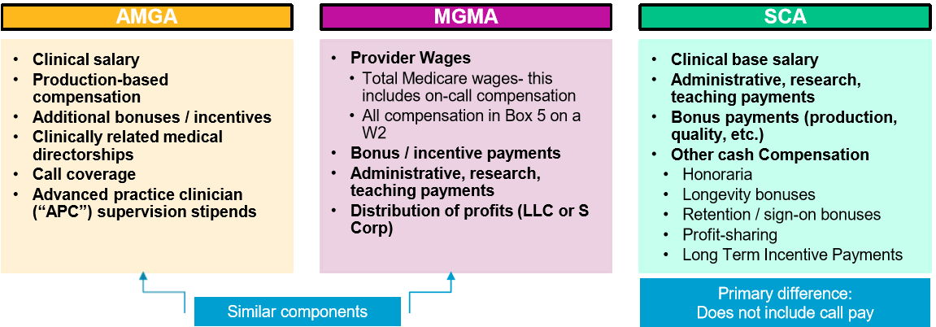
Environmental Scan: Salary Components
American Medical Group Association (“AMGA”)
Medical Group Compensation and Productivity Survey
Medical Group Management Association (“MGMA”)
Provider Compensation and Production Survey
Sullivan, Cotter and Associates (“SCA”)
Physician Compensation and Productivity Survey Report

Slide 12
One View: ‘Perfect’ Compensation Model
Base salary
80% of prior yr wRVU x 50th percentile comp per wRVU (AMGA, MGMA, SCA weighted average)
Withhold 7.5% for quality incentive “earn-back” (further information below)
Production incentive
Per wRVU payout set at 50th percentile rate (as above)
Withhold 7.5% for quality incentive “earn-back” (further information below)
wRVU threshold established by the base salary (less withhold) ÷payout rate (less withhold)
Quality/performance incentive
15% of total clinical cash compensation at-risk
7.5% withheld from base and bonus (full earn-back positions the payout rate at median)
7.5% opportunity (full earn positions the payout rate 7.5% above the median)
Reconciliation at year end, after both incentive calculations completed
Administrative, APC supervision, excess call coverage, etc. paid in addition to market rates
Adjustments made to payout rate for physicians opting out of otherwise required
call coverage
Used with permission from Eric Lebida, Willis Towers Watson.

Slide 13
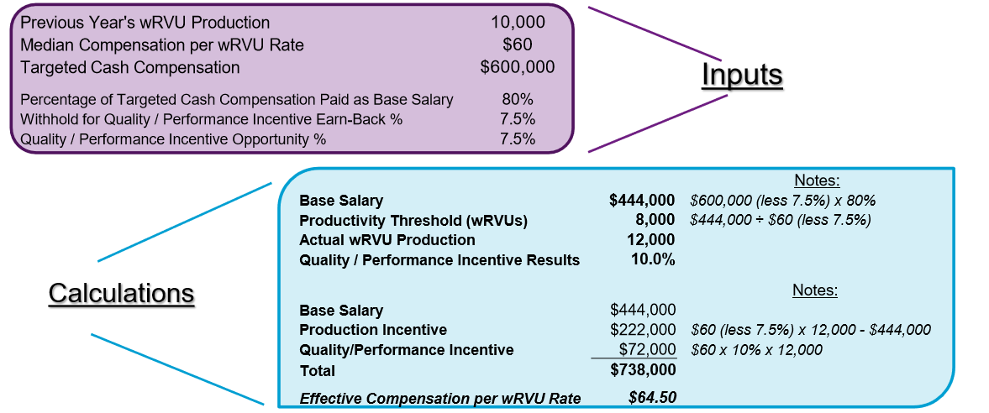
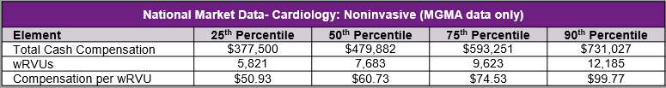
‘Perfect’ Model Example: NI Cardiologist
Used with permission from Eric Lebida, Willis Towers Watson.

Slide 14
‘Perfect’ Physician Model: Pros and Cons
Pros:
Cons:
Can be administratively burdensome to track and provide accurate calculations
Payout rates and quality/performance incentive goals and weightings will vary by specialty and must be updated annually - time consuming
>25% of their cash compensation paid at yr end
Decisions regarding asking for paybacks or adjusting future earnings for underperforming physicians
May generate cash compensation that does not align with local markets and be unnecessarily costly to the organization or produce recruitment challenges
Must be modified to fairly pay MDs with limited ability to influence the number of patients they see
May not be market competitive for complex procedures which are not accurately represented by wRVUs
May be challenging for subspecialties
with limited market data
May incent APC competition for
patients and wRVUs
Simple and transparent - physicians can project/calculate their compensation
Tied to market
Aligned with current fee-for-service reimbursement environment (i.e., large production component based on wRVUs)
Includes a variable quality/performance incentive component that can adapt and incentivize measures that align the goals of physicians and the organization-move with value-based progress
Generates compensation that will be consistent with fair market value and commercially reasonable
Used with permission from Eric Lebida, Willis Towers Watson.

Slide 15
Physician Compensation Trends: Quality/Performance-Based Compensation – Best Practices
Incentives should be carefully considered to align with the organization’s goals, be easily linked back to the mission and fit the physician compensation philosophy
Incentives need to include goals that are:
Meaningful – Results must incentivize the physicians
Measurable – Objective assessment is necessary
Actionable – MDs have adequate and appropriate control of outcomes
Limit the number of metrics to 3-5 to ensure manageability and transparency
Update annually to encourage continuous improvement
Physicians should always have a significant role when determining goals
Communication around the incentive should be abundant and transparent
Trial period for new incentive or major changes (~1y) to optimize measuring and reporting
Assess results holistically – “are we in a better or worse spot after implementing”
“Do it right the first time” or stakeholders will lose interest
Used with permission from Eric Lebida, Willis Towers Watson.

Slide 16
Physician Compensation Trends: Quality/Performance-Based Compensation – Market Data
Use of quality/performance incentive compensation increasing
SCA: quality/performance measures used by 54% of organizations
31% anticipate modifying the balance of productivity / quality/performance pay in the next year
Quality/performance incentives are 10-20% of clinical cash compensation (i.e., base salary plus production incentive)
The % increases with plan duration
The median percentage of total cash compensation of quality incentive payments was 5.6% and the median actual payment amount was $18,691
Source: SCA, 2018 Physician Compensation and Productivity Report
Used with permission from Eric Lebida, Willis Towers Watson.

Slide 17
Physician Compensation Trends: Quality/Performance-Based Compensation – Pitfalls
Common mistakes in designing and implementing quality/performance incentives:
Physicians not included in the design process
Incentives are too complex – “swinging for the fences on the first at-bat”
Setting expectations too high with regard to short-term results
Outcomes assessed too narrowly
Not understanding organizational capabilities and resource requirements
Systems not in place to measure and track performance
Poor communication throughout design and implementation
Used with permission from Eric Lebida, Willis Towers Watson.

Slide 18
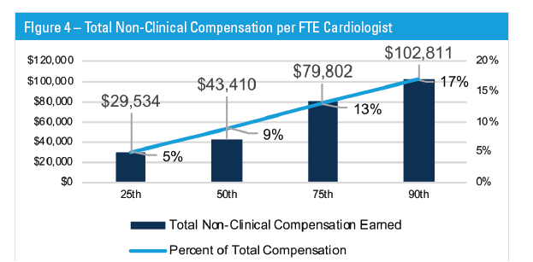
How Big Are Incentive Payments?
Survey
A. -0-
<5%
5-10%
10-15%
>15%
Includes all non-clinical compensation including call pay, directors pay, incentive or metrics pay, etc.
Source: MedAxiom 2017 Physician Compensation Survey

Slide 19
Incentive Goals Must Be Measurable
Quality
Registry improvements, MIPPS, Payer based quality program, Compliance with particular protocol, Second opinion prior to intervention, improvement in CV related system initiative
Operations
Same day discharge goals, Radial improvement, Coding related goals, Timeliness related goals (ancillary testing, start time, medical records completion).
Financial
Cost improvement per case, Successful participation in coding and clinical documentation initiative, Adherence to “on contract” goals, bundle target
Growth
Implementing new program, APP program adoption, access goals, growth of unique patients or patient panel.

Slide 20
Example: Incentive Goals/Metrics
 | YES! Initiative
Desc: | The objective of “Yes! To Excellent Service” is to grow the service line via providing patient access.
Funding: | 5% withhold from Comp Pool
Measure | Increase total number of unique patients by 5%
Measure | At the practice pod level
Source of Truth | EMR
Baseline | Measured as of 1/1/2019; monthly reports – goal attainment measured on 12/31/2019
Distribution | Equal split, prorated for < 1.0 fte
Sample tactics:
Post hospitalization pts seen w/in 5 days of d/c
New patients seen within 5 days of referral
Add APP for clinic f/u

Slide 21
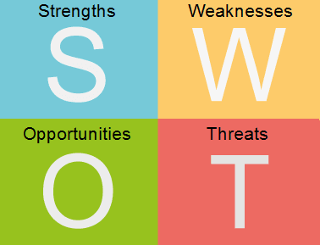
Compensation Model Design
Proposed Multi-Variable Compensation Plan Considerations
We understand that there is a high-level compensation model framework currently in the discussion phase. The plan’s primary goals are maintaining affordability for the organization and paying physicians competitively and fairly while incorporating considerations for individual physician's and physician group’s unique facts and circumstances regarding:
Practice location
Overhead expenses and staffing
Payer mix
Based on the information provided at this phase, we have performed a preliminary SWOT analysis, which is illustrated on the following slide.
Used with permission from Eric Lebida, Willis Towers Watson.

Slide 22
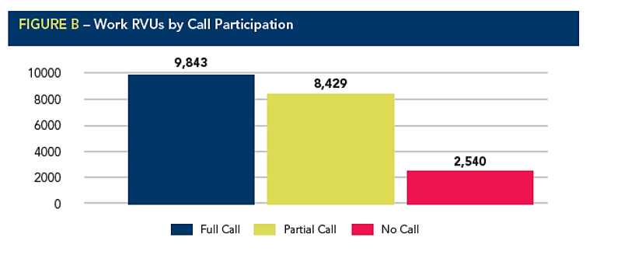
Flexible Careers: On Call, Wind Down, Part Time
Identify and value key call elements
EP call; Interventional; General/Imaging; Call in when not on call
Prospectively define which flexible options will be available
No call, Call wind-down, Part time, Retirement, Disability
Eligibility: age, tenure, eligible pool, etc.
Associated benefits and privileges (insurance, voting rights)
Prospectively define compensation for these options
Establish decision making and notification process
Trusted agent
MedAxiom 2016 survey

Slide 23
Transitioning: Balancing FFS and Value
Value >> productivity BUT FFS will not go away (entirely)
9% Penalty still means that 91% FFS (potentially)
In future, focus will have to be on Value to compete
Closed networks, bundles, national competition, etc.
Transitioning is a long-term process
Employer / System may not realize return on Value proposition in near term
Can’t change on a dime
Need to migrate to Value with incremental changes
Start before you need to
Add value component tied to meaningful longer-term quality / process goal

Slide 24

wRVU vs. TVU
wRVU
TVU
Uniform, defined by CMS
Not necessarily reflection of work or time spent
Rigid, doesn’t incent goals
Developed by complex survey mechanism
Universally considered unequal across sub-specialties
Customized to practice
Easy to define and modify
Reflects time spent
Customize to incentivize activity
Common denominator (minutes)
Can equalize across sub-specialties

Slide 25
Time Value Units: One Approach
Each CPT code has a TVU value
Based on time motion studies
Informal national comparisons
Used for clinical and non-clinical work
TVU value based on
Time to perform work or other activity
Incent what we decide is best to incent
Separate work as an integral part of larger procedure
Each TVU = one minute
On Average 10 TVU’s per wRVU

Slide 26
Sample Non-Clinical and Clinical TVU’s

Slide 27
Plan Assumptions
Base = $200,000 (Threshold 7,000 wRVU)
Call = $161,000 (33% total compensation)
Productivity Compensation = ___% of total Comp.
We measure in TVU’s
Productivity Threshold = 90% MGMA Median
Productivity Tiers
< 15% = 2 points
15% - 30% = 4 points
30% - 45% = 5 points
> 45% = 6 points

Slide 28
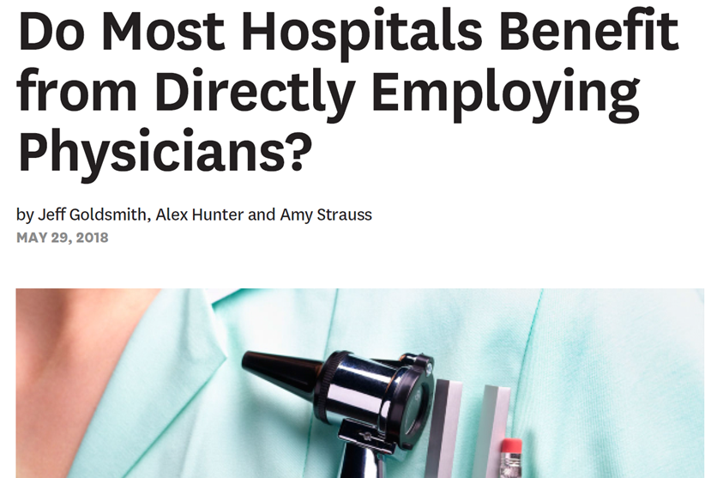
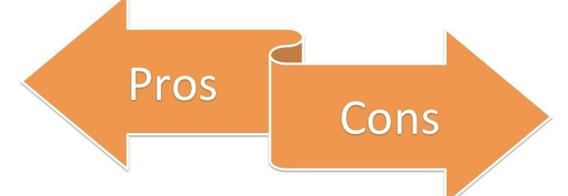
Salary Model - Pros & Cons
Pros
Internal equity
Fosters team-based case
Promotes “value” non-RVU work
Cons
TCC/RVU delta or TCC > RVU for group
Base salary drifts down

Slide 29

What is Talent Management and How is it Different From HR?
Designing and implementing a new compensation model is not easy
Recognize the significant change in performance required and the need to proactively manage this change
Invest in development of individual talent
Opportunity equity: mentorship, succession planning
Retaining is as important as recruiting
Use annual evaluations as a tool to guide and enhance multidimensional performance

Slide 30
Regulatory Framework: Federal Physician Self-Referral (Stark) Law
Prohibits physicians from making certain referrals (including referrals for inpatient and outpatient services) to entities, such as a hospital, with which they (or an immediate family member) have a financial relationship, unless the relationship meets a Stark exception.
Whether a party has the intent to violate Stark is immaterial.
Any financial relationship between a hospital and physician must be structured to meet one of the exceptions, or the arrangement will violate Stark.
Compliance generally requires that physician/hospital arrangements be both fair market value and commercially reasonable.

Slide 31
Regulatory Framework: Federal Anti-Kickback Statute (AKS)
AKS prohibits any remuneration, in cash or in kind, overt or covert, paid or received with the intent to induce referrals that are paid for by a federal health care program.
Government’s consistent position regarding intent is that if any one purpose of an arrangement is to induce referrals, the entire arrangement violates the AKS.
Due to the broad nature of the AKS, safe harbors have been established to immunize certain arrangements from government scrutiny, regardless of intent, provided the arrangement fully meets the requirements of one of the safe harbors.
Failure to meet a safe harbor does not mean that the arrangement has violated AKS; rather, it simply means that the government must prove the requisite intent to violate the statute.
Compliance requires that physician/hospital arrangements be both fair market value and commercially reasonable.

Slide 32
Physician Compensation – Hot Topics 1
Are integrated group or pool-based compensation models still possible?
Yes, but they need to be carefully structured
Recent case law (Halifax, Tuomey) highlight concerns
Structure depends on employment model
Stark law – Employment Exceptions
Prohibits compensation that takes into account the volume or value of “referrals” of DHS
Certain professional services are DHS, but personally performed services are not “referrals”
What if a physician’s share of the pool consists of more than his/her personal productivity? Need to exclude any DHS referrals
Stark law – Group Practice Model
Permits the sharing of the group’s DHS profits as long as the share is not directly related to the volume or value of referrals (for example, per capita or proportionate wRVU production)
What if a physician’s share of the pool consists of more than his/her personal productivity? Need to segregate any DHS referrals and divide the compensation in a manner that is not directly related to referrals.

Slide 33
Physician Compensation – Hot Topics 2
Can physicians be paid for midlevel work?
Yes, but the arrangement needs to be carefully structured
Recent case law highlight concerns, including concerns with commercial reasonableness
Supervision stipends
wRVU credit – structure depends on employment model
Stark law – Employment Exception
Prohibits compensation that takes into account the volume or value of “referrals” of DHS
If midlevel work is not DHS, then it can be paid to the physicians
What if midlevel work is DHS? Need to exclude from physician compensation
Stark law – Group Practice Model
Permits direct credit to a physician for services rendered “incident to” the physician’s personally performed services and billed by group
What if a physician is compensated for midlevel work that is billed by the group under the midlevel’s provider number? If not DHS, then can be paid in the same manner as any other professional service. If DHS, then need to segregate any DHS and divide the compensation in a manner that is not directly related to referrals (for example, per capita or proportionate wRVU production)
Commercial Reasonableness
Facts might dictate that some, or all, of the cost of the midlevel be charged to the physician
Promotes Team Based Care? .

Slide 34
Physician Compensation – Hot Topics 3
Can low producers still be part of an “Equal Split” compensation plan?
The concern is that the effective wRVU/payment rate for low producers in an equal split model may be too high when compared to benchmark data.
The valuation review is key and may consider a number of items, including:
Total compensation of the physician
Inverse relationship between wRVU production and wRVU conversion rates
Other work that the physician might perform for the group, including low wRVU generating work, new program development, call, outreach, administrative work, etc.
Stage of physician’s practice

Slide 35
Physician Compensation - Hot Topics 4
Should high producers (75th-90th percentile) be paid a 75th-90th percentile wRVU Conversion Rate instead of 50th %?
wRVU production and wRVU conversion rates are inversely related
Each survey can uniquely support a different position
Refer to multiple surveys to support higher compensation levels.
Surveys with a higher “n” tend to be more reliable.

Slide 36
Physician Compensation - Hot Topics 5
Should ancillary/downstream revenue for the hospital be taken into account when determining physician compensation ?
Regulatory framework prohibits compensation that takes into account or varies with the volume or value of DHS referrals
Must follow Fair Market Value definition
Must follow Commercial Reasonableness definition

Slide 37
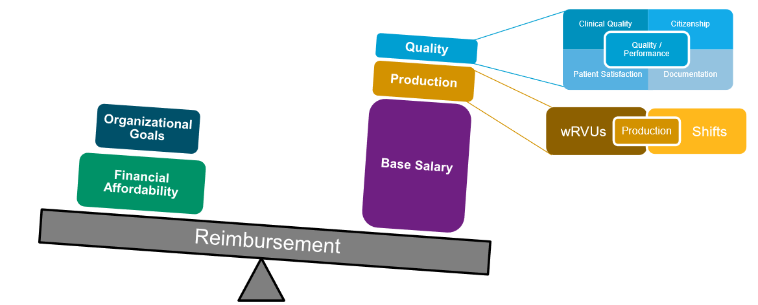
Evolving Compensation Model Design
The setting: evolving healthcare landscape influenced by shifting reimbursement
Best-fit compensation models will need to be updated or replaced
Each organization has a set of unique circumstances
Physician compensation models use similar core components
Not one-size-fits-all within an organization, or across different organizations.
Numerous considerations in designing the most optimal compensation model
Used with permission from Eric Lebida, Willis Towers Watson.

Slide 38

Want More Help?
For more tools and resources, visit:
ACC.org/Guidelines
ACC.org/about-acc/diversity-and-inclusion/features/2019/09/compensation-equity
https://www.aamc.org/initiatives/495432/understandingandaddressingfacultysalaryequity.html

Slide 39


Slide 40
Appendix: Definition of Cash Compensation
Cash Compensation
Base salary
Production-based compensation
Incentive/bonus compensation (quality/performance, shared savings, CIN, etc.)
Call pay
Administrative compensation
Other cash comp (e.g., pro-rata signing bonus, retention payments, and/or loan forgiveness
Excluded from Cash Compensation:
Fringe benefits (medical, dental, life, disability, etc.)
Paid time off
Payments to retirement plans
Expense reimbursements (CME, phone, etc.)
Moonlighting/outside income
Clinical Cash Compensation:
Base salary
Production-based compensation
Incentive/bonus compensation
Base call pay (“typical” rotation – by specialty)
Other cash compensation (e.g., pro-rata, signing bonus, retention payments, and/or loan forgiveness)
Total Cash Compensation:
Clinical cash compensation
Administrative compensation
Research/teaching compensation
Excess call payments (pay for call coverage in excess of a typical rotation - varies by specialty)
Moonlighting/outside income
Used with permission from Eric Lebida, Willis Towers Watson.

Slide 41
wRVU 2017

Slide 42
2017 Data

Slide 43
$/wRVU

Slide 44
Non-Clinical Revenue

Slide 45
Administrative Rates

Slide 46
Medical Director Rates

