Slide 1
The ACC Cardiovascular Imaging Section presents
2021 Guideline for the Evaluation and Diagnosis of Chest Pain:
Imaging and Stable Chest Pain

Slide 2
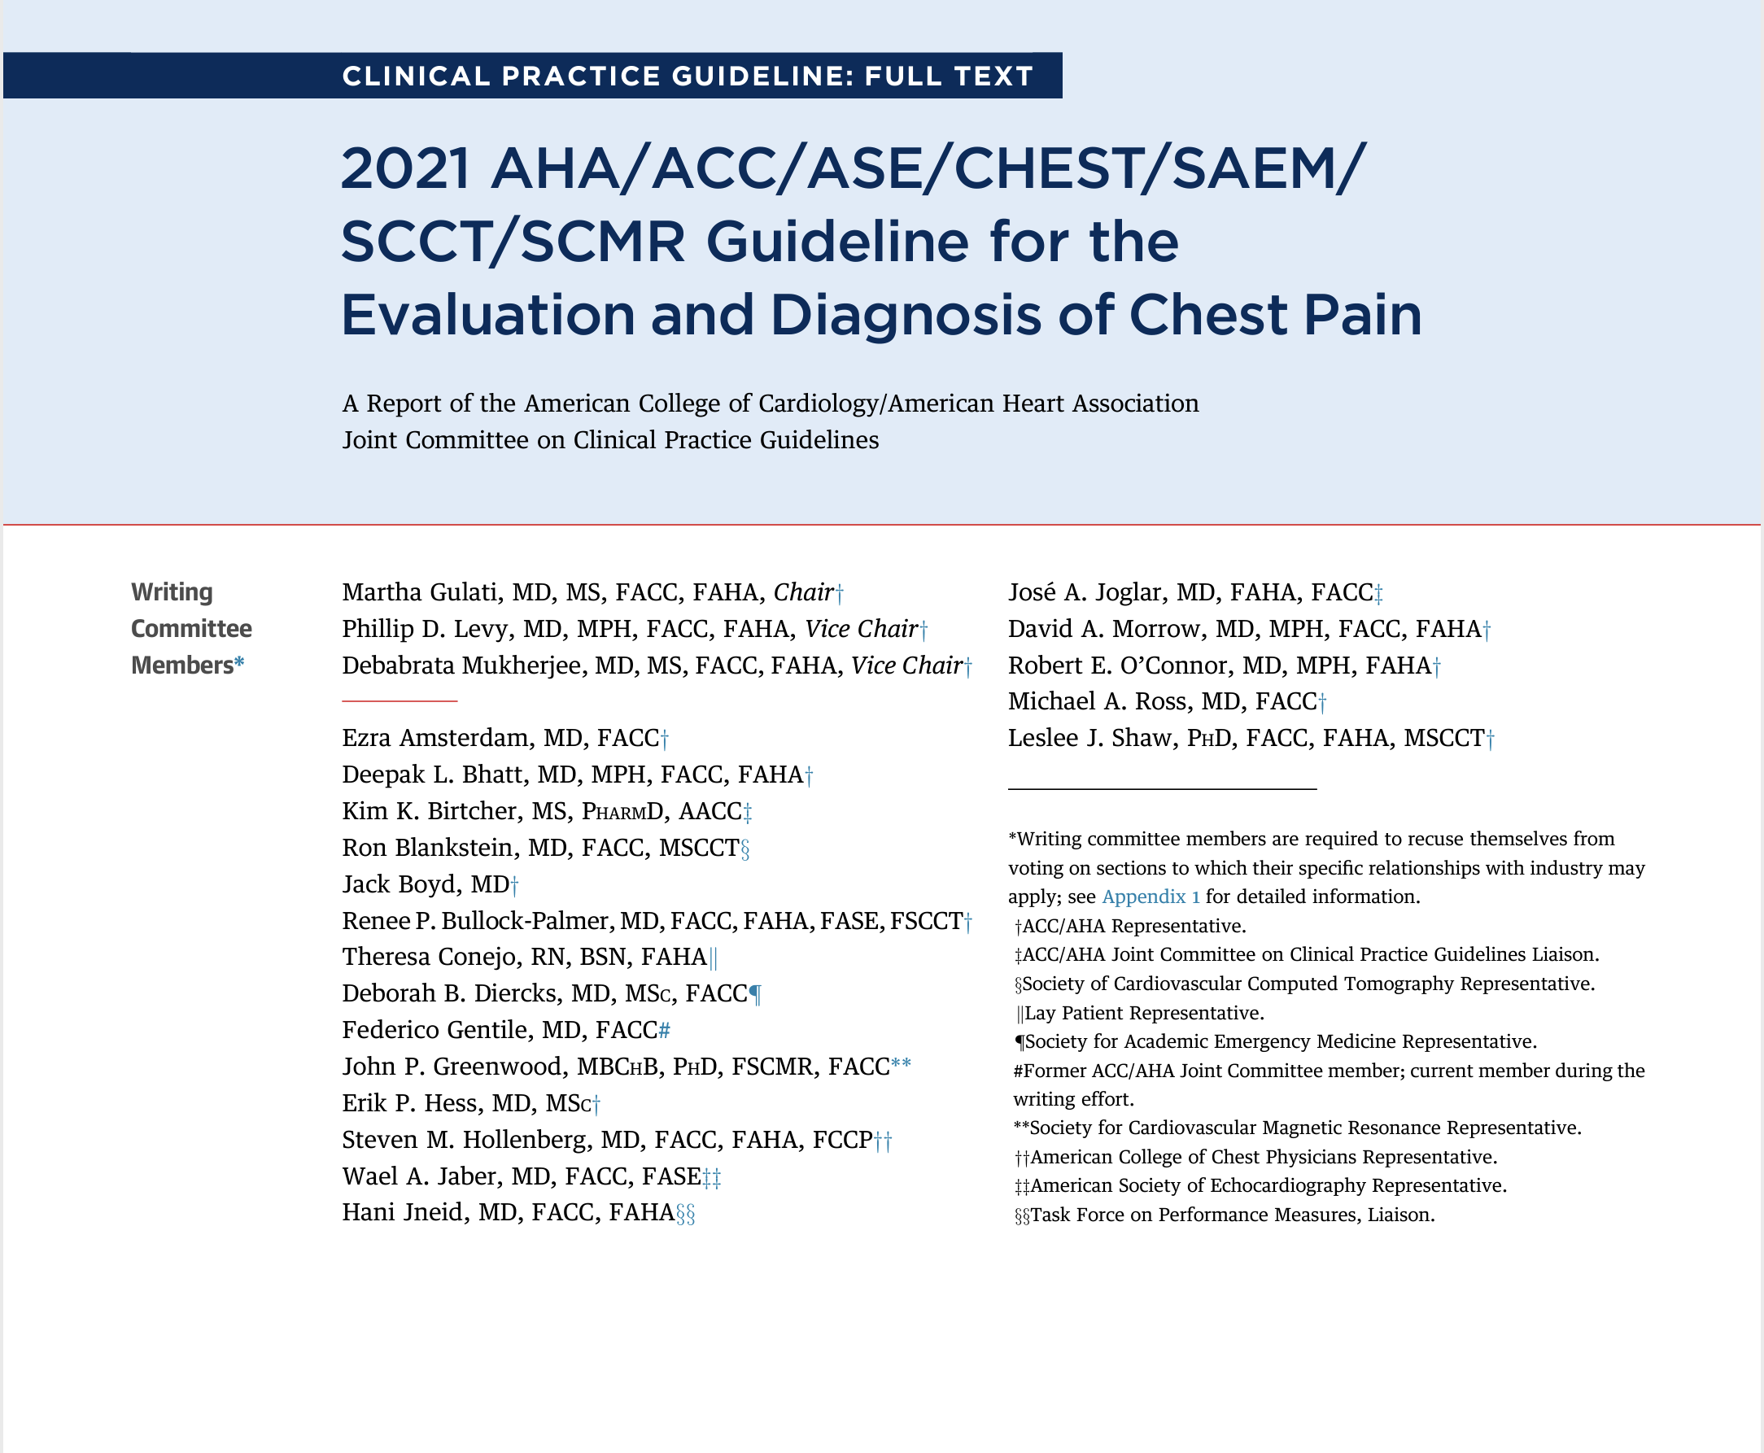

Slide 3



Slide 4
The ACC Cardiovascular Imaging Section presents 2021 Guideline for the Evaluation and Diagnosis of Chest Pain: Imaging and Stable Chest Pain
Overview of stable chest pain, including PTP of obstructive CAD Ron Blankstein, MD, FACC
Low Risk Patients – how to define? When to test? Leslee J. Shaw, PhD, FACC
No prior history of CAD - Selecting between functional imaging and CCTA Wael A. Jaber, MD, FACC
Prior CAD – Selecting between different testing option Amit R. Patel, MD, FACC
Insights on special populations Renee Bullock-Palmer, MBBS, FACC

Slide 5
Overview of stable chest pain, including PTP of obstructive CAD
Ron Blankstein, MD, FACC, FASNC, MSCCT, FASPC
Associate Director, Cardiovascular Imaging Program
Director, Cardiac Computed Tomography
Co-Director, Cardiovascular Imaging Training Program
Associate Physician, Preventive Cardiology
Cardiovascular Division & Department of Radiology
Brigham and Women’s Hospital
Professor of Medicine and Radiology, Harvard Medical School

Slide 6
Stable Chest Pain
symptoms are chronic and associated with consistent precipitants such as exertion or emotional stress
patients often report pressure, tightness, squeezing, heaviness, or burning. In this regard, a more appropriate term is “chest discomfort”
may also report a location other than the chest, including the shoulder, arm, neck, back, upper abdomen, or jaw
@RonBlankstein ACC Stable Chest Pain Webinar

Slide 7
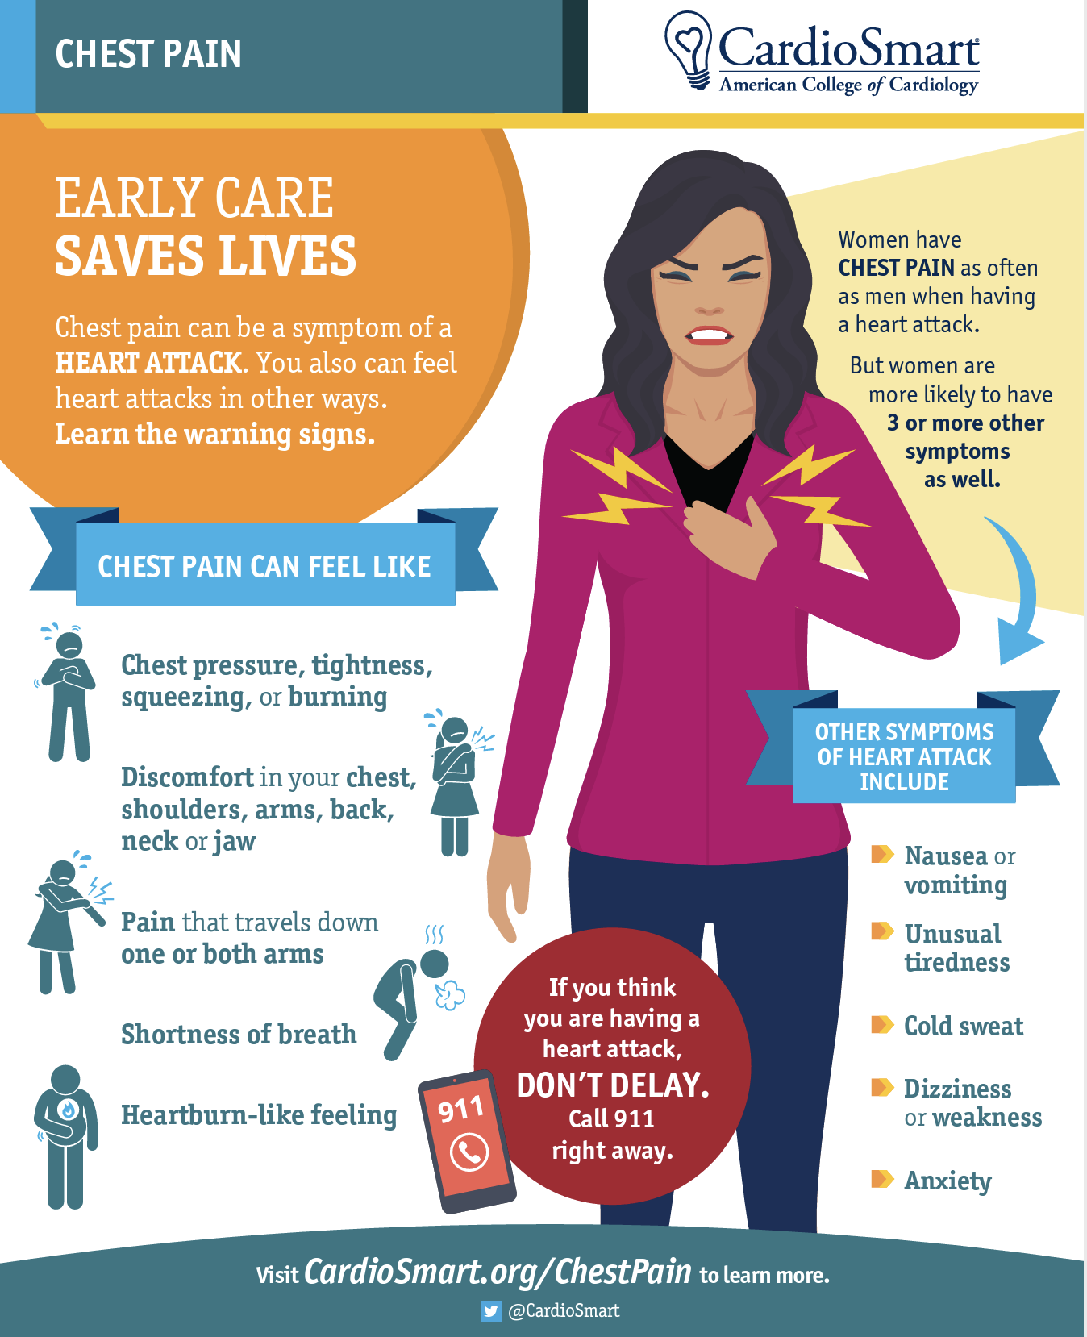
Stable Chest Pain
chest pain or chest discomfort remains the predominant symptom reported in men and women with myocardial ischemia.
@RonBlankstein ACC Stable Chest Pain Webinar

Slide 8
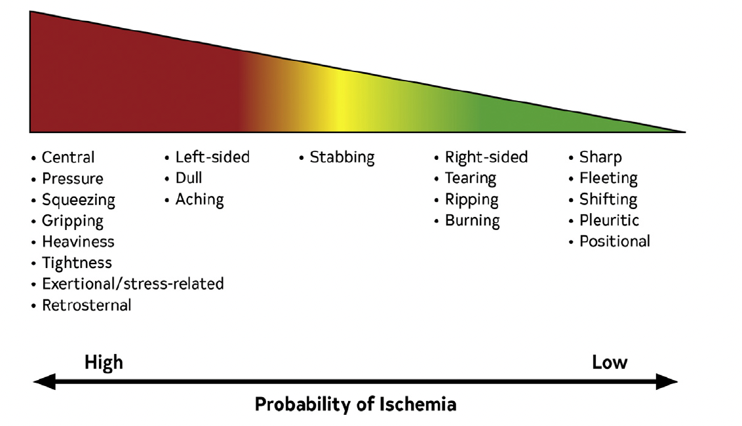
Atypical Is Out
#Cardiac #Possibly Cardiac #Non Cardiac
Gulati, M. et al. 2021 AHA/ACC/ASE/CHEST/SAEM/SCCT/SCMR Guideline for the Evaluation and Diagnosis of Chest Pain.
@RonBlankstein ACC Stable Chest Pain Webinar

Slide 9
Evaluation of Stable Chest Pain: A changing paradigm
Among patients undergoing a diagnostic evaluation, there is a relatively low prevalence of obstructive CAD and ischemia (i.e., ~10%)
Current patterns result in a high normal coronary angiography rate (upward of 50%–60%)
Traditional pretest risk scores largely overestimate disease probability and contribute to overtesting
(References # 11,14,15, 16-21 in Gulati et al, 2021)
@RonBlankstein ACC Stable Chest Pain Webinar

Slide 10
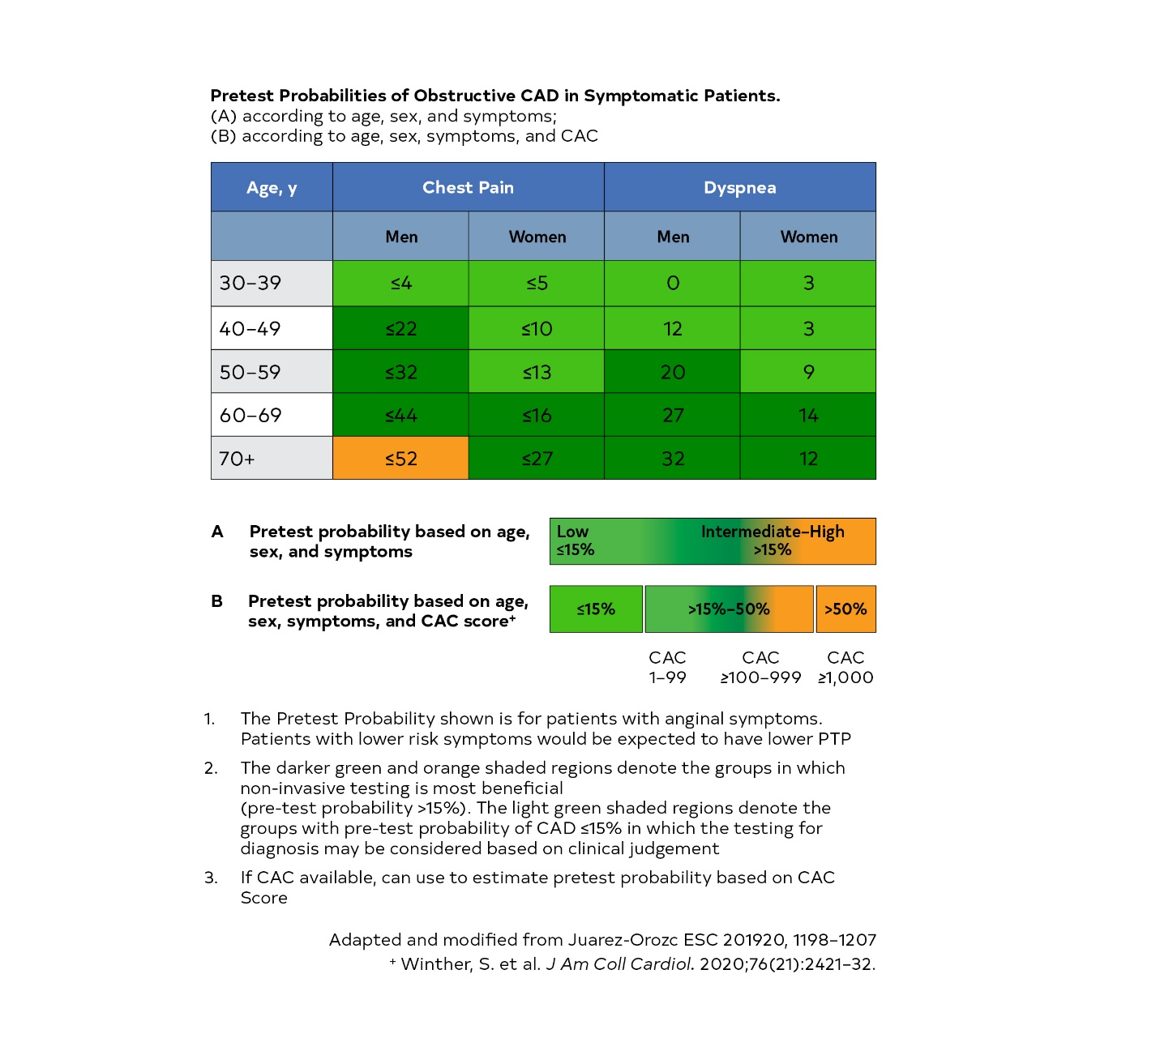
Pre-test Probability of Obstructive CAD
Revised PTP reflects significantly lower estimates than prior¹
Low PTP is ≤ 15%
Addition of CAC provides improves PTP assessment²
Intermediate / high → single group
¹Juarez-Orozco et al EHJ CV Imaging 2019
²Wintherer et al, JACC 2020
³Gulati et al, 2021 CP Guideline
@RonBlankstein ACC Stable Chest Pain Webinar

Slide 11
Intermediate-High Risk Patients: Why a single group ?
Challenging to identify high PTP group based on age, sex, risk factors
Similar management implications for stable CP patients:
“Although previous guidelines supported direct referral to ICA among patients with stable chest pain, contemporary randomized trials support that candidates for elective coronary angiography may be safely triaged using CCTA or noninvasive stress testing.”
Greenwood JP, et al, JAMA 2016
Nagel E, et al. NEJM 2019
Chang HJ, et al, JACC: CV Imaging 2019
Douglas PS, et al, EHJ 2015
Dewey M, et al, BMJ 2016
@RonBlankstein ACC Stable Chest Pain Webinar

Slide 12
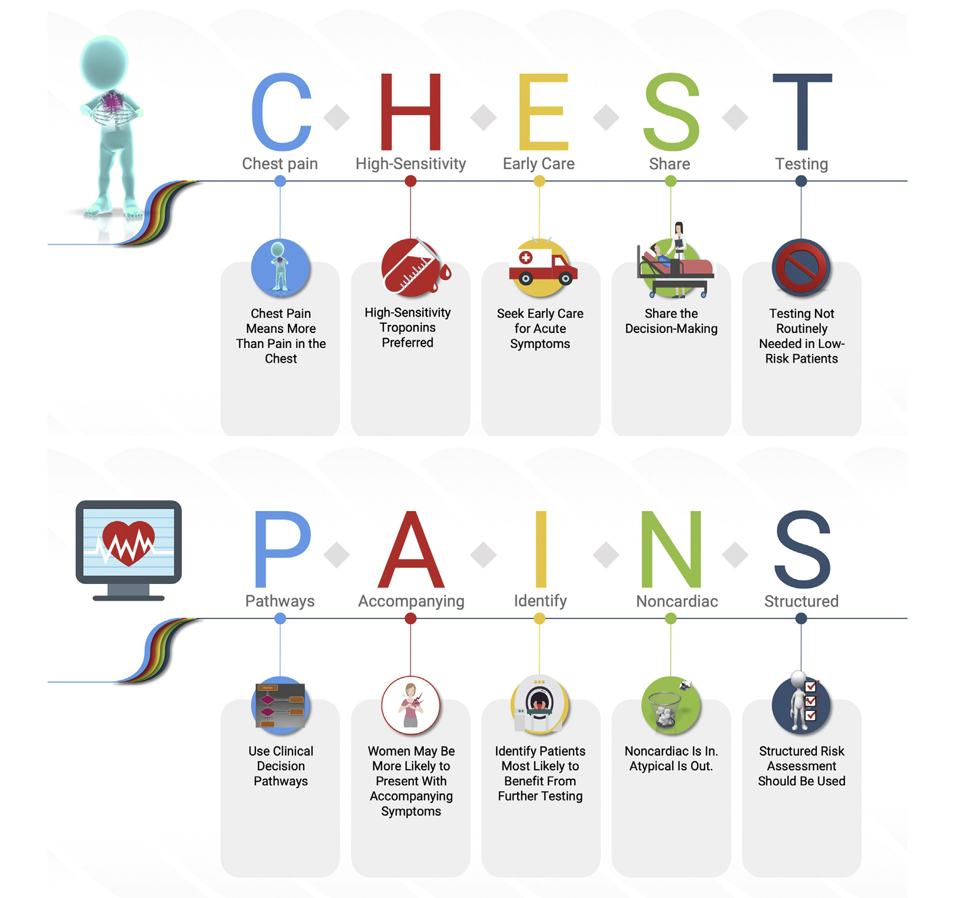


Conclusions
Gulati, M. et al. 2021 AHA/ACC/ASE/CHEST/SAEM/SCCT/SCMR Guideline for the Evaluation and Diagnosis of Chest Pain.
@RonBlankstein ACC Stable Chest Pain Webinar

Slide 13
Thank You…
#CPGuideline
rblankstein@bwh.harvard.edu
@RonBlankstein ACC Stable Chest Pain Webinar

Slide 14
Low Risk Patients -
How to Define? When to Test?
Leslee J. Shaw, PhD, MASNC, FACC, FAHA, MSCCT
Mount Sinai Chair and Professor
Director, Blavatnik Family Research Institute
Departments of Medicine (Cardiology) and
Population Health Science & Policy

Slide 15
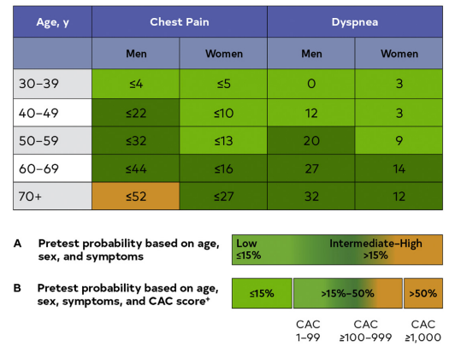

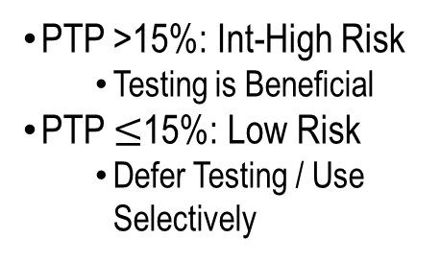
Pre-test Probability of Obstructive CAD
in Symptomatic Patients
PTP >15%: Int-High Risk
Testing is Beneficial
PTP $≤$15%: Low Risk
Defer Testing / Use Selectively
Info also available from a CAC scan or, when available, from a visual estimation of CAC from prior noncardiac chest CT
Gulati, M. et al. 2021 AHA/ACC/ASE/CHEST/SAEM/SCCT/SCMR Guideline for the Evaluation and Diagnosis of Chest Pain. JACC.

Slide 16
Figure 12. Clinical Decision Pathway for Patients With Stable Chest Pain & No Known CAD
Stable Chest Pain + No Known CAD
Clinical risk assessment
(1)
Low risk
Intermediate/high risk
Inconclusive
No testing recommended (1)
CCTA
(1)
Stress testing
Stress CMR
Stress PET
Stress SPECT
Stress echocardiography
(1)
CAC or exercise ECG
testing in selected cases
(2a)
Optimize preventive therapies
(1)
Mild ischemia
Stress testing
(2a)
Inconclusive
CAC
(2a)
Exercise ECG
(2a)
Moderate-severe ischemia
No CAD (no stenosis or plaque)
Nonobstructive CAD
(<50% stenosis)
Obstructive CAD
(≥50% stenosis)
Optimize preventive therapies
(1)
High risk CAD or frequent angina
Persistent symptoms?
FFR-CT for 40-90% stenosis
OR stress testing
(2a)
NO
YES
FFR CT ≤0.8 or moderate-severe ischemia
Invasive coronary angiography
(1)
YES
Invasive coronary angiography
(1)
Consider INOCA pathway as an outpatient for frequent or persistent symptoms
Continue preventive therapies
(1)
NO
Follow-up testing and intensification of GDMT by initial test results and persistence/worsening/frequency of symptoms
CCTA (2a)
Gulati, M. et al. 2021 AHA/ACC/ASE/CHEST/SAEM/SCCT/SCMR Guideline for the Evaluation and Diagnosis of Chest Pain. Circulation.

Slide 17
Figure 12. Clinical Decision Pathway for Patients With Stable Chest Pain & No Known CAD
Stable Chest Pain + No Known CAD
Clinical risk assessment
(1)
Low risk
No testing recommended (1)
For patients with stable chest pain & no known CAD categorized as low risk,
CAC or exercise ECG
testing in selected cases
(2a)
2a | B-R | CAC testing is reasonable as a first-line test for excluding calcified plaque and identifying patients with a low likelihood of obstructive CAD.
2a | B-NR | Exercise testing without imaging is reasonable as a first-line test for excluding myocardial ischemia and determining functional capacity in patients with an interpretable ECG.
Gulati, M. et al. 2021 AHA/ACC/ASE/CHEST/SAEM/SCCT/SCMR Guideline for the Evaluation and Diagnosis of Chest Pain. Circulation.

Slide 18
What is the Optimal Method for Ischemia Evaluation in Women? (WOMEN) Trial
N=824 Symptomatic Women Capable of Exercising
(>8 METs, most w/ Nl rest ECG)
Exercise testing is an equally effective diagnostic strategy in low-risk symptomatic women vs. Ex MPS
No difference in outcomes but exercise testing alone provided significant cost savings
Cumulative Event-Free Survival (%)
No Difference in 2-Year Rates of Death, ACS, or HF Hospitalization (p=0.59)
Abbreviations: ECG=Electrocardiogram, MPS: Myocardial Perfusion SPECT
Source: Shaw Circulation 2011;124:1239-49.

Slide 19
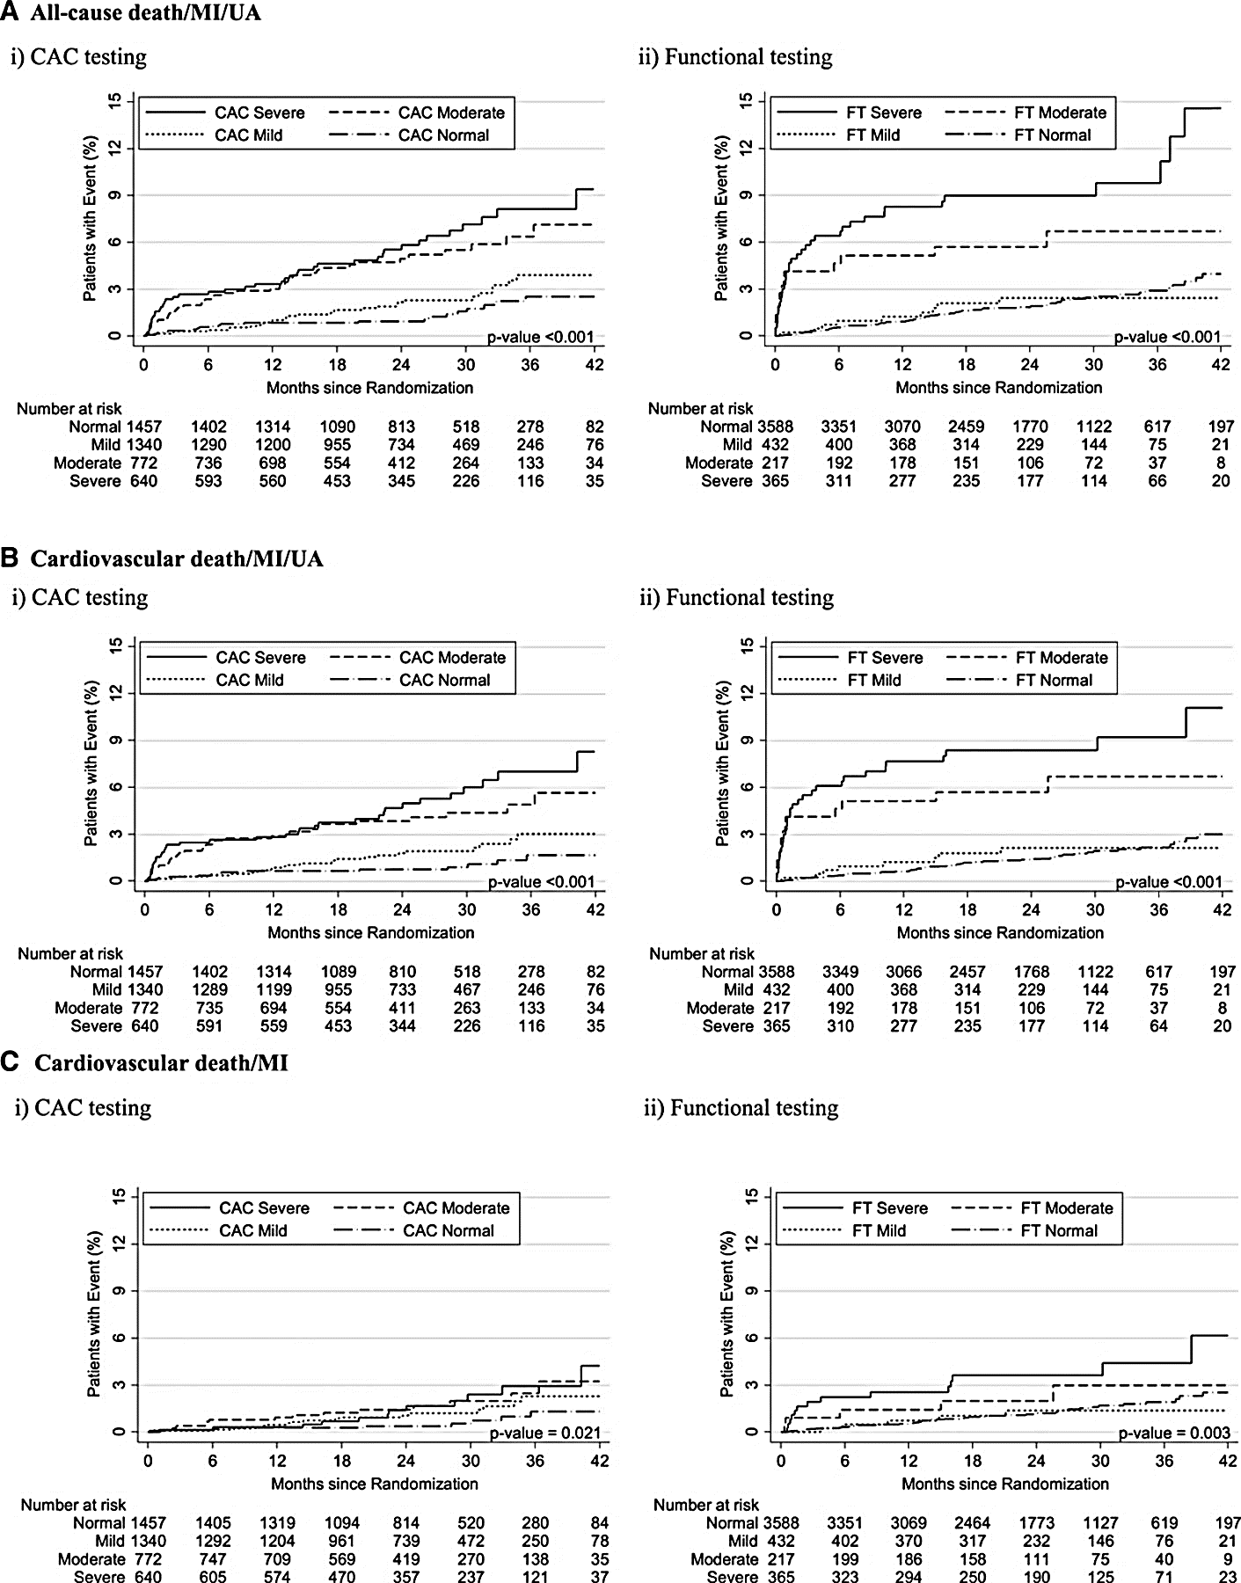
PROMISE Trial: Prognosis by Coronary Artery Calcium (CAC) & Functional Testing (FT)
(FT)
CAC: 0, 1-99, 100-400, & >400
Mean Follow-up: 26 months
Source: Budoff Circulation 2017;136:1993-2005.

Slide 20
Coronary Artery Calcium (CAC) Scoring
CAC score = 0 identifies low-risk patient - does not require additional diagnostic testing
Most events (84%) occur among patients with detectable CAC
Preventive Care for those w CAC
CAC: 0, 1-99, 100-400, & >400
Mean Follow-up: 26 months
Source: Budoff Circulation 2017;136:1993-2005.

Slide 21
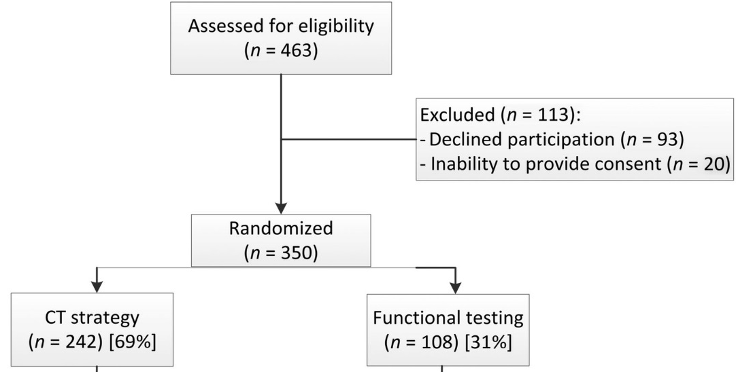
CAC + Selective CCTA vs. Exercise Testing in Suspected CAD (CRESCENT) Trial
Patient flow diagram with disposition by randomized arm.
Several randomized trials evaluated role of CAC in guiding selective use of follow-up CCTA
CRESCENT 1 trial: 350 symptomatic patients randomized to CAC vs. Ex ECG
Only patients w/ detectable CAC or high pretest risk underwent follow-up CCTA
CAC = ↓ downstream testing (p<0.0001) +
↓ diagnostic costs (p<0.0001)
CAC>0
(n=141)
1⁰ Endpoint: All-cause Mortality, MI, Stroke, UA + Objective Ischaemia or Requiring Revascularization, Unplanned CAD Evaluation, & Late Revascularization
Source: Lubbers Eur Heart J 2016;37:1232-43.

Slide 22
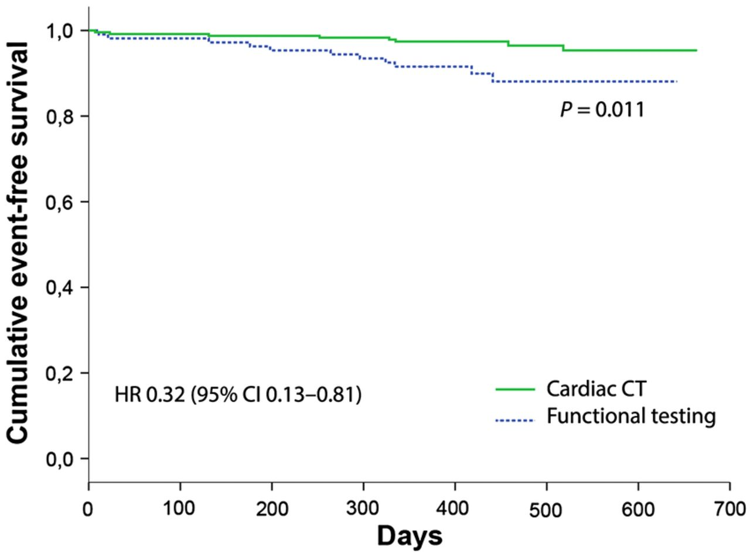
CAC + Selective CCTA vs. Exercise Testing in Suspected CAD (CRESCENT) Trial
Patient flow diagram with disposition by randomized arm.
96.7%
At 1 year, CAC associated with fewer CVD events vs. those who underwent Ex testing alone (p=0.011)
No Events in CAC=0!
89.8%
1⁰ Endpoint: All-cause Mortality, MI, Stroke, UA + Objective Ischaemia or Requiring Revascularization, Unplanned CAD Evaluation, & Late Revascularization
Source: Lubbers Eur Heart J 2016;37:1232-43.

Slide 23
Importance of Identifying Low Risk
Low risk
Defer Testing / Selective Use of Lower Cost Testing with Goal to Exclude CAD = Reinforce Low Risk Status
Strategy Results = Few Events / Lower Diagnostic Costs
CAC Strategy = Guide Preventive Care
No Testing Recommended (1)
CAC or Exercise ECG
in Selected Cases
(Class 2a)
? Consider for Selective Testing
Residual Uncertainty
Concerning Family History
High Stress Occupation
↑ASCVD Risk or Nontraditional Risk Enhancers – Autoimmune Disease, HIV, Pregnancy-Related - HTN Disorders

Slide 24

Thank you

Slide 25
No prior history of CAD - Selecting between Functional Imaging and CCTA
Wael A. Jaber MD, FACC, FESC
Cleveland Clinic
Cleveland, OHIO, USA

Slide 26
The “de novo patient” with Stable Chest Pain: Goals of Assessment
Assess Risk
Short term in Office
Long Term for follow-up
Assess disease presence or absence and thus need for primary versus secondary prevention
Need for Revascularization in addition to GDMT

Slide 27

Identify: Intelligent Choice of testing Imaging for Patients ≥ 15% pretest Probability

Slide 28
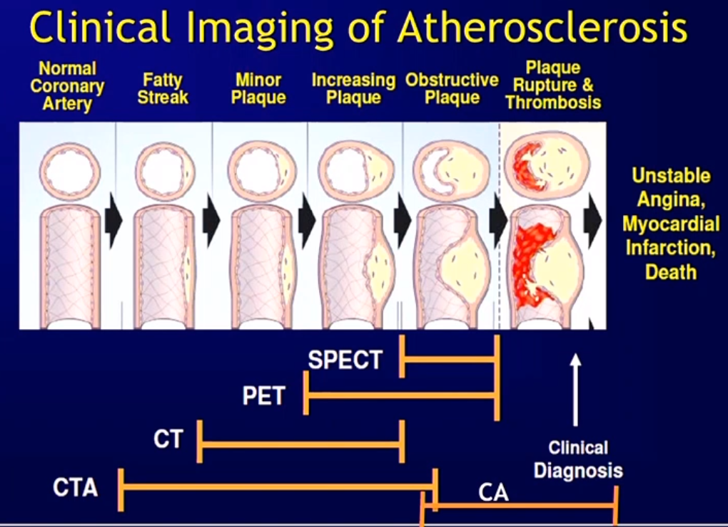
Guidelines: Acknowledging the Differences

Slide 29
Figure 12. Clinical Decision Pathway for Patients With Stable Chest Pain & No Known CAD Nuanced approach and graded response to disease severity and ischemia
Stable Chest Pain + No Known CAD
No testing recommended (1)
Clinical risk assessment (1)
Stress testing
Stress CMR
Stress PET
Stress SPECT
Stress echocardiography (1)
Exercise ECG (2a)
Low risk
CAC or exercise ECG
testing in selected cases (2a)
CCTA (1)
Intermediate/high risk
Inconclusive
No CAD (no stenosis or plaque)
Nonobstructive CAD
(<50% stenosis)
Obstructive CAD
(≥50% stenosis)
Inconclusive
Mild ischemia
Moderate-severe ischemia
Optimize preventive therapies
(1)
Optimize preventive therapies (1)
Stress testing
(2a)
Consider INOCA pathway as an outpatient for frequent or persistent symptoms
FFR-CT for 40-90% stenosis
OR stress testing (2a)
High risk CAD or frequent angina
CAC (2a)
Persistent symptoms?
FFR CT ≤0.8 or moderate-severe ischemia
Invasive coronary angiography (1)
YES
NO
Follow-up testing and intensification of GDMT by initial test results and persistence/worsening/frequency of symptoms
NO
YES
Invasive coronary angiography
(1)
Continue preventive therapies
(1)
CCTA (2a)

Slide 30
Figure 12. Clinical Decision Pathway for Patients With Stable Chest Pain & No Known CAD Anatomic risk stratification: You can always add functional testing when needed
Stable Chest Pain + No Known CAD
No testing recommended (1)
Clinical risk assessment (1)
Stress testing
Stress CMR
Stress PET
Stress SPECT
Stress echocardiography (1)
Exercise ECG (2a)
Low risk
CAC or exercise ECG
testing in selected cases (2a)
CCTA (1)
Intermediate/high risk
Inconclusive
No CAD (no stenosis or plaque)
Nonobstructive CAD
(<50% stenosis)
Obstructive CAD
(≥50% stenosis)
Inconclusive
Mild ischemia
Moderate-severe ischemia
Optimize preventive therapies
(1)
Optimize preventive therapies (1)
Stress testing
(2a)
Consider INOCA pathway as an outpatient for frequent or persistent symptoms
FFR-CT for 40-90% stenosis
OR stress testing (2a)
High risk CAD or frequent angina
CAC (2a)
Persistent symptoms?
FFR CT ≤0.8 or moderate-severe ischemia
Invasive coronary angiography (1)
YES
NO
Follow-up testing and intensification of GDMT by initial test results and persistence/worsening/frequency of symptoms
NO
YES
Invasive coronary angiography
(1)
Continue preventive therapies
(1)
CCTA (2a)

Slide 31
Figure 12. Clinical Decision Pathway for Patients With Stable Chest Pain & No Known CAD Functional risk stratification: You can always add anatomic testing when needed
Stable Chest Pain + No Known CAD
No testing recommended (1)
Clinical risk assessment (1)
Stress testing
Stress CMR
Stress PET
Stress SPECT
Stress echocardiography (1)
Exercise ECG (2a)
Low risk
CAC or exercise ECG
testing in selected cases (2a)
CCTA (1)
Intermediate/high risk
Inconclusive
No CAD (no stenosis or plaque)
Nonobstructive CAD
(<50% stenosis)
Obstructive CAD
(≥50% stenosis)
Inconclusive
Mild ischemia
Moderate-severe ischemia
Optimize preventive therapies
(1)
Optimize preventive therapies (1)
Stress testing
(2a)
Consider INOCA pathway as an outpatient for frequent or persistent symptoms
FFR-CT for 40-90% stenosis
OR stress testing (2a)
High risk CAD or frequent angina
CAC (2a)
Persistent symptoms?
FFR CT ≤0.8 or moderate-severe ischemia
Invasive coronary angiography (1)
YES
NO
Follow-up testing and intensification of GDMT by initial test results and persistence/worsening/frequency of symptoms
NO
YES
Invasive coronary angiography
(1)
Continue preventive therapies
(1)
CCTA (2a)

Slide 32
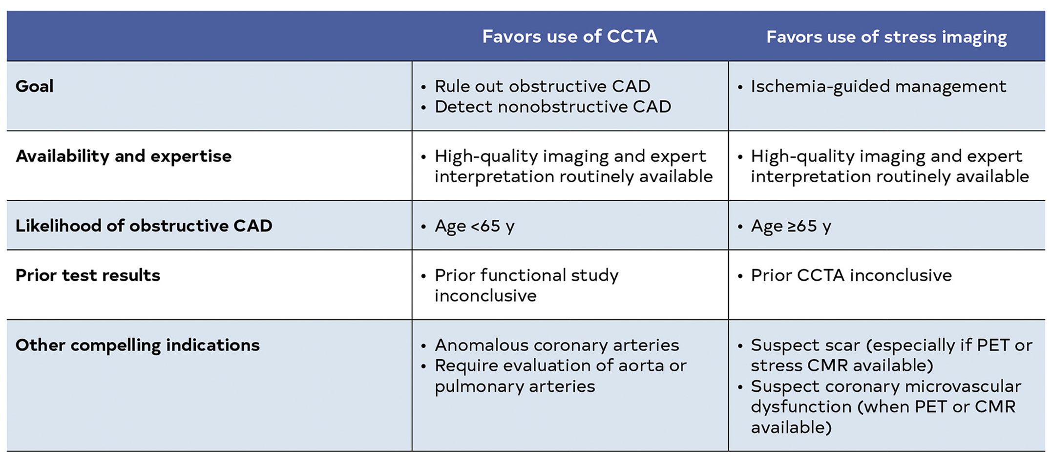

Slide 33
When Imaging is indicated: Intermediate Risk
Assess disease presence or absence and thus need for primary versus secondary prevention
Anatomic testing CCTA in <65 (Class IA)
Functional testing in all and especially >65 (Class 1A)
Layered testing in inconclusive settings (Class IA)

Slide 34
Advantages of PET
Low Specificity ( BMI) and potentially missing balanced ischemia can be addressed by PET (MBF, MFR calculations)

Slide 35
A Normal Functional Test Does Not Mean Absence of Disease

Slide 36
CAC: An opportunity to refine risk assessment and start preventive therapies
CAC Can inform decision to initiate atherosclerosis directed medical therapy beyond risk stratification

Slide 37
When Imaging is indicated: Intermediate Risk
Need for Revascularization in addition to GDMT
High risk anatomy
Moderate and severe disease with functional testing
Optimize GDMT in all and consider revascularization if symptoms continue

Slide 38
Prior Coronary Artery Disease: Selecting Between Different Testing Options
Amit R. Patel MD, FACC, FSCMR, FSCCT
University of Chicago
Associate Professor of Medicine and Radiology
Director, Cardiac MRI and CT

Slide 39
Disclosures
Research Support/ Grants: Philips, General Electric, Circle CVI, Neosoft, Arterys
Consultant/ Speaker: General Electric

Slide 40
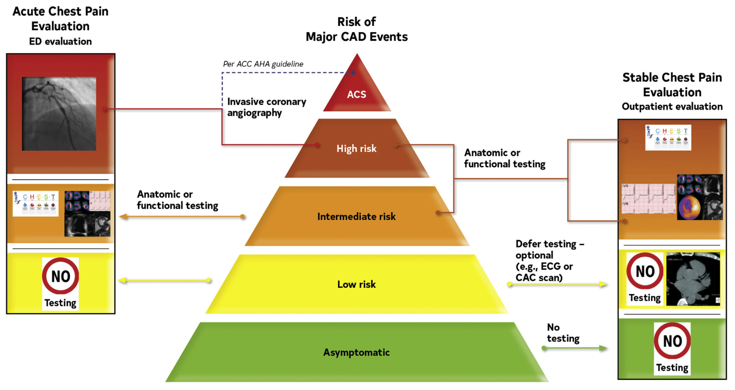

Slide 41
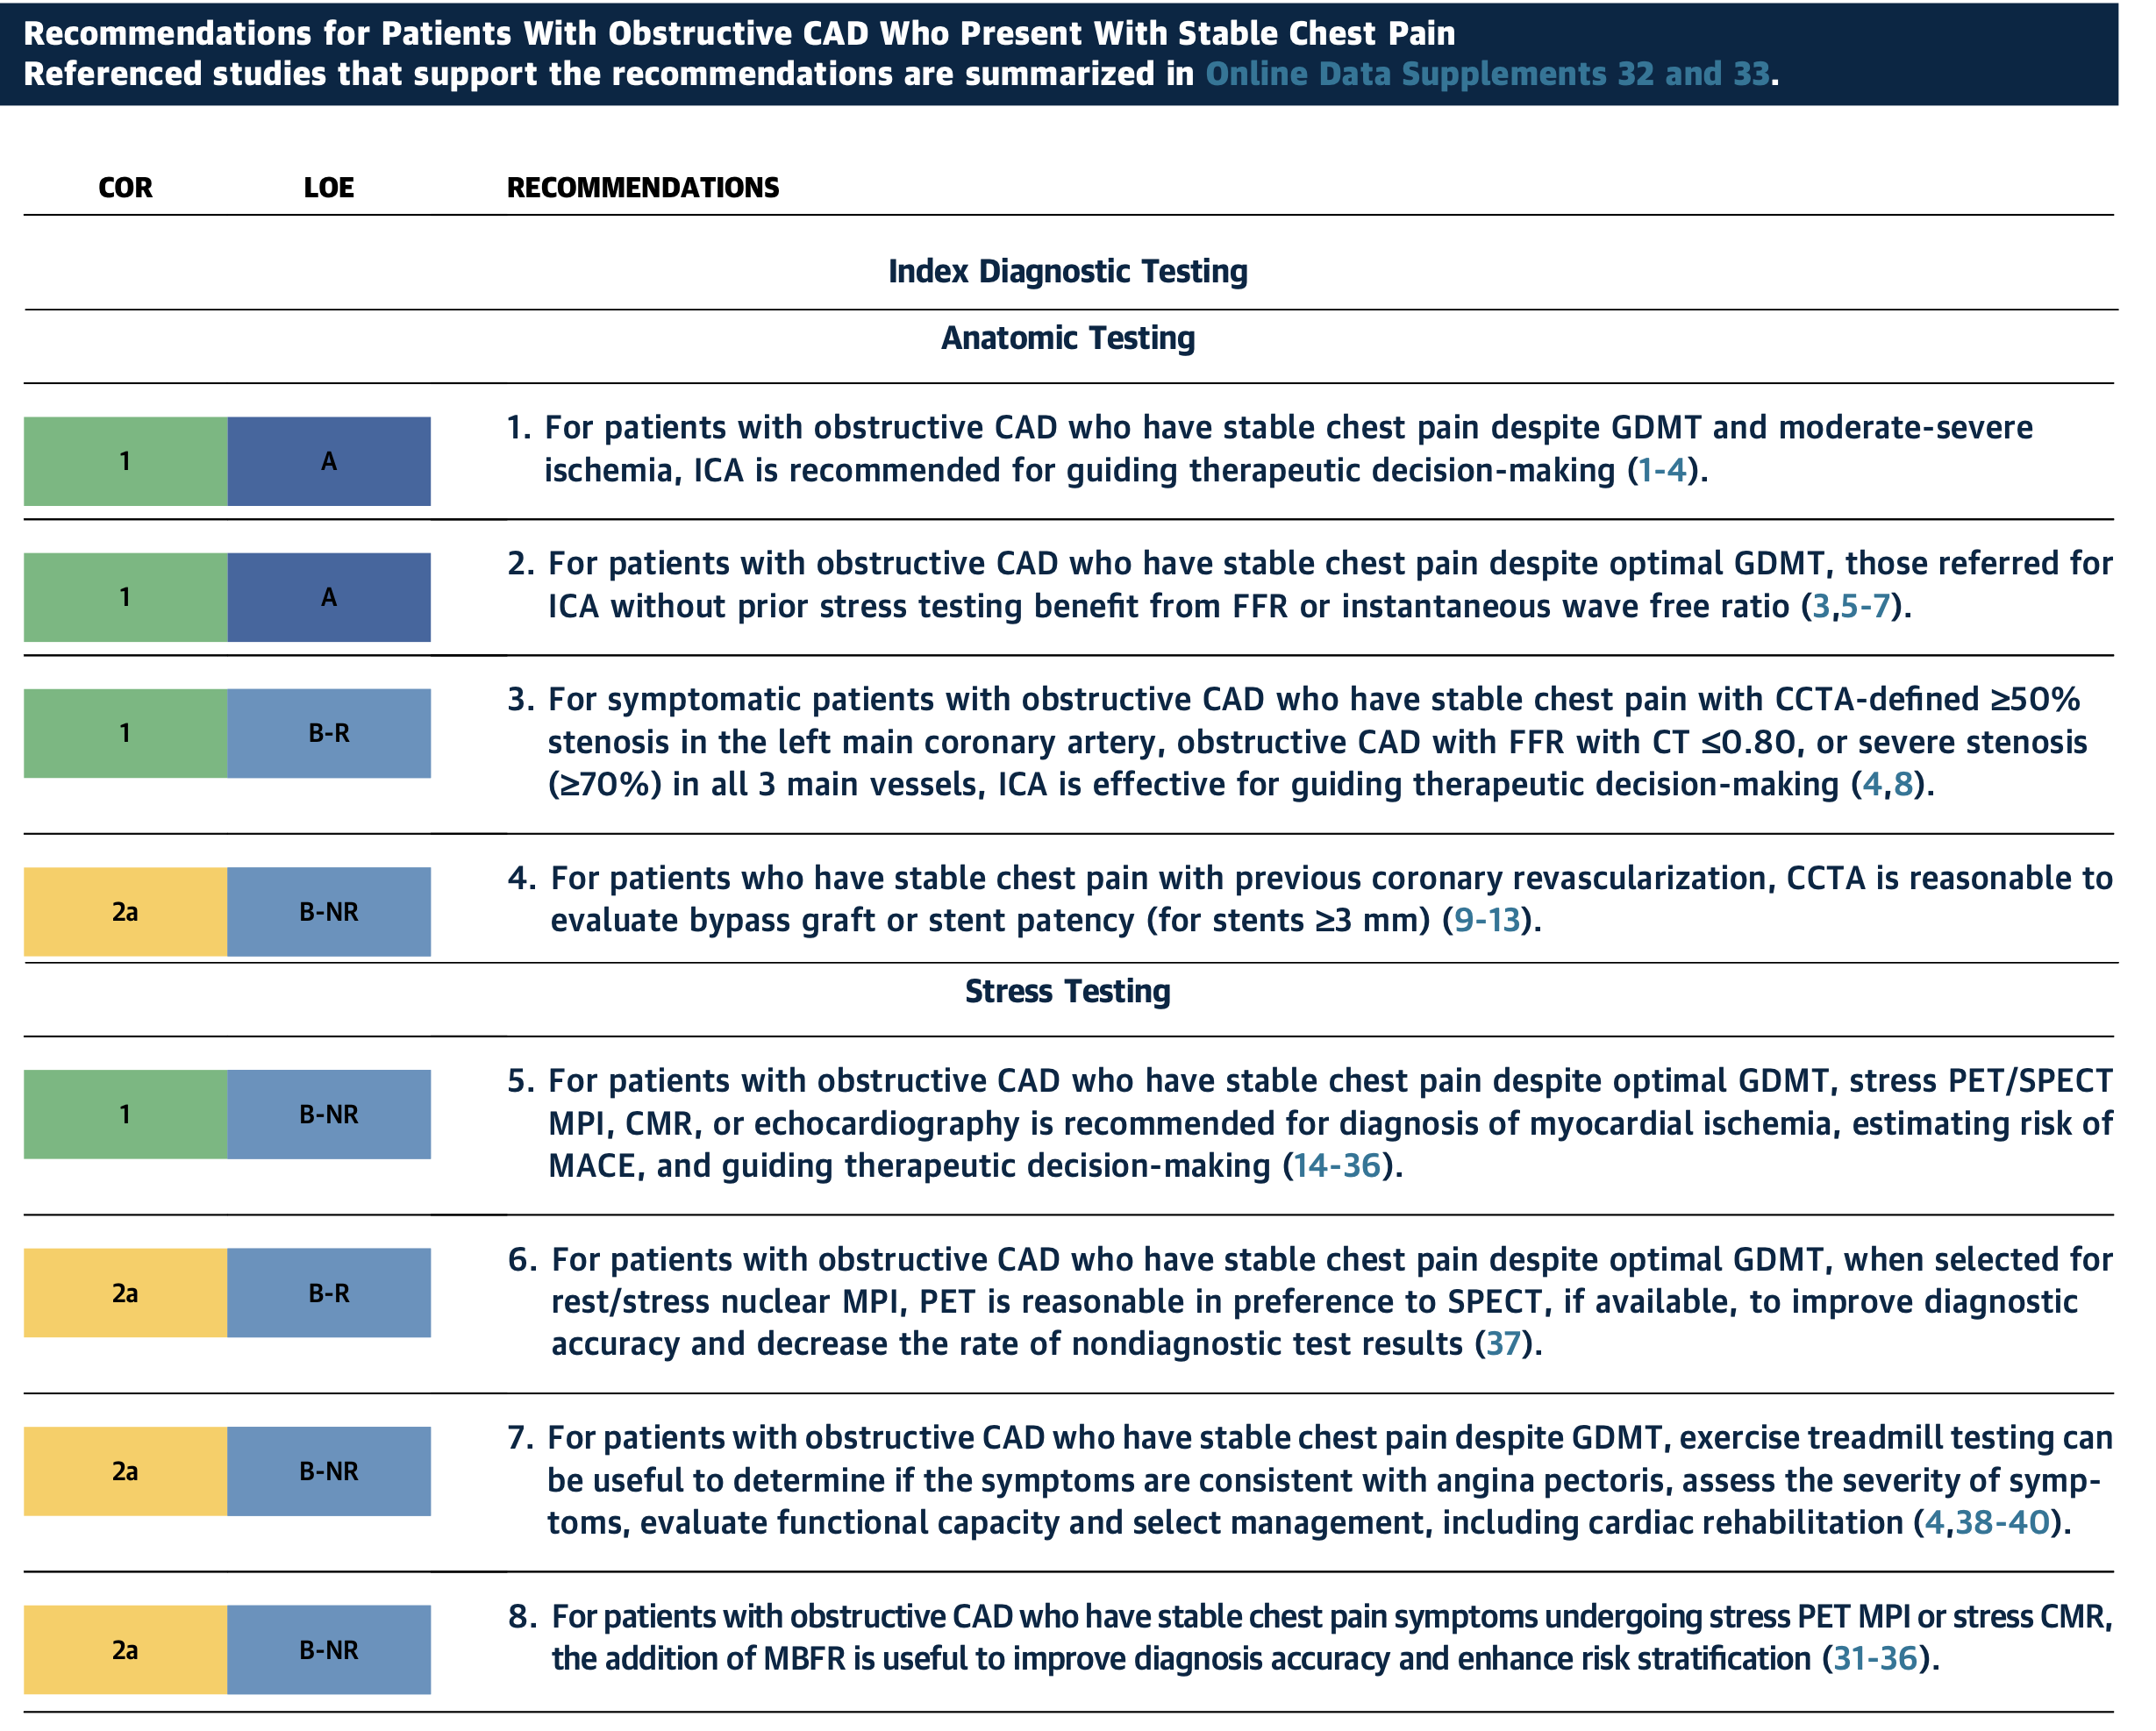

Slide 43
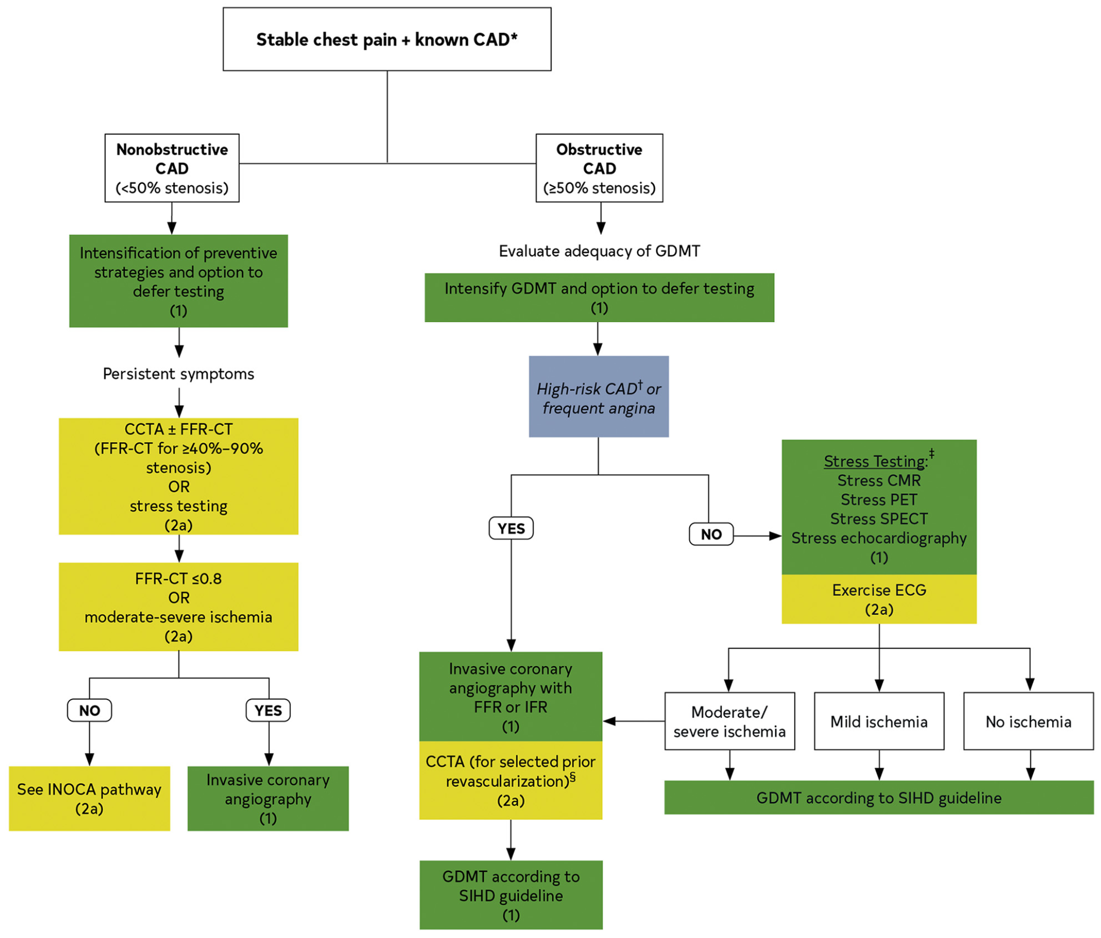

Slide 44

Insights on special populations: pericardial disease and microvascular disease
Renee P. Bullock-Palmer MD FACC FAHA FASNC FASE FSCCT
Director, Non-Invasive Cardiac Imaging
Director, Women’s Heart Center
Deborah Heart and Lung Center

Slide 45
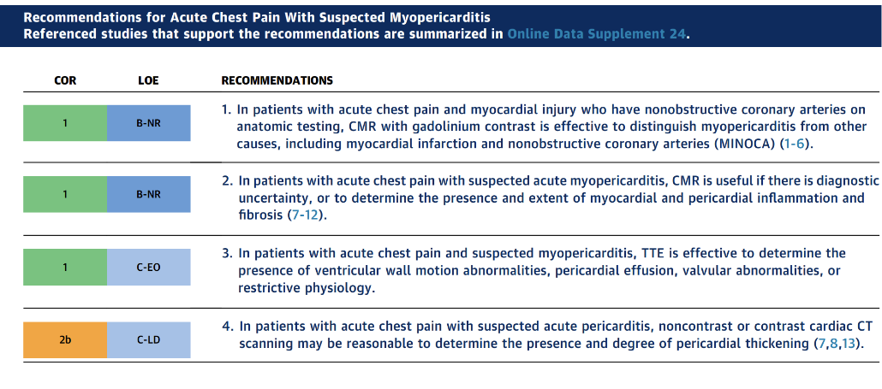
Pericardial Disease and Chest Pain
CMR
ECHO
Cardiac CT

Slide 46
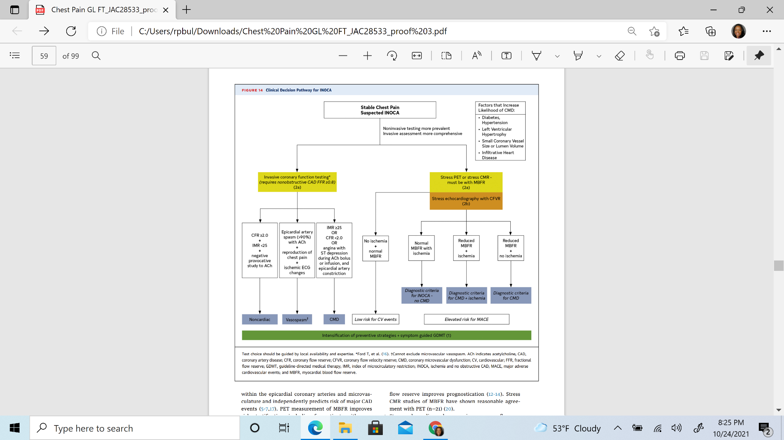
Microvascular Disease and Chest Pain

Slide 47
Microvascular Disease and Chest Pain

Slide 48
Microvascular Disease and Chest Pain

Slide 49
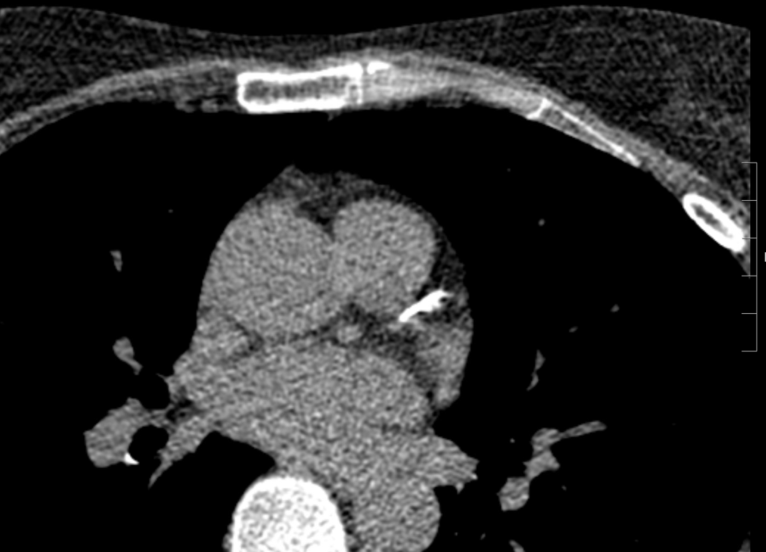
72 year old female with hypertension and dyslipidemia presented for evaluation of intermittent chest discomfort
Prior evaluation includes severe amount of CAC (Agatston score of 414)
Case courtesy of Dr. Ron Blankstein

Slide 50
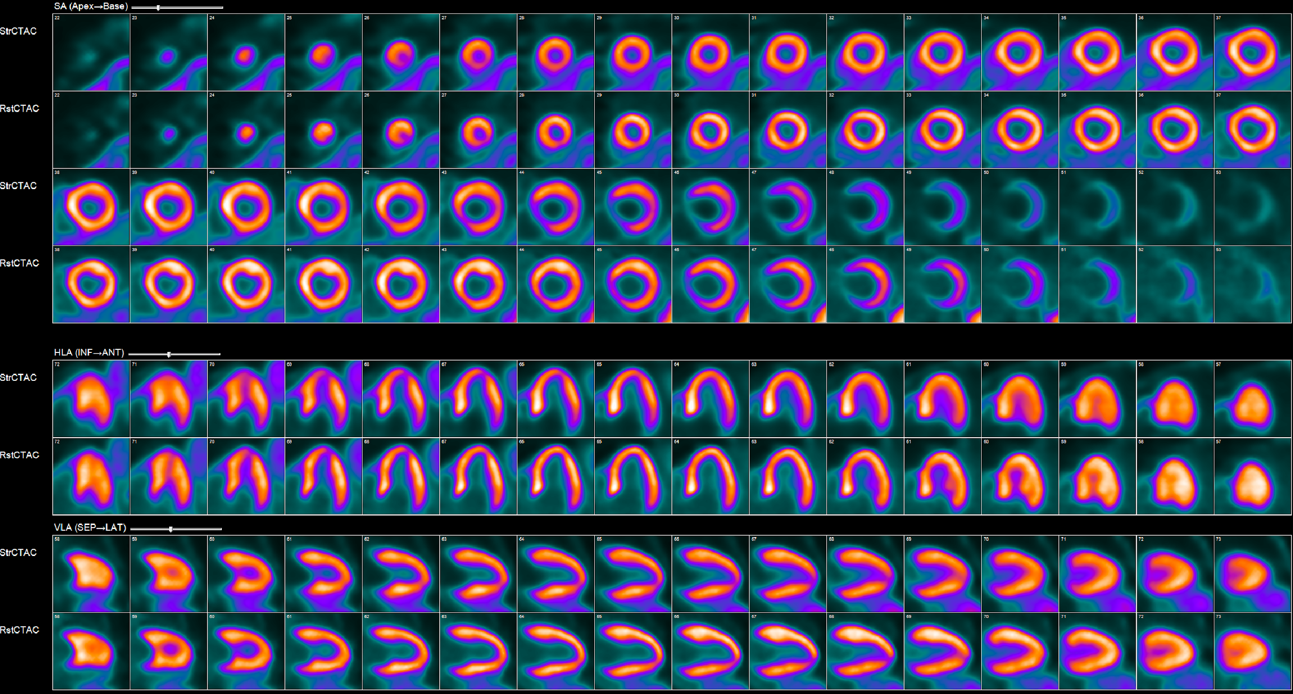
Myocardial Perfusion PET
Normal myocardial perfusion at stress and rest.

Slide 51
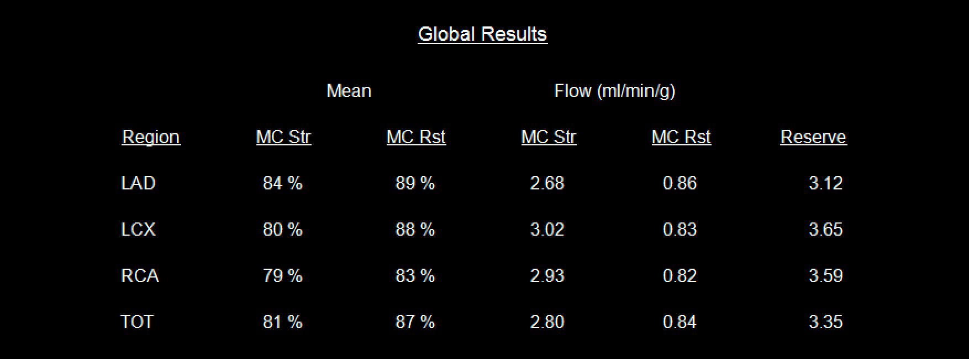
Quantitative flow: normal peak myocardial blood flow (MBF) and normal MBF reserve
excludes severe multivessel stenosis or microvascular disease and is associated with a favorable prognosis despite severe CAC

Slide 52
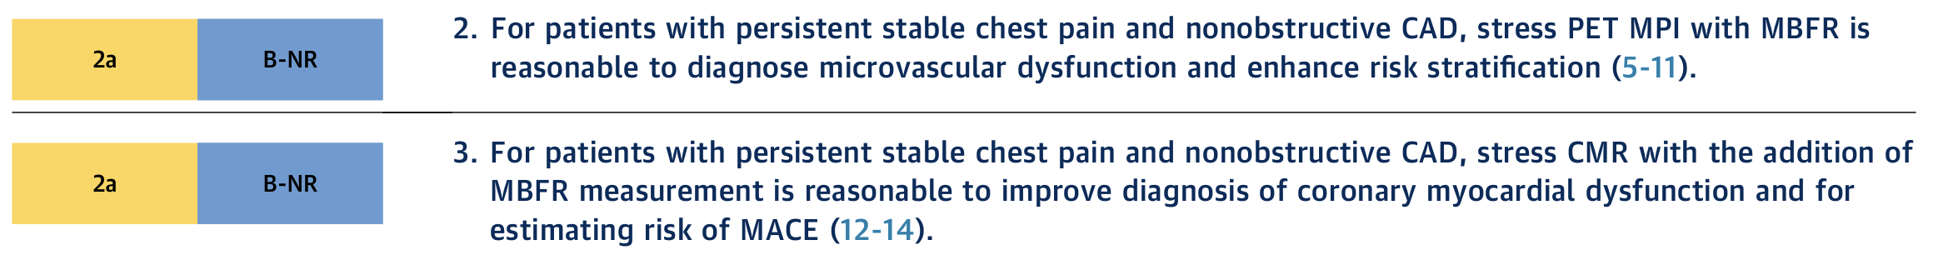

Microvascular Disease and Chest Pain

Slide 53







Ron Blankstein, MD, FACC
Renee Bullock-Palmer, MBBS, FACC
Marcelo F. Di Carli, MD, FACC
Leslee J. Shaw, PhD, FACC
Amit R. Patel, MD, FACC
Allison G. Hays, MD, FACC
Wael A. Jaber, MD, FACC

Slide 54
ACC Chest Pain Guideline Hub
https://www.acc.org/guidelines/hubs/chest-pain

