Slide 1
The ACC Cardiovascular Imaging Section presents
2021 Guideline for the Evaluation and Diagnosis of Chest Pain:
Imaging and Acute Chest Pain

Slide 2







Marcelo F. Di Carli, MD, FACC
Cory Henderson, MD
Juan C. Lopez-Mattei, MD, FACC
Hena Patel, MD
Vera H. Rigolin, MD, FACC
Michael A. Ross MD, FACC
Michael Salerno, MD, PhD, FACC
Notes:
Ron Blankstein, MD, FACC
Renee Bullock-Palmer, MBBS, FACC
Allison G. Hays, MD, FACC
Wael A. Jaber, MD, FACC
Amit R. Patel, MD, FACC
Leslee J. Shaw, PhD, FACC

Slide 3
The ACC Cardiovascular Imaging Section presents 2021 Guideline for the Evaluation and Diagnosis of Chest Pain: Imaging and Acute Chest Pain
Clinical overview of evaluation of acute chest pain Michael A. Ross MD, FACC
How to select between different testing options Michael Salerno, MD, PhD, FACC
When is imaging helpful for suspected non-coronary related chest pain? Juan C. Lopez-Mattei, MD, FACC
Case 1: Acute chest pain and no known CAD Cory Henderson, MD
Case 2: Acute chest pain and known CAD Hena Patel, MD

Slide 4
Clinical Overview of the Evaluation of Acute Chest Pain
Michael A. Ross MD FACEP FACC
Chief of Service, Observation Medicine
Professor, Emory University School of Medicine

Slide 5
Background – Why Chest Pain?
High risk - Associated with CAD, the leading cause of death
High volume - Annually 6.5 million ED visits, 4 million outpatient visits
Only 5.1% of ED chest pain patients will turn out to have ACS
Clinically challenging
Under testing – risks missed diagnosis with poor outcomes
Over testing – poor use of resources, avoidable procedures, cost inflation

Slide 6
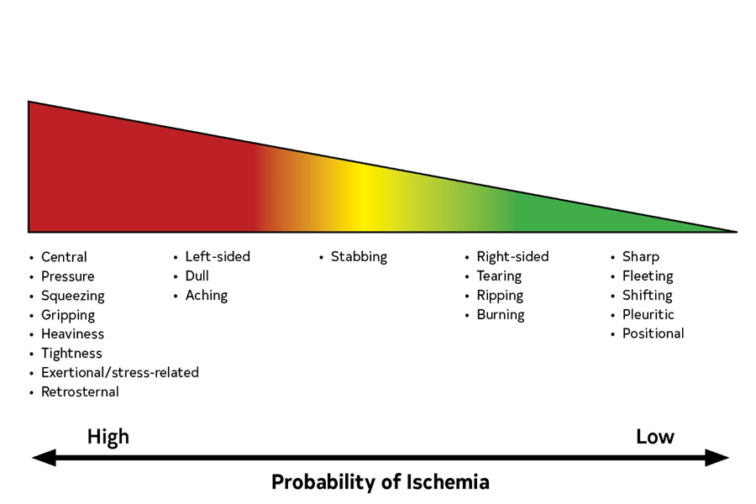
Chest “Pain” and other symptoms of cardiac ischemia

Slide 7
Initial approach to acute chest pain

Slide 8
Two Game Changers:
High Sensitivity Troponin
Clinical Decision Pathways

Slide 9
High Sensitivity-Troponins Are Preferred

Slide 10
Clinical Decision Pathways

Slide 12
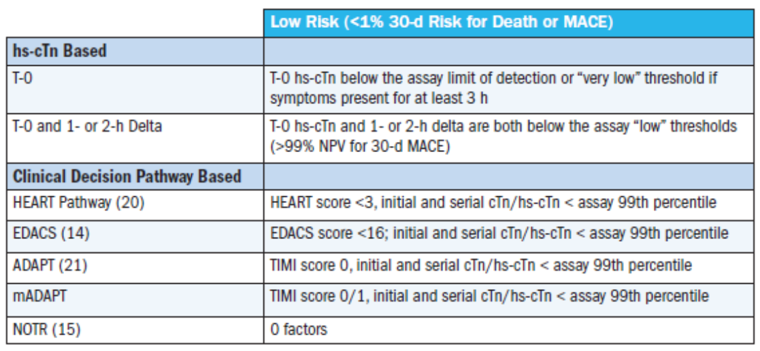
Definition Used for Low-Risk Patients With Chest Pain

Slide 14
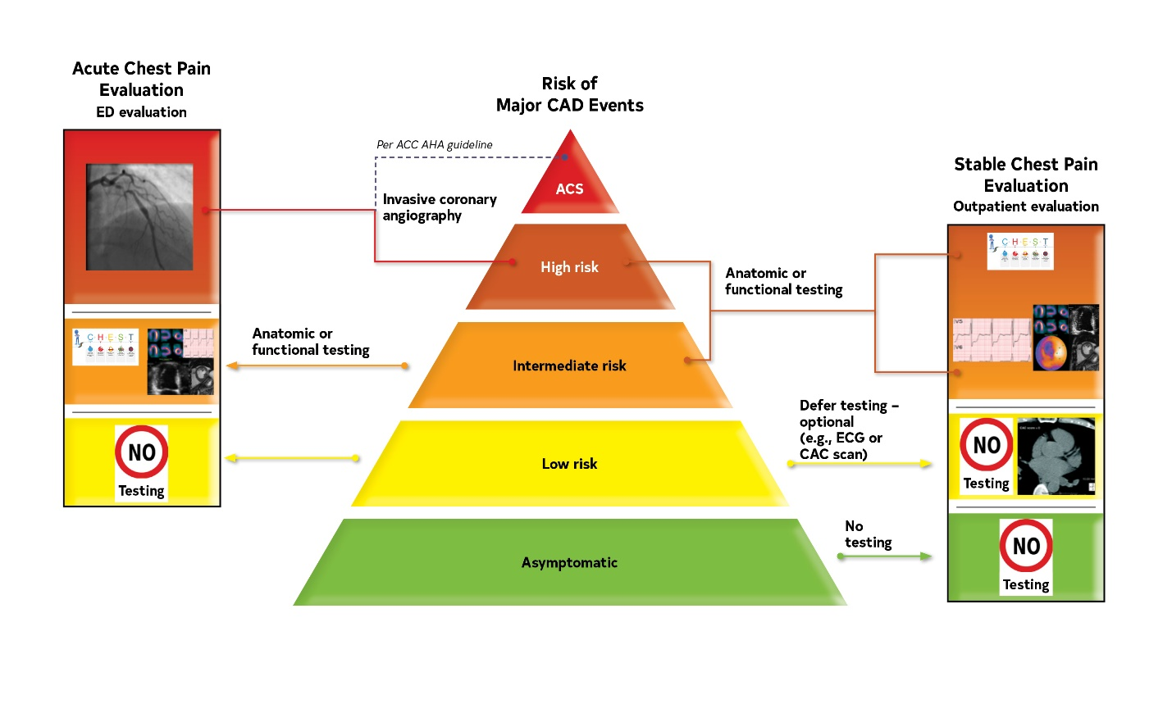
Chest Pain and Cardiac Testing Considerations.
The choice of imaging depends on the clinical question of importance, to either a) ascertain the diagnosis of CAD and define coronary anatomy or b) assess ischemia severity among patients with an expected higher likelihood of ischemia with an abnormal resting ECG or those incapable of performing maximal exercise.
ACS indicates acute coronary syndrome; CAC, coronary artery calcium; CAD, coronary artery disease; and ECG, electrocardiogram.

Slide 16
2021 Guideline for the Evaluation and Diagnosis of Chest Pain
Imaging in Acute Chest Pain: How to select between different testing options
Michael Salerno MD, PhD, MS
Section Chief of Cardiovascular Imaging
Professor of Medicine, Cardiovascular Medicine
and Professor of Radiology, Cardiovascular Imaging
Stanford University Medical Center

Slide 17
Learning Objectives
Appropriately utilize non-invasive imaging in patients with acute chest pain/likely ACS
Make patient-centered decisions regarding the choice of imaging modality in acute chest pain

Slide 18
Pathway for Acute Chest Pain/Likely ACS

Slide 19
Top 10 Take Home Messages
8. Identify Patients Most Likely to Benefit From Further Testing. Patients with acute or stable chest pain who are at intermediate risk or intermediate to high pre-test risk of obstructive coronary artery disease, respectively, will benefit the most from cardiac imaging and testing.

Slide 20
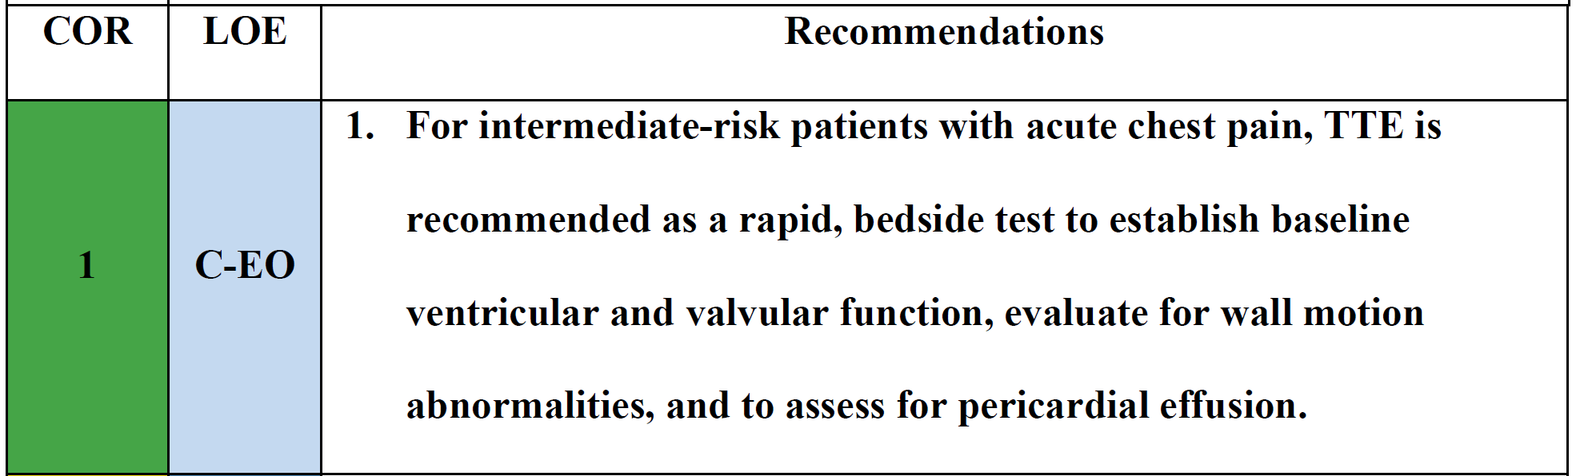
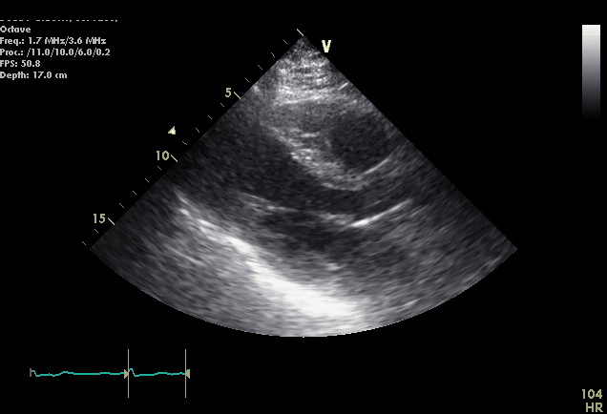
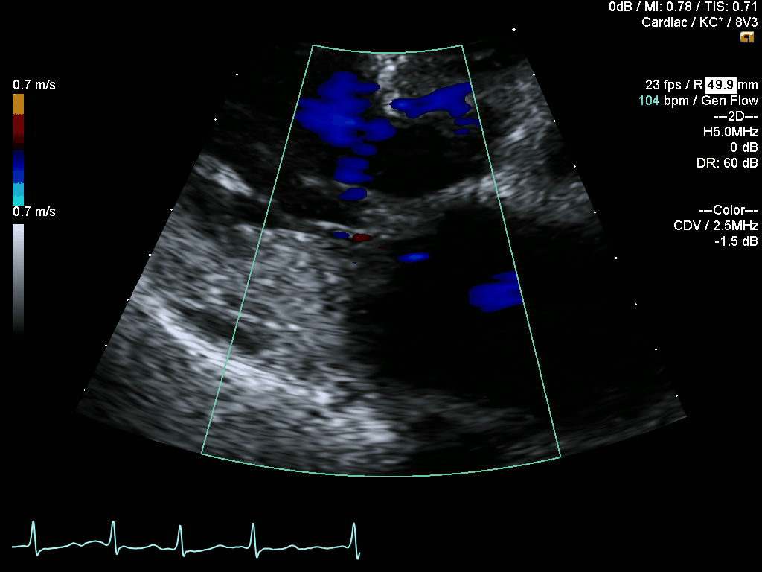
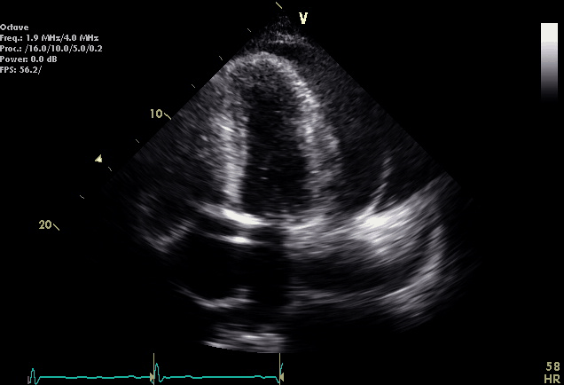
Transthoracic Echo

Slide 21
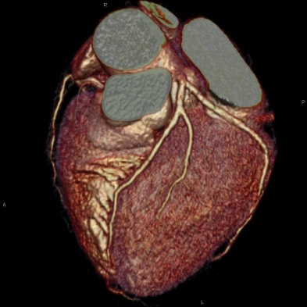
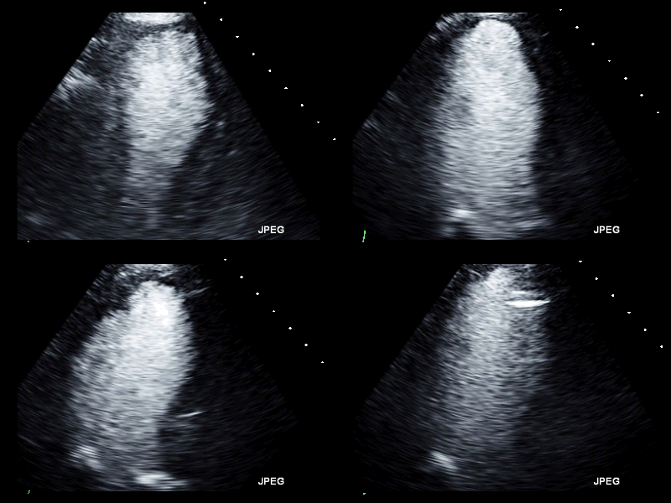
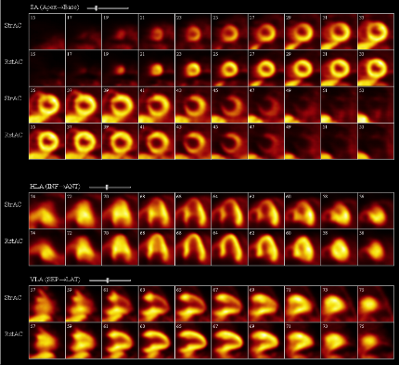
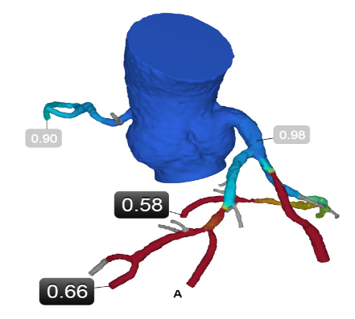
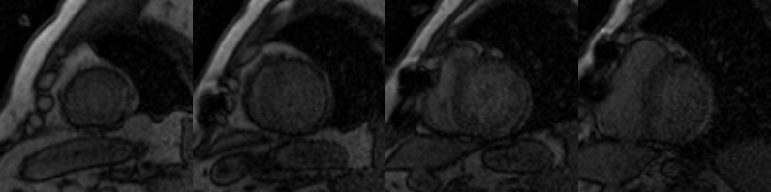
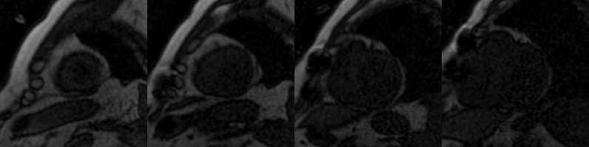
Acute Chest Pain and Cardiac Testing Considerations

Slide 22

Choosing an Imaging Test in Acute Chest Pain

Slide 23
Choosing an Imaging Test in Acute Chest Pain
CCTA +/- FFRCT
Pros: high negative predictive value, can diagnose non-obstructive CAD, potential to combine with FFR-CT in intermediate lesions
Cons: Radiation, iodinated contrast, downstream costs?
Stress Echo
Pros: Can combine with exercise, no radiation, can assess function, valves
Cons: May be less sensitive then MPI
Stress MPI (SPECT/PET)
Pros: Can combine with exercise (SPECT), high diagnostic accuracy (PET>SPECT), ability to quantify perfusion (PET)
Cons: Radiation (SPECT>PET), cost, availability (PET)
Stress Perfusion CMR
Pros: High diagnostic accuracy, comprehensive assessment of function and scar, no radiation, ability to quantify perfusion
Cons: Less available in the acute setting, claustrophobia, challenging with devices

Slide 24
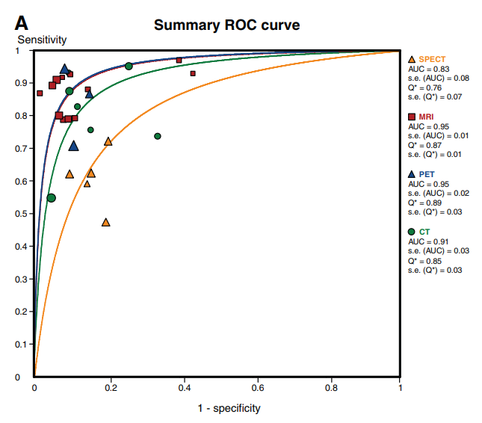
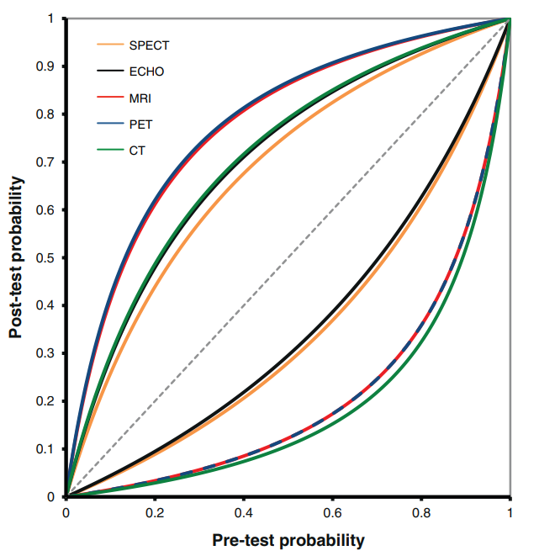
Diagnostic Performance NIT
Meta-analysis of studies using invasive FFR as the gold standard
MRI, PET and CT had higher negative likelihood ratio than SPECT/Echo
MRI and PET have a higher positive likelihood ratio then SPECT/Echo and CT
Takx et al. Circ Cardiovasc Imaging. 2015;8

Slide 25
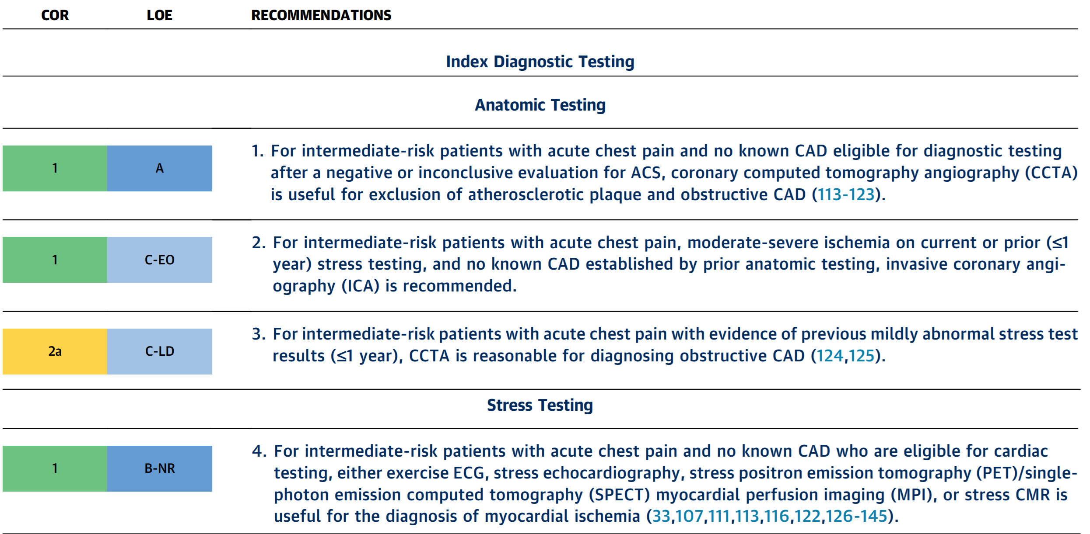
Intermediate-Risk Patients With No Known CAD

Slide 26
Intermediate-Risk Patients With No Known CAD
Anatomic Testing ->Coronary CTA
Moderate-Severe Ischemia -> ICA
Mild Ischemia (<1yr) -> CCTA
Stress Testing (EKG,SE,Nucs, CMR)

Slide 27
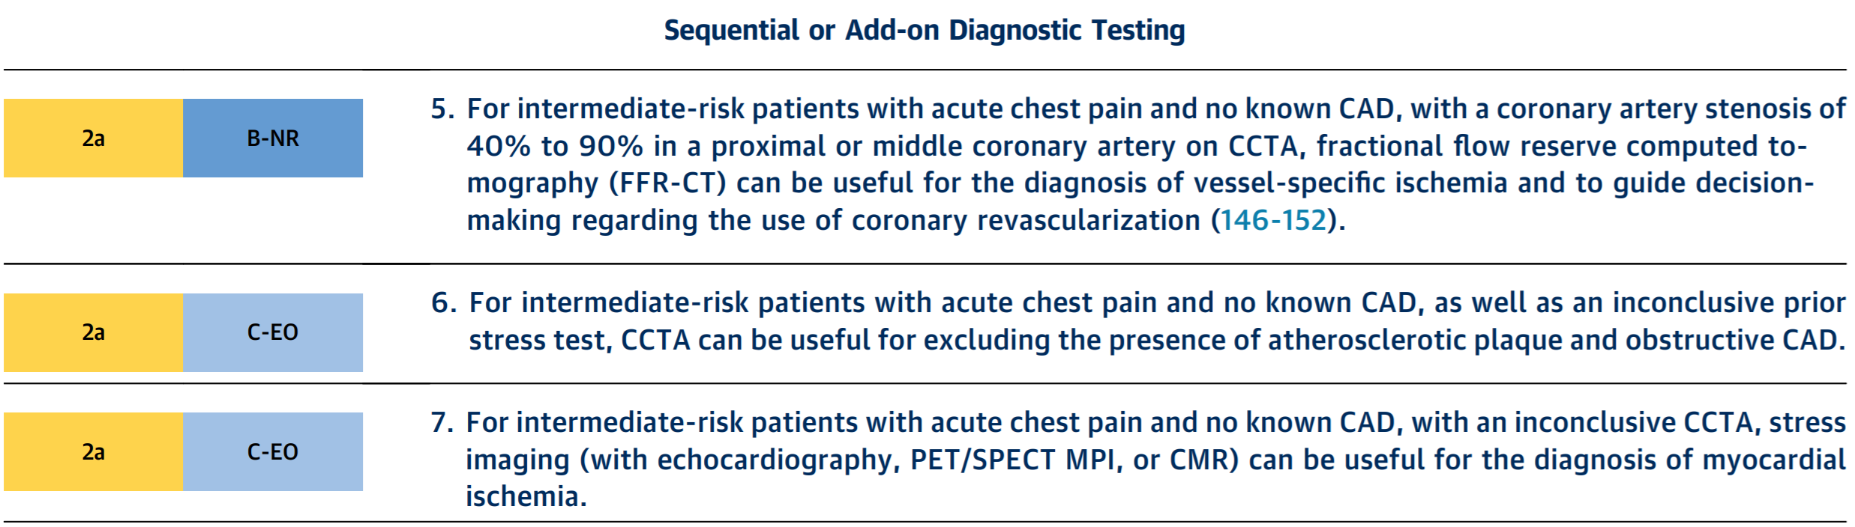
Intermediate-Risk Patients With Acute Chest Pain and No Known (CAD)
40-90% prox-mid CTA-> consider FFR-CT
Inconclusive Stress ->Consider CTA
Inconclusive CTA ->Consider Stress

Slide 28
Intermediate-Risk Patients With Acute Chest Pain and No Known (CAD)
40-90% prox-mid CCTA ->CT-FFR can be useful
Inconclusive Stress Test -> CTA can be useful
Inconclusive CCTA-> Stress Imaging (SE, PET/SPECT,CMR) can be useful

Slide 29
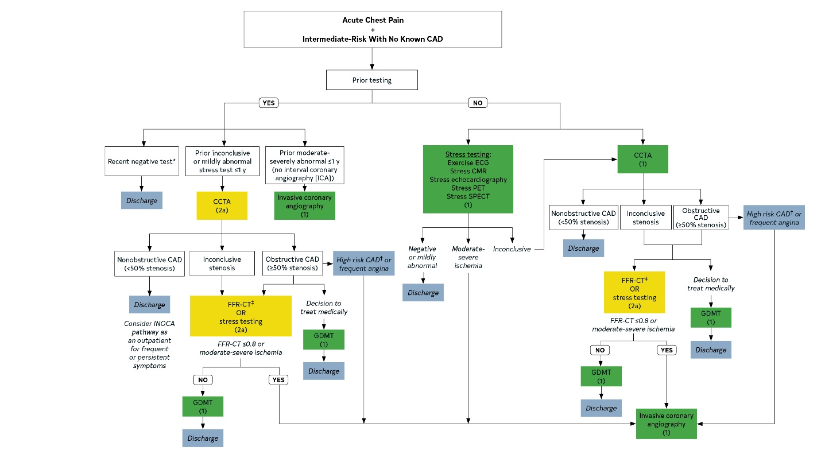
Evaluation Algorithm for Patients With Suspected ACS at Intermediate Risk With No Known CAD.

Slide 30
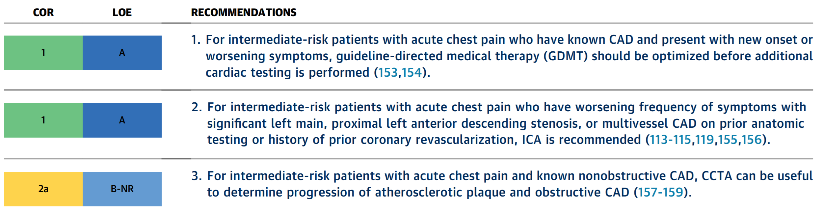
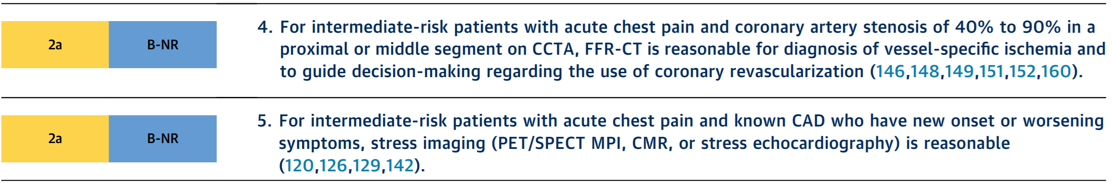
Intermediate-Risk Patients With Acute Chest Pain and Known CAD

Slide 31
Intermediate-Risk Patients With Acute Chest Pain and Known CAD
GDMT
High Risk Anatomy -> ICA
Coronary CTA
CT-FFR
Stress Imaging (SPECT/PET ,SE,CMR)

Slide 32
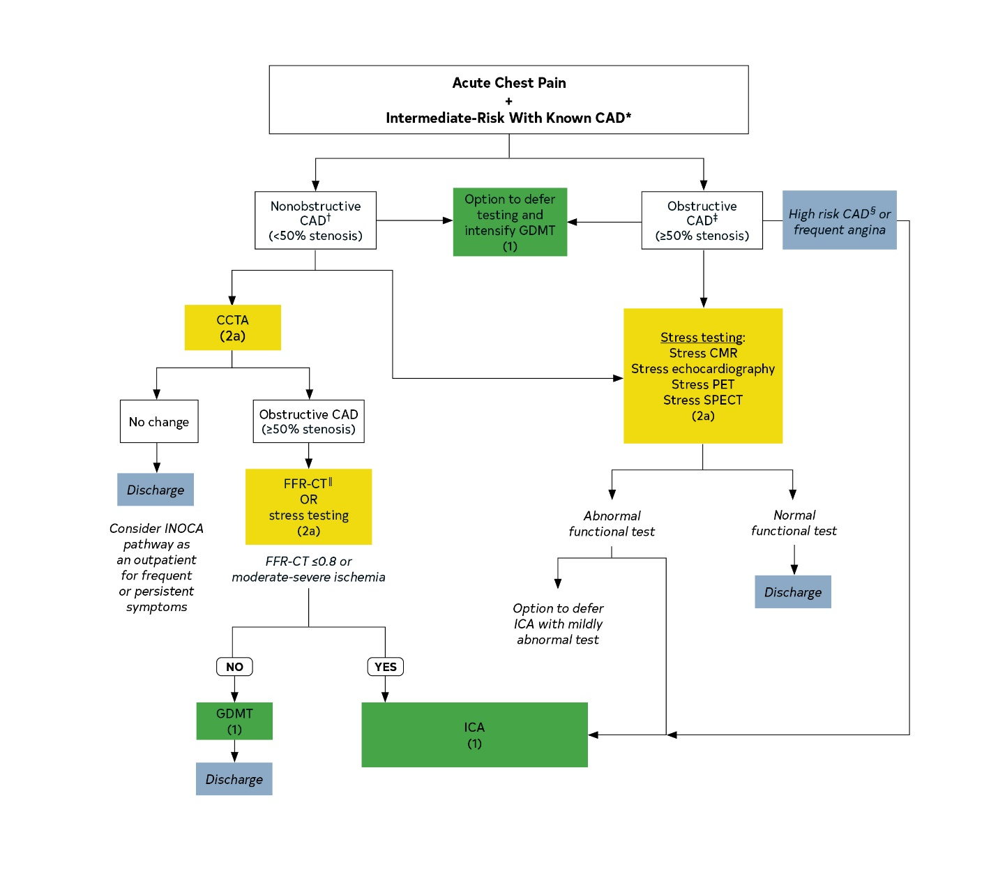
Evaluation Algorithm for Patients with Suspected ACS at Intermediate Risk with Known CAD

Slide 33
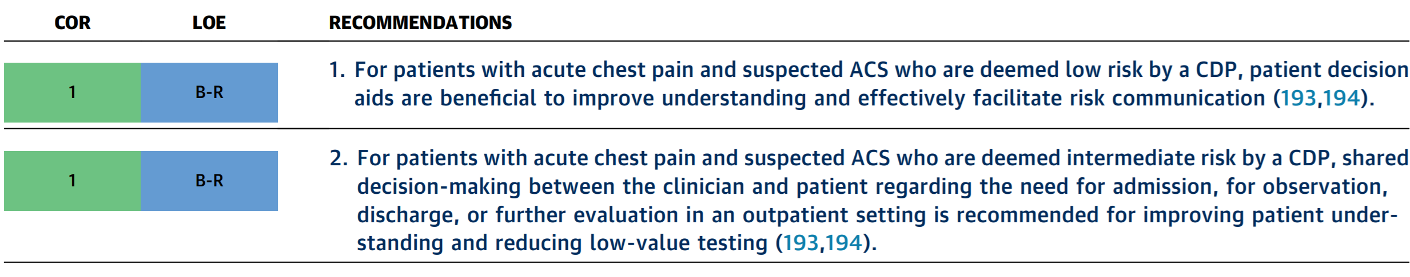
Shared Decision-Making in Patients With Acute Chest Pain

Slide 34
Summary
Both Anatomical and functional testing may be appropriate in specific acute chest pain scenarios (Class I)
CTA can help with equivocal functional tests and functional assessment can help with intermediate CTAs (Class 2a)
Precision care for patients with acute chest pain requires tailoring the strategy to the individual and the clinical scenario

Slide 36
When is imaging helpful for suspected non-coronary related chest pain?
4.2. Evaluation of Acute Chest Pain With Nonischemic
Cardiac Pathologies
4.3. Evaluation of Acute Chest Pain With Suspected
Noncardiac Causes
Juan C. Lopez-Mattei, MD, FACC, FASE, FSCCT, FSCMR
Co-Director, Cardiac Radiology Services
MD Anderson Cancer Center
Twitter: @onco_cardiology

Slide 37
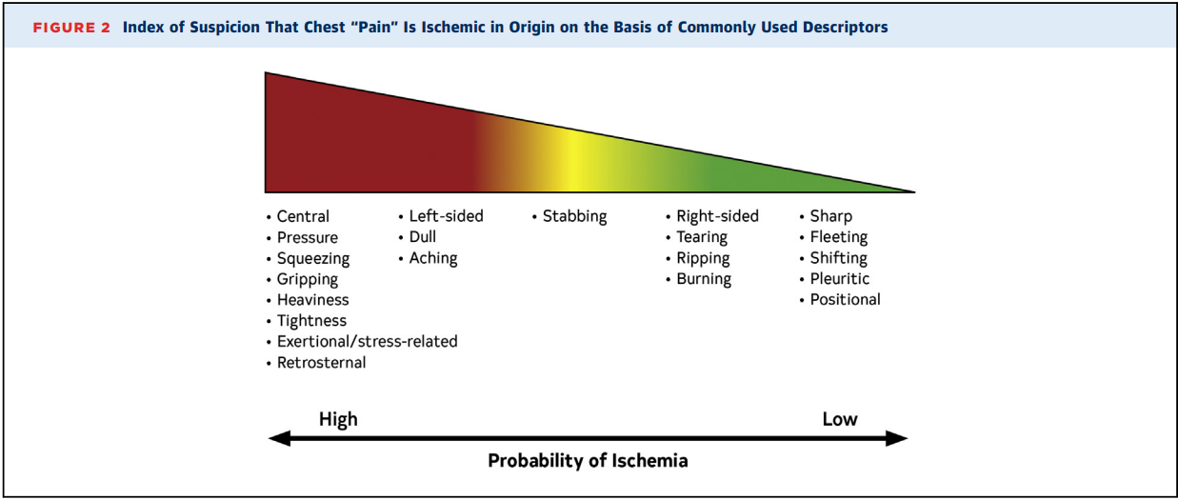
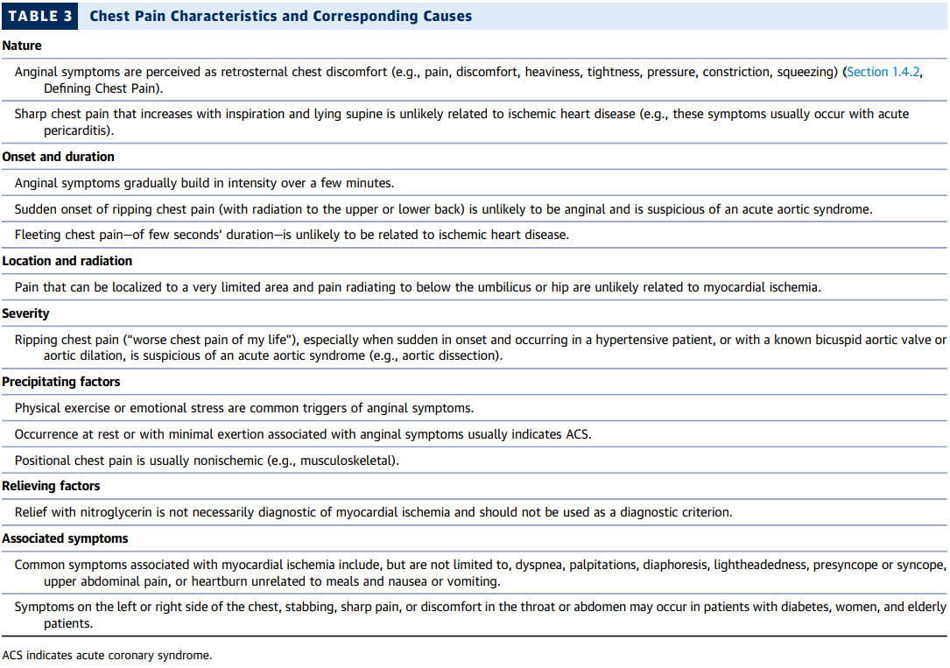

Slide 38
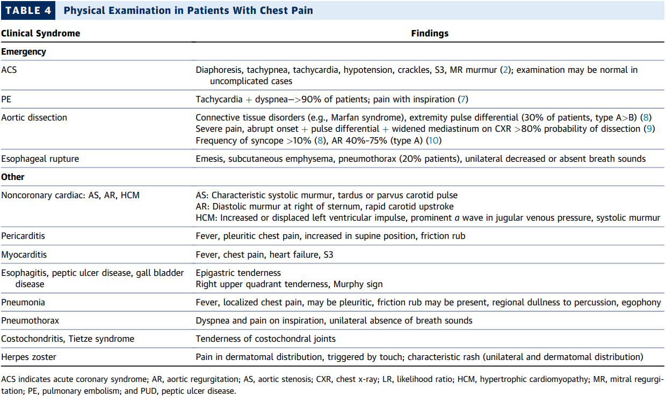

Slide 39
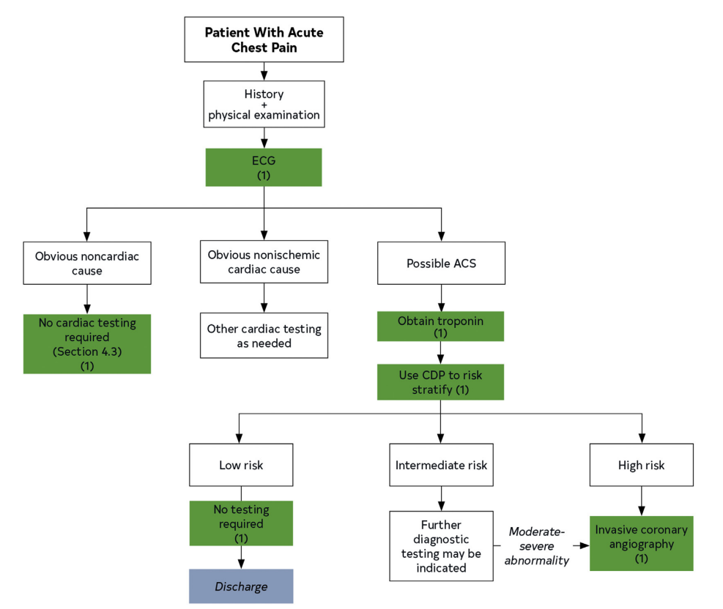
FIGURE 8. General Approach to Risk Stratification of Patients With Suspected ACS

Slide 40
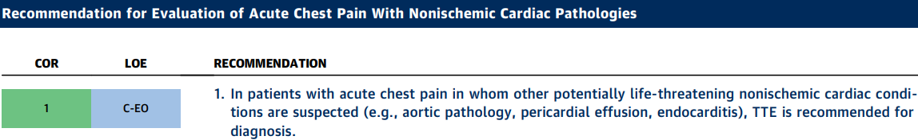
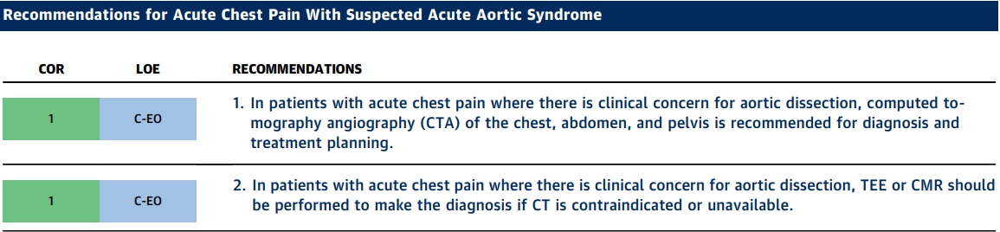
“more complete imaging of the aortic arch
requires TEE or CT. CMR is sensitive and specific, but
CT is usually more expeditious.”

Slide 41
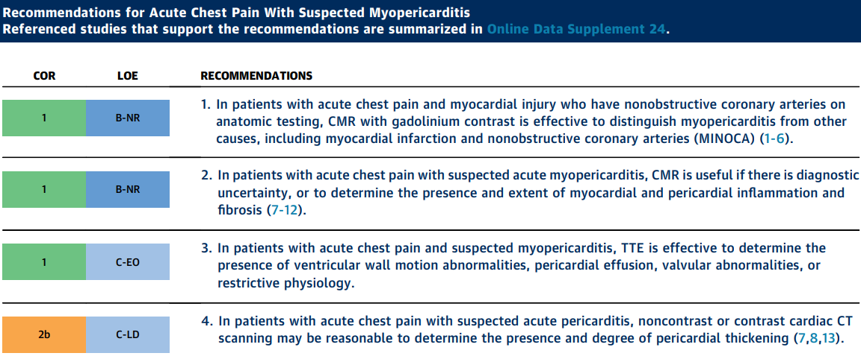

Slide 42
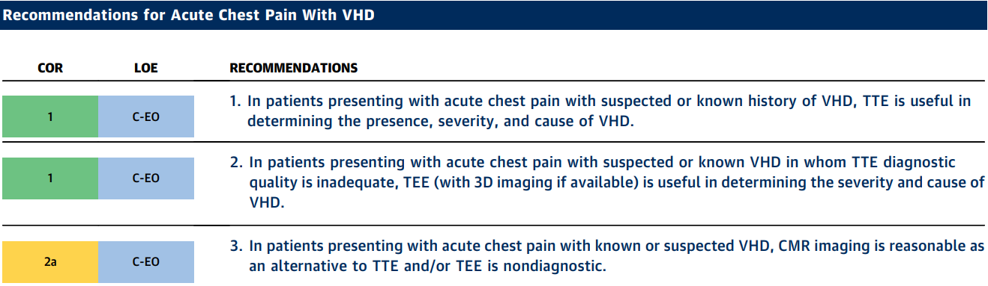

Slide 43
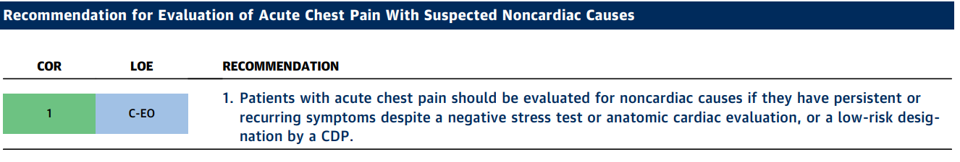
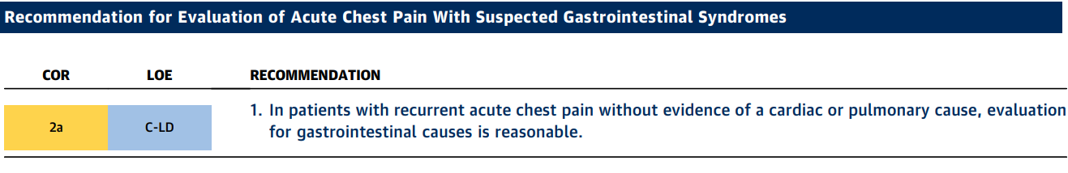

Slide 44
Highlights
Let History + Physical Exam guide decision making, directed to more likely chest pain (CP) etiologies.
In acute CP with suspected non-ischemic cardiac etiology r/o other live threatening etiologies, order TTE.
Suspected aortic dissection, 1st line is chest, abdomen and pelvis CTA. 2nd line are TEE and CMR.
Suspected PE (stable), chest CTA with PE protocol, pre-test probability should guide further testing.
Acute CP with +ve troponins and non-obstructive coronaries, consider ordering CMR to assess for other etiologies (i.e. myopericarditis, MINOCA)
CP with valvular heart disease, Echo.
Evaluate for other non-cardiac causes of CP if cardiac w/u is –ve or low risk designation by CDP.

Slide 46
Case 1: Acute chest pain with no known CAD
Cory Henderson, MD
Assistant Professor of Medicine, Division of Cardiology
Boston University Medical Center

Slide 47
Case #1: HPI
51 year old male with no history of CAD presented to the ED with chest pain x 1 week
Chest pain: Intermittent, duration: up to 30 minutes, left sided, burning, 5/10 intensity, no mitigating factors (no change with exertion)
Past medical history: Hypertension, hyperlipidemia, pre-DM
Medications: Amlodipine, Lisinopril, Atorvastatin
Family History: CAD (father – 60’s)

Slide 48
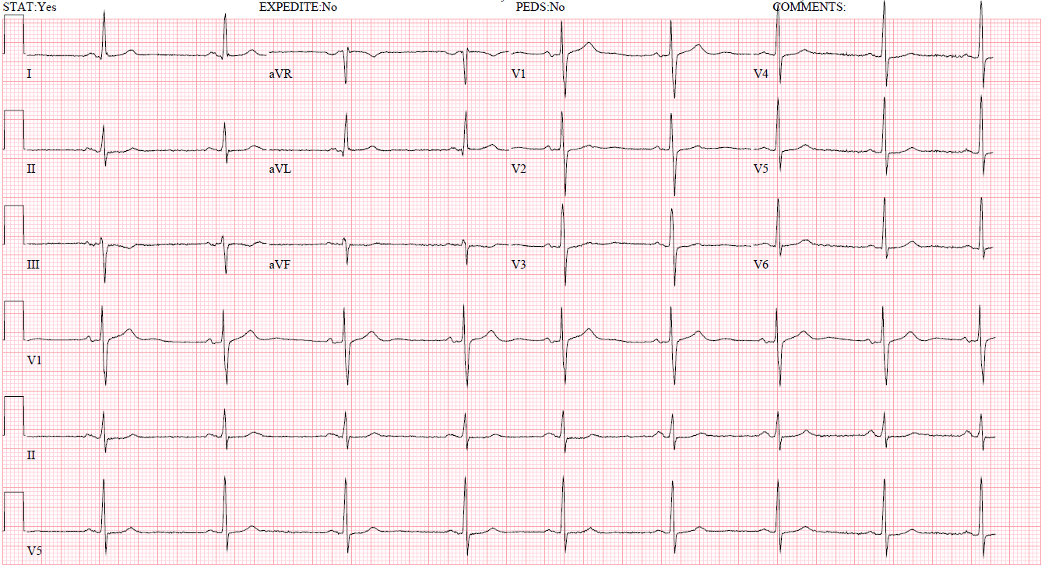
Case #1: ECG
Sinus rhythm, non-specific ST-T changes in the inferior leads

Slide 49
Case #1: ED course
Hs-cTn = 20 ng/L → 21 ng/L (1 hr later) (normal <14 ng/L)
HEART score = 5
Intermediate risk for MACE
Triaged to observation unit for further cardiac testing
Notes:
Based on the patient’s co-morbidities and presentation.

Slide 51
Acute Chest Pain with
Known Coronary Artery Disease:
Case Presentation
Hena Patel, MD
University of Chicago
Assistant Professor of Medicine

Slide 52
Presentation
45-year-old male presented to emergency department with acute chest pain
1-2 days of gradually worsening, exertional, left-sided chest pressure with radiation to shoulder
Medical & Surgical History
Hypertension
Dyslipidemia
Medications
Lisinopril 20 mg
Atorvastatin 40 mg
Family History
None
Social History
Former Smoker

Slide 53
Evaluation and Diagnostic Workup
Physical Exam
BP 132/80 HR 80 SaO2 100% RA
Normal cardiovascular exam
Laboratory Testing
Normal metabolic panel
Serial hsTn negative

Slide 54
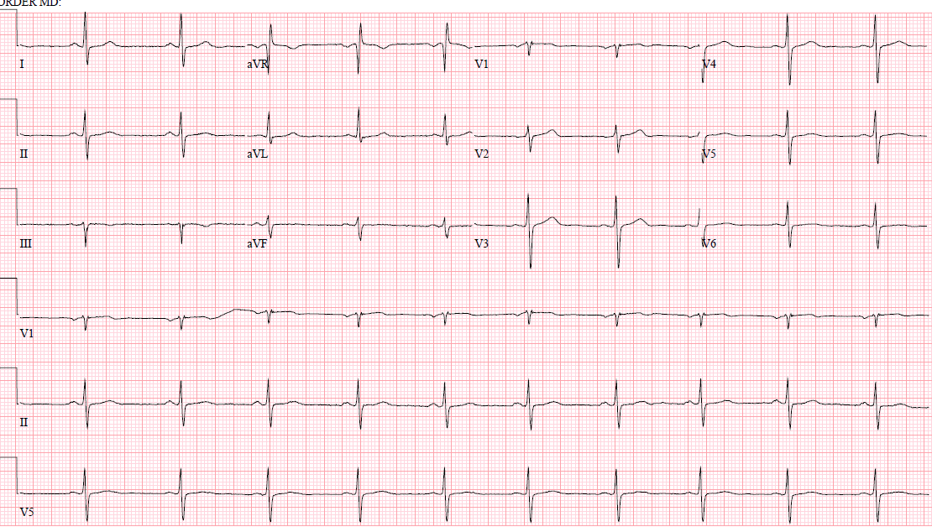

Slide 55
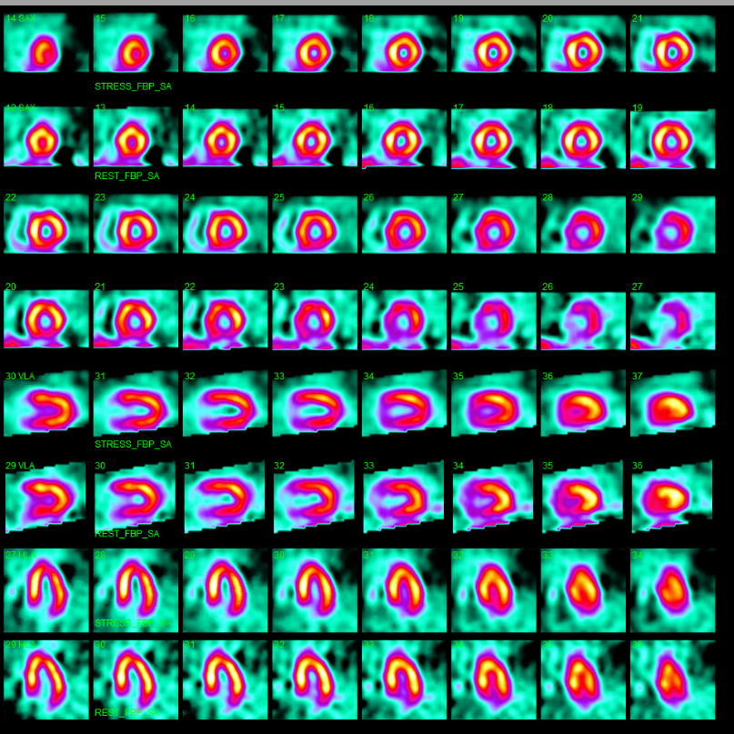
Exercise Nuclear Stress Test
Exercised 8.5 minutes;10.4 METS
Stress ECG: downsloping depression
Nuclear SPECT: small, mild reversible defects in LAD and LCx
SSS 3, SRS 0, 4% ischemic fraction

Slide 57
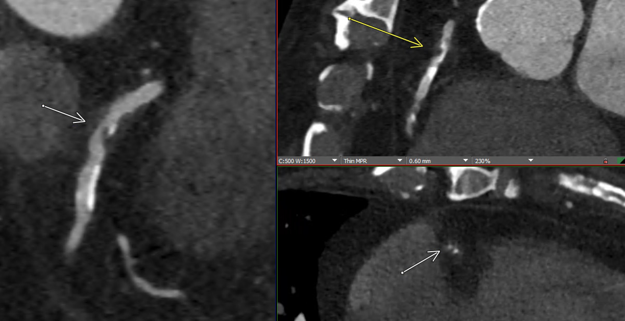
Case #1: Coronary CTA
Notes:
Coronary CTA demonstrated a large amount of non-calcified and calcified plaque in the RCA resulting in severe (>70%) stenosis in the proximal RCA. Also noted to have minimal left sided disease. The patient subsequently underwent coronary angiography

Slide 58
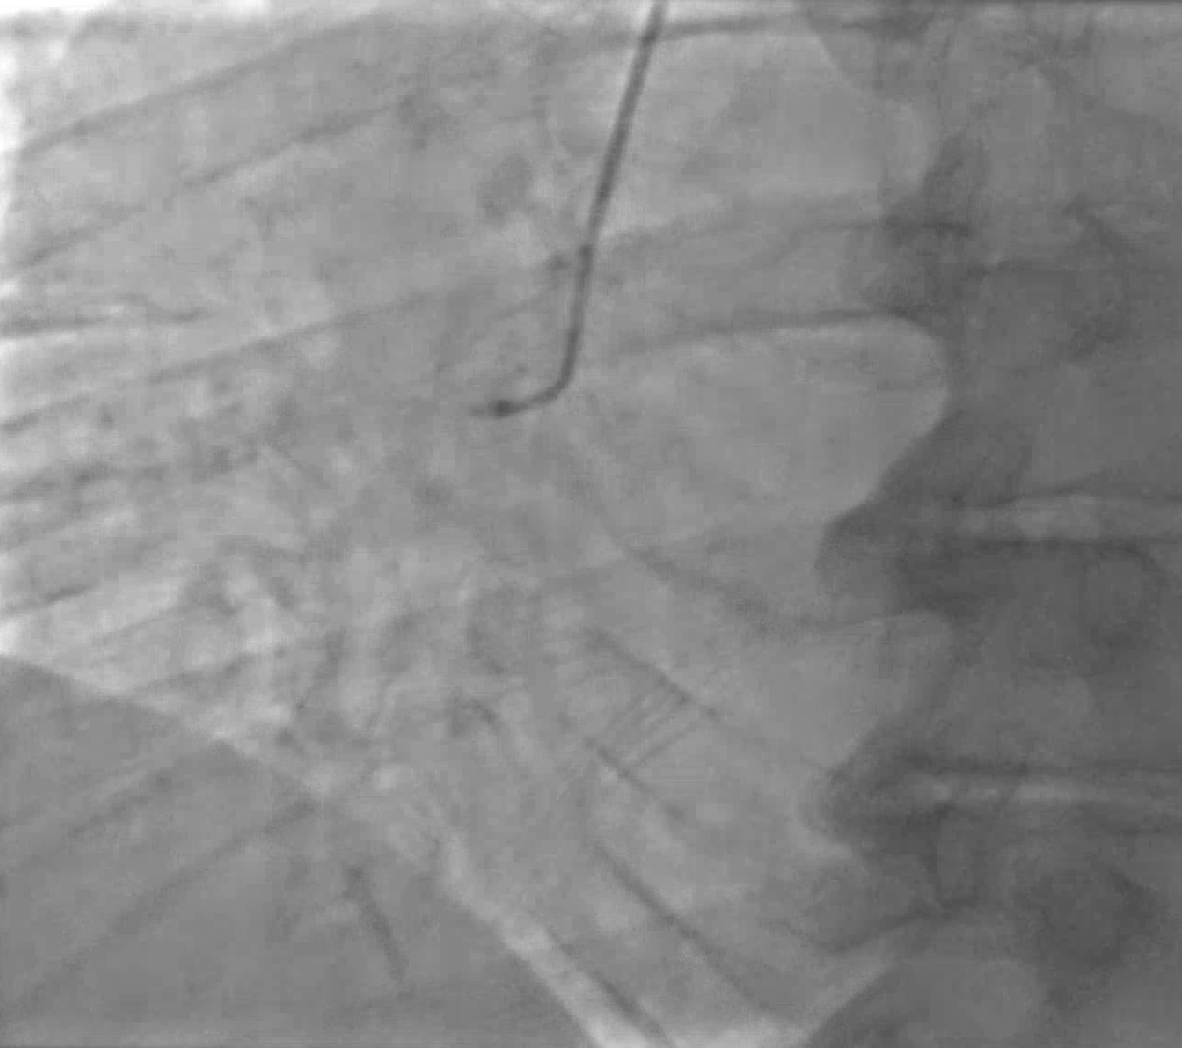
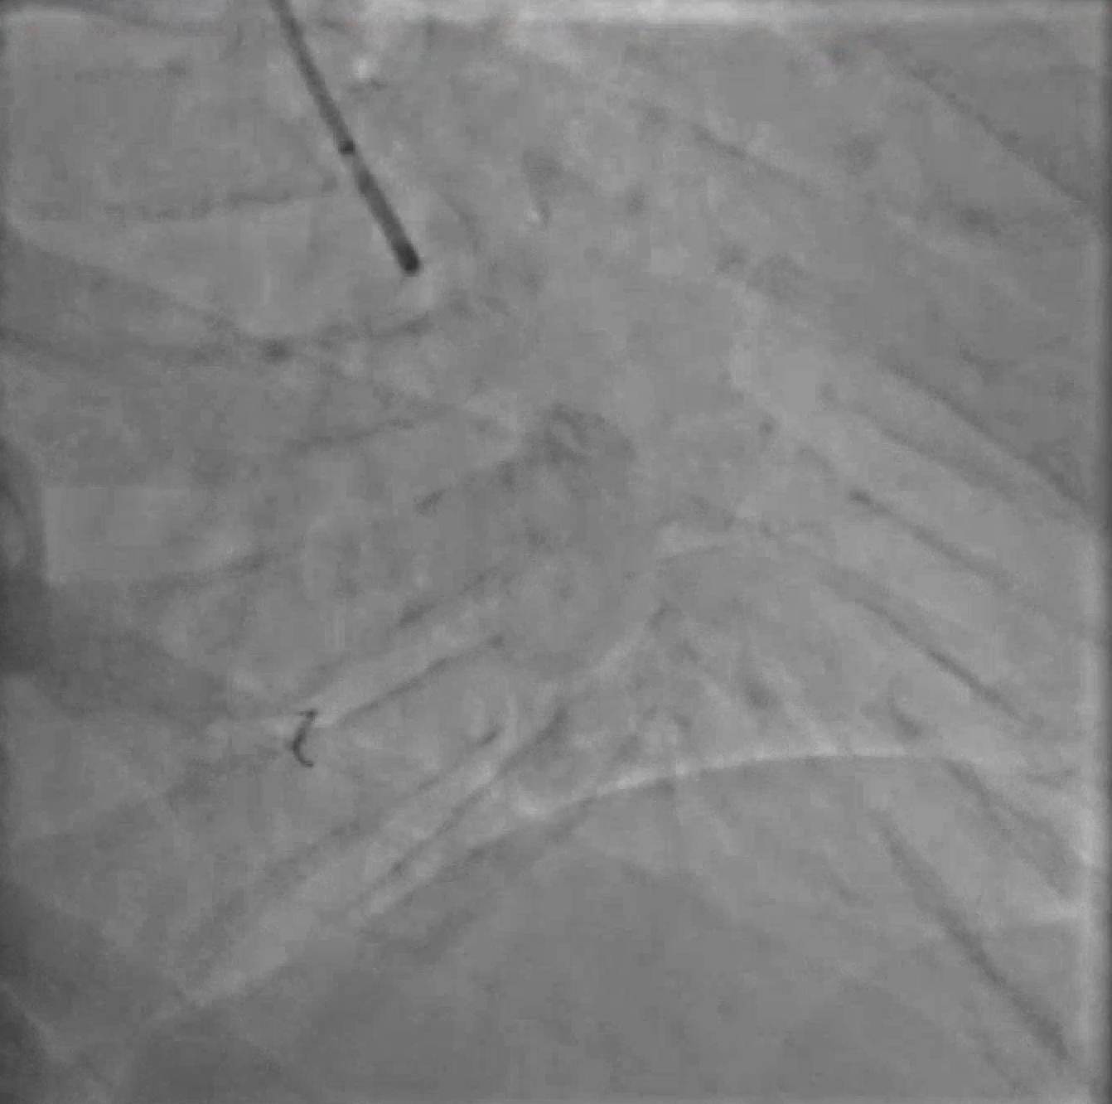
Case #1: Coronary Angiogram
Diagnostic
Post-PCI
Notes:
On the left, the diagnostic coronary angiogram demonstrates an 80% stenosis in the proximal RCA. The decision was made to proceed with PCI. The post PCI result can be seen on the right. Post-PCI the patient’s symptoms resolved and he continues to do well.

Slide 59
Case #2 Follow-up
Referred to outpatient cardiology
Started on aspirin and statin
Presents 2 years later with recurrent chest pain and shortness of breath
What would you do next?

Slide 60
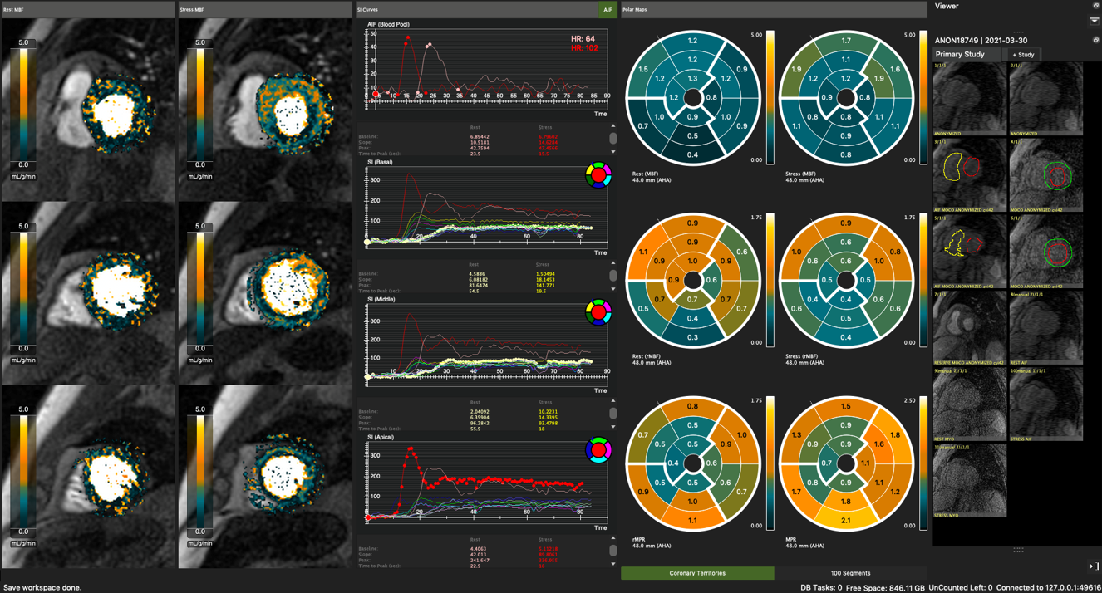
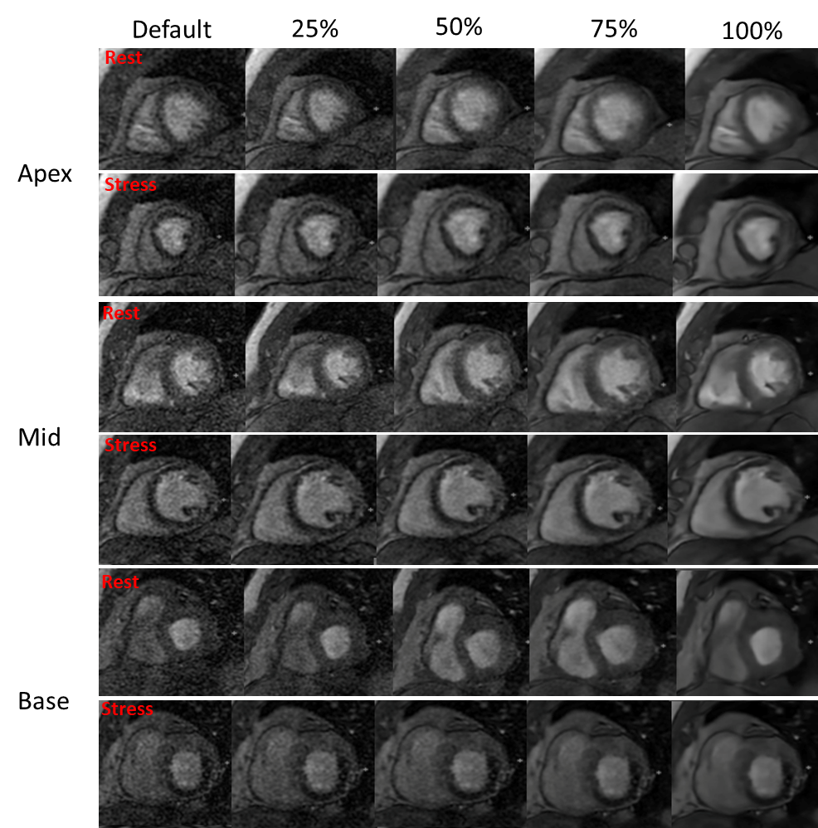
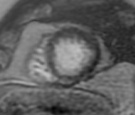
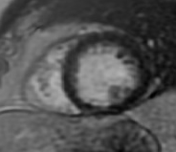
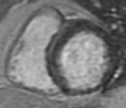
Stress Cardiac Magnetic Resonance
Rest Stress LGE
Apex
Mid
Base

Slide 61
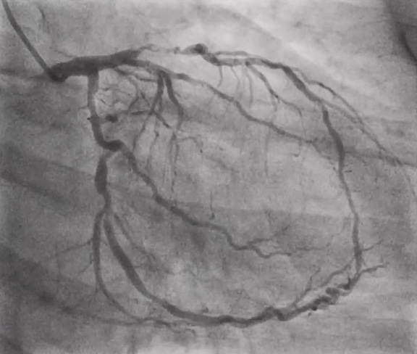
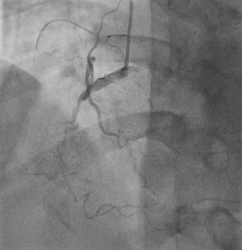
Cardiac Catheterization with Coronary Angiogram
Underwent 4 vessel CABG
Notes:
He subsequently underwent a LHC which demonstrated severe multivessel disease, involving the LAD and LCx along with CTO of the pRCA
70-80% pLAD, tubular 70% mLAD, 70% OM1, 70% pLCx, followed by 70-80% and 70% lesions, CTO of pRCA with l->r collaterals and an LVEDP of 10. His last TTE from 2/2020 noted EF 58%, trace TR, LVIDD 5.9cm.

