Slide 1
Teaching in the Clinical Setting
Sponsored by ACC’s Fellows-in-Training Leadership Council

Slide 2

Moderator
Anu Dodeja, MD, FACC
Assistant Professor
Connecticut Children’s Hospital
Hartford, Connecticut
FIT Leadership Council Member 2020-2022
@anudodejamd

Slide 3
Objectives
Learn efficient and effective methods for teaching while on service
Learn how to tackle teaching at multiple levels
Learn how to build a career in medical education

Slide 4
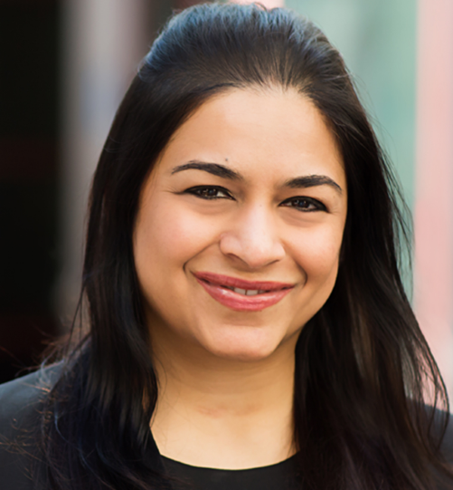
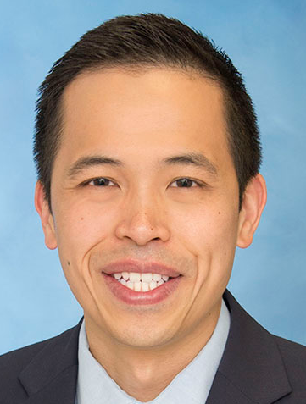
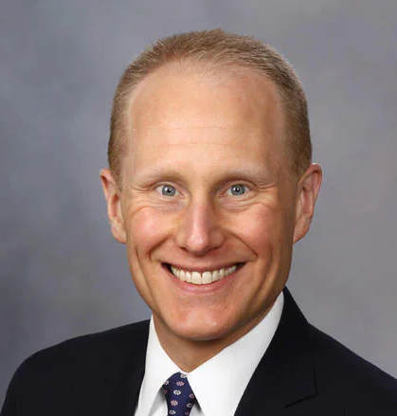
Speakers
Aarthi Sabanayagam, MBBS, FACC
Marty C. Tam, MD, FACC
Michael Cullen, MD, FACC

Slide 5
Agenda
Effective and Efficient Teaching on Service
Teaching Learners at Different Stages of Training
Building a Career in Cardiovascular Medical Education

Slide 6

Effective and Efficient
Teaching while on Service
Aarthi Sabanayagam MD FACC
Assistant Professor of Cardiology
Adult Congenital Heart Disease
Associate Program Director -CVD Fellowship program
Co-Director of Cardio-Obstetrics
University of California San Francisco

Slide 7

Music to my Ears

Slide 8
OBJECTIVES
Understand ‘Learning objectives’ – (What do I teach?)
Develop Teaching strategies – (How do I Teach?)
List - My Tips and Tricks

Slide 9

A learning objective is an outcome statement that captures specifically what knowledge, skills, attitudes learners should be able to exhibit following instruction.
Learning objectives should be “SMART”
Specific
Measurable/Observable
Attainable for target audience within scheduled time and specified conditions
Relevant and results-oriented
Targeted to the learner and to the desired level of learning
Outcome Statement – By the end ……….. the learner should be able to …………..

Slide 10
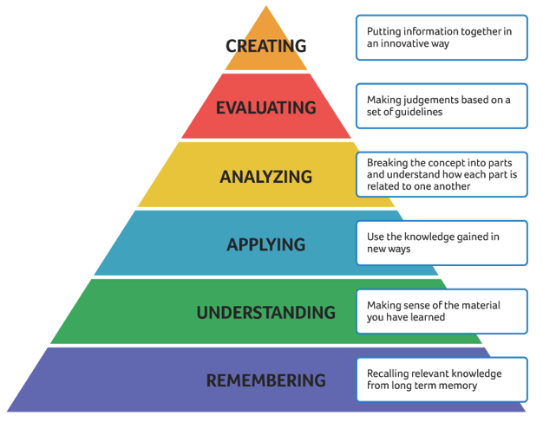
BLOOM’S TAXONOMY
Assemble, build, compile, combine, compose, concoct, construct, create,
cultivate, depict, design, develop, devise, formulate, forecast, generate,
hypothesize, imagine, invent, organize, predict, plan, prepare, set up, solve, theorize
Argue, assess, choose, compare, conclude, criticize, critique, debate, decide,
deduce, defend, determine, differentiate, discriminate, disprove, evaluate, infer,
judge, justify, prioritize, probe, prove, rank, rate, recommend, revise, validate, verify
Analyze, arrange, calculate, categorize, conclude, contrast, correlate, detect,
diagnose, differentiate, dissect, distinguish, examine, research, test
Apply, capture, calculate, collect, complete, compute, construct, customize,
derive, demonstrate, dramatize, employ, express, illustrate, interpret,
manipulate, modify, operate, tabulate, translate, use, utilize
Classify, characterize, cite, comprehend, define, describe, detail,
discuss, estimate, explain, express, extrapolate, identify, indicate,
interpret, paraphrase, recognize, relate, reorganize, rephrase,
report, research, restate, review, show, summarize, translate
Enumerate, group, indicate, label, list, memorize, name,
quote, recall, recite, record, relate, repeat, reproduce,
restate, sort, state, underline, write
Adapted

Slide 11
ACGME Competencies and Milestones
ACGME COMPETENCY
Patient Care
Medical Knowledge
Systems –based Practice
Practice-Based Learning and Improvement
Professionalism
Interpersonal & Communication skills

Slide 12


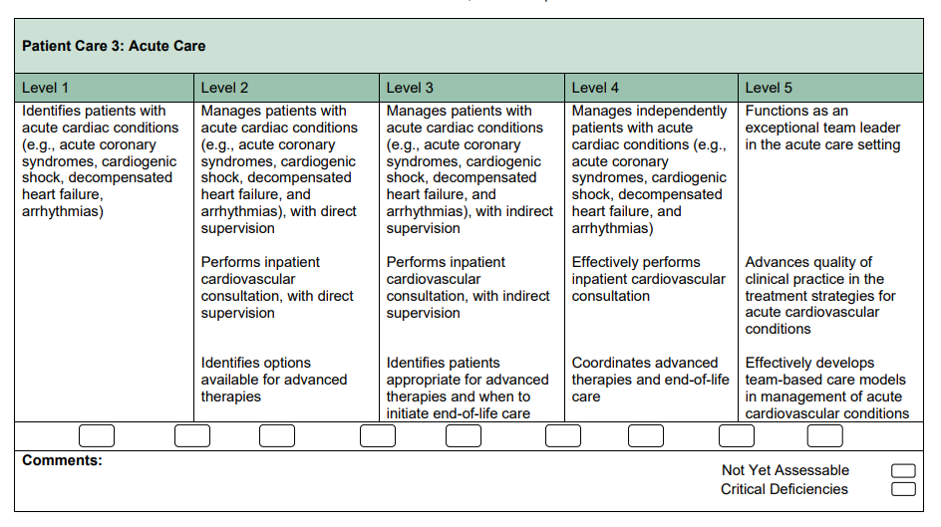
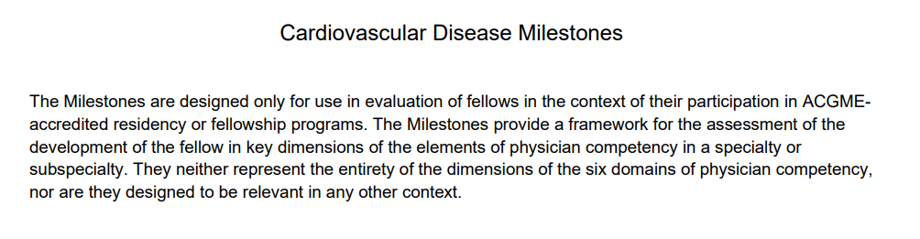
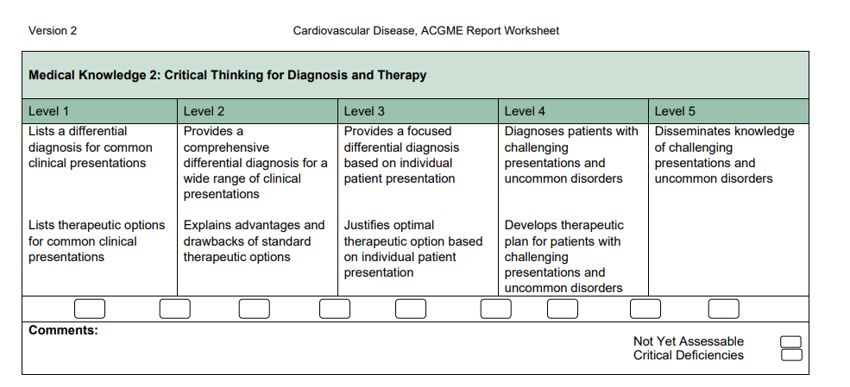


Slide 13
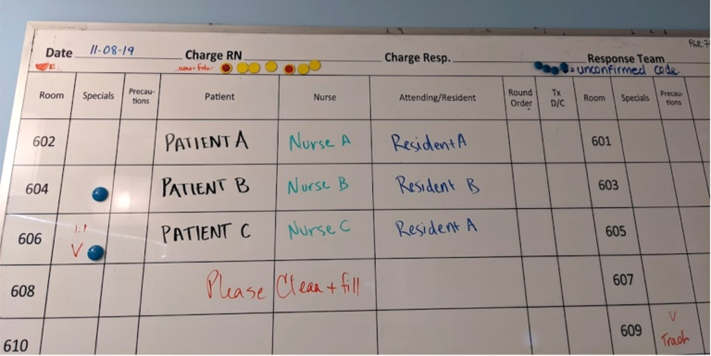
ACGME
COMPETENCY

Slide 14
Physical Exam
History
Imaging
Labs
Treatment
Plan
Assessment

Slide 15
OBJECTIVES
Understand ‘Learning objectives’ – (What do I teach?)
Develop Teaching strategies – (How do I Teach?)
List - My Tips and Tricks

Slide 16


CLINICAL REASONING involves the “synthesis of myriad clinical and investigative data to generate and prioritize an appropriate differential diagnosis and inform safe and targeted management plans.” Thampy et al 2019
Script
Typical presentation of a disease
Schema
Mental frameworks or concepts we use to organize and understand (systematic approach to clinical problem)
Problem
Representation
Summary of the case that addresses the demographics, risk factors, temporal pattern of the illness and the clinical syndrome
A diagnostic schema is a cognitive tool that provides a structured approach to a complex clinical problem.
No one gold standard diagnostic schema for a given problem, but rather that different clinicians, depending on their prior knowledge, experience and practice patterns develop schema that make sense to them and help them to organize their thinking around complex problems.

Slide 17
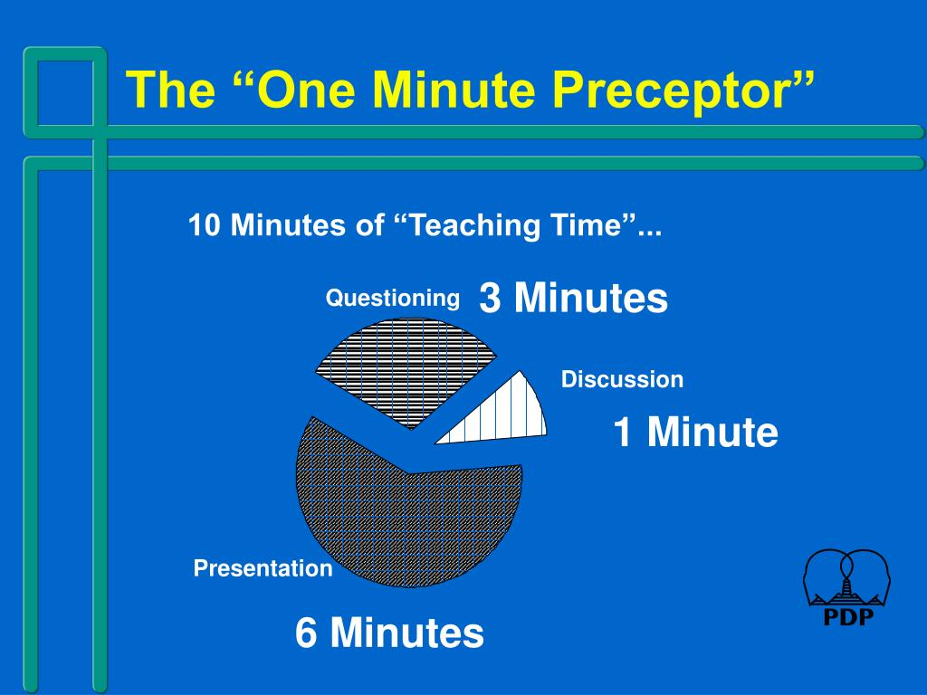
The One-Minute Preceptor approach allows the preceptor to take full advantage of the entire encounter in order to maximize the time available for teaching. The teaching encounter will still take longer than a minute but the time spent is more efficiently used and the teaching effectiveness is optimized.
Microskills
Get a Commitment
Probe for Supporting Evidence
Reinforce What Was Done Well
Give Guidance About Errors and Omissions
Teach a General Principle
Conclusion
“Five-Step `Microskills' Model of Clinical Teaching” (Neher, Gordon, Meyer, & Stevens, 1992)

Slide 18

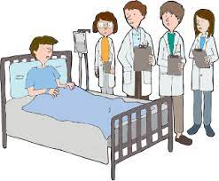



Table Rounds
Walk Rounds
Bedside Rounds

Slide 19
Organize
Prime
Time

Slide 20
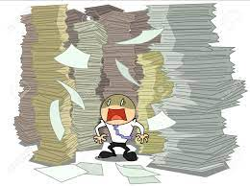


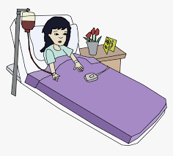
ENCOURAGE ENGAGEMENT AND INTERACTION
Interprofessional Learners
Medical students
House-staff

Slide 21
OBJECTIVES
Understand ‘Learning objectives’ – (What do I teach?)
Develop Teaching strategies – (How do I Teach?)
List - My Tips and Tricks

Slide 22
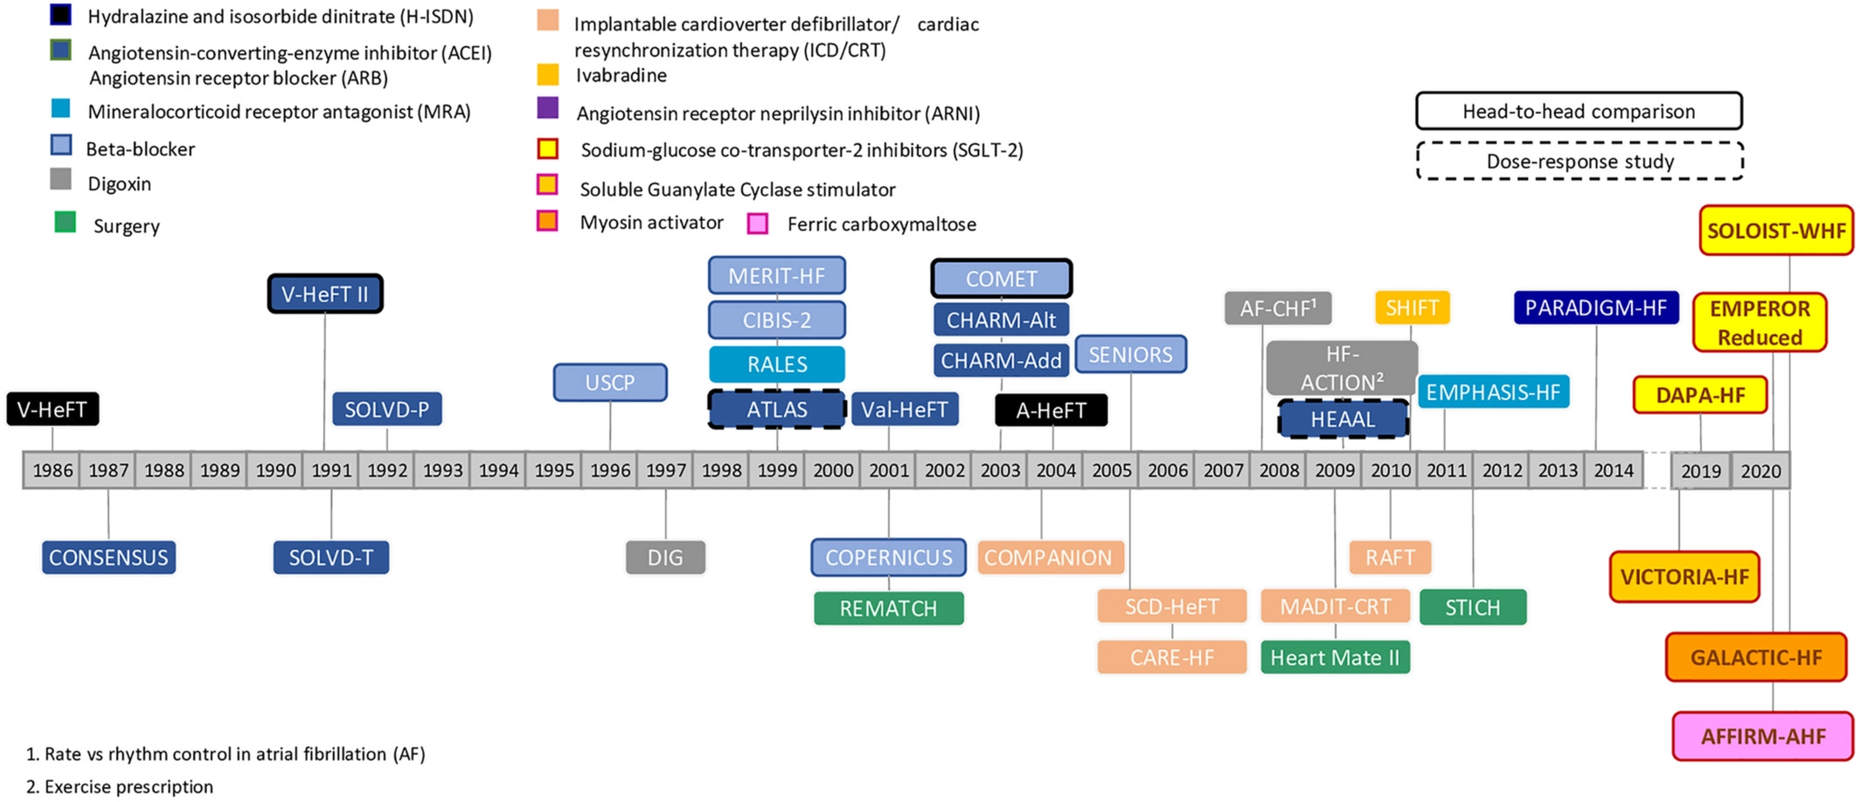
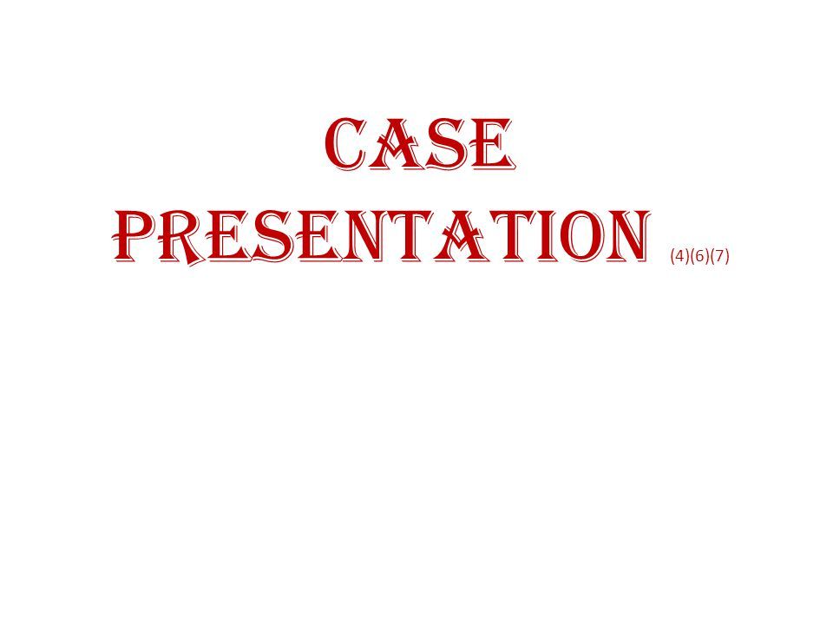
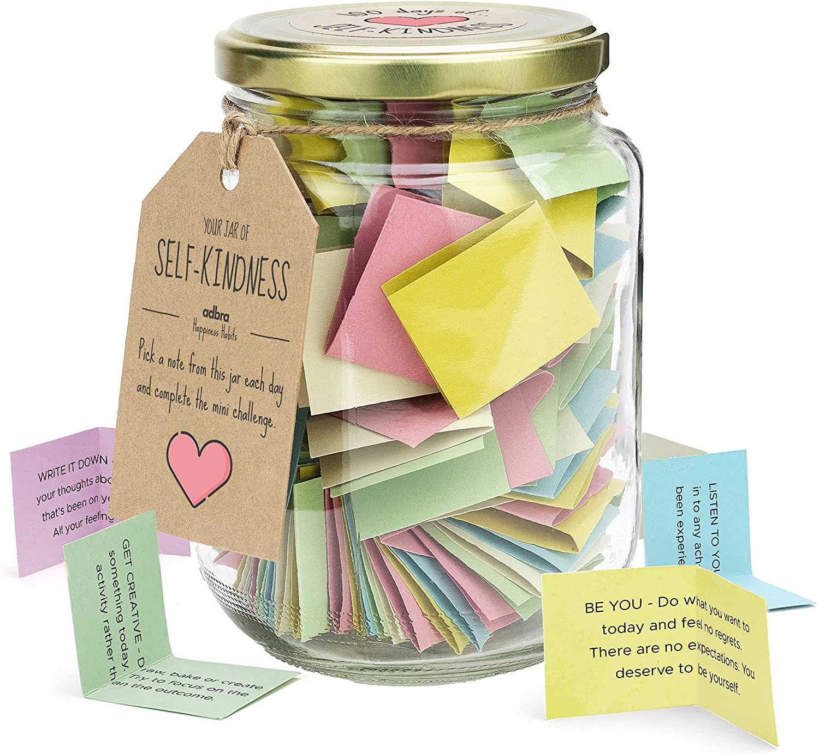


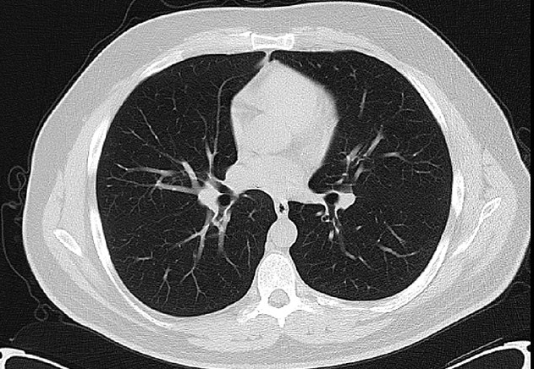
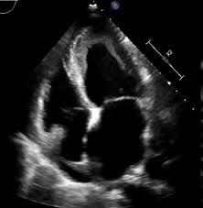

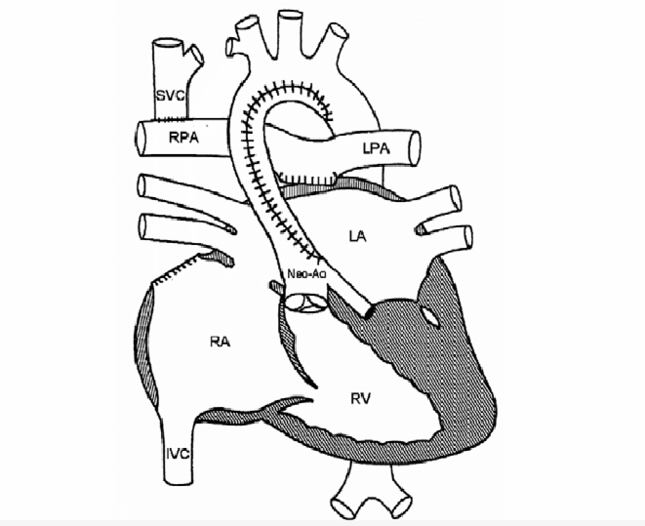
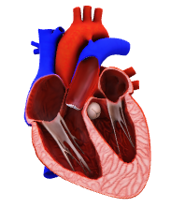
Peer Teaching
TIPS & TRICKS
Speed Trial Rounds
Prediction
Imaging Rounds
Questions
Chalk talks
Apps/Visual aids

Slide 23
I truly felt like she invested in me as a learner and young physician. One of her strengths is her ability to synthesize and summarize complex amounts of patient data and allow it to be digestible for all learner levels.
Easy to get carried away with teaching, could try to check in more about the days workload/flow to ensure its a good time for longer discussions.
+
-
EVALUATIONS
More teaching time!
One of her best qualities is her ability to assess learners where they were and teach to the learners needs. I was able to advance my knowledge in cardiac cath to the point that I felt very comfortable being able to interpret RHC’s.
I really like it when the attending went over echoes with us in the afternoon. I would encourage continued teaching in the PM once all tasks from rounds are done.

Slide 24

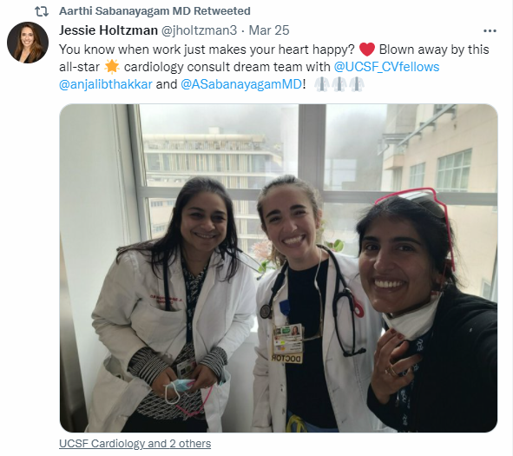

Thank You

Slide 25

Teaching to Learners at Different Stages of Training
Marty C. Tam, MD, FACC
Assistant Professor, Division of Cardiovascular Medicine
Associate Program Director, Cardiovascular Disease Fellowship
Associate Program Director, Advanced Heart Failure & Transplant Cardiology Fellowship
University of Michigan
No Disclosures
@MartyTamMD

Slide 26
Objectives
At the end of this session, you will be able to:
Describe core strategies for teaching to a group of learners at different stages of training
…

Slide 27
You are the Fellow on Service in the Cardiac ICU…
On service you have:
Two senior IM residents
One IM intern
One EM intern
One medical student
A patient with cardiogenic shock is admitted.
How do you teach this large group about management strategies?
(It’s hard!)
…

Slide 28
Tip 1: Create a Safe Learning Environment
Learners can ask questions and express uncertainty
Role model the behavior – be curious and vulnerable
Make it everyone’s job to learn and teach
…
Notes:
It is hard to know where everyone is level of training. Learners need to be open about their learning.

Slide 29
Tip 2: Decide on the Learning Objectives
Do a needs assessment
Your observations + learner-defined needs
You may find common needs
Be focused and purposeful
“Let’s talk about cardiogenic shock.”
vs.
“Let’s discuss invasive hemodynamic interpretation.”
…
Notes:
Do not assume that learners have different needs. Asking is always the best policy.

Slide 30

Tip 3: Design Team Learning Sessions
…
Notes:
This applied to formal teaching and bedside rounds

Slide 31
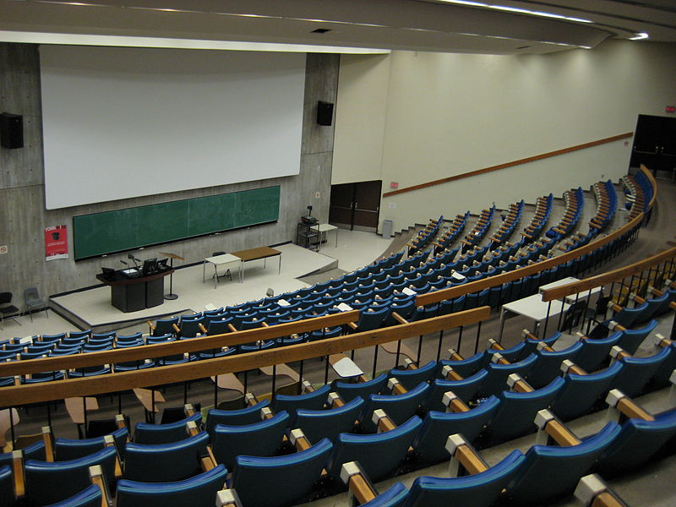
Tip 3: Design Team Learning Sessions
Avoid the lecture mentality → make it an active discussion
…

Slide 32
Tip 3: Design Team Learning Sessions
Have learners be informal teachers
Act as a facilitator for discussion, ask probing questions
“What made us place this patient on temporary MCS?”
“Can you discuss the other indications?”
…

Slide 33
Tip 3: Design Team Learning Sessions
Be adaptive
Keep the learning objective in mind
Adjust to the learner’s understanding
“Sometimes the indications for temporary MCS are not clear.
Let’s review what happened with this patient.”
…
Notes:
Remember this is a safe space. How you adapt can also influence how open learners will be to participate in the future.

Slide 34
Tip 3: Design Team Learning Sessions
Highlight key points, correct mistakes
“Cardiogenic shock has a high mortality rate.
Escalate therapy when a patient is declining.”
…

Slide 35
Tip 4: Empower Each Learner to Discover More
Encourage self-directed learning
“For those interested, here are some resources to learn more about VA ECMO.”
Encourage learners to lead the next teaching activity
Keep it limited scope to balance workload
“You seem to have a real passion for advanced heart failure. Can you talk to us briefly this week about potential contraindications for durable LVAD in this patient?”
Notes:
Take well-being into consideration

Slide 36
Key Points
A safe learning environment is critical
Be specific about your learning objectives
Learning is a team activity – everyone contributes and learns
Allow opportunity to explore a topic further
…

Slide 37
Objectives
At the end of this session, you will be able to:
Describe core strategies for teaching to a group of learners at different stages of training
…

Slide 38
Building a Career in Cardiovascular Medical Education
Michael W. Cullen, MD
Associate Program Director, Cardiovascular Diseases Fellowship
Associate Professor of Medicine
Mayo Clinic, Rochester, Minnesota

Slide 39

How do I Build a Career in Cardiovascular Medical Education?

Slide 40
Some Questions to Consider…
What does medical education mean to you?
What’s the pathway toward that vision?
What are you reading?
What are you writing?
Who’s on your team?

Slide 41
What Does Medical Education Mean to You?
Program leadership
Clinical teaching
Patient education
Cardiovascular medical education
Education research
Curriculum
development
Didactic teaching

Slide 42

What’s the Pathway?
Identify roles or careers that resonate
Talk to those leaders, teachers, role models
What’s their story?
What do they like or dislike about their current position?
What skills did they cultivate early in their career?
How did they differentiate themselves from peers?
Don’t build the road from scratch…
Chances are, it already exists…

Slide 43
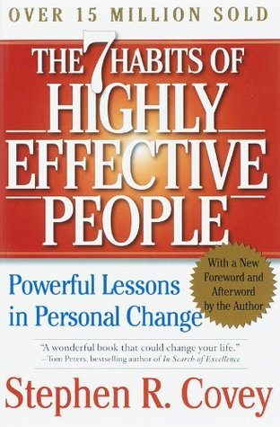
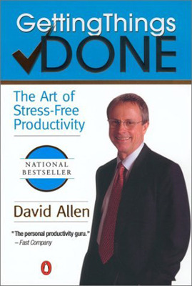
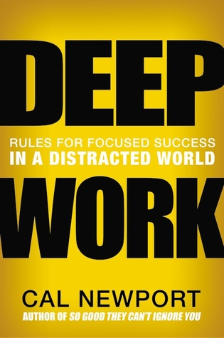
What are You Reading?
A few good books…

Slide 44
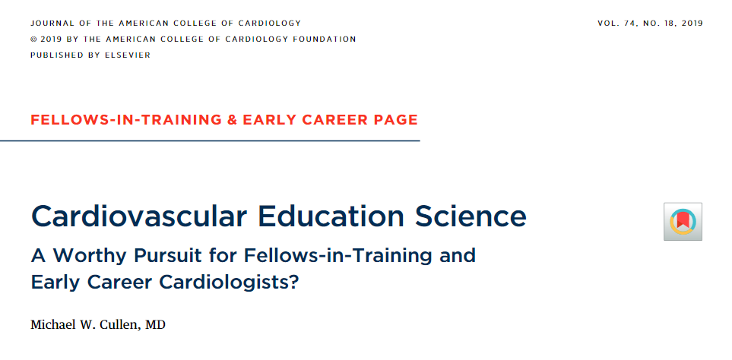
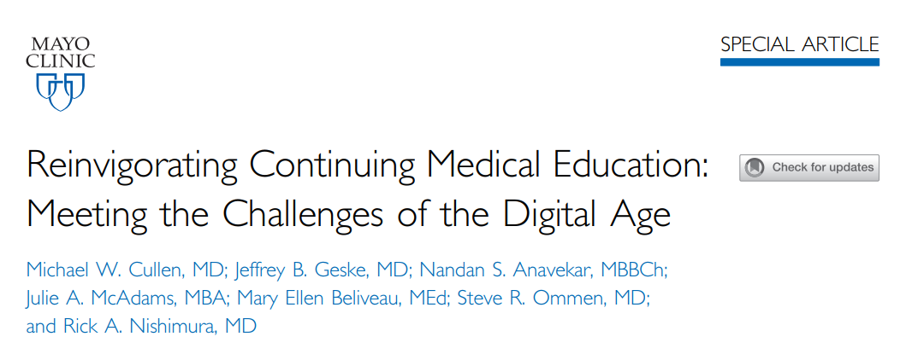
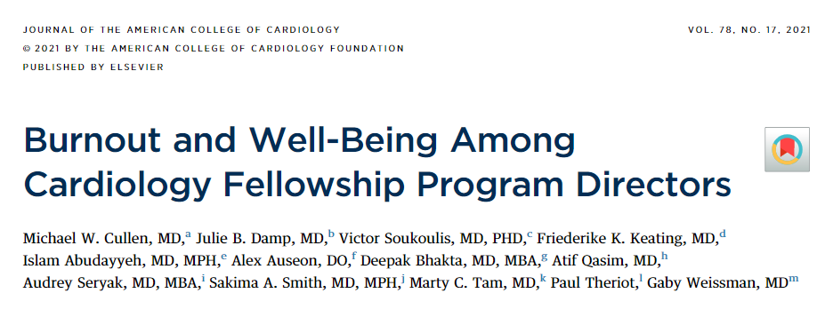
What Are You Writing?

Slide 45
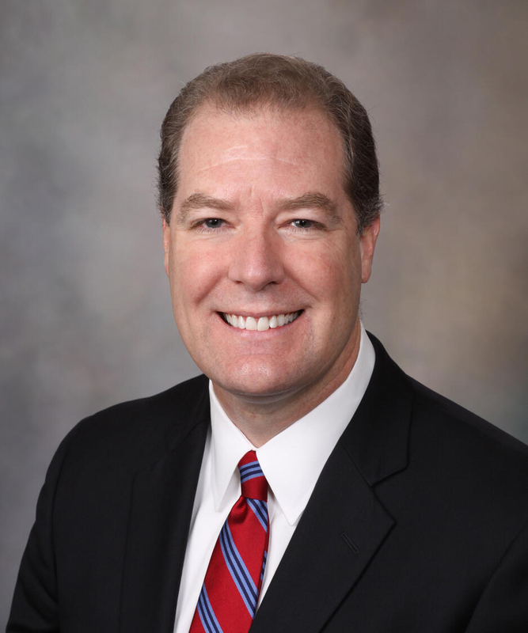
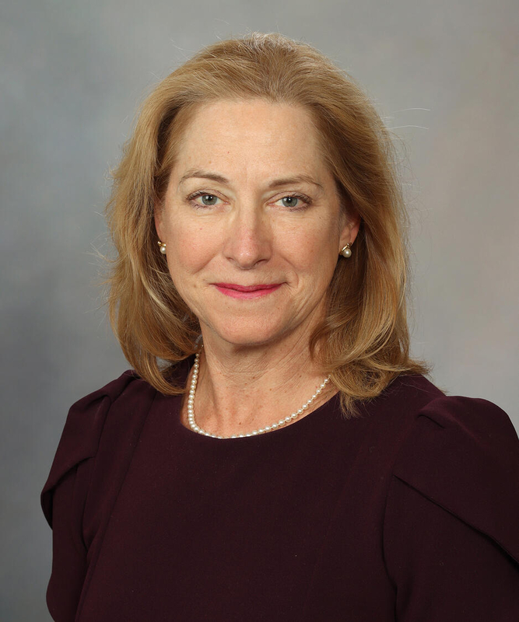
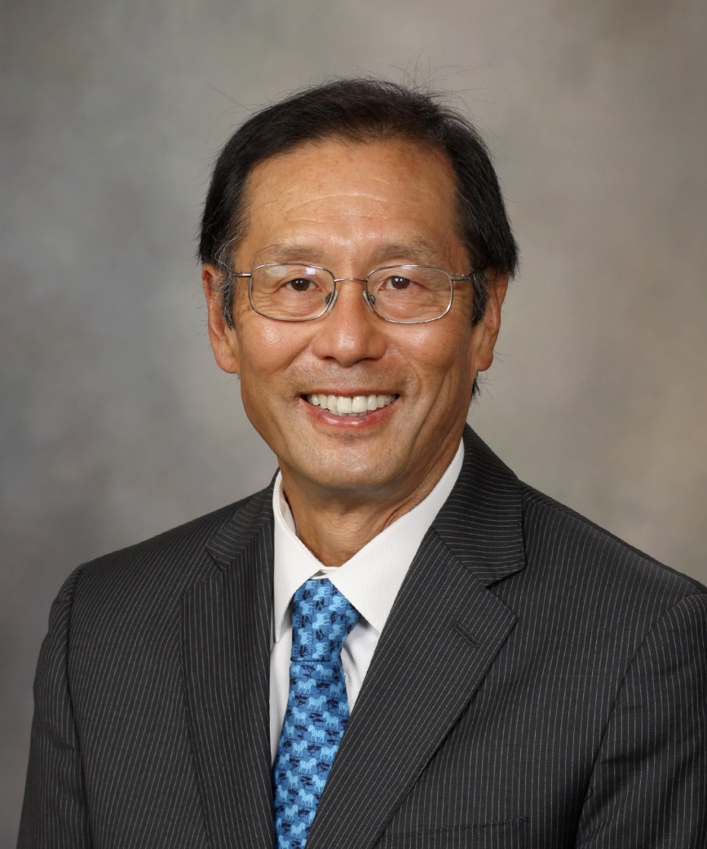
Who’s on Your Team?
Dr. Tom Beckman
Dr. Kyle Klarich
Dr. Rick Nishimura

Slide 46

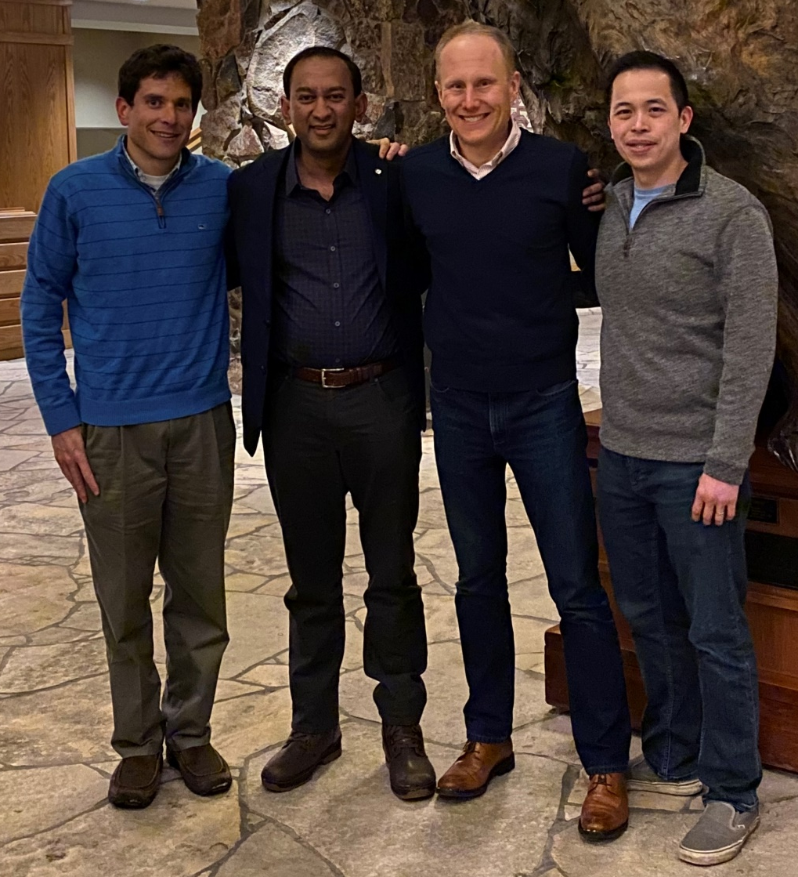
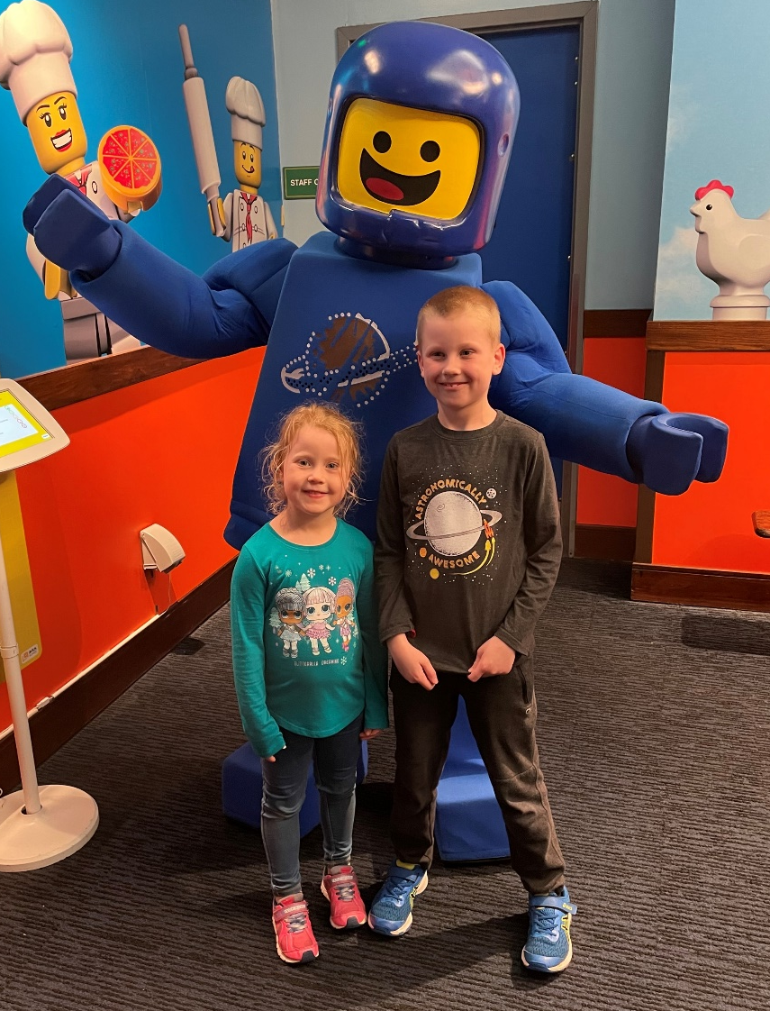
Who’s on Your Team?

Slide 47
Putting It All Together
Outline your own vision for a career in medical education
Define the pathway, then follow it with intention and focus
Read broadly, write effectively
Cultivate your team

Slide 48

QUESTIONS

Slide 49
Thank You to Our Speakers
Aarthi Sabanayagam, MBBS, FACC
Marty C. Tam, MD, FACC
Michael Cullen, MD, FACC

